Slide 1
5MD00: Single-Core Assignment
Yifan He
2011-12-15

Slide 2
What is this assignment about?
Build your own superscalar machine!
How?
A superscalar architecture simulator, with tunable hardware parameters
  e.g., branch predictor type (always taken, always not taken, bimodal, 2-level, …)

Slide 3
Which simulator are we going to use?
SimpleScalar ^{[1]}
  Cycle-accurate
  Can provide a lot of detailed information
  Very popular single-core simulator
Wattch ^{[2]}
  SimpleScalar + power information
[1]. http://www.simplescalar.com/
[2]. http://www.eecs.harvard.edu/~dbrooks/wattch-form.html

Slide 4
What are our design metrics?
Performance
  IPC (instruction per cycle)
Performance & Energy Efficiency
  EDP (energy-delay product)

Slide 5
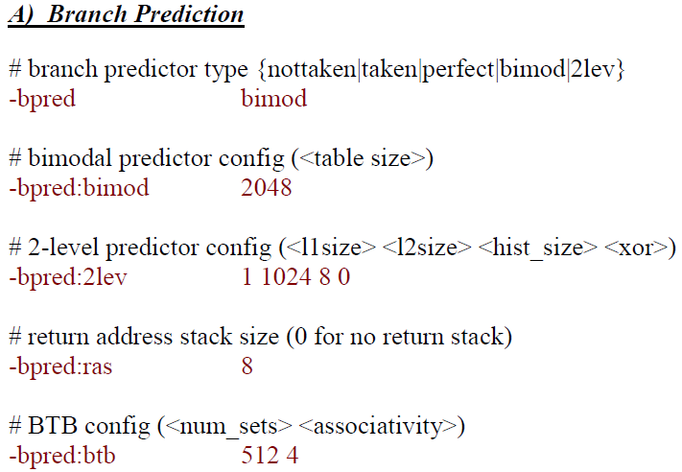
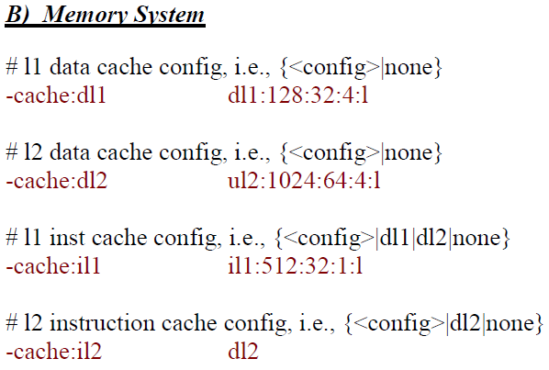
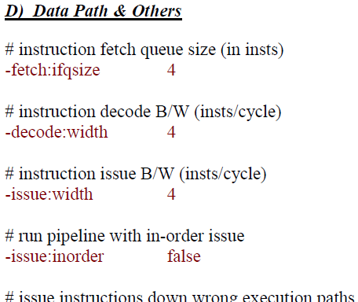
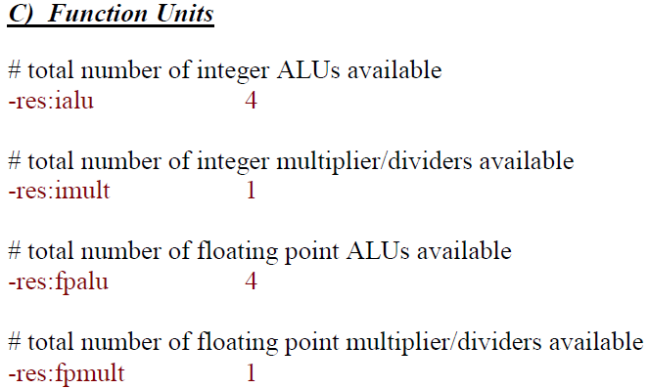
What kind of parameters can we tune?

Slide 6
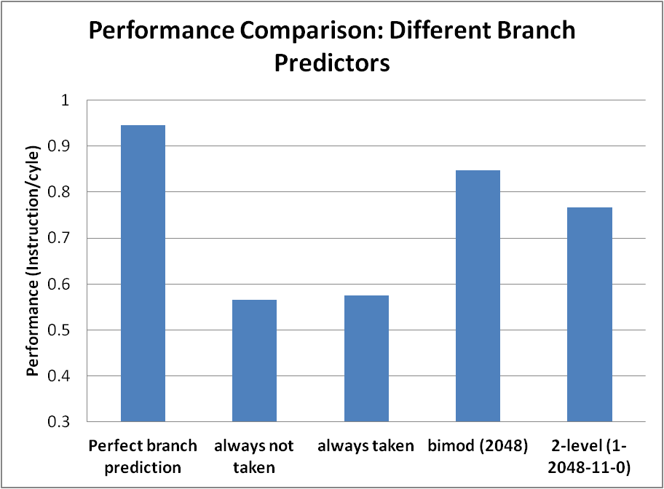
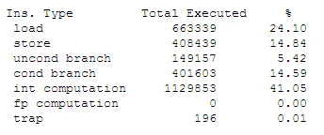
What should we do with respect to these parameters?
First Step: tune a specific parameter
For example, tune the parameter of branch predictor type (-bpred)

Slide 7
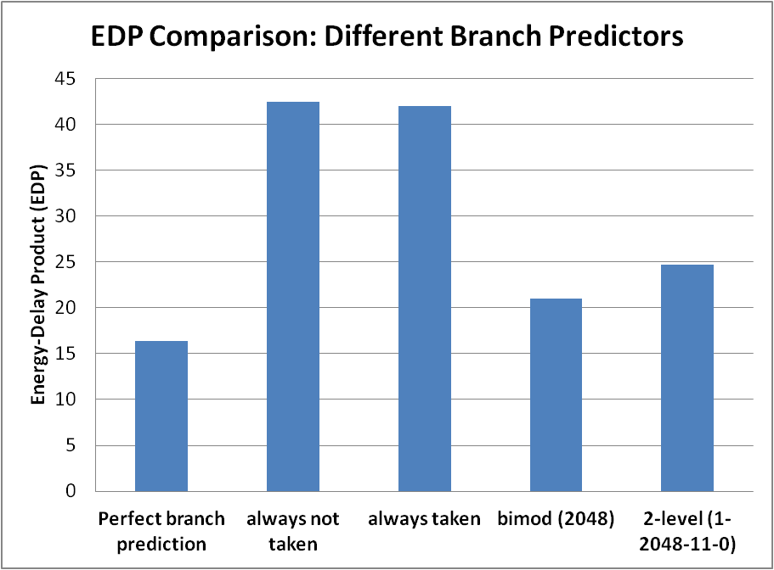
What should we do with respect to these parameters?
First Step: tune a specific parameter
For example, tune the parameter of branch predictor type (-bpred)

Slide 8
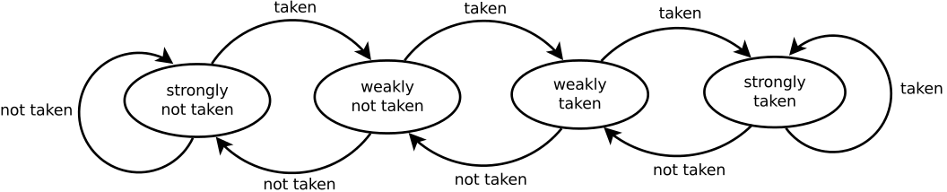
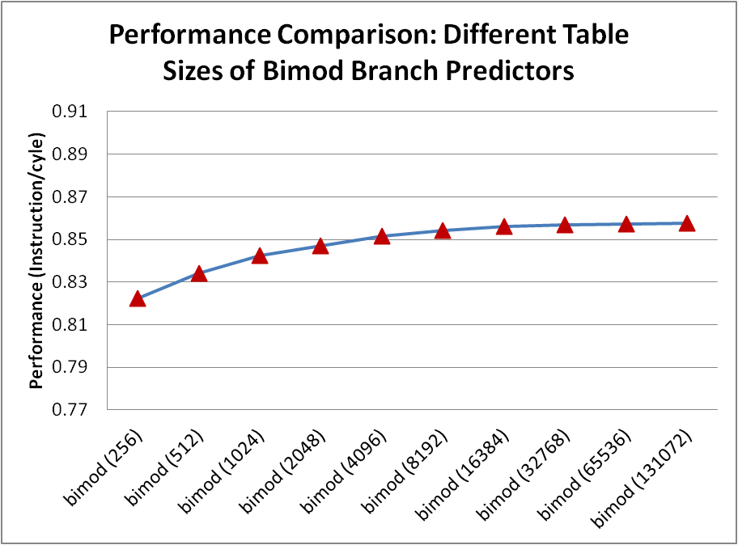
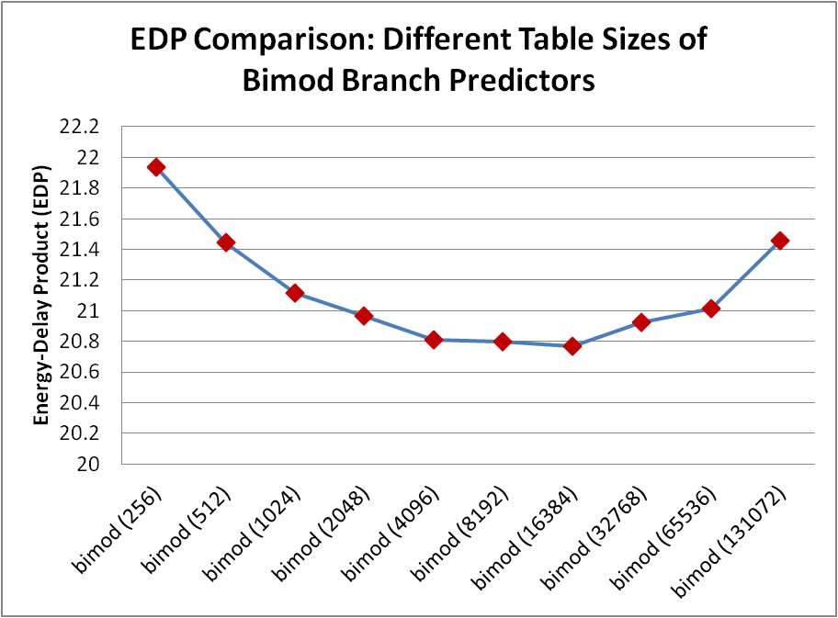
What should we do with respect to these parameters?
First Step: tune a specific parameter
Tune the parameter of bimodal branch predictor table size (-bpred:bimod)

Slide 9
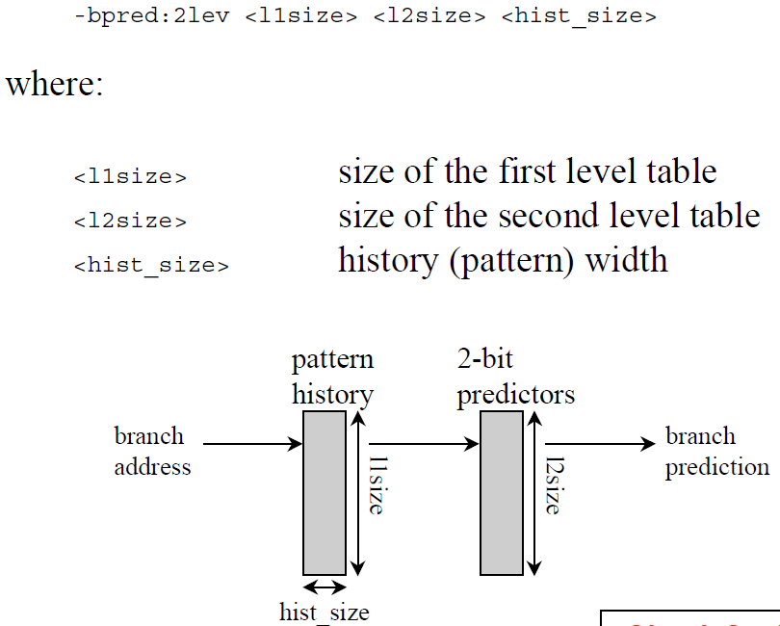
2-Level branch predictor

Slide 10
What should we do with respect to these parameters?
Second Step:
  Tune a few closely-related parameters (from the same group) together
    e.g., decode width (-decode:width), issue width (-issue:width), and commit width (-commit:width)
    Require insight into the superscalar architecture
    You can use a script to automate this!

Slide 11
What should we do with respect to these parameters?
Third Step:
  Tune a few related parameters (from different groups) together
    e.g., issue width (-issue:width), and number of function units
    (-res:ialu, -res:imult)
You can use a script to automate this!

Slide 12
Assignment information
Individual Assignment
Assignment Website:
https://sites.google.com/site/5md00sca
Server Account:
Pick up one account from our secretary (PT9.24)
Deadline
Jan. 9, 2012

Slide 13
Questions?

