Slide 1
Advanced Computer Architecture
5MD00 / 5Z033
Fundamentals
Henk Corporaal
www.ics.ele.tue.nl/~heco/courses/aca
h.corporaal@tue.nl
TUEindhoven
2014

Slide 2
Lecture overview
Trends
  Performance increase
  Technology factors
Computing classes
Cost
Performance measurement
  Benchmarks
  Metrics
Dependability

Slide 3

Trends
See the ITRS
(International Technology Roadmap Semiconductors)
http://public.itrs.net/

Slide 4
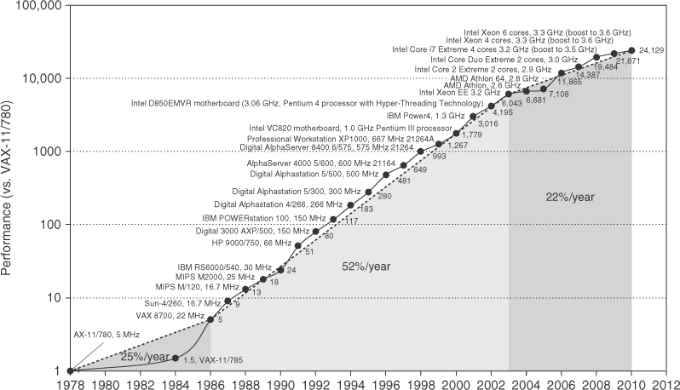
Performance of (single) processors

Slide 5
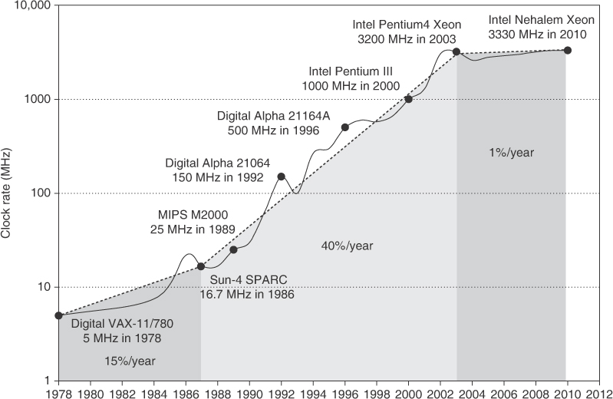
Frequency development of processors

Slide 6
Where Has This Performance Improvement Come From?
Technology
  More transistors per chip
  Faster logic
Machine Organization/Implementation
  Deeper pipelines
  More instructions executed in parallel
Instruction Set Architecture
  Reduced Instruction Set Computers (RISC)
  Multimedia extensions
  Explicit parallelism
Compiler technology
  Finding more parallelism in code
  Greater levels of optimization

Slide 7
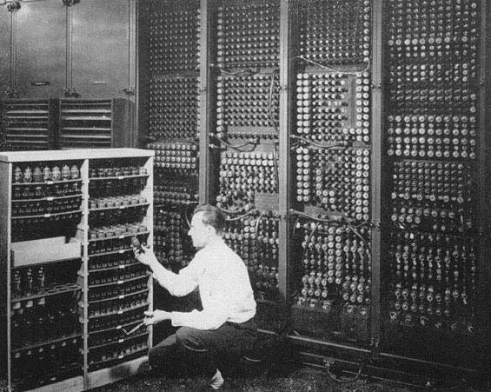
ENIAC: Electronic Numerical Integrator And Computer, 1946

Slide 8
VLSI Developments
1946: ENIAC electronic numerical integrator and computer
Floor area
  140 m²
Performance
  multiplication of two 10-digit numbers in 2 ms
Power
  160 KWatt
2014: High Performance microprocessor
Chip area
  100-400 mm² (for multi-core)
Board area
  200 cm²; improvement of 10⁴
Performance:
  64 bit multiply in O(1 ns); improvement of 10⁶
Power
  20 Watt; improvement 8000
On top
  architectural improvements, like ILP exploitation
  extreme cost reduction
Technology Improvement

Slide 9
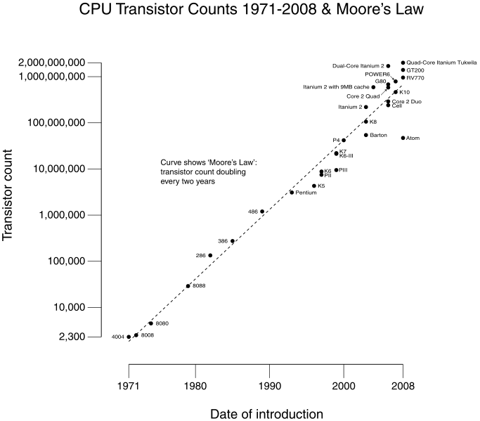
CMOS improvements:
Transistor density: 4x / 3 yrs
Die size: 10-25% / yr

Slide 10
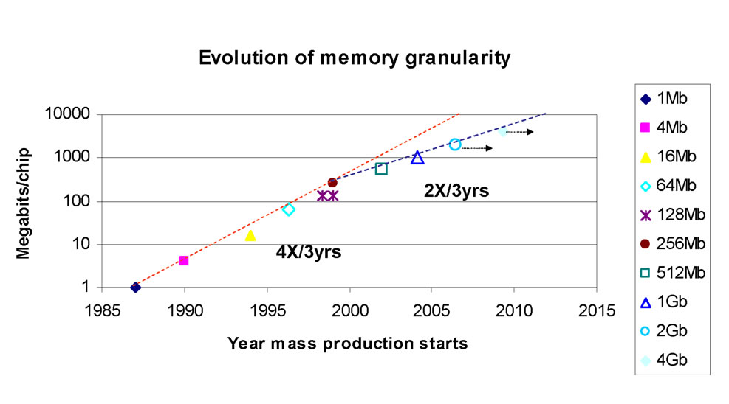
Evolution of memory granularity
From SSCS by Randall D. Isaac

Slide 11
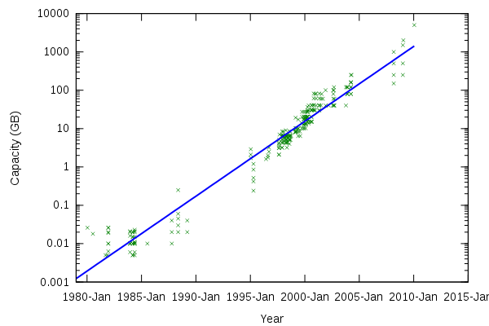
PC hard drive capacity

Slide 12
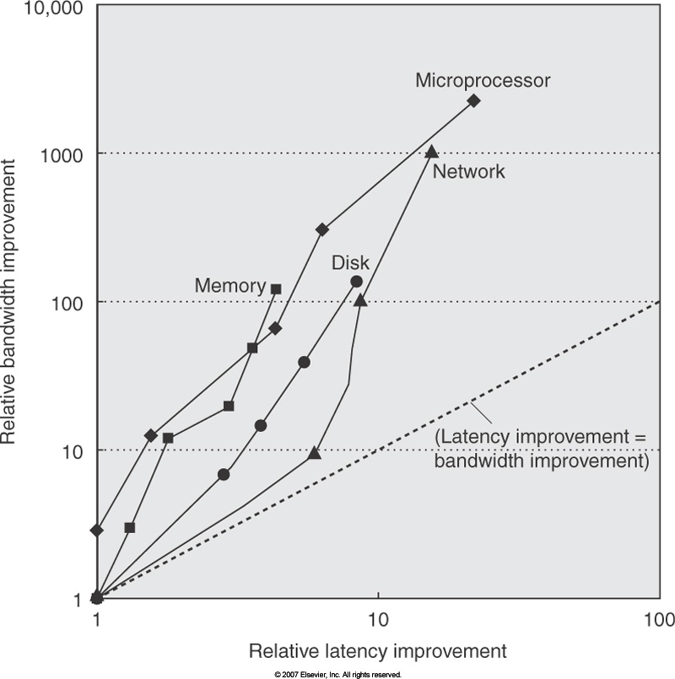
Bandwidth vs
Latency

Slide 13
Latency Lags Bandwidth (last ~20 years)
Performance Milestones
Processor: ‘286, ‘386, ‘486, Pentium, Pentium Pro, Pentium 4 (21x,2250x)
Ethernet: 10Mb, 100Mb, 1000Mb, 10000 Mb/s (16x,1000x)
Memory Module: 16bit plain DRAM, Page Mode DRAM, 32b, 64b, SDRAM,
DDR SDRAM (4x,120x)
Disk : 3600, 5400, 7200, 10000, 15000 RPM (8x, 143x)
CPU high,
Memory low
(“Memory Wall”)
Notes:
Processor: 2250X, 22X Latency

Slide 14
Technology Trends
(Summary)
Capacity Speed (latency)
Logic 2x in 3 years 2x in 3 years
DRAM 4x in 3 years 2x in 10 years
Disk 4x in 3 years 2x in 10 years

Slide 15
Computer classes
Desktop
  PC / Laptop
  PDA ?
  Game computers?
Server
Embedded
  everywhere ….
See fig. 1.2 which lists
price of system
price of microprocessor module
volume (in 2005)
critical design issues

Slide 16
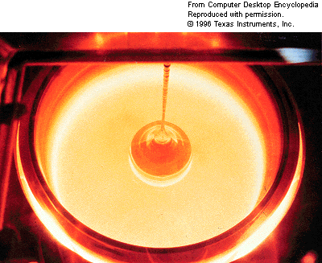
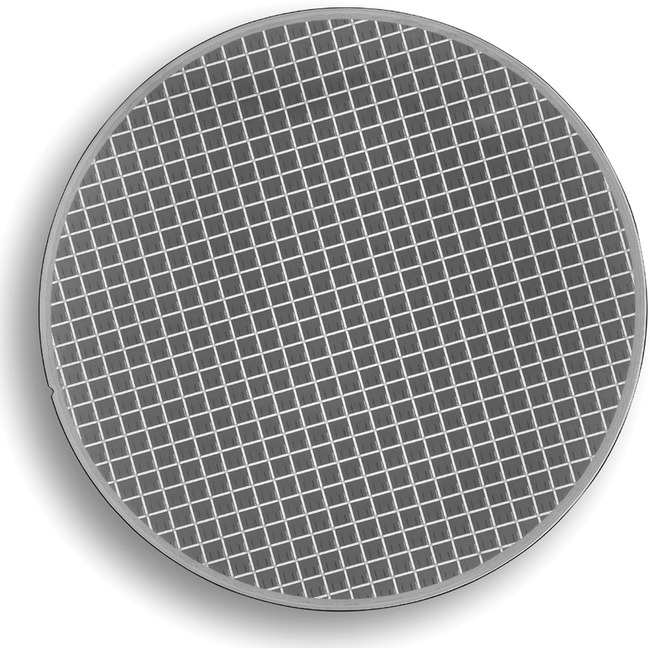
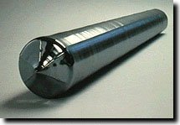
8” MIPS64 R20K wafer (564 dies)
Drawing single-crystal
Si ingot from furnace….
Then, slice into wafers and pattern it…

Slide 17
What's the price of an IC ?
Die cost + Testing cost + Packaging cost
Final test yield
Final test yield: fraction of packaged dies which pass the final testing state
IC cost =

Slide 18
Integrated Circuits Costs
IC cost = Die cost + Testing cost + Packaging cost
Final test yield
Die cost = Wafer cost
Dies per Wafer * Die yield
Final test yield: fraction of packaged dies which pass the final testing state
Die yield: fraction of good dies on a wafer

Slide 19
What's the price of the final product ?
Component Costs
Direct Costs (add 25% to 40%) recurring costs: labor, purchasing, warranty
Gross Margin (add 82% to 186%) nonrecurring costs:
R&D, marketing, sales, equipment maintenance, rental, financing cost, pretax profits, taxes
Average Discount to get List Price (add 33% to 66%): volume discounts and/or retailer markup
List Price
Average
Discount
25% to 40%
Avg. Selling Price
Gross
Margin
34% to 39%
Direct Cost
6% to 8%
Component
Cost
15% to 33%

Slide 20
Quantitative Principles of Design
Take Advantage of Parallelism
Principle of Locality
Focus on the Common Case
  Amdahl’s Law (or Gustafson's Law)
  E.g. common case supported by special hardware; uncommon cases in software
The Performance Equation

Slide 21
1. Parallelism
How to improve performance?
(Super)-pipelining
Powerful instructions
  MD-technique
    multiple data operands per operation
  MO-technique
    multiple operations per instruction
Multiple instruction issue
  single instruction-program stream
  multiple streams (or programs, or tasks)

Slide 22
Pipelined Instruction Execution
Time (clock cycles)
Cycle 1
Cycle 2
Cycle 3
Cycle 4
Cycle 5
Cycle 6
Cycle 7
I
n
s
t
r.
O
r
d
e
r
Ifetch
Reg
ALU
DMem
Reg
Ifetch
Reg
ALU
DMem
Reg
Ifetch
Reg
ALU
DMem
Reg
Ifetch
Reg
ALU
DMem
Reg

Slide 23
Limits to pipelining
Hazards prevent next instruction from executing during its designated clock cycle
  Structural hazards: attempt to use the same hardware to do two different things at once
  Data hazards: Instruction depends on result of prior instruction still in the pipeline
  Control hazards: Caused by delay between the fetching of instructions and decisions about changes in control flow (branches and jumps).
Time (clock cycles)
I
n
s
t
r.
O
r
d
e
r
Ifetch
Reg
ALU
DMem
Reg
Ifetch
Reg
ALU
DMem
Reg
Ifetch
Reg
ALU
DMem
Reg
Ifetch
Reg
ALU
DMem
Reg

Slide 24
2. The Principle of Locality
Programs access a relatively small portion of the address space at any instant of time.
Two Different Types of Locality:
  Temporal Locality (Locality in Time): If an item is referenced, it will tend to be referenced again soon (e.g., loops, reuse)
  Spatial Locality (Locality in Space): If an item is referenced, items whose addresses are close by tend to be referenced soon
  (e.g., straight-line code, array access)
Last 30 years, HW relied on locality for memory perf.
P
$
MEM
Notes:
The principle of locality states that programs access a relatively small portion of the address space at any instant of time.
This is kind of like in real life, we all have a lot of friends. But at any given time most of us can only keep in touch with a small group of them.
There are two different types of locality: Temporal and Spatial. Temporal locality is the locality in time which says if an item is referenced, it will tend to be referenced again soon.
This is like saying if you just talk to one of your friends, it is likely that you will talk to him or her again soon.
This makes sense. For example, if you just have lunch with a friend, you may say, let’s go to the ball game this Sunday. So you will talk to him again soon.
Spatial locality is the locality in space. It says if an item is referenced, items whose addresses are close by tend to be referenced soon.
Once again, using our analogy. We can usually divide our friends into groups. Like friends from high school, friends from work, friends from home.
Let’s say you just talk to one of your friends from high school and she may say something like: “So did you hear so and so just won the lottery.”
You probably will say NO, I better give him a call and find out more.
So this is an example of spatial locality. You just talked to a friend from your high school days. As a result, you end up talking to another high school friend. Or at least in this case, you hope he still remember you are his friend.
+3 = 10 min. (X:50)

Slide 25
Memory Hierarchy Levels
Capacity
Access Time
Cost
Staging
Xfer Unit
CPU Registers
100s Bytes
300 – 500 ps (0.3-0.5 ns)
Registers
Upper Level
Instr. Operands
prog./compiler
1-8 bytes
faster
L1 and L2 Cache
10s-100s K Bytes
~1 ns - ~10 ns
~ $100s/ GByte
L1 Cache
Blocks
cache cntl
32-64 bytes
L2 Cache
cache cntl
64-128 bytes
Main Memory
G Bytes
80ns- 200ns
~ $10/ GByte
Blocks
Memory
Pages
OS
4K-8K bytes
Disk
10s T Bytes, 10 ms
(10,000,000 ns)
~ $0.1 / GByte
Disk
Files
user/operator
Gbytes
Larger
Tape
infinite
sec-min
~$0.1 / GByte
Tape
Lower Level
still needed?

Slide 26
3. Focus on the Common Case
Favor the frequent case over the infrequent case
  E.g., Instruction fetch and decode unit used more frequently than multiplier, so optimize it first
  E.g., If database server has 50 disks / processor, storage dependability dominates system dependability, so optimize it first
Frequent case is often simpler and can be done faster than the infrequent case
  E.g., overflow is rare when adding 2 numbers, so improve performance by optimizing more common case of no overflow
  May slow down overflow, but overall performance improved by optimizing for the normal case
What is frequent case? How much performance improved by making case faster? => Amdahl’s Law

Slide 27
Amdahl’s Law
1
T_{exec,old}
T_{exec,new}
Speedup_{overall} =
=
(1 - f_{parallel}) + f_{parallel}
Speedup_{parallel}
f_{parallel}= parallel fraction
parallel part
exc. time
serial part
serial part

Slide 28
Amdahl’s Law
Floating point instructions improved to run 2 times faster, but only 10% of actual instructions are FP
T_{exec,new} =
Speedup_{overall}
=

Slide 29
Amdahl’s Law
Floating point instructions improved to run 2 times faster; but only 10% of actual instructions are FP
T_{exec,new} = T_{exec,old} x (0.9 + 0.1/2) = 0.95 x T_{exec,old}
1
Speedup_{overall}
=
=
1.053
0.95

Slide 30
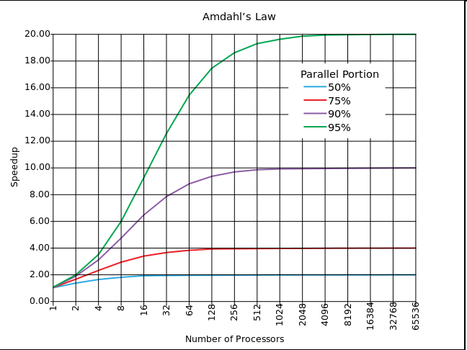
Amdahl's law

Slide 31
Gustafson's law
Gustafson proposed a change to Amdahl's law
He assumes the data (input) set for the parallel part scales (increases) linearly with the number of processors
=> much better scaling
Speedup = P - f_{seq}(P-1)
where P is number of processors (parallel speedup),
f_{seq} = sequential fraction of the original program

Slide 32
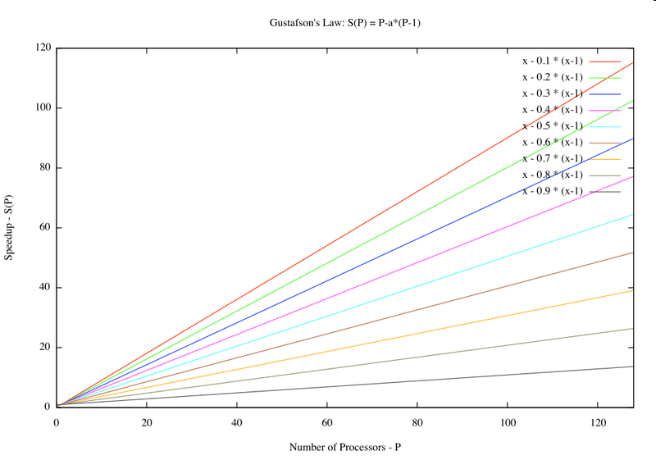
Gustafson's law

Slide 33
4. The performance equation
Main performance metric:
Total Execution Time
T_{exec} = N_{cycles} * T_{cycle}
= N_{instructions} * CPI * T_{cycle}
    CPI: (Average number of) Cycles Per Instruction

Slide 34
Example: Calculating CPI
Base Machine (Reg / Reg)
Op Freq Cycles CPI(i) (% Time)
ALU 50% 1 .5 (33%)
Load 20% 2 .4 (27%)
Store 10% 2 .2 (13%)
Branch 20% 2 .4 (27%)
1.5
Typical Mix

Slide 35
Measurement Tools
Benchmarks, Traces, Mixes
Hardware: Cost, delay, area, power estimation
Simulation (many levels)
  ISA, RT, Gate, Circuit level
Queuing Theory (analytic models)
Rules of Thumb
Fundamental “Laws”/Principles

Slide 36
Aspects of CPU Performance
CPU time = Seconds = Instructions x Cycles x Seconds
Program Program Instruction Cycle
Instr. Cnt CPI Clock Rate
Program
Compiler
Instr. Set
Organization
Technology

Slide 37
Aspects of CPU Performance
CPU time = Seconds = Instructions x Cycles x Seconds
Program Program Instruction Cycle
Inst Count CPI Clock Rate
Program X X
Compiler X X
Inst. Set. X X
Organization X X
Technology X

Slide 38
Marketing Metrics
MIPS =Instruction Count / (Time * 10^6)
= (Frequency / CPI) / 10^6
  Not effective for machines with different instruction sets
  Not effective for programs with different instruction mixes
  Uncorrelated with performance
MFLOPs = (FP Operations / Time) / 10^6
  Machine dependent
  Often not where time is spent
Peak - maximum able to achieve
Average - for a set of benchmarks
Relative - compared to another platform
Normalized MFLOPS:
  add,sub,compare,mult 1
  divide, sqrt 4
  exp, sin, . . . 8

Slide 39
Programs to Evaluate Processor Performance
(Toy) Benchmarks
  10-100 line program
  e.g.: sieve, puzzle, quicksort
Synthetic Benchmarks
  Attempt to match average frequencies of real workloads
  e.g., Whetstone, dhrystone
Kernels
  Time critical excerpts
Real Benchmarks

Slide 40
Benchmarks
Benchmark mistakes
  Only average behavior represented in test workload
  Loading level controlled inappropriately
  Caching effects ignored
  Ignoring monitoring overhead
  Not ensuring same initial conditions
  Collecting too much data but doing too little analysis
Benchmark tricks
  Compiler (soft)wired to optimize the workload
  Very small benchmarks used
  Benchmarks manually translated to optimize performance

Slide 41
SPEC benchmarks, since 1989
CPU: CPU2006
  CINT2006 and CFP2006
Graphics: SPECviewperf9 e.o.
HPC/OMP: HPC2002; OMP2001, MPI2006
Java Client/Server: jAppServer2004
Java runtime: SPECjvm2008
Mail Servers: MAIL2001
Network File System: SDS97_R1
Power (under development)
Web Servers: WEB2005

Slide 42
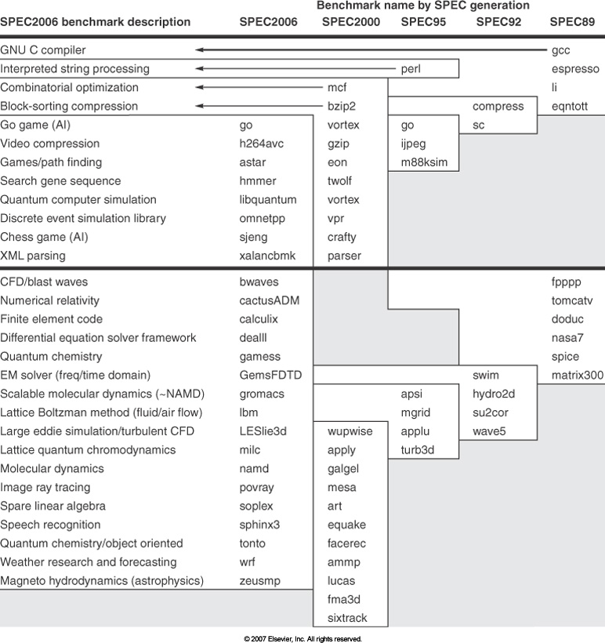
SPEC benchmarks

Slide 43
How to Summarize Performance
Arithmetic mean (weighted arithmetic mean) tracks execution time: Σ(T_{i})/n or Σ(W_{i}*T_{i})
Normalized execution time is handy for scaling performance (e.g., X times faster than
VAX-780)
But do not take the arithmetic mean of normalized execution time,
but use the geometric mean: (∏_{i} ratio_{i})^{1/n}

Slide 44
Computer Architecture Topics
Input/Output and Storage
Disks, WORM, Tape
RAID
Emerging Technologies
Interleaving
Bus protocols
DRAM
Memory
Hierarchy
Coherence,
Bandwidth,
Latency
L2 Cache
L1 Cache
Addressing,
Protection,
Exception Handling
VLSI
Instruction Set Architecture
Pipelining, Hazard Resolution,
Superscalar, Reordering,
Prediction, Speculation,
Vector, DSP
Pipelining and Instruction
Level Parallelism

Slide 45
Computer Architecture Topics
Programming model
Shared Memory,
Message Passing,
Data Parallelism
P
M
P
M
P
M
P
M
° ° °
S
Interconnection Network
Network Interfaces
Processor-Memory-Switch
Topologies,
Routing,
Bandwidth,
Latency,
Dependability /
Reliability
Multiprocessors
Networks and Interconnections

Slide 46
Dependability
MTTF: mean time between failure (in hours)
MTTR: mean time to repair (in hours)
Availability = MTTF / (MTTF + MTTR)
FIT: failures in time (per 1 billion hours)
Example
  MTTF = 1,000,000 hours
  FIT = 10⁹ / MTTF = 1000 failures per billion hours

Slide 47
Dependability of a Disk subsystem
10 disks MTTF = 1,000,000 hours
1 SCSI controller MTTF = 500,000
1 power-supply MTTF = 200,000
1 fan MTTF = 200,000
1 SCSI cable MTTF = 1,000,000
What is MTTF of this subsystem?
  assuming lifetimes exp. distributed &
  independent failures
FIT = Σ_{i} FIT_{i} = 10⁹ * (10*1/10⁶ + 1/5.10⁵ + .. )
= 23000 failures / billion hours
MTTF = 1/FIT = 10⁹ hours / 23000 = 43,500 hours

Slide 48
Dependability: let's use redundancy
Two powersupplies, each MTTF = 200,000 hour and MTTR = 1 day
What is the MTTF of the combined power supply?
On average the first disk fails in MTTF/2 = 100,000 hours
During repair second failure with probability
p = MTTR / MTTF = 24/200,000
MTTF_{pair} = 100,000/p = 830,000,000 hours

Slide 49
What is Ahead?
Bigger caches. More levels of cache? Software control.
Greater instruction level parallelism?
Increased exploiting data level parallelism:
  Vector and Subword parallel processing
Exploiting task level parallelism: Multiple processor cores per chip; how many are needed?
  Bus based communication, or
  Networks-on-Chip (NoC)
Complete MP Systems on Chip: platforms
Compute servers
Cloud computing

Slide 50
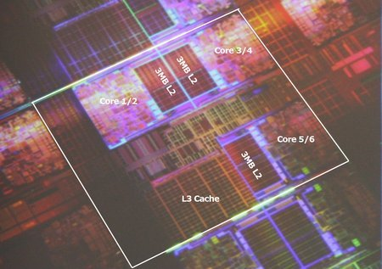
Intel Dunnington 6-core

Slide 51
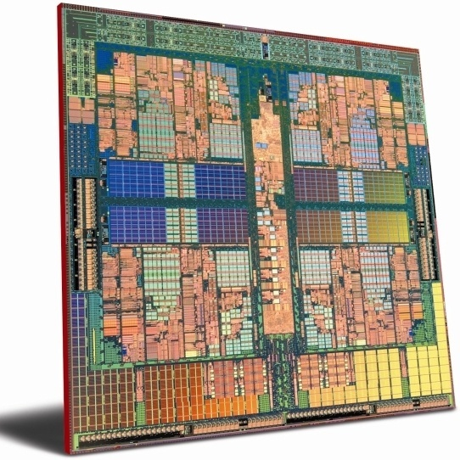
AMD Hydra 8 core
45 nm
L2: 1MByte/core
L3: shared 6MByte

Slide 52
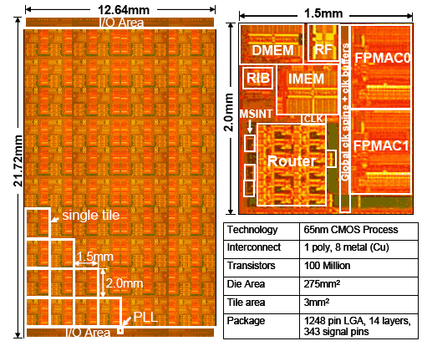
Intel 80 processor die

Slide 53
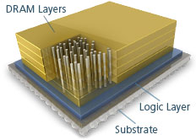
Intel MIC: many integrated core architecture, aka Intel Xeon Phi
latest version (2015): Knights Landing
build on Silvermont (Atom) x86 cores with 512-bit (SIMD) AVX units
up to 72 cores / chip => 3 TeraFlops
14 nm
using Micron’s DRAM 3D techn.
(hybrid memory cube)

Slide 54
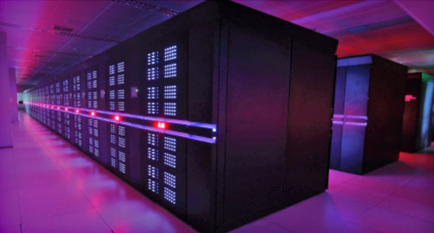
Tianhe-2: performance nr 1 in 2014
3.120.000 cores
33.8 PetaFlop
17.8 MegaWatt

