Slide 1
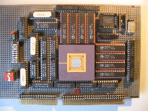
Advanced Computer Architecture
Memory Hierarchy Design
Course 5MD00
Henk Corporaal
November 2013
h.corporaal@tue.nl

Slide 2


Welcome!
This lecture:
Memory Hierarchy Design
  Hierarchy
  Recap of Caching (App B)
  Many Cache and Memory Hierarchy Optimizations
  VM: virtual memory support
  AMR Cortex-A8 and Intel Core i7 examples
Material:
  Book of Hennessy & Patterson
  appendix B
  + chapter 2:
    2.1-2.6

Slide 3
Registers vs. Memory
Arithmetic instructions operands must be registers,
— only 32 registers provided (Why?)
Compiler associates variables with registers
Question: what to do about programs with lots of variables ?
Fast
(2000Mhz)
Slower
(500Mhz)
Slowest
(133Mhz)
CPU
Main
Memory
4 Gigabyte
Cache
Memory
1MB
register file
32x4 =
128 byte
registerfile

Slide 4
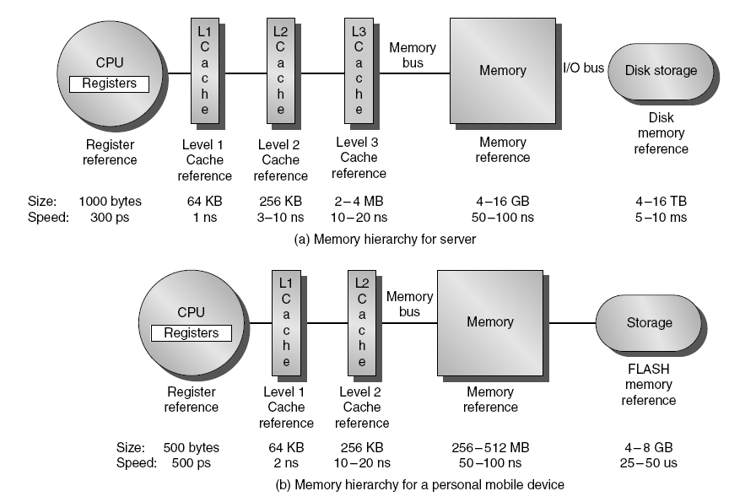
Memory Hierarchy

Slide 5
Why does a small cache still work?
LOCALITY
  Temporal: you are likely accessing the same address soon again
  Spatial: you are likely accessing another address close to the current one in the near future

Slide 6
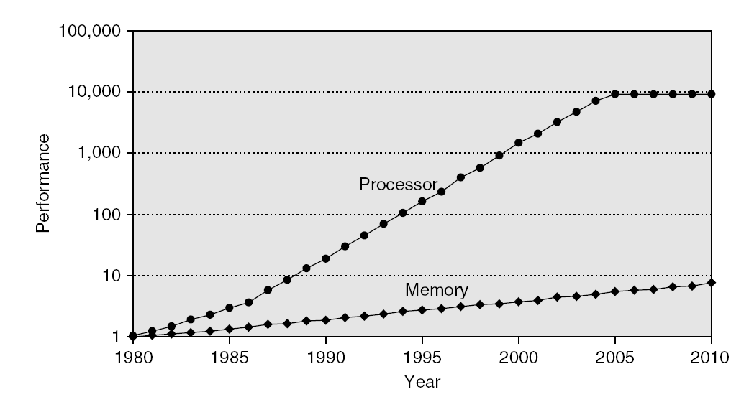
Memory Performance Gap

Slide 7
Memory Hierarchy Design
Memory hierarchy design becomes more crucial with recent multi-core processors:
  Aggregate peak bandwidth grows with # cores:
  Intel Core i7 can generate two references per core per clock
  Four cores and 3.2 GHz clock
    25.6 billion 64-bit data references/second +
    12.8 billion 128-bit instruction references
    = 409.6 GB/s!
  DRAM bandwidth is only 6% of this (25 GB/s)
  Requires:
    Multi-port, pipelined caches
    Two levels of cache per core
    Shared third-level cache on chip

Slide 8
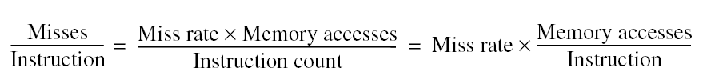
Memory Hierarchy Basics
Note that speculative and multithreaded processors may execute other instructions during a miss
  Reduces performance impact of misses

Slide 9
Cache operation
Cache / Higher level
Memory / Lower level
block / line
tags
data

Slide 10
Direct Mapped Cache
Mapping: address is modulo the number of blocks in the cache

Slide 11
Review: Four Questions for Memory Hierarchy Designers
Q1: Where can a block be placed in the upper level? (Block placement)
  Fully Associative, Set Associative, Direct Mapped
Q2: How is a block found if it is in the upper level?
(Block identification)
  Tag/Block
Q3: Which block should be replaced on a miss?
(Block replacement)
  Random, FIFO, LRU
Q4: What happens on a write?
(Write strategy)
  Write Back or Write Through (with Write Buffer)

Slide 12
Direct Mapped Cache
Address (bit positions)
3
1
3
0
1
3
1
2
1
1
2
1
0
B
y
t
o
e
f
f
s
e
Q:What kind of locality are we taking advantage of?
t
H
2
0
1
0
i
t
D
a
t
T
a
g
a
I
n
d
e
x
I
n
d
e
x
V
a
l
i
d
T
a
g
D
a
t
a
0
1
2
1
0
2
1
1
0
2
2
1
0
2
3
2
0
3
2

Slide 13
Direct Mapped Cache
Taking advantage of spatial locality:
Address (bit positions)

Slide 14
Cache Basics
cache_size = Nsets x Assoc x Block_size
block_address = Byte_address DIV Block_size in bytes
index = Block_address MOD Nsets
Because the block size and the number of sets are (usually) powers of two, DIV and MOD can be performed efficiently
block address
tag
index
block
offset
31 …
… 2 1 0

Slide 15
6 basic cache optimizations
(App. B.3)
Reduces miss rate
  Larger block size
  Bigger cache
  Associative cache (higher associativity)
    reduces conflict rate
Reduce miss penalty
  Multi-level caches
  Give priority to read misses over write misses
Reduce hit time
  Avoid address translation during indexing of the cache

Slide 16
Improving Cache Performance
T = Ninstr * CPI * Tcycle
CPI (with cache) = CPI_base + CPI_cachepenalty
CPI_cachepenalty = .............................................
Reduce the miss rate
Reduce the miss penalty
Reduce the time to hit in the cache

Slide 17
1. Increase Block Size

Slide 18
2. Larger Caches
Increase capacity of cache
Disadvantages :
  longer hit time (may determine processor cycle time!!)
  higher cost
  access requires more energy

Slide 19
3. Use / Increase Associativity
Direct mapped caches have lots of conflict misses
Example
  suppose a Cache with 128 entries, 4 words/entry
  Size is 128 x 16 = 2k Bytes
  Many addresses map to the same entry, e.g.
    Byte addresses 0-15, 2k - 2k+15, 4k - 4k+15, etc. all map to entry 0
  What if program accesses repeatedly (in a loop) following 3 addresses: (0, 2k+4, and 4k+12) ⇒
  they will all miss, although only 3 words of the cache are really used !!

Slide 20
A 4-Way Set-Associative Cache
Way 3
Set 1
4-ways: Set contains 4 blocks
Fully associative cache contains 1 set, containing all blocks

Slide 21
Example 1: cache calculations
Assume
  Cache of 4K blocks
  4 word block size
  32 bit address
Direct mapped (associativity=1) :
  16 bytes per block = 2^4
  32 bit address : 32-4=28 bits for index and tag
  #sets=#blocks/ associativity : log2 of 4K=12 : 12 for index
  Total number of tag bits : (28-12)*4K=64 Kbits
2-way associative
  #sets=#blocks/associativity : 2K sets
  1 bit less for indexing, 1 bit more for tag
  Tag bits : (28-11) * 2 * 2K=68 Kbits
4-way associative
  #sets=#blocks/associativity : 1K sets
  1 bit less for indexing, 1 bit more for tag
  Tag bits : (28-10) * 4 * 1K=72 Kbits

Slide 22
Example 2: cache mapping
3 caches consisting of 4 one-word blocks:
Cache 1 : fully associative
Cache 2 : two-way set associative
Cache 3 : direct mapped
Suppose following sequence of block addresses:
0, 8, 0, 6, 8

Slide 23
Example 2: Direct Mapped
Block address | Cache Block
0 | 0 mod 4=0
6 | 6 mod 4=2
8 | 8 mod 4=0
Address of memory block | Hit or miss | Location 0 | Location 1 | Location 2 | Location 3
0 | miss | Mem[0]
8 | miss | Mem[8]
0 | miss | Mem[0]
6 | miss | Mem[0] |  | Mem[6]
8 | miss | Mem[8] |  | Mem[6]
Coloured = new entry = miss

Slide 24
Example 2: 2-way Set Associative:
2 sets
Block address | Cache Block
0 | 0 mod 2=0
6 | 6 mod 2=0
8 | 8 mod 2=0
(so all in set/location 0)
Address of memory block | Hit or miss | SET 0 entry 0 | SET 0 entry 1 | SET 1 entry 0 | SET 1 entry 1
0 | Miss | Mem[0]
8 | Miss | Mem[0] | Mem[8]
0 | Hit | Mem[0] | Mem[8]
6 | Miss | Mem[0] | Mem[6]
8 | Miss | Mem[8] | Mem[6]
LEAST RECENTLY USED BLOCK

Slide 25
Example 2: Fully associative
(4 way assoc., 1 set)
Address of memory block | Hit or miss | Block 0 | Block 1 | Block 2 | Block 3
0 | Miss | Mem[0]
8 | Miss | Mem[0] | Mem[8]
0 | Hit | Mem[0] | Mem[8]
6 | Miss | Mem[0] | Mem[8] | Mem[6]
8 | Hit | Mem[0] | Mem[8] | Mem[6]

Slide 26
Classifying Misses: the 3 Cs
The 3 Cs:
  Compulsory—First access to a block is always a miss. Also called cold start misses
    misses in infinite cache
  Capacity—Misses resulting from the finite capacity of the cache
    misses in fully associative cache with optimal replacement strategy
  Conflict—Misses occurring because several blocks map to the same set. Also called collision misses
    remaining misses
Notes:
Intuitive Model by Mark Hill

Slide 27
3 Cs: Compulsory, Capacity, Conflict
In all cases, assume total cache size not changed
What happens if we:
1) Change Block Size:
Which of 3Cs is obviously affected? compulsory
2) Change Cache Size:
Which of 3Cs is obviously affected? capacity misses
3) Introduce higher associativity :
Which of 3Cs is obviously affected? conflict misses
Notes:
Ask which affected?
Block size
1) Compulsory
2) More subtle, will change mapping

Slide 28
3Cs Absolute Miss Rate (SPEC92)
Conflict
Miss rate per type

Slide 29
3Cs Relative Miss Rate
Conflict
Miss rate per type

Slide 30
Improving Cache Performance
Reduce the miss rate
Reduce the miss penalty
Reduce the time to hit in the cache

Slide 31
4. Second Level Cache (L2)
Most CPUs
  have an L1 cache small enough to match the cycle time (reduce the time to hit the cache)
  have an L2 cache large enough and with sufficient associativity to capture most memory accesses (reduce miss rate)
L2 Equations, Average Memory Access Time (AMAT):
AMAT = Hit Time_{L1} + Miss Rate_{L1} x Miss Penalty_{L1}
Miss Penalty_{L1} = Hit Time_{L2} + Miss Rate_{L2} x Miss Penalty_{L2}
AMAT = Hit Time_{L1} + Miss Rate_{L1} x (Hit Time_{L2} + Miss Rate_{L2} x Miss Penalty_{L2})
Definitions:
  Local miss rate— misses in this cache divided by the total number of memory accesses to this cache (Miss rate_{L2})
  Global miss rate—misses in this cache divided by the total number of memory accesses generated by the CPU
  (Miss Rate_{L1} x Miss Rate_{L2})

Slide 32
4. Second Level Cache (L2)
Suppose processor with base CPI of 1.0
Clock rate of 500 Mhz
Main memory access time : 200 ns
Miss rate per instruction primary cache : 5%
What improvement with second cache having 20ns access time, reducing miss rate to memory to 2% ?
Miss penalty : 200 ns/ 2ns per cycle=100 clock cycles
Effective CPI=base CPI+ memory stall per instruction = ?
  1 level cache : total CPI=1+5%*100=6
  2 level cache : a miss in first level cache is satisfied by second cache or memory
    Access second level cache : 20 ns / 2ns per cycle=10 clock cycles
    If miss in second cache, then access memory : in 2% of the cases
    Total CPI=1+primary stalls per instruction +secondary stalls per instruction
    Total CPI=1+5%*10+2%*100=3.5
  Machine with L2 cache : 6/3.5=1.7 times faster

Slide 33
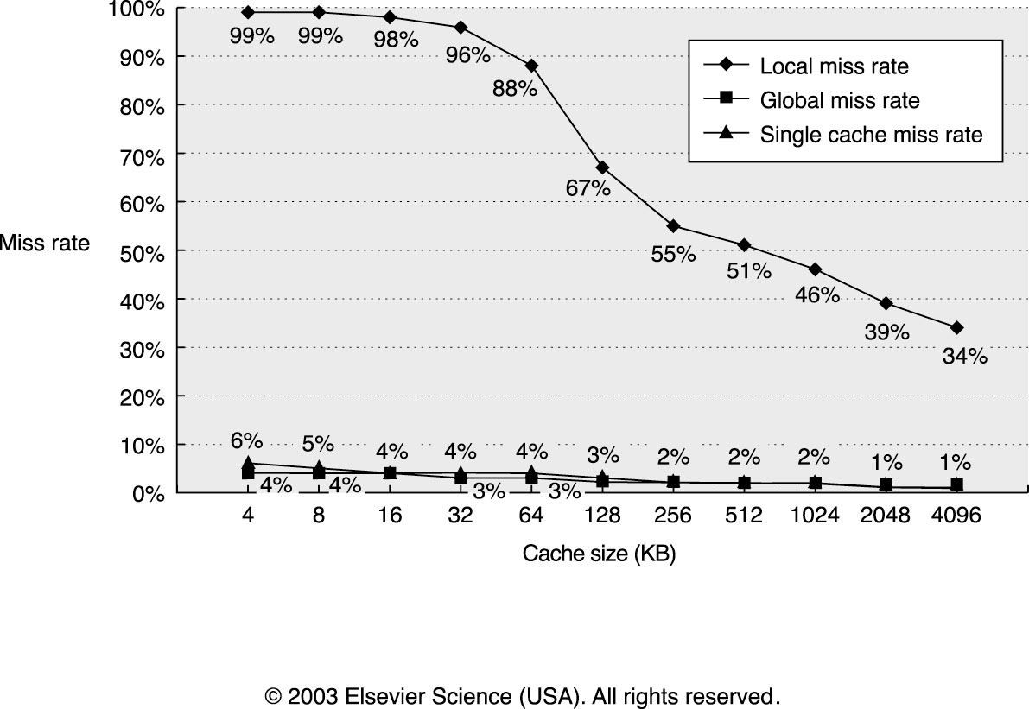
4. Second Level Cache
Global cache miss is similar to single cache miss rate of second
level cache provided L2 cache is much bigger than L1.
Local cache rate is NOT good measure of secondary caches as it is function of L1 cache.
Global cache miss rate should be used.
Notes:
Assumptions: L1 64Kbyte + 64 KByte I&D caches.
Plotted are
miss rate of single cache of size 4k – 4Mbyte
global and local missrate of L2, assuming L1 = 64+64 Kbyte.
Note that the local L2 miss rate only starts to drop after size > 128 (= total L1 size). It does not make sense to add a L2 which is smaller than L1 !!

Slide 34
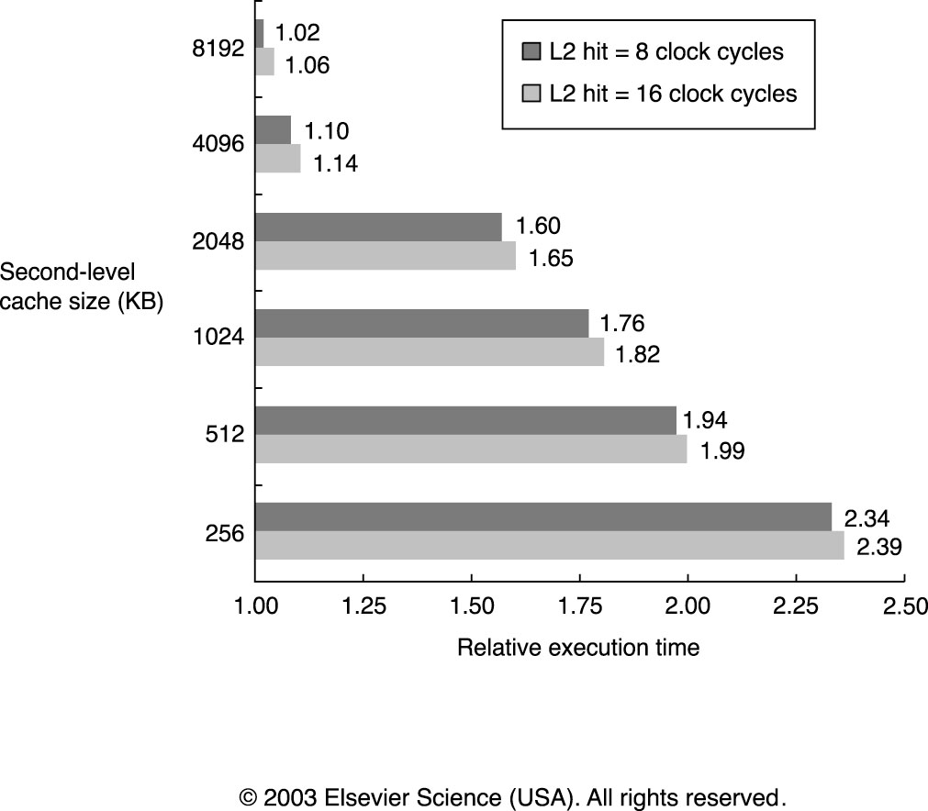
4. Second Level Cache

Slide 35
5. Read Priority over Write on Miss
Write-through with write buffers can cause RAW data hazards:
    SW 512(R0),R3 ; Mem[512] = R3
    LW R1,1024(R0) ; R1 = Mem[1024]
    LW R2,512(R0) ; R2 = Mem[512]
Problem: if write buffer used, final LW may read wrong value from memory !!
Solution 1 : Simply wait for write buffer to empty
  increases read miss penalty (old MIPS 1000 by 50% )
Solution 2 : Check write buffer contents before read: if no conflicts, let read continue
Map to same
cache block
Notes:
Data in R3 is placed in write buffer after store. The following load uses same cache index and results in miss and replaces the value. Second load instruction tries to put the value in location 512 in memory in register R2. If buffer not completed writing then wrong value will be placed in R2.

Slide 36
5. Read Priority over Write on Miss
What about write-back?
Dirty bit: whenever a write is cached, this bit is set (made a 1) to tell the cache controller "when you decide to re-use this cache line for a different address, you need to write the current contents back to memory”
What if read-miss:
Normal: Write dirty block to memory, then do the read
Instead: Copy dirty block to a write buffer, then do the read, then the write
Fewer CPU stalls since restarts as soon as read done

Slide 37
Improving Cache Performance
Reduce the miss rate
Reduce the miss penalty
Reduce the time to hit in the cache

Slide 38
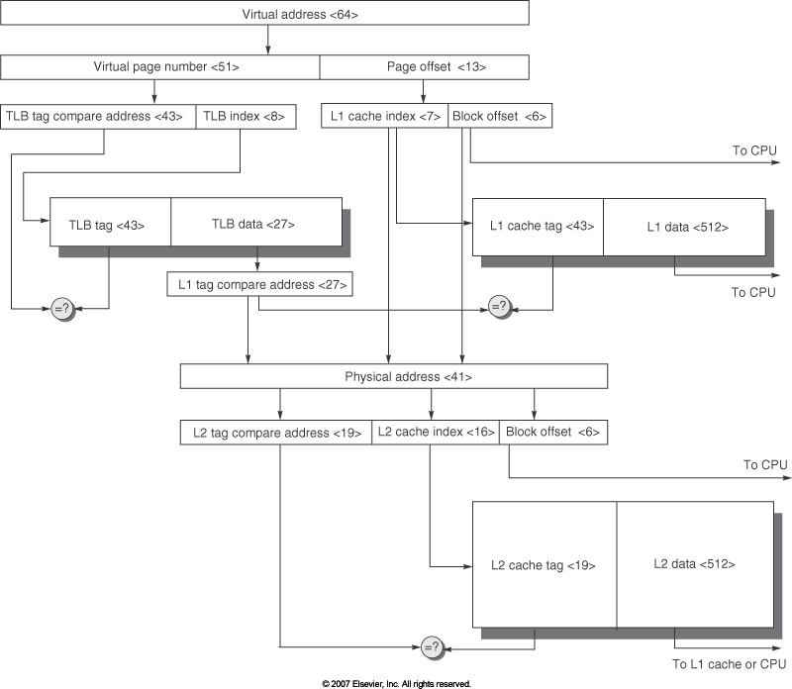
6. No address translation during cache access

Slide 39
11 Advanced Cache Optimizations (2.2)
Reducing hit time
Small and simple caches
Way prediction
Trace caches
Increasing cache bandwidth
Pipelined caches
Multibanked caches
Nonblocking caches
Reducing Miss Penalty
Critical word first
Merging write buffers
Reducing Miss Rate
Compiler optimizations
Reducing miss penalty or miss rate via parallelism
Hardware prefetching
Compiler prefetching

Slide 40
1. Small and simple first level caches
Critical timing path:
  addressing tag memory, then
  comparing tags, then
  selecting correct set
Direct-mapped caches can overlap tag compare and transmission of data
Lower associativity reduces power because
  fewer cache lines are accessed, and
  less complex mux to select the right way

Slide 41
Recap: 4-Way Set-Associative Cache
Way 3
Set 2

Slide 42
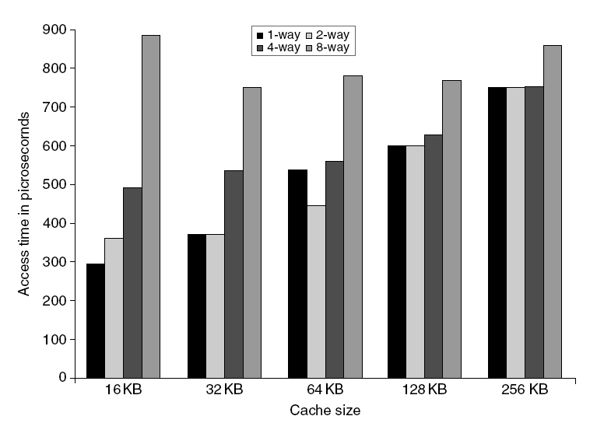
L1 Size and Associativity
Access time vs. size and associativity

Slide 43
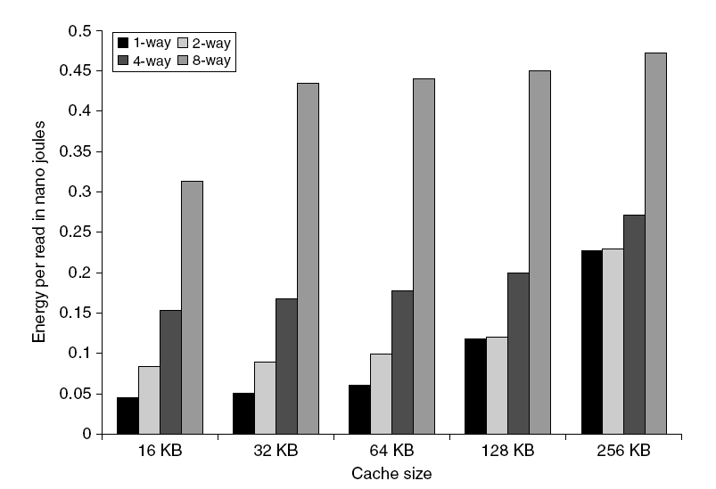
L1 Size and Associativity
Energy per read vs. size and associativity

Slide 44
2. Fast Hit via Way Prediction
Make set-associative caches faster
Keep extra bits in cache to predict the “way,” or block within the set, of next cache access.
  Multiplexor is set early to select desired block, only 1 tag comparison performed
  Miss ⇒ first check other blocks for matches in next clock cycle
Accuracy ≈ 85%
Saves also energy
Drawback: CPU pipeline is hard if hit takes 1 or 2 cycles
Hit Time
Way-Miss Hit Time
Miss Penalty

Slide 45
Way Predicting Instruction Cache
(Alpha 21264-like)
Jump target
0x4
Jump
control
Add
PC
addr
inst
Primary
Instruction
Cache
way
Sequential Way
Branch Target Way
Notes:
New slide (jse)
If way prediction is wrong – need to retrain and reaccess.

Slide 46
3. Fast (Inst. Cache) Hit via Trace Cache
Key Idea: Pack multiple non-contiguous basic blocks into one contiguous trace cache line
instruction
trace:
BR
BR
BR
trace cache line:
BR
BR
BR
Single fetch brings in multiple basic blocks
Trace cache indexed by start address and next n branch predictions

Slide 47
3. Fast Hit times via Trace Cache
Trace cache in Pentium 4 and its successors
  Dynamic instr. traces cached (in level 1 cache)
  Cache the micro-ops vs. x86 instructions
    Decode/translate from x86 to micro-ops on trace cache miss
  + better utilize long blocks (don’t exit in middle of block, don’t enter at label in middle of block)
  - complicated address mapping since addresses no longer aligned to power-of-2 multiples of word size
  - instructions may appear multiple times in multiple dynamic traces due to different branch outcomes

Slide 48
4. Pipelining Cache
Pipeline cache access to improve bandwidth
  Examples:
    Pentium: 1 cycle
    Pentium Pro – Pentium III: 2 cycles
    Pentium 4 – Core i7: 4 cycles
Increases branch mis-prediction penalty
Makes it easier to increase associativity

Slide 49
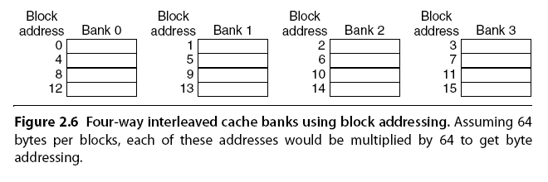
5. Multi-banked Caches
Organize cache as independent banks to support simultaneous access
  ARM Cortex-A8 supports 1-4 banks for L2
  Intel i7 supports 4 banks for L1 and 8 banks for L2
Interleave banks according to block address

Slide 50
5. Multi-banked caches
Banking works best when accesses naturally spread themselves across banks ⇒ mapping of addresses to banks affects behavior of memory system
Simple mapping that works well is “sequential interleaving”
  Spread block addresses sequentially across banks
  E.g., with 4 banks,
    Bank 0 has all blocks with address%4 = 0;
    Bank 1 has all blocks whose address%4 = 1; …
Notes:
Answer is 3 stages between branch and new instruction fetch and 2 stages between load and use (even though if looked at red insertions that it would be 3 for load and 2 for branch)
Reasons:
1) Load: TC just does tag check, data available after DS; thus supply the data & forward it, restarting the pipeline on a data cache miss
2) EX phase does the address calculation even though just added one phase; presumed reason is that since want fast clockc cycle don’t want to sitck RF phase with reading regisers AND testing for zero, so just moved it back on phase

Slide 51
6. Nonblocking Caches
Allow hits before previous misses complete
  “Hit under miss”
  “Hit under multiple miss”
L2 must support this
In general, processors can hide L1 miss penalty but not L2 miss penalty
Requires OoO processor
Makes cache control much more complex

Slide 52
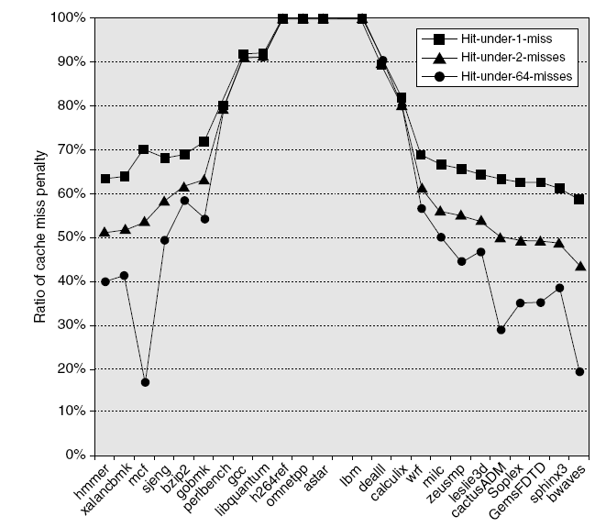
Non-blocking cache

Slide 53
7. Critical Word First, Early Restart
Critical word first
  Request missed word from memory first
  Send it to the processor as soon as it arrives
Early restart
  Request words in normal order
  Send missed work to the processor as soon as it arrives
Effectiveness of these strategies depends on block size and likelihood of another access to the portion of the block that has not yet been fetched

Slide 54
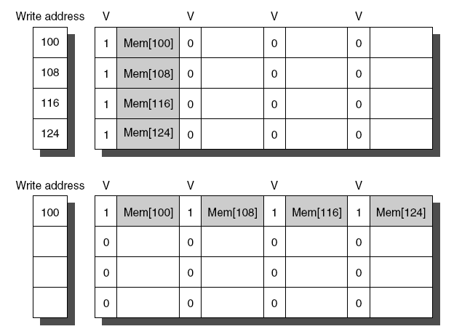
8. Merging Write Buffer
When storing to a block that is already pending in the write buffer, update write buffer
Reduces stalls due to full write buffer
Do not apply to I/O addresses
No write buffering
Write buffering

Slide 55
9. Compiler Optimizations
Loop Interchange
  Swap nested loops to access memory in sequential order
Blocking
  Instead of accessing entire rows or columns, subdivide matrices into blocks
  Requires more memory accesses but improves locality of accesses

Slide 56
9. Reducing Misses by Compiler Optimizations
Instructions
  Reorder procedures in memory so as to reduce conflict misses
  Profiling to look at conflicts (using developed tools)
Data
  Merging Arrays: improve spatial locality by single array of compound elements vs. 2 arrays
  Loop Interchange: change nesting of loops to access data in order stored in memory
  Loop Fusion: combine 2 independent loops that have same looping and some variables overlap
  Blocking: Improve temporal locality by accessing “blocks” of data repeatedly vs. going down whole columns or rows
Huge miss reductions possible !!

Slide 57
Merging Arrays
int val[SIZE]; struct record{
int key[SIZE]; int val;
int key;
for (i=0; i<SIZE; i++){ };
key[i] = newkey; struct record records[SIZE];
val[i]++;
} for (i=0; i<SIZE; i++){
records[i].key = newkey;
records[i].val++;
}
Reduces conflicts between val & key and improves spatial locality

Slide 58
Loop Interchange
for (col=0; col<100; col++)
for (row=0; row<5000; row++)
X[row][col] = X[row][col+1];
for (row=0; row<5000; row++)
for (col=0; col<100; col++)
X[row][col] = X[row][col+1];
Sequential accesses instead of striding through memory every 100 words
Improves spatial locality
columns
rows
array X

Slide 59
Loop Fusion
for (i = 0; i < N; i++)
for (j = 0; j < N; j++)
a[i][j] = 1/b[i][j] * c[i][j];
for (i = 0; i < N; i++)
for (j = 0; j < N; j++)
d[i][j] = a[i][j] + c[i][j];
for (i = 0; i < N; i++)
for (j = 0; j < N; j++){
a[i][j] = 1/b[i][j] * c[i][j];
d[i][j] = a[i][j] + c[i][j];
}
Splitted loops: every access to a and c misses. Fused loops: only 1st access misses. Improves temporal locality
Reference can be directly to register

Slide 60
Blocking (Tiling) applied to array multiplication
for (i=0; i<N; i++)
for (j=0; j<N; j++){
c[i][j] = 0.0;
for (k=0; k<N; k++)
c[i][j] += a[i][k]*b[k][j];
}
c
=
The two inner loops:
  Read all NxN elements of b
  Read all N elements of one row of a repeatedly
  Write all N elements of one row of c
If a whole matrix does not fit in the cache many cache misses result.
Idea: compute on BxB submatrix that fits in the cache
a
x
b

Slide 61
Blocking Example
for (ii=0; ii<N; ii+=B)
for (jj=0; jj<N; jj+=B)
for (i=ii; i<min(ii+B-1,N); i++)
for (j=jj; j<min(jj+B-1,N); j++){
c[i][j] = 0.0;
for (k=0; k<N; k++)
c[i][j] += a[i][k]*b[k][j];
}
B is called Blocking Factor
Can reduce capacity misses from 2N³ + N² to 2N³/B +N²
c
=
a
x
b

Slide 62
Reducing Conflict Misses by Blocking
Conflict misses in caches vs. Blocking size
  Lam et al [1991]: a blocking factor of 24 had a fifth the misses compared to 48, despite both fit in cache

Slide 63
Summary of Compiler Optimizations to Reduce Cache Misses (by hand)

Slide 64
10. Hardware Data Prefetching
Prefetch-on-miss:
  Prefetch block (b + 1) upon miss on b
One Block Lookahead (OBL) scheme
  Initiate prefetch for block (b + 1) when block b is accessed
  Why is this different from doubling block size?
  Can extend to N block lookahead
Strided prefetch
  If observed sequence of accesses to block: b, b+N, b+2N, then prefetch b+3N etc.
Example: IBM Power 5 [2003] supports eight independent streams of strided prefetch per processor, prefetching 12 lines ahead of current access
Note: instructions are usually prefetched in instr. buffer
Notes:
HP PA 7200 uses OBL prefetching
Tag prefetching is twice as effective as prefetch-on-miss in
reducing miss rates.

Slide 65
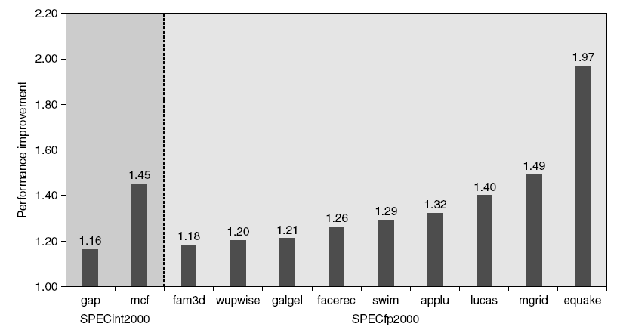
10. Hardware Prefetching
Fetch two blocks on miss (include next sequential block)
Pentium 4 Pre-fetching

Slide 66
Issues in HW Prefetching
Usefulness – should produce hits
  if you are unlucky, the pretetched data/instr is not needed
Timeliness – not too late and not too early
Cache and bandwidth pollution
L1 Instruction
Unified L2 Cache
CPU
L1 Data
RF
Prefetched data

Slide 67
Issues in HW prefetching: stream buffer
Instruction prefetch in Alpha AXP 21064
  Fetch two blocks on a miss; the requested block (i) and the next consecutive block (i+1)
  Requested block placed in cache, and next block in instruction stream buffer
  If miss in cache but hit in stream buffer, move stream buffer block into cache and prefetch next block (i+2)
Prefetched
instruction block
Req
block
Stream
Buffer
CPU
Unified L2 Cache
L1 Instruction
RF
Req
block
Notes:
Need to check the stream buffer if the requested block is in there.
Never more than one 32-byte block in the stream buffer.

Slide 68
11. Compiler Prefetching
Insert prefetch instructions before data is needed
Non-faulting: prefetch doesn’t cause exceptions
Register prefetch
  Loads data into register
Cache prefetch
  Loads data into cache
Combine with loop unrolling and software pipelining
Cost of prefetching: more bandwidth (speculation) !!

Slide 69
Technique | Hit Time | Band-width | Miss penalty | Miss rate |  | HW cost/ complexity | Comment
Small and simple caches | + |  |  | – |  | 0 | Trivial; widely used
Way-predicting caches | + |  |  |  |  | 1 | Used in Pentium 4
Trace caches | + |  |  |  |  | 3 | Used in Pentium 4
Pipelined cache access | – | + |  |  |  | 1 | Widely used
Nonblocking caches |  | + | + |  |  | 3 | Widely used
Banked caches |  | + |  |  |  | 1 | Used in L2 of Opteron and Niagara
Critical word first and early restart |  |  | + |  |  | 2 | Widely used
Merging write buffer |  |  | + |  |  | 1 | Widely used with write through
Compiler techniques to reduce cache misses |  |  |  | + |  | 0 | Software is a challenge; some computers have compiler option
Hardware prefetching of instructions and data |  |  | + | + |  | 2 instr. 3 data | Many prefetch instructions; AMD Opteron prefetches data
Compiler-controlled prefetching |  |  | + |  | + | 3 | Needs nonblocking cache; in many CPUs
Notes:
E.g.
Non blocking cache:
- increases the effective bandwidth: you do the same number of accesses in a much shorter time
reduces miss penalty: if you can handle hits under multiple misses, it happens that the next miss can be handled much earlier; it does not have to wait till the earlier misses are finished.
- Huge HW cost (3); the cache controller and memory system needs to support multiple, interleaved / pipelined misses. So memory accesses become non-atomic (so-called split-transactions), ie. the next access can start before the first one finished.

Slide 70
Memory Technology
Performance metrics
  Latency is concern of cache
  Bandwidth is concern of multiprocessors and I/O
  Access time
    Time between read request and when desired word arrives
  Cycle time
    Minimum time between unrelated requests to memory
DRAM used for main memory, SRAM used for cache

Slide 71
Memory Technology
SRAM
  Requires low power to retain bit
  Requires 6 transistors/bit
DRAM
  Must be re-written after being read
  Must also be periodically refeshed
    Every ~ 8 ms
    Each row can be refreshed simultaneously
  One transistor/bit
  Address lines are multiplexed:
    Upper half of address: row access strobe (RAS)
    Lower half of address: column access strobe (CAS)

Slide 72
Memory Technology
Amdahl:
  Memory capacity should grow linearly with processor speed
  Unfortunately, memory capacity and speed has not kept pace with processors
Some optimizations:
  Multiple accesses to same row
  Synchronous DRAM
    Added clock to DRAM interface
    Burst mode with critical word first
  Wider interfaces
  Double data rate (DDR)
  Multiple banks on each DRAM device

Slide 73
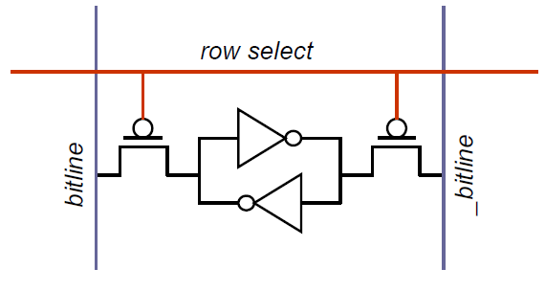
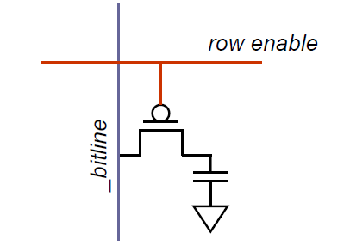
SRAM vs DRAM
Static Random Access Memory
Dynamic Random Access Memory
  Bitlines driven by transistors
    - Fast (10x)
1 transistor and 1 capacitor vs. 6 transistors
  Large (~6-10x)
  A bit is stored as charge on the capacitor
  Bit cell loses charge over time (read operation and circuit leakage)
    Must periodically refresh
    Hence the name Dynamic RAM
Credits: J.Leverich, Stanford

Slide 74
DRAM: Internal architecture
Bank 4
Bank 3
Bank 2
Bank 1
Address register
Bit cells are arranged to form a memory array
Multiple arrays are organized as different banks
  Typical number of banks are 4, 8 and 16
Sense amplifiers raise the voltage level on the bitlines to read the data out
Address
MS bits
Row decoder
Memory Array
Row Buffer
Row Buffer
Row Buffer
Sense amplifiers (row buffer)
LS bits
Column decoder
Data
Credits: J.Leverich, Stanford

Slide 75
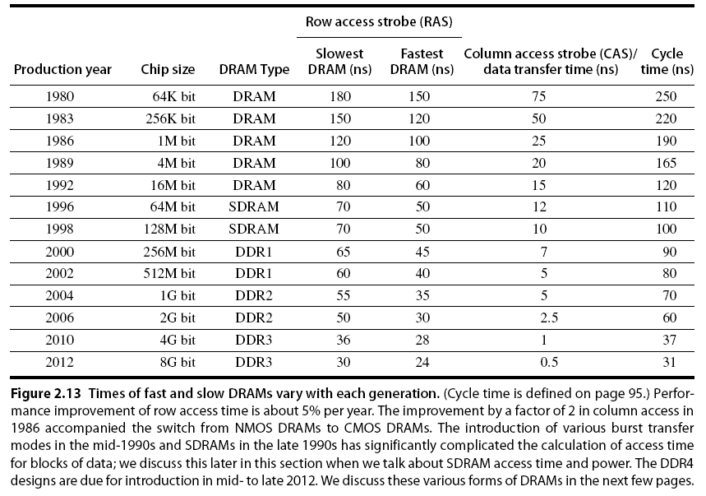
Memory Optimizations

Slide 76
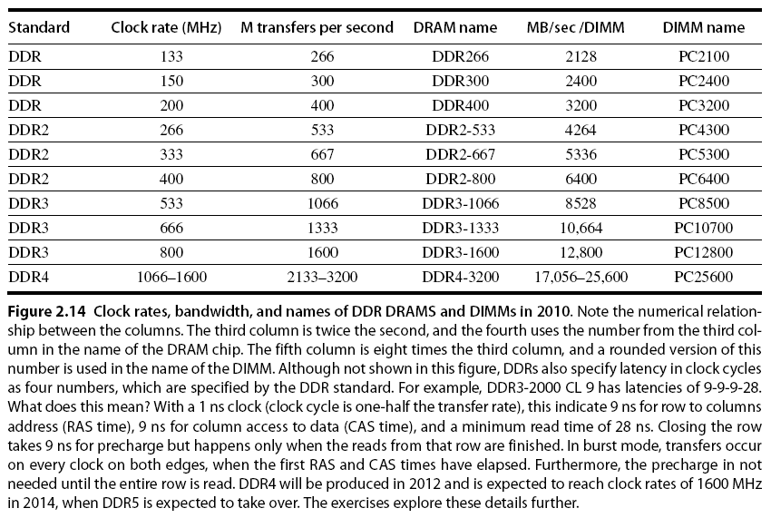
Memory Optimizations

Slide 77
Memory Optimizations
DDR:
  DDR2
    Lower power (2.5 V -> 1.8 V)
    Higher clock rates (266 MHz, 333 MHz, 400 MHz)
  DDR3
    1.5 V
    800 MHz
  DDR4
    1-1.2 V
    1600 MHz
GDDR5 is graphics memory based on DDR3

Slide 78
Memory Optimizations
Graphics memory:
  Achieve 2-5 X bandwidth per DRAM vs. DDR3
    Wider interfaces (32 vs. 16 bit)
    Higher clock rate
      Possible because they are attached via soldering instead of socketted DIMM modules
Reducing power in SDRAMs:
  Lower voltage
  Low power mode (ignores clock, continues to refresh)

Slide 79
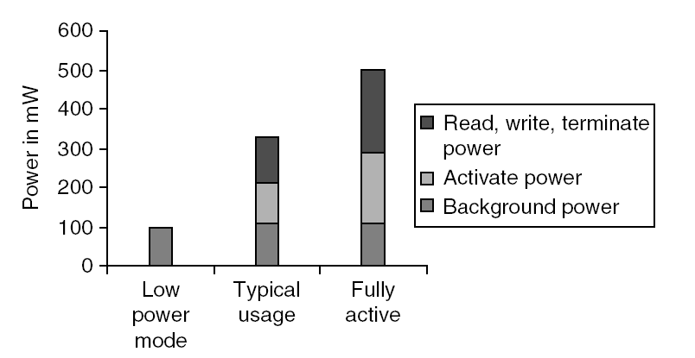
Memory Power Consumption

Slide 80
Flash Memory
Type of EEPROM
  (Electrical Erasable Programmable Read Only Memory)
Must be erased (in blocks) before being overwritten
Non volatile
Limited number of write cycles
Cheaper than SDRAM, more expensive than disk
Slower than SRAM, faster than disk

Slide 81
Memory Dependability
Memory is susceptible to cosmic rays
Soft errors: dynamic errors
  Detected and fixed by error correcting codes (ECC)
Hard errors: permanent errors
  Use sparse rows to replace defective rows
Chipkill: a RAID-like error recovery technique

Slide 82
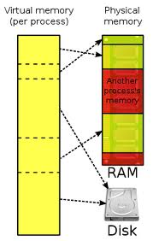
Virtual Memory
Protection via virtual memory
  Keeps processes in their own memory space
Role of architecture:
  Provide user mode and supervisor mode
  Protect certain aspects of CPU state
  Provide mechanisms for switching between user and supervisor mode
  Provide mechanisms to limit memory accesses
    read-only pages
    executable pages
    shared pages
  Provide TLB to translate addresses

Slide 83
Memory organization
The operating system, together with the MMU hardware, take care of separating the programs.
Each program runs in its own ‘virtual’ environment, and uses logical addressing that is (often) different the the actual physical addresses.
Within the virtual world of a program, the full 4 Gigabytes address space is available. (Less under Windows)
In the von Neumann architecture, we need to manage the memory space to store the following:
  The machine code of the program
  The data:
    Global variables and constants
    The stack/local variables
    The heap
Main memory
Program
+
Data

Slide 84
Memory Organization: more detail
The memory that is reserved
by the memory manager
0xFFFFFFFF
Heap
Variable
size
If the heap and the
stack collide, we’re out
of memory
The local variables in the
routines. With each routine
call, a new set of variables
if put in the stack.
Free memory
Stack pointer
Before the first line
of the program is run,
all global variables and
constants are initialized.
Variable
size
Stack
Global variables
Fixed
size
The program itself:
a set of machine
instructions.
This is in the .exe
Machine code
Fixed
size
0x00000000

Slide 85
Memory management
Problem: many programs run simultaneously
MMU manages the memory access.
Swap file
on
hard disk
Memory Management Unit
Main memory
No: access
violation
2K block
No: load 2K block
from swap file
on disk
2K block
CPU
Logical
address
Process
table
Yes:
Virtual
Memory
Manager
2K block
Physical
address
2K block
2K block
Yes:
Physical
address
Physical
address
Cache
memory
2K block
2K block
2K block
Each program thinks
that it owns all the
memory.
Checks whether the
requested address
is ‘in core’

Slide 86
Virtual Memory
Main memory can act as a cache for the secondary storage (disk)
virtual memory
physical memory
Advantages:
  illusion of having more physical memory
  program relocation
  protection

Slide 87
Pages: virtual memory blocks
Page faults: the data is not in memory, retrieve it from disk
  huge miss penalty, thus pages should be fairly large (e.g., 4KB)
  reducing page faults is important (LRU is worth the price)
  can handle the faults in software instead of hardware
  using write-through is too expensive so we use writeback

Slide 88
Page Tables
V
i
r
t
u
a
l
p
a
g
e
n
u
m
b
e
r
P
a
g
e
t
a
b
l
e
P
h
y
s
i
c
a
l
m
e
m
o
r
P
h
y
s
y
i
c
a
l
p
a
g
e
o
r
d
i
s
k
a
d
d
r
V
a
e
s
s
l
i
d
1
1
1
1
0
1
1
0
1
D
i
s
k
s
t
o
r
a
g
e
1
0
1

Slide 89
Page Tables

Slide 90
Size of page table
Assume
  40-bit virtual address; 32-bit physical
  4 Kbyte pages; 4 bytes per page table entry (PTE)
Solution
  Size = N_{entries} * Size-of-entry = 2 ⁴⁰ / 2 ¹² * 4 bytes = 1 Gbyte
Reduce size:
  Dynamic allocation of page table entries
  Hashing: inverted page table
    1 entry per physical available instead of virtual page
  Page the page table itself (i.e. part of it can be on disk)
  Use larger page size (multiple page sizes)

Slide 91
Fast Translation Using a TLB
Address translation would appear to require extra memory references
  One to access the PTE (page table entry)
  Then the actual memory access
However access to page tables has good locality
  So use a fast cache of PTEs within the CPU
  Called a Translation Look-aside Buffer (TLB)
  Typical: 16–512 PTEs, 0.5–1 cycle for hit, 10–100 cycles for miss, 0.01%–1% miss rate
  Misses could be handled by hardware or software

Slide 92
Making Address Translation Fast
A cache for address translations: translation lookaside buffer (TLB)
TLB
Valid Tag Page address
1
Virtual page
number
1
Physical memory
1
1
0
1
Physical page
or disk address
Valid
1
1
Disk storage
1
1
0
1
1
Page table
0
1
1
0
1

Slide 93
TLBs and caches
V
i
r
t
u
a
l
a
d
d
r
e
s
s
T
L
B
a
c
c
e
s
s
T
L
B
m
i
s
s
N
o
T
L
B
h
i
t
?
Y
e
s
e
x
c
e
p
t
i
o
n
P
h
y
s
i
c
a
l
a
d
d
r
e
s
s
N
o
W
r
i
t
e
?
Y
e
s
T
r
y
t
o
r
e
a
d
d
a
t
a
f
r
o
m
c
a
c
h
e
N
o
W
r
i
t
e
a
c
c
e
s
s
Y
e
s
b
i
t
o
n
?
W
r
i
t
e
p
r
o
t
e
c
t
i
o
n
W
r
i
t
e
d
a
t
a
i
n
t
o
c
a
c
h
e
,
e
x
c
e
p
t
i
o
n
u
p
d
a
t
e
t
h
e
t
a
g
,
a
n
d
p
u
t
C
a
c
h
e
m
i
s
s
s
t
a
l
l
N
o
C
a
c
h
e
h
i
t
?
Y
e
s
t
h
e
d
a
t
a
a
n
d
t
h
e
a
d
d
r
e
s
s
i
n
t
o
t
h
e
w
r
i
t
e
b
u
f
f
e
r
D
e
l
i
v
e
r
d
a
t
a
t
o
t
h
e
C
P
U

Slide 94
Overall operation of memory hierarchy
Each instruction or data access can result in three types of hits/misses: TLB, Page table, Cache
Q: which combinations are possible?
Check them all! (see fig 5.26)
TLB | Page table | Cache | Possible?
hit | hit | hit | Yes, that’s what we want
hit | hit | miss | Yes, but page table not checked if TLP hit
hit | miss | hit | no
hit | miss | miss | no
miss | hit | hit
miss | hit | miss
miss | miss | hit | no
miss | miss | miss

Slide 95
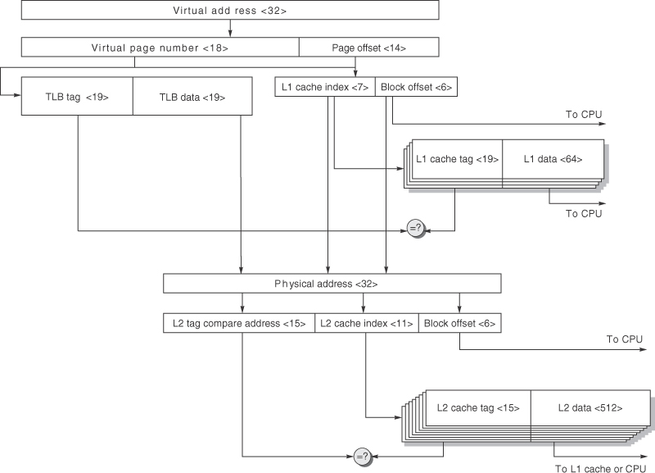
AMR Cortex-A8 data caches/TLP.
Since the instruction and data hierarchies are symmetric, we show only one. The TLB (instruction or data) is fully associative with 32 entries. The L1 cache is four-way set associative with 64-byte blocks and 32 KB capacity. The L2 cache is eight-way set associative with 64-byte blocks and 1 MB capacity. This figure doesn’t show the valid bits and protection bits for the caches and TLB, nor the use of the way prediction bits that would dictate the predicted bank of the L1 cache.

Slide 96
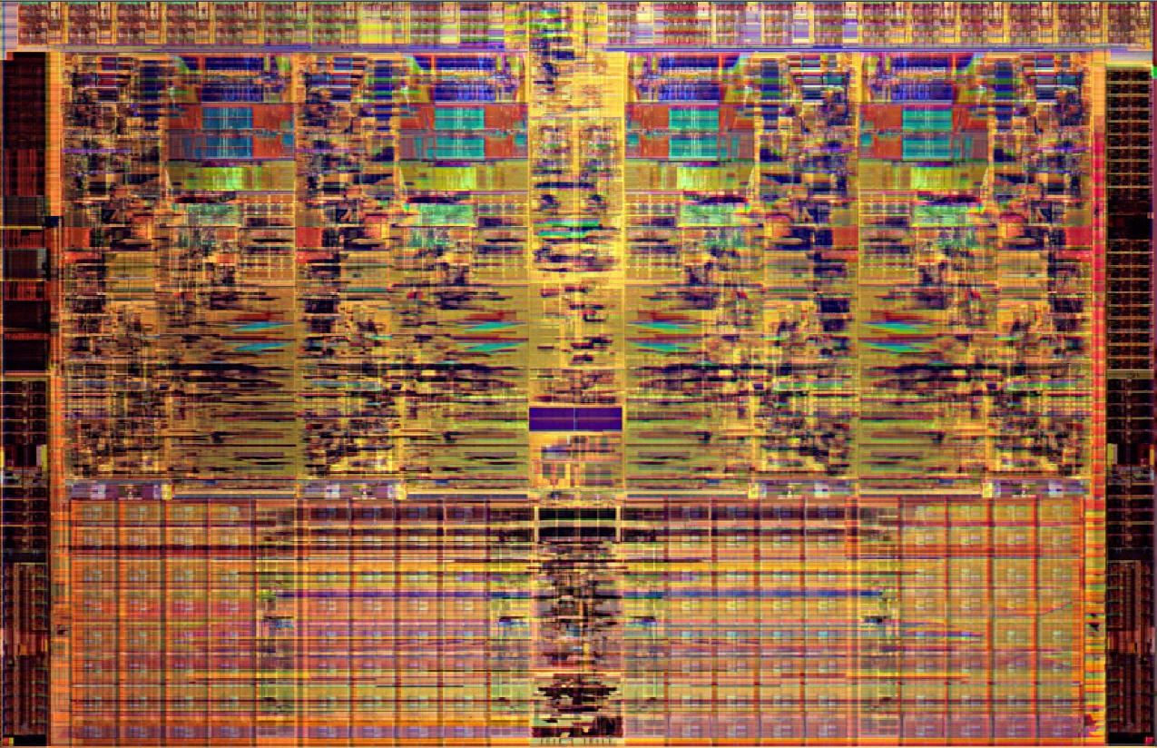
Intel Nehalem (i7)
13.5 x 19.6 mm
Per core:
  731 Mtransistors
  32-KB I & 32-KB data $
  512 KB L2
  2-level TLB
Shared:
  8 MB L3
  2 128bit DDR3 channels

Slide 97
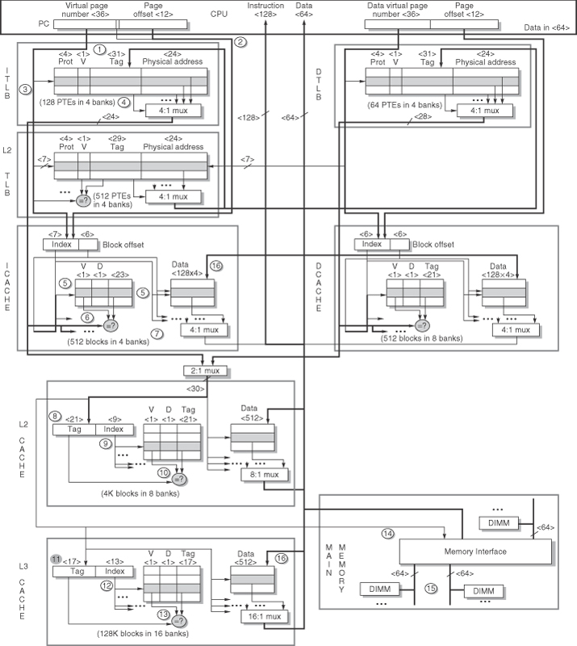
The Intel i7 memory hierarchy
The steps in both instruction and data access. We show only reads for data. Writes are similar, in that they begin with a read (since caches are write back). Misses are handled by simply placing the data in a write buffer, since the L1 cache is not write allocated.

Slide 98
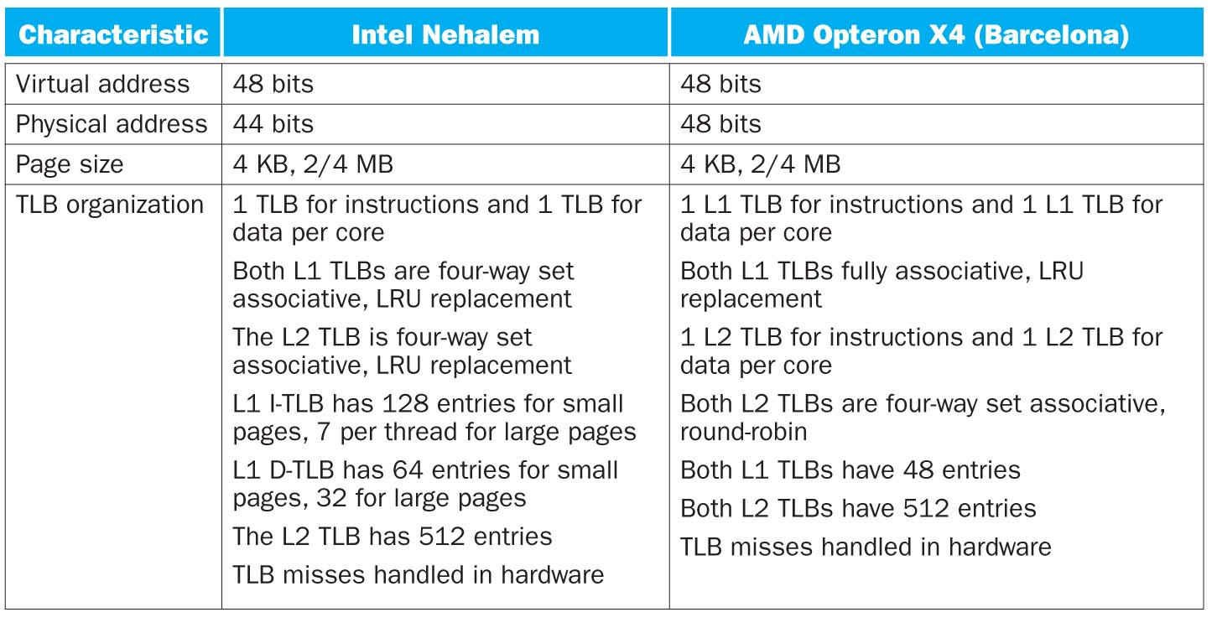
Address translation and TLBs

Slide 99
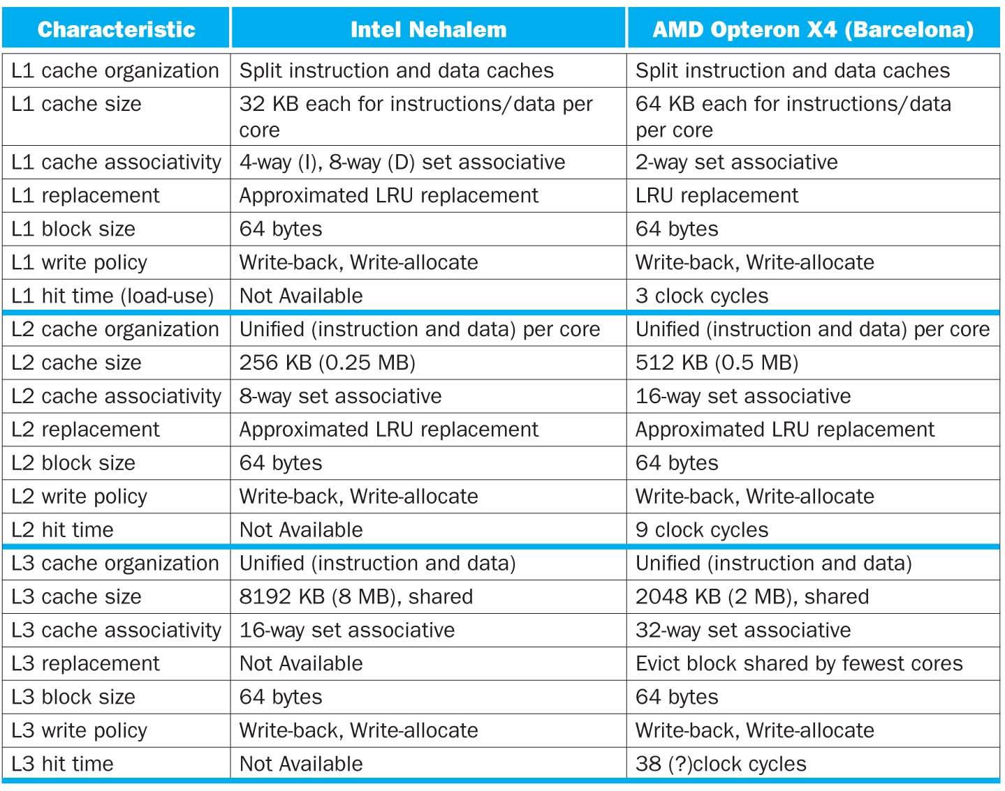
Cache L1-L2-L3 organization

Slide 100
Virtual Machines
Supports isolation and security
Sharing a computer among many unrelated users
Enabled by raw speed of processors, making the overhead more acceptable
Allows different operating systems to be presented to user programs
  “System Virtual Machines”
  SVM software is called “virtual machine monitor” or “hypervisor”
  Individual virtual machines run under the monitor are called “guest VMs”

Slide 101
Impact of VMs on Virtual Memory
Each guest OS maintains its own set of page tables
  VMM adds a level of memory between physical and virtual memory called “real memory”
  VMM maintains shadow page table that maps guest virtual addresses to physical addresses
    Requires VMM to detect guest’s changes to its own page table
    Occurs naturally if accessing the page table pointer is a privileged operation

