Slide 1
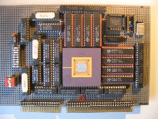
Advanced Computer Architecture
Data-Level Parallel Architectures
Course 5MD00
Henk Corporaal
January 2015
h.corporaal@tue.nl

Slide 2

This lecture
Data-level parallel architectures
Vector machine
SIMD (Single Instruction Multiple Data) processors
  sub-word parallelism support
GPU (Graphic Processing Unit)
Material:
  Book of Hennessy & Patterson
  Study: Chapter 4: 4.1-4.7
  (extra material: app G: vector processors)

Slide 3
Data Parallelism
Vector operations
Multiple data elements per operation, e.g.
  ADDV V1, V2, V3 // forall i V1[i] = V2[i]+V3[i]
Executed using either
  Vector archtitecture: highly pipelined (fast clocked) FU (function unit)
  SIMD: multiple FUs acting in parallel
or
time
SIMD architecture
Vector architecture

Slide 4
SIMD vs MIMD
SIMD architectures can exploit significant data-level parallelism for:
  matrix-oriented scientific computing
  media-oriented image and sound processors
SIMD is more energy efficient than MIMD
  Only needs to fetch and decode one instruction per data operation
  Makes SIMD attractive for personal mobile devices
SIMD allows programmer to continue to think sequentially
MIMD is more generic: why?

Slide 5
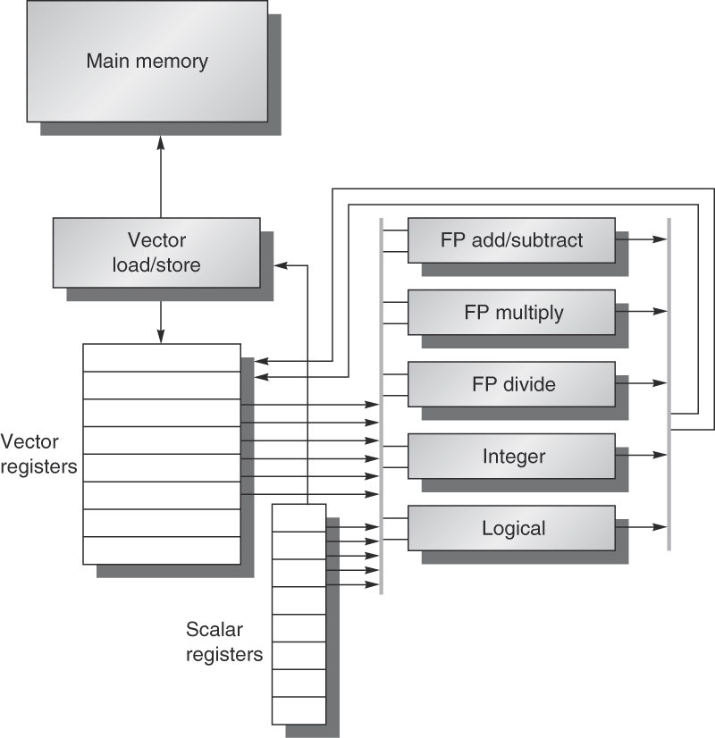
Vector Architecture
Basic idea:
  Read sets of data elements into “vector registers”
  Operate on those registers
  Disperse the results back into memory
Registers are controlled by compiler
  Used to hide memory latency
    by loading data early (many cycles before their use)
  Leverage memory bandwidth

Slide 6
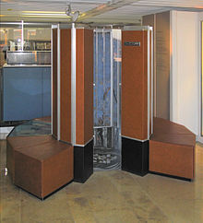
Example architecture: VMIPS
Loosely based on Cray-1
Vector registers
  Each register holds a 64-element,
  64 bits/element vector
  Register file has 16 read- and 8 write-ports
Vector functional units
  Fully pipelined
  Data and control hazards are detected
Vector load-store unit
  Fully pipelined
  One word per clock cycle after initial latency
Scalar registers
  32 general-purpose registers
  32 floating-point registers
Cray-1 1976

Slide 7
VMIPS Instructions
ADDVV.D: add two vectors (of Doubles)
ADDVS.D: add vector to a scalar (Doubles)
LV/SV: vector load and vector store from address
Example: DAXPY ((double) Y=a*X+Y), inner loop of Linpack
  L.D F0,a ; load scalar a
  LV V1,Rx ; load vector X
  MULVS.D V2,V1,F0 ; vector-scalar multiply
  LV V3,Ry ; load vector Y
  ADDVV V4,V2,V3 ; add
  SV Ry,V4 ; store the result
Requires 6 instructions vs. almost 600 for MIPS

Slide 8
Vector Execution Time
Execution time depends on three factors:
  Length of operand vectors
  Structural hazards
  Data dependencies
VMIPS functional units consume one element per clock cycle
  Execution time is approximately the vector length:
  Texec ~ Vl
Convey
  Set of vector instructions that could potentially execute together

Slide 9
Chimes
Sequences with read-after-write dependency hazards can be in the same convey via chaining
Chaining
  Allows a vector operation to start as soon as the individual elements of its vector source operand become available
Chime
  Unit of time to execute one convey
  m conveys executes in m chimes
  For vector length of n, requires m x n clock cycles

Slide 10
Example
LV V1,Rx ;load vector X
MULVS.D V2,V1,F0 ;vector-scalar multiply
LV V3,Ry ;load vector Y
ADDVV.D V4,V2,V3 ;add two vectors
SV Ry,V4 ;store the sum
Convoys:
1 LV -> MULVS.D
2 LV -> ADDVV.D
3 SV
3 chimes, 2 FP ops per result, cycles per FLOP = 1.5
For 64 element vectors, requires 64 x 3 = 192 clock cycles
Question: why not combining Convoys 2 and 3 into one?

Slide 11
Challenges
Start up time:
  Latency of vector functional unit
  Assume the same as Cray-1
    Floating-point add => 6 clock cycles
    Floating-point multiply => 7 clock cycles
    Floating-point divide => 20 clock cycles
    Vector load => 12 clock cycles
Improvements:
  > 1 element per clock cycle
  Non-64 wide vectors
  IF statements in vector code
  Memory system optimizations to support vector processors
  Multiple dimensional matrices
  Sparse matrices
  HLL support: Programming a vector computer

Slide 12
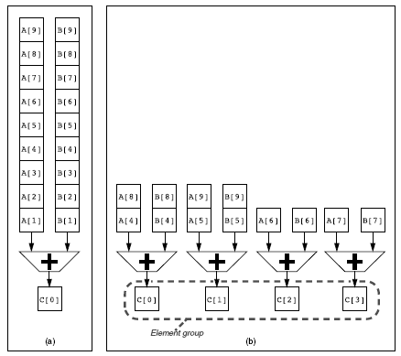
Multiple Lanes
Left: single lane
Right: 4 lanes; vector elements are interleaved !

Slide 13
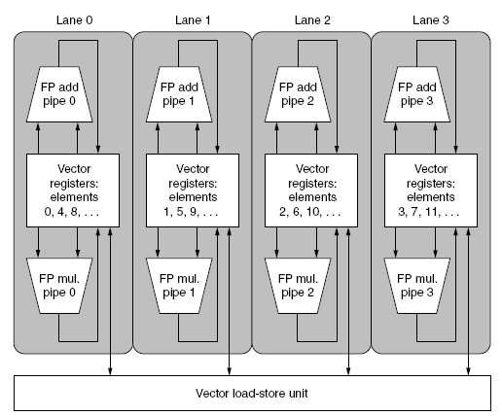
Multiple lanes structure
4 lanes
3 vector units: ADD, MUL, LD-ST
Not shown: scalar processor can broadcast a scalar to all vector units

Slide 14
Memory Banks
to/from load-store units
interconnect, connecting banks to ld-st ports
bank 0
bank 1
bank 2
bank
N-1
Banks are (usually) single ported (1 rd/wr port)
To the load-store units the memory system looks multi- ported except for bank conflicts

Slide 15
Memory Banks
Memory system must be designed to support high bandwidth for vector loads and stores
Spread accesses across multiple banks
  Control bank addresses independently
  Load or store non sequential words
  Support multiple vector processors sharing the same memory
Example:
  32 processors, each generating 4 loads and 2 stores/cycle
  Processor cycle time is 2.167 ns, SRAM cycle time is 15 ns
  How many memory banks needed?
  Answer: think about how many accesses are needed in 15 ns !

Slide 16
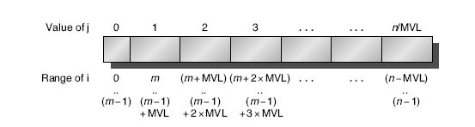
Vector Length Register
Vector length not known at compile time?
Use Vector Length Register (VLR)
Use strip mining for vectors over the maximum length:
  low = 0;
  VL = (n % MVL); /*find odd-size piece using modulo % */
  for (j = 0; j <= (n/MVL); j=j+1) { /*outer loop*/
  for (i = low; i < (low+VL); i=i+1) /*runs for length VL*/
  Y[i] = a * X[i] + Y[i] ; /*main operation*/
  low = low + VL; /*start next vector*/
  VL = MVL; /*reset length to maximum vector length*/
  }
Execution order:

Slide 17
Vector Mask Registers
Consider:
for (i = 0; i < 64; i=i+1)
if (X[i] != 0)
X[i] = X[i] – Y[i];
Use vector mask register to “disable” elements:
LV V1,Rx ;load vector X into V1
LV V2,Ry ;load vector Y
L.D F0,#0 ;load FP zero into F0
SNEVS.D V1,F0 ;sets VM(i) to 1 if V1(i)!= F0
SUBVV.D V1,V1,V2 ;subtract under vector mask
SV Rx,V1 ;store the result in X
GFLOPS rate decreases! Why???

Slide 18
Stride (see pg 278 e.v.)
Consider matrix multiplication: A=B*D
for (i = 0; i < 100; i=i+1)
for (j = 0; j < 100; j=j+1) {
A[i][j] = 0.0;
for (k = 0; k < 100; k=k+1)
A[i][j] = A[i][j] + B[i][k] * D[k][j];
}
Must vectorize multiplication of rows of B with columns of D
Use non-unit stride
D
j
A
B
i,j
=
i
*

Slide 19
Stride
Bank conflict (stall) occurs when the same bank is hit faster than bank busy time:
  LCM(stride, N_banks) / Stride < bank busy time
    LCM = least common multiple
Example:
E.g. stride = 6, 16 banks, you hit bank 0, 6, 12, 2, 8, 14, 4, etc.; you hit the same bank after LCM(6,16)/6 = 48/6 = 8 cycles.
If busy time > 8 cycles you have to wait

Slide 20
Stride
See example pg 279
  8 memory banks, busy time 6 cycles, memory latency 12 cycles
  Q: how long does it take to complete a 64-element vector load
    with stride 1
    with stride 32
Answer
  stride 1:
  12+64 = 76 cycles (= 1.2 cycles/element)
  stride 32: Since 32 = 4*8, every access goes to the same bank ! Every access after the first has to wait the 6 cycles busy time =>
  12+1+6*63 = 391 cycles (=6.1 cycles/element)

Slide 21
Scatter-Gather
Consider indirect vector access:
for (i = 0; i < n; i=i+1)
A[K[i]] = A[K[i]] + C[M[i]];
Use index vector to load e.g. only the non-zero elements of A into vector Va:
LV Vk, Rk ;load K
LVI Va, (Ra+Vk) ;load A[K[]]
LV Vm, Rm ;load M
LVI Vc, (Rc+Vm) ;load C[M[]]
ADDVV.D Va, Va, Vc ;add them
SVI (Ra+Vk), Va ;store A[K[]]

Slide 22
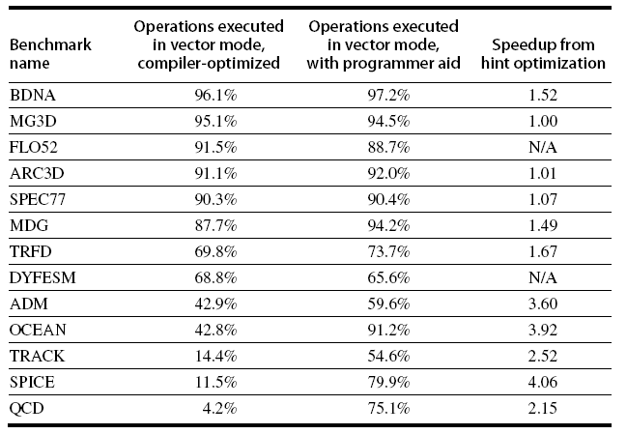
Programming Vector Architectures
Compilers can provide feedback to programmers
Programmers can provide hints to compiler (last column):
Notes:
Perfect Club benchmarks executed on Cray Y-MP [1991]

Slide 23
Sub-word Parallelism
Divide word into multiple parts (sub-words) and perform operations on these parts in parallel

Slide 24
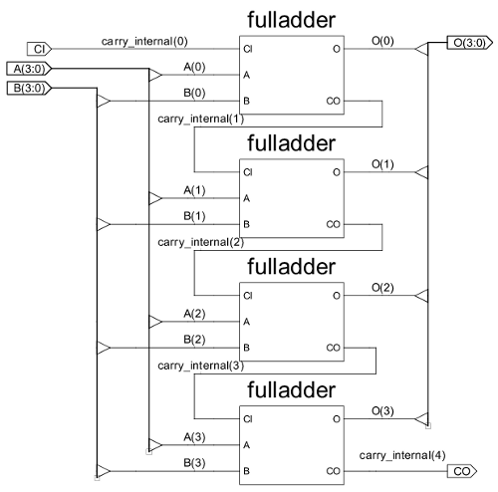
SIMD Extensions
Media applications operate on data types narrower than the native word size
  Example: disconnect carry chains to “partition” adder
Limitations, compared to vector instructions:
  Number of data operands encoded
  into op code
  No sophisticated addressing
  modes (strided, scatter-gather)
  No mask registers

Slide 25
SIMD Implementations
Implementations:
  Intel MMX (1996)
    Eight 8-bit integer ops or four 16-bit integer ops
  Streaming SIMD Extensions (SSE, 1999)
    Eight 16-bit integer ops
    Four 32-bit integer/fp ops or two 64-bit integer/fp ops
  Advanced Vector Extensions (AVE, 2010)
    Four 64-bit integer/fp ops
  Operands must be consecutive and aligned memory locations
E.g. 16 bytes in parallel:
+

Slide 26
Example SIMD Code
Example DXPY: (double) Y = a×X + Y (see pg 284-285)
L.D F0,a ;load scalar a
MOV F1, F0 ;copy a into F1 for SIMD MUL
MOV F2, F0 ;copy a into F2 for SIMD MUL
MOV F3, F0 ;copy a into F3 for SIMD MUL
DADDIU R4,Rx,#512 ;last address to load
Loop:
L.4D F4,0[Rx] ;load X[i], X[i+1], X[i+2], X[i+3]
MUL.4D F4,F4,F0 ;a×X[i],a×X[i+1],a×X[i+2],a×X[i+3]
L.4D F8,0[Ry] ;load Y[i], Y[i+1], Y[i+2], Y[i+3]
ADD.4D F8,F8,F4 ;a×X[i]+Y[i], ..., a×X[i+3]+Y[i+3]
S.4D 0[Ry],F8 ;store in Y[i],Y[i+1],Y[i+2],Y[i+3]
DADDIU Rx,Rx,#32 ;increment index to X
DADDIU Ry,Ry,#32 ;increment index to Y
DSUBU R20,R4,Rx ;compute bound
BNEZ R20,Loop ;check if done

Slide 27
Performance model
What is peak performance of an architecture
  compute limited?
  memory bandwidth limited?

Slide 28
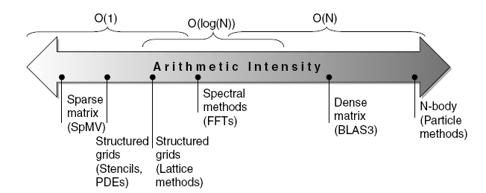
Roofline Performance Model
Basic idea:
  Plot peak floating-point throughput as a function of arithmetic intensity
  Ties together floating-point performance and memory performance for a target machine
Arithmetic intensity =
  Floating-point operations per byte read from memory

Slide 29
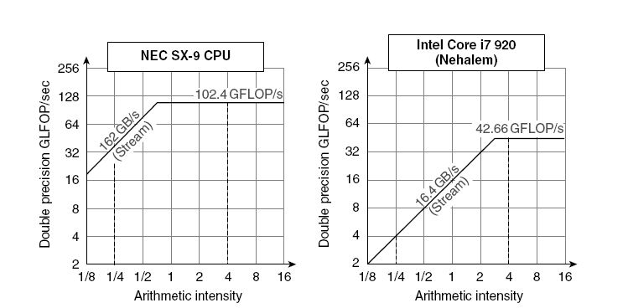
Examples
Max GFLOPs/sec =
Min (Peak Memory BW × Arithmetic Intensity, Peak Fl.Point Perf.)
NEC SX-9: vector processor (2008)

Slide 30
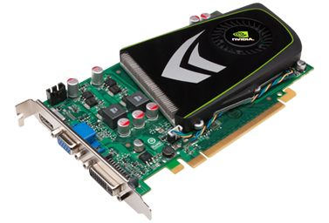
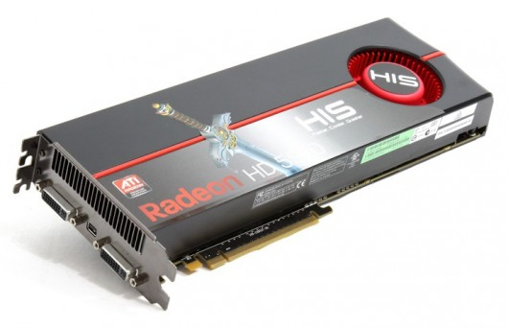
Graphic Processing Units (GPUs)
NVIDIA GT 340
(2010)
ATI 5970
(2009)

Slide 31
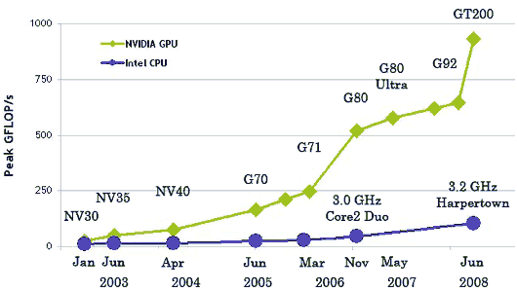
Why GPUs

Slide 32
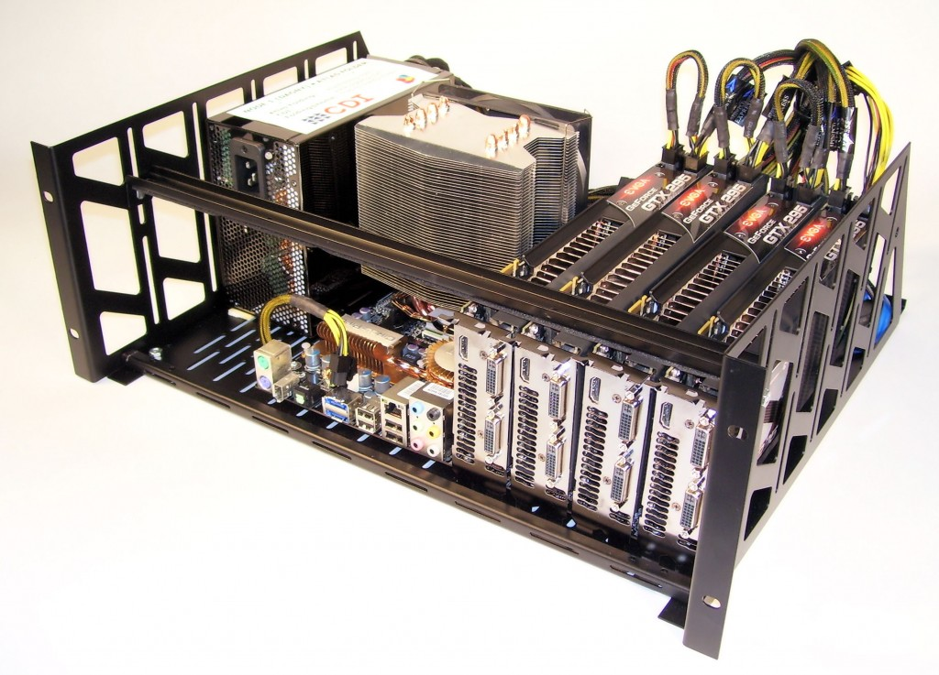
In need of TeraFlops on your desk?
3 * Nvidia GTX295
1440 PEs
5.3 TeraFlop

Slide 33
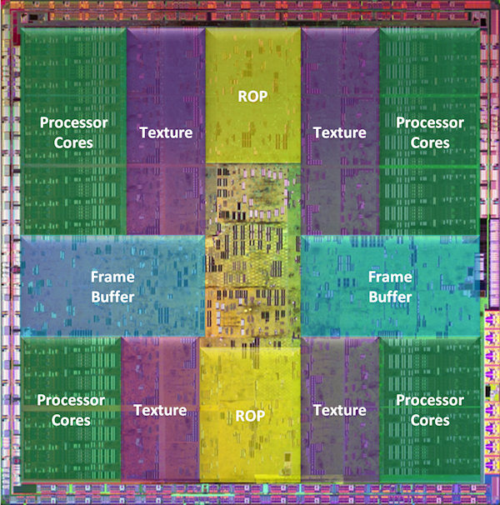
How Do GPUs Spend Their Die Area?
GPUs are designed to match the workload of 3D graphics.
Nvidia GTX 280
most area spend on
processing
relatively small
on-chip memories
huge off-chip
memory latencies
J. Roca, et al. "Workload Characterization of 3D Games", IISWC 2006, link
T. Mitra, et al. "Dynamic 3D Graphics Workload Characterization and the Architectural Implications", Micro 1999, link
Notes:
ROP Unit is doing depth test, color blending, etc.

Slide 34
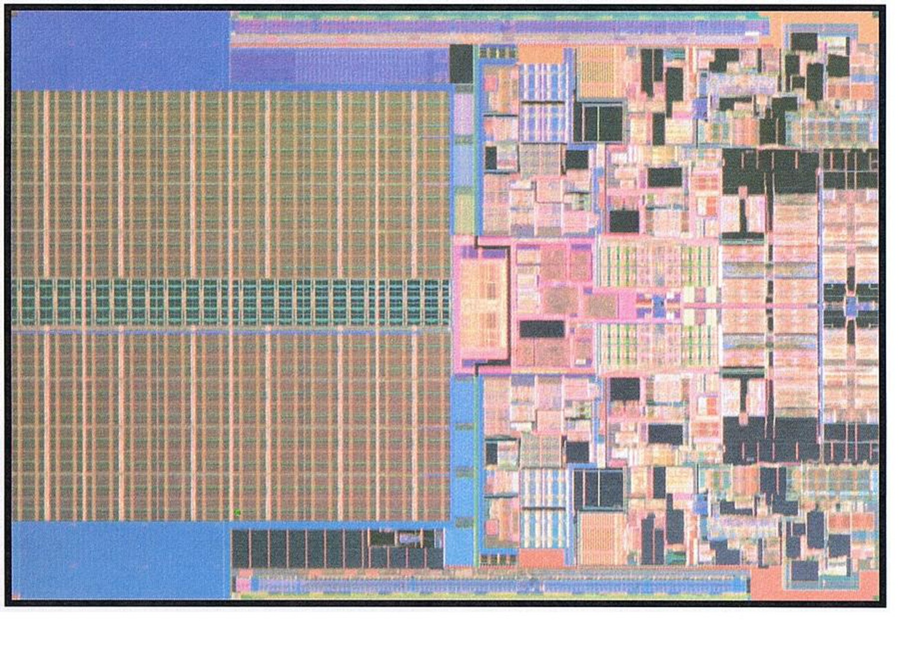
How Do CPUs Spend Their Die Area?
CPUs are designed for low latency instead of high throughput
Die photo of Intel Penryn (source: Intel)

Slide 35
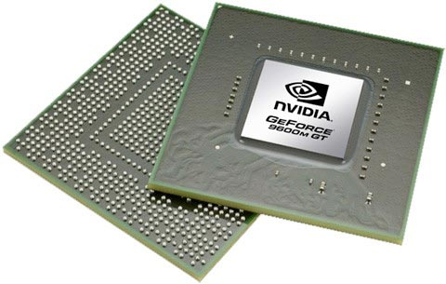
Graphical Processing Units
Given the hardware invested to do graphics well, how can be supplement it to improve performance of a wider range of applications?
Basic idea:
  Heterogeneous execution model
    CPU is the host, GPU is the device
  Develop a C-like programming language for GPU
  Unify all forms of GPU parallelism as CUDA thread
  Programming model is SIMT: “Single Instruction Multiple Thread”

Slide 36
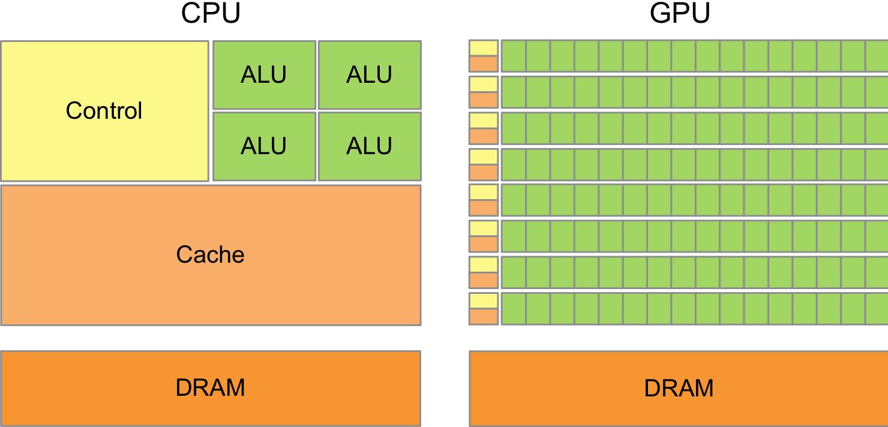
CPU vs. GPU
Different design philosophies:
  CPU
    A few out-of-order cores with huge caches
    Sequential computation
  GPU
    Many in-order cores
    Massively parallel computation

Slide 37
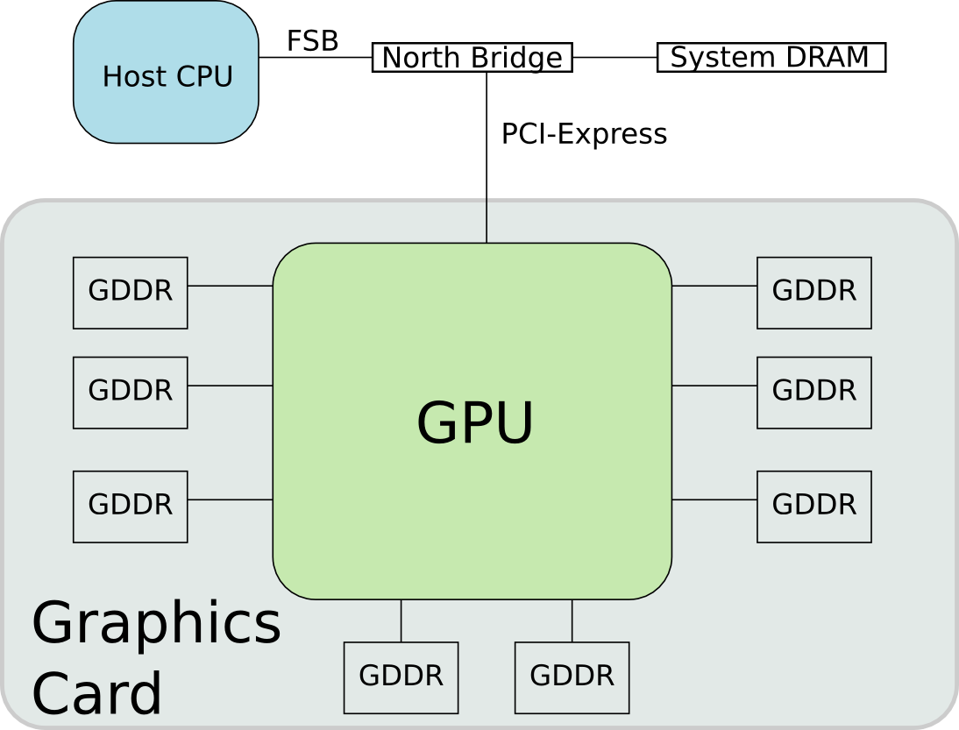
System Architecture
Erik Lindholm, et al. "NVIDIA Tesla: A Unified Graphics and Computing Architecture", IEEE Micro 2008, link

Slide 38
GPUs: what's inside?
Basically it's an SIMD:
A single instruction stream operates on multiple data streams
All PEs execute the same instruction at the same time
PEs operate concurrently on their own piece of memory
However, GPU is far more complex !!
Add
Add
Add
Add
Add
Add
Add
Add
Add
Notes:
Same operation on multiple data streams : data level parallellism
SIMD can match the inherent data-parallelism present in pixel-to-pixel operations due to its repetetive structure
Very power-efficient
Inter-PE communication can be crucial for performance

Slide 39
CPU Programming: NVIDIA CUDA example
  CUDA program expresses data level parallelism (DLP) in terms of thread level parallelism (TLP).
  Hardware converts TLP into DLP at run time.
Single thread program
float A[4][8];
do-all(i=0;i<4;i++){
do-all(j=0;j<8;j++){
A[i][j]++;
}
}
CUDA program
float A[4][8];
kernelF<<<(4,1),(8,1)>>>(A);
__device__ kernelF(A){
i = blockIdx.x;
j = threadIdx.x;
A[i][j]++;
}
Now I specify 4*1*8*1 threads

Slide 40
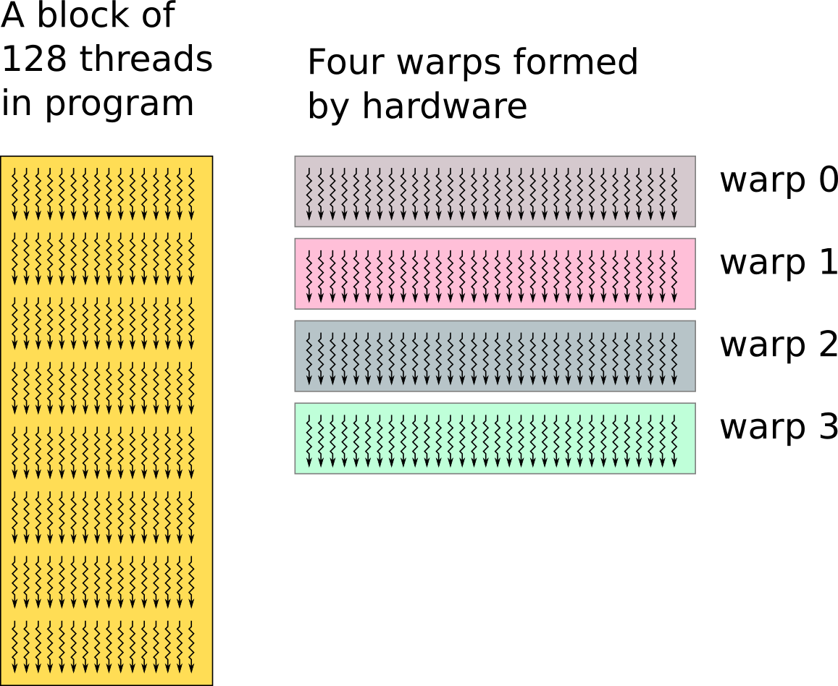
Warp: Basic Scheduling Unit in Hardware
Blocks are defined by programmer
Warps are transparent to programmer, formed at load/run time
  One warp consists of 32 consecutive threads

Slide 41
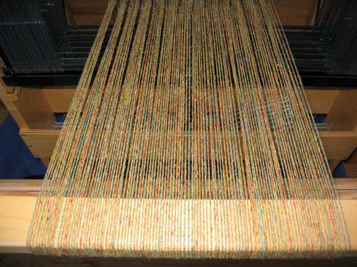
Scheduling of SIMD threads
SM hardware implements zero-overhead warp scheduling
  Operands ready?
  => Eligible for execution
SIMD thread scheduler
time
warp 8 instruction 11
warp 1 instruction 42
warp 3 instruction 95
.
.
.
warp 8 instruction 12
warp 3 instruction 96
Notes:
Fetch one warp instruction/cycle
from instruction L1 cache
into any instruction buffer slot
Issue one “ready-to-go” warp instruction/cycle
from any warp - instruction buffer slot
operand scoreboarding used to prevent hazards
Issue selection based on round-robin/age of warp
SM broadcasts the same instruction to 32 Threads of a Warp

Slide 42
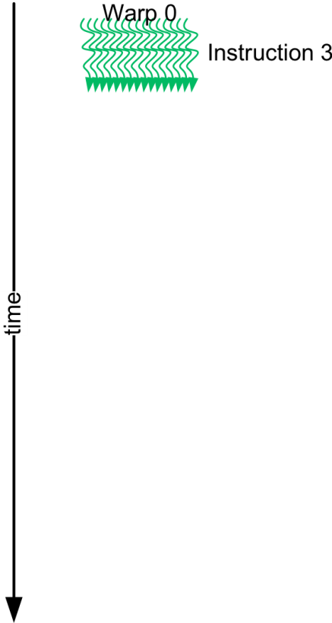
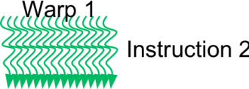
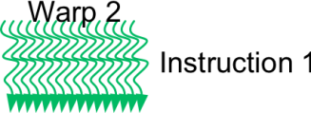
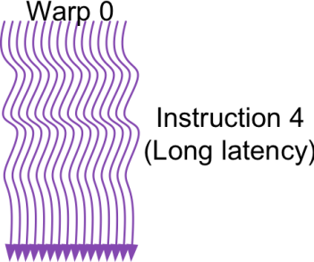
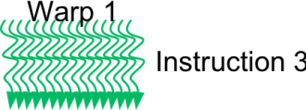
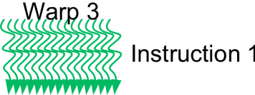
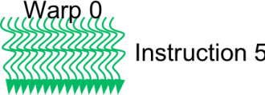
Thread scheduling to hide latencies
Long latency operations (memory accesses, special function units) => latency hiding by scheduling many warps in between dependend operations
4 active warps (or SIMD threads)
2 active warps
Notes:
The importance of occupancy is seeing while examining the multithreaded architecture of the GPU. Multithreading permits to hide latencies due to register dependencies or memory accesses.
Let’s look an example of the impact of the occupancy value.

Slide 43
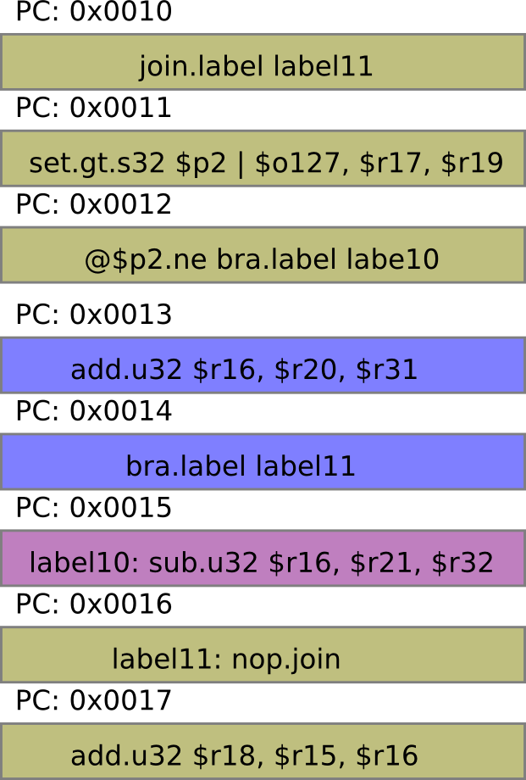
Handling Branch: Warp Divergence !!
Threads within a warp are free to branch.
if( $r17 > $r19 ){
$r16 = $r20 + $r31
}
else{
$r16 = $r21 - $r32
}
$r18 = $r15 + $r16
Assembly code on the right are disassembled from cuda binary (cubin) using "decuda", link

Slide 44
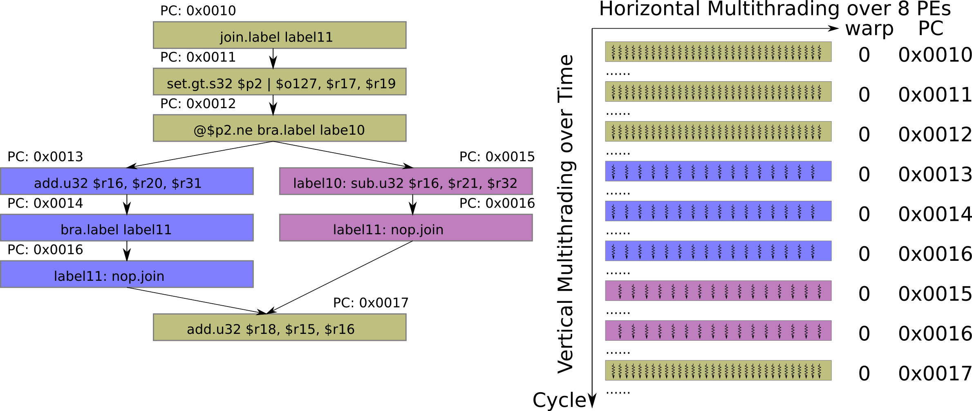
Branch Divergence within a Warp
If threads within a warp diverge, both paths have to be executed.
Masks are set to filter out threads not executing on current path.

Slide 45
CPU Programming: NVIDIA CUDA example
  CUDA program expresses data level parallelism (DLP) in terms of thread level parallelism (TLP).
  Hardware converts TLP into DLP at run time.
Single thread program
float A[4][8];
do-all(i=0;i<4;i++){
do-all(j=0;j<8;j++){
A[i][j]++;
}
}
CUDA program
float A[4][8];
kernelF<<<(2,2),(4,2)>>>(A);
__device__ kernelF(A){
i = blockIdx.x;
j = threadIdx.x;
A[i][j]++;
}

Slide 46
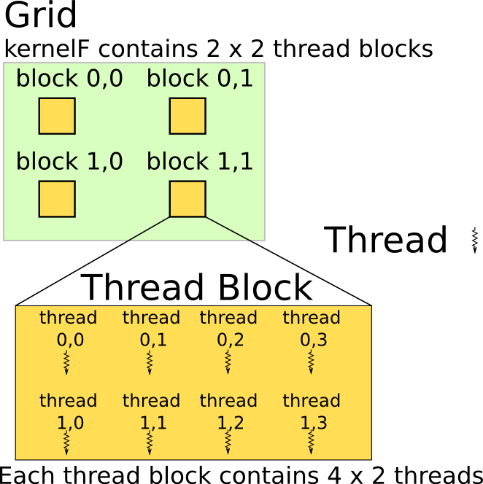
CUDA Programming
Both grid and thread block can have two dimensional index
kernelF<<<(2,2),(4,2)>>>(A);
__device__ kernelF(A){
i = blockDim.x * blockIdx.y
+ blockIdx.x;
j = threadDim.x * threadIdx.y
+ threadIdx.x;
A[i][j]++;
}

Slide 47
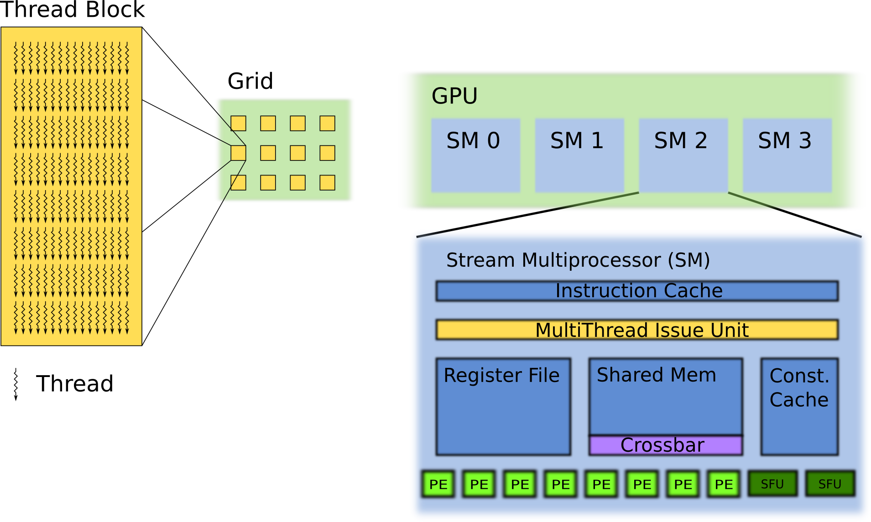
Mapping Thread Blocks to SMs
Rules of the game:
One thread block can only run on one SM (StreamMultiprocessor)
Thread block can not migrate from one SM to another SM
Threads of the same thread block can share data using shared memory
Example: mapping 12 thread blocks on 4 SMs.
Notes:
We will show how the thread blocks are mapped to the StreamMultiprocessors (SMs)

Slide 48
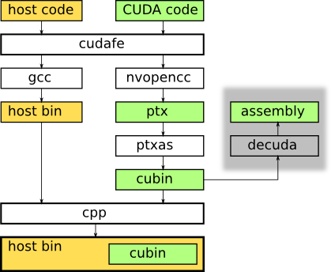
CUDA Compilation Trajectory
cudafe: CUDA front end
nvopencc: customized open64 compiler for CUDA
ptx: high level assemble code (documented)
ptxas: ptx assembler
cubin: CUDA binrary
decuda, http://wiki.github.com/laanwj/decuda

Slide 49
Threads and Blocks
A thread is associated with each data element / loop body
Threads are organized into blocks
Blocks are organized into a grid
GPU hardware handles thread management, not applications or OS

Slide 50
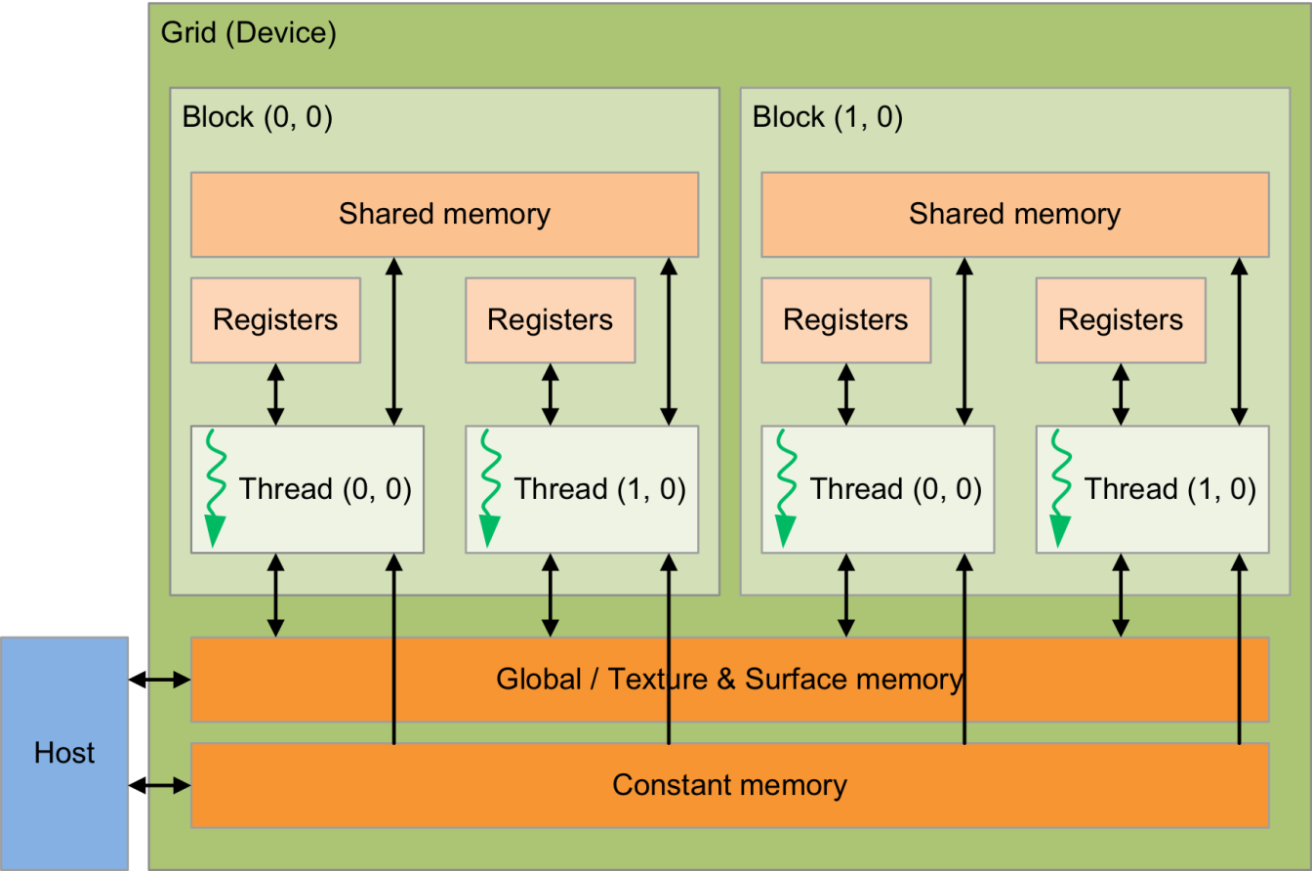

CUDA programming model
  Arrangment: Threads ⊂ Blocks ⊂ Grid (see also fig 4.13)
  Single-instruction multiple-thread (SIMT) fashion
Notes:
Partitioned register file.
Old slide:
- A thread is associated with each data element: CUDA thread – abstraction for all forms of parallelism: TLP, SIMD, MIMD, even ILP
- Threads are organized into blocks
- Blocks are organized into a grid
- GPU hardware handles thread management, not applications or OS

Slide 51
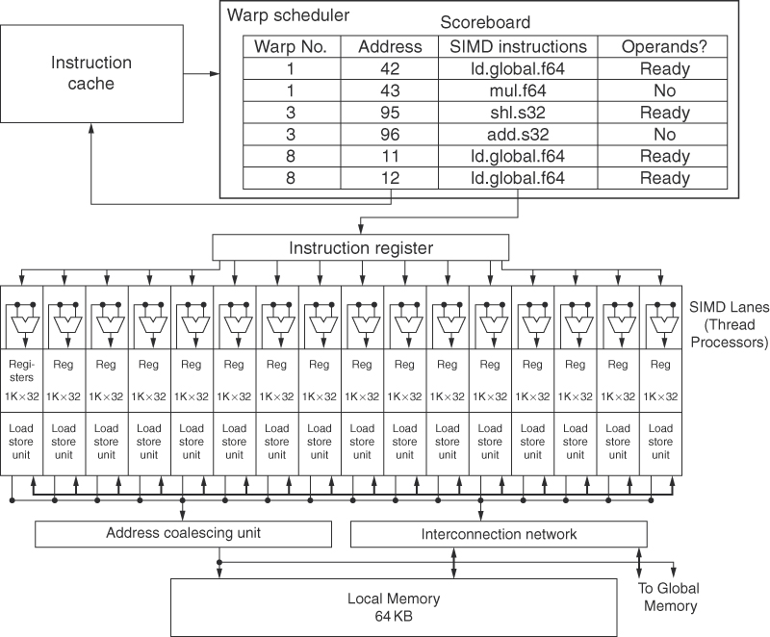
Multi-threaded SIMD processor
Shown a single
SM (streaming
Multiprocessor
with 16 lanes
Warp =
thread of SIMD
instructions

Slide 52
Example
DAXPY (Y=aX + Y): vectors of length 8192
  Independent loop iterations
  Threads in thread blocks
// DAXPY in C
for (int i = 0; i < 8192; ++i) // n = 8192
y[i] = a * x[i] + y[i];
// DAXPY in CUDA GPU code
{
int i = blockIdx.x * blockDim.x + threadIdx.x;
if(i < n) y[i] = a * x[i] + y[i];
}
...
// Kernel invocation CPU
daxpy<<16, 512>>(n, a, x, y);
this grid has 16 blocks, each with 512 threads (blockDim = 512)
Notes:
Double precision A times X plus Y
Old slide:
Multiply two vectors of length 8192
Code that works over all elements is the grid
Thread blocks break this down into manageable sizes
512 threads per block
SIMD instruction executes 32 elements at a time
Thus grid size = 16 blocks
Block is analogous to a strip-mined vector loop with vector length of 32
Block is assigned to a multithreaded SIMD processor by the thread block scheduler
Current-generation GPUs (Fermi) have 7-15 multithreaded SIMD processors

Slide 53
Transparent Scalability
Thread block scheduler assigns blocks to any multithreaded SIMD processor at any time
Kernel grid
Block 0
Block 1
Device with 2 SMs
Block 2
Block 3
Device with 4 SMs
Block 4
Block 5
Block 6
Block 7
Block 0
Block 1
Block 0
Block 1
Block 2
Block 3
Block 2
Block 3
time
time
Block 4
Block 5
Block 6
Block 7
Block 4
Block 5
Each block can execute in any order relative to other blocks
Block 6
Block 7
Notes:
Tesla: up to 30 SMs
Fermi: up to 16 SMs
Kepler: 13 SMs

Slide 54
GPU computational structures
Blocks within each SIMD processor:
  SIMD lanes: 32 in NVIDIA devices
  Wide and shallow compared to vector processors
Threads of SIMD instructions: Warps
  Each Warp has its own PC
  SIMD thread scheduler uses scoreboard to dispatch
  No data dependencies between threads!
  Keeps track of up to 48 warps (Fermi)
    Latency hiding

Slide 55
Example
Multiply two vectors of length 8192
Code that works over all elements is the grid
Thread blocks break this down into manageable sizes
  512 threads per block
Thus grid size = 16 blocks
Block is assigned to a multithreaded SIMD processor by the thread block scheduler
Block is analogous to a strip-mined vector loop with vector length of 32
SIMD instruction execute (e.g.) 32 elements at a time
Fermi generation of GPUs has 7-15 multithreaded SIMD processors
(called SMs: Streaming Multi-processors)

Slide 56
Example
NVIDIA GPU having 32,768 registers
  Divided into lanes
  Each SIMD thread is limited to 64 registers
  SIMD thread has up to:
    64 vector registers of 32 32-bit elements
    32 vector registers of 32 64-bit elements
  Fermi architecture has 16 physical SIMD lanes, each containing 2048 registers

Slide 57
NVIDIA Instruction Set Arch.
ISA is an abstraction of the hardware instruction set
  “Parallel Thread Execution (PTX)”
  Uses virtual registers
  Translation to machine code is performed in software
  Example PTX code of 1 DAXPY iteration:
shl.s32 R8, blockIdx,9 ; Thread Block ID*Block size (512=2⁹)
add.s32 R8, R8, threadIdx ; R8 = i = my CUDA thread ID
shl.u32 R8, R8, 3 ; byte offset
ld.global.f64 RD0, [X+R8] ; RD0 = X[i]
ld.global.f64 RD2, [Y+R8] ; RD2 = Y[i]
mul.f64 RD0, RD0, RD4 ; Product in RD0 = RD0 * RD4 (scalar a)
add.f64 RD0, RD0, RD2 ; Sum in RD0 = RD0 + RD2 (Y[i])
st.global.f64 [Y+R8], RD0 ; Y[i] = sum (X[i]*a + Y[i])
R8 contains unique id for each of the 8192 threads (calculated by first 3 instructions)

Slide 58
Conditional Branching
Like vector architectures, GPU branch hardware uses internal masks
Also uses
  Branch synchronization stack
    Entries consist of masks for each SIMD lane
    I.e. which threads commit their results (all threads execute)
  Instruction markers to manage when a branch diverges into multiple execution paths
    Push on divergent branch
  …and when paths converge
    Act as barriers
    Pops stack
Per-thread-lane 1-bit predicate register, specified by programmer

Slide 59
Conditional Branching Example
if (X[i] != 0)
X[i] = X[i] – Y[i];
else X[i] = Z[i];
Assume R8 contains (scaled) thread-id:
ld.global.f64 RD0, [X+R8] ; RD0 = X[i]
setp.neq.s32 P1, RD0, #0 ; P1 is predicate register = (X[i]!=0)
@!P1, bra ELSE1, *Push ; Push old mask, set new mask bits
; if P1 false, go to ELSE1
ld.global.f64 RD2, [Y+R8] ; RD2 = Y[i]
sub.f64 RD0, RD0, RD2 ; Difference in RD0
st.global.f64 [X+R8], RD0 ; X[i] = RD0
@P1, bra ENDIF1, *Comp ; complement mask bits
; if P1 true, go to ENDIF1
ELSE1:
ld.global.f64 RD0, [Z+R8] ; RD0 = Z[i]
st.global.f64 [X+R8], RD0 ; X[i] = RD0
ENDIF1:
<next instruction>, *Pop ; pop to restore old mask

Slide 60
NVIDIA GPU Memory Structures
Each SIMD Lane has private section of off-chip DRAM
  “Private memory”
  Contains stack frame, spilling registers, and private variables
Each multithreaded SIMD processor also has local memory
  Shared by SIMD lanes / threads within a block
Memory shared by SIMD processors is GPU Memory
  Host can read and write GPU memory

Slide 61
NVIDIA GPU Memory Structures
CUDA Thread
Private Memory
Block
Local
Memory
Grid 0
Global
Memory
. . .
Sequential
Grids
in Time
Grid 1
. . .
Notes:
Each SIMD Lane has private section of off-chip DRAM
“Private memory”
Contains stack frame, spilling registers, and private variables
Each multithreaded SIMD processor also has local memory
Shared by SIMD lanes / threads within a block
Memory shared by SIMD processors is GPU Memory
Host can read and write GPU memory

Slide 62
Fermi Architecture
Each SIMD processor has
  Two SIMD thread schedulers, two instruction dispatch units
  16 SIMD lanes (SIMD width=32, chime=2 cycles), 16 load-store units, 4 special function units
  Thus, two threads of SIMD instructions are scheduled every two clock cycles
Fast double precision
Caches for GPU memory: L1, L2
64-bit addressing and unified address space
Error correcting codes
Faster context switching
Faster atomic instructions

Slide 63
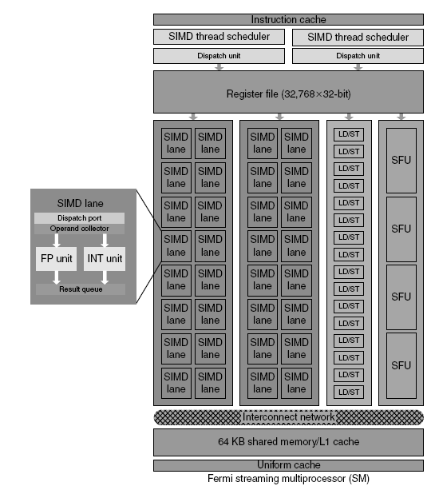
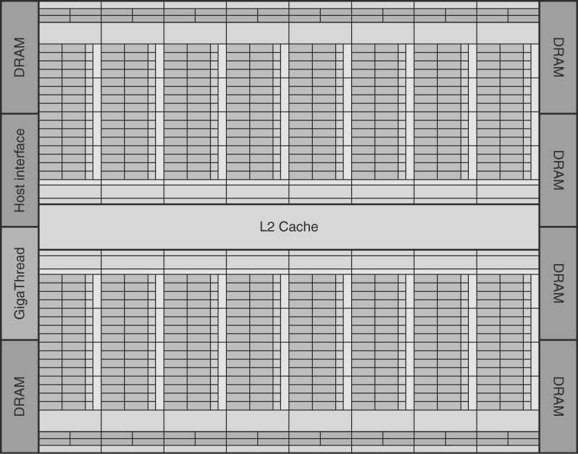
Fermi Multithreaded SIMD Proc.

Slide 64
Kepler Architecture Innovations
Each SIMD processor has
  4 SIMD thread schedulers
  Each with 2 dispatch units – Instruction Level Parallelism
  32 SIMD lanes for each SIMD thread (chime = 1 cycle)
  Thus, two instructions of 4 threads of SIMD instructions are scheduled every clock cycle
Compiler determines when instructions are ready to issue
  This information is included in the instruction
Even faster atomic instructions
Shuffle instructions

Slide 65
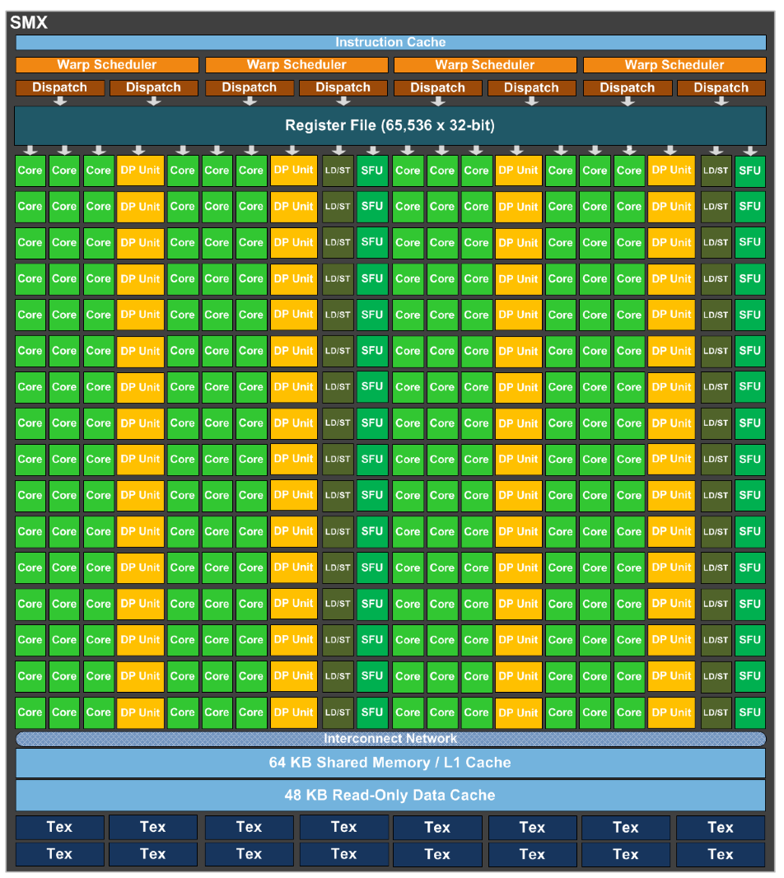
Kepler Multithreaded SIMD Proc.

Slide 66
Maxwell: more energy efficient
Successor of Kepler:
Feb 2014 -> GeForse GTX 750 series
L2 increased from 256 KiB to 2MiB
Memory bus reduced from 192 to 128 bits (saving power)
4 warp schedulers (per SM) do not share cores anymore
  Texture units and FP64 still shared
Claims, compared to Kepler
  1.35 x performance per core
  2x more energy efficient

Slide 67
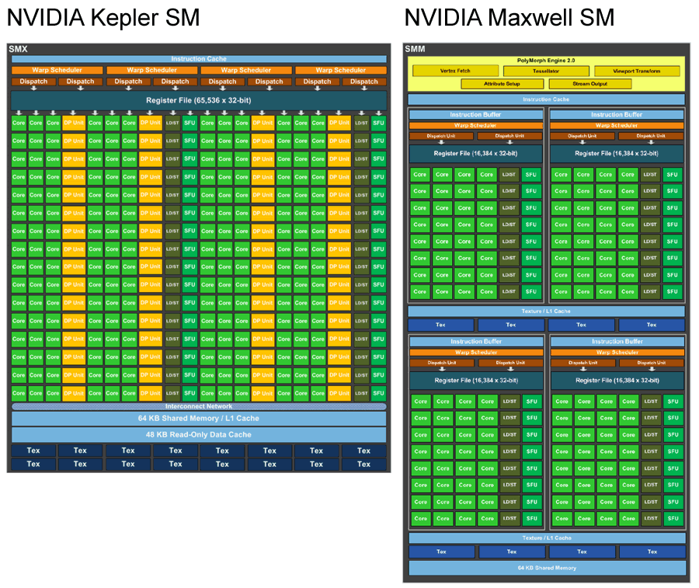
Maxwell vs. Kepler: comparing 1 SM

Slide 68
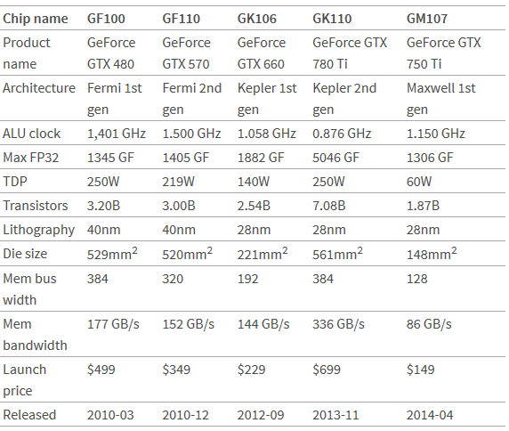

Maxwell vs. Kepler vs. Fermi
Mandelbroth
Notes:
Note: GM107 is a first generation (Feb 2014), and entry model (low end); its peak performance is much lower than GK110. However,
on e.g. Mandelbroth it scores almost as good.

Slide 69
GPUs vs. Vector machines
Similarities to vector machines:
  Works well with data-level parallel problems
  Scatter-gather transfers
  Mask registers
  Large register files
GPU Differences:
  No scalar processor
    use Host processor for this
  Uses multithreading to hide memory latency
  Has many functional units, as opposed to a few deeply pipelined units like a vector processor

Slide 70
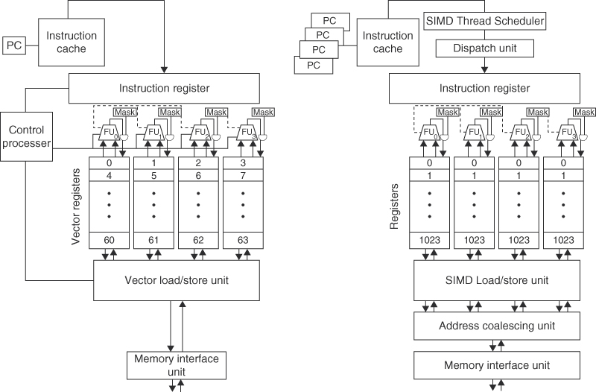
GPUs vs. Vector machines (pg 308 e.v.)
Notes:
Note, GPU has one PC per SIMD thread to help with multithreading

Slide 71
Loop-Level Parallelism
Detection of parallelism
Enhancing loop parallelism

Slide 72
Detecting Loop-Level Parallelism
Focuses on determining whether data accesses in later iterations are dependent on data values produced in earlier iterations
  Loop-carried dependence
Example 1:
for (i=999; i>=0; i=i-1)
x[i] = x[i] + s;
No loop-carried dependence

Slide 73
Loop-Level Parallelism
Example 2:
for (i=0; i<100; i=i+1) {
A[i+1] = A[i] + C[i]; /* S1 */
B[i+1] = B[i] + A[i+1]; /* S2 */
}
S1 and S2 use values computed by S1 in previous iteration
S2 uses value computed by S1 in same iteration

Slide 74
Loop-Level Parallelism
Example 3:
for (i=0; i<100; i=i+1) {
A[i] = A[i] + B[i]; /* S1 */
B[i+1] = C[i] + D[i]; /* S2 */
}
S1 uses value computed by S2 in previous iteration but dependence is not circular so loop is parallel
Transform to:
A[0] = A[0] + B[0]; // prologue
for (i=0; i<99; i=i+1) {
B[i+1] = C[i] + D[i];
A[i+1] = A[i+1] + B[i+1];
}
B[100] = C[99] + D[99]; // epilogue

Slide 75
Loop-Level Parallelism
Example 4:
for (i=0;i<100;i=i+1) {
A[i] = B[i] + C[i];
D[i] = A[i] * E[i];
}
Example 5:
for (i=1;i<100;i=i+1) {
Y[i] = Y[i-1] + Y[i];
}

Slide 76
Finding dependencies
Assume array indices are affine (i.e. linear function of loop indices), e.g.:
  a x i + b (i is loop index)
Assume:
  Store to a x i + b, then
  Load from c x i + d
  i runs from m to n
  Dependence exists if:
    Given j, k such that m ≤ j ≤ n, m ≤ k ≤ n
    Store to a x j + b, load from a x k + d, and a x j + b = c x k + d

Slide 77
Finding dependencies
Test for absence of a dependence:
  GCD test:
    If a dependency exists, GCD(c,a) must evenly divide (d-b)
Example:
  for (i=0; i<100; i=i+1) {
  X[2*i+3] = X[2*i] * 5.0;
  }
Cannot always determine dependencies at compile time

Slide 78
Finding dependencies
Example 2:
  for (i=0; i<100; i=i+1) {
  Y[i] = X[i] / c; /* S1 */
  X[i] = X[i] + c; /* S2 */
  Z[i] = Y[i] + c; /* S3 */
  Y[i] = c - Y[i]; /* S4 */
  }
Watch for anti-dependencies and output dependencies
  rename e.g. Y into T in S1, S3

Slide 79
Reductions
Reduction Operation:
for (i=9999; i>=0; i=i-1)
sum = sum + x[i] * y[i];
Transform to…
for (i=9999; i>=0; i=i-1)
sum [i] = x[i] * y[i];
for (i=9999; i>=0; i=i-1)
finalsum = finalsum + sum[i];
Do on p processors:
for (i=999; i>=0; i=i-1)
finalsum[p] = finalsum[p] + sum[i+1000*p];
Note: assumes associativity!

Slide 80
Concluding remarks
Increasing importance of data-level parallelism (DLP)
  Personal mobile devices
  Audio, video, games
SIMD architectures support DLP
  used by almost any architecture (e.g. as sub-word par)
GPUs tend to become mainstream in many platforms, from mobile to supercomputers
  new SIMT programming model: supported by CUDA and OpenCL
however:
  Small size of GPU memory
  CPU-GPU transfer bottleneck (traffic over PCI bus)
  Solution: Unified physical memories
    AMD Fusion

