Slide 1
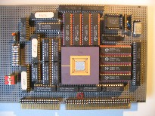
Advanced Computer Architecture Multi-Processing and Thread-Level parallellism
Course 5MD00
Henk Corporaal
January 2015
h.corporaal@tue.nl

Slide 2
Welcome back
Multi-Processors and Thread-Level parallelism
Multi-threading: SMT (simultaneous multi-threading)
called hyperthreading by Intel
Shared memory architectures
symmetric
distributed
Coherence
Consistency
Material:
Book of Hennessy & Patterson
Chapter 5: 5.1 – 5.6
extra material: app I, large scale multiprocessors and scientific applications

Slide 3
Should we go Multi-Processing?
Today:
Diminishing returns for exploiting ILP
Power issues
Wiring issues (faster transistors do not help that much)
More parallel applications
Multi-core architectures hit the market
In chapter 4 and we studied DLP: SIMD, GPUs, Vector processors
there can be lots of DLP, however:
Divergence problem
branch outcome different for different data lanes
reducing efficiency
Task parallelism can not be handled by DLP processors

Slide 4
New Approach: Multi-Threaded
Multithreading: multiple threads share the functional units of 1 processor
duplicate independent state of each thread e.g., a separate copy of register file, a separate PC
HW for fast thread switch; much faster than full process switch ≈ 100s to 1000s of clocks
When to switch?
Next instruction next thread (fine grain), or
When a thread is stalled, perhaps for a cache miss, another thread can be executed (coarse grain)

Slide 5
Fine-Grained Multithreading
Switches between threads on each instruction, causing the execution of multiples threads to be interleaved
Usually done in a round-robin fashion, skipping any stalled threads
CPU must be able to switch threads every clock
Advantage: it can hide both short and long stalls, since instructions from other threads executed when one thread stalls
Disadvantage: may slow down execution of individual threads
Used in e.g. Sun’s Niagara

Slide 6
Course-Grained Multithreading
Switches threads only on costly stalls, such as L2 cache misses
Advantages
Relieves need to have very fast thread-switching
Doesn’t slow down thread, since instructions from other threads issued only when the thread encounters a costly stall
Disadvantage: hard to overcome throughput losses from shorter stalls, due to pipeline start-up costs
Since CPU issues instructions from 1 thread, when a stall occurs, the pipeline must be emptied or frozen
New thread must fill pipeline before instructions can complete
Because of this start-up overhead, coarse-grained multithreading is better for reducing penalty of high cost stalls, where pipeline refill << stall time
Used in e.g. IBM AS/400

Slide 7
Simultaneous Multi-threading ...
One thread, 8 units
Two threads, 8 units
Cycle
M
M
FX
FX
FP
FP
BR
CC
Cycle
M
M
FX
FX
FP
FP
BR
CC
1
2
3
4
5
6
7
8
9
1
2
3
4
5
6
7
8
9
M = Load/Store, FX = Fixed Point, FP = Floating Point, BR = Branch, CC = Condition Codes

Slide 8
Simultaneous Multithreading (SMT)
SMT: dynamically scheduled processors already has many HW mechanisms to support multithreading:
Large set of virtual registers that can be used to hold the register sets of independent threads
Register renaming provides unique register identifiers, so instructions from multiple threads can be mixed in datapath without confusing sources and destinations across threads
Out-of-order completion allows the threads to execute out of order, and get better utilization of the HW
Just adding a per thread renaming table and keeping separate PCs

Slide 9
Multithreaded Categories
Simultaneous
Multithreading
Time (processor cycle)
Superscalar
Fine-Grained
Coarse-Grained
Multiprocessing
Thread 1
Thread 3
Thread 5
Thread 2
Thread 4
Idle slot

Slide 10
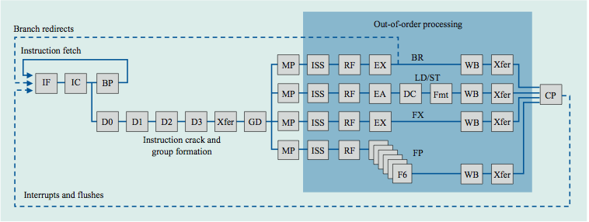
IBM Power4
Single threaded
8 FUs
4-issue out-of-order

Slide 11
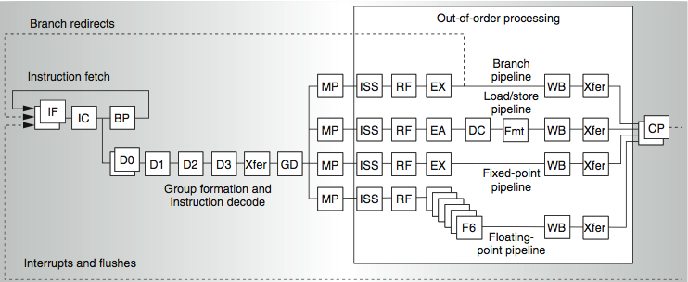
IBM Power5: supports 2 threads
2 commits (architected register sets)
2 fetch (PC), 2 initial decodes

Slide 12
Changes in Power 5 to support SMT
Increased associativity of L1 instruction cache and the instruction address translation buffers
Added per thread load and store queues
Increased size of the L2 (1.92 vs. 1.44 MB) and L3 caches
Added separate instruction prefetch and buffering per thread
Increased the number of virtual registers from 152 to 240
Increased the size of several issue queues
The Power5 core is about 24% larger than the Power4 core because of the addition of SMT support

Slide 13
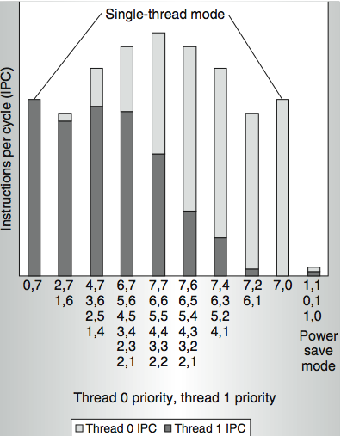
Power 5 thread performance ...
Relative priority of each thread controllable in hardware.
For balanced operation, both threads run slower than if they “owned” the machine.

Slide 14
Going Multicore
If a single core is not enough
or required due to power reasons (allows same work to be done at lower frequency, and therefore lower Vdd)

Slide 15
Multi-core Architecture
Parallel / Multi-core Architecture extends traditional computer architecture with a communication network
abstractions (HW/SW interface)
organizational structure to realize abstraction efficiently
Communication Network
Processing
node
Processing
node
Processing
node
Processing
node
Processing
node

Slide 16
Communication models: Shared Memory
Shared
Memory
(read, write)
(read, write)
Process P1
Process P2
Coherence problem
Memory consistency issue
Synchronization problem

Slide 17
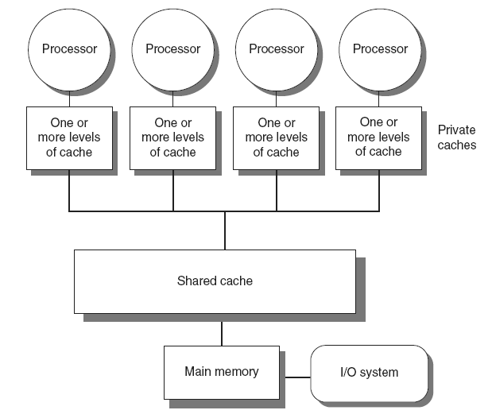
Shared memory multiprocessors: Types
Shared memory multi-processors
all memory addresses visible by every processor
communication by loads and stores
Types:
a. Symmetric multiprocessors (SMP)
Small number of cores
Share single memory with uniform memory latency

Slide 18
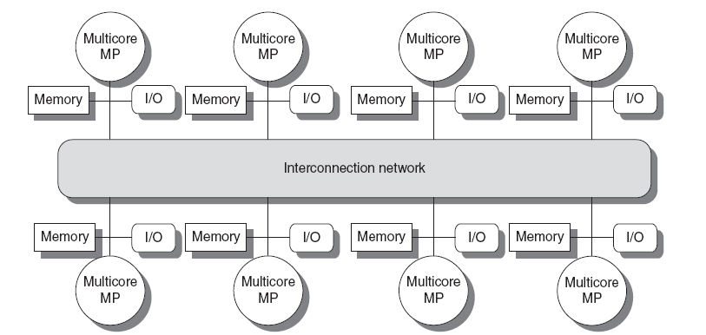
Shared memory multiprocessors: Types
b. Distributed shared memory (DSM)
Memory distributed among processors
Non-uniform memory access/latency (NUMA)
Processors connected via direct (switched) and non-direct (multi-hop) interconnection networks

Slide 19
Communication models: Message Passing
Communication primitives
e.g., send, receive library calls
standard MPI: Message Passing Interface
www.mpi-forum.org
Note that MP can be build on top of SM and vice versa !
receive
send
Process P2
Process P1
send
receive
FiFO

Slide 20
Message Passing Model
Explicit message send and receive operations
Send specifies local buffer + receiving process on remote computer
Receive specifies sending process on remote computer + local buffer to place data
Typically blocking communication, but may use DMA
Message structure
Header
Data
Trailer

Slide 21
Message passing communication
Processor
Processor
Processor
Processor
Cache
Cache
Cache
Cache
Memory
Memory
Memory
Memory
DMA
DMA
DMA
DMA
Network
interface
Network
interface
Network
interface
Network
interface
Interconnection Network

Slide 22
Communication Models: Comparison
Shared-Memory (used by e.g. OpenMP)
Compatibility with well-understood (language) mechanisms
Ease of programming for complex or dynamic communications patterns
Shared-memory applications; sharing of large data structures
Efficient for small items
Supports hardware caching
Messaging Passing (used by e.g. MPI)
Simpler hardware
Explicit communication
Implicit synchronization (with any communication)

Slide 23
Three fundamental issues for shared memory multiprocessors
Coherence, about: Do I see the most recent data?
Consistency, about: When do I see a written value?
e.g. do different processors see writes at the same time (w.r.t. other memory accesses)?
Synchronization How to synchronize processes?
how to protect access to shared data?

Slide 24
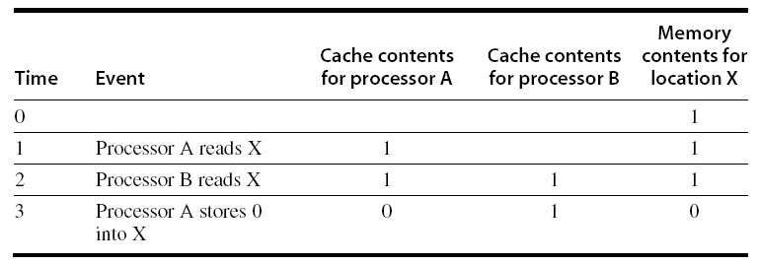
Cache Coherence Example Problem
Processors may see different values through their caches:

Slide 25
Cache Coherence
Coherence
All reads by any processor must return the most recently written value
Writes to the same location by any two processors are seen in the same order by all processors
Consistency
It’s about the observed order of reads and writes by the different processors
is this order for every processor the same?
At least should be valid: If a processor writes location A followed by location B, any processor that sees the new value of B must also see the new value of A

Slide 26
Enforcing Coherence
Coherent caches provide:
Migration: movement of data
Replication: multiple copies of data
Cache coherence protocols
Snooping
Each core tracks sharing status of each block
Directory based
Sharing status of each block kept in one location
Centralized Shared-Memory Architectures

Slide 27
Snoopy Coherence Protocols
Write invalidate
On write, invalidate all other copies
Use inter-processor communication-bus itself to serialize
Write cannot complete until bus access is obtained
Write update
Alternative: On write, update all copies

Slide 28
Snoopy Coherence Protocols
In core i7 there are 3-levels of caching.
level 3 is shared between all cores
levels 1 and 2 have to be kept coherent by e.g. snooping.
Locating an item when a read miss occurs
In write-through cache: item is always in (shared) memory
note for a core i7 this can be L3 cache
In write-back cache, the updated value must be sent to the requesting processor
Cache lines marked as shared or exclusive/modified
Only writes to shared lines need an invalidate broadcast
After this, the line is marked as exclusive

Slide 29
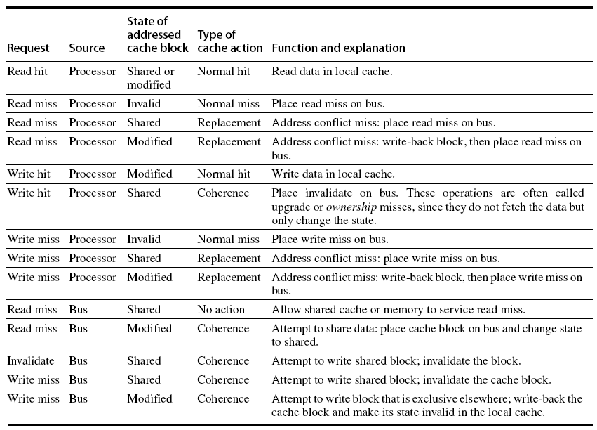
Snoopy Coherence Protocols

Slide 30
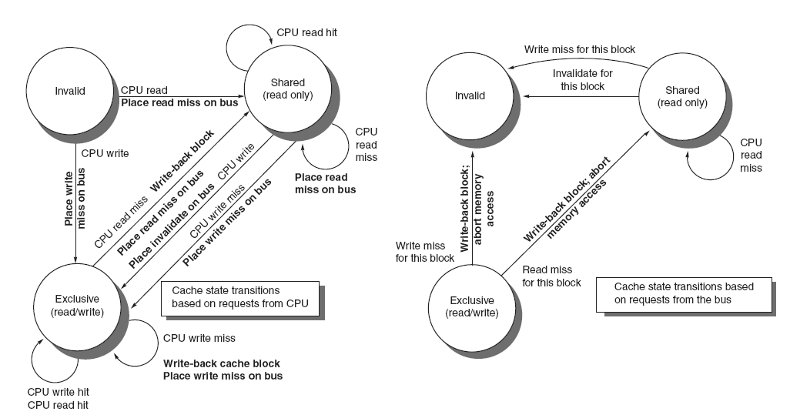
Snoopy Coherence Protocols
3 cache states
Bus transactions in bold (indicated along transitions)
When block in shared state, next level should be up-to-date

Slide 31
Snoopy Coherence Protocols
Complications for the basic MSI (Modified, Shared, Invalid) protocol:
Operations are not atomic
E.g. detect miss, acquire bus, receive a response
Creates possibility of deadlock and races
One solution: processor that sends invalidate can hold bus until other processors receive the invalidate
Extensions:
Add exclusive state (E) to indicate clean block in only one cache (MESI protocol)
Prevents needing to write invalidate on a write
Owned state (O), used by AMD (MOESI protocol)
A block can change from M -> O when others will share it, but the block is not written back to memory. It is shared by 2 or more processors, but owned by 1. This one is responsible for writing it back (to next level), when needed.

Slide 32
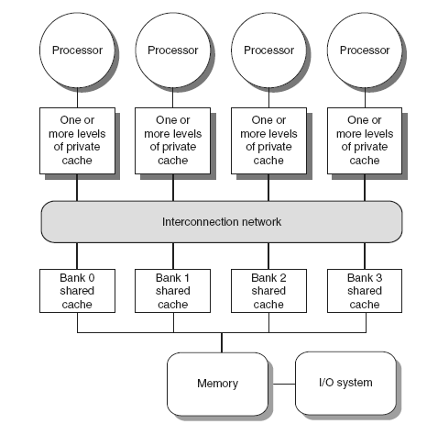
Coherence Protocols: Extensions
Shared memory bus and snooping bandwidth is bottleneck for scaling symmetric multiprocessors
Duplicating tags
Place directory in outermost cache
Use crossbars or point-to-point networks with banked memory

Slide 33
Performance
Coherence influences cache miss rate
Coherence misses
True sharing misses
Write to shared block (transmission of invalidation)
Read an invalidated block
False sharing misses
Read an unmodified word in an invalidated block
Cache block:
(4 words)
written by P1
written by P2

Slide 34
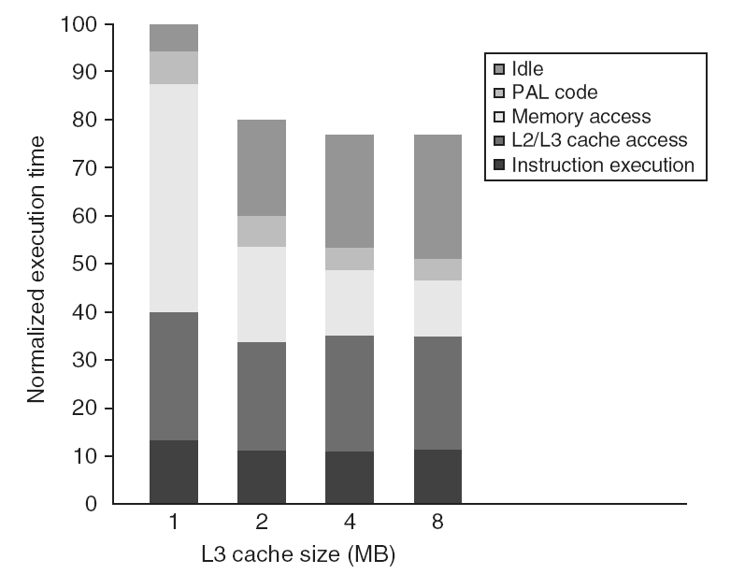
Performance Study: Commercial Workload

Slide 35
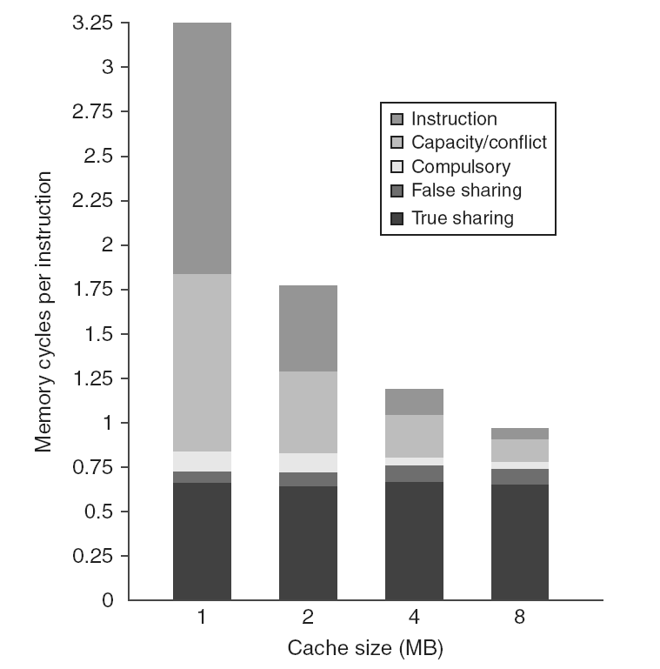
Performance Study: Commercial Workload

Slide 36
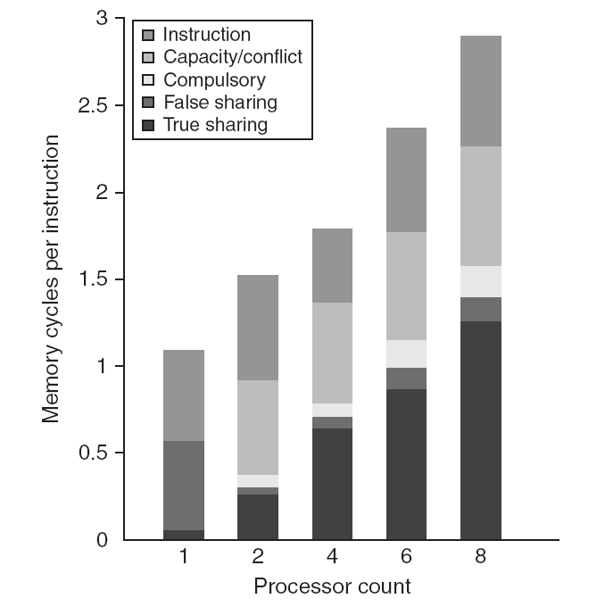
Performance Study: Commercial Workload

Slide 37
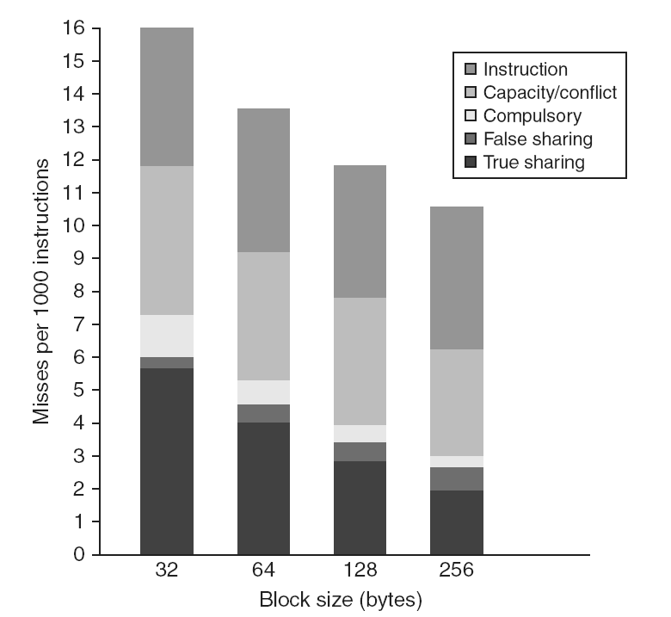
Performance Study: Commercial Workload

Slide 38
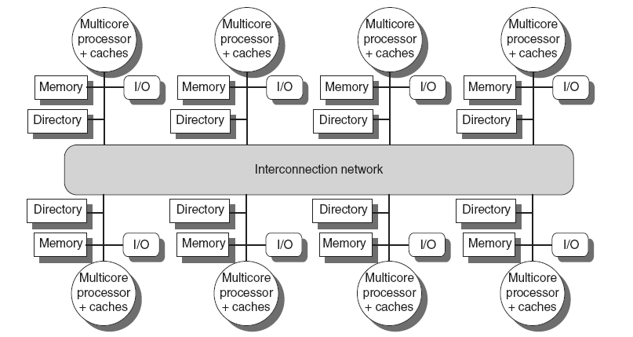
Directory Protocols (5.4)
Directory keeps track of every block
Which caches have each block
Dirty status of each block
Implement in shared L3 cache
Keep bit vector of size = # cores for each block in L3
Not scalable beyond shared L3
Directory implemented in a distributed fashion:

Slide 39
Directory Protocols
For each block, maintain state (e.g. in the shared L3 cache; note this shared L3 can be distributed):
Shared
One or more nodes have the block cached, value in memory is up-to-date
Set of node IDs
Uncached (Invalid)
Modified
Exactly one node has a copy of the cache block, value in memory is out-of-date
Owner node ID
Directory maintains block states and sends invalidation messages

Slide 40
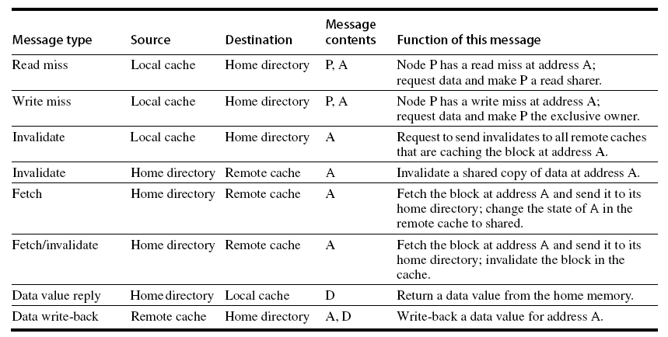
Messages
P: requesting node
A: requested address
D: data contents

Slide 41
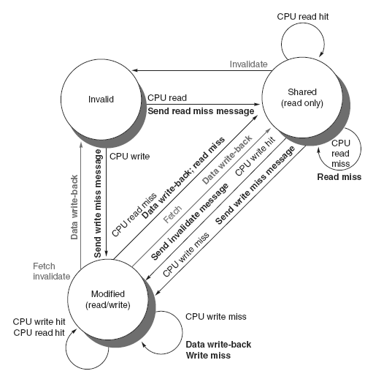
Directory Protocols
Comparable to snooping transactions
grey: requests from home directory
black: requests from local processor
bold: messages

Slide 42
Directory Protocols
For uncached (invalid) block:
Read miss
Requesting node is sent the requested data and is made the only sharing node, block is now shared
Write miss
The requesting node is sent the requested data and becomes the sharing node, block is now exclusive
For shared block:
Read miss
The requesting node is sent the requested data from memory, node is added to sharing set
Write miss
The requesting node is sent the value, all nodes in the sharing set are sent invalidate messages, sharing set only contains requesting node, block is now exclusive

Slide 43
Directory Protocols
For exclusive block:
Read miss
The owner is sent a data fetch message, block becomes shared, owner sends data to the directory, data written back to memory, sharers set contains old owner and requestor
Data write back
Block becomes uncached, sharer set is empty
Write miss
Message is sent to old owner to invalidate and send the value to the directory, requestor becomes new owner, block remains exclusive

Slide 44
Three fundamental issues for shared memory multiprocessors
Coherence, about: Do I see the most recent data?
Synchronization How to synchronize processes?
how to protect access to shared data?
Consistency, about: When do I see a written value?
e.g. do different processors see writes at the same time (w.r.t. other memory accesses)?

Slide 45
What's the Synchronization problem?
Assume: Computer system of bank has credit process (P_c) and debit process (P_d)
/* Process P_c */ /* Process P_d */
shared int balance shared int balance
private int amount private int amount
balance += amount balance -= amount
lw $t0,balance lw $t2,balance
lw $t1,amount lw $t3,amount
add $t0,$t0,t1 sub $t2,$t2,$t3
sw $t0,balance sw $t2,balance

Slide 46
Critical Section Problem
n processes all competing to use some shared data; they need synchronization
Each process has code segment, called critical section, in which shared data is accessed.
Problem – ensure that when one process is executing in its critical section, no other process is allowed to execute in its critical section
Structure of process
while (TRUE){
entry_section ();
critical_section ();
exit_section ();
remainder_section ();
}

Slide 47
Synchronization
Problem: synchronization protocol requires atomic read-write action on the bus
e.g. to check a bit and if zero, set it.
Basic building blocks:
Atomic exchange
Swaps register with memory location
Test-and-set
Sets under condition
Fetch-and-increment
Reads original value from memory and increments it in memory
Requires memory read and write in uninterruptable instruction
load linked/store conditional
If the contents of the memory location specified by the load linked are changed before the store conditional to the same address, the store conditional fails

Slide 48
Implementing Locks
Spin lock
If no coherence:
DADDUI R2,R0,#1 ;R2=1
lockit: EXCH R2,0(R1) ;atomic exchange
BNEZ R2,lockit ;already locked?
If coherence, avoid too much snooping traffic:
lockit: LD R2,0(R1) ;load of lock
BNEZ R2,lockit ;not available-spin
DADDUI R2,R0,#1 ;R2=1
EXCH R2,0(R1) ;swap
BNEZ R2,lockit ;branch if lock wasn’t 0

Slide 49
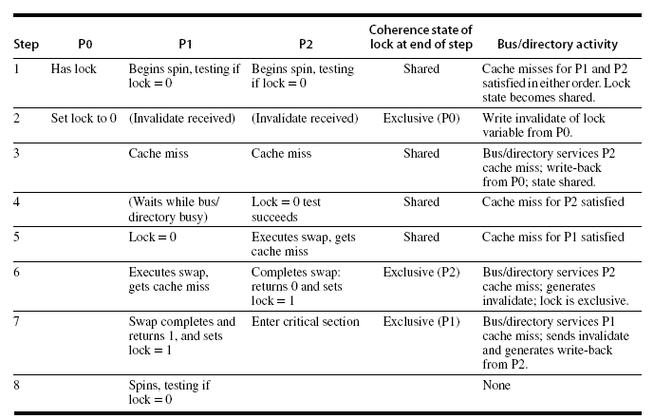
Implementing Locks
Advantage of this scheme: reduces memory traffic

Slide 50
Three fundamental issues for shared memory multiprocessors
Coherence, about: Do I see the most recent data?
Synchronization How to synchronize processes?
how to protect access to shared data?
Consistency, about: When do I see a written value?
e.g. do different processors see writes at the same time (w.r.t. other memory accesses)?

Slide 51
Memory Consistency: The Problem
Process P1 | Process P2
A = 0; ... A = 1; L1: if (B==0) ... | B = 0; ... B = 1; L2: if (A==0) ...
Observation: If writes take effect immediately (are immediately seen by all processors), it is impossible that both if-statements evaluate to true
But what if write invalidate is delayed ……….
Should this be allowed, and if so, under what conditions?

Slide 52
How to implement Sequential Consistency
Delay the completion of any memory access until all invalidations caused by that access are completed
Delay next memory access until previous one is completed
delay the read of A and B (A==0 or B==0 in the example) until the write has finished (A=1 or B=1)
Note: Under sequential consistency, we cannot place the (local) write in a write buffer and continue

Slide 53
Sequential consistency overkill?
Schemes for faster execution then sequential consistency
Observation: Most programs are synchronized
A program is synchronized if all accesses to shared data are ordered by synchronization operations
Example:
P1
write (x) ... release (s) {unlock} ...
P2
acquire (s) {lock} ... read(x)
ordered

Slide 54
Cost of Sequential Consistency (SC)
Enforcing SC can be quite expensive
Assume write miss = 40 cycles to get ownership,
10 cycles = to issue an invalidate and
50 cycles = to complete and get acknowledgement
Assume 4 processors share a cache block, how long does a write miss take for the writing processor if the processor is sequentially consistent?
Waiting for invalidates : each write =sum of ownership time + time to complete invalidates
10+10+10+10= 40 cycles to issue invalidate
40 cycles to get ownership + 50 cycles to complete
=130 cycles ➔very long !
Solutions:
Exploit latency-hiding techniques
Employ relaxed consistency

Slide 55
Relaxed Memory Consistency Models
Key: (partially) allow reads and writes to complete out-of-order
Orderings that can be relaxed:
relax W ⇒ R ordering
allows reads to bypass earlier writes (to different memory locations)
called processor consistency or total store ordering
relax W ⇒ W
allow writes to bypass earlier writes
called partial store order
relax R ⇒ W and R ⇒ R
weak ordering, release consistency, Alpha, PowerPC
Note, seq. consistency means:
W ⇒ R, W ⇒ W, R ⇒ W and R ⇒ R

Slide 56
Relaxed Consistency Models
Consistency model is multiprocessor specific
Programmers will often implement explicit synchronization
Speculation gives much of the performance advantage of relaxed models with sequential consistency
Basic idea: if an invalidation arrives for a result that has not been committed, use speculation recovery

Slide 57
Concluding remarks
Number of transistors still scales well
However power/energy limits reached
Frequency not further increased
Therefore: After 2005 going Multi-Core
exploiting task / thread level parallelism
can be combined with exploiting DLP (SIMD / Sub-word parallelism)
The extreme:
Top 500: www.top500.org
The most efficient (in Operations / Joule, or Ops/sec / Watt)
Green Top 500: www.green500.org

