Slide 1
Multi-Core Programming Assignment
Dongrui She
December 9, 2010

Slide 2
Goal of the Assignment
The purpose of this assignment is to
Have in-depth understanding of the architectures of real-world multi-core CPUs
Learn about how to develop parallel applications on such architectures, and how to analyze the performance in a real environment

Slide 3
Outline
Parallelism in Mainstream CPUs
Exploiting Parallelism in CPUs
Methods to analyze application performance
Introduction to VTune
Example: Matrix Multiplication

Slide 4
Parallelism in Typical Mainstream CPUs
1-12 cores with shared memory
  Large on-chip cache
  Both private and shared cache
Inside a core:
  ILP: 3-4 issue out-of-order superscalar core
  DLP: 128-bit SIMD instructions (SSE)
  TLP: 2-way SMT (Intel’s hyper-threading)
  Typical core frequency: 2-3 GHz

Slide 5
Ways to Exploit Parallelism
ILP: cannot be controlled directly
  Compiler optimization and proper coding style can help
TLP and multi-core: multi-threaded programming
  Logically they are the same for the OS
  Many programming models available, e.g., OpenMP, Cilk, pthread.
    We will introduce OpenMP in more detail latter

Slide 6
Exploiting DLP
Two ways to do vectorization
  Auto-vectorization by compilers
    The Intel compiler is considered the best
    Most compilers are limited to (simple) inner-most loops
    Pragmas can be use to tell compilers more information to enable more aggressive optimization
  Intrinsics or inline assembly
    Vectorization by programmers, more information about app.
    Examples / Documentation will be on the assignment website
Two most common obstacle
  Cross-iteration dependency
  Alignment issues

Slide 7
Vectorization Example – FIR
Basic idea to vectorize a loop: unroll and pack multiple scalar iterations into one vector iteration
Inner-most loop is an obvious choice, but
  Packing and unpack can be costly, especially if the trip count is not aligned with the machine vector length
  Inner loops may have low trip count
for(i=0; i< N; i++){
s = 0;
for(j=0; j < 4; j ++)
s += x[i+j] * c[j]
y[i] = s
}
vc[0:3] = {c[0], c[1],
c[2], c[3]}
for (i=0; i< N; i++){
vs[0:3] = x[i:i+3] * vc
y[i] = sum(vs[0:3])
}

Slide 8
Vectorization Example – FIR (2)
Outer-loop vectorization can be more efficient
  However, most compiler cannot do it
for (i=0; i< N; i+=4){
vs[0:3] = {0, 0, 0, 0}
for (j =0; j < 4; j ++) {
vc[0:3] = vsplat(c[j])
vs[0:3] += x[i+j:i+j+3] * vc
}
y[i:i+3] = vs[0:3]
}
for(i=0; i<N; i++){
s = 0;
for(j=0; j<4; j++)
s += x[i+j] * c[j]
y[i] = s
}

Slide 9
Analyzing Application Performance
Understand and optimize application performance
  Is the performance good or bad?
  Which part should run in parallel?
  Where to optimize?
Static analysis and execution time measurement are not enough
  They are not enough to understand the dynamic behavior of complex applications
  We need profiling

Slide 10
Ways to Profile an Application
Emulation/Simulation
  Accurate (if the model is accurate enough) but slow
Intrusive profilers:
  The profiling codes may change the program (timing) behavior
Statistical profilers:
  Periodically halt the program and sample the PC and other data. Less overhead and better overall accuracy
  Most commonly used profilers are based on this approach, e.g., Intel VTune, AMD CodeAnalyst.

Slide 11
Profiling with Intel VTune
Features
  Based on sampling
  Supports event counters in the PMU (Performance Monitoring Unit) of Intel CPUs
Requirements
  Intel CPUs (Core or newer) running Linux or Windows
  Program compiled with debug symbols (-g)
Alternatives
  For AMD CPUs: AMD CodeAnalyst is similar to VTune
  Open source solution for Linux: pfmon
    May require some effort to get it running

Slide 12
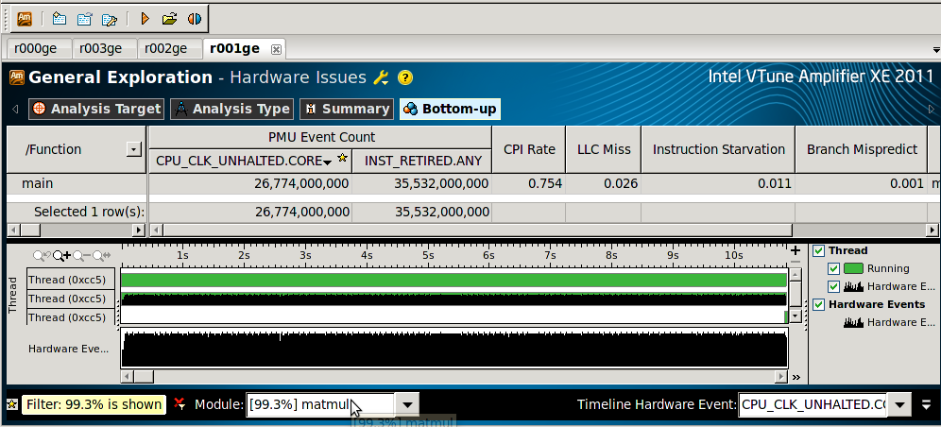
VTune User Interface
Information of each function
Total number of cycles (for main);
Note: these are statistical values
Cycles per instruction ratio(for main);
Note: these are derived values
Distribution of events over time
Choose event to show in the distribution diagram

Slide 13
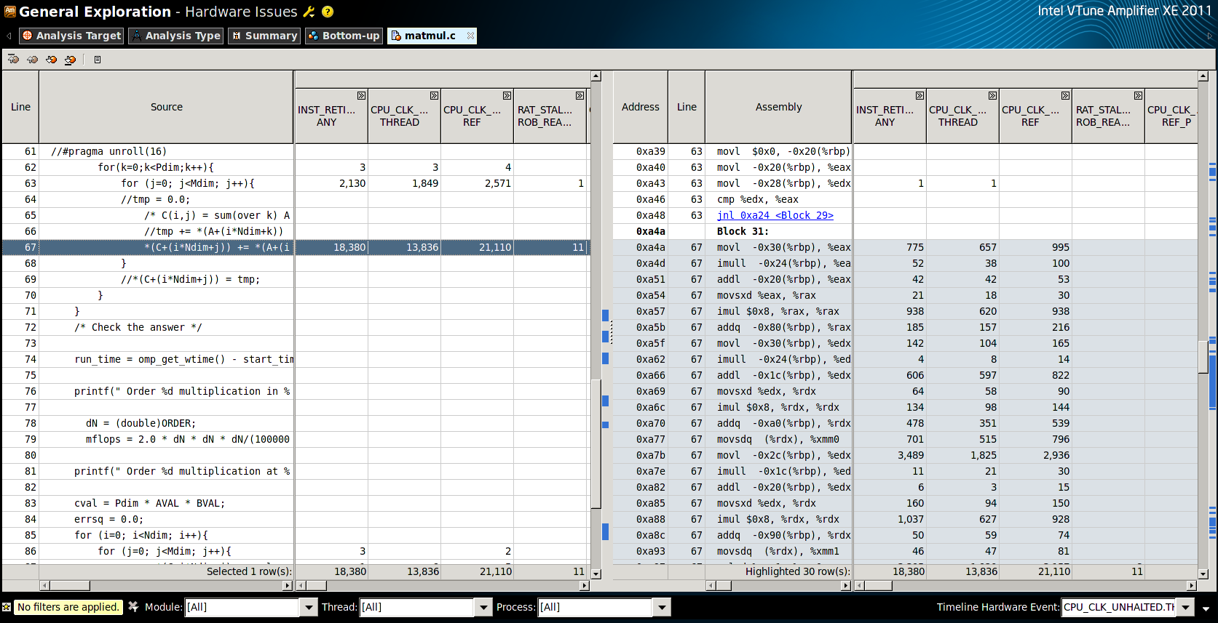
VTune Detailed View
Counter values
Shaded lines are corresponding disassembly of the selected line in the original source

Slide 14
Example: Matrix Multiplication
Straightforward implementation
A = (double *)malloc(N*P*sizeof(double));
B = (double *)malloc(P*M*sizeof(double));
C = (double *)malloc(N*M*sizeof(double));
... // Initialize A, B and C
for (i=0; i < N; i++){
for (j=0; j < M; j++){
for(k=0; k <P; k++){
*(C+(i*N+j))+= *(A+(i*N+k)) * *(B+(k*P+j));
}
}
}
1024x1024 matrices. Program compiled with optimization off (-O0), performance on a Core 2 Quad 8300 with 32bit Linux:
Order 1024 multiplication in 58.7 seconds
Order 1024 multiplication at 36.6 mflops
Number of operations is 2*N*N*N

Slide 15
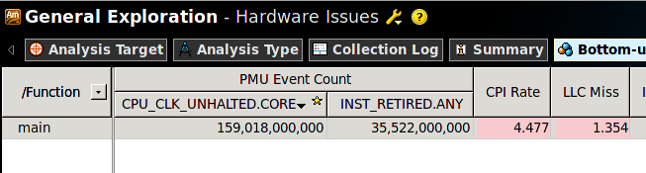
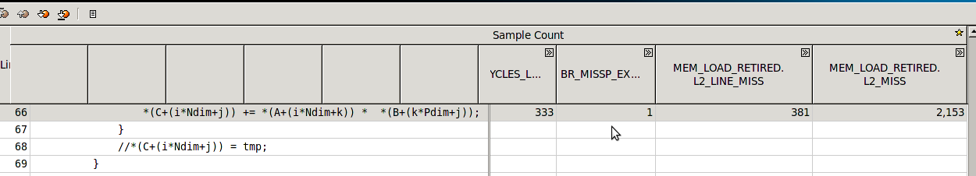
Initial Profiling Result
CPI is very high, and LLC miss is an obvious problem
The inner-most loop is causing a lot of cache misses
This line is the hotspot

Slide 16
Analyze the Problem
Access pattern of B is the problem
A = (double *)malloc(N*P*sizeof(double));
B = (double *)malloc(P*M*sizeof(double));
C = (double *)malloc(N*M*sizeof(double));
... // Initialize A, B and C
for (i=0; i < N; i++){
for(k=0; k <P; k++){
for (j=0; j < M; j++){
*(C+(i*N+j))+= *(A+(i*N+k)) * *(B+(k*P+j));
}
}
}
A = (double *)malloc(N*P*sizeof(double));
B = (double *)malloc(P*M*sizeof(double));
C = (double *)malloc(N*M*sizeof(double));
... // Initialize A, B and C
for (i=0; i < N; i++){
for (j=0; j < M; j++){
for(k=0; k <P; k++){
*(C+(i*N+j))+= *(A+(i*N+k)) * *(B+(k*P+j));
}
}
}
Just inter-change the loops
Access to B is not contiguous as B is stored in row-major order
~5.7x speed-up by a minor change !
Order 1024 multiplication in 10.315131 seconds
Order 1024 multiplication at 208.187717 mflops

Slide 17
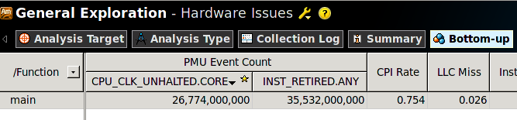
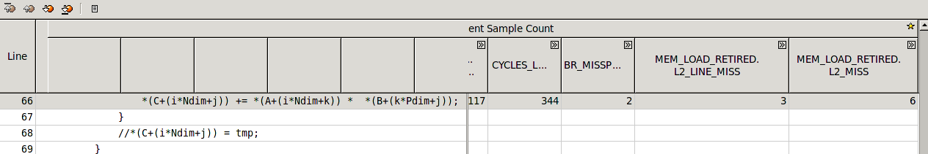
Profiling Result After Optimization
In this case, compilers should be able to interchange the loop automatically (in our experiment, ICC can, but GCC cannot). But further optimizations like tiling still need to be done by hand.
Use -fast in ICC and you get:
Order 1024 multiplication in 0.507935 seconds
Order 1024 multiplication at 4227.870591 mflops

Slide 18
Assignment Setup
Platform: a PC with multi-core CPU
  TU/e Notebook 2009 and 2010 are OK
Software: Intel compiler and VTune Profiler
  Available on both Windows and Linux
  A 30-day evaluation license can be obtained from the web-site for free
    For linux, a 1-year non-commercial license is available
Assignment can be done in team of two students
  Make sure at least one has the proper platform

Slide 19
Some General Remarks
Both GCC and ICC have options to report whether the loops are vectorized and if not what’s the reason. It can be quite helpful
ICC’s optimization tends to be quite aggressive, but it doesn’t always payoff. So check the manual and use the proper flags and pragmas
Bear in mind that VTune is based on sampling. So the numbers are NOT exact

