Slide 1
Halide tutorials summary and lessons learned for Intel IPU
Rosilde Corvino, Sander Vocke, Ruud Schellekens and Orlando Moreira

Slide 2
Outline
What is Halide?
  Summary of Halide tutorials __________________
Our initial contributions __________________

Slide 3
Halide tutorials summary
From http://halide-lang.org/tutorials

Slide 4
Introduction to Halide language and compiler
General concepts
Premises of the language (tutorials)
Compiler
Auto-scheduler for CPU
Limitations and strengths of the approach

Slide 5
General information on Halide (1)
Designed by | Jonathan Ragan-Kelley and Andrew Adams
Developer | MIT, (with help from Stanford and Adobe)
First appeared | 2012
Implementation language | C++
OS | Mac OS X / Linux / Windows
Website | http://halide-lang.org/
Halide
bytecode
Input.cpp
gcc
Code generator
LLVM IR
C code, etc.

Slide 6
General information on Halide (2)
Halide is a functional language
computation are evaluation of a mathematical function
follows a declarative programming paradigm
no states only expressions and declarations
it immediately captures the application intrinsic parallelism
  Advantage with respect to languages like C for which the algorithm has to be made sequential to fit the imperative paradigm and then based on data dependency analysis we need to infer application parallelization opportunities.

Slide 7
Halide a language and compiler for image processing
Jonathan Ragan-Kelley
Andrew Adams
Algorithm
Organization of computation
Hardware
redundant work
locality
tradeoff
parallelism
From a deck of Jonathan Regan Kelly

Slide 8
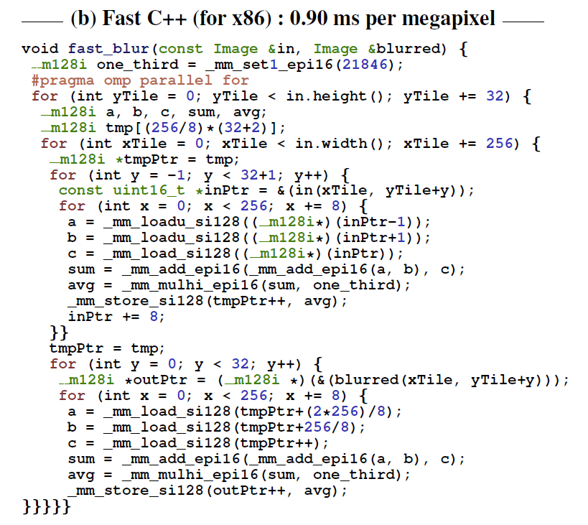
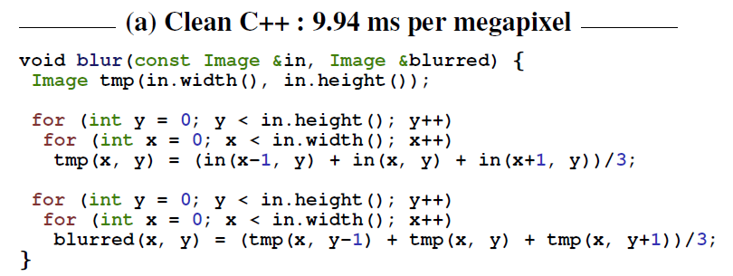
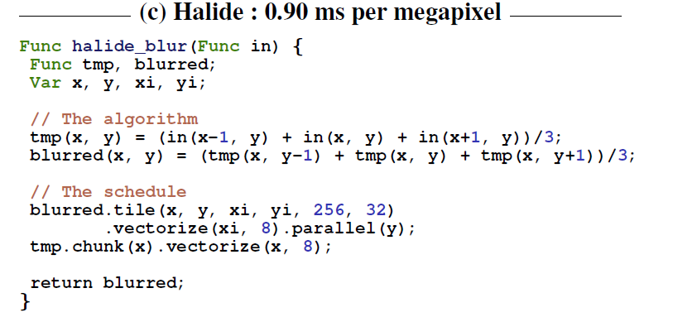
Why Halide?
tiling
multithreading
vectorization
fusion
Readability,
portability and
modularity.
Optimizations correct by construction ☺.

Slide 9
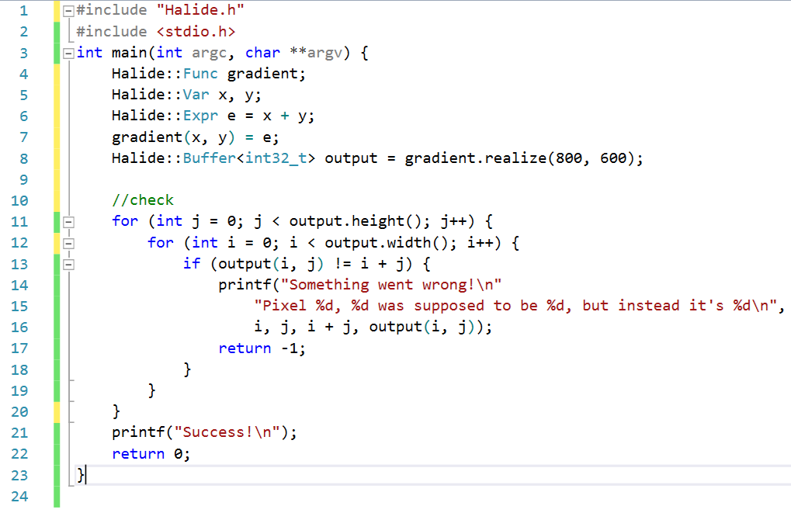
Tutorial 1:
Funcs, Vars and Exprs
Halide is a c++ library
A Func is a pipeline step
A Func is a combination of Exprs and an Expr is a combination of Vars
A Func is realized over a domain
Func values can be stored in buffers
Halide can be embedded in C++ when JIT compiled

Slide 10
Tutorial 5:
Initial code
Schedule directives:
Iteration re-order
Iteration domain split
Tile
Vectorize
Parallelize

Slide 11

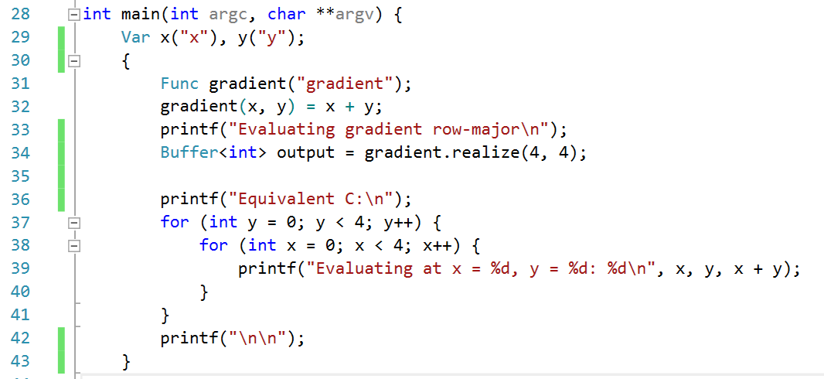
Tutorial 5:
Initial code → row major
Gradient(x,y) → x is the innermost iterator

Slide 12
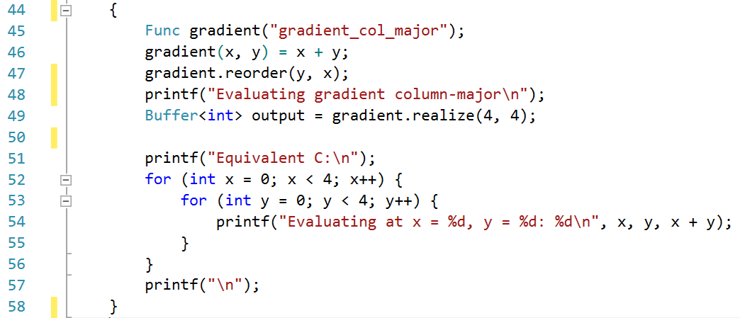
Tutorial 5:
Iterations re-order
Reorder directive →y is the innermost iterator

Slide 13
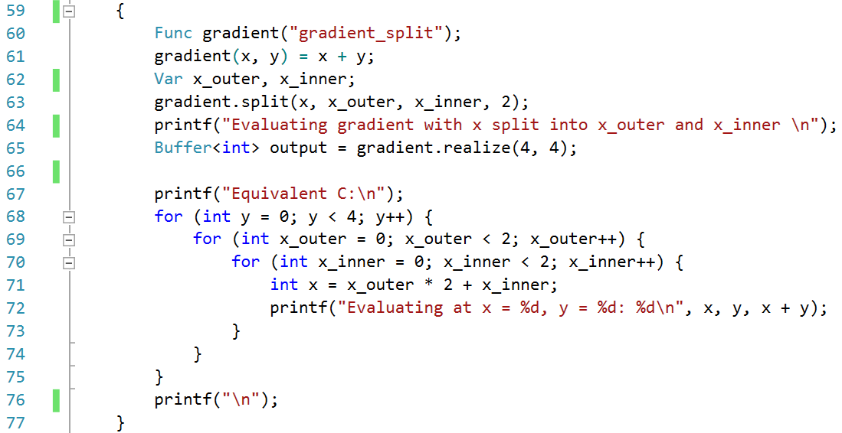
Tutorial 5:
Iteration domain split
Split directive →x loop is split over an outer an inner loop
Equivalent fuse directive exists

Slide 14

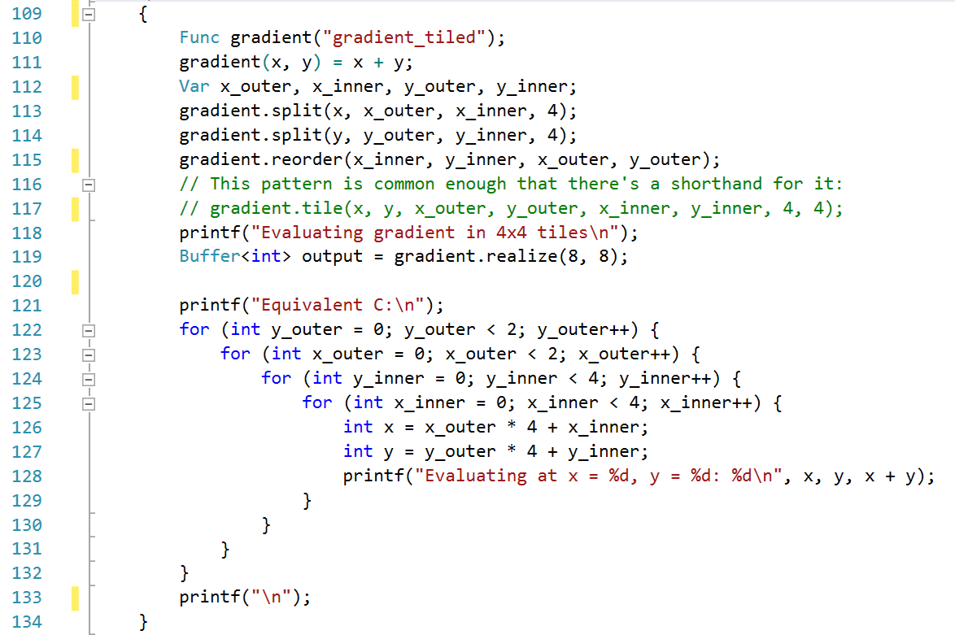
Tutorial 5:
Iteration domain tiling
Tile directive →partition and re-order the iteration domains in tiles

Slide 15

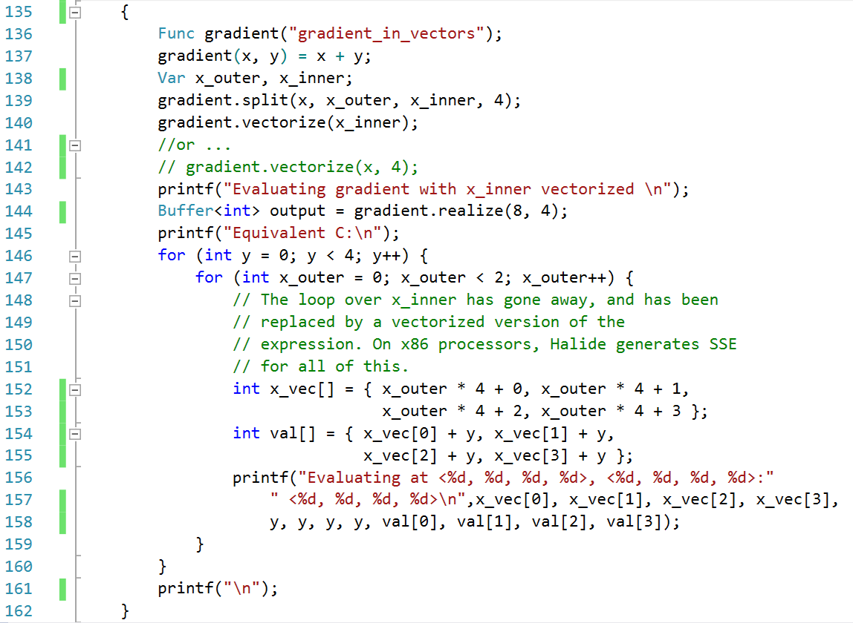
Tutorial 5:
Vectorization
Vectorize directive →only works on machine with SIMD extensions

Slide 16

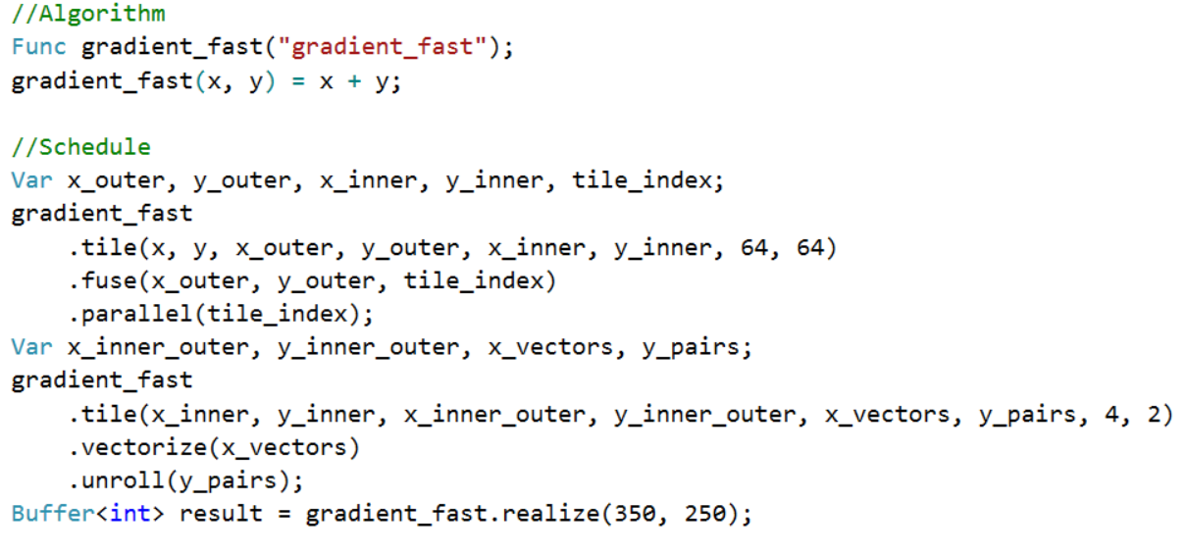
Tutorial 5:
Putting all together

Slide 17
Tutorial 8:
Schedule a multi-stage pipeline
2 stages pipeline: producer → consumer
The schedule of the producer and consumer execution influences:
  The number of re-computations ←→ redundant work
  The size of used memory ←→ data locality

Slide 18
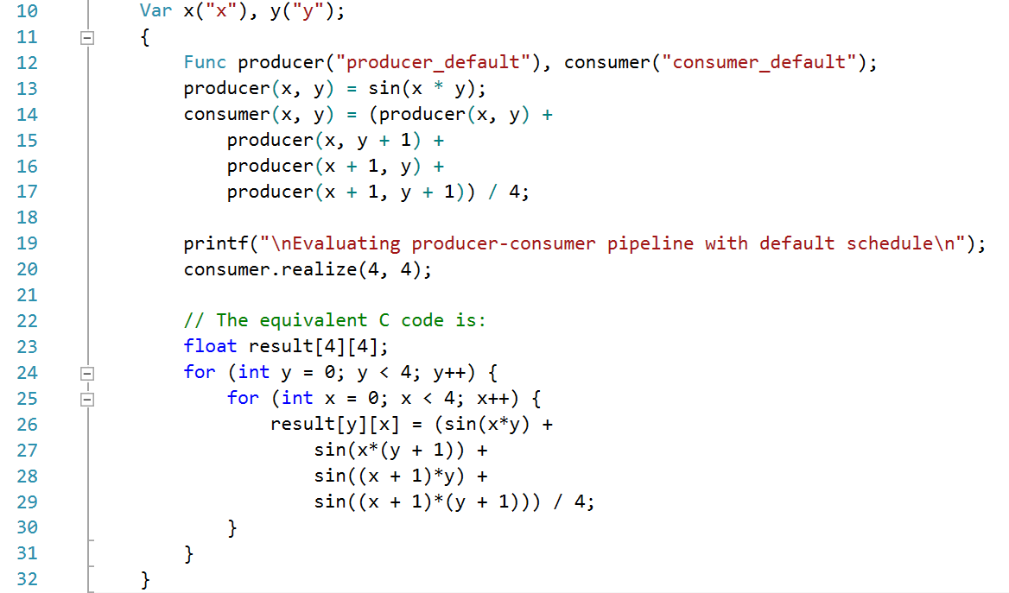
Tutorial 8:
Schedule a multi-stage pipeline
2 stages pipeline:
Producer → Consumer
Default schedule is all functions inline
y
recomputed
x

Slide 19

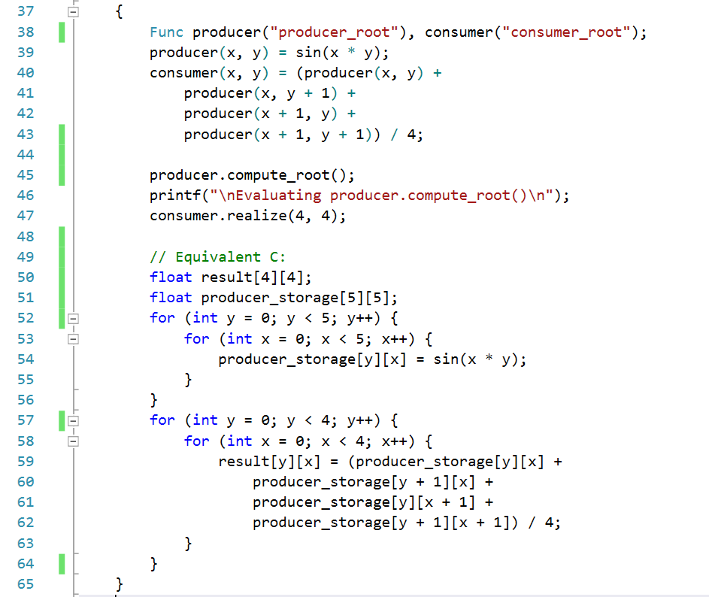
Tutorial 8:
Schedule a multi-stage pipeline
The directive compute_root()
A 5X5 array is needed to store all the producer values
All the producer values are computed beforehand
No producer values are recomputed

Slide 20
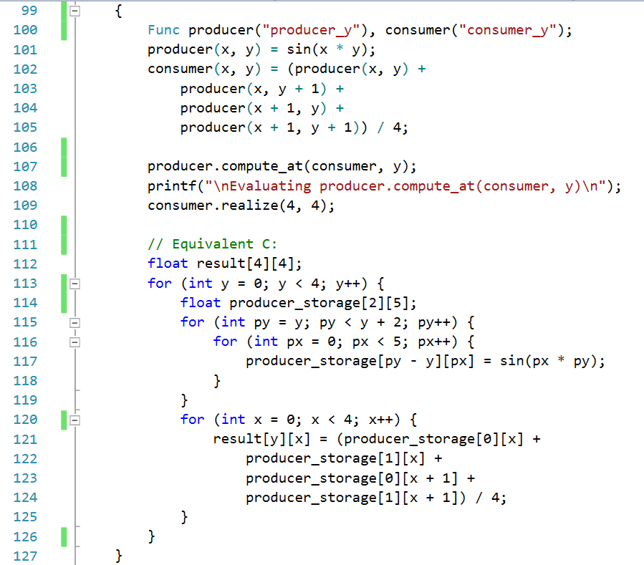
Tutorial 8:
Schedule a multi-stage pipeline
The directive compute_at()
A 2X5 array is needed to store the producer values
2 lines of the producer values are computed beforehand
Lines 2, 3 and 4 of the producers are computed twice

Slide 21
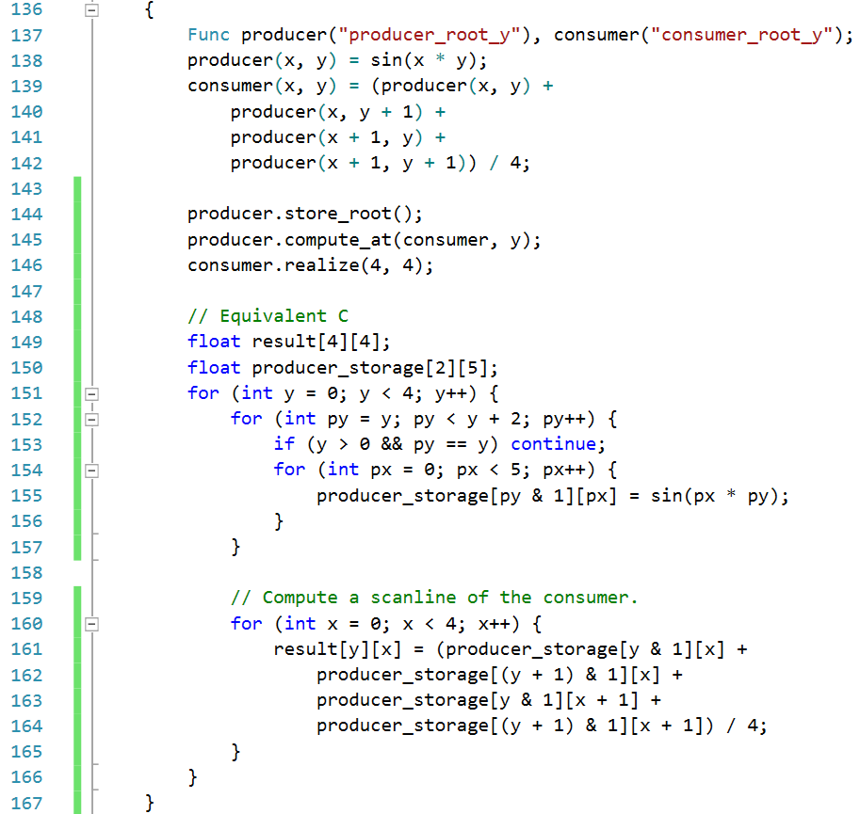
Tutorial 8:
Schedule a multi-stage pipeline
The directive store_root() → storage folding
A producer storage appear before the loop nest
Halide detects that only 2 lines are used at a time
1 lines of the producer values are computed beforehand. Except for the first iteration.
No values of the producers are re-computed

Slide 22
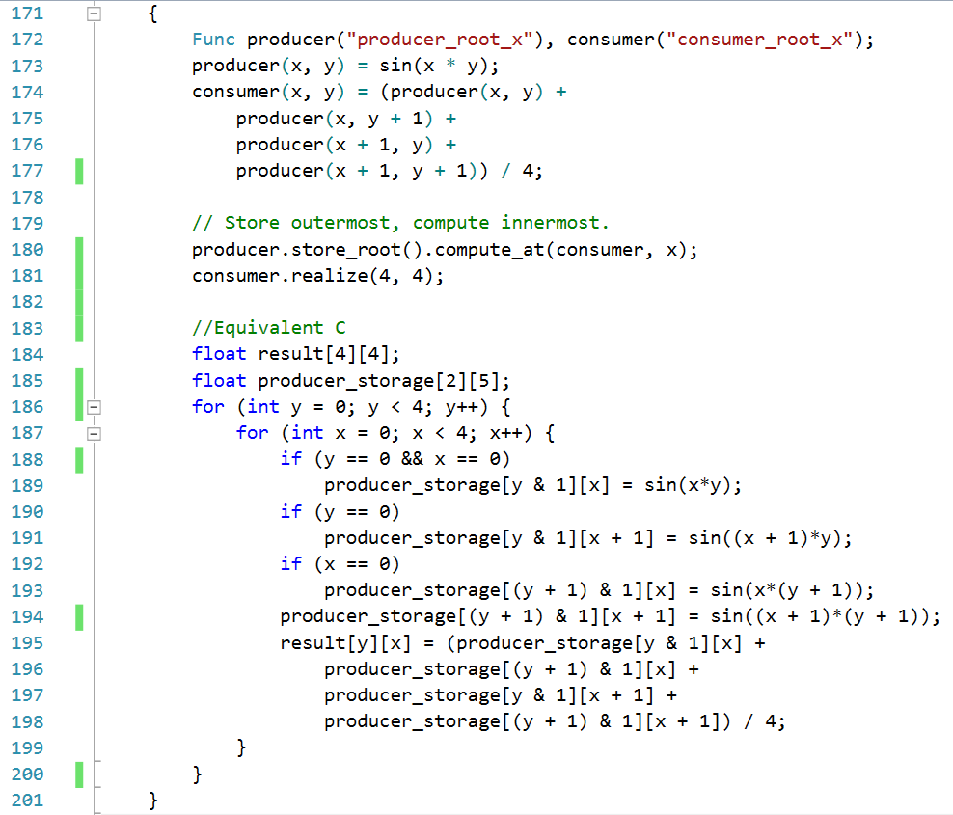
Tutorial 8:
Schedule a multi-stage pipeline
Store outermost and compute innermost
Storage folding
Produces JIT what the consumer needs. No re-computations
A loop nest can be tiled, vectorized, parallelized, etc.

Slide 23
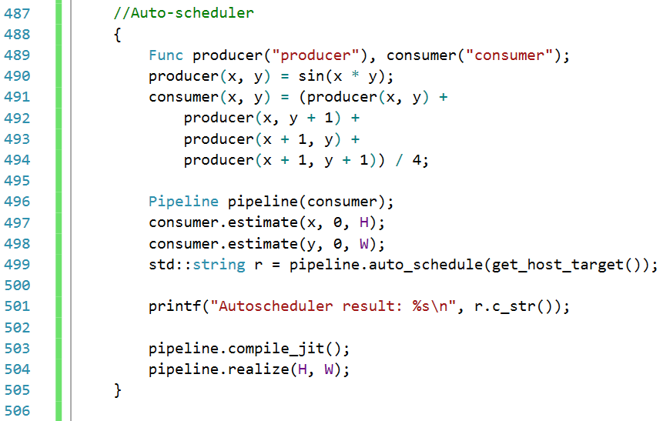
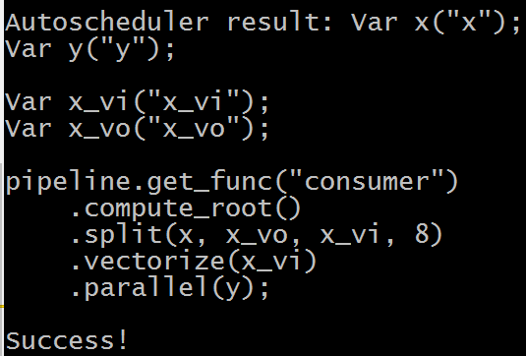
Auto-scheduler for CPU
For the CPU the auto-scheduler will find an optimized schedule
But we could do better for re-computations !!!!

Slide 24
Halide Compiler
CPU (JIT, LLVM-IR, C, …
GPU (JIT, OpenCL, Metal, …
Hexagon (LLVM-IR, …
HLS (C++, OpenCL, …
Intel IPU (C)
Matlab
Halide.cpp
Synthesis
Bound Inference
Optimizations
Code generation

Slide 25
Limitations of the approach (1)
Halide language can describe only :
  non recursive and without state-holding algorithms
  Algorithms with address and loop-bounds known at compile time
  … but, for image processing these algorithms are the largest majority
  … also, what cannot be written in Halide can be called as an external function
Halide-generated loop nests always iterate over rectangular / hypercubic domains
  Memory foot-prints and re-computations can be oversized for the algorithm

Slide 26
Limitations of the approach (2)
Maturity of the Halide Compilers
  No debugger support
  Poor error messages
  … but, we plan to work on this aspect
Maturity of the Halide language
  New language (2012- paper, 2014 –release)
    not known, not standard, still evolving
  Limited support (forum)
  … but, a community using Halide is growing inside and outside Intel

Slide 27
Strengths of the approach
Clear and concise code compared to C.
Easy (or automatic) re-scheduling and re-targeting
  Saves time, guarantees correctness, handles edge conditions
Targets: x86, ARM, GPU (OpenCL / OpenGL / CUDA), Qualcomm Hexagon, Matlab…
Industry-proven in mobile, desktop, datacenter
  …examples on next slide (from J. Regan-Kelly creator of Halide – MIT)

Slide 28



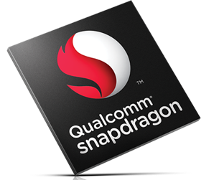


Real-world adoption
Open source at http://halide-lang.org
Google
> 200 pipelines
10s of kLOC in production
Halide touches every video uploaded.
65B frames/day
From a deck of Jonathan Regan Kelly
G Photos auto-enhance
Data center
Android
Browser
HDR+
Glass
Nexus devices

Slide 30
Halide for IPU: contributions overview
Sander Vocke, Ruud Schellekens, Rosilde Corvino

Slide 31
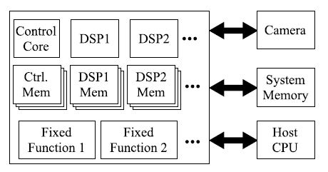
High-level view of IPU architectures
Intel DSP are VLIW

Slide 32
Challenges
How to generate efficient embedded VLIW programs from Halide?
How do we facilitate the tiled transfer of data to/from VLIW cores?
How do we deal with multiple cores?
How do we deal with fixed-function accelerators?

Slide 33
Generating efficient VLIW programs from Halide
Halide is already well-suited to deal with many optimization concepts important for imaging on VLIW targets:
Loop nest fusion
Tiling
Vectorization (SIMD)
Exploring options of data re-use
Functional description
Synthesis
Naïve IR
Optimizations
Optimized IR
Code generation
Output (LLVM IR / C / …)

Slide 34
Generating efficient VLIW programs from Halide
However, Halide generates native vector types and operations.
VLIW cores:
Tend to have complex vector instructions, targeted by the programmer via intrinsics.*
Tend to require emulation for some types of operations
(e.g. unaligned access, gather/scatter operations)

Slide 35
Generating efficient VLIW programs from Halide
For Halide_IPU, we address this with a pattern-matching engine, which transforms structures of Halide IR into other structures or intrinsics.
Functional description
Synthesis
Naïve IR
Optimizations
Optimized IR
Pattern matching / replacement
IR with intrinsics, emulation
Code generation
Output (C)

Slide 36
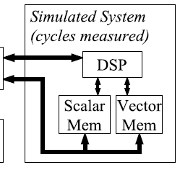
Tiled data transfer to/from VLIW cores
IPU DSP cores are data cache-less and contain multiple local memories:
A DMA needs to be configured to do double-buffered transfer of data subsets to/from local memories.
The programmer should be able to manipulate memory assignment of buffers.
DMA
DDR

Slide 37
Tiled data transfer to/from VLIW cores
In Halide_IPU (single-core):
Each input/output has a remote version (the full buffer in DDR) and a
local version (a partial buffer in a local memory).
A new scheduling directive controls the transfer between them:
  ipu_data_transfer() sets the transfer granularity, much like compute_at().
Another new scheduling directive determines to which local memory a local buffer (input, output or intermediate) is assigned:
  ipu_store_in() assigns a buffer to a memory (e.g. func.ipu_store_in(VMEM)).
The compiler is capable of generating DMA transfer commands into the loop nest, which facilitate the transfer.

Slide 38
Retiming
Retiming command will allow programmer to explicitly retime loops.
Benefits:
  Explicit software pipelining of computation
  Explicit pipelining of data transfers with computation
  Potential for multi-core applications (processors in pipeline)
For X = 0 : N
Producer ( x )
Consumer ( x )
Producer ( 0 )
For X = 0 : N - 1
Producer ( x + 1 )
Consumer ( x )
Consumer ( N )

Slide 39
Conclusions
Halide is a domain specific functional language for image processing
Algorithm / Schedule separation for improved readability, re-use and correct-by-construction code optimization
Language spreading in the industry: Adobe, Google, Intel, etc.
Our contributions:
An Halide back-end for our VLIW DSP
Mechanism to manage data transfer and storage on IPU
Retiming

Slide 40
Questions, remarks and information exchange
rosilde.corvino@intel.com

