Slide 1
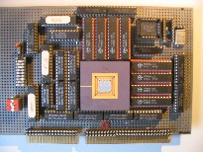


Embedded Computer Architecture
5SAI0
Coherence,
Synchronization, and
Memory Consistency
Henk Corporaal
www.ics.ele.tue.nl/~heco/courses/ECA
h.corporaal@tue.nl
TUEindhoven
2021-2022

Slide 2
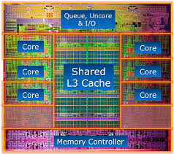

Welcome back
Shared memory architecture issues:
  Coherence
  Synchronization
  Consistency
Material from our study books:
  H&P : Chapter 5.2 + 5.4-5.6
  Dubois e.a.: Chapter 5.4 – 5.4.3 + Chapter 7.4-7.6
You should work on the CGRA lab
Make the try-out exam: you need an 8; you can try many times

Slide 3
Three fundamental issues for shared memory multiprocessors
Coherence,
about: Do I see the most recent data?
  coherence assures that a value written (to e.g. address 1200) by one processor is ‘seen’ by others (read from location 1200)
  however, when do they others the updates?
Consistency,
about: When do I see a written value?
  e.g. do different processors see all accesses to different locations in the same order
  (w.r.t. other memory accesses)?
Synchronization
How to synchronize processes?
  how to protect access to shared data?
  how to make sure 2 processes communicate correctly?

Slide 4
i7 Nehalem 4 core architecture
core 1
core 1
core 1
core 1
ALUs+RF
+control
ALUs+RF
+control
ALUs+RF
+control
ALUs+RF
+control
L1-I
L1-D
L1-I
L1-D
L1-I
L1-D
L1-I
L1-D
L2
(non-inclusive)
L2
(non-inclusive)
L2
(non-inclusive)
L2
(non-inclusive)
I/O
buffer
read buffers
write buffers
I/O
buffer
MMU: memory mngt unit
QPI
quick path
interconnect
L3
(inclusive)
memory
controller
other cores
3 DDR channels

Slide 5
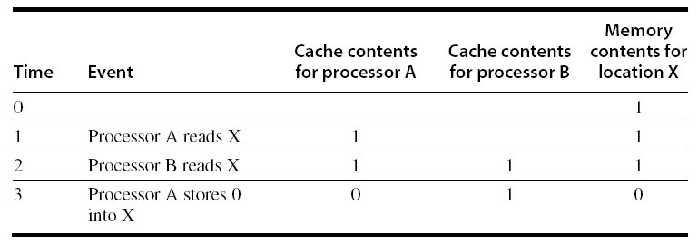
Cache Coherence Problem: Example
Processors may see different values through their caches:

Slide 6
Enforcing Coherence
Coherent caches provide:
  Replication: multiple copies of the same data
  Migration: movement of data
    from memory to one or more caches,
    or even from one cache directly to a
    cache of another processor
Cache coherence protocols:
  Snooping
    Each core tracks sharing status of each block
  Directory based
    Sharing status of each block kept in one location
Processor
Processor
Processor
Processor
Cache
Cache
Cache
Cache
Main memory
I/O System

Slide 7
2 Potential HW Coherency Solutions
Processor
Processor
Processor
Processor
Cache
Cache
Cache
Cache
Snooping Solution (Snoopy Bus):
  Send all requests for data to all processors
  (or their local caches)
  Processors snoop to see if they have a copy and respond accordingly
  Requires broadcast, since caching information is at processors
  Works well with a bus (natural broadcast medium)
  Most used method for small scale number of cores (most of the market)
Directory-Based Schemes
  Keep track of what is being shared in one centralized place
  Distributed memory => distributed directory for scalability
    avoids bottlenecks, hot spots
  Scales better than Snooping
  Actually existed BEFORE Snooping-based schemes
Main memory
I/O System

Slide 8
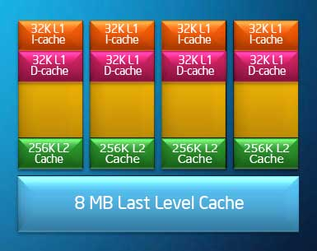
Snoopy Coherence Protocols
Core i7 has 3-levels of caching
  (last) level 3 is shared between all cores
  levels 1 and 2 have to be kept
  coherent by e.g. snooping
Locating an item when a read miss occurs:
  In write-through cache: item is always in (shared) memory
    Note: for a core i7 this can be L3 cache
  In write-back cache, the updated value must be sent to the requesting processor
Cache lines marked as shared or exclusive/modified
  Only writes to shared lines need an invalidate broadcast
    After this, the line is marked as exclusive

Slide 9
Example Snooping protocol (MSI protocol)
3 states for each cache line:
  Invalid, Shared (read only), Modified (also called Exclusive, i.e., you may write it)
FSM (finite state machine) controllers per cache, get requests from processor and bus
Processor
Processor
Processor
Processor
Cache
Cache
Cache
Cache
state of a line
Main memory
I/O System

Slide 10
Snooping Protocol: Write Invalidate
Get exclusive access to a cache block (invalidate all other copies) before writing it
When processor reads an invalid cache block it is forced to fetch a new copy
If two processors attempt to write simultaneously, one of them is first (bus arbitration decides on this).
The other one must obtain a new copy, thereby enforcing serialization
Example: address X in memory initially contains value '0'
Processor activity | Bus activity | Cache CPU A | Cache CPU B | Memory addr. X
 |  |  |  | 0
CPU A reads X | Cache miss for X | 0 |  | 0
CPU B reads X | Cache miss for X | 0 | 0 | 0
CPU A writes 1 to X | Invalidation for X | 1 | invalidated | 0
CPU B reads X | Cache miss for X | 1 | 1 | 1

Slide 11
Basics of Write Invalidate (MSI protocol)
Use the bus to perform invalidates
  Acquire bus access and broadcast the address to be invalidated
    all processors snoop the bus, listening to addresses on this bus
    if the address is in my cache, invalidate my copy
Serialization of bus access enforces write serialization
Where is the most recent value?
  Easy for write-through caches: in the memory (or next cache level)
  For write-back caches, again use snooping
Can use cache tags to implement snooping
  Might interfere with cache accesses coming from CPU
  Duplicate tags, or employ multilevel cache with inclusion
core_{i}
Processor
Cache
Bus
Memory

Slide 12
2 Finite State Machine controllers (per cache)
Processor
Processor
Processor
Processor
FSM 1, dealing
with CPU requests
to the cache
Cache
Cache
Cache
Cache
FSM 2, dealing
with BUS requests
to the cache, snooping
Snoop on this Bus
Memory (or higher level Cache)
Note: in i7 the L3 cache is performing most of the coherency control
  L3 contains e.g. 4 extra bits per cache block, 1 bit / core stating in which core (either in L1 or L2) a (shared) copy of the data is

Slide 13
FSM 1: Snoopy-Cache State Machine-1 (MSI protocol)
CPU Read hit
State machine for CPU requests
updates the state
of accessed cache blocks
Cache Block State can be
  Invalid,
  Shared, or
  Exclusive
CPU can do Read or Write
  can be miss or hit
CPU Read
Shared
(read-only)
Invalid
Place read miss
on bus
CPU Write
CPU Read miss
Place read miss
on bus
CPU read miss
Write back block
Place Write
Miss on bus
CPU Write
Place Write Miss on Bus
CPU read hit
CPU write hit
Exclusive
(read/write)
CPU Write Miss
Write back cache block
Place write miss on bus
Notes:
Invalid:
read => shared
write => dirty
shared looks the same

Slide 14
FSM 2: Snoopy-Cache State Machine-2 (MSI protocol)
State machine for BUS requests
also updates state of
cache blocks
Question:
  looking at diagram,
  how to get out of the
  invalid state?
Write miss
for this block
Invalid
Shared
(read/only)
Write Back
Block; (abort
memory access)
Write Back
Block; (abort
memory access)
Write miss
for this block
Read miss
for this block
Exclusive
(read/write)

Slide 15
Responds to Events Caused by Processor (FSM 1)
Event | State of block in cache | Action
Read hit | shared or exclusive | read data from cache
Read miss | invalid | place read miss on bus
Read miss | shared | wrong block (conflict miss): place read miss on bus
Read miss | exclusive | conflict miss: write back block then place read miss on bus
Write hit | exclusive | write data in cache
Write hit | shared | place write miss on bus (invalidates all other copies)
Write miss | invalid | place write miss on bus
Write miss | shared | conflict miss: place write miss on bus
Write miss | exclusive | conflict miss: write back block, then place write miss on bus

Slide 16
Responds to Events on Bus (FSM 2)
Event | State of addressed cache block | Action
Read miss | shared | No action: memory services read miss
Read miss | exclusive | Attempt to share data: place block on bus and change state to shared
Write miss | shared | Attempt to write: invalidate block
Write miss | exclusive | Another processor attempts to write "my" block: write back the block and invalidate it

Slide 17
Snoopy Coherence Protocols
Complications for the basic MSI (Modified, Shared, Invalid) protocol:
  Operations are not atomic
    E.g. 1) detect miss => 2) acquire bus => 3) receive a response
    Creates possibility of deadlock and races
    One solution: processor that sends invalidate can hold bus until other processors receive the invalidate
Extensions (see Dubois pg 258-260):
  Add Exclusive state (E) to indicate clean block in only one cache (MESI protocol)
    Prevents needing to send invalidate on a write
  Add Owned state (O), used by AMD (MOESI protocol)
    A block can change from M -> O when others will share it, but the block is not written back to memory.
    It is shared by 2 or more processors, but owned by 1. This one is responsible for writing it back (to next level), when needed.

Slide 18
Performance
Coherence influences cache miss rate
  Coherence misses
    True sharing misses
      Write word (at address a) to shared block (transmission of invalidation)
      Read (from same address a) an invalidated block
    False sharing misses
      Read an unmodified word in an invalidated block
      Example:
Same memory data
cached by 2 processors:
4 words, in 2 caches
cache P2
cache P1
written by P2
in its own cache,
at the same block address
- invalidates P1 entry
written by P1
in its own cache
- invalidates P2 entry

Slide 19
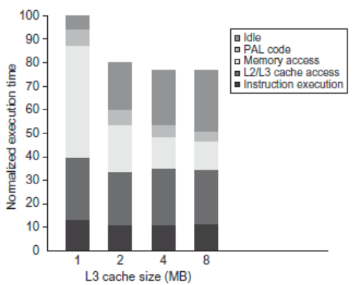
Performance Study: Commercial Workload
8 processors
Multi-processor workload
Performance vs L3 size

Slide 20
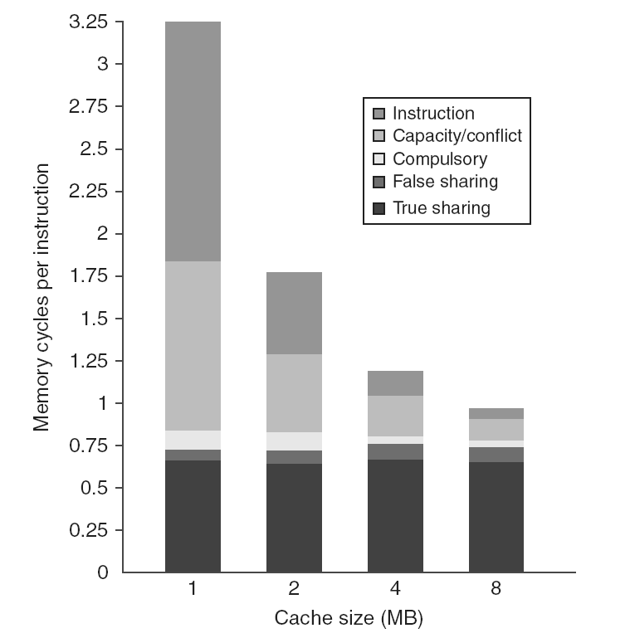
Performance Study: Commercial Workload
Influence of L3 cache size (details): 1 – 8 MB
Fixed # of processors
What do you
observe here?
Notes:
Fig 5.11 H&P. The contributing causes of memory access cycle shift as the cache size is increased. The number of instruction and capacity/conflict misses largely reduce, but not the true and false sharing.
L3 cache is simulated as two-way set associative.

Slide 21
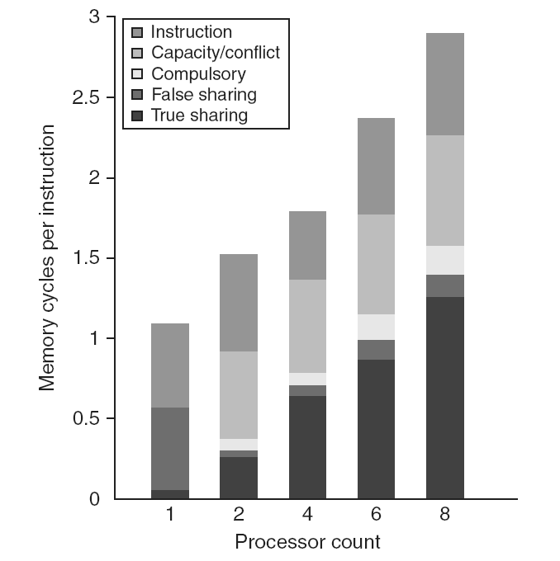
Performance Study: Commercial Workload
Influence of number of cores: 1 - 8
More true sharing
with increasing
number of
processors
Notes:
The contribution to memory access cycles increases as processor count increases primarily due to increased true sharing. The Compulsory misses slightly increase since each processor must now handle more compulsory misses.

Slide 22
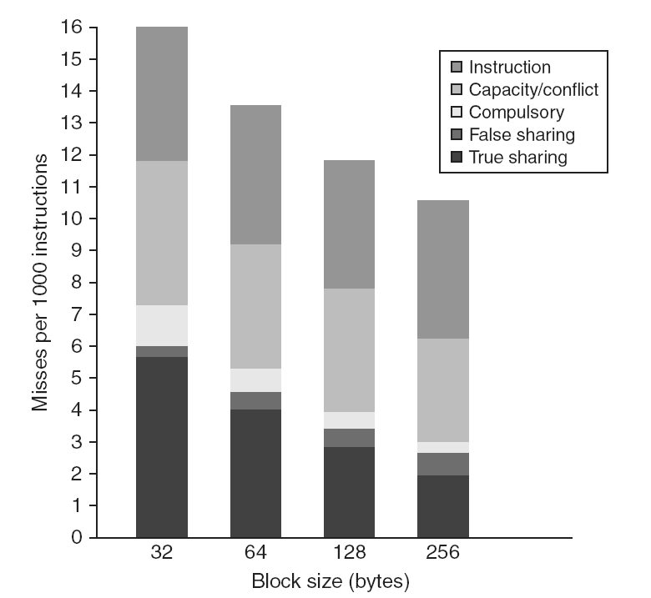
Performance Study: Commercial Workload
Influence of block size: 32 – 256 bytes
Larger blocks are
effective, but
false sharing
increases
Notes:
The number of misses per 1000 instructions drops steadily as the block size of the L3 cache is increased,
making a good case for an L3 block size of at least 128 bytes.
The L3 cache is 2 MB, two-way set associative.

Slide 23
Scalable Coherence Solutions

Slide 24
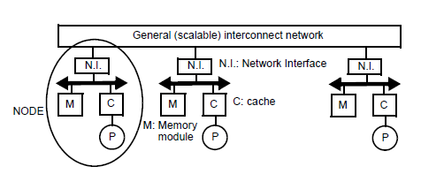
Scalable cache coherence solutions
Bus-based multiprocessors are inherently non-scalable
Scalable cache protocols should keep track of sharers
Solution? ..... see next slides...

Slide 25
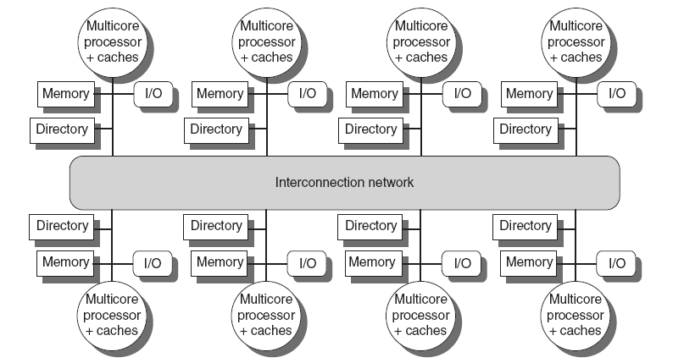
Directory Protocols (H&P 5.4 , Dubois 5.5.1-5.5.2)
Directory keeps track of every block
  Which caches have copies of a certain block
  Dirty status of each block
  Note: all memories are shared
Either: Integrated in shared L3 cache
  Keep bit vector of size =
  # cores for each block in L3
or, Directory implemented
in a distributed fashion
  a directory keeps track of its
  local memory blocks
    in which caches are copies
    of these blocks?
    is the copy dirty?

Slide 26
Directory-based protocols
Directory
Memory

Slide 27
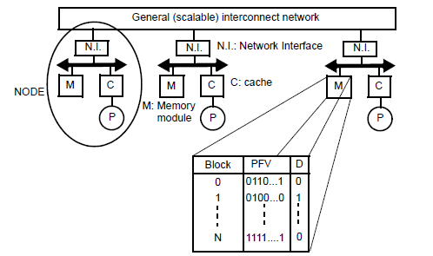
Presence-flag vector scheme, example
Example:
Block 1 is cached by proc. 2 only and is dirty
Block N is cached by all processors and is clean
Let’s consider how the protocol works

Slide 28
cc-NUMA (Non Uniform Memory Arch.) protocols
Use same protocol as for snooping protocols
(e.g. MSI-invalidate, MSI-update, or MESI, etc.)
Protocol agents:
  Home node (h): node where the memory block and its directory entry reside
  Requester node (r): node making the request
  Dirty node (d): node holding the latest, modified copy
  Shared nodes (s): nodes holding a shared copy
Note: Home may be the same node as requester or dirty node

Slide 29
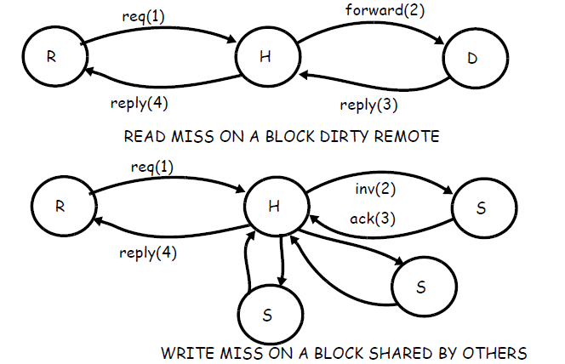
MSI invalidate protocol in cc-NUMAs

Slide 30
MSI invalidate protocol in cc-NUMAs
Note: in MSI-update the transitions are the same except that updates are sent instead of invalidations

Slide 31
Memory requirements of directory protocols
Directory per core
Memory requirement of a presence-flag vector protocol
n processors (nodes)
m memory blocks per node
b block size (in bits)
Size of total directory = m x n²
Directory scales with the square (why?) of number of processors; a scalability concern!
Alternative: limited pointer scheme
Limited pointer protocols: maintain i pointers, each log n bits (instead of n presence flags/entry);
so each entry contains i*log n bits
Memory overhead = size (dir) / (size(memory) + size(dir))
Example: memory overhead for limited pointer scheme:
m x n x i log n / (m x n x b + m x n x i log n) = i log n / (b + i log n)
m Blocks | n Precense bits
1 | 001000000000
..
m | 101100000000
Notes:
Each processor has a directory of size n*m

Slide 32
Three fundamental issues for shared memory multiprocessors
Coherence,
about: Do I see the most recent data?
Synchronization
How to synchronize processes?
  how to protect access to shared data?
Consistency,
about: When do I see a written value?
  e.g. do different processors see writes at the same time (w.r.t. other memory accesses)?

Slide 33
What's the Synchronization problem?
Assume: Computer system of bank has credit process (P_c) and debit process (P_d)
/* Process P_c */ /* Process P_d */
shared int balance shared int balance
private int amount private int amount
balance += amount balance -= amount
lw $t0,balance lw $t2,balance
lw $t1,amount lw $t3,amount
add $t0,$t0,t1 sub $t2,$t2,$t3
sw $t0,balance sw $t2,balance

Slide 34
Critical Section Problem
N processes all competing to use some shared data; they need synchronization
Each process has code segment, called critical section, in which shared data is accessed
Problem – ensure that when one process is executing in its critical section, no other process is allowed to execute in its critical section
Structure of a process:
initial_code () ;
while (TRUE){
entry_critical_section ();
critical_section ();
exit_critical_section ();
remainder_section ();
}
other_code ()

Slide 35
Synchronization
Problem: synchronization protocol requires atomic read-write action on the bus
  e.g. to check a memory bit and if zero, set it (make it one)
Basic building blocks supporting this atomic action:
  Atomic exchange
    Swaps register with memory location
  Test-and-set
    Sets under condition
  Fetch-and-increment
    Reads original value from memory and increments it in memory
All 3 require memory read + write in an 'uninterruptable' instruction
Alternative:
  load linked/store conditional
    If the contents of the memory location specified by the load linked is changed before the store conditional to the same address, the store conditional fails
Register file
Memory
1
  Atomic exchange
0

Slide 36
Implementing Locks (example of EXCH, exchange)
Spin lock
  If no coherence:
ADDUI R2,R0,#1 ;R2=1
lockit: EXCH R2,0(R1) ;atomic exchange (swap): R2 ⬄ Mem[0+R1]
BNEZ R2,lockit ;already locked?
Problem EXCH includes a write, causing snooping traffic (in case of coherence)
How to avoid too much snooping?
lockit: LD R2,0(R1) ;load of lock; first see whether nobody has it
BNEZ R2,lockit ;if not available: spin
ADDUI R2,R0,#1 ;R2=1
EXCH R2,0(R1) ;atomic exchange (swap)
BNEZ R2,lockit ;branch if lock wasn’t 0, access likely succeeds
Next slides shows this protocol in action

Slide 37
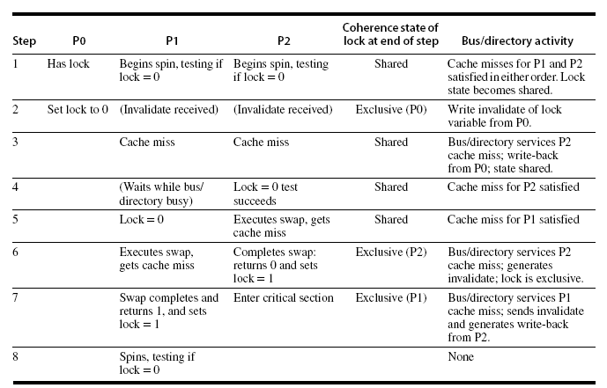
Details on memory traffic when requesting lock
P1 and P2 try at the
same time to acquire
the lock
P0 has lock, and releases it in step 2
  cache entry exclusive
  same entry in other caches invalidated
P2 gains
P1 keeps spinning

Slide 38
Three fundamental issues for shared memory multiprocessors
Coherence,
about: Do I see the most recent data?
Synchronization
How to synchronize processes?
  how to protect access to shared data?
Consistency,
about: When do I see a written value?
  e.g. do different processors see writes at the same time (w.r.t. other memory accesses)?
  see also
    https://www.cs.utexas.edu/~bornholt/post/memory-models.html
    A Primer on Memory Consistency and Cache Coherence
      https://www.morganclaypool.com/doi/abs/10.2200/S00346ED1V01Y201104CAC016

Slide 39
Memory Consistency: What is the problem?
Process P1 | Process P2
A = 0; ... A = 1; L1: if (B==0) ... | B = 0; ... B = 1; L2: if (A==0) ...
Educative
example
Observation: If writes take effect immediately (are immediately seen by all processors), it is impossible that both if-statements evaluate to true
But what if write invalidate is delayed ……….
  E.g., when write is still in the write buffer (and not send to cache/memory)
  Should this be allowed, and if so, under what conditions?

Slide 40
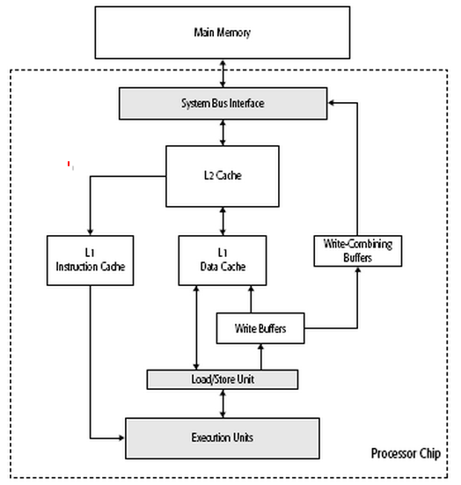
Write buffer
Process P1 | Process P2
A = 0; ... A = 1; L1: if (B==0) .. | B = 0; ... B = 1; L2: if (A==0)..

Slide 41
Sequential Consistency
Sequential consistency = All processors see all memory accesses in the same order
How to achieve this?
Delay the completion of any memory access until all invalidations caused by that access are completed
Delay next memory access until previous one is completed
  delay the read of A and B (A==0 or B==0 in the example)
  until the write has finished (A=1 or B=1)
Note: Under sequential consistency, we cannot place
the (local) write in a write buffer and continue

Slide 42
Cost of Sequential Consistency (SC)
Enforcing SC can be quite expensive; assume:
  write miss and get ownership = 40 cycles
  issue an invalidate = 10 cycles
  complete and get acknowledgement = 50 cycles
  Assume 4 processors share a cache block, how long does a write miss take for the writing processor if the processor is sequentially consistent?
Waiting for invalidates : each write = sum of ownership time + time to complete invalidates
  cycles to issue invalidate = 10+10+10+10= 40
  40 cycles to get ownership + 50 cycles to complete
  => 130 cycles ➔very long !
Solutions:
  Exploit latency-hiding techniques, and/or
  Employ relaxed consistency

Slide 43
Sequential Consistency overkill?
Schemes for faster execution then sequential consistency
Observation: Most programs are synchronized
  A program is synchronized if all accesses to shared data are ordered by synchronization operations
Example:
  P1
  write (x)
  ...
  release (s) {unlock}
  ...
  P2
  acquire (s) {lock}
  ...
  read(x)
ordered

Slide 44
Relaxed Memory Consistency Models
Key: (partially) allow reads and writes to complete out-of-order
Orderings that can be relaxed:
  relax W ⇒ R ordering
    allows reads to bypass earlier writes (to different memory locations)
    called processor consistency or total store ordering
  relax W ⇒ W
    allow writes to bypass earlier writes
    called partial store order
  relax R ⇒ W and R ⇒ R
    weak ordering, release consistency, Alpha, PowerPC
Note, sequential consistency means:
  W ⇒ R, W ⇒ W, R ⇒ W, and R ⇒ R

Slide 45
Relaxed Consistency Models
Consistency model is multiprocessor specific
Programmers will often implement explicit synchronization
For superscalar processors: Speculation gives much of the performance advantage of relaxed models with sequential consistency
Basic idea of speculation recovery:
  exploit the recovery mechanism of the reorder buffer
  e.g. a load happens; assume a hit in a local cache
  (entry has not (yet) been invalidated)
    use result of this load by following instructions
  as long as this load is in the reorder buffer:
  if a coherence invalidation arrives for this result
  that has not been committed, we can use
  speculation recovery, i.e. redo the load and
  all following instructions
Processor
Processor
Processor
Processor
Cache
Cache
Cache
Cache
Main memory
I/O System

Slide 46

Shared memory is conceptually easy but requires solutions
for the following 3 issues:
  Coherence
    problem caused if copies of data in system exist (caches)
    even in single processor system with DMA the problem exists
    Snooping for small systems
    Directory based protocols for large systems
    Hybrid (Snooping + Directory) is also possible
    Many protocol variations exist
  Synchronization
    requires atomic read/write access operations to memory, like
      exchange, test-and-set, ...
    or use a load-linked / store-conditional scheme
  Consistency
    sequential the most costly, but easiest for reasoning about your programs
      makes write buffer largely useless
    relaxed models used in practice (i.e. ignore certain orderings)

Slide 47
Extra slides about:
Coherence vs Consistency
Reducing latency in directory protocols
Other scalable protocols
Hierarchical systems

Slide 48
Coherence vs Consistency
Coherence
  All reads by any processor must return the most recently written value
  Writes to the same location by any two processors are seen in the same order by all processors
Consistency
  It’s about the observed order of reads and writes to different locations by the different processors
    is this order for every processor the same?
  At least should be valid:
  If a processor writes location A followed by a write to location B, any processor that sees the new value of B must also see the new value of A

Slide 49
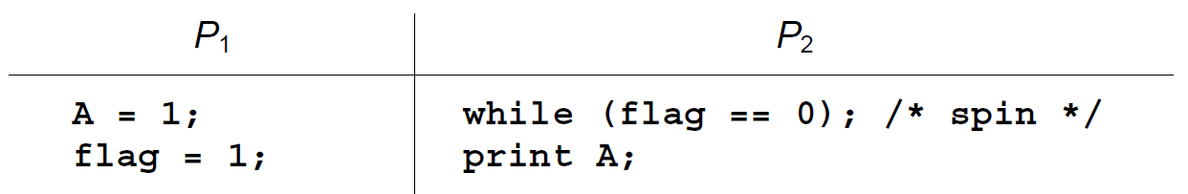
Coherence vs Consistency Question:
Assume: Two processors are synchronizing on a variable called flag.
  Assume A and flag are both initialized to 0
What value do you expect to be printed?
What can go wrong?
Is this a coherence problem?
Is this a consistency problem?
For the experts: Sorin, Daniel J; Hill, Mark D; Wood, David A: A Primer on Memory Consistency and Cache Coherence, Morgan & Claypool, 2011

Slide 50
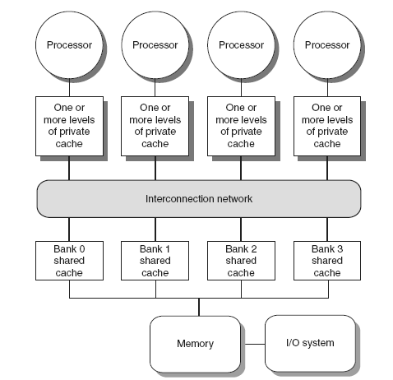
Coherence Protocols: More Extensions for Snooping
Shared memory bus and snooping bandwidth is bottleneck for scaling symmetric multiprocessors
Improvements:
  Duplicating tags
    both FSMs can access them in parallel
  Place directory in outermost cache
    it keeps track of state of cache lines
  Use crossbars or point-to-point networks with banked memory

Slide 51
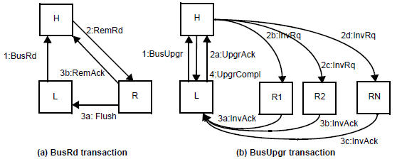
Reducing latencies in directory protocols
Baseline directory protocol invokes 4 hops (in worst case) on a remote miss.
Optimizations are possible (Dubois pg 282-283):
Request is sent to home
Home redirects the request to remote
Remote responds directly to local
Local notifies home (off the critical access path)

Slide 52
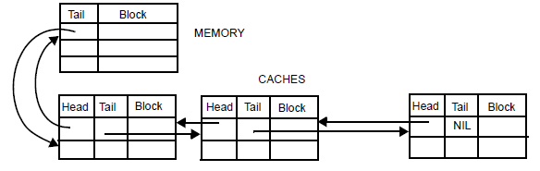
Other scalable protocols
Coarse vector scheme
    Presence flags identify groups rather than individual nodes
Directory cache
  Directory overhead is proportional to dir. Cache size instead of main memory size (leveraging locality)
Cache-centric schemes: Make overhead proportional to (private) cache size instead of memory
Example: Scalable Coherent Interface (SCI)

Slide 53
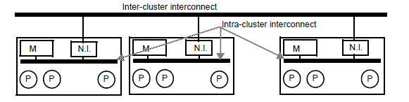
Hierarchical systems
Instead of scaling in a flat configuration we can form clusters in a hierarchical organization
  Relevant inside as well as across chip-multiprocessors
Coherence options:
  Intra-cluster coherence: snoopy/directory
  Inter-cluster coherence: snoopy/directory
  Tradeoffs affect memory overhead and performance to maintain coherence

