Slide 1
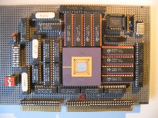
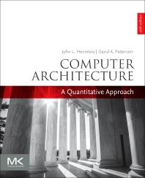
Embedded Computer Architecture 5SAI0 DLP Architectures Vector, SIMD, GPU
Henk Corporaal
www.ics.ele.tue.nl/~heco/courses/ECA
h.corporaal@tue.nl
TUEindhoven
2021-2022

Slide 2
Today’s program:
Data-level parallel architectures
Vector machine
SIMD (Single Instruction Multiple Data) processors
sub-word parallelism support
GPU (Graphic Processing Unit); see earlier slides
Material:
Book of Hennessy & Patterson
Study: Chapter 4: 4.1-4.7
(extra material: app G: vector processors)

Slide 3
Data Parallelism
A = b * C + D
Vector operations, e.g.:
Multiple data elements per operation, e.g.
ADDV V1, V2, V3 // forall i: V1[i] = V2[i]+V3[i]
Executed using either
Vector archtitecture: highly pipelined (fast clocked) FU (function unit)
SIMD: multiple FUs acting in parallel
add
or
add
add
add
add
add
add
add
add
add
time
add
add
add
add
add
SIMD architecture
add
add
add
add
Vector architecture

Slide 4
Intermezzo: SIMD vs MIMD
SIMD architectures can exploit significant data-level parallelism for:
matrix-oriented: scientific computing
media-oriented: image, video and sound processors
SIMD is more energy efficient than MIMD
Needs to fetch and decode only one instruction per data operation
Makes SIMD attractive for personal mobile devices
SIMD allows programmer to continue to think sequentially
MIMD is more generic: why?

Slide 5
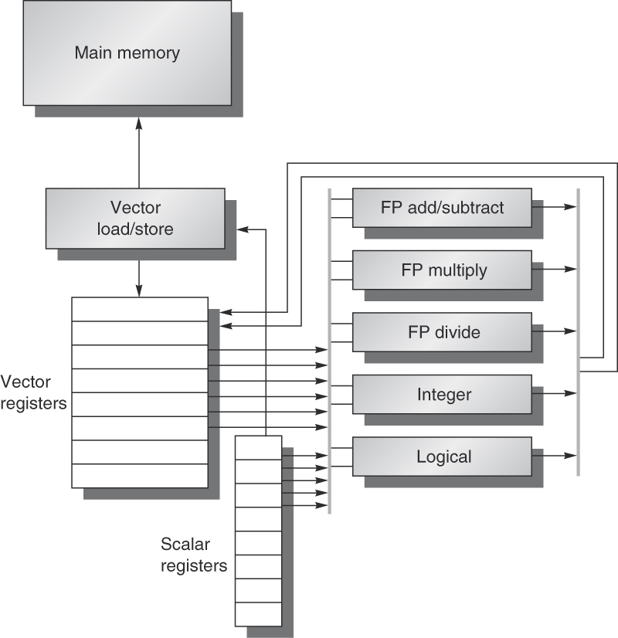
Vector Architecture
Basic idea:
Read sets of data elements into “vector registers”
Operate on those registers
Disperse the results back into memory
Registers are controlled by compiler
Used to hide memory latency
by loading data early (many cycles before their use)
Leverage memory bandwidth

Slide 6
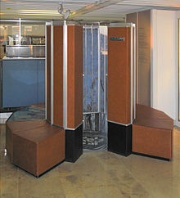
Example architecture: VMIPS
Loosely based on Cray-1
Vector registers
Each register holds a 64-element, 64 bits/element vector
Register file has 16 read- and 8 write-ports
Vector functional units
Fully pipelined; Data and control hazards are detected
Vector load-store unit
Fully pipelined; One word per clock cycle after initial latency
Scalar registers
32 general-purpose registers+ 32 floating-point registers
Cray-1 1976

Slide 7
VMIPS Instructions
ADDVV.D: add two vectors (of Doubles)
ADDVS.D: add vector to a scalar (Doubles)
LV/SV: vector load and vector store from address
Example: DAXPY ((double) Y=a*X+Y), inner loop of Linpack
L.D F0,a ; load scalar a
LV V1,Rx ; load vector X
MULVS.D V2,V1,F0 ; vector-scalar multiply
LV V3,Ry ; load vector Y
ADDVV V4,V2,V3 ; add
SV Ry,V4 ; store the result
Requires 6 instructions vs. almost 600 for MIPS

Slide 8
Vector Execution Time
Execution time depends on three factors:
Length of operand vectors
Structural hazards
Data dependencies
VMIPS functional units consume one element per clock cycle
Execution time is approximately the vector length (VL): Texec ~ VL
Convoy
Set of vector instructions that could potentially execute together

Slide 9
Chimes
Sequences with read-after-write dependency hazards can be in the same convey via chaining
Chaining
Allows a vector operation to start as soon as the individual elements of its vector source operand become available
Chime
Unit of time to execute one convoy
m convoys executes in m chimes
For VL=n, requires m x n clock cycles (+ pipeline filling latency)

Slide 10
Example
LV V1,Rx ;load vector X
MULVS.D V2,V1,F0 ;vector-scalar multiply
LV V3,Ry ;load vector Y
ADDVV.D V4,V2,V3 ;add two vectors
SV Ry,V4 ;store the sum
Convoys:
1 LV -> MULVS.D
2 LV -> ADDVV.D
3 SV
3 chimes, 2 FP ops per result, cycles per FLOP = 1.5
For 64 element vectors, requires 64 x 3 = 192 clock cycles
Question: why not combining Convoys 2 and 3 into one?

Slide 11
Challenges
Start up time:
Latency of vector functional unit
Assume the same as Cray-1
Floating-point add => 6 clock cycles
Floating-point multiply => 7 clock cycles
Floating-point divide => 20 clock cycles
Vector load => 12 clock cycles
Improvements:
more than 1 element per clock cycle
Non-64 wide vectors
IF-statements in vector code
Memory system optimizations to support vector processors
Support for
multiple dimensional matrices
Sparse matrices

Slide 12
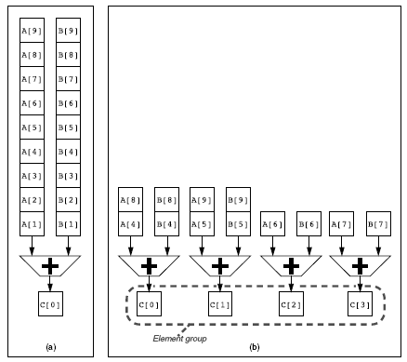
SIMD: Multiple Lanes
a) single lane
b) 4 lanes; vector elements are interleaved !

Slide 13
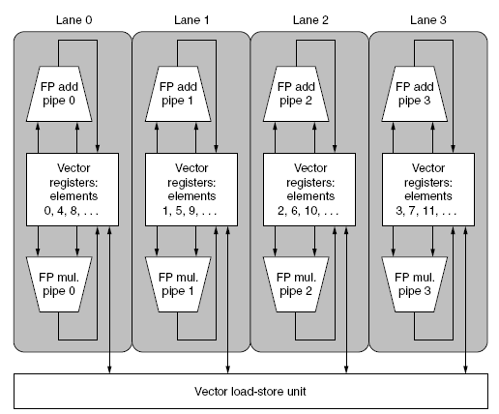
SIMD: Multiple lanes structure
4 lanes
4 vector units: ADD, MUL, LD-ST
Not shown: scalar processor can broadcast a scalar to all vector units

Slide 14
Memory Banks, supporting multiple load/stores/cycle
to/from load-store units
interconnect, connecting banks to ld-st ports
bank 0
bank 1
bank 2
bank N-1
Memory banks are (usually) single ported (1 rd/wr port)
To the load-store units this memory system looks multi-ported except for bank conflicts

Slide 15
Memory Banks
Memory system must be designed to support high bandwidth for vectors
Spread accesses across multiple banks
Control bank addresses independently
Support multiple vector processors sharing the same memory
Example:
32 processors, each generating 2 loads and 1 stores/cycle
Processor cycle time is 2 ns, SRAM cycle time is 10 ns
How many memory banks needed?
Answer: think about how many accesses are needed in 10 ns !
Nr_accesses/10ns =3 * 32 * 10/2 = 480 !!
How to improve this?

Slide 16
Vector Length Register / Strip mining
Vector length not known at compile time? => Use Vector Length Register (VL)
Use strip mining for vectors over the maximum length:
low = 0;
VL = (n % MVL); /*find odd-size piece using modulo % */
for (j = 0; j <= (n/MVL); j=j+1) { /*outer loop*/
for (i = low; i < (low+VL); i=i+1) /*runs for length VL*/
Y[i] = a * X[i] + Y[i] ; /*main operation*/
low = low + VL; /*start next vector*/
VL = MVL; /*reset length to maximum vector length*/
}
Execution order:
Example:
n = 200
MVL = 64
n%MVL = 8

Slide 17
Vector Mask Registers: handling If-statements
Consider:
for (i = 0; i < 64; i=i+1)
if (X[i] != 0)
X[i] = X[i] – Y[i];
Use vector mask register, VM, to “disable” elements:
LV V1,Rx ;load vector X into V1
LV V2,Ry ;load vector Y
L.D F0,#0 ;load FP zero into F0
SNEVS.D V1,F0 ;sets VM(i) to 1 if V1(i)!= F0
SUBVV.D V1,V1,V2 ;subtract under vector mask
SV Rx,V1 ;store the result in X
Q: GFLOPS rate decreases! Why???
Compare to GPU solution (coming Wednesday)

Slide 18
Stride (see App G)
Consider matrix multiplication: A=B*D
for (i = 0; i < 100; i=i+1)
for (j = 0; j < 100; j=j+1) {
A[i][j] = 0.0;
for (k = 0; k < 100; k=k+1)
A[i][j] = A[i][j] + B[i][k] * D[k][j];
}
Must vectorize multiplication of rows of B with columns of D
Need non-unit stride
for either B or D, depending on row-major vs column-major element ordening in memory
j
D
A
B
i,j
=
i
*

Slide 19
Stride: possible Bank Conflicts
Bank conflict (stall) occurs when the same bank is hit faster than bank busy time:
LCM(stride, N_banks) / Stride < bank busy time
where LCM = least common multiple
Example:
E.g. stride = 6, 16 banks, you hit bank 0, 6, 12, 2, 8, 14, 4, 10, 0, 6, …. etc.;
You hit the same bank after LCM(6,16)/6 = 48/6 = 8 cycles.
If busy time > 8 cycles you have to wait

Slide 20
Stride example
8 memory banks, busy time 6 cycles, memory latency 12 cycles
Q: how long does it take to complete a 64-element vector load
with stride 1
with stride 32
Answers
stride 1: 12+64 = 76 cycles (= 1.2 cycles/element)
stride 32: Since 32 = 4*8, every access goes to the same bank ! Every access after the first has to wait the 6 cycles busy time => 12+1+6*63 = 391 cycles (=6.1 cycles/element)
0
1
13
14
15
12
cycle

Slide 21
Scatter-Gather: Indirect Vector Access
for (i = 0; i < n; i=i+1)
A[K[i]] = A[K[i]] + C[M[i]]; indirect memory accesses
Use index vector to load e.g. only the non-zero elements of A into vector Va:
LV Vk, Rk ;load K
LVI Va, (Ra+Vk) ;load A[K[]]
LV Vm, Rm ;load M
LVI Vc, (Rc+Vm) ;load C[M[]]
ADDVV.D Va, Va, Vc ;add them
SVI (Ra+Vk), Va ;store A[K[]]

Slide 22
SIMD architecture exploiting Sub-word Parallelism
Divide word into multiple parts (sub-words) and perform operations on these parts in parallel
E.g VectorAdd of 16 parallel Adds:
+

Slide 23
SIMD Implementations
Implementations:
Intel MMX (1996)
Eight 8-bit integer ops or four 16-bit integer ops
Streaming SIMD Extensions (SSE, 1999)
Eight 16-bit integer ops
Four 32-bit integer/fp ops or two 64-bit integer/fp ops
Advanced Vector Extensions (AVE, 2010)
Four 64-bit integer/fp ops
Operands must be consecutive and aligned memory locations

Slide 24
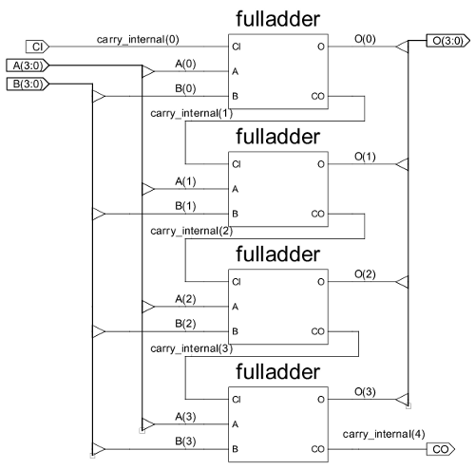
SIMD Extensions
Media applications operate on data types narrower than the native word size
Example: disconnect carry chains to “partition” adder
Limitations, compared to vector instructions:
Number of data operands encoded into op code
No sophisticated addressing modes (strided, scatter-gather)
No mask registers

Slide 25
Example SIMD Code: DXPY: (double) Y = a×X + Y
L.D F0,a ;load scalar a
MOV F1, F0 ;copy a into F1 for SIMD MUL
MOV F2, F0 ;copy a into F2 for SIMD MUL
MOV F3, F0 ;copy a into F3 for SIMD MUL
DADDIU R4,Rx,#512 ;final address to load
Loop:
L.4D F4,0[Rx] ;load X[i], X[i+1], X[i+2], X[i+3]
MUL.4D F4,F4,F0 ;a×X[i],a×X[i+1],a×X[i+2],a×X[i+3]
L.4D F8,0[Ry] ;load Y[i], Y[i+1], Y[i+2], Y[i+3]
ADD.4D F8,F8,F4 ;a×X[i]+Y[i], ..., a×X[i+3]+Y[i+3]
S.4D 0[Ry],F8 ;store in Y[i],Y[i+1],Y[i+2],Y[i+3]
DADDIU Rx,Rx,#32 ;increment index to X
DADDIU Ry,Ry,#32 ;increment index to Y
DSUBU R20,R4,Rx ;compute bound
BNEZ R20,Loop ;check if done
Note: today we typically use separate vector registers instead of multiple scalars, as in above example!!
Vector
operations

Slide 26
Performance model
What is peak performance of an architecture?
compute limited?
or, memory bandwidth limited?

Slide 27
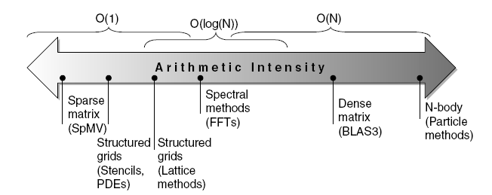
Roofline Performance Model
Basic idea:
Plot peak floating-point throughput as a function of arithmetic intensity
Ties together floating-point performance and memory performance for a target machine
Arithmetic intensity =
Floating-point operations per byte read from memory

Slide 28
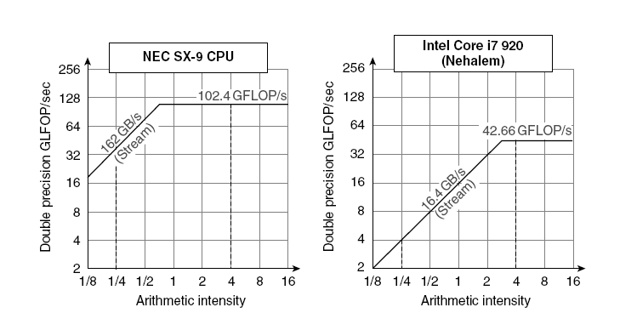
Examples
Max GFLOPs/sec = Min (Peak Memory BW × Arithmetic Intensity, Peak Fl.Point Perf.)
NEC SX-9: vector processor (2008)

Slide 29
Concluding remarks
Amount of ILP in general programs limited
However, often plenty of DLP, data-level parallelism
Signal processing, Video, Imaging, Deep Learning, etc.
Vector, SIMD and GPU architectures support DLP
used by almost any architecture (e.g. as sub-word parallelism)
GPUs become mainstream in many platforms, from mobile to supercomputers
new SIMT programming model: supported by CUDA and OpenCL
However:
CPU-GPU transfer bottleneck (traffic over PCI bus)
Solution: Unified physical memories for CPU and GPU
Q: Clearly explain the differences between Vector, SIMD, and GPU?
Q: Interpret the different Rooflines

