Slide 1
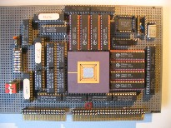
Embedded Computer Architecture 5SAI0 Instruction Level Parallel Architectures Part I
Henk Corporaal
www.ics.ele.tue.nl/~heco/courses/ECA
TUEindhoven
2021-2022

Slide 2
Topics on ILP architectures
Introduction, Hazards (short recap)
Out-Of-Order (OoO) execution (H&P sect 3.4-3.6):
Dependences limit ILP: dynamic scheduling
Hardware speculation
Branch prediction (H&P sect 3.6 + 3.9)
Multiple issue (H&P sect 3.7-3.8)
How much ILP is there?
Material Ch 3 (H&P or Dubois, second part)

Slide 3
What is ILP = Instruction level parallelism
multiple operations (or instructions) can be executed in parallel, from a single instruction stream
so we are not yet talking about MIMD, multiple instruction streams
Needed:
Sufficient (HW) resources
Parallel scheduling
Hardware solution
Software solution
Application should contain sufficient ILP

Slide 4
Single Issue RISC vs Superscalar
instr
op
instr
op
instr
op
instr
op
instr
op
instr
op
instr
op
instr
op
instr
op
instr
op
instr
op
Change HW,
but can use
same code
instr
op
instr
op
instr
op
instr
op
instr
op
instr
op
instr
op
instr
op
instr
op
instr
op
instr
op
instr
op
instr
op
execute
1 instr/cycle
issue and (try to) execute
3 instr/cycle
3-issue Superscalar
(1-issue)
RISC CPU

Slide 5
Recap (from pipelining lectures): Hazards
Three types of hazards (see previous lecture)
Structural
Multiple instructions need access to the same hardware at the same time
Data dependence
There is a dependence between operands (in register or memory) of successive instructions
Control dependence
Determines the order of the execution of basic blocks
When jumping/branching to another address the pipeline has to be (partly) squashed and refilled
Hazards cause scheduling problems and delay the pipeline

Slide 6
Impact of Hazards
Hazards cause pipeline 'bubbles' Increase of CPI (and therefore execution time)
T_{exec} = N_{instr} * CPI * T_{cycle}
where
CPI = CPI_{base} + Σ_{i} <CPI_{hazard_i}>
<CPI_{hazard}> = f_{hazard} * <Cycle_penalty_{hazard}>
f_{hazard} = fraction [0..1] of occurrence of this hazard

Slide 7
Data dependences (see earlier lectures for details & examples)
RaW read after write
real or flow dependence
can only be avoided by value prediction (i.e. speculating on the outcome of a previous operation)
WaR write after read
WaW write after write
WaR and WaW are false or name dependencies
Could be avoided by renaming (if sufficient registers are available); see later slide
Notes:
data dependences can be both between registers and memory data operations
data dependencies are shown in de DDG: Data Dependence Graph

Slide 8
Control Dependences: CFG
C input code:
1
sub t1, a, b
bgz t1, 2, 3
CFG (Control Flow Graph):
if (a > b) { r = a % b; }
else { r = b % a; }
y = a*b;
2
rem r, a, b
goto 4
3
rem r, b, a
goto 4
4
mul y,a,b
…………..
Questions:
How real are control dependences?
Can ‘mul y,a,b’ be moved to block 2, 3 or even block 1?
Can ‘rem r, a, b’ be moved to block 1 and executed speculatively?

Slide 9
Avoiding pipeline stalls due to Hazards
Structural
Buy more hardware
Extra units, pipelined units, more ports on RF and data memory (or banked memories), etc.
Note: more HW means bigger chip => could increase cycle time t_{cycle}
Data dependence
Real (RaW) dependences: add Forwarding (aka Bypassing) logic
Compiler optimizations
False (WaR & WaW) dependences: use renaming (either in HW or in SW)
Control dependence
Adding extra pipeline HW to reduce the number of Branch delay slots
Branch prediction
Avoiding Branches

Slide 10
Topics on ILP architectures
Introduction, Hazards (short recap)
Out-Of-Order (OoO) execution:
Dependences limit ILP: dynamic scheduling
Hardware speculation
Branch prediction
Multiple issue
How much ILP is there?
Material Ch 3 (H&P or Dubois, second part)

Slide 11
Let's look at Out-of-Order execution:
Dynamic Scheduling

Slide 12
Dynamic Scheduling Principle
What we examined so far is static scheduling
Compiler reorders instructions so as to avoid hazards and reduce stalls
Dynamic scheduling: hardware rearranges instruction execution to reduce stalls
Example:
DIV.D F0,F2,F4 ; takes 24 cycles and
; is not pipelined
ADD.D F10,F0,F8
SUB.D F12,F8,F14
Key idea: Allow instructions behind stall to proceed
Book describes Tomasulo algorithm in detail, but we first describe general idea
RaW; real dependence
This instruction cannot continue
even though it does not depend
on previous Div and Add

Slide 13
Advantages of Dynamic Scheduling (compared to static scheduling, by compiler)
Handles cases when dependences are unknown at compile time
e.g., because they may involve a memory reference
Simplifies the compiler (although a good compiler helps)
Binary compatible: Allows code compiled for one machine to run efficiently on a different machine, with different number of function units (FUs), and different pipelining
Allows hardware speculation, a technique with significant performance advantages, that builds on dynamic scheduling
Speculation = Doing something early, before you know it is really needed
In processing: Executing instructions before control dependend branch is handled
i.e., we speculate on the branch outcome

Slide 14
Superscalar: General Architecture Concept
Instruction
Memory
Instruction
Instruction
Cache
N = issue rate
Decoder
N
Reservation Stations
Branch
Unit
ALU-1
ALU-2
Logic &
Shift
Load
Unit
Store
Unit
Address
Data
Cache
Reorder
Buffer
Data
Data
Register
File
Data
Memory

Slide 15
Example of Superscalar Execution
Superscalar processor organization, example:
simple pipeline: IF, EX, WB
fetches/issues upto 2 instructions each cycle (= 2-issue)
2 ld/st units, dual-ported memory; 2 FP adders; 1 FP multiplier
Instruction window (buffer between IF and EX stage) is of size 2
FP ld/st takes 1 cc; FP +/- takes 2 cc; FP * takes 4 cc; FP / takes 8 cc
Cycle 1 2 3 4 5 6 7
L.D F6,32(R2)
L.D F2,48(R3)
MUL.D F0,F2,F4
SUB.D F8,F2,F6
DIV.D F10,F0,F6
ADD.D F6,F8,F2
MUL.D F12,F2,F4

Slide 16
Example of Superscalar Processor Execution
Superscalar processor organization:
simple pipeline: IF, EX, WB
fetches 2 instructions each cycle
2 ld/st units, dual-ported memory; 2 FP adders; 1 FP multiplier
Instruction window (buffer between IF and EX stage) is of size 2
FP ld/st takes 1 cc; FP +/- takes 2 cc; FP * takes 4 cc; FP / takes 8 cc
Cycle 1 2 3 4 5 6 7
L.D F6,32(R2) IF
L.D F2,48(R3) IF
MUL.D F0,F2,F4
SUB.D F8,F2,F6
DIV.D F10,F0,F6
ADD.D F6,F8,F2
MUL.D F12,F2,F4

Slide 17
Example of Superscalar Processor Execution
Superscalar processor organization:
simple pipeline: IF, EX, WB
fetches 2 instructions each cycle
2 ld/st units, dual-ported memory; 2 FP adders; 1 FP multiplier
Instruction window (buffer between IF and EX stage) is of size 2
FP ld/st takes 1 cc; FP +/- takes 2 cc; FP * takes 4 cc; FP / takes 8 cc
Cycle 1 2 3 4 5 6 7
L.D F6,32(R2) IF EX
L.D F2,48(R3) IF EX
MUL.D F0,F2,F4 IF
SUB.D F8,F2,F6 IF
DIV.D F10,F0,F6
ADD.D F6,F8,F2
MUL.D F12,F2,F4

Slide 18
Example of Superscalar Processor Execution
Superscalar processor organization:
simple pipeline: IF, EX, WB
fetches 2 instructions each cycle
2 ld/st units, dual-ported memory; 2 FP adders; 1 FP multiplier
Instruction window (buffer between IF and EX stage) is of size 2
FP ld/st takes 1 cc; FP +/- takes 2 cc; FP * takes 4 cc; FP / takes 8 cc
Cycle 1 2 3 4 5 6 7
L.D F6,32(R2) IF EX WB
L.D F2,48(R3) IF EX WB
MUL.D F0,F2,F4 IF EX
SUB.D F8,F2,F6 IF EX
DIV.D F10,F0,F6 IF
ADD.D F6,F8,F2 IF
MUL.D F12,F2,F4

Slide 19
Example of Superscalar Processor Execution
Superscalar processor organization:
simple pipeline: IF, EX, WB
fetches 2 instructions each cycle
2 ld/st units, dual-ported memory; 2 FP adders; 1 FP multiplier
Instruction window (buffer between IF and EX stage) is of size 2
FP ld/st takes 1 cc; FP +/- takes 2 cc; FP * takes 4 cc; FP / takes 8 cc
Cycle 1 2 3 4 5 6 7
L.D F6,32(R2) IF EX WB
L.D F2,48(R3) IF EX WB
MUL.D F0,F2,F4 IF EX EX
SUB.D F8,F2,F6 IF EX EX
DIV.D F10,F0,F6 IF
ADD.D F6,F8,F2 IF
MUL.D F12,F2,F4
stall because
of data dep.
cannot be fetched because window full

Slide 20
Example of Superscalar Processor Execution
Superscalar processor organization:
simple pipeline: IF, EX, WB
fetches 2 instructions each cycle
2 ld/st units, dual-ported memory; 2 FP adders; 1 FP multiplier
Instruction window (buffer between IF and EX stage) is of size 2
FP ld/st takes 1 cc; FP +/- takes 2 cc; FP * takes 4 cc; FP / takes 8 cc
Cycle 1 2 3 4 5 6 7
L.D F6,32(R2) IF EX WB
L.D F2,48(R3) IF EX WB
MUL.D F0,F2,F4 IF EX EX EX
SUB.D F8,F2,F6 IF EX EX WB
DIV.D F10,F0,F6 IF
ADD.D F6,F8,F2 IF EX
MUL.D F12,F2,F4 IF

Slide 21
Example of Superscalar Processor Execution
Superscalar processor organization:
simple pipeline: IF, EX, WB
fetches 2 instructions each cycle
2 ld/st units, dual-ported memory; 2 FP adders; 1 FP multiplier
Instruction window (buffer between IF and EX stage) is of size 2
FP ld/st takes 1 cc; FP +/- takes 2 cc; FP * takes 4 cc; FP / takes 8 cc
Cycle 1 2 3 4 5 6 7
L.D F6,32(R2) IF EX WB
L.D F2,48(R3) IF EX WB
MUL.D F0,F2,F4 IF EX EX EX EX
SUB.D F8,F2,F6 IF EX EX WB
DIV.D F10,F0,F6 IF
ADD.D F6,F8,F2 IF EX EX
MUL.D F12,F2,F4 IF
cannot execute
structural hazard

Slide 22
Example of Superscalar Processor Execution
Superscalar processor organization:
simple pipeline: IF, EX, WB
fetches 2 instructions each cycle
2 ld/st units, dual-ported memory; 2 FP adders; 1 FP multiplier
Instruction window (buffer between IF and EX stage) is of size 2
FP ld/st takes 1 cc; FP +/- takes 2 cc; FP * takes 4 cc; FP / takes 8 cc
Cycle 1 2 3 4 5 6 7
L.D F6,32(R2) IF EX WB
L.D F2,48(R3) IF EX WB
MUL.D F0,F2,F4 IF EX EX EX EX WB
SUB.D F8,F2,F6 IF EX EX WB
DIV.D F10,F0,F6 IF EX
ADD.D F6,F8,F2 IF EX EX WB
MUL.D F12,F2,F4 IF ?

Slide 23
Superscalar: General Architecture Concept
Instruction
Memory
Instruction
Instruction
Cache
N = issue rate
Decoder
N
Reservation Stations
Branch
Unit
ALU-1
ALU-2
Logic &
Shift
Load
Unit
Store
Unit
Address
Data
Cache
Reorder
Buffer
Data
Data
Register
File
Data
Memory

Slide 24
Superscalar Issues
How to fetch multiple instructions in time? (especially across basic block boundaries)
Predicting branches
Non-blocking memory system
Tune #resources(#FUs, #ports on RF, Ld/St capacity, #entries, etc.)
Handling dependencies
How to support precise interrupts?
How to recover from a mis-predicted branch path?
For the latter two issues you may wish to look at speculative and architectural state ,
Processor Microarchitecture by Antonio González e.a., Morgan&Claypool 2011
Superscalar Microprocessor Design, Mike Johnson, 1991 (or thesis 1989)

Slide 25
Beginning of dynamic scheduling
1967 @ IBM
Robert Tomasulo
Dynamic scheduling of Floating Point operations on multiple execution units
Allowing Out-Of-Order execution
Register renaming in HW
Only a few architectural visible Floating Point registers were available
Renaming extends this number (although not architectural visible)
Reservation stations in front of Execution Units
CDB: Common Data Bus for all result broadcasts
see https://en.wikipedia.org/wiki/Tomasulo_algorithm

Slide 26
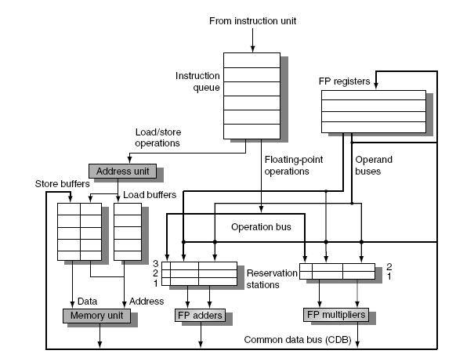
Tomasulo’s Algorithm
Top-level design:
Note: Load and Store buffers contain data and addresses, act like reservation stations

Slide 27
Tomasulo’s Algorithm
3 basic steps:
Issue
Get next instruction from FIFO queue
If available RS (reservation station), issue instruction to the RS, with operand values if they are available
If operand values not available, stall the instruction
Execute
When operand becomes available, store it in all reservation stations waiting for it
When all operands are ready, issue the instruction
Loads and stores are maintained in program order
No instruction allowed to initiate execution until all earlier branches (that precede it in program order) have completed
Write result
Write result on CDB into reservation stations and store buffers
(Stores must wait until address and value are received)

Slide 28
Register Renaming: general idea
Example, look at F6:
DIV.D F0, F2, F4
ADD.D F6, F0, F8
S.D F6, 0(R1)
SUB.D F8, F10, F14
MUL.D F6, F10, F8
False (aka “name”) dependences with F6
anti: WaR and
output: WaW in this example
F6: RaW
F6: WaR
F6: WaW
Question: how can this code (optimally) be executed?

Slide 29
Register Renaming Technique
Eliminate name/false dependencies:
anti- (WaR) and output (WaW)) dependencies
Can be implemented
by the compiler
advantage: low cost
disadvantage: “old” codes perform poorly
by hardware
advantage: binary compatibility
disadvantage: extra hardware needed

Slide 30
Register Renaming by HW
Original code:
DIV.D F0, F2, F4
ADD.D F6, F0, F8
S.D F6, 0(R1)
SUB.D F8, F10, F14
MUL.D F6, F10, F8
Same example after renaming:
DIV.D R, F2, F4
ADD.D S, R, F8
S.D S, 0(R1)
SUB.D T, F10, F14
MUL.D U, F10, T
Each destination gets a new (physical) register assigned
Now only RaW hazards remain, which can be strictly ordered
We will see several HW implementations of Register Renaming
use ReOrder Buffer (ROB) & Reservation Stations, or
use large register file with mapping table

Slide 31
Register Renaming with Tomasulo
Register renaming can be provided by reservation stations (RS)
Each RS entry contains 3 fields:
Instruction
Buffered operand values (when available)
Reservation station number of instruction providing the operand values
Operation of RS:
RS fetches and buffers an operand as soon as it becomes available
not necessarily involving register file
Pending instructions designate the RS to which they will send their output
Result values broadcast on a result bus, called the common data bus (CDB)
Only the last output updates the register file
As instructions are issued, the register-IDs are renamed with the reservation station
We can have many more reservation stations than (architectural) registers

Slide 32
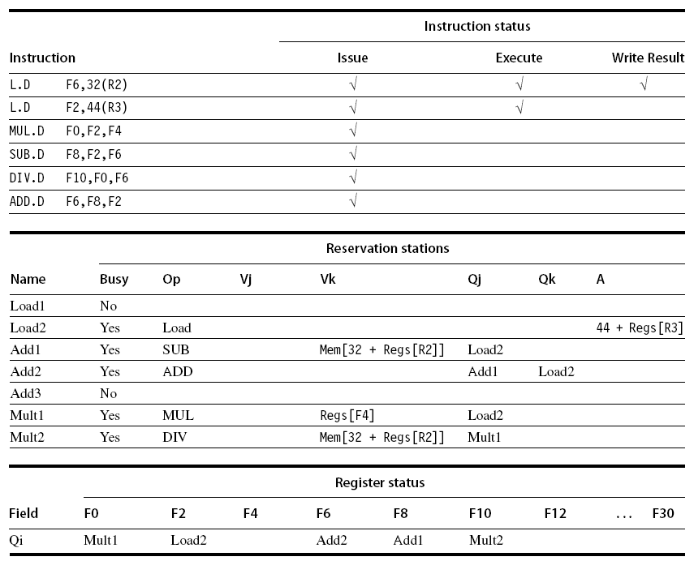
Example
snapshot, first L.D just finished

Slide 33
Speculation (Hardware based)
Execute instructions along predicted execution paths but only commit the results if the prediction was correct
Instruction commit: allowing an instruction to only update the register file when instruction is no longer speculative
Need an additional piece of hardware to prevent any irrevocable action until an instruction commits:
Reorder buffer, or Large renaming register file
why? think about it?

Slide 34
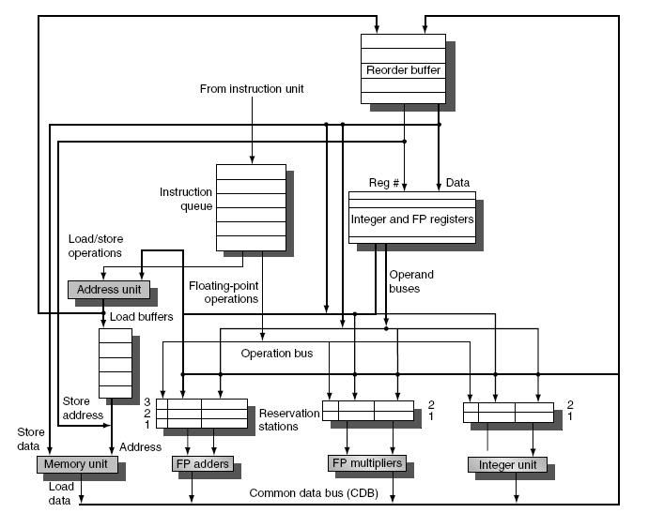
Speculative OoO
NEW
execution with
speculation
using RoB

Slide 35
Reorder Buffer (RoB)
RoB – holds the result of instruction between completion and commit
Four fields per entry:
Instruction type: branch/store/register
Destination field: register number
Value field: output value
Ready field: completed execution?
is the data valid
Modify reservation stations:
Operand source-id is now RoB (if its producer is still in the RoB) instead of functional unit (check yourself!)

Slide 36
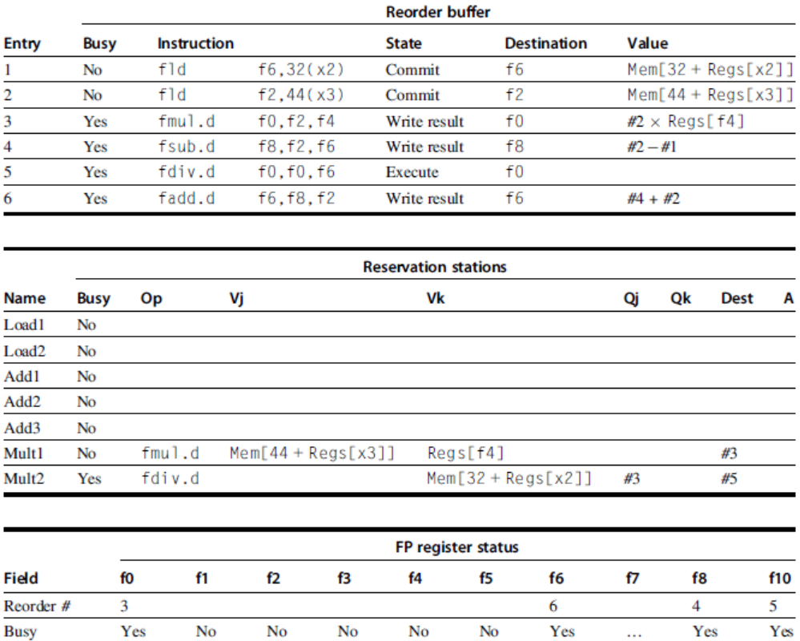
Reorder buffer in operation
After finishing the two loads

Slide 37
Reorder Buffer (RoB)
Register values and memory values are not written until an instruction commits
RoB effectively renames the destination registers
every destination gets a new entry in the RoB
On misprediction:
Speculated entries in RoB are cleared
Exceptions:
Not recognized/taken until it is ready to commit
Precise exceptions require that ‘later’ entries in RoB are cleared
Notes:
precise exceptions require that instructions started earlier should complete, instructions started after the excepting instruction should be squased, before the exception is taken

Slide 38
Register renaming
The RoB together with the Reservation station effectively implement register renaming => avoiding WaW and WaR Hazards when reordering code
But...
there is an alternative.....

Slide 39
Register Renaming using RAT
ri
Ri
there’s a physical register file larger than logical (aka architectural)register file
mapping table associates logical registers with physical register
called RAT = Register Alias Table
when an instruction is decoded:
its physical source registers are obtained from mapping table
its physical destination register is obtained from a free list
mapping table is updated
Logic RF
Physical RF
before:
addi r3,r3,4
after:
addi R2,R1,4
current
mapping table:
updated
mapping table:
r0
R8
r0
R8
r1
R7
r1
R7
r2
R5
r2
R5
r3
R1
r3
R2
r4
R9
r4
R9
current free list:
R2 R6
new free list:
R6

Slide 40
Register Renaming using RAT: Another example:
Before (assume r0->R8, r1->R6, r2->R5, .. ):
addi r1, r2, 1
addi r2, r0, 0 // WaR
addi r1, r2, 1 // WaW + RaW
After (free list: R7, R9, R10)
addi R7, R5, 1
addi R10, R8, 0 // WaR disappeared
addi R9, R10, 1 // WaW disappeared, // RaW renamed to R10

Slide 41
Summary O-o-O architectures
Instructions issue in-order, execute out-of-order, and commit in-order !!
Renaming avoids naming (false) dependences
via RoB: allocating an entry for every result, or
via Register Mapping: Architectural registers are mapped on (many more) Physical registers
Speculation beyond branches
branch prediction required (see next slides)
recovery needed in case of miss prediction
in-order-completion
also needed for precise exception support

Slide 42
Topics on ILP architectures
Introduction, Hazards (short recap)
Out-Of-Order (OoO) execution:
Branch prediction
1&2 bit prediction
Branch correlation
Avoiding branches: if-conversion
Multiple issue
How much ILP is there?
Material Ch 3 (H&P or Dubois, second part)

Slide 43
Branch Prediction
what is it?
why do we need it?
how does it work?
various schemes
subi R3,R1,#2
b1: bnez R3,L1
add R1,R0,R0
subi R3,R2,#2
add R2,R0,R0
sub R3,R1,R2
Just a code example with branches:
can instructions after branch execute while branch outcome not yet known?

Slide 44
Branch Prediction Principles
breq r1, r2, label // if r1==r2 // then PCnext = label
// else PCnext = PC + 4 (for a RISC)
Questions:
do I jump ? -> branch prediction
where do I jump ? -> branch target prediction
what's the average branch penalty?
<CPI_{branch_penalty}>
i.e. how many instruction slots do I miss (or squash) due to branches

Slide 45
Branch Prediction & Speculation
High branch penalties in heavily pipelined processors:
CPI = CPI_{base} + f_{branch} * f_{misspredict} * cycles_penalty
Large impact if:
long pipeline → cycles_penalty high
multiple-issue processors → CPI_{base} low
Many branches; if no speculation, and about 20% of the instructions being a branch, the maximum ILP is five (but actually much less!)
Idea: predict the outcome of branches based on their history and execute instructions at the predicted branch target speculatively

Slide 46
Branch Prediction Schemes
Predict branch direction:
1-bit Branch Prediction Buffer
2-bit Branch Prediction Buffer
Correlating Branch Prediction Buffer
Predicting next address:
Branch Target Buffer
Return Address Predictors
+ Or: try to get rid (some) of those malicious branches

Slide 47
1-bit Branch Prediction Buffer
1-bit branch prediction buffer or branch history table (BHT):
Buffer is like a cache without tags
Does not help for our MIPS pipeline because target address calculations performed in same stage as branch condition calculation
PC
10…..10 101 00
BHT
0
1
0
1
0
1
1
0
k-bits
size=2^{k}

Slide 48
Two 1-bit predictor problems
Aliasing: lower k bits of different branch instructions could be the same
Solution: Use tags (just like in a cache); however very expensive; tag requires many more bits per entry
Better: just accept this problem, and make table big
Loops are predicted wrong twice
Solution: Use n-bit saturation counter prediction
taken if counter ≥ 2 ^{(n-1)}
not-taken if counter < 2 ^{(n-1)}
A 2-bit saturating counter predicts a loop wrong only once
PC
10…..10 101 00
BHT
0
1
0
1
0
1
1
0
k-bits
size=2^{k}

Slide 49
2-bit Branch Prediction Buffer
Solution: 2-bit scheme where prediction is changed only if mispredicted twice
Can be implemented as a saturating counter, e.g. as following state diagram:
T
NT
Predict Taken
Predict Taken
T
T
NT
NT
Predict Not
Taken
Predict Not
Taken
T
NT

Slide 50
Next step: Correlating Branches
Fragment from SPEC92 benchmark eqntott:
if (aa==2)
aa = 0;
if (bb==2)
bb=0;
if (aa!=bb){..}
subi R3,R1,#2
b1: bnez R3,L1
add R1,R0,R0
L1: subi R3,R2,#2
b2: bnez R3,L2
add R2,R0,R0
L2: sub R3,R1,R2
b3: beqz R3,L3

Slide 51
Correlating Branch Predictor
4 bits from branch address
Idea: behavior of current branch is related to (taken/not taken) history of recently executed branches
Then behavior of recent branches selects between, say, 4 predictions of next branch, updating just that prediction
(2,2) predictor: 2-bit global, 2-bit local
(k,n) predictor uses behavior of last k branches to choose from 2^{k} predictors, each of which is n-bit predictor
2-bits per branch local predictors
Prediction
shift register,
remembers
last 2 branches
2-bit global
branch history register
(01 = not taken, then taken)

Slide 52
Branch Correlation: the General Scheme
4 parameters: (a, k, m, n)
Pattern History Table
2^{m}-1
n-bit
saturating
Up/Down
Counter
m
1
Prediction
Branch Address
0
0
1
2^{k}-1
a
k
Branch History Table (BHT)
Table size (usually n = 2): N_{bits} = k * 2ª + 2^{k} * 2^{m} *n
mostly n = 2

Slide 53
Two varieties
GA: Global history, a = 0
only one (global) history register ⇒ correlation is with previously executed branches (often different branches)
Variant: Gshare (Scott McFarling’93): GA which takes logic OR of PC address bits and branch history bits
PA: Per address history, a > 0
if a large almost each branch has a separate history
so we correlate with same branch

Slide 54
Accuracy, taking the best combination of parameters (a, k, m, n) :
GA (0,11,5,2)
98
PA (10, 6, 4, 2)
97
96
95
Bimodal
94
GAs
Branch Prediction Accuracy (%)
93
PAs
92
91
89
64
128
256
1K
2K
4K
8K
16K
32K
64K
Predictor Size (bytes)

Slide 55
Branch Prediction; summary
Basic 2-bit predictor:
For each branch:
Predict taken or not taken
If the prediction is wrong two consecutive times, change prediction
Correlating (global history) predictor:
Multiple 2-bit predictors for each branch
One for each possible combination of outcomes of preceding n branches
Local predictor:
Multiple 2-bit predictors for each branch
One for each possible combination of outcomes for the last n occurrences of this branch
Tournament predictor:
Combine correlating global predictor with local predictor

