Slide 1
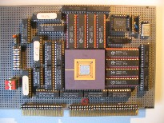
Embedded Computer Architecture 5SAI0 Instruction Level Parallel Architectures Part II
Henk Corporaal
www.ics.ele.tue.nl/~heco/courses/ECA
TUEindhoven
2021-2022

Slide 2
Topics on ILP architectures
Introduction, Hazards (short recap)
Out-Of-Order (OoO) execution:
Dependences limit ILP: dynamic scheduling
Hardware speculation
Branch prediction (finish)
Multiple issue
How much ILP is there?
What can the compiler do?
Material Ch 3 (H&P or Dubois, second part)
But first … coming back on Tomasulo

Slide 3
Speculation (Hardware based)
Execute instructions along predicted execution paths but only commit the results if the prediction was correct
Instruction commit: allowing an instruction to update the register file when instruction is no longer speculative
Need an additional piece of hardware to prevent any irrevocable action until an instruction commits:
Reorder buffer, or Large renaming register file
why? think about it?

Slide 4
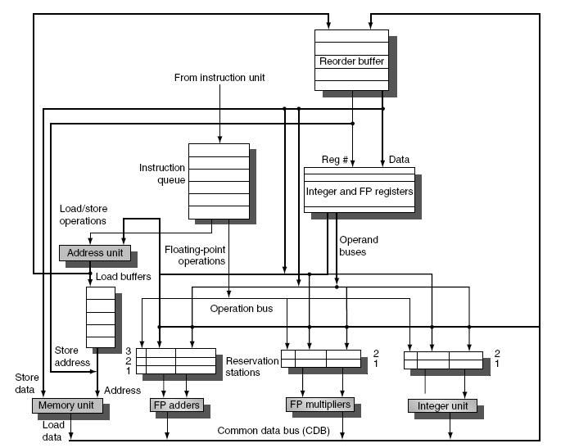
OoO execution with speculation using RoB
NEW

Slide 5
Reorder Buffer (RoB)
RoB – holds the result of instruction between completion and commit
Four fields per entry:
Instruction type: branch/store/register
Destination field: register number
Value field: output value
Ready field: completed execution? (is the data valid)
Modify reservation stations:
Operand source-id is now RoB (if its producer is still in the RoB) instead of functional unit (check yourself!)

Slide 6
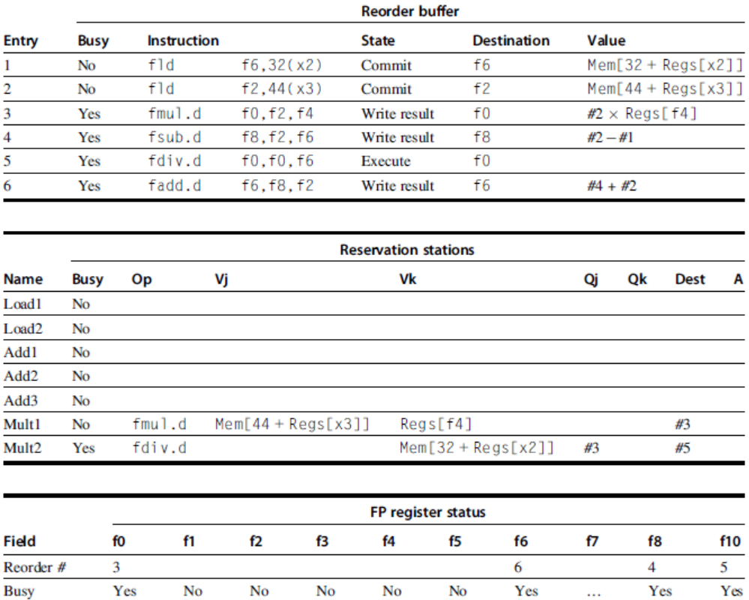
Reorder buffer in operation
Book: H&P sect 3.6
# refers to reorder buffer entry

Slide 7
Topics on ILP architectures
Introduction, Hazards (short recap)
Out-Of-Order (OoO) execution (H&P sect 3.4 - 3.6)
Branch prediction (H&P sect 3.3+3.9)
1&2 bit prediction
Branch correlation
Avoiding branches: if-conversion
Multiple issue (H&P sect 3.7 – 3.8)
How much ILP is there?
What can the compiler do? (H&P sect 3.2)
Material Ch 3 (H&P or Dubois, second part)

Slide 8
Branch Prediction
what is it?
why do we need it?
how does it work?
various schemes

Slide 9
Branch Prediction Principles
breq r1, r2, label // if r1==r2 // then PCnext = label
// else PCnext = PC + 4 (for a RISC)
Questions:
do I jump ? -> branch prediction
where do I jump ? -> branch target prediction
what's the average branch penalty?
<CPI_{branch_penalty}>
i.e. how many instruction slots do I miss (or squash) due to branches

Slide 10
Branch Prediction & Speculation
High branch penalties in pipelined processors:
With about 20% of the instructions being a branch, the maximum ILP is five (but actually much less!)
CPI = CPI_{base} + f_{branch} * f_{misspredict} * cycles_penalty
Large impact if:
Penalty high: long pipeline
CPI_{base} low: for multiple-issue processors,
Idea: predict the outcome of branches based on their history and execute instructions at the predicted branch target speculatively

Slide 11
Branch Prediction Schemes
Predict branch direction:
1-bit Branch Prediction Buffer
2-bit Branch Prediction Buffer
Correlating Branch Prediction Buffer
Predicting next address:
Branch Target Buffer
Return Address Predictors
+ Or: try to get rid (some) of those malicious branches

Slide 12
1-bit Branch Prediction Buffer
1-bit branch prediction buffer or branch history table (BHT):
Buffer is like a cache without tags
Does not help for our MIPS pipeline because target address calculations performed in same stage as branch condition calculation
PC
10…..10 101 00
BHT
0
1
0
1
0
1
1
0
k-bits
size=2^{k}

Slide 13
Two 1-bit predictor problems
PC
10…..10 101 00
BHT
0
1
0
1
0
1
1
0
k-bits
size=2^{k}
Aliasing: lower k bits of different branch instructions could be the same
Solution: Use tags (the buffer becomes a tag); however very expensive
Loops are predicted wrong twice
Solution: Use n-bit saturation counter prediction
taken if counter ≥ 2 ^{(n-1)}
not-taken if counter < 2 ^{(n-1)}
A 2-bit saturating counter predicts a loop wrong only once

Slide 14
2-bit Branch Prediction Buffer
Solution: 2-bit scheme where prediction is changed only if mispredicted twice
Can be implemented as a saturating counter, e.g. as following state diagram:
T
NT
Predict Taken
Predict Taken
T
T
NT
NT
Predict Not
Taken
Predict Not
Taken
T
NT

Slide 15
Next step: Correlating Branches
Fragment from SPEC92 benchmark eqntott:
if (aa==2)
aa = 0;
if (bb==2)
bb=0;
if (aa!=bb){..}
subi R3,R1,#2
b1: bnez R3,L1
add R1,R0,R0
L1: subi R3,R2,#2
b2: bnez R3,L2
add R2,R0,R0
L2: sub R3,R1,R2
b3: beqz R3,L3

Slide 16
Correlating Branch Predictor
4 bits from branch address
Idea: behavior of current branch is related to (taken/not taken) history of recently executed branches
Then behavior of recent branches selects between, say, 4 predictions of next branch, updating just that prediction
(2,2) predictor: 2-bit global, 2-bit local
(k,n) predictor uses behavior of last k branches to choose from 2^{k} predictors, each of which is n-bit predictor
2-bits per branch local predictors
Prediction
shift register,
remembers
last 2 branches
2-bit global
branch history register
(01 = not taken, then taken)

Slide 17
Branch Correlation: the General Scheme
4 parameters: (a, k, m, n)
Pattern History Table
2^{m}-1
n-bit
saturating
Up/Down
Counter
m
1
Prediction
Branch Address
0
0
1
2^{k}-1
a
k
Branch History Table (BHT)
Table size (usually n = 2): N_{bits} = k * 2ª + 2^{k} * 2^{m} *n
mostly n = 2

Slide 18
Two varieties
GA: Global history, a = 0
only one (global) history register ⇒ correlation is with previously executed branches (often different branches)
Variant: Gshare (Scott McFarling’93): GA which takes logic OR of PC address bits and branch history bits
PA: Per address history, a > 0
if a large almost each branch has a separate history
so we correlate with the previous outcomes of the same branch

Slide 19
Accuracy, taking the best combination of parameters (a, k, m, n) :
GA (0,11,5,2)
98
PA (10, 6, 4, 2)
97
96
95
Bimodal
94
GAs
Branch Prediction Accuracy (%)
93
PAs
92
91
89
64
128
256
1K
2K
4K
8K
16K
32K
64K
Predictor Size (bytes)

Slide 20
Branch Prediction; summary
Basic 2-bit predictor:
For each branch:
Predict taken or not taken
If the prediction is wrong two consecutive times, change prediction
Correlating (global history) predictor:
Multiple 2-bit predictors for each branch
One for each possible combination of outcomes of preceding n branches
Local predictor:
Multiple 2-bit predictors for each branch
One for each possible combination of outcomes for the last n occurrences of this branch
Tournament predictor:
Combine correlating global predictor with local predictor

Slide 21
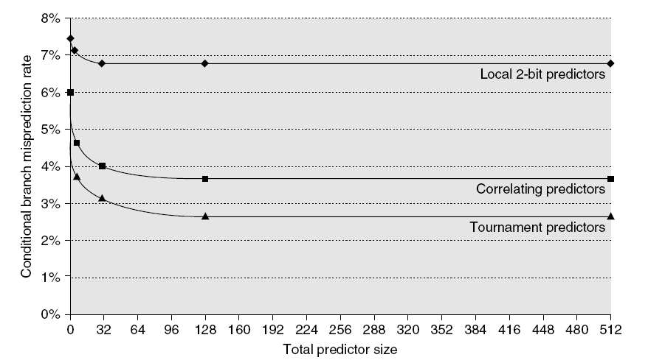
Branch Prediction Performance

Slide 22
Branch predition performance details for SPEC92 benchmarks
18%
Mispredictions Rate
0%
4096 Entries Unlimited Entries 1024 Entries
n = 2-bit BHT n = 2-bit BHT (a,k) = (2,2) BHT
Notes:
As you see, using unlimited number of entries does not bring a big improvement w.r.t. 4 k entries (it just reduces the alias problem),
however, exploiting correlation is a big gain.

Slide 23
Branch Prediction Accuracy
Mispredict because either:
Wrong guess for that branch
Got branch history of wrong branch when indexing the table (i.e. an alias occurred)
4096 entry table: misprediction rates vary from 1% (nasa7, tomcatv) to 18% (eqntott), with spice at 9% and gcc at 12%
For SPEC92, 4096 entries almost as good as infinite table
Real programs + OS are more like 'gcc'

Slide 24
Branch Target Buffer
Predicting the Branch Condition is not enough !!
Where to jump? Branch Target Buffer (BTB):
each entry contains a Tag and Target address
PC
10…..10 101 00
Tag branch PC
PC if taken
Yes: instruction is branch. Use predicted PC as next PC if branch predicted taken.
=?
Branch
prediction
(often in separate table)
No: instruction is not a
branch. Proceed normally

Slide 25
Instruction Fetch Stage
4
Instruction
Memory
PC
Instruction register
BTB
found & taken
target address
Not shown: hardware needed when prediction was wrong

Slide 26
Special Case: Return Addresses
Register indirect branches: hard to predict target address
MIPS instruction: jr r3 // this means: PC_{next} = (r3)
implementing switch/case statements
FORTRAN computed GOTOs
procedure return (mainly): jr r31 on MIPS
SPEC89: 85% of indirect branches used for procedure return
Since stack discipline for procedures, save return address in small buffer that acts like a stack:
8 to 16 entries has already very high hit rate

Slide 27
Return address prediction: example
main()
{ …
f();
…
}
f()
{ …
g()
…
}
100 main: ….
104 jal f
108 …
10C jr r31
120 f: …
124 jal g
128 …
12C jr r31
308 g: ….
30C
310 jr r31
314 ..etc..
128
108
main ra
return stack
Q: when does the return stack predict wrong?

Slide 28
Or: ……..?? Avoid branches !

Slide 29
Predicated Instructions (discussed before)
Avoid branch prediction by turning branches into conditional or predicated instructions:
If false, then neither store result nor cause exception
Expanded ISA of Alpha, MIPS, PowerPC, SPARC have conditional move; PA-RISC can annul any following instr.
IA-64/Itanium: conditional execution of any instruction
Examples:
if (R1==0) R2 = R3; CMOVZ R2,R3,R1
if (R1 < R2) SLT R9,R1,R2
R3 = R1; CMOVNZ R3,R1,R9
else CMOVZ R3,R2,R9
R3 = R2;

Slide 30
General guarding: if-conversion
if (a > b) { r = a % b; }
else { r = b % a; }
y = a*b;
4 basic blocks
sub t1,a,b
bgz t1,then
else: rem r,b,a
j next
then: rem r,a,b
next: mul y,a,b
CFG:
1
sub t1, a, b
bgz t1, 2, 3
2
rem r, a, b
goto 4
3
rem r, b, a
goto 4
if-conversion
4
mul y,a,b
…………..
1 basic block
sub t1,a,b
t1 rem r,a,b
!t1 rem r,b,a
mul y,a,b
Guards t1 & !t1

Slide 31
Dynamic Branch Prediction: Summary
Prediction important part of scalar execution
Branch History Table: 2 bits for loop accuracy
Correlation: Recently executed branches correlated with next branch
Either correlate with previous branches
Or different executions of same branch
Branch Target Buffer: include branch target address (& prediction)
Return address stack for prediction of indirect jumps
Or….avoid branches: if-conversion

Slide 32
Topics on ILP architectures
Introduction, Hazards (short recap)
Out-Of-Order (OoO) execution:
Branch prediction
Multiple issue
Superscalar
VLIW
TTA (not in H&P)
How much ILP is there?
What can the compiler do?
Material Ch 3 (H&P or Dubois, second part)

Slide 33
Going Parallel: Multiple Instructions Combined with OOO
Issue multiple instructions (or operations) per cycle

Slide 34
Going parallel: Multiple Issue
Multiple parallel pipelines: CPI can get < 1
complete multiple instructions per clock
Two Options:
Statically scheduled superscalar processors
VLIW (Very Long Instruction Word) processors
Dynamically scheduled superscalar processors
Superscalar processor
EPIC (explicit parallel instruction computer)
somewhat in between

Slide 35
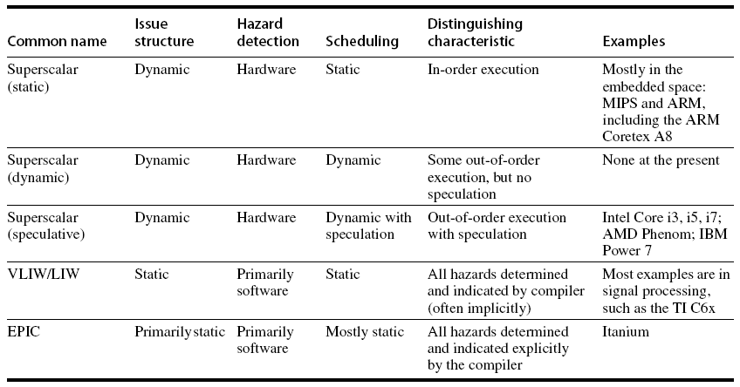
Multiple Issue Options:
Most used

Slide 36
Modern Superscalar
Modern (superscalar) microarchitectures =
Dynamic scheduling + Multiple Issue + Speculation
Issue logic can become bottleneck
Several approaches:
Assign reservation stations and update pipeline control table in half a clock cycle
Only supports 2 instructions/clock
Design logic to handle any possible dependencies between the instructions
Hybrid approaches

Slide 37
Multiple Issue: reduce complexity
Limit the number of instructions of a given class that can be issued in a “bundle”
I.e. one FloatingPt, one Integer, one Load, one Store
Examine all the dependencies among the instructions in the bundle
If dependencies exist in bundle, encode them in reservation stations
Need multiple completions&commits per cycle

Slide 38
Example: increment array elements
Loop: LD R2, 0(R1) ;R2=array element
DADDIU R2, R2,#1 ;increment R2
SD R2, 0(R1) ;store result
DADDIU R1, R1, #8 ;increment R1 to point to next double
BNE R2, R3, Loop ;branch if not final iteration

Slide 39
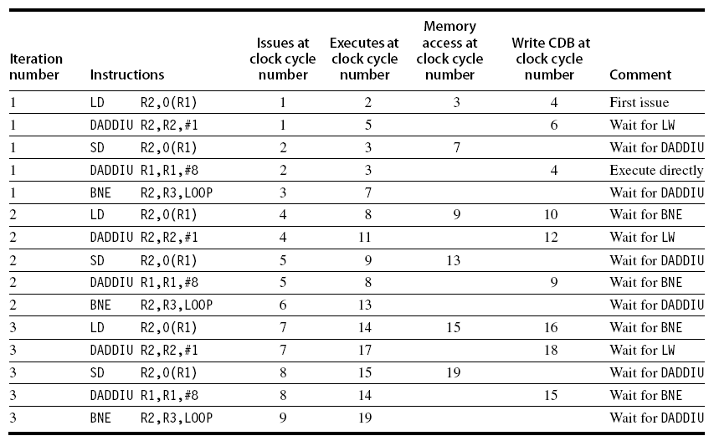
Example (No Speculation)
Note: LD following BNE must wait on the branch outcome (no speculation)!

Slide 40
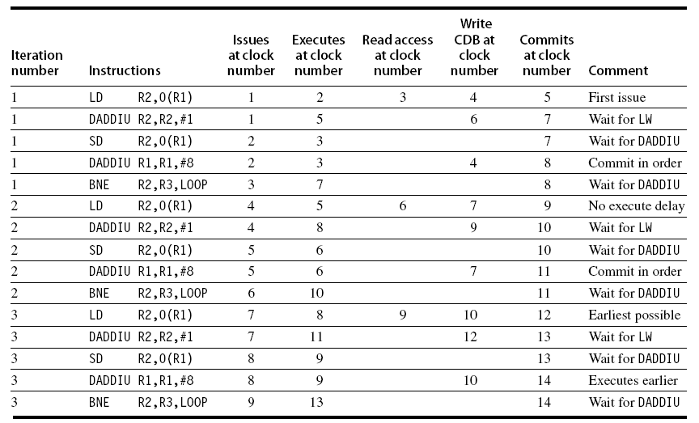
Example (with branch Speculation)
Note: Execution of 2nd DADDIU is earlier than 1th, but commits later, i.e. in order!

Slide 41
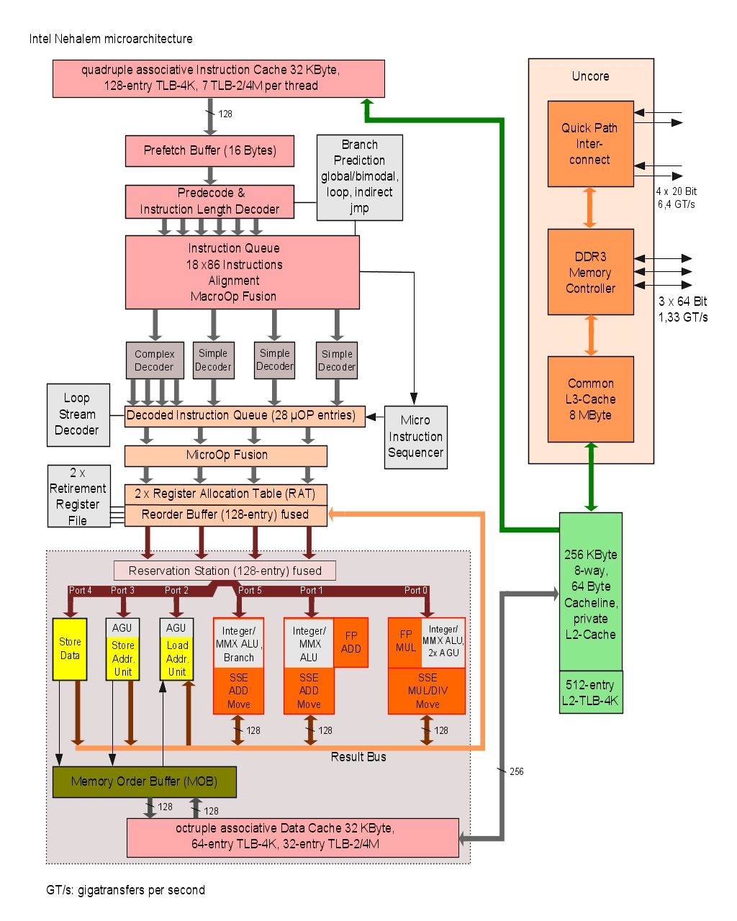
Nehalem microarchitecture (Intel)
first use: Core i7
2008
45 nm
hyperthreading
shared L3 cache
3 channel DDR3 controler
QIP: quick path interconnect
32K+32K L1 per core
256 L2 per core
4-8 MB L3 shared between cores

Slide 42
Limitations of OoO Superscalar
Available ILP is limited
usually we’re not programming with parallelism in mind
Huge hardware cost when increasing issue width
adding more functional units is easy, however:
more memory ports and register ports needed
dependency check needs O(n²) comparisons
renaming needed
complex issue logic (check and select ready operations)
complex forwarding circuitry
Any cheaper alternatives ???

Slide 43
VLIW: alternative to Superscalar
Hardware much simpler!! Why??
Limitations of VLIW processors
Very smart compiler needed (but largely solved!)
Loop unrolling helps but increases code size
Unfilled slots waste instruction bits (need NOPs)
Cache miss stalls whole pipeline
Research topic: scheduling loads
Binary incompatibility
(.. can partly be solved: EPIC or JITC .. )
Note:
Still many ports on register file needed
Complex forwarding circuitry and many bypass buses
Solve these issues later

Slide 44
Single Issue RISC vs Superscalar
instr
op
instr
op
instr
op
instr
op
instr
op
instr
op
instr
op
instr
op
instr
op
Change HW,
but can use
same code
instr
op
instr
op
instr
op
instr
op
instr
op
instr
op
instr
op
instr
op
instr
op
instr
op
instr
op
instr
op
instr
op
instr
op
instr
op
execute
1 instr/cycle
issue and (try to) execute
3 instr/cycle
3-issue Superscalar
(1-issue)
RISC CPU

Slide 45
Single Issue RISC vs VLIW
instr
op
instr
op
instr
op
instr
op
instr
op
op
op
instr
op
instr
nop
op
op
Compiler
instr
op
op
nop
instr
op
instr
op
instr
op
nop
op
instr
op
instr
op
op
op
instr
op
execute
1 instr/cycle
3 ops/cycle
instr
op
instr
op
instr
op
execute
1 instr/cycle
3-issue VLIW
RISC CPU

Slide 46
VLIW: general concept
Instruction Memory
A VLIW architecture with 7 FUs
Instruction register
Function
units
Int FU
Int FU
Int FU
LD/ST
LD/ST
FP FU
FP FU
Int Register File
Floating Point
Register File
Data Memory

Slide 47
VLIW characteristics
Multiple operations per instruction
One instruction per cycle issued (at most)
Compiler is in control
Only RISC like operation support
Short cycle times
Easier to compile for
Flexible: Can implement any FU mixture
Extensible / Scalable
However:
tight inter FU connectivity required
not binary compatible !!
(new long instruction format)
low code density
add
sub
sll
nop
bne
Example VLIW instructions

Slide 48
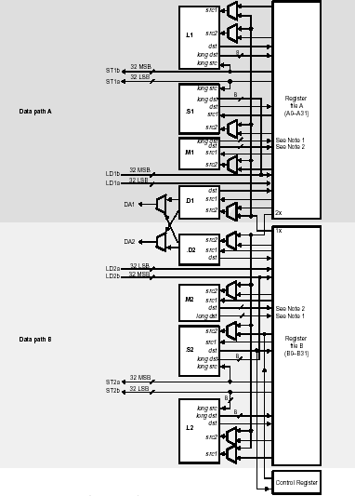
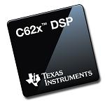
VelociTIC6x datapath

Slide 49
VLIW example: TMS320C62
TMS320C62 VelociTI Processor
8 operations (of 32-bit) per instruction (256 bit)
Two clusters
8 Fus: 4 Fus / cluster : (2 Multipliers, 6 ALUs)
2 x 32 registers
One bus available to write in register file of other cluster
Flexible addressing modes (like circular addressing)
Flexible instruction packing
All instruction conditional
Originally: 5 ns, 200 MHz, 0.25 um, 5-layer CMOS
128 KB on-chip RAM

Slide 50
VLIW example: Philips TriMedia TM1000
5 constant
5 ALU
2 memory
2 shift
2 DSP-ALU
2 DSP-mul
3 branch
2 FP ALU
2 Int/FP ALU
1 FP compare
1 FP div/sqrt
Register file (128 regs, 32 bit, 15 ports)
Exec
unit
Exec
unit
Exec
unit
Exec
unit
Exec
unit
Data
cache
(16 kB)
Instruction register (5 issue slots)
PC
Instruction
cache (32kB)

Slide 51
Summary (so far) on ILP architectures
Superscalar
Binary compatible
Multi-issue, OoO, branch speculation
VLIW
Not binary compatible, requires re-compilation of source code
More energy efficient
ILP architectures to be discussed in part III:
EPIC
TTA

