Slide 1
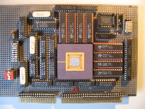
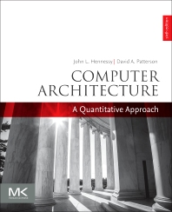

Embedded Computer Architecture
5SAI0
Instruction Level Parallel
Architectures
Part III (final part)
Henk Corporaal
www.ics.ele.tue.nl/~heco/courses/ECA
TUEindhoven
2021-2022

Slide 2
Topics on ILP architectures
Introduction, Hazards (short recap)
Out-Of-Order (OoO) execution (H&P sect 3.4 - 3.6)
Branch prediction (H&P sect 3.3+3.9)
Multiple issue (H&P sect 3.7 – 3.8)
  Superscalar
  VLIW & EPIC
  TTA (not in H&P)
How much ILP is there?
What can the compiler do? (H&P sect 3.2)
Material Ch 3 (H&P or Dubois, second part)

Slide 3
Recap: Single Issue RISC vs Superscalar
instr
op
instr
op
instr
op
instr
op
instr
op
instr
op
instr
op
instr
op
instr
op
Change HW,
but can use
same code
instr
op
instr
op
instr
op
instr
op
instr
op
instr
op
instr
op
instr
op
instr
op
instr
op
instr
op
instr
op
instr
op
instr
op
instr
op
execute
1 instr/cycle
issue and (try to) execute
3 instr/cycle
3-issue Superscalar
(1-issue)
RISC CPU

Slide 4
Recap: Single Issue RISC vs VLIW
instr
op
instr
op
instr
op
instr
op
instr
op
op
op
instr
op
instr
nop
op
op
Compiler
instr
op
op
nop
instr
op
instr
op
instr
op
nop
op
instr
op
instr
op
op
op
instr
op
execute
1 instr/cycle
3 ops/cycle
instr
op
instr
op
instr
op
execute
1 instr/cycle
3-issue VLIW
RISC CPU

Slide 5
Recap: VLIW: general concept
Instruction Memory
Instruction register
A VLIW architecture with 7 FUs
Function
units
Int FU
Int FU
Int FU
LD/ST
LD/ST
FP FU
FP FU
Int Register File
Floating Point
Register File
Data Memory

Slide 6
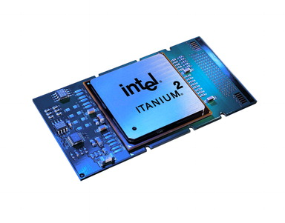
VLIW alternative: Intel EPIC Architecture IA-64
Explicit Parallel Instruction Computer (EPIC)
IA-64 architecture -> Itanium, first realization 2001
Idea: instead of packing a fixed number of operations into a large instruction,
keep the original instructions but add control bits indicating if current instruction can be executed in parallel with previous one.
Many Registers:
128 64-bit int x bits, stack, rotating
128 82-bit floating point, rotating
64 1-bit boolean
8 64-bit branch target address
system control registers
See http://en.wikipedia.org/wiki/Itanium

Slide 7
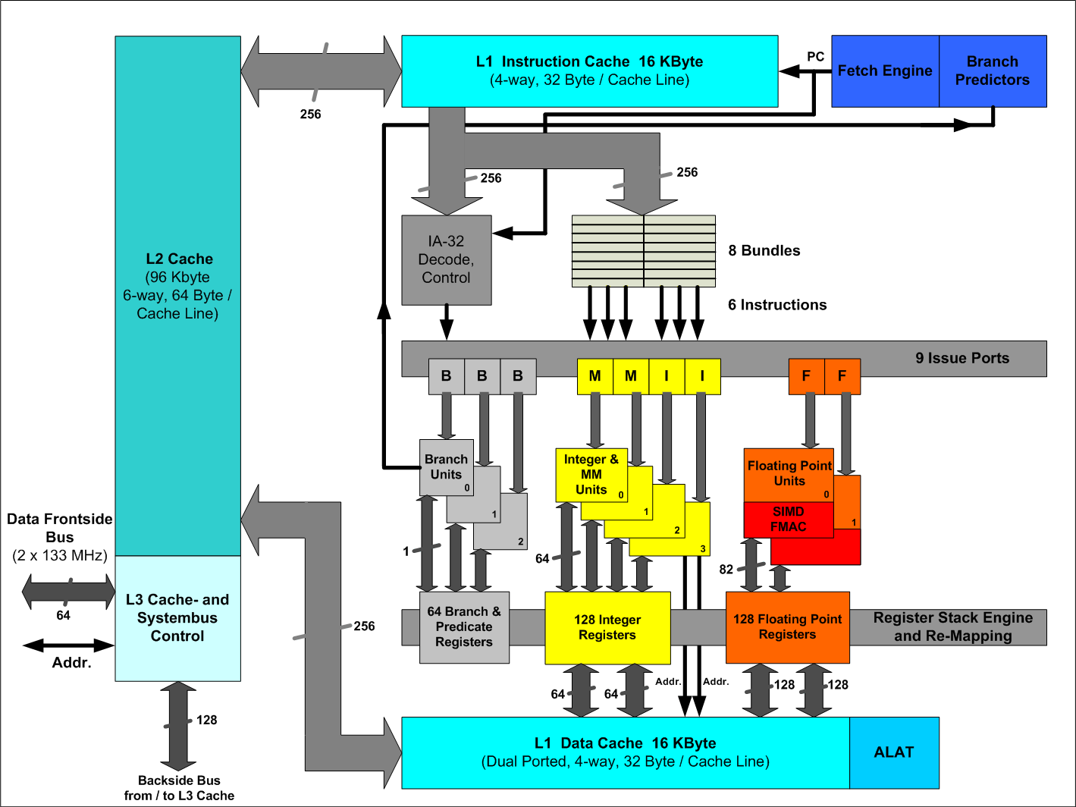
Itanium organization

Slide 8
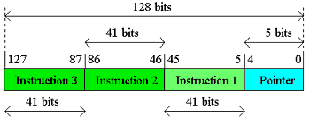
EPIC Architecture: IA-64
Instructions grouped in 128-bit bundles (of 3 instr. each):
  3 * 41-bit instruction
  5 template bits, indicate type and stop location
Each 41-bit instruction
  starts with 4-bit opcode, and
  ends with 6-bit guard (boolean) register-id
Supports speculative loads
(follows later)

Slide 9
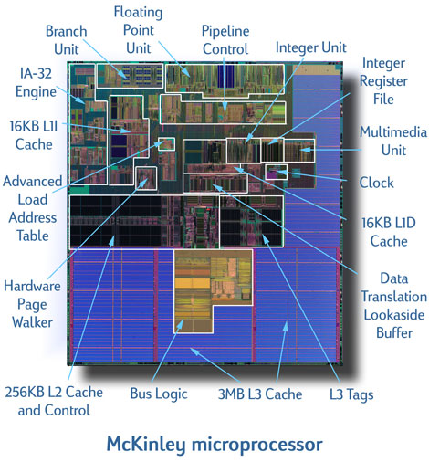
Itanium 2: McKinley
Chip layout:

Slide 10
EPIC Architecture advantages
EPIC allows for more binary compatibility then a plain VLIW:
  Function unit assignment performed at run-time
    => Nr of FUs architectural invisible
  Lock when FU results not available
    => FU pipeline latencies architectural invisible
Intel stopped Itanium in 2017: why?
  See course and other websites for more info
  (look at related material)
Mul r2,r5,r6 // 2-cycles
…. // other operations
Add r1,r2,r3 // r2 ready

Slide 11
Architecture options
Architecture options | Bind operations (where)
Schedule operations (when) | Static | Dynamic
Static | VLIW | EPIC
Dynamic | TRIPS | Superscalar
Other design choices, like:
  Visible pipeline latencies (yes/no)
  Visible FU-RF data transports (yes/no)
  Visible local memory (= called Scratchpad) vs Cache
  … and many more …
Architectural invisibility gives backwards binary compatibility !!

Slide 12
What did we talk about?
ILP = Instruction Level Parallelism =
ability to perform multiple operations (or instructions),
from a single instruction stream,
in parallel
VLIW = Very Long Instruction Word architecture
Example Instruction format (5-issue):
operation 1
operation 2
operation 3
operation 4
operation 5

Slide 13
VLIW evaluation
Instruction memory
Instruction fetch unit
Control problem
CPU
Instruction decode unit
FU-5
FU-4
FU-3
FU-2
FU-1
With N function units
O(N²)
Bypassing network
O(N)-O(N²)
Register file
13
Data memory

Slide 14
VLIW evaluation
Strong points of VLIW:
  Scalable (add more FUs)
  Flexible (an FU can be almost anything; e.g. multimedia support)
Weak points:
With N FUs:
  Bypassing complexity: O(N²)
  Register file complexity: O(N)
  Register file size: O(N²)
Register file design restricts FU flexibility
Solution: .................................................. ?

Slide 15
Solution
Mirroring the Programming Paradigm
TTA: Transport Triggered Architecture
+
-
+
-
>
*
>
*
st
st

Slide 16
Transport
Triggered
Architecture
Instruction memory
Instruction fetch unit
CPU
General organization
of a TTA
Instruction decode unit
Bypassing network
Register file
FU-5
FU-4
FU-3
FU-2
FU-1
Data memory

Slide 17
TTA structure; datapath details
Data Memory
load/store
unit
load/store
unit
integer
ALU
integer
ALU
float
ALU
Socket
integer
RF
float
RF
boolean
RF
instruct.
unit
immediate
unit
Instruction Memory
Note: TTAs have a lot in common with the Blocks CGRA from Lab 1

Slide 18

TTA hardware characteristics
Modular: building blocks easy to reuse
Very flexible and scalable
  easy inclusion of Special Function Units (SFUs)
Very low complexity
  > 50% reduction on # register ports
  reduced bypass complexity (no associative matching)
  up to 80 % reduction in bypass connectivity
  trivial decoding
  reduced register pressure
  easy register file partitioning (a single port is enough!)

Slide 19
TTA software characteristics
That does not
look like an
improvement !?!
add r3, r1, r2
  r1 → add.o1;
  r2→ add.o2;
  add.r → r3
o1
o2
+
r

Slide 20
Program TTAs
How to do data operations ?
1. Transport of operands to FU
  Operand move (s)
  Trigger move
2. Transport of results from FU
  Result move (s)
Trigger
Operand
Internal stage
Example Add r3,r1,r2 becomes
r1 → Oint // operand move to integer unit
r2 → Tadd // trigger move to integer unit
…………. // addition operation in progress
Rint → r3 // result move from integer unit
Result
How to do Control flow ?
1. Jumps: #jump-address → pc
2. Branch: #displacement → pcd
3. Call: pc → r; #call-address → pcd
FU Pipeline

Slide 21
Scheduling example
VLIW
load/store
unit
integer
ALU
integer
ALU
add r1,r1,r2
sub r4,r1,95
TTA
r1 -> add.o1, r2 -> add.o2
add.r -> sub.o1, 95 -> sub.o2
integer
RF
immediate
unit
sub.r -> r4

Slide 22
TTA Instruction format
General MOVE field:
g : guard specifier
i : immediate specifier
src : source
dst : destination
g
i
src
dst
General MOVE instructions: multiple fields
move 1
move 2
move 3
move 4
How to use immediates?
Small, 6 bits
Long, 32 bits
g
1
imm
dst
g
0
Ir-1
dst
imm

Slide 23

Summary on ILP architecture
Superscalar
  Binary compatible
  Multi-issue, OoO, branch speculation
VLIW
  Not compatible, requires re-compilation of source code
  More energy efficient
TTA (and Blocks CGRA)
  A kind of VLIW
  Solves / relaxes remaining VLIW inefficiencies when scaling up
  RF #ports reduction
  Connectivity reduction

Slide 24
Topics on ILP architectures
Introduction, Hazards (short recap)
Out-Of-Order (OoO) execution:
Branch prediction
Multiple issue
How much ILP is there?
  Measuring ILP
  Exceeding ILP limits
What can the compiler do?
Material Ch 3 (H&P or Dubois, second part)

Slide 25
How parallel should we make a processor?
Depends on how much parallelism is there in your application?

Slide 26
Measuring available ILP: How?
Using existing compiler
Using trace analysis
  Track all the real data dependencies (RaWs) of instructions from issue window
    register dependences
    memory dependences
  Check for correct branch prediction
    if prediction correct continue
    if wrong, flush schedule and start in next cycle

Slide 27
Trace analysis
Trace
set r1,0
set r2,3
set r3,&A
st r1,0(r3)
add r1,r1,1
add r3,r3,4
brne r1,r2,Loop
st r1,0(r3)
add r1,r1,1
add r3,r3,4
brne r1,r2,Loop
st r1,0(r3)
add r1,r1,1
add r3,r3,4
brne r1,r2,Loop
add r1,r5,3
Compiled code
set r1,0
set r2,3
set r3,&A
Loop: st r1,0(r3)
add r1,r1,1
add r3,r3,4
brne r1,r2,Loop
add r1,r5,3
Program
For i := 0..2
A[i] := i;
S := X+3;
How parallel can this code be executed?
Notes:
Explain trace analysis using the trace on the right-hand side for different models.
No renaming + oracle prediction + unlimited window size
Full renaming + oracle prediction + unlimited window size (shown in next slide)
Full renaming + 2-bit prediction (assuming back-edge taken) + unlimited window size
etc.

Slide 28
Trace analysis
Parallel Trace
set r1,0 set r2,3 set r3,&A
st r1,0(r3) add r1,r1,1 add r3,r3,4
st r1,0(r3) add r1,r1,1 add r3,r3,4 brne r1,r2,Loop
st r1,0(r3) add r1,r1,1 add r3,r3,4 brne r1,r2,Loop
brne r1,r2,Loop
add r1,r5,3
Max ILP = Speedup = Lserial / L_{parallel} = 16 / 6 = 2.7
Is this the maximum?
Notes:
Note that with oracle prediction and renaming the last operation, add r1,r5,3, can be put in the first cycle.

Slide 29
Ideal Processor
Assumptions for ideal/perfect processor:
1. Register renaming – infinite number of virtual registers => all register WAW & WAR hazards avoided
2. Branch and Jump prediction – Perfect => all program instructions available for execution
3. Memory-address alias analysis – addresses are known. A store can be moved before a load provided addresses not equal
Also:
  unlimited number of instructions issued/cycle (unlimited resources), and
  unlimited instruction window
  perfect caches
  1 cycle latency for all instructions (FP *,/)
Programs were compiled using MIPS compiler with maximum optimization level

Slide 30
Upper Limit to ILP: Ideal Processor
Integer: 18 - 60
FP: 75 - 150
IPC

Slide 31
Window Size and Branch Impact
Change from infinite instr. window to examine 2000, and issue at most 64 instructions per cycle
FP: 15 - 45
Integer: 6 – 12
IPC
Perfect Tournament BHT(512) Profile No prediction

Slide 32
Impact of Limited Renaming Registers
Assume: 2000 instr. window, 64 instr. issue, 8K 2-level predictor
(slightly better than tournament predictor)
Integer: 5 - 15
FP: 11 - 45
IPC
Infinite 256 128 64 32

Slide 33
Memory Address Alias Impact
Assume: 2000 instr. window, 64 instr. issue, 8K 2-level predictor, 256 renaming registers
FP: 4 - 45
(Fortran,
no heap)
IPC
Integer: 4 - 9
Memory
disambiguation
quality:
Perfect Global/stack perfect Inspection None

Slide 34
Window Size Impact
Assumptions: Perfect disambiguation, 1K Selective predictor, 16 entry return stack, 64 renaming registers, issue as many as in window
FP: 8 - 45
IPC
Integer: 6 - 12
Window and
issue size:

Slide 35
How to Exceed ILP Limits of this Study?
Solve WAR and WAW hazards through memory:
  eliminated WAW and WAR hazards through register renaming, but not yet for memory operands
Avoid unnecessary dependences
  E.g., compiler did not unroll loops so we keep the iteration index variable dependence; e.g. in i=i+1
Overcoming the data flow limit: value prediction = predicting values and speculating on prediction
  E.g. predict next load address and speculate by reordering loads and stores.

Slide 36
Topics on ILP architectures
Introduction, Hazards (short recap)
Out-Of-Order (OoO) execution:
Branch prediction
Multiple issue
How much ILP is there?
  Measuring ILP
  Exceeding ILP limits
What can the compiler do?
Material Ch 3 (H&P or Dubois, second part)

Slide 37

What can the compiler do?
Loop transformations
Code scheduling
Special course 5LIM0
on Parallelization and
Compilers
  LLVM based
An oldy on
compilers

Slide 38
Basic compiler techniques
Dependencies limit ILP (Instruction-Level Parallelism)
  We can not always find sufficient independent operations to fill all the delay slots
  May result in pipeline stalls
Scheduling to avoid stalls (= reorder instructions)
(Source-)code transformations to create more exploitable parallelism
  Loop Unrolling
  Loop Merging (Fusion)
    see online slide-set about loop transformations !!

Slide 39
Dependencies Limit ILP: Example
C loop:
  for (i=1; i<=1000; i++)
  x[i] = x[i] + s;
MIPS assembly code:
  ; R1 = &x[1] // compiler choices
  ; R2 = &x[1000]+8
  ; F2 = s
  Loop: L.D F0,0(R1) ; F0 = x[i]
  ADD.D F4,F0,F2 ; F4 = x[i]+s
  S.D 0(R1),F4 ; x[i] = F4
  ADDI R1,R1,8 ; R1 = &x[i+1]
  BNE R1,R2,Loop ; branch if R1!=&x[1000]+8

Slide 40
Schedule this on an example processor
FP operations are mostly multicycle
The pipeline must be stalled if an instruction uses the result of a not yet finished multicycle operation
We’ll assume the following latencies:
  Producing Consuming Latency
  instruction instruction (clock cycles)
  FP ALU op FP ALU op 3
  FP ALU op Store double 2
  Load double FP ALU op 1
  Load double Store double 0

Slide 41
Where to Insert Stalls?
How would this loop be executed on the MIPS FP pipeline?
3 Intra-iteration
dependences !!
3 Inter-iteration
dependences !!
Loop: L.D F0,0(R1)
  ADD.D F4,F0,F2
  S.D F4,0(R1)
  ADDI R1,R1,8
  BNE R1,R2,Loop
What are the true (flow) dependences?

Slide 42
Where to Insert Stalls
How would this loop be executed on the MIPS FP pipeline?
10 cycles per iteration
Loop: L.D F0,0(R1)
stall
ADD.D F4,F0,F2
stall
stall
S.D 0(R1),F4
ADDI R1,R1,8
stall
BNE R1,R2,Loop
stall
Producing Consuming Latency
instruction instruction ( cycles)
FP ALU FP ALU op 3
FP ALU Store double 2
Load double FP ALU 1
Load double Store double 0

Slide 43
Code Scheduling to Avoid Stalls
Can we reorder the order of instruction to avoid stalls?
Execution time reduced from 10 to 6 cycles per iteration
But only 3 instructions perform useful work, rest is loop overhead !!
How to avoid this ???
Loop: L.D F0,0(R1)
ADDI R1,R1,8
ADD.D F4,F0,F2
stall
BNE R1,R2,Loop
S.D -8(R1),F4
watch out!

Slide 44
Loop Unrolling: increasing ILP
Code after scheduling:
  Loop: L.D F0,0(R1)
  L.D F6,8(R1)
  L.D F10,16(R1)
  L.D F14,24(R1)
  ADD.D F4,F0,F2
  ADD.D F8,F6,F2
  ADD.D F12,F10,F2
  ADD.D F16,F14,F2
  S.D 0(R1),F4
  S.D 8(R1),F8
  ADDI R1,R1,32
  SD -16(R1),F12
  BNE R1,R2,Loop
  SD -8(R1),F16
At source level:
  for (i=1; i<=1000; i++)
  x[i] = x[i] + s;
  for (i=1; i<=1000; i=i+4)
  {
  x[i] = x[i] + s;
  x[i+1] = x[i+1]+s;
  x[i+2] = x[i+2]+s;
  x[i+3] = x[i+3]+s;
  }
14 cycles/4 iterations => 3.5 cycles/iteration
Any drawbacks?
  loop unrolling increases code size
  more registers needed

Slide 45
Strip Mining
Split the iteration space in chunks (strips) of k iterations each
  Strip can be completely unrolled (as in previous slide)
  Strip can be vectorized (on SIMD or GPU architecture)
What if unknown number of loop iterations?
  Number of iterations = n
  Goal: make k copies of the loop body
Solution:
  Generate pair of loops:
    First executes n mod k times
    Second executes n / k times
    “Strip mining”

Slide 46
Hardware support for compile-time scheduling
Predication
  see earlier slides on conditional move and
  if-conversion
Speculative loads
  Deferred exceptions

Slide 47
Deferred Exceptions
  ld r1,0(r3) # load A
  bnez r1,L1 # test A
  ld r1,0(r2) # then part; load B
  j L2
  L1: addi r1,r1,4 # else part; inc A
  L2: st r1,0(r3) # store A
if (A==0)
A = B;
else
A = A+4;
How to optimize when then-part (A = B;)
is usually selected? => Load B before the branch
ld r1,0(r3) # load A
ld r9,0(r2) # speculative load B
beqz r1,L3 # test A
addi r9,r1,4 # else part
L3: st r9,0(r3) # store A
What if this load generates a page fault?
What if this load generates an “index-out-of-bounds” exception?

Slide 48
HW supporting Speculative Loads
2 new instructions:
  Speculative load (sld): does not generate exceptions
  Speculation check instruction (speck): check for exception. The exception occurs when this instruction is executed.
  ld r1,0(r3) # load A
  sld r9,0(r2) # speculative load of B
  bnez r1,L1 # test A
  speck 0(r2) # perform exception check
  j L2
  L1: addi r9,r1,4 # else part
  L2: st r9,0(r3) # store A

Slide 49
What did you learn?
O-O-O execution mechanisms
Multi-issue
VLIW vs Superscalar
Advanced branch prediction techniques
HW and SW speculation techniques
TTAs
Measuring ILP in programs
Compiler tricks
And.... many illustrative examples

