Slide 1
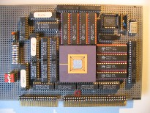
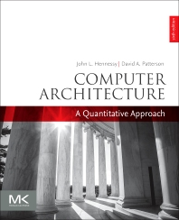
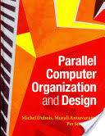
Embedded Computer Architecture 5SIA0 Overview + Guidelines
Henk Corporaal
www.ics.ele.tue.nl/~heco/courses/ECA
h.corporaal@tue.nl
TUEindhoven
2020-2021

Slide 2
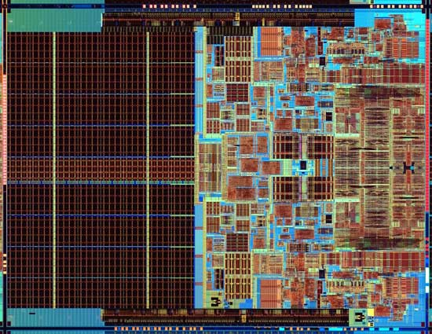
ECA summary
The miniMIPS processor some of you built
What you’ll understand after taking 5SIA0
Also, the technology behind chip-scale multiprocessors
Notes:
Photo is of an Intel Conroe (Core 2 Duo Desktop processor). Photo taken from Intel web site.

Slide 3
Course goals
Learn advanced computer architecture concepts like:
ILP, DLP, Vector, Spatial computing, and Multi-issue architectures
O-o-O (Out-of-Order) execution
Correlating branch prediction
Advanced memory hierarchy; speedup methods
Energy consumption and Technology issues
etc.
Learn multi-processor architecture concepts like:
Multi-threading
Topologies
Synchronization
Cache Coherence and Memory Consistency, etc.

Slide 4
We use a very good book
Computer Architecture A quantitative approach
6th ed. by Hennessy and Patterson (Nov 2017)
Material:
Chapters 1-5, 7
Appendices A-C
Extra material: App: E, F, K

Slide 5
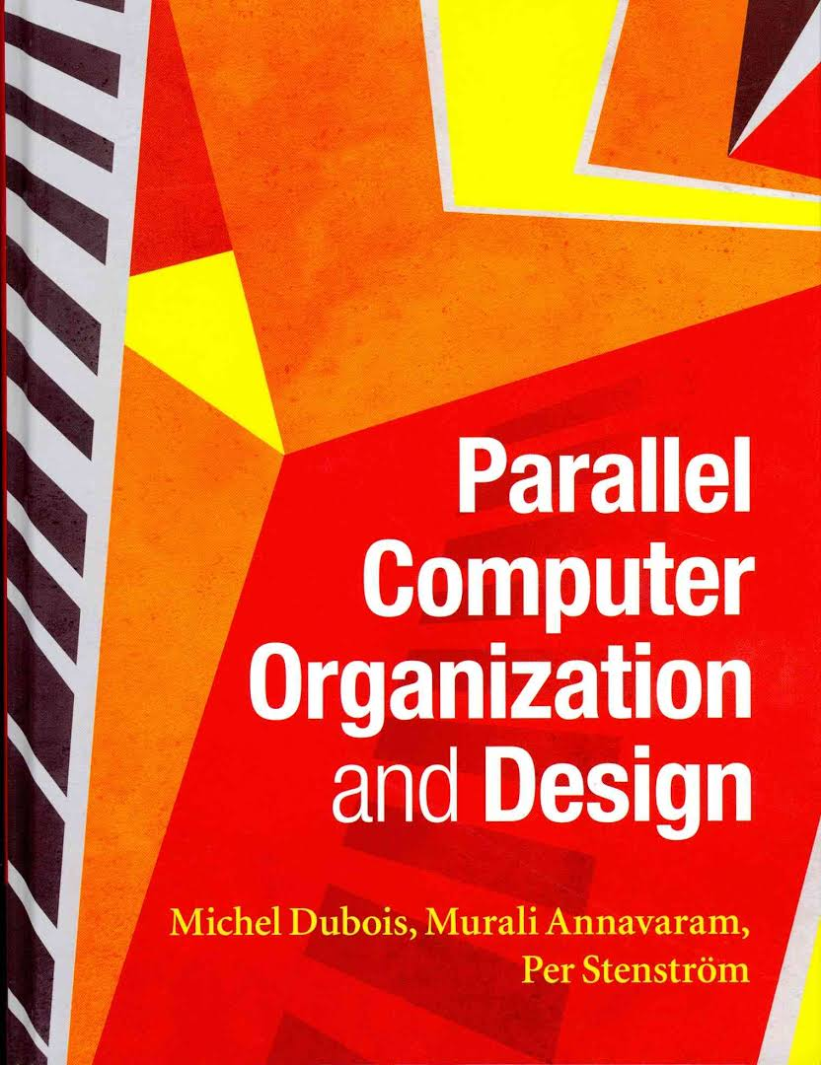
Alternative, also very good = background reading
Topics in these books:
Impact of technology
Processor microarchitecture
Memory hierarchies
Multiprocessor systems
Interconnection networks
Coherence, synchronization, and memory consistency
Chip multiprocessors
Quantitative evaluations

Slide 6
Organization
Credits:
5SIA0: 5 credit points (ECTS)
Weekly class meetings
Mondays: 10.45-12.30 (Online)
Wednesdays: 17.30-19.15 (Aud 3+6)
Very advanced Labs: you can do them at home
Student literature research of TOP recent conferences
Examination at the end of exam weeks

Slide 7
Practical Experience
3 lab assignments:
Design and evaluation of a CGRA (Coarse Grain Reconfigurable Array) processor
Extreme parallel, GPU – SIMD programming
Processor design space exploration using the GEM5 simulator+ARM
Lab assistents:
Ali Banagozar (lab 1)
Sun Wei (lab 2)
Patrick Wijnings (lab 3)

Slide 8
Lab 1: CGRA
Co-optimization of application and architecture for a coarse grained reconfigurable architecture

Slide 9
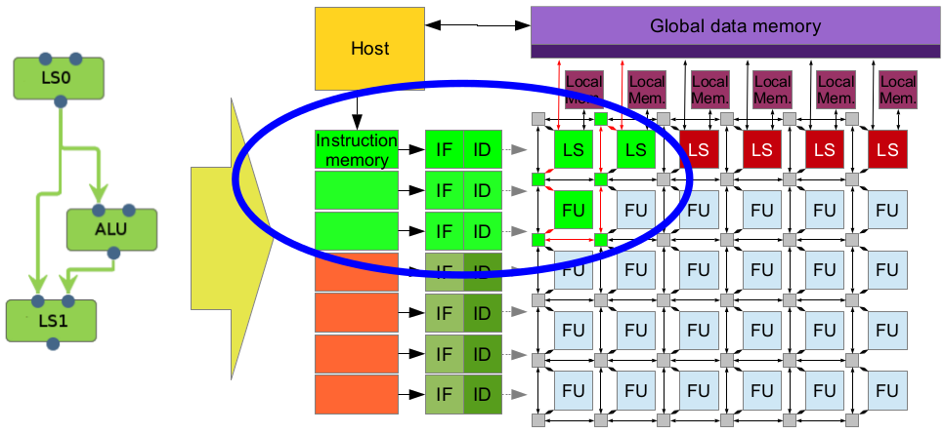
Architecture and application
CGRA:
Application: to be announced

Slide 10
Your job:
Modify the architecture to:
Reduce energy
Reduce area
Improve performance
Modify the algorithm
Code optimizations
Modify code to use architecture configuration
Enjoy!

Slide 11
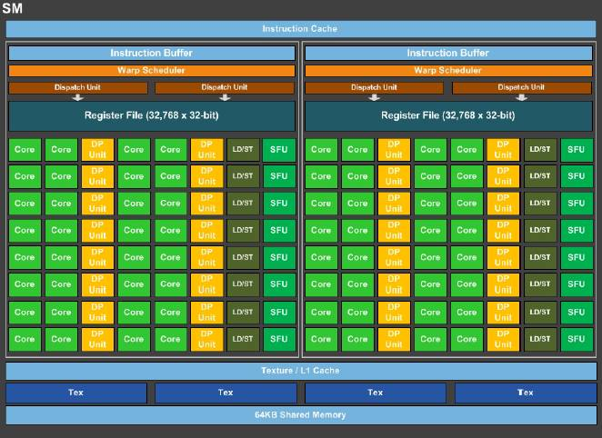
Lab 2: GPU - SIMD
One PASCAL SM
NVIDIA's PASCAL architecture
The NVIDIA work hourse:
Streaming multiprocessor (SM)
Many function units (FUs)
supports FP16, 32 & 64

Slide 12
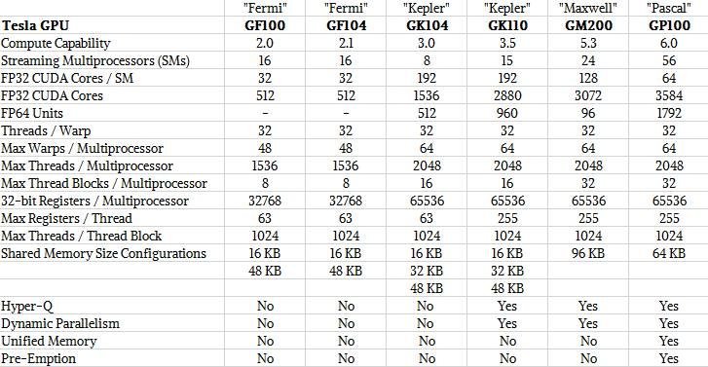
GPU trends, till 2016 (NVIDIA)
see: https://www.nextplatform.com/2016/04/19/drilling-nvidias-pascal-gpu/

Slide 13
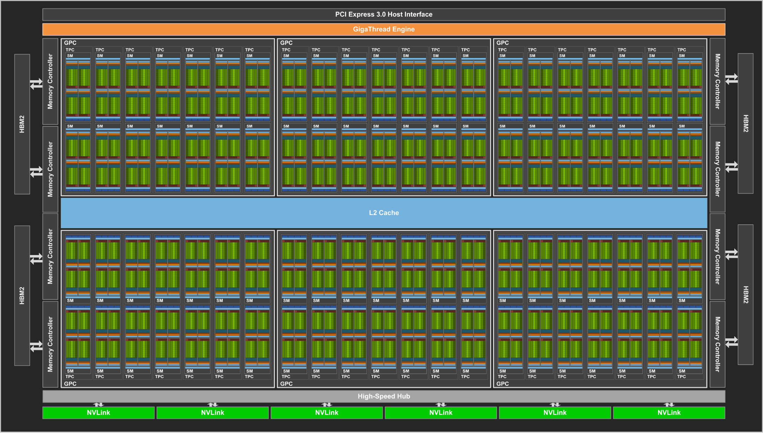
NVIDIA Volta V100 (GTC May 2017)
up to 80 cores,
5120 PEs (FP32),
815 mm²,
21.1 Btransistors,
12 nm, 300 W
20 MB register space
peak performance: 120 TFlops/s (FP16) => 2.5 pJ/op

Slide 14
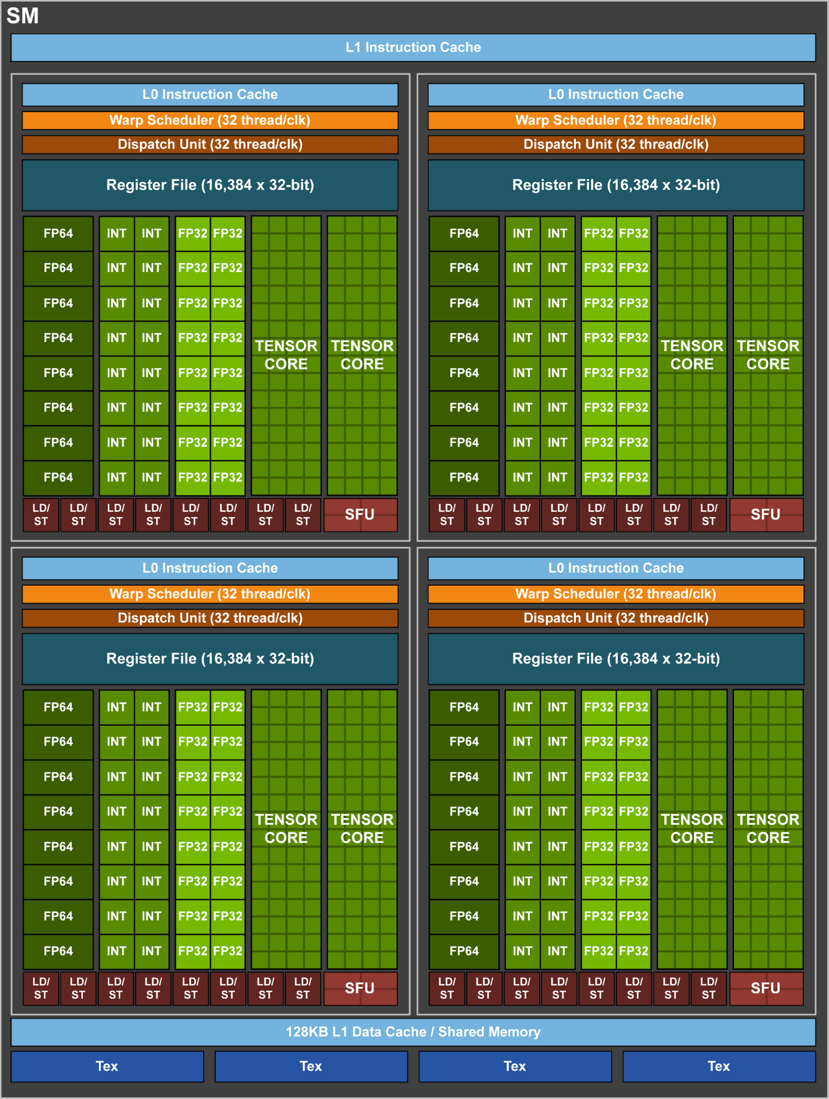
1 SM core
Units:
8 tensor cores/SM
64 Int units
64 FP32
32 FP64
32 Ld/St
4 SFUs
128 kB L1 Data $
4 warp schedulers

Slide 15
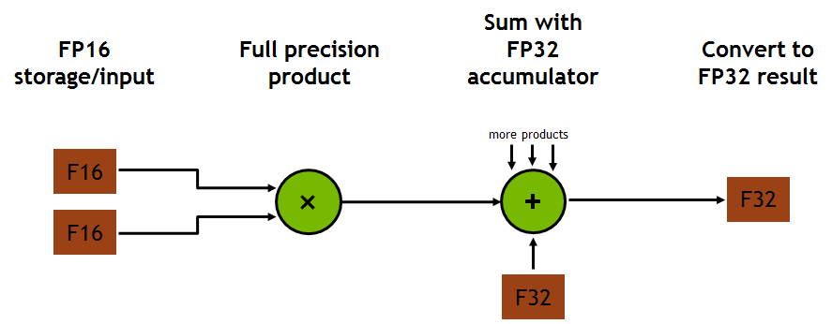
Tensor core operation
D = AxB + C, all 4x4 matrices
64 floating point MAC operations per clock cycle

Slide 16
NVIDIA Turing, introduced 2018
72 SMs (Streaming Multiprocessors = SIMD units), high-end TU102
Each SM:
64 PEs (CUDA cores) => total of 4608 PEs
8 Tensor cores => total of 572 Tensor cores
256 KB register file
4 texture units
96 KB L1 cache/shared memory
L2: 6 MByte
384-bit 7 GHz GDDR6 external memory interface
Cost? die area = 754 mm^2, 18.6 billion transistors

Slide 17
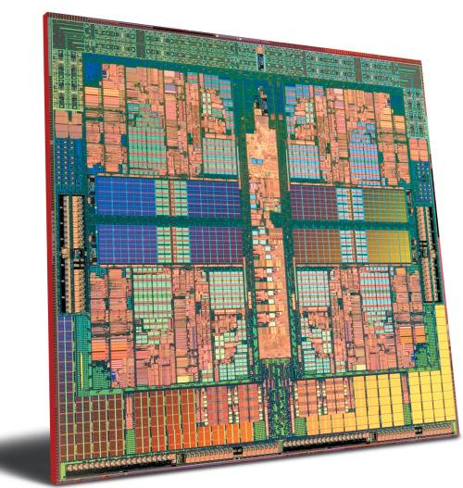
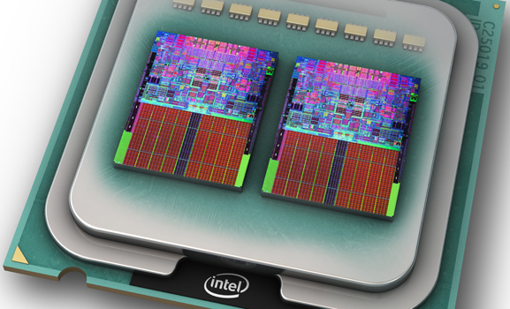
Lab 3: Processor design space explorations
Using GEM5 simulator

Slide 18
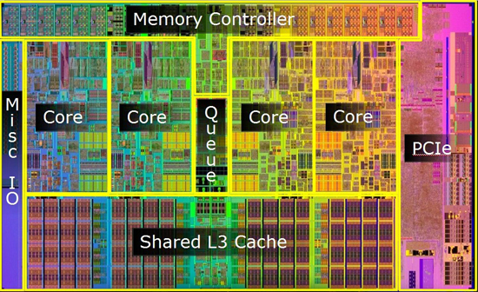
What are the objectives?
To get familiar with advanced processor architectures and their programming models
To look at different configurations, cache levels and sizes, etc.
Finally to optimize the Energy-Delay-Area-Product (EDAP) of the system

Slide 19
What you will learn
How to use the GEM5 as cycle accurate simulator to run applications
The impacts of different architectural parameters on performance
The size of different levels of caches
Cache Associativity
Applying loop transformation techniques to optimize the memory accesses
Applying the application partitioning technique for task level parallelism
Using McPAT for power and area estimation

Slide 20
Extra Material
Handouts and slides; see course web site:
www.ics.ele.tue.nl/~heco/courses/ECA
Chapter 2 from Microprocessor Architectures, 1998
http://www.es.ele.tue.nl/~heco/courses/ECA/chapter2.pdf
Optional: Study recent articles from top conferences and journals
http://www.es.ele.tue.nl/~heco/lit/conf+journals.html

Slide 21
Schedule 2020-2021 (preliminary)
Date | Topic | Book H&P
09 Nov | Overview + Introduction | Ch 1
11 Nov | RISC recap: ISA | App A
16 Nov | CGRA arch + Lab 1
18 Nov | RISC recap: pipelining/hazards | App C
 | CGRA lab1 < Dec 4
23 Nov | Mem 1 | Ch 2+App B
25 Nov | Mem 2 | Ch 2
30 Nov | GPU: Gert-Jan van den Braak (Philips Medical Systems) | Ch 4
2 Dec | SIMD / GPU + lab 2 | Ch 4
 | GPU lab2 < Jan 4
7 Dec | ILP 1 | Ch 3
09 Dec | ILP 2 | Ch 3
14 Dec | Loop trafos
16 Dec | Simulation + Lab 3 | D ch 9
 | GEM5 multiproc. lab3 Jan 15
4 Jan | Thread-Level par + Coherence, synchr. and consistency 1 | Ch 5
6 Jan | Coherence, synchr. and consistency 2 | Ch 5
11 Jan | Domain-Specific Arch + ML: Maurice Peemen (FisherScientific) | Ch 7
13 Jan | Wrap-up + Recap

Slide 22
Grading
with a maximum of 100 points (giving a grade 10):
3 lab reports, each up to 10 points
online exam (bring your laptop): likely Monday 18 January (check)
questions about each lab: each 15 points
questions about general / discussed theory: 25 points
note: we make a trial exam available. You have to pass this one with an 8, before the 17 Jan. 2021, in order to be allowed to the exam
you may try the trial exam as often as you like, in order to pass.
bonus, studying and presenting a recent scientific high quality article, strongly related to the course: up to 10 points
Note: only one bonus opportunity (after exam; not after resit)

Slide 23
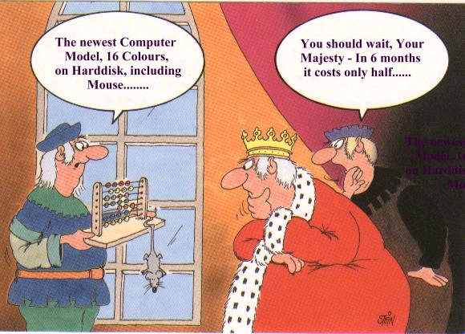
Where is computing going?
Notes:
23

