Slide 1
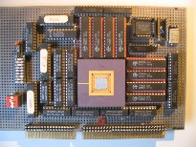
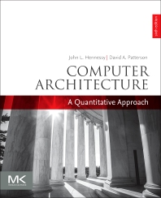
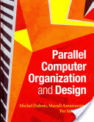
Embedded Computer Architecture
5SIA0
Overview + Guidelines
Henk Corporaal
www.ics.ele.tue.nl/~heco/courses/ECA
h.corporaal@tue.nl
TUEindhoven
2021-2022

Slide 2
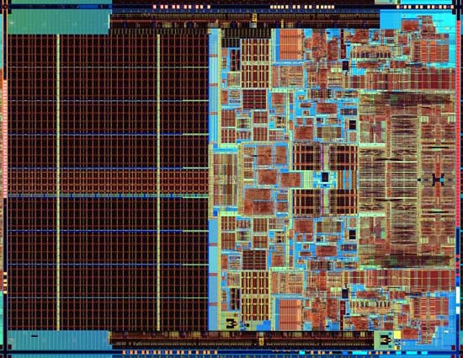
ECA summary
The miniMIPS processor some EE students built
What you’ll understand (and much more0 after taking 5SIA0
Also, the technology behind chip-scale multiprocessors
Notes:
Photo is of an Intel Conroe (Core 2 Duo Desktop processor). Photo taken from Intel web site.

Slide 3
Course goals
Learn advanced computer architecture concepts like:
  ILP, DLP, Vector, Spatial computing, and Multi-issue architectures
  O-o-O (Out-of-Order) execution
  Correlating branch prediction
  Advanced memory hierarchy, Cache operation; Speedup methods
  Energy consumption and Technology issues
  etc.
Learn multi-processor architecture concepts like:
  Multi-threading
  Topologies
  Synchronization
  Cache Coherence and Memory Consistency, etc.

Slide 4
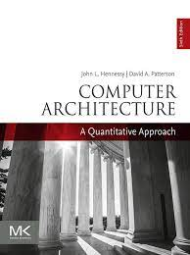
We use a very good book
Computer Architecture
A quantitative approach
6th ed. by Hennessy and Patterson
(Nov 2017)
Material:
  Chapters 1-5, 7
  Appendices A-C
  Extra material: App: E, F, K

Slide 5
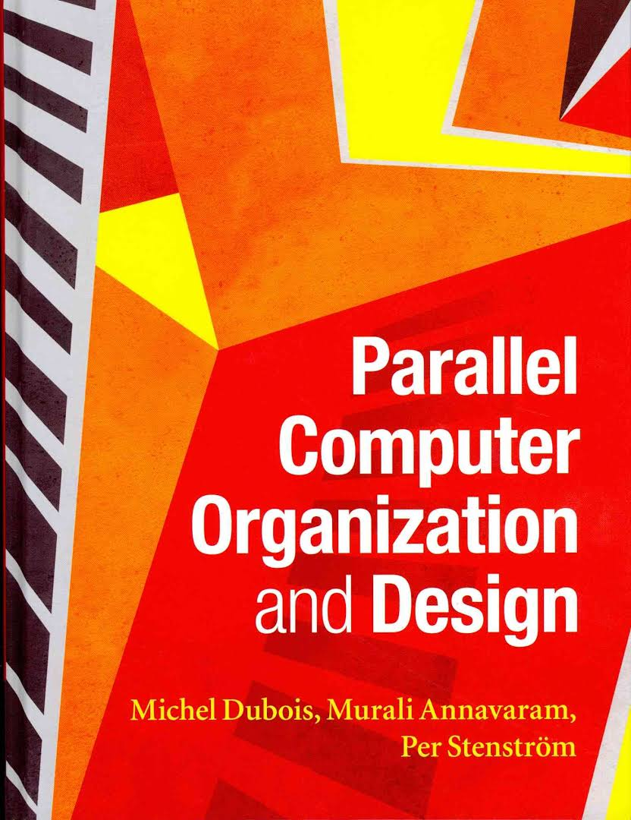
Alternative = very good background reading
Topics in these books:
Impact of technology
Processor microarchitecture
Memory hierarchies
Multiprocessor systems
Interconnection networks
Coherence, synchronization, and
memory consistency
Chip multiprocessors
Quantitative evaluations

Slide 6
Organization
Credits:
  5SIA0: 5 credit points (ECTS)
Weekly class meetings
  Mondays: 10.45-12.30 (Aud 13/10)
  Wednesdays: 17.30-19.15 (Aud 09/16)
  Very advanced Labs: you can do them at home (partly using our servers)
Student literature research of TOP recent conferences
Examination: Monday Jan 31, 13.30 – 16.30 h.

Slide 7


Practical Experience
3 lab assignments:
  DSE: Processor Design Space Exploration using the GEM5 simulator+ARM
  GPU: Extreme parallel, GPU – SIMD programming
  CGRA: Design and evaluation of a CGRA (Coarse Grain Reconfigurable Array) processor
Lab assistents:
  Ali Banagozar (lab CGRA)
  Sun Wei (lab GPU)
  Patrick Wijnings (lab DSE with GEM5)

Slide 8
Lab CGRA: in complete control (application+arch.)
Co-optimization of application and architecture for a coarse grained reconfigurable architecture

Slide 9
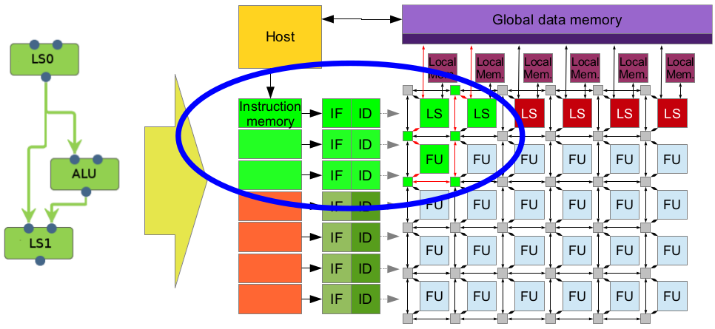
Architecture and Application
CGRA:
Application: to be announced

Slide 10

Your job:
Modify the architecture to:
  Reduce energy
  Reduce area
  Improve performance
Modify the algorithm
  Code optimizations
  Modify code to use architecture configuration
Enjoy!

Slide 11
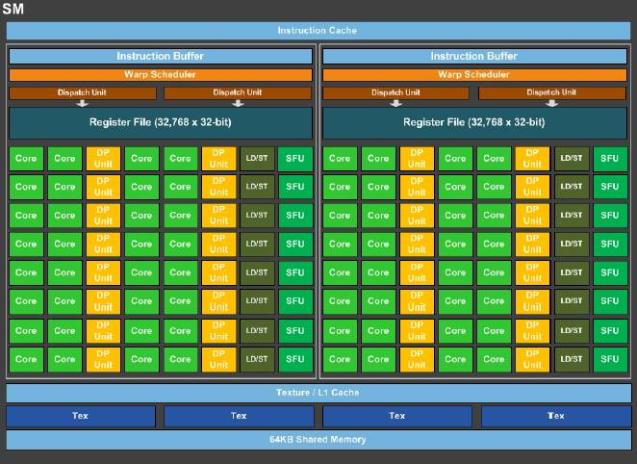
Lab GPU: programming and optimization
One PASCAL SM
NVIDIA's PASCAL architecture
The NVIDIA work hourse:
Streaming multiprocessor (SM)
Many function units (FUs)
supports FP16, 32 & 64

Slide 12
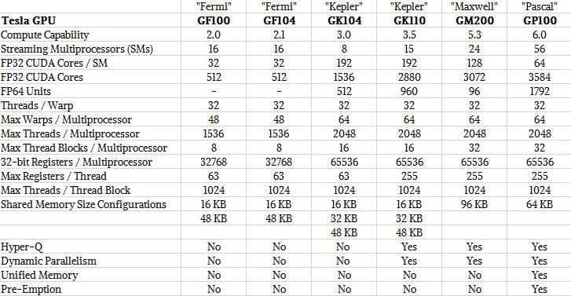
GPU trends, till 2016 (NVIDIA)
see: https://www.nextplatform.com/2016/04/19/drilling-nvidias-pascal-gpu/

Slide 13
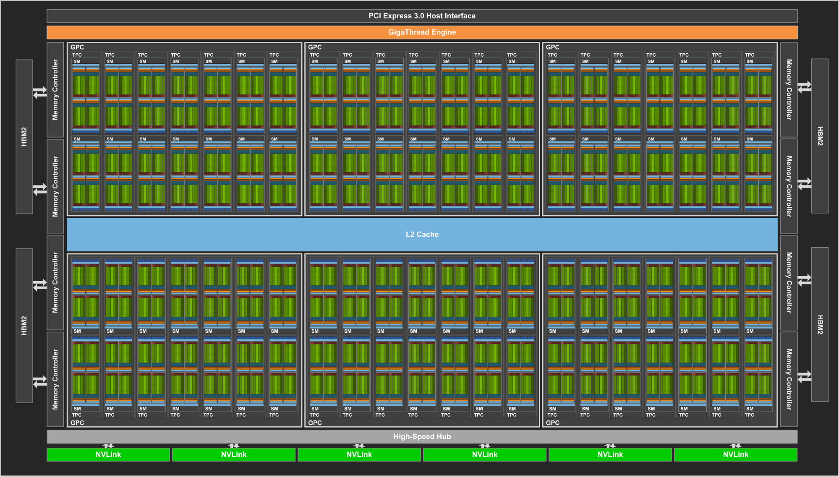
NVIDIA Volta V100 (GTC May 2017)
up to 80 cores,
5120 PEs (FP32),
815 mm²,
21.1 Btransistors,
12 nm, 300 W
20 MB register space
peak performance: 120 TFlops/s (FP16) => 2.5 pJ/op

Slide 14
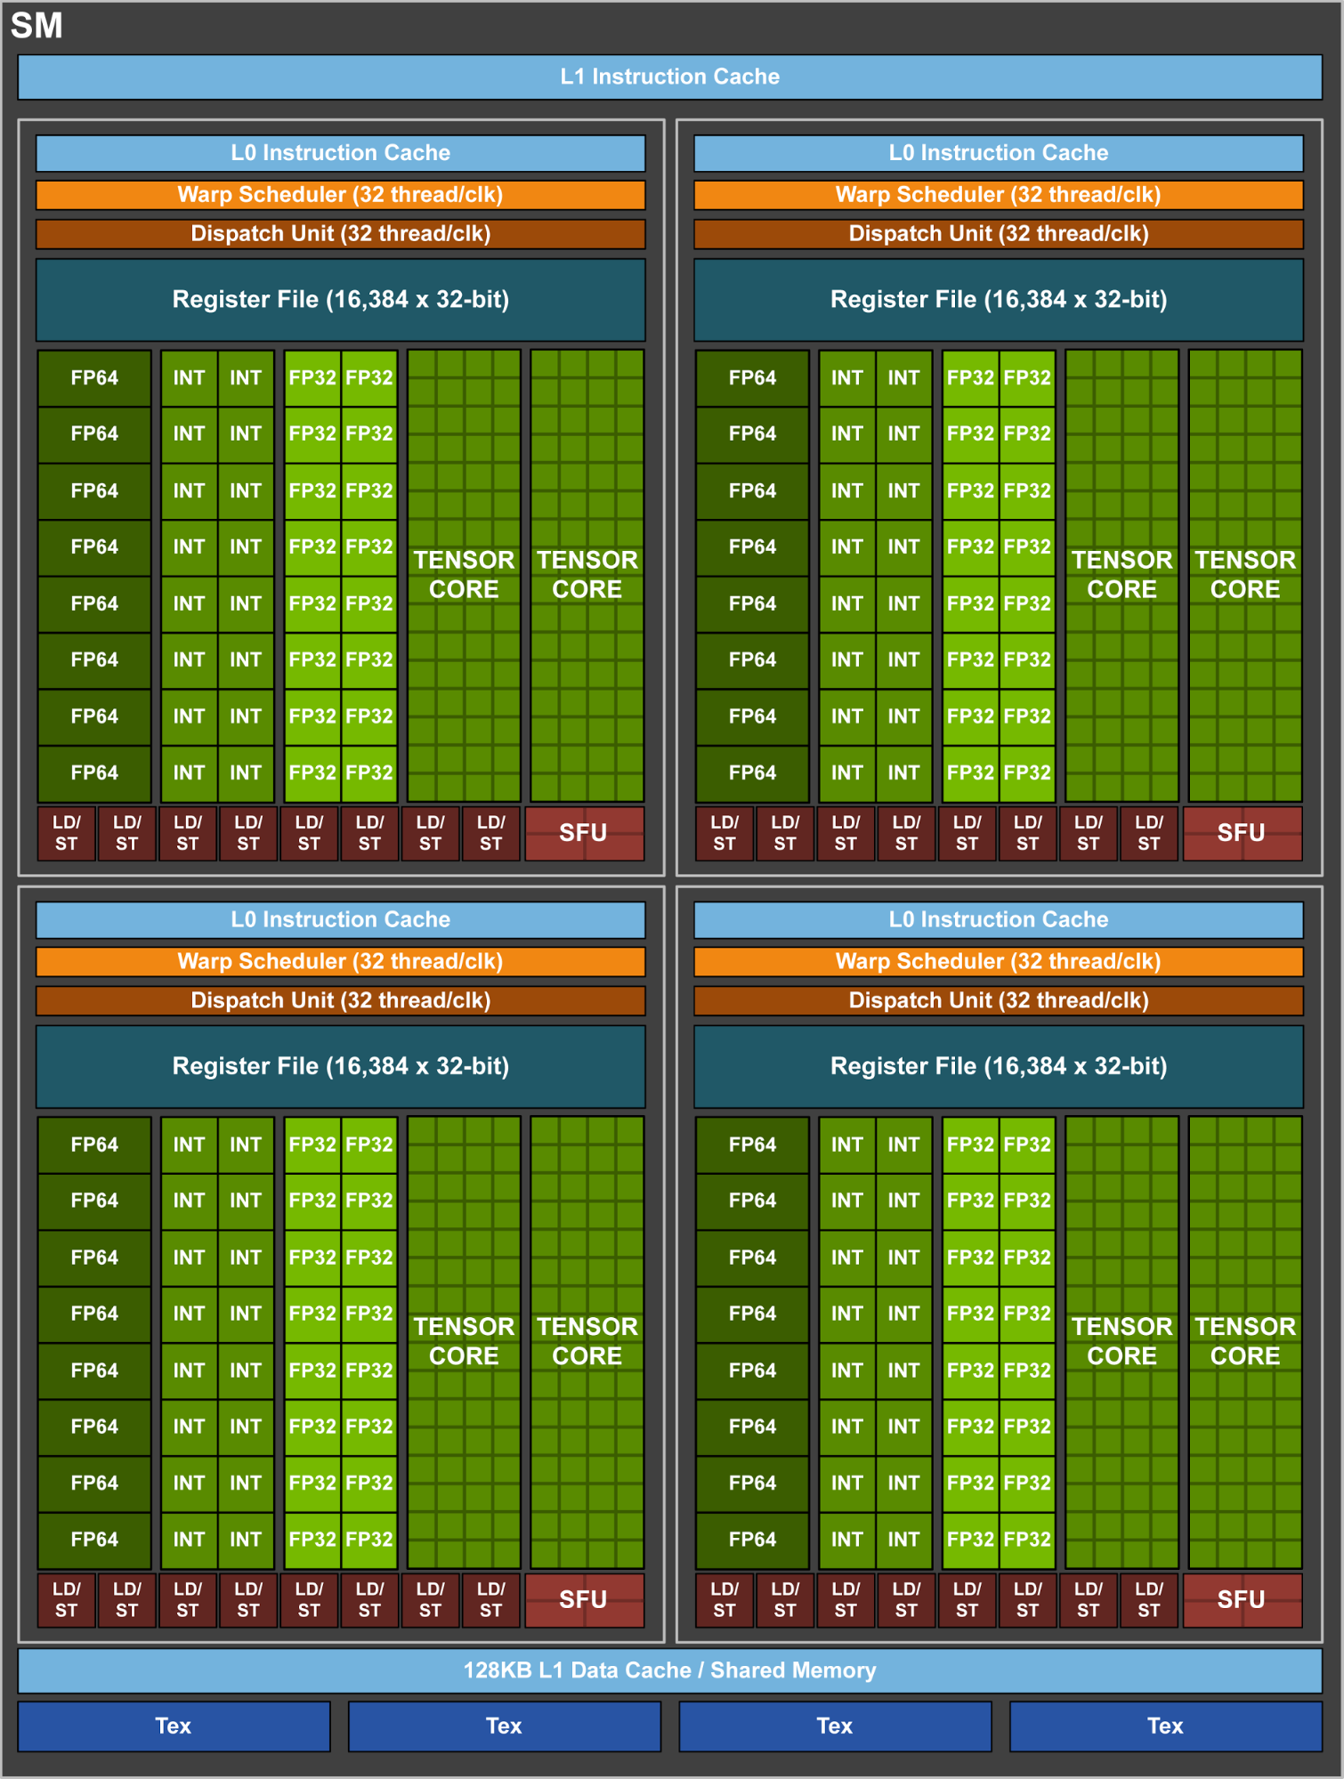
1 SM core
Units:
  8 tensor cores/SM
  64 Int units
  64 FP32
  32 FP64
  32 Ld/St
  4 SFUs
128 kB L1 Data $
4 warp schedulers

Slide 15
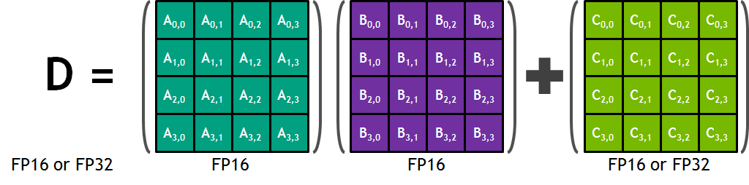
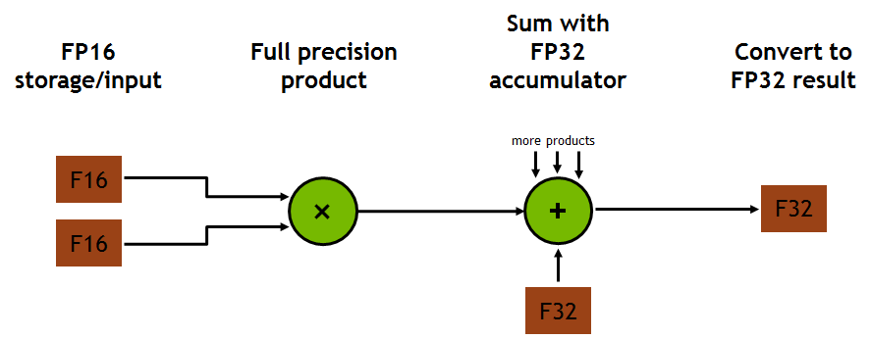
Tensor core operation
D = AxB + C, all 4x4 matrices
64 floating point (16-bit) MAC operations per clock cycle

Slide 16
NVIDIA Turing, introduced 2018
72 SMs (Streaming Multiprocessors = SIMD units), high-end TU102
Each SM:
  64 PEs (CUDA cores) => total of 4608 PEs
  8 Tensor cores => total of 572 Tensor cores
  256 KB register file
  4 texture units
  96 KB L1 cache/shared memory
L2: 6 MByte
384-bit 7 GHz GDDR6 external memory interface
Cost? die area = 754 mm^2, 18.6 billion transistors

Slide 17
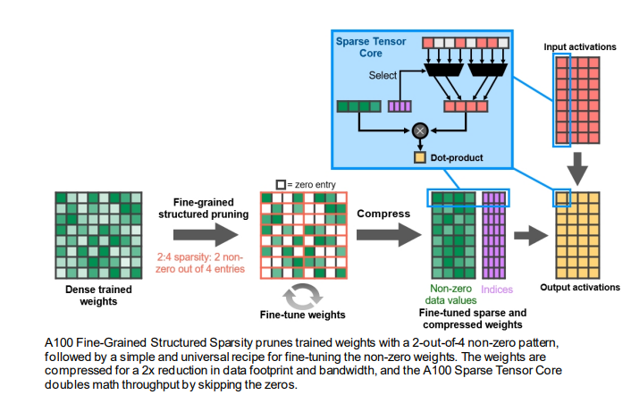
NVIDIA Ampere, introduced 2020
Third generation Sparse Tensor Core
128SMs per A100 high-end GPU
  64 FP32 CUDA cores/SM
  4 Tensor Cores/SM
  192KB combined shared memory+L1 cache
New data types
  TF32
  BF32
  FP64

Slide 18
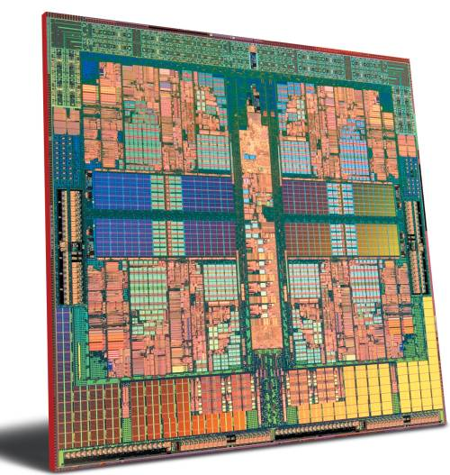
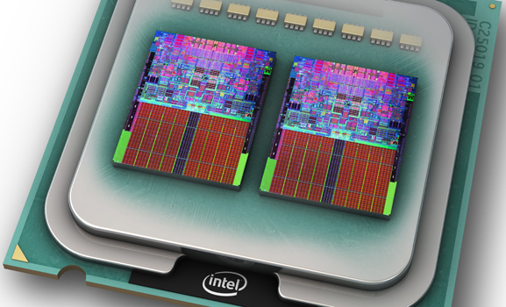
Lab DSE: Processor design space explorations
Using GEM5 simulator

Slide 19
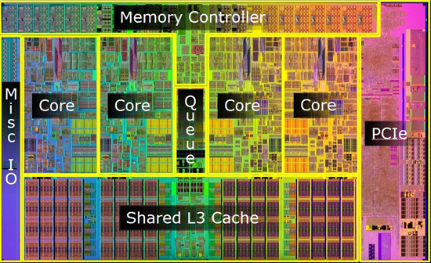
What are the objectives?
To get familiar with advanced processor architectures and their programming models
To look at different configurations, cache levels and sizes, etc.
Finally to optimize the Energy-Delay-Product (EDP) of the system

Slide 20
What you will learn
How to use the GEM5 as cycle accurate simulator to run applications
The impacts of different architectural parameters on performance
  The size of different levels of caches
  Cache Associativity
Applying loop transformation techniques to optimize the memory accesses
Applying the application partitioning technique for task level parallelism
Using McPAT for power and area estimation

Slide 21
Extra Material
Handouts and slides; see course web site:
  www.ics.ele.tue.nl/~heco/courses/ECA
Chapter 2 from Microprocessor Architectures, 1998
  http://www.es.ele.tue.nl/~heco/courses/ECA/chapter2.pdf
Optional: Study recent articles from top conferences and journals
  http://www.es.ele.tue.nl/~heco/lit/conf+journals.html

Slide 22
Schedule
2021-2022
(preliminary)
Date | Topic | Book H&P
15 Nov | Overview + Fundamentals of Computer Architecture | Ch 1
17 Nov | RISC/MIPS recap (1): ISA (Instruction-Set Architecture) | App A
 | DSE/SImulation Lab < Dec 12
22 Nov | Memory hierarchy 1 | Ch 2+App B
24 Nov | Simulation + Loop trafos (Intro) | Dubois ch 9
29 Nov | RISC/MIPS recap (2): pipelining/hazards | App C
1 Dec | Memory hierarchy 2, incl. Flash memory, Virtual Memory | Ch 2
6 Dec | DLP Architectures: Vector, SIMD and GPU architectures | Ch 4.1-4.3, 4.5
 | GPU lab < Jan 9
8 Dec | GPU: Gert-Jan van den Braak (Philips Medical Systems) | Ch 4.4
13 Dec | ILP Architecturen 1: Out-of-Order execution | Ch 3
15 Dec | ILP Architecturen 2: Branch Pred + Multiple Issue architectures | Ch 3
20 Dec | ILP Architectures 3: TTA, How much ILP, compiler support | Ch 3
22 Dec | CGRA arch (video) + CGRA Lab
 | CGRA lab < Jan 21
10 Jan | Multi-threading/processing + Networks-on-Chip | Ch 5
12 Jan | Domain-Specific Arch + ML: Maurice Peemen (FisherScientific) | Ch 7.1-7.4
 | Try-out exam online
17 Jan | Coherence, synchr. and consistency 1 | Ch 5.3
19 Jan | Coherence, synchr. and consistency 2 + Wrap up | Ch 5.5-5.6

Slide 23
Grading
With a maximum of 100 points (giving a grade 10):
3 lab reports, each up to 10 points
online exam (bring your laptop): questions about each lab: each 15 points
  questions about general / discussed theory: 25 points
note: we make a trial exam available. You have to pass this one with an 8, before Jan. 28, 2021, in order to be allowed to the exam
  good news: you may try the trial exam as often as you like, in order to pass
optional bonus, studying and presenting a recent scientific high quality article, strongly related to the course: up to 10 points
  Note: only one bonus opportunity (after exam; not after resit)

Slide 24
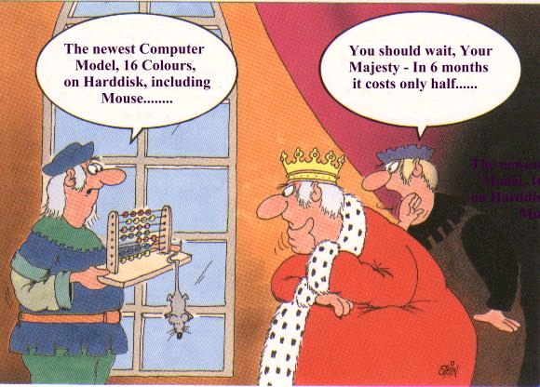
Where is computing going?
Notes:
24

