Slide 1
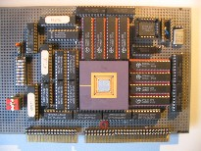
Embedded Computer Architecture 5SAI0 Exploiting Data Reuse: Loop Transformations
Patrick Wijnings
Original slides by Henk Corporaal
www.ics.ele.tue.nl/~heco/courses/ECA
h.corporaal@tue.nl p.w.a.wijnings@tue.nl
TU/e 2021-2022

Slide 2
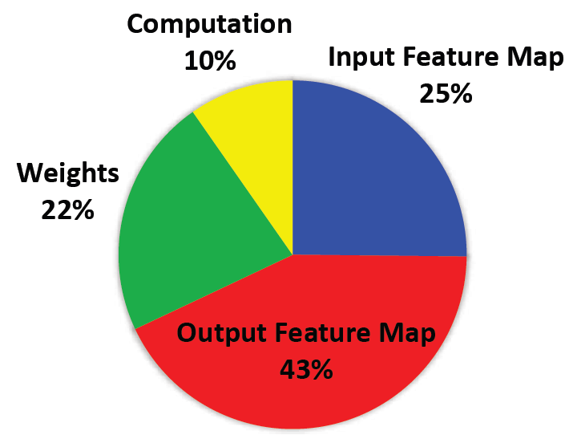
GoogLeNet: Energy
CNN layers: 21 depth, 57 in total
FC layer: 1
Weights: 7.0 M
MACs: 1.43 G per input
Yang.e.a CVPR'17

Slide 3
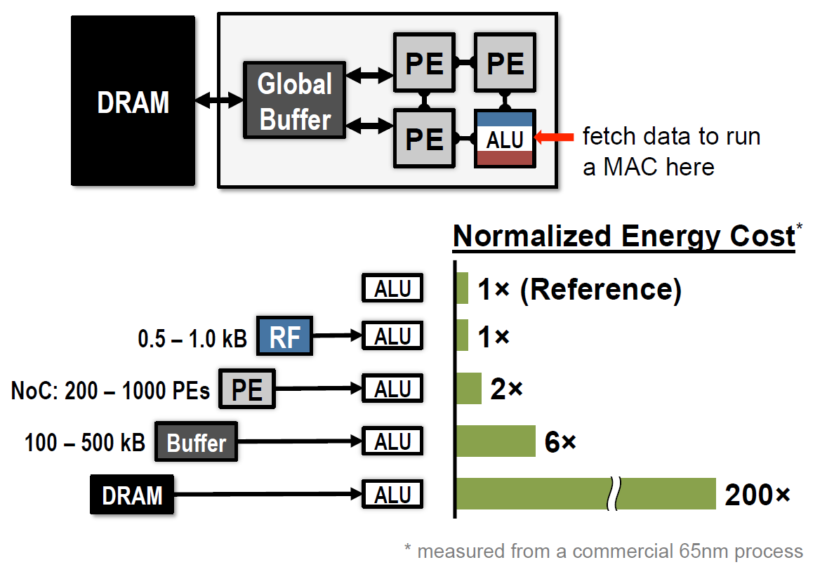
Where is the energy going

Slide 4
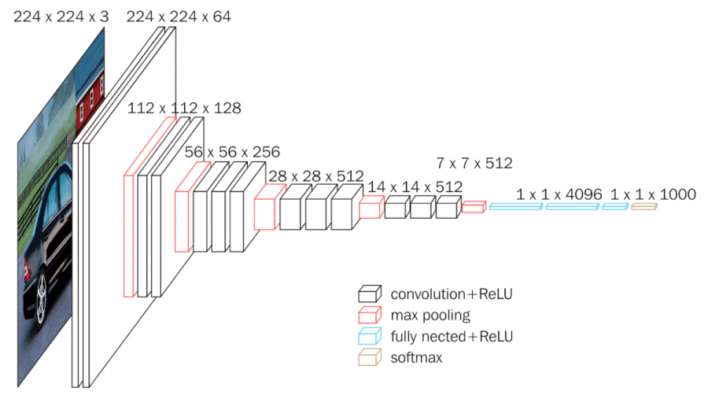
VGG16 example
Conv layers: 13
FC Layers: 3
Weights: 138 M
MACs: 15.5 G per input
Simonyan, ICLR 2015

Slide 5
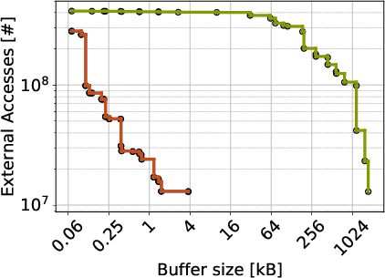
Reducing external memory accesses
VGG16 example
Original code
Rescheduled code
Conclusion: we need advanced loop transformation to
exploit data locality (in local buffers), reducing external accesses

Slide 6
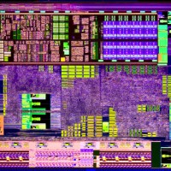
Overview loop transformations
Motivation
Data flow transformations
Loop scheduling transformations: iteration reordering
Loop restructuring
Material
partly in H&P: 4.5
GPU lab material (online)

Slide 7
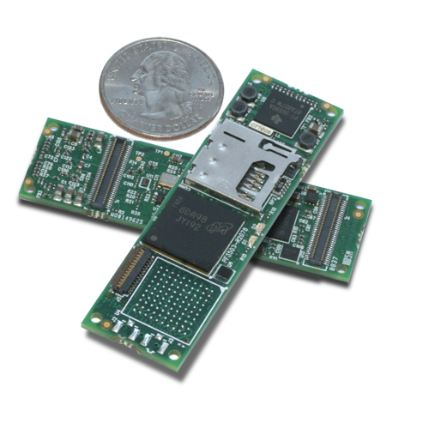
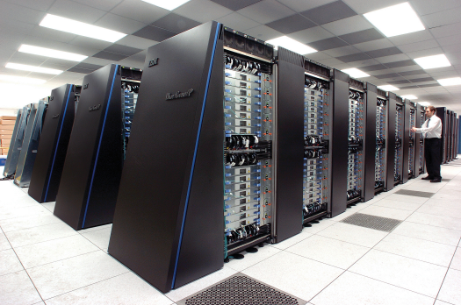
Application Excecution Time
High performance computing
Embedded computing
Small portions of the code dominate execution time
Hot spots
Loops
Apply Loop Transformations
for(i=0; i<N; i++){
for(j=0; j<N; j++){
for(k=0; k<N; k++)
c[i][j] += a[i][k] * b[k][j];
}}

Slide 8
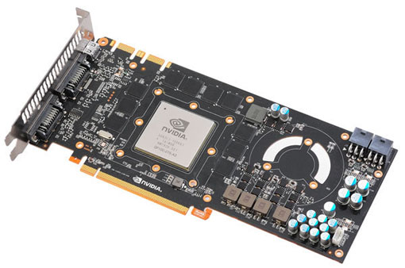
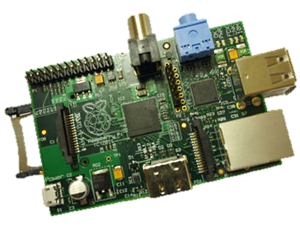
Loop Transformations
Can help you in many compute domains
Convert Loops to
GPU Threads
Embedded Devices
Fine-tune for architecture
CPU Code
Parallelism
Memory Hierarchy
HDL (HW Description Languages)

Slide 9
Data flow transformations

Slide 10
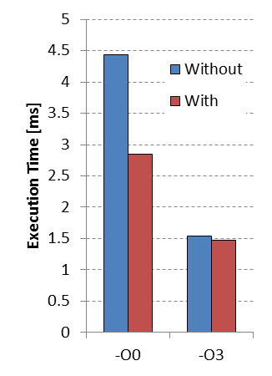
Data flow transformation: Loop-Based Strength Reduction
Replace an expensive operation
Can be multiplication, especially for embedded cores
No HW multiplier, e.g. MicroBlaze
An optimizing compiler can help
c=3;
for(i=0; i<N; i++){
a[i] = a[i] + i*c;
}
c=3;
T=0;
for(i=0; i<N; i++){
a[i] = a[i] + T;
T = T + c;
}
* Examples are from: D.F. Bacon, S.L. Graham, and O.J. Sharp, Compiler transformations for high-performance computing. ACM Comput. Surv. 26, (1994)

Slide 11
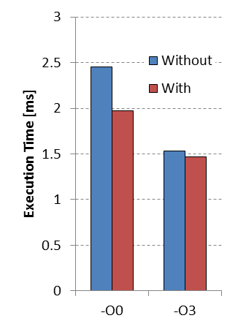
Data flow transformation: Induction Variable Elimination
Induction variable?
Compute loop exit conditions
Compute memory addresses
Given a known final value and relation to addresses
Possible to eliminate index calculations
Again an optimizing compiler can help
for(i=0; i<N; i++){
a[i] = a[i] + c;
}
A = &a[0];
T = &a[0] + N;
while(A<T){
*A = *A + c;
A++;
}
Notes:
Performing the control of a loop is basically overhead. I refer to the increment of i and the compare of i<N to check if the exit condition is not met.
With induction variable elimination we can reduce this overhead.

Slide 12
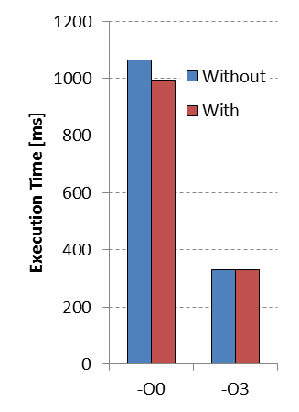
Data flow transformation: Loop-Invariant Code Motion
Index of c[] does not change
Move one loop up and store in register
Reuse it over iterations of inner loop
Most compilers can perform this
Example is similar to Scalar Replacement Transformation
for(i=0; i<N; i++){
for(j=0; j<N; j++){
a[i][j]=b[j][i]+c[i];
}
}
for(i=0; i<N; i++){
T=c[i];
for(j=0; j<N; j++){
a[i][j]=b[j][i]+T;
}
}

Slide 13
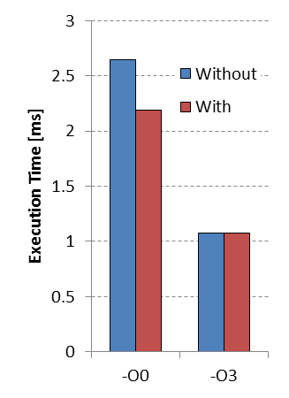
Data flow transformation: Loop Unswitching
Conditional execution in body
Speculative branch prediction helps but
This branch is loop invariant code
Move it outside the loop
Each execution path independent loops
Increases code size
if(x<7){
for(i=0; i<N; i++){
a[i]=b[i];
a[i]+=5;
}
}
else{
for(i=0; i<N; i++){
a[i]=b[i];
}
}
for(i=0; i<N; i++){
a[i] = b[i];
if(x<7){a[i]+=5;}
}

Slide 14
Iteration reordering

Slide 15
Loop representation as Iteration Space
for(i=0; i<N; i++){
for(j=0; j<N; j++){
A[i][j] = B[j+3][i+2];
Each position represents an iteration
At each position 1 or more array elements are accessed

Slide 16
Visitation order in Iteration Space
for(i=0; i<N; i++){
for(j=0; j<N; j++){
A[i][j] = B[j+3][i+2];
Iteration space is not data space
for(j=0; j<N; j++){
for(i=0; i<N; i++){
A[i][j] = B[j+3][i+2];

Slide 17
But we don’t have to be regular
A[i][j] = B[j+3][i+2];
But order can have huge impact on:
Memory Hierarchy
E.g. Reuse of data (improve locality)
Parallelism
Loop or control overhead

Slide 18
Iteration Reordering Transformations
Change the relative ordering
Improve locality by matching with a memory hierarchy
Expose parallelism by altering iteration dependencies
Reduce loop or control overhead
We need more theory to understand these
Or combine the tricks to form a methodology
Normal compilers often don’t help you with this
Only state-of-the-art (research) compilers can help
*Based on:
M. Wolf, M. Lam, A Data Locality Optimizing Algorithm. ACM SIGPLAN, PLDI (1991)

Slide 19
Loop Interchange or Loop Permutation
for(i=0; i<N; i++){ for(j=0; j<N; j++){
for(j=0; j<N; j++){ for(i=0; i<N; i++){
A[j][i] = i*j; A[j][i] = i*j;
N is large with respect to cache size
Normal compilers will not help you!
Notes:
Example to demonstrate the possible locality increase due to interchange

Slide 20
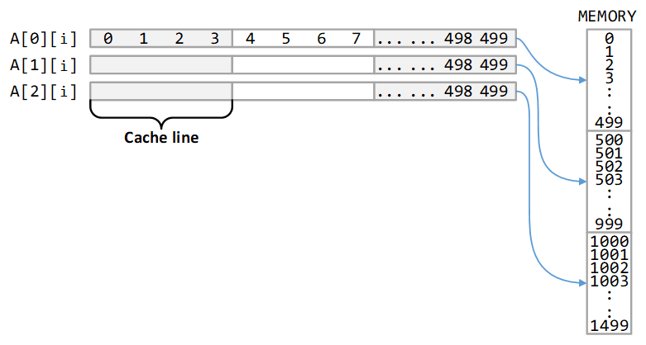
Loop Interchange or Loop Permutation
for(i=0; i<N; i++){ for(j=0; j<N; j++){
for(j=0; j<N; j++){ for(i=0; i<N; i++){
A[j][i] = i*j; A[j][i] = i*j;
Assumptions:
1. Memory layout row major
2.Cache line size=4 elements
Notes:
Example to demonstrate the possible locality increase due to interchange

Slide 21
Types of data reuse
for i := 0 to 2
for j := 0 to 100
A[i][j] = B[j+1][0] + B[j][0];
Notes:
Spatial reuse = reuse of neighboring values in cache lines; Temporal reuse = Single value reused at different moment in time;
Group reuse = multiple memory references in the loop body point to the same memory location at different iteration values (temporal) or they point to neighboring values (spatial)

Slide 22
Optimize array accesses for memory hierarchy
Solve the following questions?
When do misses occur?
Use “locality analysis”
Is it possible to change iteration order to produce better behavior?
Evaluate the cost of various alternatives
Does the new ordering produce correct results?
Use “dependence analysis”
Notes:
Introduce theory for memory hierarchy optimization

Slide 23
Different Reordering Transformations
Loop Interchange
Tiling
Loop Reversal
Skewing
Can improve locality
Can enable above

Slide 24
Tiling the Iteration Order
Result in Iteration Space
for(jj=0; jj<N; jj+=Tj){
for(i=0; i<N; i++){ for(i=0; i<N; i++){
for(j=0; j<N; j++){ for(j=jj; j<jj+Tj; j++){
f(A[i],A[j]); f(A[i],A[j]);
assume
Tj=4
Notes:
Example to show the potential locality increase due to tiling

Slide 25
Cache Effects of Tiling
for(jj=0; jj<N; jj+=Tj){
for(i=0; i<N; i++){ for(i=0; i<N; i++){
for(j=0; j<N; j++){ for(j=jj; j<jj+Tj; j++){
f(A[i],A[j]); f(A[i],A[j]);
Iteration
space (i,j)
assume Tj=4
Again, assume N >> cache size - A does not fit in the cache

Slide 26
Is this always possible?
No, dependencies can prevent transformations
Interchange and Tiling is not always valid!
Example Interchange
Spatial locality
Dependency (1,-1)
Should be lexicographically correct
Dependence vectors
for(i=1; i<N; i++){
for(j=0; j<N; j++){
a[j][i] = a[j+1][i-1] + 1;
}
}

Slide 27
Lexicographical ordering
Each iteration is a node identified by its n-dim. index vector: p = (p₁, p₂, …, p_{n})
Iterations are executed in lexicographic order
For p = (p₁, p₂, …, p_{n}) and q = (q₁, q₂, …, q_{n}) p is lexicographically greater than q written as p q
Therefore iteration p must be executed after q
Example:
(1,1,1), (1,1,2), (1,1,3), …,
(1,2,1), (1,2,2), (1,2,3), …,
…,
(2,1,1), (2,1,2), (2,1,3), …,
(1,2,1) (1,1,2) ? (1,4,2) (2,1,1) ?
A little quiz?
Notes:
Lexicographical ordering introduced this will be used during the dependency analysis later on.

Slide 28
Dependence vectors
Dependence vector in an n-nested loop is denoted as a vector: d = (d₁, d₂, …, d_{n})
A single dependence vector represents a set of distance vectors
A distance vector defines a distance in the iteration space
Distance vector is difference between target and source iterations:
d = I_{T} – I_{S}
Notes:
Dependence distance introduced. Not always possible can also be a direction vector.

Slide 29
Example of dependence vector
For(i=0; i<N; i++){
for(j=0; j<N; j++)
A[i,j] = …;
= A[i,j];
B[i,j+1] = …;
= B[i,j];
C[i+1,j] = …;
= C[i,j+1];
A yields: B yields: C yields:
A_{2,0}= =A_{2,0}
B_{2,1}= =B_{2,0}
C_{3,0}= =C_{2,1}
A_{2,1}= =A_{2,1}
B_{2,2}= =B_{2,1}
C_{3,1}= =C_{2,2}
A_{2,2}= =A_{2,2}
B_{2,3}= =B_{2,2}
C_{3,2}= =C_{2,3}
A_{1,0}= =A_{1,0}
B_{1,1}= =B_{1,0}
C_{2,0}= =C_{1,1}
A_{1,1}= =A_{1,1}
B_{1,2}= =B_{1,1}
C_{2,1}= =C_{1,2}
A_{1,2}= =A_{1,2}
B_{1,3}= =B_{1,2}
C_{2,2}= =C_{1,3}
i
A_{0,0}= =A_{0,0}
B_{0,1}= =B_{0,0}
C_{1,0}= =C_{0,1}
A_{0,1}= =A_{0,1}
B_{0,2}= =B_{0,1}
C_{1,1}= =C_{0,2}
A_{0,2}= =A_{0,2}
B_{0,3}= =B_{0,2}
C_{1,2}= =C_{0,3}
j

Slide 30
Plausible dependence vectors
A dependence vector is plausible iff it is lexicographically non-negative
For(i=0; i<N; i++){
for(j=0; j<N; j++)
.......
Plausible: (1,-1)
Implausible: (-1,0)

Slide 31
Loop Reversal
Dependency (1,-1) Dependency (1,1)
loop interchange is valid after loop reversal
for(i=0; i<N; i++){
for(j=0; j<N; j++){
a[j][i] = a[j+1][i-1] + 1;
}
}
for(i=0; i<N; i++){
for(j=N-1; j>=0; j--){
a[j][i] = a[j+1][i-1] + 1;
}
}

Slide 32
More difficult example
For(i=0; i<6; i++){ D={(0,1),(1,0),(1,-1)}
for(j=0; j<7; j++){
A[j+1] += 1/3 * (A[j] + A[j+1] + A[j+2]);
What are other legal visit orders?

Slide 33
Loop Skewing
for(i=0 i<6; i++){ D = {(0,1),(1,0),(1,-1)}
for(j=0; j<7; j++){
A[j+1] = 1/3 * (A[j] + A[j+1] + A[j+2]);
for(i=0; i<6; i++){ D = {(0,1),(1,1),(1,0)}
for(j=i; j<7+i; j++){
A[j-i+1] = 1/3 * (A[j-i] + A[j-i+1] + A[j-i+2]);
Notes:
Original dependence vector top vs dependence vector bottom

Slide 34
Loop skewing enables Tiling
Apply Skew Transformation
Apply Tiling

Slide 35
Is It Really That Easy ?
No, we forget a few things
Cache capacity and reuse distance
If caches were infinitely large, we would be finished
For deep loopnests analysis can be very difficult
It would be much better to automate these steps
We need more theory and tools
Cost models

Slide 36
Data Reuse distance
The number of unique accesses between a use and a reuse is defined as the (data) reuse distance:
( a[0] a[6] a[20] b[1] a[6] a[0] ) => R_{D} (a[0])= 3
* C. Ding, Y. Zhong, Predicting Whole-Program Locality through Reuse Distance Analysis, PLDI (2003)
Second a[0] access is a cache hit if
Fully associative cache with n=4 entries
Optimal LRU, least recently used, replacement policy
In general:
Cache hit if R_{D} < n
Cache miss if R_{D} ≥ n
We can measure reuse distance with profiling tools:
Suggestions for Locality Optimization (SLO)
Beyls, K., D'Hollander, E. Refactoring for Data Locality, IEEE Computer Vol. 42, no. 2 2009
Notes:
Can be line adresses

Slide 37
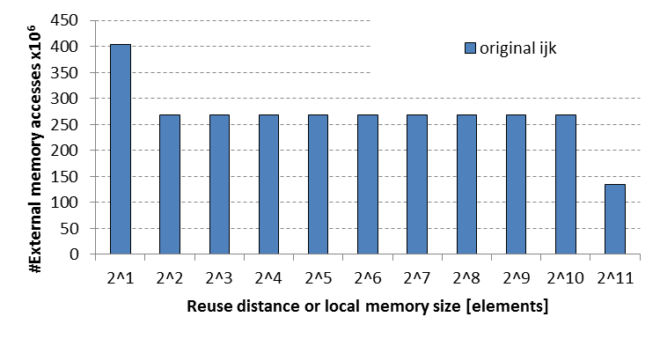
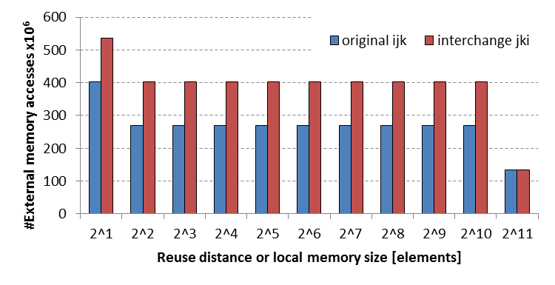
Study a matrix multiplication kernel
Loop interchange
for(i=0; i<Bi; i++){
for(j=0; j<Bj; j++){
for(k=0; k<Bk; k++){
C[i][j] += A[i][k] * B[k][j];
for(j=0; j<Bj; j++){
for(k=0; k<Bk; k++){
for(i=0; i<Bi; i++){
C[i][j] += A[i][k] * B[k][j];

Slide 38
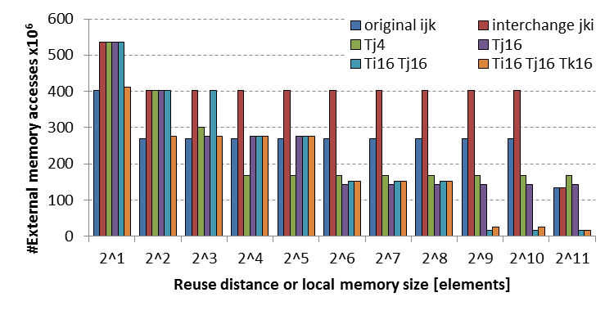
Loop tiling
Can be done in multiple dimensions
Manual exploration is intractable
for(i=0; i<Bi; i++){
for(j=0; j<Bj; j++){
for(k=0; k<Bk; k++){
C[i][j] += A[i][k] * B[k][j];
for(i=0; i<Bi; i++){
for(jj=0; jj<Bj; jj+=Tj){
for(k=0; k<Bk; k++){
for(j=jj; j<jj+Tj; j++)
C[i][j] += A[i][k] * B[k][j];

Slide 39
LOOP RESTRUCTURING

Slide 40
Loop Unrolling
Duplicate loop body and adjust loop header
Increases ILP (Instruction Level Parallelism)
Reduces loop overhead (fewer branches and counter increments)
Possibilities for common subexpression elimination
If partial unroll, loop should stay in original bound!
Downsides
Code size increases, can increase I-cache miss-rate
for(i=1; i<N-1; i+=2){
a[i]=a[i-1]+a[i]+a[i+1];
a[i+1]=a[i]+a[i+1]+a[i+2];
}
if(mod(N-1,2)==1){
a[N-1]=a[N-2]+a[N-1]+a[N];
for(i=1; i<N; i++){
a[i]=a[i-1]+a[i]+a[i+1];
}

Slide 41
Loop Merge or Fusion
Why?
Improve locality
Reduce loop overhead
for(i=0; i<N; i++){
b[i]=a[i]+1;
}
for(j=0; j<N; j++){
c[j]=b[j]+a[j];
}
for(i=0; i<N; i++){
b[i]=a[i]+1;
c[i]=b[i]+a[i];
}
Location
Location
Production/Consumption
Production/Consumption
Consumption(s)
Consumption(s)
Time
Time

Slide 42
Fusion is not always allowed
Data dependencies from first to second loop
Fusion is allowed if
∀ I: cons(I) in loop 2 ≤ prod(I) in loop 1
Enabling transformations: Bump, Reverse, Skew
for(i=0; i<N; i++){
b[i]=a[i]+1;
}
N-1>=i
for(i=0; i<N; i++){
c[i]=b[N-1]+a[i];
}
for(i=0; i<N; i++){
b[i]=a[i]+1;
}
i-2 < i
for(i=0; i<N; i++){
c[i]=b[i-2]+a[i];
}

Slide 43
Loop Bump: Example as enabler
for(i=2; i<N; i++){
b[i]=a[i]+1;
}
for(i=0; i<N-2; i++){
c[i]=b[i+2]*0.5;
}
i+2 > i => direct merging not possible
for(i=2; i<N; i++){
b[i]=a[i]+1;
}
for(i=2; i<N; i++){
c[i-2]=b[i+2-2]*0.5;
}
i+2-2 = i => possible to merge
for(i=2; i<N; i++){
b[i]=a[i]+1;
c[i-2]=b[i]*0.5;
}

Slide 44
Main Take-Aways
Data-Flow-Based Transformations
Good compilers can help
Iteration Reordering Transformations
High-level transformations
Compilers are often not enough
Huge gains for parallelims and locality
Be carefull with dependencies
Loop Restructuring Transformations
Similar to reordering

Slide 45
Extra Enabler Transformations
Many of these can be very useful
Especially to enable the beneficial ones:
Interchange
Tiling
Fusion
Often you need combinations to get the job done!
Try to use them all in the assignments!

