Slide 1
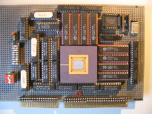


Embedded Computer Architecture
5SAI0
Memory Hierarchy
Part I
Henk Corporaal
www.ics.ele.tue.nl/~heco/courses/ECA
h.corporaal@tue.nl
TUEindhoven
2021-2022

Slide 2
Topics Memory Hierarchy Part I
Memory hierarchy motivation
Caches
  direct mapped
  set-associative
Basic cache optimizations
Part II (Dec 1)
  Advanced cache optimizations
  Memory design
  Virtual memory
    Address mapping and Page tables, TLB
=> Material book: Ch2 + App B (H&P) / Ch 4 (Dubois)
But first: Other Architecture Styles

Slide 3
Remember RISC? Keep it simple
RISC characteristics:
Reduced number of instructions
Limited number of instruction sizes (preferably one)
  know directly where the following instruction starts
Limited number of instruction formats
Limited addressing modes
  load-store architecture
  enables pipelining
Large register set
  uniform (no distinction between e.g. address and data registers)
Memory alignment restrictions
Pipelined implementation

Slide 4
Other architecture styles
Accumulator architecture
  one operand (in register or memory), accumulator almost always implicitly used
Stack
  zero operand: all operands implicit (on TOS)
Register (load store) = RISC
  three operands, all in registers
  loads and stores are the only instructions accessing memory (i.e. with a memory (indirect) addressing mode
Register-Memory
  two operands, one in memory
Memory-Memory
  three operands, may be all in memory
(there are more varieties / combinations)

Slide 5
Accumulator Architecture
latch
Accumulator
ALU
Memory
address
registers
latch
Example code: a = b+c;
load b; // accumulator is implicit operand
add c;
store a;

Slide 6
Stack Architecture
latch
latch
top of
stack
ALU
Memory
latch
stack pt
Example code: a = b+c;
push b;
push c;
add;
pop a;
push b
push c
add
pop a
stack:
b
c
b+c
b

Slide 7
Other architecture styles
RISC
Let's look at the code for C = A + B
Stack Architecture | Accumulator Architecture | Register-Memory | Memory-Memory | Register (load-store)
Push A | Load A | Load r1,A | Add C,B,A | Load r1,A
Push B | Add B | Add r1,B |  | Load r2,B
Add | Store C | Store C,r1 |  | Add r3,r1,r2
Pop C |  |  |  | Store C,r3
Note: in code A stands for (r) where register r contains &a; similar for B,C
Q: What are the advantages / disadvantages of load-store (RISC) architecture?
Notes:
Pros:
• Small set of instructions: easier for compilers to produce more efficient codes.
• A single instruction takes one cycle.
• Fixed length of instruction, few parameters, easier to pipeline.
• Fewer instruction formats, a lesser number of instructions, and fewer addressing modes.
• Decoding logic is simple.
• More general-purpose registers. Shorter time for loading.
• Smaller area chip.
• More energy-efficient than CISC.
Cons:
• Performance depends on compiler/programmer.
• Compiler needs to decompose high-level instructions into many simple ones.
• Increased the code size.
• Large memory caches.

Slide 8
Many addressing modes; RISC uses only 3-4
MODE | EXAMPLE | MEANING
REGISTER | ADD R4, R3 | reg[R4] <- reg[R4] +reg[R3]
IMMEDIATE | ADD R4, #3 | reg[R4] <- reg[R4] + 3
DISPLACEMENT | ADD R4, 100(R1) | reg[R4] <- reg[R4] + Mem[100 + reg[R1]]
REGISTER INDIRECT | ADD R4, (R1) | reg[R4] <- reg[R4] + Mem[reg[R1]]
INDEXED | ADD R3, (R1+R2) | reg[R3] <- reg[R3] + Mem[reg[R1] + reg[R2]]
DIRECT OR ABSOLUTE | ADD R1, (1001) | reg[R1] <- reg[R1] + Mem[1001]
MEMORY INDIRECT | ADD R1, @R3 | reg[R1] <- reg[R1] + Mem[Mem[Reg[3]]]
POST INCREMENT | ADD R1, (R2)+ | ADD R1, (R2) then R2 <- R2+d
PREDECREMENT | ADD R1, -(R2) | R2 <- R2-d then ADD R1, (R2)
PC-RELATIVE | BEZ R1, 100 | if R1==0, PC <- PC+100
PC-RELATIVE | JUMP 200 | Concatenate bits of PC and offset

Slide 9
Topics Memory Hierarchy Part I
Memory hierarchy motivation
Caches
  direct mapped
  set-associative
Basic cache optimizations
  Classification of cache misses: the 3 C’s
=> Material book: Ch2 + App B (H&P) / Ch 4 (Dubois)

Slide 10
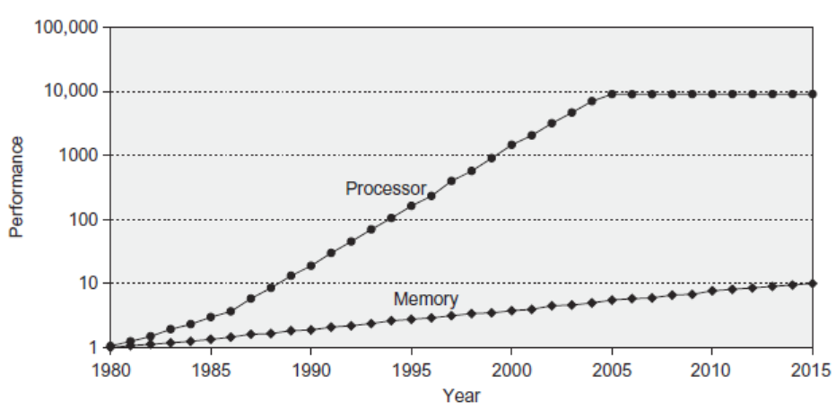
Memory Performance Gap single processor performance vs memory latency
Huge performance gap between CPU and Memory

Slide 11
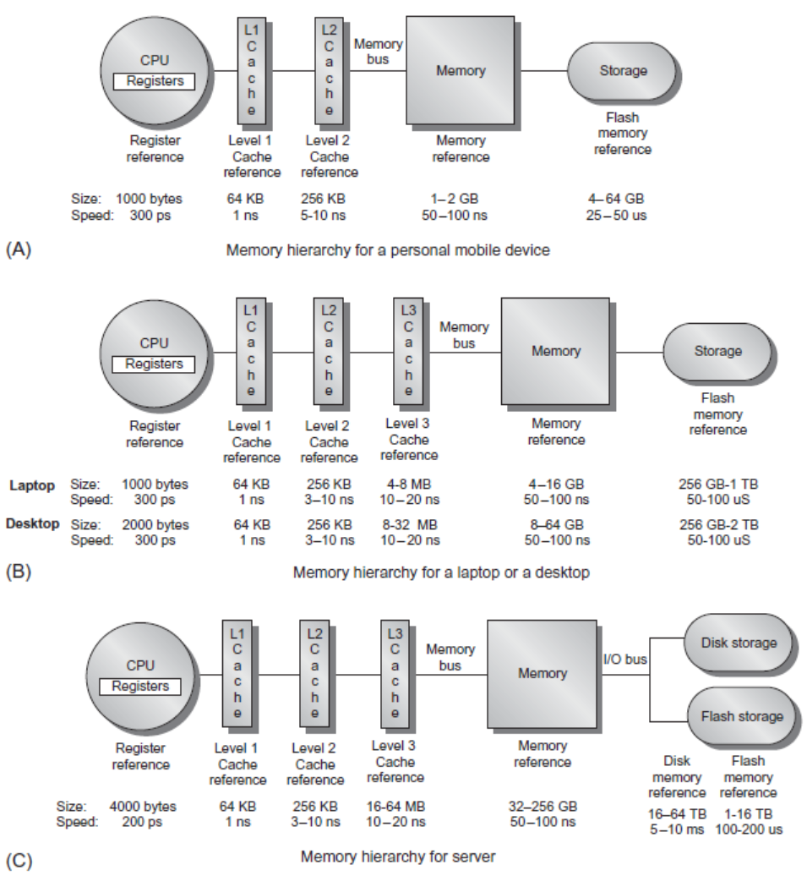
Memory
Hierarchy

Slide 12
Memory Hierarchy Design
Very crucial with recent multi-core processors:
  Aggregate peak bandwidth grows with # cores !
Example:
  Intel Core i7 can generate two references per core per clock
  With 4 cores and 3.2 GHz clock =>
    25.6 billion 64-bit data references/second +
    12.8 billion 128-bit instruction references
    = 409.6 GB/s!
  DRAM bandwidth is only 6% of this (25 GB/s)
  We need:
    Multi-port, pipelined caches
    Two levels of cache per core
    Shared (between cores) third-level (L3) cache on chip
Microprocessors have >> MB on-chip cache; huge area
Memory and caches consume much energy

Slide 13
Why does a (small) cache work?
Your program and data sizes >> cache size ??
LOCALITY !!!!!
  Temporal: you are likely accessing the same address soon again
  Spatial: you are likely accessing another address close to the current one in the near future

Slide 14
Topics Memory Hierarchy Part I
Memory hierarchy motivation
Caches
  direct mapped
  set-associative
Basic cache optimizations
  Classification of cache misses: the 3 C’s
=> Material book: Ch2 + App B (H&P) / Ch 4 (Dubois)

Slide 15
Cache operation
Cache / Higher level
Memory / Lower level
block / line
tags
data

Slide 16
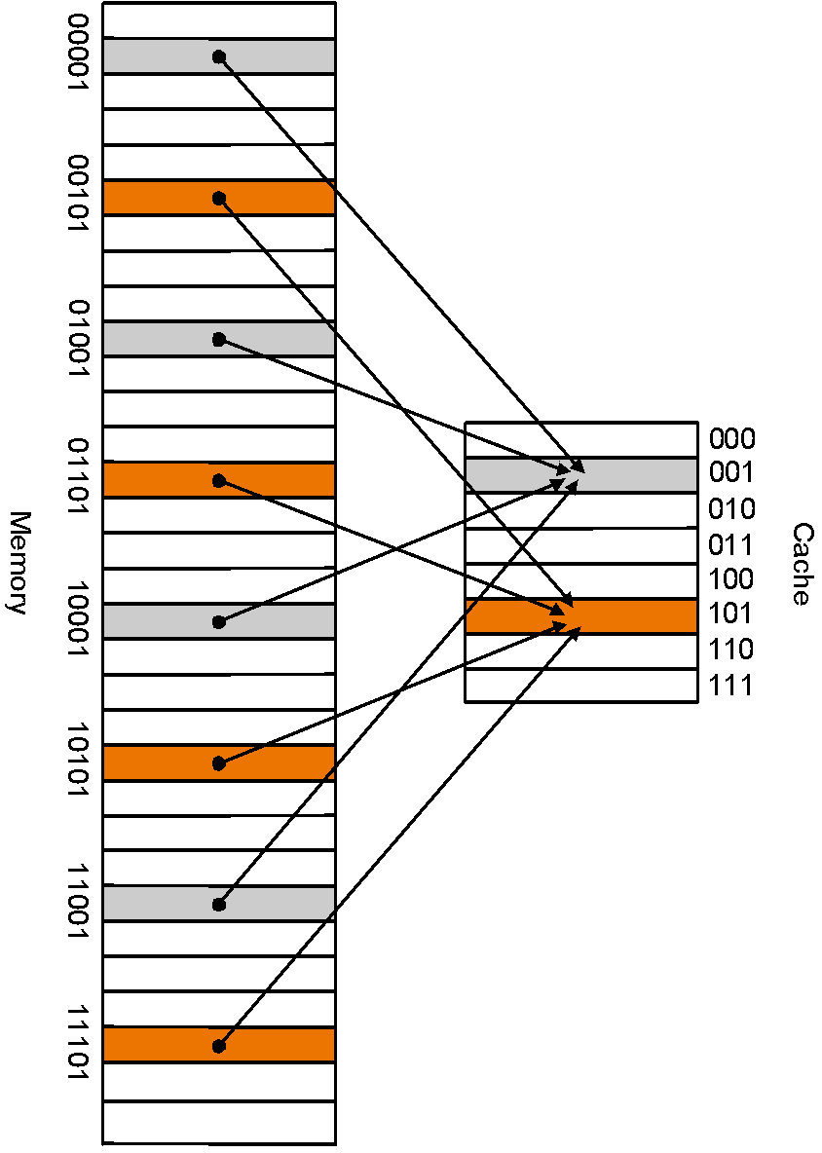
Direct Mapped
Cache
Mapping:
block address modulo the number of blocks in the cache

Slide 17
Direct Mapped Cache
Address (bit positions)
3
1
3
0
1
3
1
2
1
1
2
1
0
Q:What kind of locality are we taking advantage of?
B
y
t
o
e
f
f
s
e
t
H
2
0
1
0
i
t
D
a
t
T
a
g
a
I
n
d
e
x
I
n
d
e
x
V
a
l
i
d
T
a
g
D
a
t
a
0
1
2
1
0
2
1
1
0
2
2
1
0
2
3
2
0
3
2

Slide 18
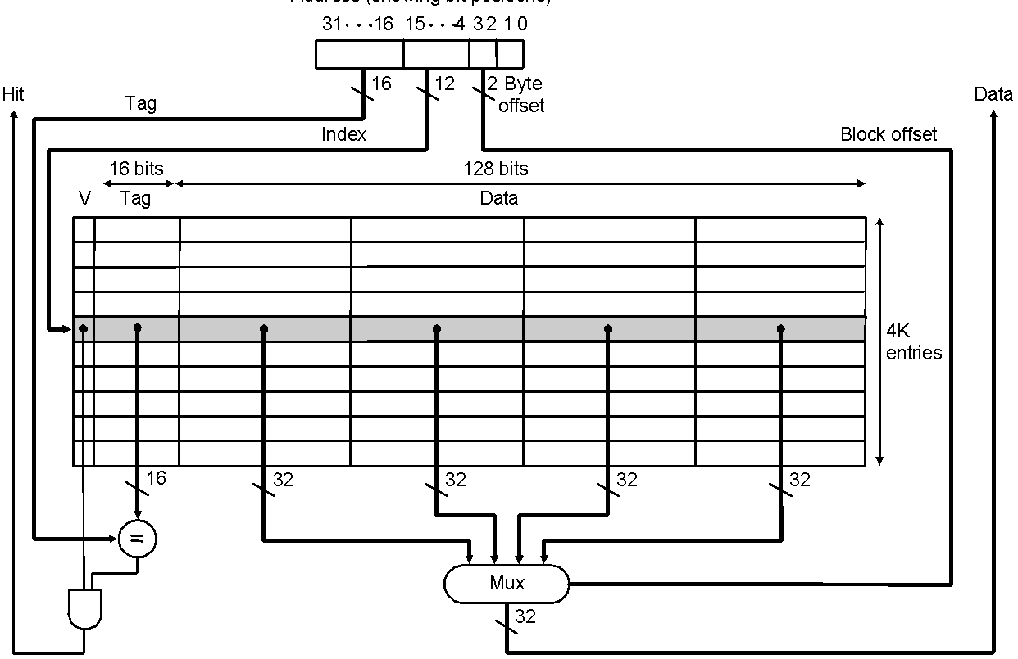
Direct Mapped Cache
Taking advantage of spatial locality:
Address (bit positions)

Slide 19
Memory hierarchy basics
When a word is not found in the cache, a miss occurs:
  Fetch word from lower level in hierarchy, requiring a higher latency reference
  Lower level may be another cache or the main memory
  Also fetch the other words contained within the block
    Takes advantage of spatial locality
    Often costs extra cycles delay
  Place block into cache in any location within its set, determined by address
    block address MOD number of sets in cache

Slide 20
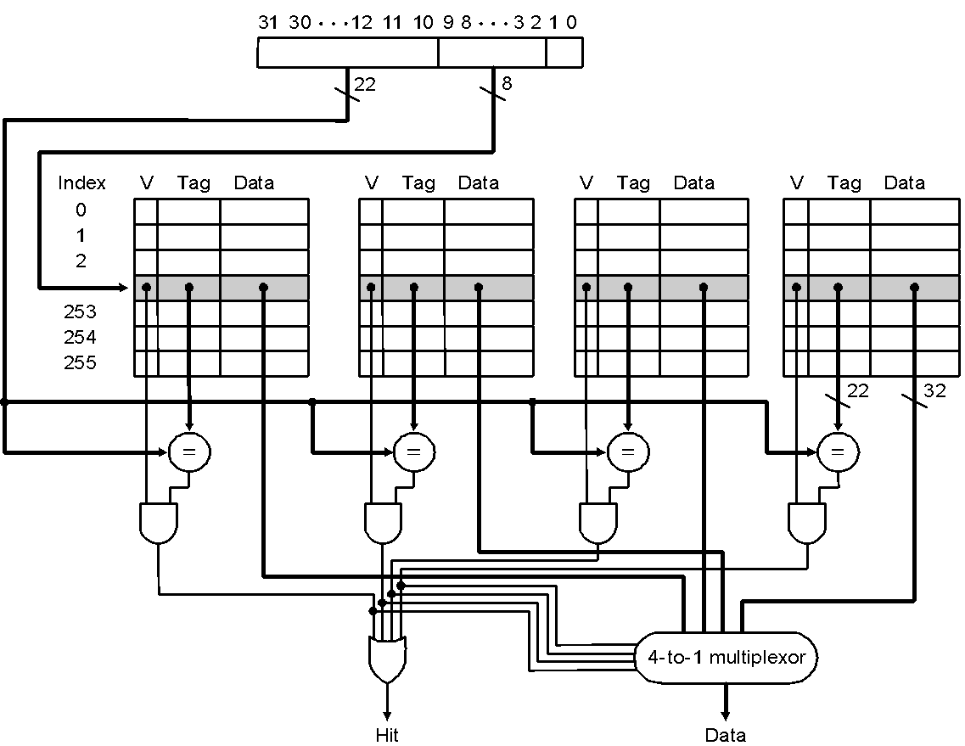
Cache basics
Way 3
Set 1
4-ways set-associative cache (N_{sets} =4): each set contains 4 blocks

Slide 21
Cache basics
cache_size = N_{sets} * Assoc * Block_size
block_address = Byte_address DIV Block_size (in bytes)
index = Block_address MOD N_{sets}
Because the block size and N_{sets} are (usually) powers of two, DIV and MOD can be performed efficiently;
how?
block address
tag
index
block
offset
31 …
… 2 1 0

Slide 22
Cache performance: metrics & terminology
Average memory access time (AMAT)
AMAT= hit_time + miss_rate * miss_penalty
Miss rate: fraction of accesses not satisfied by the cache (at a certain level L_{i})
  Number of misses is divided by the number of processor references
  Also hit_rate = 1 – miss_rate
Miss_penalty: average delay per miss caused in the processor
  If processor blocks on misses, then this is simply the number of clock cycles to bring a block from memory, also called miss latency
  In a OoO (Out-of-Order) processor, the penalty of a miss cannot be measured directly
  Different from miss latency
Miss rate and penalty can be defined for all cache levels L_{i}

Slide 23
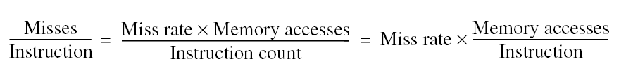
Cache performance: metrics&terminology
Misses per instructions (MPI)
  Number of misses in Level_i (Li) divided by number of instructions
  Easier to use than miss rate: CPI = CPI₀ + MPI*miss_penalty
Note: speculative and multithreaded processors may execute other instructions during a miss
  Reduces performance impact of misses

Slide 24
4 questions for designers
Q1: Where can a block be placed in the upper level? (Block placement)
  Fully Associative, Set Associative, Direct Mapped
Q2: How is a block found if it is in the upper level?
(Block identification)
  Tag/Block
Q3: Which block should be replaced on a miss?
(Block replacement)
  Random, FIFO (First-in First-out), LRU (Least Recently Used)
Q4: What happens on a write?
(Write strategy)
  Write Back or Write Through (with Write Buffer)

Slide 25
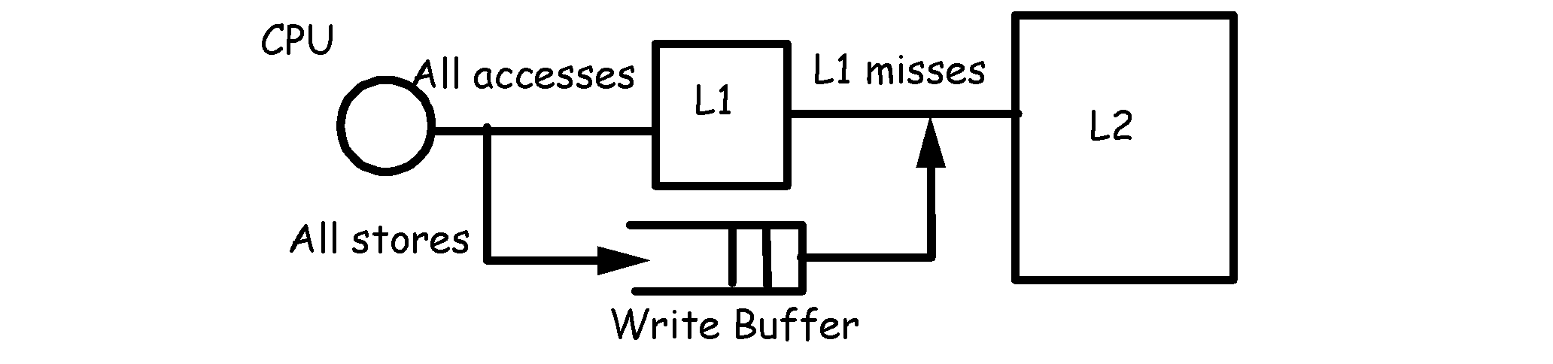
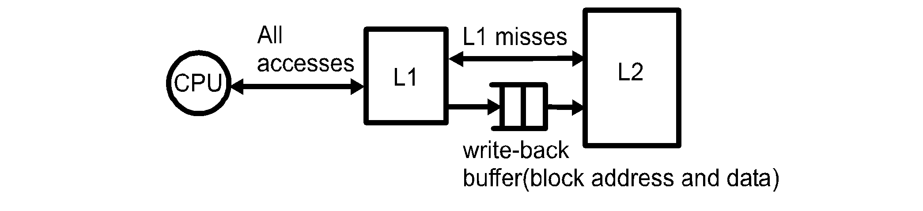
Write policies
Write through: write to next level on all writes
  Combined with write buffer to avoid CPU stalls
  Simple, no inconsistency among levels
Write-back: write to next level only on replacement
    With the help of a dirty bit and a write-back buffer
  Writes happen on a miss only
Allocation on write miss
  Always allocate in write-back; design choice in write-through

Slide 26
Topics Memory Hierarchy Part I
Memory hierarchy motivation
Caches
  direct mapped
  set-associative
Basic cache optimizations
  Classification of cache misses: the 3 C’s
=> Material book: Ch2 + App B (H&P) / Ch 4 (Dubois)

Slide 27
Basic Cache optimizations
Larger cache capacity to reduce miss rate
  Increases hit time, increases power consumption
Larger block size
  Reduces compulsory misses (by exploiting more spatial locality)
  Increases capacity and conflict misses, increases miss penalty
Higher associativity
  Reduces conflict misses
  Increases hit time, increases power consumption
More cache levels
  Reduces overall memory access time
Split L1 data and L1 instruction cache
  can access data and instructions in parallel, even for single ported caches

Slide 28
Effect of cache parameters
Larger caches
  Slower, more complex, more energy/access, but fewer capacity misses
Larger block size
  Exploit more spatial locality
  However: Too big a block increases capacity misses
  Big blocks also increase miss penalty (takes much more time to load a line from next level
Higher associativity
  Addresses conflict misses
  However: higher hit time, more energy/access
  8-16 way SA (Set-Associative) is as good as Fully Associative

Slide 29
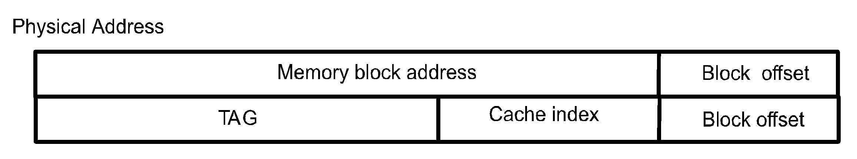
Cache mapping
Direct-mapped: each memory block can be mapped to only one cache line:
  cache index = block address modulo the number of lines in cache
Set-associative: each memory block can be mapped to a set of lines in cache;
  set number = block address modulo the number of cache sets
Fully associative: each memory block can be in any cache line
  effectively there is only one set
Notes:
Memory blocks are mapped to cache lines
Mapping can be direct, set-associative or fully associative

Slide 30
Direct Mapped
Cache: Problem !?!
Many memory addresses
map to the same
cache line
=> Conflicts
Solution:
  Associative caches

Slide 31
A 4-Way Set-Associative Cache
Way 3
Set 1
4-ways: Each set contains 4 blocks
Fully associative cache has only 1 set, containing all blocks

Slide 32
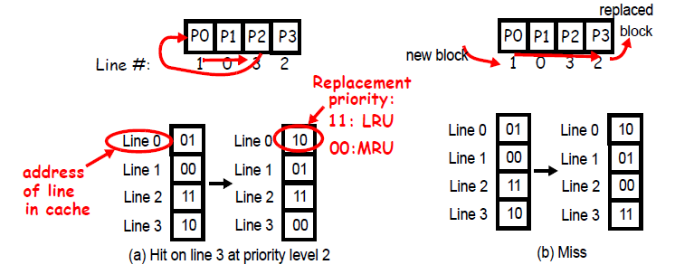
Replacement policies
Random, LRU, FIFO, pseudo-LRU
Example: least-recently used (LRU)
  replacement priority per cache line (11 = should be replaced)
Notes:
Numbers indicate replacement priority, highest = 11. Higher means closer to replacement. So priority 0 = MRU (most recently used) line.
line 3 gets lowest replacement priority = 00.
all entries below the original priority of line 3 (was 10) get incremented.
miss => replace line 2 => its priority is set to 00, all others are incremented.

Slide 33
LRU Visualised
Line 1 - 00
Most Recently Used (MRU)
Line 0 - 01
Line 3 - 10
Line 2 - 11
Least Recently Used (LRU)
Priority level == index in this stack

Slide 34
LRU Visualised
Line 1 - 00
Most Recently Used
Line 0 - 01
Hit on line 3
Line 3 - 10
Line 2 - 11
Least Recently Used
Hit on Line 3

Slide 35
LRU Visualised
Line 1 - 00
Line 0 - 01
Hit on line 3
Line 3 - 10
Most Recently Used
Line 2 - 11
Least Recently Used
Line 3 needs to become MRU

Slide 36
Hit on line 3
Line 3 - 10
Most Recently Used
Line 1 - 00
Line 0 - 01
Line 2 - 11
Least Recently Used
Move line 3 to top
Indexes need fixing!

Slide 37
Hit on line 3
Line 3 - 00
Most Recently Used
Line 1 - 00
Line 0 - 01
Line 2 - 11
Least Recently Used
line 3 gets index 00

Slide 38
Hit on line 3
Line 3 - 00
Most Recently Used
Line 1 - 00
+1
Line 0 - 01
Line 2 - 11
Least Recently Used
Every line with index lower than old index of line 3 is incremented

Slide 39
Hit on line 3
Line 3 - 00
Most Recently Used
Line 1 - 01
+1
Line 0 - 10
Line 2 - 11
Least Recently Used
Every line with index lower than old index of line 3 is incremented

Slide 40
LRU Visualised
Line 3 - 00
Most Recently Used
Line 1 - 01
Line 0 - 10
Line 2 - 11
Least Recently Used
All indexes are up to date

Slide 41
LRU Index Update Hardware
Line 3 - 00
Most Recently Used
Line 1 - 01
Line 0 - 10
Line 2 - 11
Least Recently Used
index = hit ? 00 : ( index<hit_index) ? index+1 : index

Slide 42
LRU Index Update Hardware
Line 3 - 00
Most Recently Used
Line 1 - 01
Line 0 - 10
Line 2 - 11
Least Recently Used
index = hit ? 00 : ( index<hit_index) ? index+1 : index
Mux
Sub+Comp
Mux
Mux
Incr.

Slide 43
LRU Index Update Hardware
Line 3 - 00
Most Recently Used
Line 1 - 01
Line 0 - 10
Line 2 - 11
Least Recently Used
index = hit ? 00 : ( index<hit_index) ? index+1 : index
Mux
Sub+Comp
Mux
Mux
Incr.
For each way!!

Slide 44
Multilevel Caches
Primary, level-1 cache attached to CPU
  Small, but fast
Level-2 cache services misses from primary cache
  Larger, slower, but still faster than main memory
Some high-end systems include L-3 cache
In that case, main memory services L-3 cache misses
Main Memory
L3 $
L2 $
CPU
L1 $

Slide 45
The cache/memory performance equation
T_{exec} = N_{cycles} • T_{cycle} = N_{inst}• CPI • T_{cycle}
with
CPI = CPI_{ideal} + CPI_{stall}
CPI_{stall} = %reads • missrate_{read} • misspenalty_{read} +
%writes • missrate_{write} • misspenalty_{write}
or:
T_{exec} = (N_{normal-cycles} + N_{stall-cycles} ) • T_{cycle}
with
N_{stall-cycles} = N_{reads} • missrate_{read} • misspenalty_{read} +
N_{writes} • missrate_{write} • misspenalty_{write}
(+ Write-buffer stalls )
Note: 1) often reads and writes are combined
2) often Instructions and Data are taken separately

Slide 46
Multilevel Cache: calculate CPI?
Let’s first look at a 1-level cache:
  CPU with CPI_{base} = 1, clock rate = 4GHz
  Miss rate/instruction = 2%
  Main memory access time = 100ns
What is the CPI with only a L1 cache?
Miss penalty = 100ns/0.25ns = 400 cycles
CPI = CPI_{base} + miss_rate * miss_penalty
= 1 + 0.02 × 400 = 9 cycles/instruction
Main Memory
CPU
L1 $

Slide 47
Example (cont.)
Main Memory
L2 $
CPU
L1 $
Now add L2 cache
  Access time = 5ns
  Global miss rate to main memory = 0.5%
L1 miss with L2 hit
  Penalty = 5ns/0.25ns = 20 cycles
L1 miss with L2 miss
  Extra penalty = 400 cycles
What is speedup of adding L2 cache?
CPI = 1 + 0.02 × 20 + 0.005 × 400 = 3.4 cycles/instruction
Speedup L2 = 9/3.4 = 2.6

Slide 48
Multilevel Cache Considerations
L1 cache
  Focus on minimal hit time
  Usually separate L1 Instruction and L1 Data cache
  Why?
L2 cache
  Focus on low miss rate to avoid main memory access
  Hit time has less overall impact
  Shared I & D; why?
L3 cache
  Shared between all cores: why?
Main Memory
L3 $
L2 $
CPU
L1 $

Slide 49
Splitting first level cache
Use split Instruction and Data caches
  Caches can be tuned differently
  Avoids dual ported cache
Main Memory
I$
I&D
$
CPU
D$
L1
L2

Slide 50
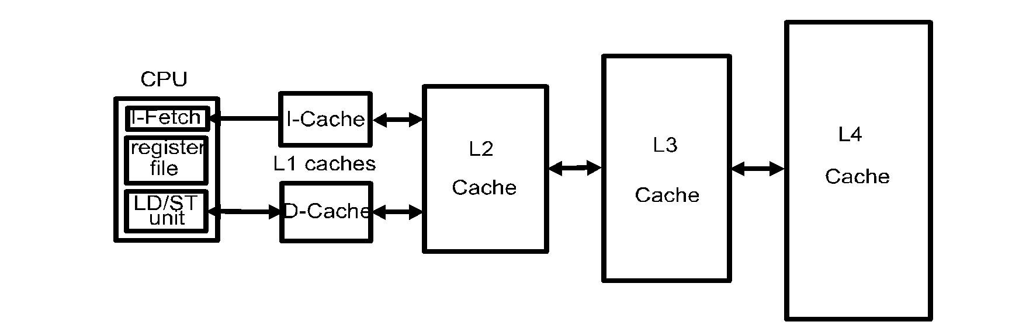
Multi-level cache hierarchies; policies
Usually, cache inclusion is maintained
  When a block misses in L1 then it must be brought into all Li.
  When a block is replaced in Li, then it must be removed from all Lj, j<i
The opposite: exclusion
  If a block is in Li then it is not in any other cache level
  Miss in L1 then all copies are removed from all Li’s, i>1
  If a block is evicted from Li then this block is allocated in Li+1
Notes:
Or no policy
We will assume inclusion; easier for coherency, but more costly (consumes more cache space)

Slide 51
Classification of cache misses: 3 Cs
Compulsory (cold) misses: on the 1st reference to a block
Capacity misses: space is not sufficient to host data or code
Conflict misses: happen when two memory blocks map on the same cache block in direct-mapped or set-associative caches
Later we add Coherence misses ➔ 4 Cs classification
How to measure these misses?
  Cold misses: simulate infinite cache size
  Capacity misses: simulate fully associative cache then deduct cold misses
  Conflict misses: simulate cache then deduct cold and capacity misses

Slide 52
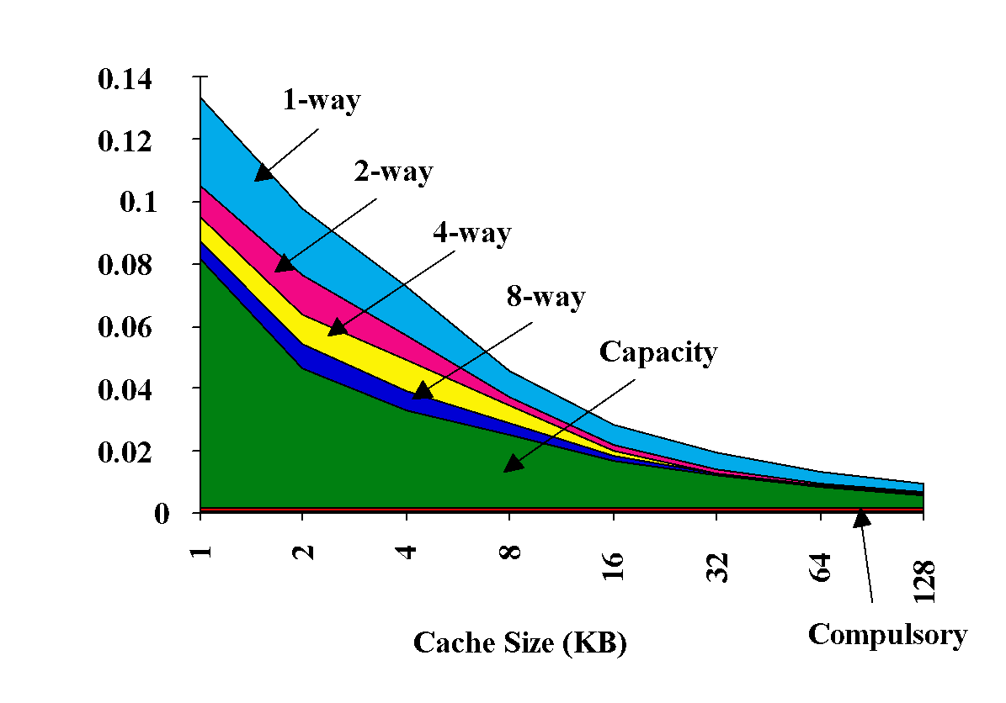
3Cs Absolute Miss Rate (on SPEC92)
Conflict
Miss rate per type

Slide 53
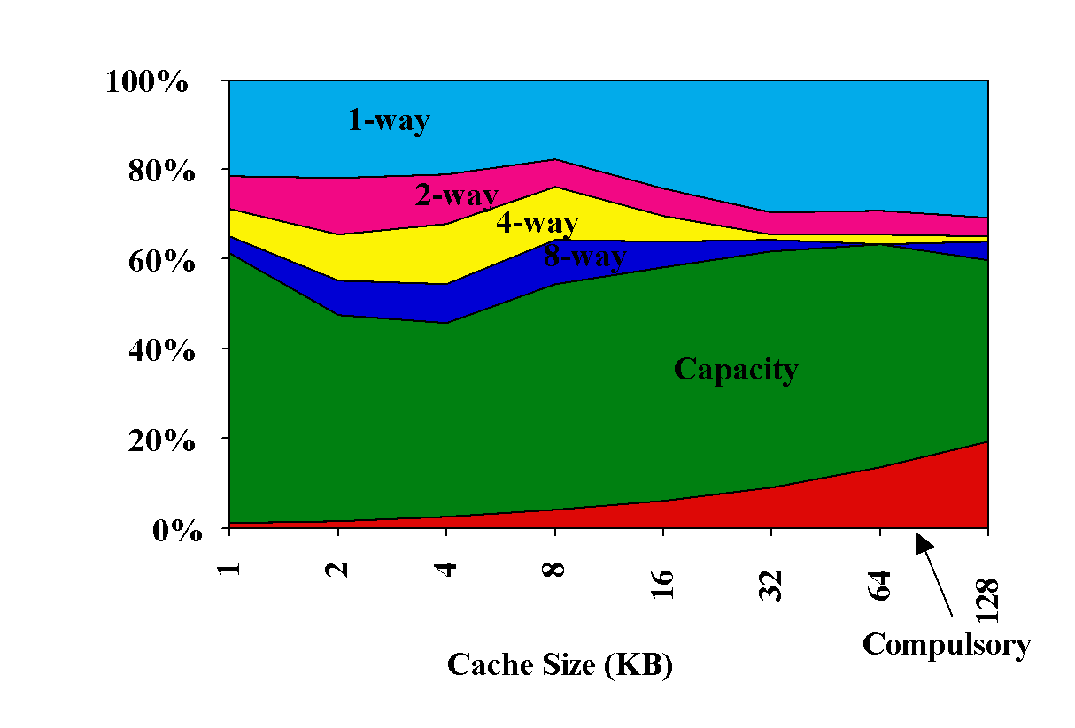
3Cs Relative Miss Rate (on SPEC92) same figure; now relative miss-rate i.s.o. absolute
Conflict
Miss rate per type
Notes:
Same picture as previous slide, now plotted with 'relative' metric

Slide 54

Part I
5 architecture alternatives (RISC is one of them)
What did you learn in Memory Hierarchy Part I ?
  Make yourself a recap !!
Some questions:
Write a program for a stack based architecture and show its operation
Why do we need a memory hierarchy?
Explain exactly how associative caches operate!
Translate cache metrics to instruction fields and vice-versa
Calculate the (multi-level) cache impact on CPI
How can we improve the cache & the memory hierarchy?
How to avoid collision misses? In HW? In SW?

