Slide 1
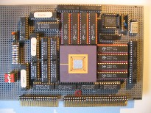
Embedded Computer Architecture 5SAI0 Memory Hierarchy Part II
Henk Corporaal
www.ics.ele.tue.nl/~heco/courses/ECA
h.corporaal@tue.nl
TUEindhoven
2021-2022

Slide 2
Topics Memory Hierarchy Part II
Advanced Cache Optimization
multi-level cache
prefetching
.... many other techniques
Memory design
Virtual memory
Address mapping and Page tables, TLB
=> Material book: Ch2 + AppB (H&P) / Ch 4 (Dubois)
First a few remaining slides from Part I:
Multi-level caches: inclusion vs exclusion
Miss classification: the 3/4 C model

Slide 3
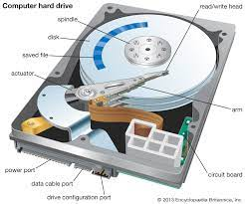
Splitting first level cache
Use split Instruction and Data caches @ L1
Caches can be tuned differently
Avoids dual ported cache
I$
I$
I&D
$
Main Memory
CPU
I$
I&D
$
Shared
I&D
$
CPU
I$
I&D
$
CPU
I&D
$
CPU
D$
D$
D$
D$
L0
Single core
L1
L2
L3
On die multi-core

Slide 4
Multilevel Cache Considerations
L1 cache
Focus on minimal hit time
Usually separate L1 Instruction and L1 Data cache Why? (previous slide)
L2 cache
Focus on low miss rate to avoid main memory access
Hit time has less overall impact
Shared I & D; Why?
L3 cache
Shared between all cores: Why?
Main Memory
L3 $
L2 $
CPU
L1 $

Slide 5
Multi-level cache hierarchies; policies
Usually, cache inclusion is maintained:
When a block misses in L1 then it must be brought into all Li, i≥1
When a block is replaced in Li, then it must be also removed from all Lj, j<i
The opposite: exclusion:
If a block is in Li then it is not in any other cache level
Miss in L1 then all copies are removed from all Li’s, i>1
If a block is evicted from Li then this block is allocated in Li+1
Notes:
Or no policy
We will assume inclusion; easier for coherency, but more costly (consumes more cache space)
see https://en.wikipedia.org/wiki/Cache_inclusion_policy

Slide 6
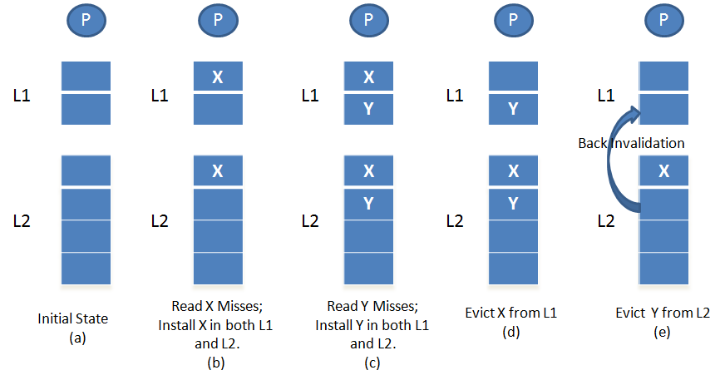
Inclusion example
See: https://en.wikipedia.org/wiki/Cache_inclusion_policy

Slide 7
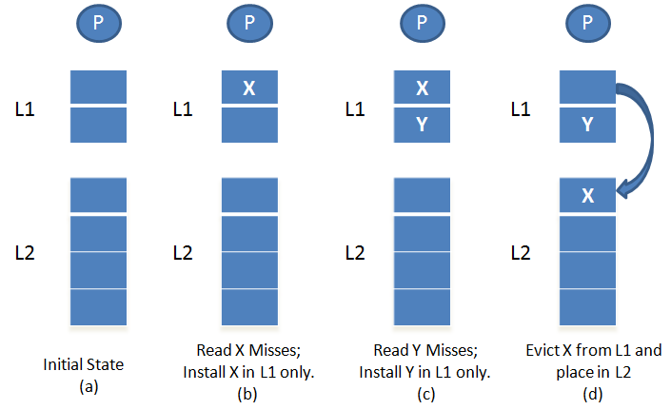
Exclusion example
Exclusion advantage:
less memory waste
Inclusion advantage:
if miss by processor P1 in L1, L2, and L3, no need to check L1 of other processors
See https://en.wikipedia.org/wiki/Cache_inclusion_policy for other options and a more extensive comparison

Slide 8
Classification of cache misses: the 3 Cs
Compulsory (cold) misses: on the 1st reference to a block
Capacity misses: space is not sufficient to host data or code
Conflict misses: happen when two memory blocks map on the same cache block in direct-mapped or set-associative caches
Later we add Coherence misses ➔ 4-C classification
How to measure these 3-C misses?
Cold misses: simulate infinite cache size
Capacity misses: simulate fully associative cache then deduct cold misses
Conflict misses: simulate cache then deduct cold and capacity misses

Slide 9
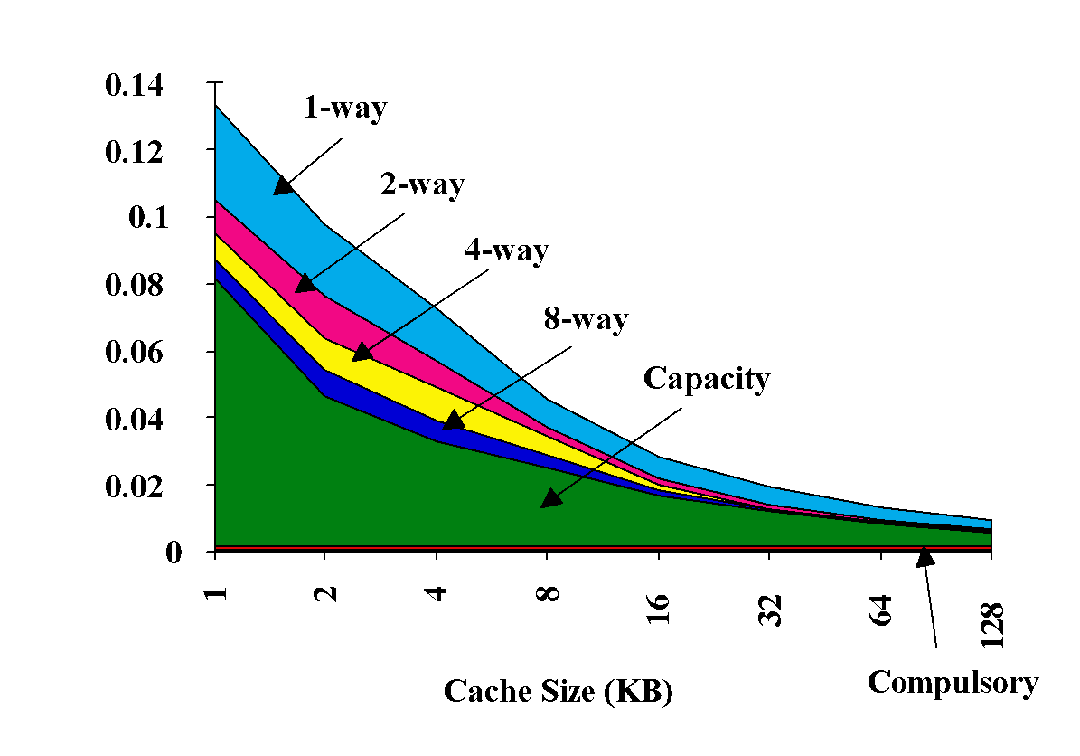
3Cs Absolute Miss Rate (on SPEC92)
Compulsary misses do not depend on cache size
1-Way = Direct mapped cache, has the highest number of conflict misses
Conflict
Miss rate per type

Slide 10
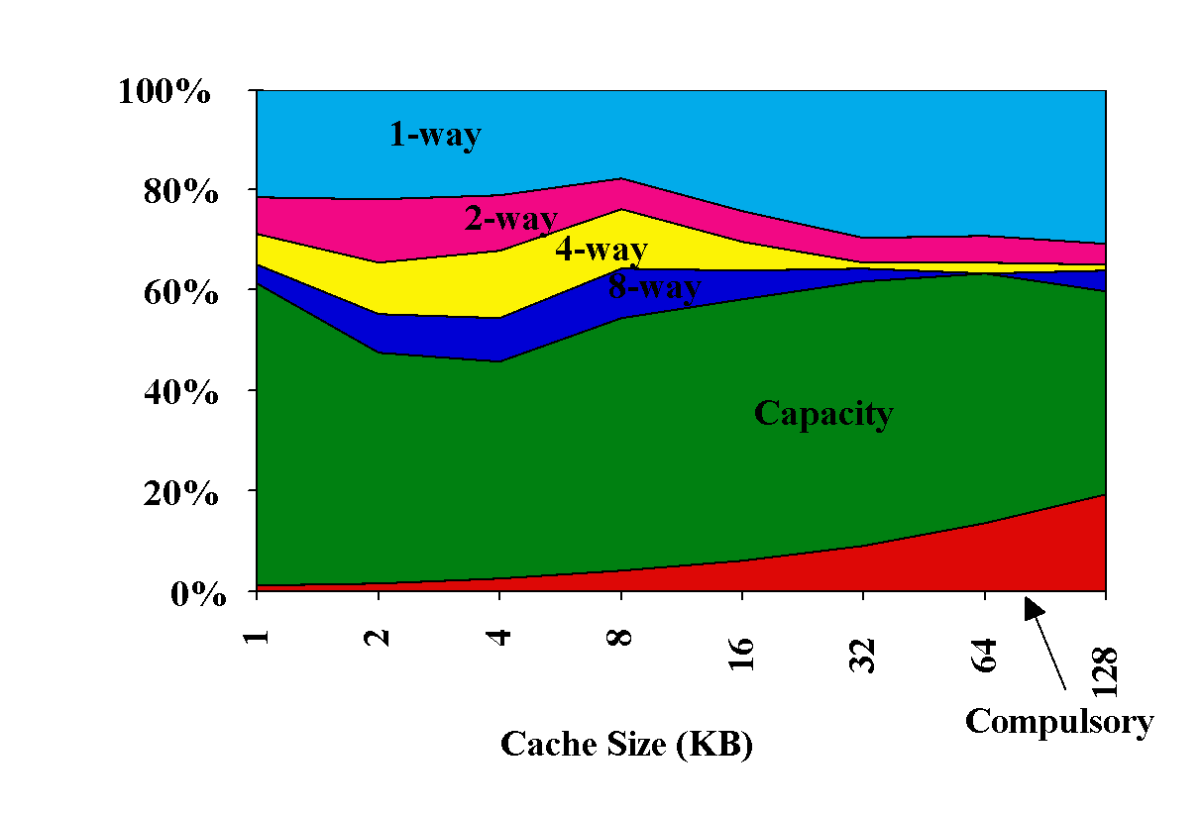
3Cs Relative Miss Rate (on SPEC92) same figure; now relative miss-rate i.s.o. absolute
Conflict
Miss rate per type
Notes:
Same picture as previous slide, now plotted with 'relative' metric

Slide 11
Advanced cache optimizations
Non-blocking cache
supports multiple outstanding cache misses
HW prefetching
SW prefetching
Way prediction
Trace cache
Multi-banked cache
There are more….

Slide 12
Non-blocking (Lockup-free ) cache
If a non-blocking cache misses, it does not block
Rather, it handles the miss and keeps accepting accesses =>
Concurrent processing of multiple misses and hits
Cache has to 'remember' all pending misses
MSHRs (miss status handling registers) contain the addresses of pending misses, the destination block in cache, and the destination register
Note: Number of MSHRs limits the number of pending misses
Data dependencies eventually block the processor
Non-blocking caches are required in dynamically scheduled processors, and also for supporting prefetching

Slide 13
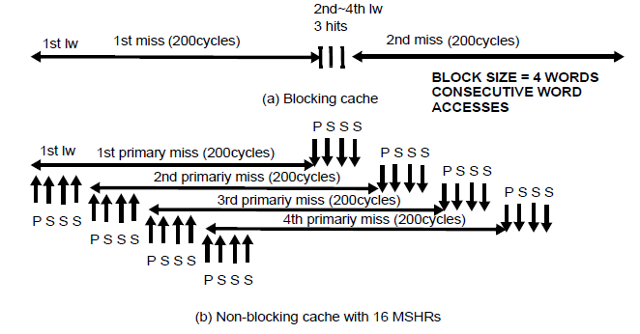
Non-blocking primary/secondary misses
Primary miss (P) : the first miss to a block
Secondary miss (S) : following accesses to same pending block (block not yet arrived)
Many more misses (blocking cache only has primary misses)
Needs MSHRs for both primary and secondary misses
Misses can be overlapped with computation and other misses
Notes:
Assume:
- block size = 4 words (16 bytes)
Initial empty cache
P= primary miss; S = secondary miss, to the same cache line

Slide 14
HW prefetching of instructions and data
Prefetching instructions (SW approach)
On a miss, fetch two blocks instead of one
Second block is stored in a buffer
If hit in this buffer, block is moved to L1
Picture shows prefetching for instructions; also applicable to data
Hardware Prefetch Engines (PFEs): stride prediction
Example accesses with stride = 4: access addreses: 20, 24, 28, 32, etc
Detect strides in stream of miss addresses, then start fetching ahead

Slide 15
Compiler-controlled (SW) prefetching
Insert prefetch instructions in code
These are non-binding, load in cache only
Example: prefetch data needed in future loop iterations
Loop: l.D f2,0(r1) Pref -24(r1) // why -24 ?
Add.D f4,f2,f0
S.D f4,o(r1) Subi r1,r1,#8 Bnez r1, loop
Remarks:
Works for loads and stores
Requires non-blocking cache (why?)
Some instruction overhead
Data must be prefetched in time, but not too early ! Why not??

Slide 16
4-way associative cache: Way prediction
Way 3
Set 1
4-ways set-associative cache (N_{sets} =4): each set contains 4 blocks
What if we could predict the way an access hits?

Slide 17
Fast Hit via Way Prediction
Make set-associative caches faster
Keep extra bits in cache to predict the “way,” or block within the set, of next cache access.
Multiplexor is set early to select desired block, only 1 tag comparison performed
Miss ⇒ first check other blocks for matches in next clock cycle
Accuracy ≈ 85%
Saves also energy
Drawback: CPU pipeline design is harder if hit time is not constant: 1 or 2 cycles
Hit Time
Way-Miss Hit Time
Miss Penalty

Slide 18
Fast (Inst. Cache) Hit via Trace Cache
Key Idea: Pack multiple non-contiguous basic blocks into one contiguous trace cache line
Branch: jumping to different cach line
instruction
trace:
BR
BR
BR
trace cache line:
BR
BR
BR
Single fetch brings in multiple basic blocks
Trace cache indexed by start address and next n branch predictions

Slide 19
Fast Hit times via Trace Cache
Trace cache in Pentium 4 and its successors
Dynamic instruction traces cached (in separate level 1 cache)
Caches the micro-ops vs. x86 (macro) instructions
Decode/translate from x86 to micro-ops on trace cache miss
Pros and Cons:
+ better utilize long blocks (don’t exit in middle of block, don’t enter at label in middle of block)
- complicated address mapping since addresses no longer aligned to power-of-2 multiples of word size
instructions may appear multiple times in trace cache
in multiple dynamic traces due to different branch outcomes
trace cache line:
BR
BR
BR

Slide 20
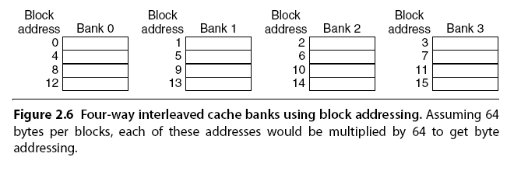
Multi-banked Caches
Organize cache as independent banks to support simultaneous access
ARM Cortex-A8 supports 1-4 banks for L2
Intel i7 supports 4 banks for L1 and 8 banks for L2
Banking works best when accesses naturally spread themselves across banks
mapping of addresses to banks affects memory efficiency

Slide 21
Multi-banked Caches
Sequential interleaving: simple mapping that usually works well:
Spread block addresses sequentially across banks
E.g., with 4 banks,
Bank 0 has all blocks with address%4 = 0;
Bank 1 has all blocks whose address%4 = 1;
etc.
Notes:
Answer is 3 stages between branch and new instruction fetch and 2 stages between load and use (even though if looked at red insertions that it would be 3 for load and 2 for branch)
Reasons:
1) Load: TC just does tag check, data available after DS; thus supply the data & forward it, restarting the pipeline on a data cache miss
2) EX phase does the address calculation even though just added one phase; presumed reason is that since want fast clockc cycle don’t want to sitck RF phase with reading regisers AND testing for zero, so just moved it back on phase

Slide 22
Advanced cache optimizations
Book (ch2 H&P) describes more optimizations, like:
Giving priority to read misses over writes
Reduces miss penalty
Avoiding address translation in cache indexing
Reduces hit time
Critical word first
Write merging
Compiler optimizations:
Loop interchange
Blocking (= Tiling)

Slide 23
Topics Memory Hierarchy Part II
Advanced Cache Optimization
Memory design
SRAM vs DRAM
Stacked DRAM
Memory optimizations
Flash memory
Memory dependability
Virtual memory
Address mapping and Page tables, TLB
=> Material book: Ch2 + AppB (H&P) / Ch 4 (Dubois)

Slide 24
Memory Technology
Performance metrics
Latency is concern of cache
Bandwidth is concern of multiprocessors and I/O
Access time =
Time between start of read request and when desired word arrives
Cycle time =
Minimum time between unrelated requests to memory
DRAM used for main memory, SRAM used for cache

Slide 25
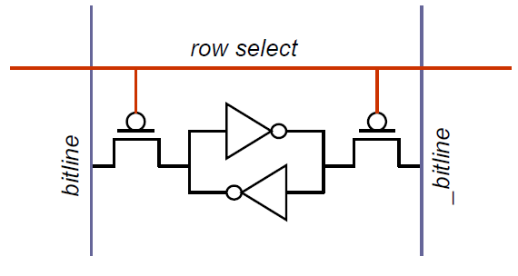
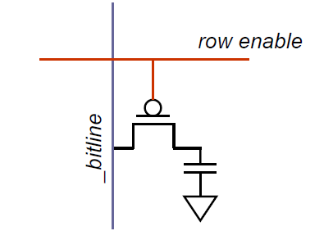
SRAM vs DRAM
Static Random Access Memory
Dynamic Random Access Memory
Bit stored by 2 cross-coupled inverters
Bitlines driven by transistors
Fast (10x)
Bit is stored as charge on the capacitor
Bit cell loses charge over time (read operation and circuit leakage)
Must periodically refresh (5ms)
Hence the name Dynamic RAM
1 transistor and 1 capacitor vs. 6 transistors
Larger (~6-10x)

Slide 26
DRAM: Internal architecture
Bank 4
Bank 3
Bank 2
Bank 1
MS bits
Address register
Address
Row decoder
Memory Array
Row Buffer
Row Buffer
Row Buffer
Bit cells arranged as a memory array
Multiple arrays are organized as different banks
Typical number of banks are 4, 8 and 16
Sense amplifiers raise the voltage level on the bitlines to read the data out
Sense amplifiers (row buffer)
LS bits
Column decoder
Data
Credits: J.Leverich, Stanford

Slide 27
Memory DRAM optimizations
Multiple accesses to same row
Synchronous DRAM
Added clock to DRAM interface
Burst mode with critical word first
Wider interfaces
Double data rate (DDR)
Data send on both clock edges (up and down edge)
Multiple banks on each DRAM device

Slide 28
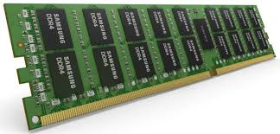
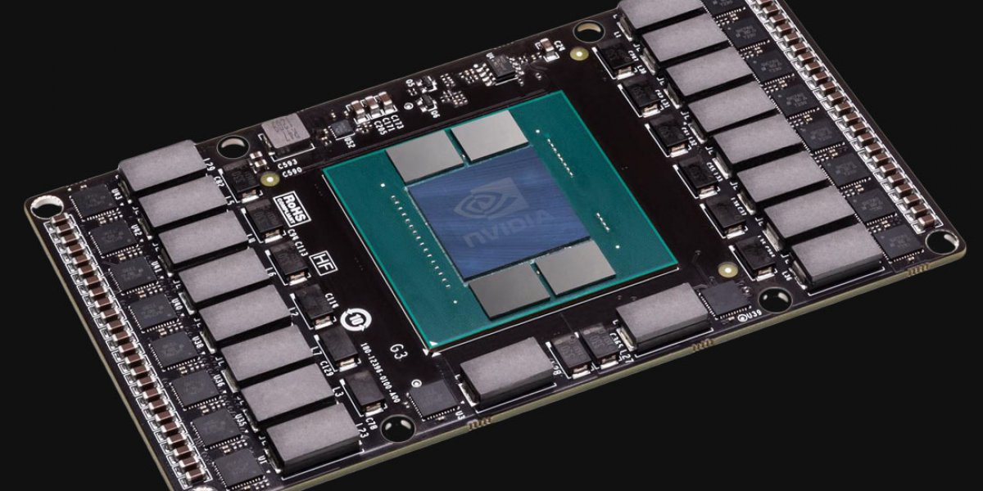
Memory Optimizations
DDR: double data rate
DDR2
Lower power (2.5 V -> 1.8 V)
Higher clock rates (266 MHz, 333 MHz, 400 MHz)
DDR3
1.5 V
800 MHz
DDR4
1-1.2 V
1600 MHz (meaning 3.2 G transfers/sec)
GDDR3 is graphics memory based on DDR3:
higher frequency
wider interface
2.5 times higher bandwidth (vs DDR3)
DIMM
package
GPU with GDDR memory on board

Slide 29
Memory Latencies

Slide 30
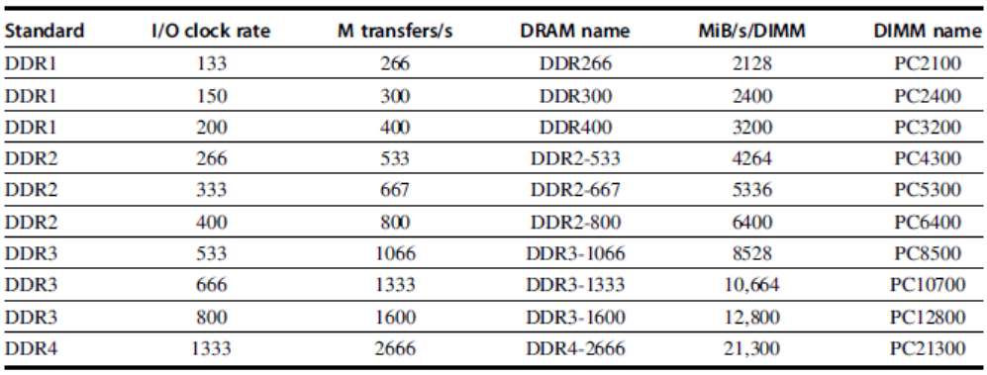
Memory Bandwith (of a DIMM
DIMM
package

Slide 31
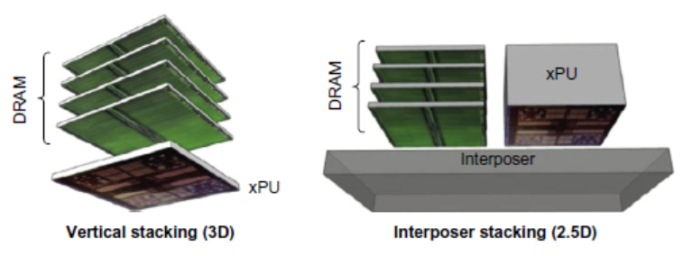
Going in the 3rd dimension: Stacked DRAM
Stacked DRAMs in same package as processor
High Bandwidth Memory (HBM)

Slide 32
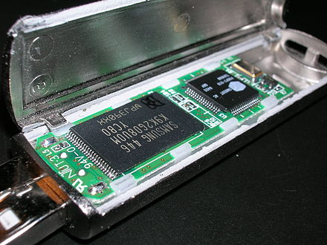
Flash Memory
Type of EEPROM
(Electrical Erasable Programmable Read Only Memory)
NAND (denser) and NOR (faster)
Must be erased (in blocks) before being overwritten
Non volatile memory (NVM)
Limited number of write cycles
Cheaper than SDRAM, more expensive than disk
Slower than SRAM, faster than disk
Dissasemled Flash (Solid State) Drive
(source Wikipedia)

Slide 33
NAND Flash performance comparison
Reads are sequential, reads entire page (0.5 to 4 KiB)
25 us for first byte,
40 MiB/s for subsequent bytes
compare to SDRAM: 40 ns for first byte, 4.8 GB/s for subsequent bytes
2 KiB transfer: 75 usec
500 ns for SDRAM, 150X slower
300 to 500X faster than magnetic disk
And, as already mentioned:
Must be erased (in blocks) before being overwritten
Nonvolatile, can use as little as zero power
Limited number of write cycles (~100,000)
Price: inbetween SDRAM and Magnetic disk

Slide 34
Memory Dependability
Memory is susceptible to cosmic rays
Soft errors: dynamic errors
Detected and fixed by Error Correcting Codes (ECC)
Hard errors: permanent errors
Use sparse rows to replace defective rows
Chipkill: a RAID-like error recovery technique
Note on RAID = Redundant Array of Inexpensive Disks
RAID 1: mirroring disk (so 2 disks)
RAID 5: can tolerate one broken disk

Slide 35
Topics
Memory hierarchy motivation
Caches
direct mapped
set-associative
Cache performance improvements
Memory design
Virtual memory
Address mapping
Page tables
Translation Lookaside Buffer: TLB

Slide 36
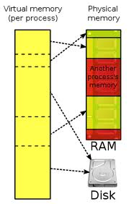
Virtual Memory
Protection via virtual memory
Keeps processes in their own memory space
Role of processor architecture:
Provide user mode and supervisor mode
Protect certain aspects of CPU state in user mode
Provide mechanisms for switching between user and supervisor mode
Provide mechanisms to limit memory accesses
read-only pages
executable pages
shared pages
Provide TLB to speedup address translation

Slide 37
Memory organization
The operating system, together with the MMU hardware, takes care of separating the program address spaces
Each process runs in its own ‘virtual’ environment, and uses logical addressing that is (often) different the the actual physical addresses
Within the virtual world of a process, the full address space is available (see next slide)

Slide 38
Memory Organization (per process !)
The memory that is reserved by the memory manager
0xFFFFFFFF
Heap
Variable
size
If the heap and the stack collide, we’re out
of memory
The local variables in the routines. With each routine call, a new set of variables is put in the stack.
Free memory
Stack pointer
Before the first line of the program is run, all global variables and constants are initialized.
Stack
Variable
size
Global variables
Fixed
size
Machine code
Fixed
size
The program itself:
a set of machine instructions. This is in the .exe
0x00000000

Slide 39
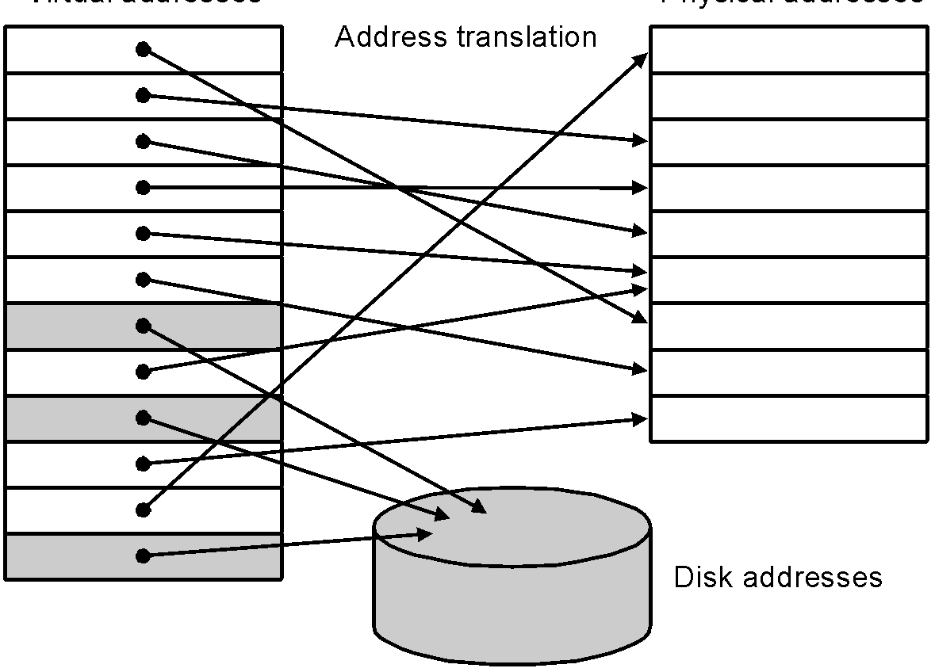
Virtual Memory
Main memory acts as cache for the secondary storage (disk)
virtual memory
physical memory
Advantages:
illusion of having more physical memory
program relocation
protection

Slide 40
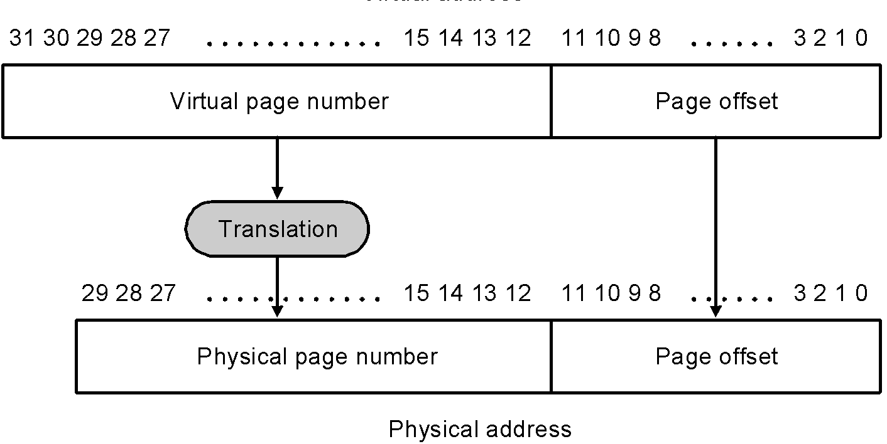
Pages: virtual memory blocks
Page faults: data is not in memory, retrieve it from disk
huge miss penalty, thus pages should be fairly large (e.g., 4KB)
reducing page faults is important (LRU is worth the price)
can handle the faults in software instead of hardware
using write-through is too expensive so we use writeback (with dirty bit per page)
Translating a virtual into a physical address:
Page offset does not change

Slide 41
Page Tables (one per process!)
V
i
r
t
u
a
l
p
a
g
e
n
u
m
b
e
r
P
a
g
e
t
a
b
l
e
P
h
y
s
i
c
a
l
m
e
m
o
r
P
h
y
s
y
i
c
a
l
p
a
g
e
o
r
d
i
s
k
a
d
d
r
V
a
e
s
s
l
i
d
1
1
1
1
0
1
1
0
1
D
i
s
k
s
t
o
r
a
g
e
1
0
1
Note: check the difference with picture slide 30

Slide 42
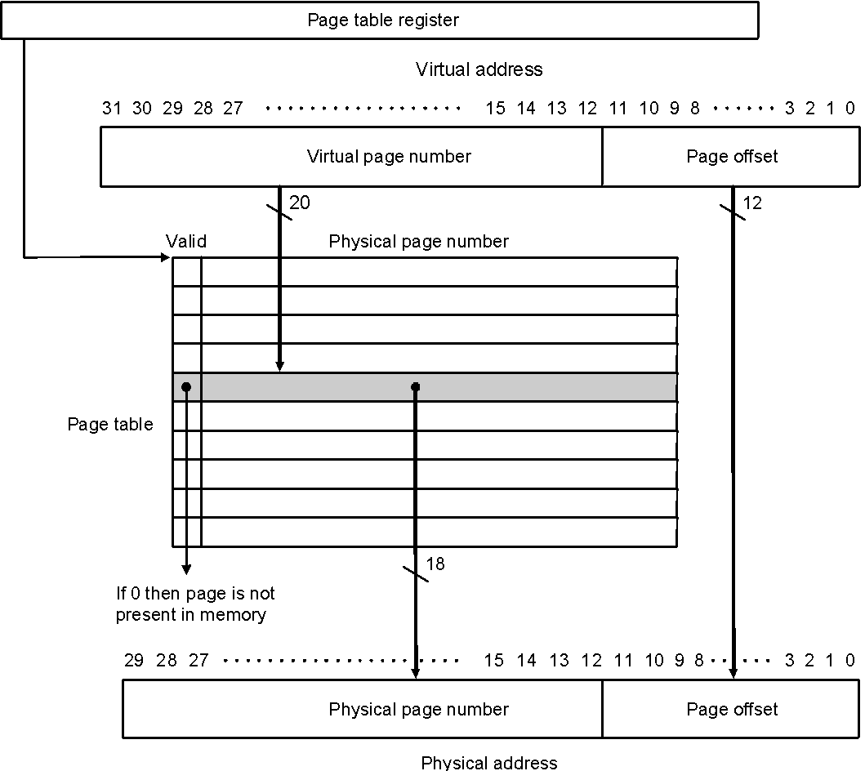
Page Tables

Slide 43
Size of page table
Assume
40-bit virtual address; 32-bit physical
4 Kbyte pages; 4 bytes per page table entry (PTE)
Solution
Size = N_{entries} * Size-of-entry = (2 ⁴⁰ / 2 ¹² ) * 4 bytes = 1 Gbyte
Reduce size:
Dynamic allocation of page table entries
Hashing: inverted page table
1 entry per physical available instead of virtual page
Page the page table itself (i.e. part of it can be on disk)
Use larger page size (multiple page sizes)

Slide 44
Fast Translation Using a TLB
Address translation requires extra memory references
One to access the PTE (page table entry)
Then the actual memory access
However access to page tables has good locality
So use a fast cache of PTEs within the CPU
Called a Translation Look-aside Buffer (TLB)
Typical:
16–512 PTEs, 0.5–1 cycle for hit, 10–100 cycles for miss, 0.01%–1% miss rate
Misses could be handled by hardware or software

Slide 45
Making Address Translation Fast
A cache for address translations: translation lookaside buffer (TLB)
Valid Tag Page address
1
TLB
Virtual page
number
1
Physical memory
1
1
0
1
Physical page
or disk address
Valid
1
1
Disk storage
1
1
0
1
1
Page table
0
1
1
0
1

Slide 46
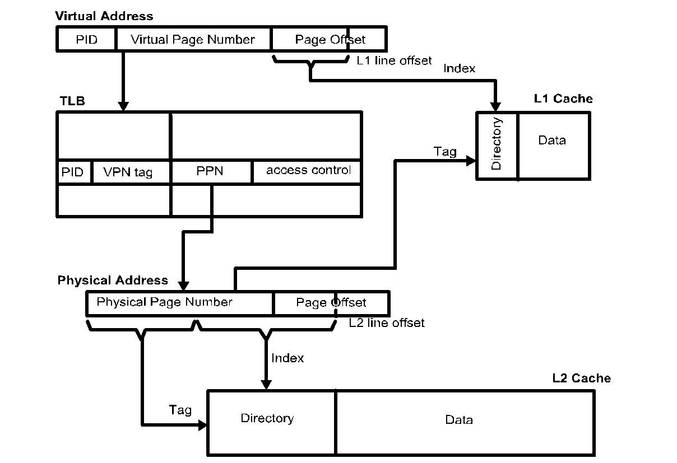
Typical memory hierarchy
PID: processor ID
PPN: physical page nr.
L1 cache and TLB are accessed in parallel
assumes L1 cache ≤ 1 page

Slide 47
TLBs and caches
V
i
r
t
u
a
l
a
d
d
r
e
s
s
T
L
B
a
c
c
e
s
s
T
L
B
m
i
s
s
N
o
T
L
B
h
i
t
?
Y
e
s
e
x
c
e
p
t
i
o
n
P
h
y
s
i
c
a
l
a
d
d
r
e
s
s
N
o
Y
e
s
W
r
i
t
e
?
T
r
y
t
o
r
e
a
d
d
a
t
a
f
r
o
m
c
a
c
h
e
N
o
W
r
i
t
e
a
c
c
e
s
s
Y
e
s
b
i
t
o
n
?
W
r
i
t
e
p
r
o
t
e
c
t
i
o
n
W
r
i
t
e
d
a
t
a
i
n
t
o
c
a
c
h
e
,
e
x
c
e
p
t
i
o
n
u
p
d
a
t
e
t
h
e
t
a
g
,
a
n
d
p
u
t
C
a
c
h
e
m
i
s
s
s
t
a
l
l
N
o
C
a
c
h
e
h
i
t
?
Y
e
s
t
h
e
d
a
t
a
a
n
d
t
h
e
a
d
d
r
e
s
s
i
n
t
o
t
h
e
w
r
i
t
e
b
u
f
f
e
r
D
e
l
i
v
e
r
d
a
t
a
t
o
t
h
e
C
P
U

Slide 48
Overall operation of memory hierarchy
Each instruction or data access can result in three types of hits/misses: TLB, Page table, Cache
Q: which combinations are possible? Check them all!
TLB | Page table | Cache | Possible?
hit | hit | hit | Yes, that’s what we want
hit | hit | miss | Yes, but page table not checked if TLP hit
hit | miss | hit | no
hit | miss | miss | no
miss | hit | hit
miss | hit | miss
miss | miss | hit | no
miss | miss | miss

Slide 49
What did you learn?
Make yourself a recap !!
Some questions:
Explain exactly how caches operate!
Which cache optimizations reduce hit-time, or miss-rate, or miss-time
Calculate the (multi-level) cache impact on CPI
How can we improve the cache & the memory hierarchy?
Why do we need virtual memory, and how does it exactly work?
Explain TLBs
Understand memory hierarchy of recent processors: ARM, x86

Slide 50
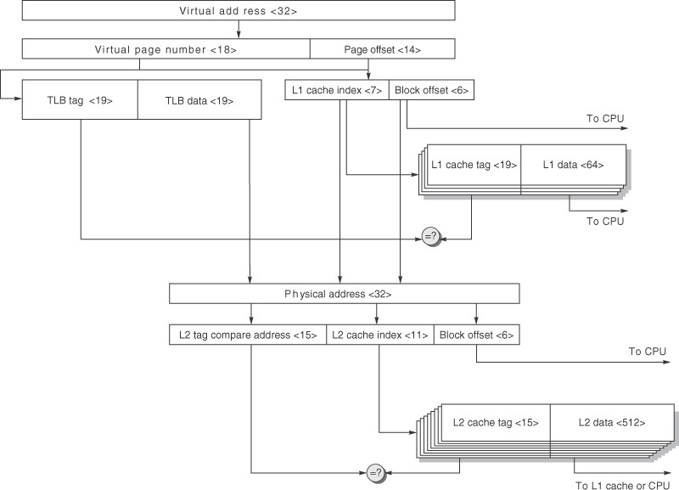
AMR Cortex-A8 data caches/TLP.
Since the instruction and data hierarchies are symmetric, we show only one. The TLB (instruction or data) is fully associative with 32 entries. The L1 cache is four-way set associative with 64-byte blocks and 32 KB capacity. The L2 cache is eight-way set associative with 64-byte blocks and 1 MB capacity. This figure doesn’t show the valid bits and protection bits for the caches and TLB, nor the use of the way prediction bits that would dictate the predicted bank of the L1 cache.

Slide 51
(first) Intel Nehalem (i7)
13.5 x 19.6 mm
Per core:
731 Mtransistors
32-KB I & 32-KB data $
512 KB L2
2-level TLB
Shared:
8 MB L3
2 * 128bit DDR3 channels

Slide 52
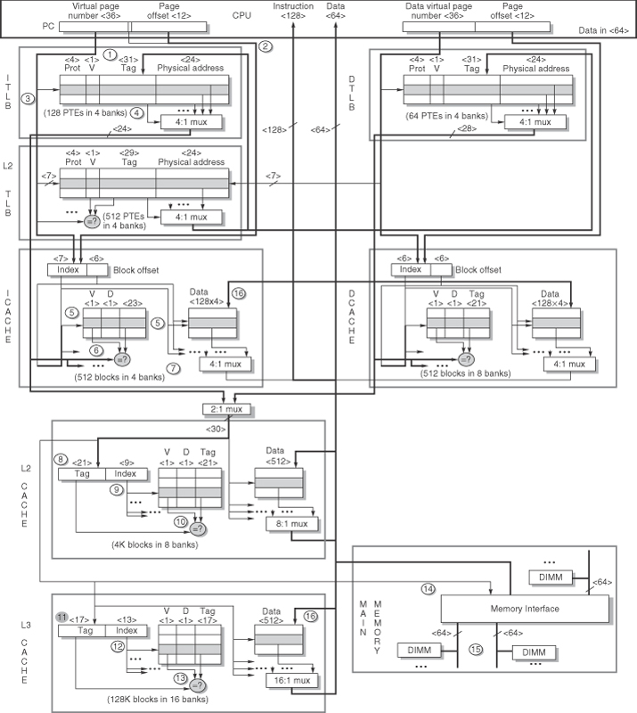
The Intel i7 memory hierarchy
The steps in both instruction and data access. We show only reads for data. Writes are similar, in that they begin with a read (since caches are write back). Misses are handled by simply placing the data in a write buffer, since the L1 cache is not write allocated.

Slide 53
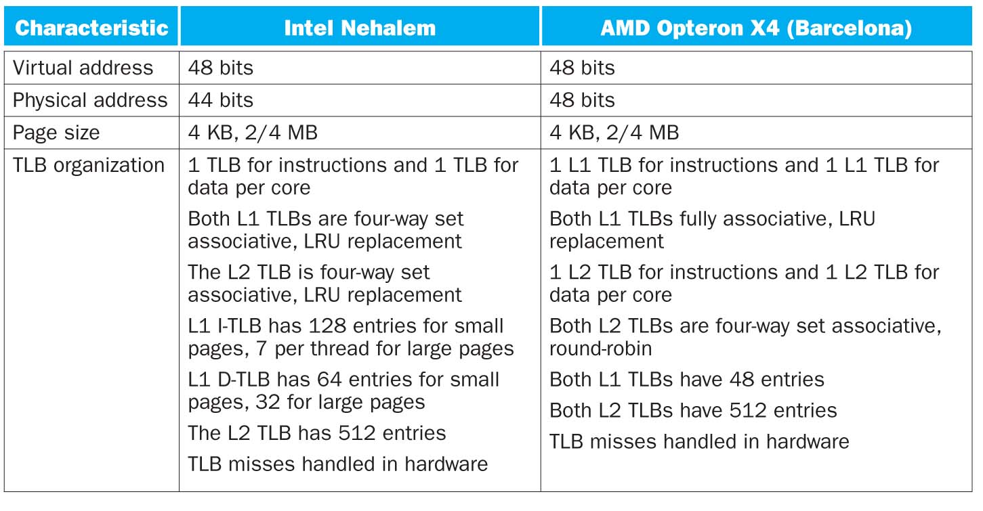
Address translation and TLBs

Slide 54
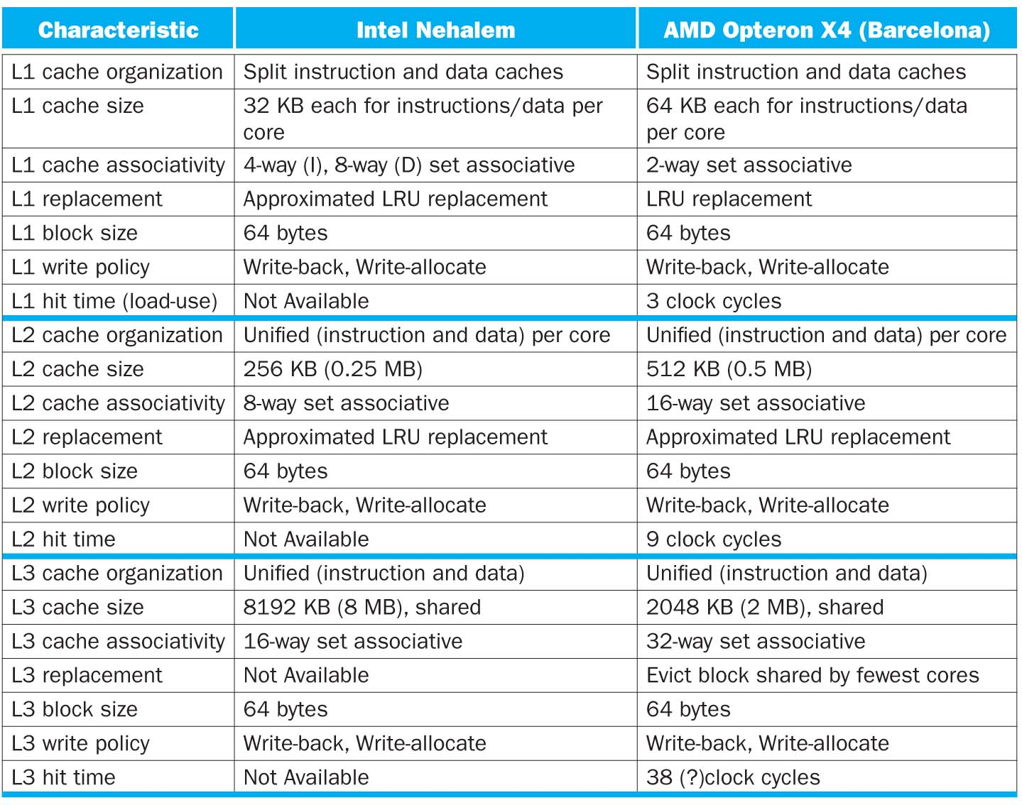
Cache L1-L2-L3 organization of Intel & AMD

Slide 55
Virtual Machines
Supports isolation and security
Sharing a computer among many unrelated users
Enabled by raw speed of processors, making the overhead more acceptable
Allows different OSs to be presented to user programs
“System Virtual Machines (SVMs)”
SVM software is called “virtual machine monitor” or “hypervisor”
Individual virtual machines run under the monitor are called “guest VMs”

Slide 56
Impact of VMs on Virtual Memory
Each guest OS maintains its own set of page tables
VMM adds a level of memory between physical and virtual memory called “real memory”
VMM maintains shadow page table that maps guest virtual addresses to physical addresses
Requires VMM to detect guest’s changes to its own page table
Occurs naturally if accessing the page table pointer is a privileged operation

