Slide 1
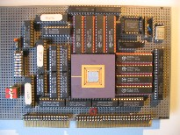
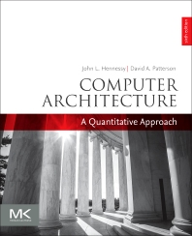
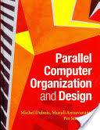
Embedded Computer Architecture 5SAI0 Multi-Threading & Multi-Processor Systems
Henk Corporaal
www.ics.ele.tue.nl/~heco/courses/ECA
h.corporaal@tue.nl
TUEindhoven
2021-2022

Slide 2
Overview
Multi-threading architectures:
Coarse grain multi-threading
Fine-grain multi-threading
SMT (simultaneous multi-threading)
called hyperthreading by Intel
Multi-processing architectures
Material, our study books:
Multi-threading
H&P section 3.11: Multithreading
Dubois e.a. section 8.3: SMT
Multi-processing
H&P: Chapter 5-5.2
Dubois: Chapter 5-5.4.1

Slide 3
New Approach: Multi-Threaded
Multithreading = multiple threads share the functional units of 1 processor
duplicate independent state of each thread e.g., a separate copy of register file, a separate PC
HW for fast thread switch; much faster than full process switch ≈ 100s to 1000s of clocks
When to switch?
Fine grain: Next instruction is next thread, or
Coarse grain: When a thread is stalled, perhaps for a cache miss, another thread can be executed

Slide 4
Multithreaded Categories
Simultaneous
Multithreading
Time (processor cycle)
Superscalar
Fine-Grained
Coarse-Grained
Multiprocessing
Thread 1
Thread 3
Thread 5
Thread 2
Thread 4
Idle slot

Slide 5
Fine-Grained Multithreading
Switches between threads on each instruction, causing the execution of multiples threads to be interleaved
Usually done in a round-robin fashion, skipping any stalled threads
CPU must be able to switch threads every clock
Advantage: it can hide both short and long stalls, since instructions from other threads executed when one thread stalls
Disadvantage: may slow down execution of individual threads
Used in e.g. Sun’s Niagara

Slide 6
Course-Grained Multithreading
Switches threads only on costly stalls, such as L2 cache misses
Advantages
Relieves need to have very fast thread-switching
Doesn’t slow down thread, since instructions from other threads issued only when the thread encounters a costly stall
Disadvantage: hard to overcome throughput losses from shorter stalls, due to pipeline start-up costs
Since CPU issues instructions from 1 thread, when a stall occurs, the pipeline must be emptied or frozen
New thread must fill pipeline before instructions can complete
Because of this start-up overhead, coarse-grained multithreading is better for reducing penalty of high cost stalls, where pipeline refill << stall time
Used in e.g. IBM AS/400

Slide 7
Simultaneous Multi-threading ...
One thread, 8 units
Two threads, 8 units
Cycle
M
M
FX
FX
FP
FP
BR
CC
Cycle
M
M
FX
FX
FP
FP
BR
CC
1
2
3
4
5
6
7
8
9
1
2
3
4
5
6
7
8
9
M = Load/Store, FX = Fixed Point, FP = Floating Point, BR = Branch, CC = Condition Codes

Slide 8
Simultaneous Multithreading (SMT)
SMT: in each cycle operations from multiple threads can be issued and active
dynamically scheduled processors already has many HW mechanisms to support multithreading:
Large set of virtual registers that can be used to hold the register sets of independent threads
Register renaming provides unique register identifiers, so instructions from multiple threads can be mixed in datapath without confusing sources and destinations across threads
Out-of-order completion allows the threads to execute out of order, and get better utilization of the HW
Just adding a per thread renaming table and keeping separate PCs

Slide 9
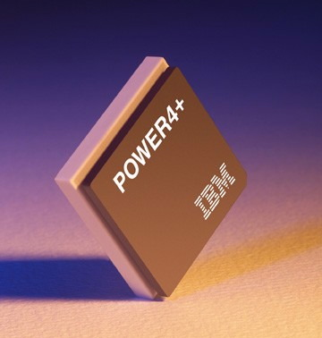
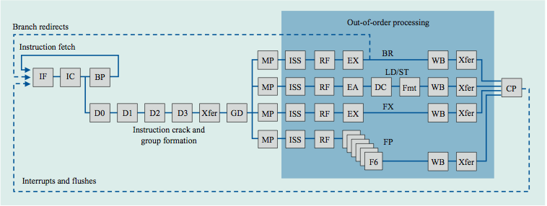
IBM Power4
Single threaded
8 FUs
4-issue out-of-order

Slide 10
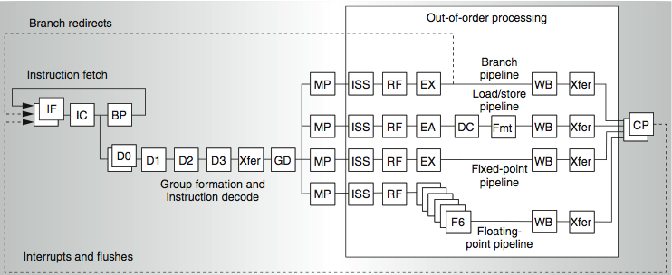
IBM Power5
supports 2 threads
2 commits (architected register sets)
2 fetch (PC), 2 initial decodes

Slide 11
Changes in Power 5 to support SMT
Increased associativity of L1 instruction cache and the instruction address translation buffers
Added per thread load and store queues
Increased size of the L2 (1.92 vs. 1.44 MB) and L3 caches
Added separate instruction prefetch and buffering per thread
Increased the number of virtual registers from 152 to 240
Increased the size of several issue queues
The Power5 core is about 24% larger than the Power4 core because of the addition of SMT support

Slide 12
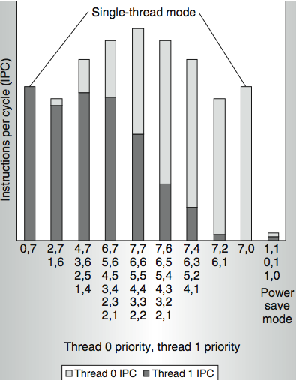
Power 5 thread performance ...
Relative priority of each thread controllable in hardware.
For balanced operation, both threads run slower than if they “owned” the machine.

Slide 13
Multi-threading….
What is exactly Multi-Threading?
how does it differ from multi-processing?
What processor changes are needed to support Multi-Threading?
What is the performance impact?
running a single thread? When
running multiple threads?
Do we need it?
when?
Can you compare pros and cons of MT and Multi-Processing ?

Slide 14
Overview
Multi-threading architectures
Multi-processing architectures
Shared memory architectures
symmetric
distributed
Message passing architectures
Programming model
Material, our study books on multi-processing:
H&P: Chapter 5-5.2
Dubois: Chapter 5-5.4.1

Slide 15
Should we go Multi-Processing?
Diminishing returns for exploiting ILP
limited Instruction Level Parallelism costly to exploit
Power issues
Wiring issues (faster transistors do not help that much)
More vector and task-level parallel applications
Multi-core architectures hit all markets (even embedded)
lower energy (due to same performance with lower V_{dd})
silicon technology still scales => abundance of transistors

Slide 16
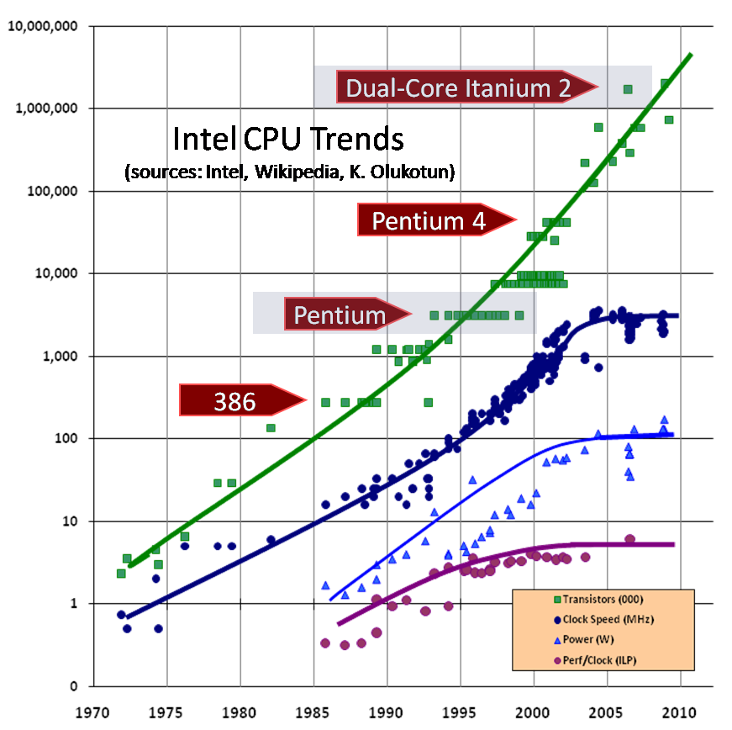
Next?
Core i7
Trends:
since ~2003
#transistors follows Moore
but not freq. and performance/core
3GHz
100W
5

Slide 17
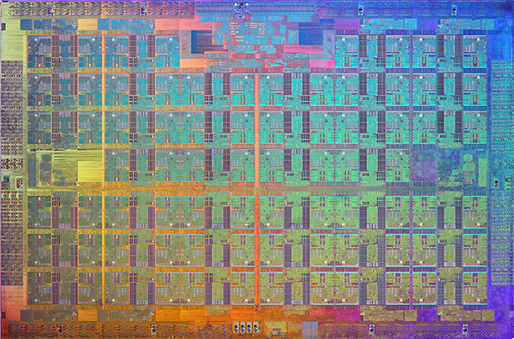
Example:Intel’s 72-core ‘Knight’s Landing’ XEON Phi
KNL 2016 introduced
14 nm
3D Tri-gate transistors
3 TFlops double / 6 TFlops single precision
512-bit SIMD/Vector processing per core
MCDRAM: multi-channel 3D stacked DRAM (like HBM, high BW mem.)

Slide 18
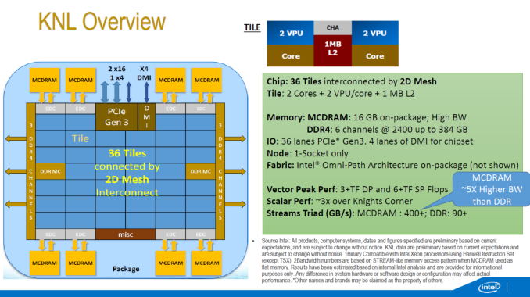
Example: Intel’s 72-core ‘Knight’s Landing’ XEON Phi

Slide 19
Multi-core Architecture
Parallel / Multi-core Architecture extends traditional computer architecture with a communication network
abstractions (HW/SW interface)
organizational structure to realize abstraction efficiently
Memory
I/O
Communication Network
Processing
node
Processing
node
Processing
node
Processing
node
Processing
node

Slide 20
Parallel programming models
How parallel computations can be expressed in a high-level language?
Simple extensions through an API (application-programming interface) of common programming languages such as C/C++ or FORTRAN:
Shared-memory: OpenMP or Pthreads
Message-passing: MPI (message-passing interface)
Threads or processes must communicate and coordinate their activity (synchronization)
Who is parallizing your program?
Parallelizing compilers translate a sequential program into parallel threads
Yourself !

Slide 21
Data vs function parallelism
Data parallelism:
Partition the data set
Apply the same function to each partition
SPMD (= single program multiple data)
SPMD ≠ SIMD; what's the difference?
Massive parallelism
Function (Task-level) parallelism
Partition the functionality
Independent functions are executed on different processors
E.g.: Streaming--software pipeline
More complex, limited parallelism
Combine both: function + data parallelism

Slide 22
Shared memory multiprocessors
Key characteristics:
all memory addresses visible by every processor
inter-processor communication by (normal) loads and stores
synchronization needed to control order between loads and store (for proper communication)
Memory
Memory
I/O
Communication Network
Processing
node
Processing
node
Processing
node
Processing
node
Processing
node

Slide 23
Communication models: Shared Memory
Shared
Memory
(read, write)
(read, write)
Process P1
Process P2
3 Problems:
Coherence problem
Memory consistency issue
Synchronization problem

Slide 24
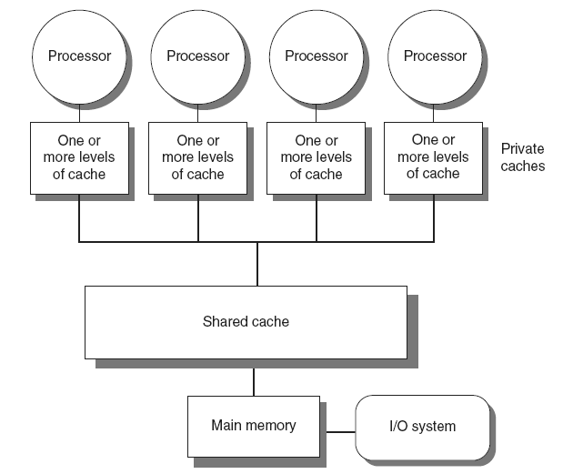
Shared memory multiprocessors: Type 1
Symmetric multiprocessors (SMP)
Small number of cores
Share single memory with uniform memory latency

Slide 25
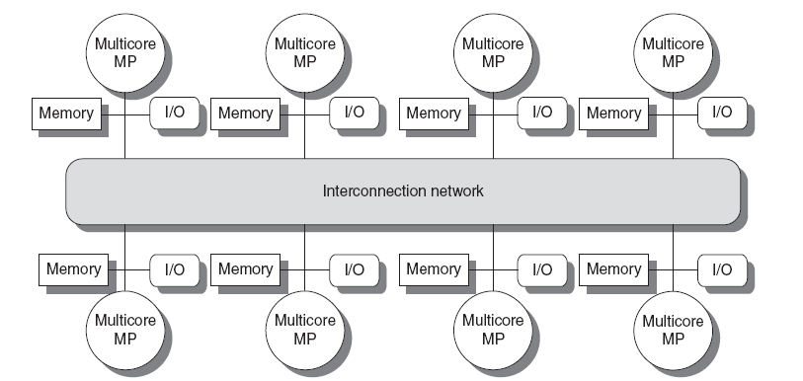
Shared memory multiprocessors: Type 2
Distributed shared memory (DSM)
Memory distributed among processors
Non-uniform memory access/latency (NUMA)
Processors connected via direct (switched) and non-direct (multi-hop) interconnection networks

Slide 26
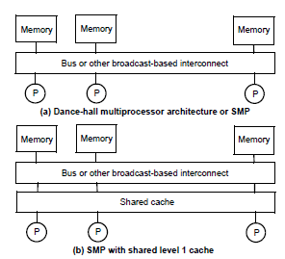
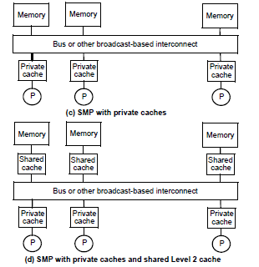
Four Cache organizations for SMPs
Rest of discussion considers organizations (c) and (d)

Slide 27
Example: matrix multiply + sum
Sequential program:
1 sum = 0;
2 for (i=0,i<n, i++)
3 for (j=0,j<n, j++){
4 C[i,j] = 0;
5 for (k=0,k<n, k++)
6 C[i,j] = C[i,j] + A[i,k]*B[k,j];
7 sum += C[i,j];
8 }
- Multiply A[n,n] by B[n,n] and store result in C[n,n]
- Add all elements of matrix C

Slide 28
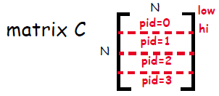
Shared mem: matrix multiply + sum
/* A, B, C, bar, lv and sum are shared, all others are private
*/
1a low = pid*n/nproc; /pid=0...Nproc-1; pid= processor ID
1b hi = low + n/nproc; /each proc sums n/nproc rows
1c mysum = 0; sum = 0; /low to hi
2 for (i=low,i<hi, i++)
3 for (j=0,j<n, j++){
4 C[i,j] = 0;
5 for (k=0,k<n, k++)
6 C[i,j] = C[i,j] + A[i,k]*B[k,j];
7 mysum +=C[i,j]; /C summed in shared memory
8 }
9 barrier(bar);
10 lock(lv);
sum += mysum;
unlock(lv);
Synchronization
Mutual exclusion

Slide 29
Why Mutual Exclusion?
Assume the following statements are executed by 2 threads, T1 and T2, on sum
T1 T2
sum<- sum+1 sum<- sum+1
Compiled code on a RISC machine includes several instructions
A possible interleaving of execution is:
T1 T2
r1 <- sum
R1 <- sum
r1 <- r1 + 1
r1 <- r1 + 1
sum <- r1
sum <- r1
At the end the result is that sum is incremented by 1 (not 2)
time

Slide 30
Communication models: Message Passing
Communication primitives
e.g., send, receive library calls
standard MPI: Message Passing Interface
www.mpi-forum.org
Note that MP can be build on top of SM and vice versa !
receive
send
Process P2
Process P1
send
receive
FiFO

Slide 31
Message Passing Model
Explicit message send and receive operations:
Send specifies local buffer + receiving process on remote computer
Receive specifies sending process on remote computer + local buffer to place data
Typically blocking communication, but may use DMA
DMA = Direct Memory Access (check this out!)
Message structure
Header
Data
Trailer

Slide 32
Message passing communication
Processor
Processor
Processor
Processor
Cache
Cache
Cache
Cache
Memory
Memory
Memory
Memory
DMA
DMA
DMA
DMA
Network
interface
Network
interface
Network
interface
Network
interface
Interconnection Network

Slide 33
Synchronous message-passing
Thread T1: Thread T2:
a = 10; b = 5;
send(&a,sizeof(a),t2,send_a); recv(&b,sizeof(b),t1,send_a);
a = a+1; b=b+1;
recv(&a,sizeof(a),t2,send_b); send(&b,sizeof(b),t1,send_b);
printf(a);
Each send/recv has 4 operands:
Starting address in memory
Size of message
Destination/source thread id
Tag connecting sends and receives
Synchronous communication =
sender blocks until recv is completed and receiver blocks until message has been sent
What value is printed under synchronous MP?
Tag, not always
needed; why not?

Slide 34
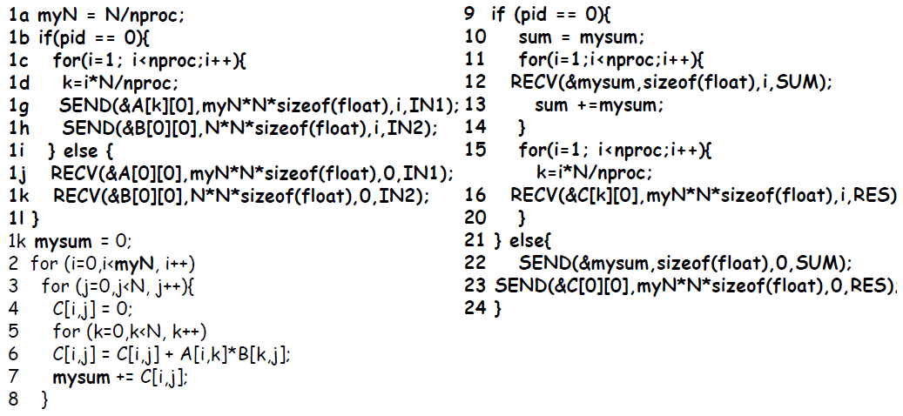
Message-passing: matrix multiply + sum
Notes:
pid = process id
pid 0 is the controlling process, distributing data, collecting results
compare shared memory solution (slide 28); what are differences?

Slide 35
Synchronous message-passing
Advantage:
Communication protocol enforces synchronization
Disadvantages:
Prone to deadlock
Block threads: no overlap of communication with computation
Deadlock example:
thread T1: thread T2:
a = 10; b = 5;
send(&a,sizeof(a),t2,send_a); send(&b,sizeof(b),t1,send_b)
recv(&c,sizeof(c),t2,send_b); recv(&d,sizeof(d),t1,send_a);
To eliminate the deadlock: swap the send/recv pair in T2,
or employ asynchronous message-passing

Slide 36
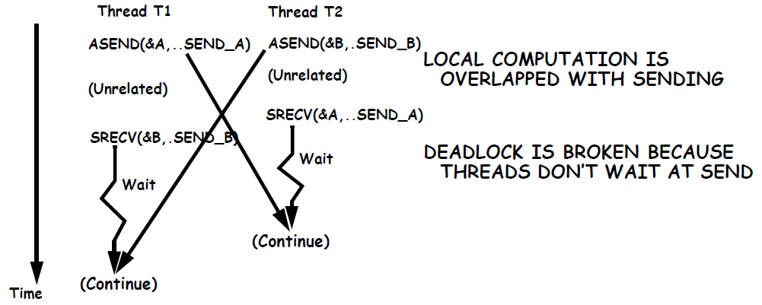
(A)Synchronous message-passing
thread T1: thread T2:
a = 10; b = 5;
asend(&a,sizeof(a),t2,send_a); asend(&b,sizeof(b),t1,send_b);
<unrelated computation;> <unrelated computation;>
srecv(&b,sizeof(b),t2,send_b); srecv(&a,sizeof(b),t1,send_a);

Slide 37
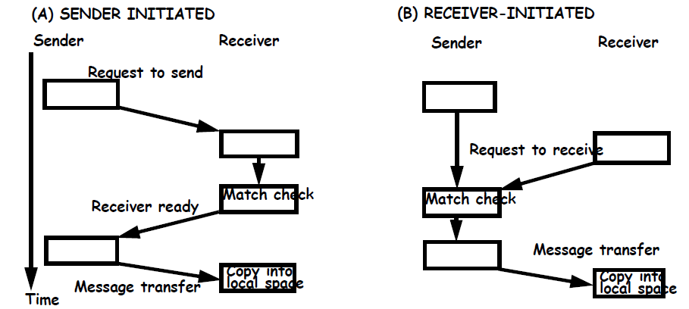
(A)Synchronous message-passing
In general multiple threads are running on a core
This handshake is for synchronous message passing
Can also be applied to blocking or non-blocking asynchronous
Sender continues after send (a) and receiver after recv (b)
If blocking, sender must make a copy of message first

Slide 38
Support for message passing protocols
Data must be copied from/to memory to/from NI (= Network Interface)
Processor could do it
DMA (direct memory access) unit can speed up message transfers and off-load the processor
programmed by the processor by specifying start address and size
Dedicated message processors
Use a special processor to process messages on both ends
Thus relieving the compute O/S from doing it
Support for user-level messages by OS (operating system):
DMA engine controlled by OS
Message is copied from user space to system space (send)
Message is first copied into system space and then into user space (receive)
Tag user messages so that they are picked up and delivered directly in user memory space (zero copy)

Slide 39
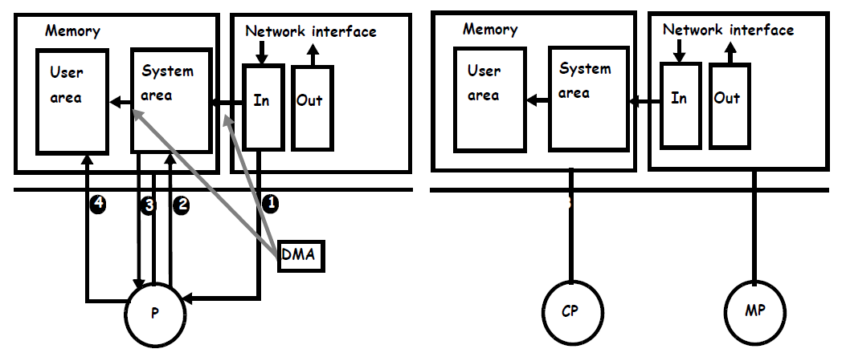
Message-passing support

Slide 40
Communication Models: Shared-Memory vs Message Passing
Shared-Memory (used by e.g. OpenMP)
Compatibility with well-understood (language) mechanisms
Ease of programming for complex or dynamic communications patterns
Shared-memory applications; sharing of large data structures
Efficient for small items
Supports hardware caching
Messaging Passing (used by e.g. MPI)
Simpler hardware
Explicit communication
Implicit synchronization (with any communication)
What do you prefer?

Slide 41
Next: 3 fundamental issues for shared memory multiprocessors
Coherence, about: Do I see the most recent data?
Consistency, about: When do I see a written value?
e.g. do different processors see writes at the same time (w.r.t. other memory accesses)?
Synchronization How to synchronize processes?
how to protect access to shared data?

Slide 42
Concluding remarks
Number of transistors still scales well (how long?)
However power/energy limits reached
Frequency not further increased
Therefore: After 2003 going Multi-Core
exploiting task / thread level parallelism (TLP)
can be combined with exploiting DLP (SIMD / Sub-word parallelism)
2 types of systems and programming models
Shared memory
Message passing
What are the pros and cons of both systems?

