Slide 1
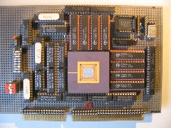


Embedded Computer Architecture
5SAI0
Interconnection Networks
- for multiprocessing systems -
Henk Corporaal
www.ics.ele.tue.nl/~heco/courses/ECA
h.corporaal@tue.nl
TUEindhoven
2021-2022

Slide 2

Overview
Connecting multiple processors or processing elements
How to connect?
  Topologies
  Routing
    Deadlock
  Switching
  Performance: Bandwidth and Latency
Supplementary (background) material:
  H&P Appendix F
  Dubois Chapter 6

Slide 3
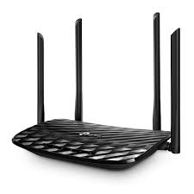
Parallel computer systems
Interconnect between processor chips (system area network--san)
Interconnect between cores on each chip = Network On Chip -- NOC
Other Networks, not covered:
  WAN (wide-area network), your connection with the outsie world
  LAN (local area network), e.g. your home network

Slide 4
1. Network (switched) or 2. Bus (shared resource )
Network:
  claimed to be more scalable
  no bus arbitration
  point-to-point connections
  Disadvantage: router overhead
Example:
NoC with 2x4 mesh
routing network
node
node
node
node
R
R
R
R
node
node
node
node
R
R
R
R

Slide 5
NW Example: MESH topology
Connects nodes: cache and modules, processing elements, processors, …
  Nodes are connected to switches through a network interface (NI)
  Switch: connects input ports to output ports
  Link: wires transferring signals between switches
Links
  Width and Clock rate determine Bandwidth
  Transfer can be synchronous or asynchronous
From A to B: hop from switch to switch
Decentralized (direct)

Slide 6
Simple communication model
Point-to-point message transfer
Request / Reply: request carries ID of sender
Multicast: one to many
Broadcast: one to all

Slide 7
Messages and packets
Messages contain the information transferred
  Messages are broken down into packets
  Packets are sent one by one
  Payload: the actual message contents
  Header/trailer: contains information to route packet
  Error Correction Code: ECC to detect and correct transmission errors

Slide 8
1. Network (switched) or 2. Bus (shared resource)
Bus = set of parallel wires connecting everybody
  All-to-All connection via shared medium
  Supports broadcast communication, i.e. 1 => All communication
Needs bus arbitration
  Centralized vs distributed arbitration
Line (wire) multiplexing (e.g. address & data)
Pipelining
  For example: arbitration => address => data
Split-transaction bus vs Circuit-switched bus
Properties:
  Centralized (indirect)
  Low cost
  Shared
  Low bandwidth (single hop), under low utilization

Slide 9
Design Characteristics of a Network
Topology (how things are connected):
  Crossbar, ring, 2-D and 3-D meshes or torus, hypercube, tree, butterfly, perfect shuffle, ....
Routing algorithm (path used):
  Example in 2D torus: first east-west, then north-south (avoids deadlock)
Switching strategy:
  Circuit switching: full path reserved for entire message, like the telephone.
  Packet switching: message broken into separately-routed packets, like the post office.
Flow control and buffering (what if there is congestion):
  Stall, store data temporarily in buffers
  re-route data to other nodes
  tell source node to temporarily halt, discard, etc.
QoS (quality of service) guarantees
Error handling
etc, etc.

Slide 10
Switch / Network: Topology
Topology determines important metrics:
Degree: number of links from a node
Diameter: max number of links crossed between nodes
Average distance: number of links to random destination
Bisection bandwidth = link bandwidth * bisection
  Bisection = minimum number of links that separate the network into two halves

Slide 11
Bisection Bandwidth
Bisection bandwidth = bandwidth across smallest cut that divides network into two equal halves
  ~ Bandwidth across “narrowest” part of the network
not a
bisection
cut
bisection
cut
bisection bw= link bw
bisection bw = sqrt(n) * link bw
Bisection bandwidth is important for algorithms in which all processors need to communicate with all others

Slide 12
Linear and Ring Topologies
Linear array
  Diameter = n-1; average distance ~n/3
  Bisection bandwidth = 1 (in units of link bandwidth)
Torus or Ring
  Diameter = n/2; average distance ~ n/4
  Bisection bandwidth = 2
  Natural for algorithms that work with 1-D arrays

Slide 13
Meshes and Tori
Two dimensional mesh
Diameter = 2 * (sqrt( n ) – 1)
Bisection bandwidth = sqrt(n)
Two dimensional torus
Diameter = sqrt( n )
Bisection bandwidth = 2* sqrt(n)
Generalizes to higher dimensions
Natural for algorithms that work with 2D and/or 3D arrays

Slide 14
Hypercubes
Number of nodes n = 2d for dimension d
  Diameter = d
  Bisection bandwidth = n/2
0d 1d 2d 3d 4d
Popular in early machines (Intel iPSC, NCUBE, CM)
  Lots of clever algorithms
  Extension to: k-ary n-cubes (k nodes per dimension, so k^{n} nodes)
Greycode addressing:
  Each node connected to others with 1 different address bit
110
111
010
011
100
101
000
001

Slide 15
Trees
Diameter = log n.
Bisection bandwidth = 1
Easy layout as planar graph
Many tree algorithms (e.g., summation)
Fat trees avoid bisection bandwidth problem:
  More (or wider) links near top
  Example: Thinking Machines CM-5 (next slide)

Slide 16
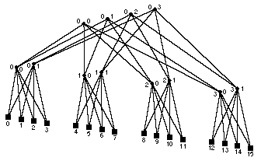
Fat Tree example
A multistage fat tree (CM-5) avoids congestion at the root node
Randomly assign packets to different paths on way up to spread the load
Increase degree near root, decrease congestion

Slide 17
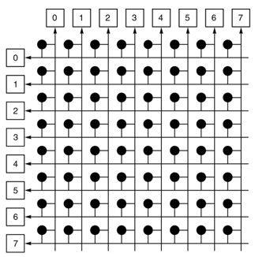
Crossbar
Requires n² switches (very costly)
Diameter = 1 !!

Slide 18
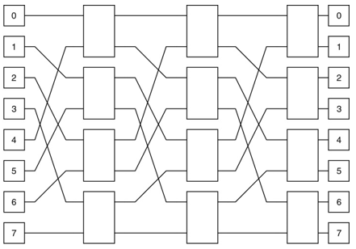
Multistage Networks: Butterflies with n = (k-1)2^{k} switches
Connecting 2^{k} processors, with Bisection bandwidth = 2*2^{k}
Cost: lots of wires
²log(k) hop-distance for all connections, however blocking possible
Used e.g. in BBN (Bolt, Beranek and Newman) Butterfly, in 1980^{s}
Natural for FFT (fast fourier transform)
Butterfly 2x2 Switch
PE
O 1
O 1
O 1
O 1
4x4 Butterfly switch
made of 4x (2x2) switches
Multistage butterfly network: k=3
(connecting 8 PEs with 3 stages)

Slide 19
Routing in butterflies: Omega NW
Use source and/or destination addresses
( = 110 )

Slide 20
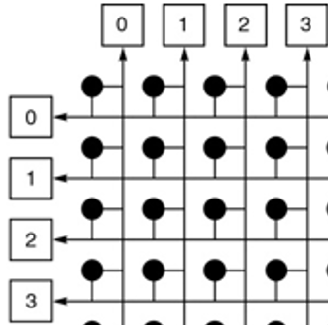
Comparison between topologies
Interconnection network | Switch degree | Network diameter | Bisection width | Network size
Crossbar switch | N | 1 | N | N
Butterfly (built from k-by-k switches) | k | log_{k} N | N/2 | N
k-ary tree | k+1 | 2log_{k} N | 1 | N
Linear array | 2 | N-1 | 1 | N
Ring | 2 | N/2 | 2 | N
n-by-n mesh | 4 | 2(n-1) | n | N=n²
n-by-n torus | 4 | n=√N | 2n | N=n²
k-dimensional hypercube | k | k=log₂ N | 2^{k-1} | N=2^{k}
k-ary n-cube | 2k | nk/2 | 2k^{n-1} | N=n^{k}
NW Metrics:
Switch degree: (max) # of ports for each switch (switch complexity)
Network diameter: worst-case routing distance between any two nodes
Bisection width: # of links in bisection (worst-case bandwidth)
Network size: # of nodes

Slide 21
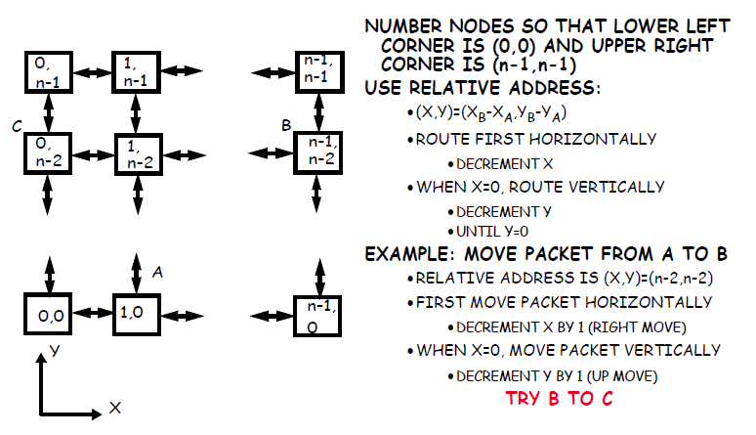
Routing algorithm: Dimension-order Routing
Route 1-dimension
at a time, e.g.
  first x then y-dim
Deterministic
routing
(only 1 option)

Slide 22

Deadlock: when possible?
4 necessary conditions for deadlock, given a set of agents accessing shared resources:
  Mutual exclusion
    Only one agent can access the resource at a time
  Hold and wait
    Agent holds on its acquired resources while waiting for others
  No preemption
    No mechanism can force agent to relinquish acquired resource
  Circular wait
    A set of agents wait on each other to acquire each others’ resources
    => no one can make any progress
shared resources can be SW or HW: critical code sections, disk, printer, ..
In NW: Agents = packets; resources = physical or logical channels

Slide 23
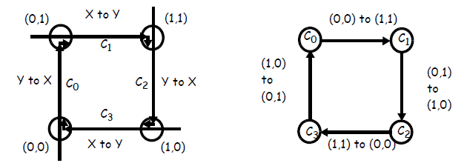
Deadlock avoidance
Assume Mesh or Tori
Assume that packets are free to follow any route
In this example each node is trying to send a packet to the diagonally opposite node at the same time: (0,0) → (1,1), (0,1) → (1,0), etc.
To avoid link conflicts, (1,0) uses c₃ then c0, and (0,0) uses c0 then c₁, etc...
The resource acquisition graph (or channel-dependency graph) on the right shows circular wait => DEADLOCK Possible

Slide 24
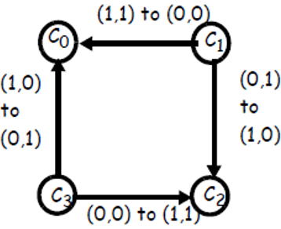
Deadlock avoidance
No circular dependency!
Enforce dimension-order routing (xy-routing)
  Packet moves first horizontally, then vertically
  No cycle possible!!!
  However: this restricts routing, and could result into more congestion on the channels
Alternative to avoid deadlocks: use virtual channels
  E.g.: support an alternate set of channels in which yx routing is enforced e.g., c₁’
  If c₃ is occupied, the packet can safely route through c₀’ and c₁’

Slide 25
Switch micro-architecture, supporting virtual channels
Physical channel = link
Virtual channel = buffers + link
  link is time-multiplexed among flits
One buffer per
virtual channel

Slide 26
Switching strategy: how are connections established in the NW ?
Circuit switching = Establish a connection for the duration of the network service
  Example: circuit switching in mesh
    Establish path in network
    Transmit (many) packets
    Release path
    Low latency; high bandwidth, but requires (long) path set-up time
    Good when packets are transmitted continuously between two nodes
Packet switching = Every packet includes destination address, and finds its own route
  Example: remote memory access on a bus
    Send a request packet to remote node
    Release bus while memory access takes place
    Remote node sends reply packet to requester
    In between send and reply, other transfers are supported
  Example: remote memory access on a mesh

Slide 27
Switching strategies: how are packets forwarded
store-and-forward = packets move from node to node and are stored in buffers in each node
  this increases the transmission time (see next slide).
cut-through = packets move through nodes in pipelined fashion, so that the entire packet moves through several nodes at one time
  Two implementations of cut-through:
    Virtual cut-through switching:
      The entire packet is buffered in the node when there is a transmission conflict
      When traffic is congested and conflicts are high, virtual cut through behaves like store-and-forward
    Wormhole switching:
      Each node has enough buffering for a flit (flow control unit)
      A flit is made of consecutive phits (physical transfer unit)
      A phit basically is the width of a link (= number of bits transferred per clock)
      A flit is a fraction of the packet, so the packet can be stored in several nodes (one or more flits per node) on its path
Info: see books, and
  e.g. http://pages.cs.wisc.edu/~tvrdik/7/html/Section7.html
  https://en.wikipedia.org/wiki/Wormhole_switching

Slide 28
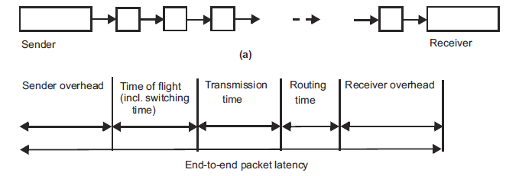
Latency models
Sender Overhead (SO): creating the packet and moving it to NI (Network Interface)
Time of Flight (ToF): time to send a bit from source to destination when the route is established and without conflicts; this includes switching time
  ToF can include buffering time at switches (as in store-and-forward or virtual cut-through)
Transmission Time (TT): time to transfer a packet from source to destination, once the first bit has arrived at destination
  phit: number of bits transferred on a link per cycle, so Link BW = phit*freq_{link}
  Transmission time = packet size/phit size
  note: a flit = unit of flow control (over a link), containing 1 or more phits
Routing Time (RT): time to set-up route (as in circuit switching), or setting switches (in packet switching)
Receiver Overhead (RO): time to strip packet and move it out of the input buffer (of the NI)

Slide 29
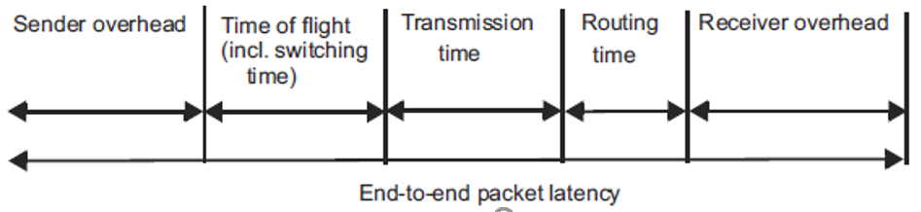
Packet latency calculation
Packet send from A to B:
  size = 100 bytes
  circuit-switching
    route set-up: 200ns
  distancy (A to B) = 9 hops
  phit = 10 bits, t_{cycle} = 8ns
  sender and receiver overhead each 12ns
Q: what is the total latency, L_{packet}, required to send this packet?
Answer (see figure):
  L_{packet} = SO+ ToF + TT +RT + RO =
  12ns + 9*10ns + 800 bits/(10bits/8ns) + 200ns + 12 ns =
  12ns + 90 ns + 640ns + 200ns + 12ns =
  954 ns
  Note: BW_{link} = 10bits/8ns = 1.25 Gbps
A
12ns
12ns
B
10ns
10ns
10ns
10 switches => 9 hops ( or links)

Slide 30
Message sending latency
Message contains n packets
  Transfer of these packets can be pipelined:
    Transfer pipeline has 3 stages:
      Sender overhead --> Transmission --> Receiver overhead
    Total message time, L_{message} = time for the first packet + (n-1)/pipeline throughput
End-to-end message latency, L_{message}, a message contains multiple (n) packets:
L_{message} = Sender Overhead + Time of Flight + Transmission Time + Routing Time + Receiver Overhead
(n-1) * Max(Sender Overhead, Transmission Time, Receiver Overhead)
L_{message} = SO + ToF + TT + RT + RO + (n-1)*Max(SO, TT, RO)

Slide 31
Message latency calculation
Message
Message of 10 packets
  Transmission Time = 100 ns
  Sender/receiver overhead = 110/80 ns
  Time of Flight = 20ns, including switching time
  Assume that Routing time, RT = 0ns
Q: what is total transfer time?
L_{message} = SO + ToF + TT + RT + RO + (n-1)*Max(SO, TT, RO) =
110ns + 20ns + 100ns + 0ns + 80ns + (n-1)*Max(110,100,80) ns =
110 + 20 + 100 + 0 + 80 + 9*110 ns =
1300 ns
  Note: sender overhead is the main bottleneck
Q (do it yourself): what is L_{message} if you send a message with 10 packets of previous example (slide 28) ?
P
P
P
P
P
P
P
P
P
P
A
110ns, per packet
80ns
B
ToF = 20 ns, TT = 100ns
per packet

Slide 32
Message effective BW calculation
Message
Message of n packets, each 15 bytes payload
  Transmission Time = 100 ns
  Sender/receiver overhead = 110/80 ns
  Time of Flight = 20ns, including switching time
  Routing time is zero
Q: what is the effective bandwith when sending 10, what if sending many packets?
BW_{effective, 10 packets} = payload size/transmission latency =
10*15 bytes/1300ns = 115 Mbyte/sec = 0.92 Gbps
BW_{effective, many packets} = packet size / Max (SO, TT, RO)
15 bytes / Max (110ns, 100ns, 80ns) =
15 bytes/110ns = 136 MByte/sec = 1.09 Gbps
Note: sender overhead is the main bottleneck
P
P
P
P
P
P
P
P
P
P
A
110ns, per packet
80ns
B
ToF = 20 ns, TT = 100ns
per packet

Slide 33

What did you learn on NOCs ?
The main interconnect topologies and their properties
Several routing protocols
  Deadlock conditions, how to avoid it
Switching protocols
  circuit vs packet switching
  store-and-forward vs (virtual) cut-through
Network metrics
  comparing metrics of various networks:
    Diameter, Bi-section BW, Degree, Cost (~ nr of switches * degree)
Calculate effective BW and Latencies

