Slide 1
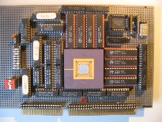
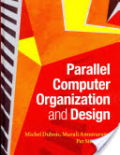
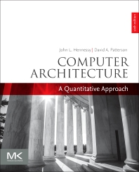
Embedded Computer Architecture
5SAI0
Micro Processor Architecture
ISA = Instruction-Set Architecture
Henk Corporaal
www.ics.ele.tue.nl/~heco/courses/ECA
h.corporaal@tue.nl
TUEindhoven
2021-2022

Slide 2
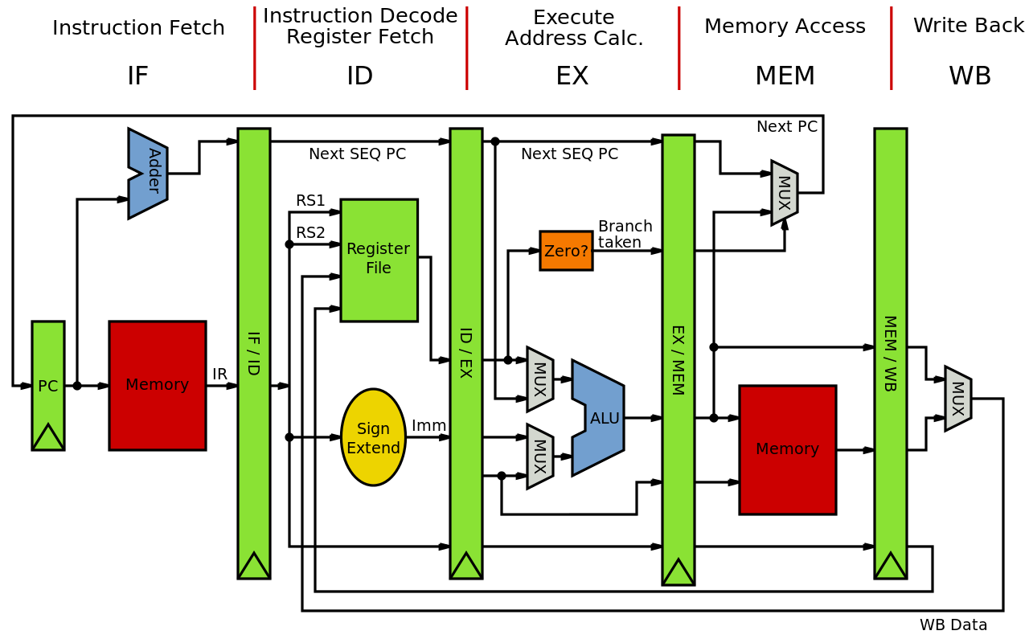
Overview Processor Microarchitecture
Instruction set architecture (ISA)
  we use the MIPS ISA as example
Pipelining and Implementation
  discuss the MIPS 5-stage pipeline in detail
Hazards = problems with the pipeline
Exceptions
RISC principles &
Other architecture styles
Material
  H&P: Appendix A + C
  Dubois: Chapter 3.1-3.3

Slide 3

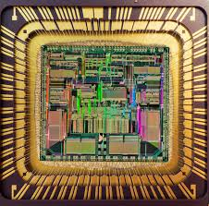
ISA in relation to other abstraction layers
Notes:
The ISA is the interface between software and hardware
Design objectives
Functionality and flexibility for os and compilers
Implementation efficiency in available technology
Backward compatibility

Slide 4
Instruction types: 3 main classes
Arithmetic
  Integer arithmetic/logic instructions
    ADD, SUB, MULT
    ADDU, SUBU,MULTU
    OR, AND, NOR, NAND
  Floating point instructions
    FADD, FMUL, FDIV
Memory transfer instructions
  Loads and Stores
  TEST-and-SET, and SWAP
    May apply to various operand sizes: bytes, half-words, words, doubles, etc.
Control instructions
  Branches are conditional
    Condition may be condition bits (ZCVXN)
    Condition may test the value of a register (set by SLT instruction)
    Condition may be computed in the branch instruction itself
  Jumps are unconditional with absolute address or address in register
  JAL (jump and link) needed for procedures

Slide 5
MIPS arithmetic
Most instructions have 3 operands
Operand order is fixed (destination register first, if there is a destination)
Example:
C code: A = B + C
MIPS code: add $s0, $s1, $s2
  $ notation indicates a register (register files are very close to the ALUs)
  $s0, $s1 and $s2 are associated with variables by compiler
  each corresponds to one of the 32 registers r0-r31

Slide 6
MIPS arithmetic
C code: A = B + C + D;
E = F - A;
MIPS code: add $t0, $s1, $s2
add $s0, $t0, $s3
sub $s4, $s5, $s0
Operands must be registers, only 32 registers provided
Design Principle: smaller is faster. Why?

Slide 7
Registers vs. Memory
Arithmetic instruction operands must be registers,
— only 32 registers provided
Compiler associates variables with registers
What about programs with lots of variables ?
Picture: all I/O is memory-mapped
i.e., can be accesses by Load and Store
operations
Memory
CPU
register file
IO

Slide 8
Register allocation
Compiler tries to keep as many variables in registers as possible
Some variables can not be allocated:
  large arrays (too few registers)
  aliased variables (variables accessible through pointers in C)
  dynamic allocated variables
    heap
    stack
Compiler may run out of registers => spilling
Memory
a
Register file
Store
a
Load

Slide 9
Memory Organization
Viewed as a large, single-dimension array, with an address
A memory address is an index into the array
"Byte addressing" means that successive addresses are one byte apart
0
8 bits of data
1
8 bits of data
2
8 bits of data
3
8 bits of data
4
8 bits of data
5
8 bits of data
6
8 bits of data
...

Slide 10
Memory Organization
Bytes are nice, but most data items use larger "words"
For MIPS, a word is 32 bits or 4 bytes.
2³² bytes with byte addresses from 0 to 2³²-1
2³⁰ words with byte addresses 0, 4, 8, ... 2³²-4
0
32 bits of data
4
32 bits of data
Registers hold 32 bits of data
(or 64-bit, or even more bits)
8
32 bits of data
12
...
32 bits of data

Slide 11
Memory layout: Alignment
31
23
15
7
0
0
this word is aligned; the others are not!
4
8
12
address
16
20
24
For a RISC: Instruction words are aligned
What are the least 2 significant bits of a word address?

Slide 12
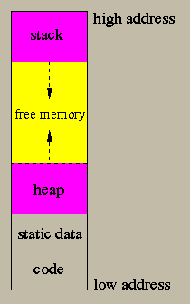
Stack vs Heap

Slide 13
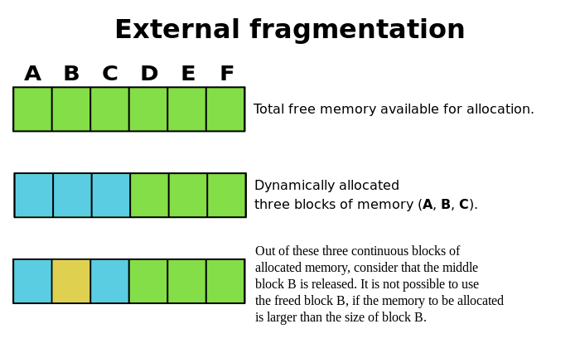
Heap

Slide 14
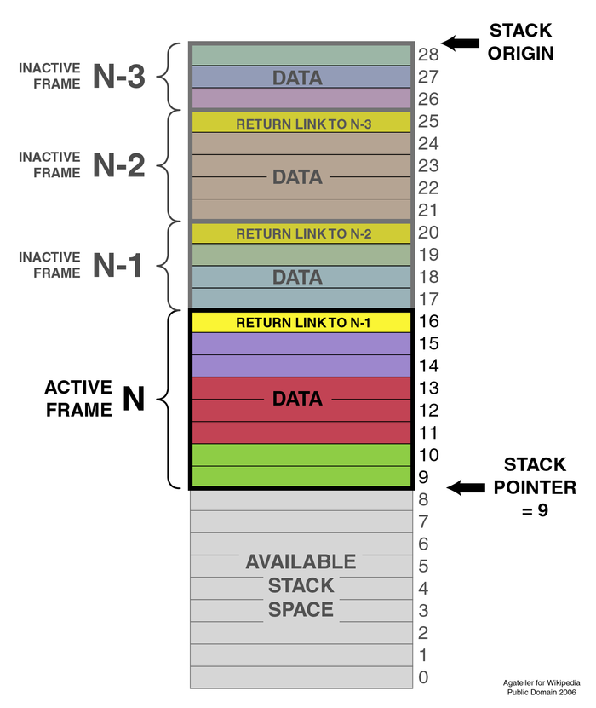
Stack
used for storing stack frames used for function calls
they contain variables related to functions
  actual arguments
  local variables
  return address
  frame pointer
Note, this stack grows to lower addresses

Slide 15
Instructions: load and store
Example:
C code: A[8] = h + A[8];
MIPS code: lw $t0, 32($s3)
add $t0, $s2, $t0
sw $t0, 32($s3)
Store word operation has no destination (reg) operand
Remember arithmetic operands are registers, not memory!

Slide 16
Let's translate some C-code
Can we figure out the code?
swap(int v[], int k);
{ int temp;
temp = v[k]
v[k] = v[k+1];
v[k+1] = temp;
}
swap:
muli $2 , $5, 4
add $2 , $4, $2
lw $15, 0($2)
lw $16, 4($2)
sw $16, 0($2)
sw $15, 4($2)
jr $31
Explanation:
index k : $5
base address of v: $4
address of v[k] is $4 + 4 * $5

Slide 17
Machine Language: R-format
Instructions, like registers and words of data, are also 32 bits long
  Example: add $t0, $s1, $s2
  Registers have numbers: $t0=9, $s1=17, $s2=18
Instruction Format:
op rs rt rd shamt funct
000000 10001 10010 01001 00000 100000
6 bits
5 bits
5 bits
5 bits
5 bits
6 bits
Can you guess what the field names stand for?

Slide 18
Machine Language: I-format
Introduce a new type of instruction format
  I-type for data transfer instructions
  other format was R-type for register
Example: lw $t0, 32($s2)
35 18 9 32
op rs rt 16 bit number

Slide 19
Control flow
Decision making instructions
  alter the control flow,
  i.e., change the "next" instruction to be executed
MIPS conditional branch instructions:
BNE $t0, $t1, Label
BEQ $t0, $t1, Label
Example: if (i==j) h = i + j;
BNE $s0, $s1, Label
ADD $s3, $s0, $s1
Label: ....

Slide 20
Control flow
MIPS unconditional branch instructions:
j label
Example:
if (i!=j) BEQ $s4, $s5, Lab1
h=i+j; ADD $s3, $s4, $s5
else J Lab2
h=i-j; Lab1: SUB $s3, $s4, $s5
Lab2: ...
Can you build a simple for loop?

Slide 21
So far:
Instruction Meaning
add $s1,$s2,$s3 $s1 = $s2 + $s3
sub $s1,$s2,$s3 $s1 = $s2 – $s3
lw $s1,100($s2) $s1 = Memory[$s2+100]
sw $s1,100($s2) Memory[$s2+100] = $s1
bne $s4,$s5,L Next instr. is at Label if $s4 ° $s5
beq $s4,$s5,L Next instr. is at Label if $s4 = $s5
j Label Next instr. is at Label
Formats:
op rs rt rd shamt funct
R
I
J
op rs rt 16 bit address
op 26 bit address

Slide 22
Control Flow
We have: beq, bne, what about Branch-if-less-than?
New instruction:
meaning:
if $s1 < $s2 then
$t0 = 1
slt $t0, $s1, $s2 else
$t0 = 0
Can use this instruction to build "blt $s1, $s2, Label"
  note: this is a pseudo instruction, i.e. the assembler understands it, but translates it to other instructions
  you can now build all general control structures
  Note that the assembler needs a register to do this,
  use conventions for registers

Slide 23
MIPS compiler/assembler conventions

Slide 24
Constants
Small constants are used quite frequently (50% of operands) e.g.,
A = A + 5;
B = B + 1;
C = C - 18;
Solutions? Why not?
  put 'typical constants' in memory and load them
  create hard-wired registers (like $zero) for constants like 0, 1, 2, …
  or …….
MIPS Instructions:
addi $29, $29, 4
slti $8, $18, 10
andi $29, $29, 6
ori $29, $29, 4

Slide 25
How about larger constants?
We'd like to be able to load a 32 bit constant into a register
Must use two instructions; new "load upper immediate" instruction
lui $t0, 1010101010101010
filled with zeros
1010101010101010
0000000000000000
Then must get the lower order bits right, i.e.,
ori $t0, $t0, 1010101010101010
1010101010101010
0000000000000000
0000000000000000
1010101010101010
ori
1010101010101010
1010101010101010

Slide 26
Assembly Language vs. Machine Language
Assembly provides convenient symbolic representation
  much easier than writing down numbers
  e.g., destination first
However: Machine language is the underlying reality
  e.g., destination is no longer first
Assembly can provide 'pseudoinstructions'
  e.g., “move $t0, $t1” exists only in Assembly
  would be implemented using “add $t0,$t1,$zero”
  Another pseudo instr: blt $t1, $t2, label
When considering performance you should count real instructions

Slide 27
Addresses in Branches and Jumps
Instructions:
  bne $t4,$t5,Label Next instruction is at Label if $t4 ≠ $t5
  beq $t4,$t5,Label Next instruction is at Label if $t4 = $t5
  j Label Next instruction is at Label
Formats:
Addresses are not 32 bits
— How do we handle this with load and store instructions?
op rs rt 16 bit address
bne/beq use I-format
I
J
op 26 bit address

Slide 28
Addresses in Branches and Jumps
Instructions:
  bne $t4,$t5,Label Next instruction is at Label if $t4 ≠ $t5
  beq $t4,$t5,Label Next instruction is at Label if $t4 = $t5
  j Label Next instruction is at Label
Branch
  PC_next = PC_branch + 4 + ( Instr[15..0] || [00] ), or
  PC_next = PC_branch + 4 + 4*Label
Jump: use high order (4) bits of PC (assuming 32-bit address)
  PC_next = (PC_jump+4)[31..28] || Instr[25..0] || [00]
  Jump range = 2²⁸ byte = 256 MB
  Note, since top 4 bits do not change, you always stay on the same ‘page’ of 256 MB
Questions:
  Why do we concat 2 zero’s for instruction addresses? And why the 4 upper PC bits?
  Why don’t we do this for data memory addresses?
Concatenating 2 zero bits

Slide 29
MIPS has (only) 3 data addressing modes
data operands
next instruction address

Slide 30
Summary

Slide 31

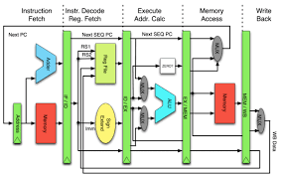
Why RISC? Keep it simple
RISC characteristics:
Reduced number of instructions
Limited addressing modes
  load-store architecture
  enables pipelining
Large register set
  uniform (no distinction between e.g. address and data registers)
Limited number of instruction sizes (preferably one)
  know directly where the following instruction starts
Limited number of instruction formats
Memory alignment restrictions
......
Based on quantitative analysis
  " the famous MIPS one % rule": don't even think about it when its not used more than one percent

