Slide 1
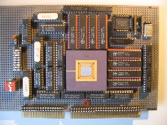


Embedded Computer Architecture
5SAI0
Micro Processor Architecture
Pipelining + Hazards
Henk Corporaal
www.ics.ele.tue.nl/~heco/courses/ECA
h.corporaal@tue.nl
TUEindhoven
2021-2022

Slide 2
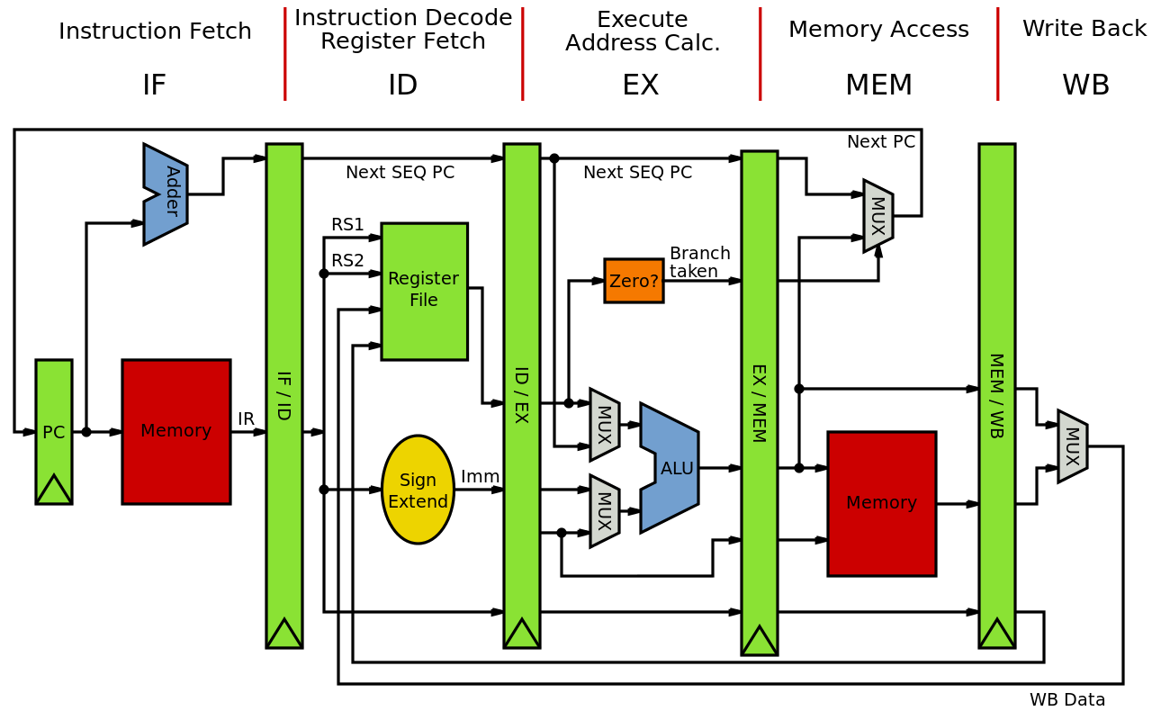
Overview Processor Microarchitecture
Pipelining and Implementation
  discuss the MIPS 5-stage pipeline in detail
Hazards = problems with the pipeline
Exceptions
RISC principles &
Other architecture styles (already treated)
Material
  H&P Appendix A + C
  Dubois: Chapter 3.1-3.3
First finalize ISA part I

Slide 3
Memory Organization
Viewed as a large, single-dimension array, with an address
A memory address is an index into the array
"Byte addressing" means that successive addresses are one byte apart
In a shop you usually buy byte addressable
(DRAM) memory
0
8 bits of data
1
8 bits of data
2
8 bits of data
3
8 bits of data
4
8 bits of data
5
8 bits of data
6
8 bits of data
...

Slide 4
Memory Organization
Bytes are nice, but most data items use larger "words"
For MIPS, a word is 32 bits or 4 bytes.
2³² bytes with byte addresses from 0 to 2³²-1
2³⁰ words with byte addresses 0, 4, 8, ... 2³²-4
0
32 bits of data
4
32 bits of data
Registers hold 32 bits of data
(or 64-bit, or even more bits)
8
32 bits of data
12
...
32 bits of data

Slide 5
Memory layout: Alignment
31
23
15
7
0
0
this word is aligned; the others are not!
4
8
12
address
16
20
24
For a RISC: Instruction words are aligned =>
Instruction address mod 4 = 0, or Instruction address = 4*N
What are the least 2 significant bits of a word address?

Slide 6
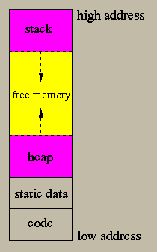
Stack vs Heap

Slide 7
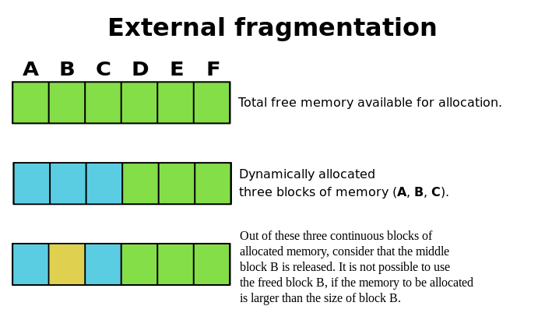
Heap
Q: how is dynamic memory allocated?

Slide 8
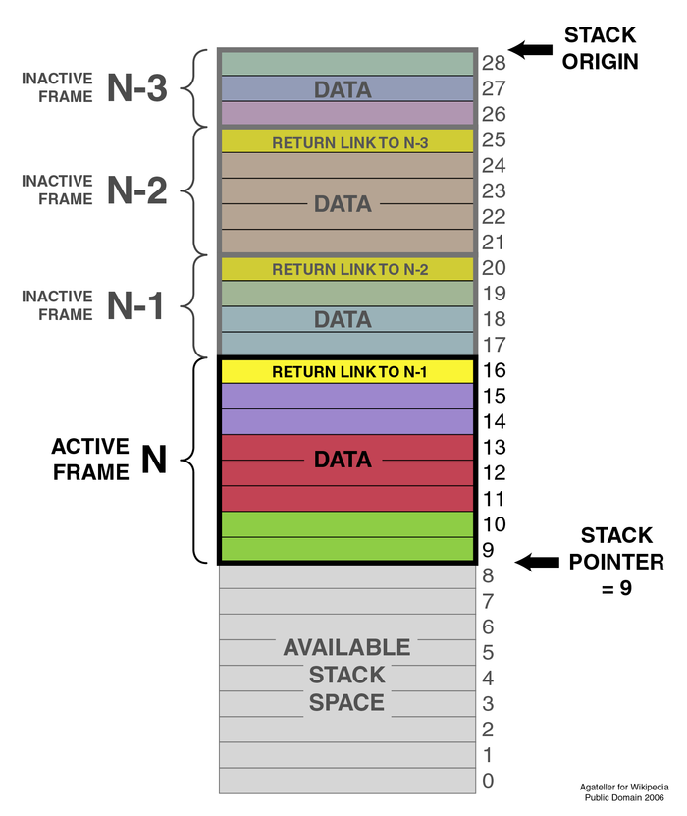
Stack
Used for storing stack frames used for function calls
They contain variables related to functions
  actual arguments
  local variables
  return address
  frame pointer
Note, this stack grows to lower addresses

Slide 9
Instructions: load and store
Example:
C code: A[8] = h + A[8];
MIPS code: lw $t0, 32($s3)
add $t0, $s2, $t0
sw $t0, 32($s3)
Store word operation has no destination (reg) operand
Remember arithmetic operands are registers, not memory!

Slide 10
Let's translate some C-code
Can we figure out the code?
swap(int v[], int k);
{ int temp;
temp = v[k]
v[k] = v[k+1];
v[k+1] = temp;
}
swap:
muli $2 , $5, 4
add $2 , $4, $2
lw $15, 0($2)
lw $16, 4($2)
sw $16, 0($2)
sw $15, 4($2)
jr $31
Explanation:
index k : $5
base address of v: $4
address of v[k] is $4 + 4 * $5

Slide 11
Machine Language: R-format
Instructions, like registers and words of data, are also 32 bits long
  Example: add $t0, $s1, $s2
  Registers have numbers: $t0=9, $s1=17, $s2=18
Instruction Format:
op rs rt rd shamt funct
000000 10001 10010 01001 00000 100000
6 bits
5 bits
5 bits
5 bits
5 bits
6 bits
Can you guess what the field names stand for?

Slide 12
Machine Language: I-format
Introduce a new type of instruction format
  I-type for data transfer instructions
  other format was R-type for register
Example: lw $t0, 32($s2)
35 18 9 32
op rs rt 16 bit number

Slide 13
Control flow: Branches
Branch: Decision making instruction
  alter the control flow,
  i.e., change the "next" instruction to be executed
MIPS conditional branch instructions:
BNE $t0, $t1, Label
BEQ $t0, $t1, Label
Example: if (i==j) h = i + j;
BNE $s0, $s1, Label
ADD $s3, $s0, $s1
Label: ....

Slide 14
Control flow: Jumps
MIPS unconditional branch instructions:
j label
Example:
if (i!=j) BEQ $s4, $s5, Lab1
h=i+j; ADD $s3, $s4, $s5
else J Lab2
h=i-j; Lab1: SUB $s3, $s4, $s5
Lab2: ...
Can you build simple for loops? Try yourself:
  for (i=0; i<80; i++) A[i]++ ;
  for (i=0; i<N; i=i+2) if A[i] < 0 then A[i] = 0;

Slide 15
So far:
Instruction Meaning
add $s1,$s2,$s3 $s1 = $s2 + $s3
sub $s1,$s2,$s3 $s1 = $s2 – $s3
lw $s1,100($s2) $s1 = Memory[$s2+100]
sw $s1,100($s2) Memory[$s2+100] = $s1
bne $s4,$s5,L Next instr. is at Label if $s4 ° $s5
beq $s4,$s5,L Next instr. is at Label if $s4 = $s5
j Label Next instr. is at Label
Formats:
op rs rt rd shamt funct
R
I
J
op rs rt 16 bit address
op 26 bit address

Slide 16
Control Flow
We have: beq, bne, what about Branch-if-less-than?
Need a new instruction:
meaning:
if $s1 < $s2 then
$t0 = 1
slt $t0, $s1, $s2 else
$t0 = 0
Can use this instruction to build "blt $s1, $s2, Label"
  note: this is a pseudo instruction, i.e. the assembler understands it, but translates it to other instructions
  you can now build all general control structures
  Note that the assembler needs a register to do this,
  use conventions for registers

Slide 17
MIPS compiler/assembler conventions

Slide 18
Constants
Small constants are used quite frequently (50% of operands) e.g.,
A = A + 5;
B = B + 1;
C = C - 18;
Solutions? Why not?
  put 'typical constants' in memory and load them
  create hard-wired registers (like $zero) for constants like 0, 1, 2, …
  or …….
MIPS Instructions:
addi $29, $29, 4
slti $8, $18, 10
andi $29, $29, 6
ori $29, $29, 4

Slide 19
How about larger constants?
We'd like to be able to load a 32 bit constant into a register
Must use two instructions; new "load upper immediate" instruction
lui $t0, 1010101010101010
filled with zeros
1010101010101010
0000000000000000
Then must get the lower order bits right, i.e.,
ori $t0, $t0, 1010101010101010
1010101010101010
0000000000000000
0000000000000000
1010101010101010
ori
1010101010101010
1010101010101010

Slide 20
Assembly Language vs. Machine Language
Assembly provides convenient symbolic representation
  much easier than writing down numbers
  e.g., destination first
However: Machine language is the underlying reality
  e.g., destination is no longer first
Assembly can provide 'pseudoinstructions'
  e.g., “move $t0, $t1” exists only in Assembly
  would be implemented using “add $t0,$t1,$zero”
  Another pseudo instr: blt $t1, $t2, label
When considering performance you should count real instructions

Slide 21
Addresses in Branches and Jumps
Instructions:
  bne $t4,$t5,Label Next instruction is at Label if $t4 ≠ $t5
  beq $t4,$t5,Label Next instruction is at Label if $t4 = $t5
  j Label Next instruction is at Label
Formats:
Addresses are not 32 bits
— How do we handle this with load and store instructions?
op rs rt 16 bit address
bne/beq use I-format
I
J
op 26 bit address

Slide 22
Addresses in Branches and Jumps
Instructions:
  bne $t4,$t5,Label Next instruction is at Label if $t4 ≠ $t5
  beq $t4,$t5,Label Next instruction is at Label if $t4 = $t5
  j Label Next instruction is at Label
Branch
  PC_next = PC_branch + 4 + ( Instr[15..0] || [00] ), or
  PC_next = PC_branch + 4 + 4*Label
Jump: use high order (4) bits of PC (assuming 32-bit address)
  PC_next = (PC_jump+4)[31..28] || Instr[25..0] || [00]
  Jump range = 2²⁸ byte = 256 MB
  Note, since top 4 bits do not change, you always stay on the same ‘page’ of 256 MB
Questions:
  Why do we concat 2 zero’s for instruction addresses? And why the 4 upper PC bits?
  Why don’t we do this for data memory addresses?
Concatenating 2 zero bits

Slide 23
MIPS has (only) 3 data addressing modes
data operands
next instruction address

Slide 24
Summary

Slide 25
Overview Processor Microarchitecture
Pipelining and Implementation
  discuss the MIPS 5-stage pipeline in detail
Hazards = problems with the pipeline
Exceptions
RISC principles &
Other architecture styles

Slide 26

Pipelining
Why: Ideal speedup = number of stages
Do we achieve this? NO! HAZARDS
Let’s look at Pipeline implementation (= processor organization)

Slide 27
Pipelining
Improve performance by increasing instruction throughput
P
r
o
g
r
a
m
e
x
e
c
u
t
i
o
n
2
4
6
8
1
0
1
2
1
4
1
6
1
8
o
r
d
e
r
T
i
m
e
(
i
n
i
n
s
t
r
u
c
t
i
o
n
s
)
l
w
$
1
,
1
0
0
(
$
0
)
I
n
s
t
r
u
c
t
i
o
n
R
e
g
A
L
U
D
a
t
a
R
e
g
f
e
t
c
h
a
c
c
e
s
s
l
w
$
2
,
2
0
0
(
$
0
)
8
n
s
I
n
s
t
r
u
c
t
i
o
n
R
e
g
A
L
U
D
a
t
a
R
e
g
f
e
t
c
h
a
c
c
e
s
s
l
w
$
3
,
3
0
0
(
$
0
)
8
n
s
I
n
s
t
r
u
c
t
i
o
n
f
e
t
c
h
.
.
.
8
n
s
P
r
o
g
r
a
m
e
x
e
c
u
t
i
o
n
2
4
6
8
1
0
1
2
1
4
o
r
d
e
r
T
i
m
e
(
i
n
i
n
s
t
r
u
c
t
i
o
n
s
)
l
w
$
1
,
1
0
0
(
$
0
)
I
n
s
t
r
u
c
t
i
o
n
R
e
g
A
L
U
D
a
t
a
R
e
g
f
e
t
c
h
a
c
c
e
s
s
l
w
$
2
,
2
0
0
(
$
0
)
2
n
s
I
n
s
t
r
u
c
t
i
o
n
R
e
g
A
L
U
D
a
t
a
R
e
g
f
e
t
c
h
a
c
c
e
s
s
l
w
$
3
,
3
0
0
(
$
0
)
2
n
s
I
n
s
t
r
u
c
t
i
o
n
R
e
g
A
L
U
D
a
t
a
R
e
g
f
e
t
c
h
a
c
c
e
s
s
2
n
s
2
n
s
2
n
s
2
n
s
2
n
s

Slide 28
Pipelining
What makes it easy
  all instructions are the same length
  just a few instruction formats (3 for MIPS)
  memory operands appear only in loads and stores (= RISC principle)
What makes it hard?
  structural hazards: suppose we had only one memory
  control hazards: need to worry about branch instructions
  data hazards: an instruction depends on a previous instruction
We’ll build a simple pipeline and look at these issues
We’ll talk about modern processors and what really makes it hard:
  exception handling
  trying to improve performance with Out-of-Order execution, etc.

Slide 29
Basic idea: start from single cycle impl.
What do we need to add to actually split the datapath into stages?
I
F
:
I
n
s
t
r
u
c
t
i
o
n
f
e
t
c
h
I
D
:
I
n
s
t
r
u
c
t
i
o
n
d
e
c
o
d
e
/
E
X
:
E
x
e
c
u
t
e
/
M
E
M
:
M
e
m
o
r
y
a
c
c
e
s
s
W
B
:
W
r
i
t
e
b
a
c
k
r
e
g
i
s
t
e
r
f
i
l
e
r
e
a
d
a
d
d
r
e
s
s
c
a
l
c
u
l
a
t
i
o
n
0
M
u
x
1
A
d
d
4
A
d
d
r
e
A
d
d
s
u
l
t
S
h
i
f
t
l
e
f
t
2
R
e
a
d
P
C
A
d
d
r
e
s
s
r
e
g
i
s
t
e
r
1
R
e
a
d
R
e
a
d
d
a
t
a
1
Z
e
r
o
I
n
s
t
r
u
c
t
i
o
n
r
e
g
i
s
t
e
r
2
W
r
i
t
e
R
e
g
i
s
t
e
r
s
d
R
e
a
d
0
A
L
U
A
L
U
R
e
a
d
I
n
s
t
r
u
c
t
i
o
n
r
e
g
i
s
t
e
r
a
t
a
2
M
r
e
s
u
l
t
A
d
d
r
e
s
s
d
a
t
a
1
u
D
a
t
a
M
m
e
m
o
r
y
W
r
i
t
e
x
m
e
m
o
r
y
u
d
a
t
a
1
x
W
r
i
t
e
0
d
a
t
a
1
6
S
3
2
e
x
i
g
n
t
e
n
d

Slide 30
Pipelined Datapath
Can you find a problem even if there are no dependencies?
Which instruction sequence can we execute to demonstrate this problem?
0
M
u
x
1
I
F
/
I
D
I
D
/
E
X
E
X
/
M
E
M
M
E
M
/
W
B
A
d
d
4
A
d
d
r
e
A
d
d
s
u
l
t
S
h
i
f
t
l
e
f
t
2
n
R
e
a
d
o
r
e
g
i
s
t
e
r
1
P
C
A
d
d
r
e
s
s
i
t
R
e
a
d
c
u
d
a
t
a
1
r
t
R
e
a
d
s
Z
e
r
o
n
r
e
g
i
s
t
e
r
2
I
n
s
t
r
u
c
t
i
o
n
I
R
e
g
i
s
t
e
r
s
R
e
a
d
A
L
U
A
L
U
m
e
m
o
r
y
W
r
i
t
e
d
a
t
a
2
0
r
e
s
u
l
t
A
d
d
r
e
s
s
R
e
a
d
1
r
e
g
i
s
t
e
r
M
d
a
t
a
M
W
r
i
t
e
u
D
a
t
a
u
d
a
t
a
x
m
e
m
o
r
y
x
1
0
W
d
r
i
t
e
a
t
a
1
6
S
3
2
i
g
n
e
x
t
e
n
d

Slide 31
Corrected Datapath: problem solved!
0
M
u
x
1
I
F
/
I
D
I
D
/
E
X
E
X
/
M
E
M
M
E
M
/
W
B
A
d
d
4
A
d
d
r
e
A
d
d
s
u
l
t
S
h
i
f
t
l
e
f
t
2
n
R
e
a
d
o
r
e
g
P
C
A
d
d
r
e
s
s
i
i
s
t
e
r
1
R
e
a
d
t
c
u
d
a
t
a
1
r
R
e
a
d
t
s
r
e
g
Z
e
r
o
I
n
s
t
r
u
c
t
i
o
n
n
i
s
t
e
r
2
m
e
m
o
r
y
I
R
e
g
i
s
t
e
r
s
R
e
a
d
0
A
L
U
A
L
U
R
e
a
d
W
r
i
t
e
d
a
t
a
2
r
e
s
u
l
t
A
d
d
r
e
s
s
d
a
t
a
1
r
e
g
i
s
t
e
r
M
D
a
t
a
M
W
r
i
t
e
u
u
d
a
t
a
x
m
e
m
o
r
y
x
1
W
0
d
r
i
t
e
a
t
a
1
6
S
3
2
i
g
n
e
x
t
e
n
d

Slide 32
Graphically Representing Pipelines
T
i
m
e
(
i
n
c
l
o
c
k
c
y
c
l
e
s
)
P
r
o
g
r
a
m
C
C
1
C
C
2
C
C
3
C
C
4
C
C
5
C
C
6
e
x
e
c
u
t
i
o
n
o
r
d
e
r
(
i
n
i
n
s
t
r
u
c
t
i
o
n
s
)
l
w
$
1
0
,
2
0
(
$
1
)
I
M
R
e
g
A
L
U
D
M
R
e
g
s
u
b
$
1
1
,
$
2
,
$
3
I
M
R
e
g
A
L
U
D
M
R
e
g
Can help with answering questions like:
  how many cycles does it take to execute this code?
  what is the ALU doing during cycle 4?
  use this representation to help understand datapaths

Slide 33
Pipeline control
We have 5 stages. What needs to be controlled in each stage?
  Instruction Fetch and PC Increment
  Instruction Decode / Register Fetch
  Execution
  Memory Stage
  Write Back
How would control be handled in an automobile plant?
  a fancy control center telling everyone what to do?
  should we use a finite state machine (FSM)?
We use ‘op’ (operation code)
and ‘funct’ fields
to specify the operation
op rs rt rd shamt funct
R
I
J
op rs rt 16 bit address
op 26 bit address

Slide 34
Pipeline Control
P
C
S
r
c
0
M
u
x
1
I
F
/
I
D
I
D
/
E
X
E
X
/
M
E
M
M
E
M
/
W
B
A
d
d
4
A
d
d
r
e
A
d
d
s
u
l
t
B
r
a
n
c
h
R
e
g
W
r
i
t
e
l
S
h
i
f
t
e
f
t
2
n
R
e
a
d
M
e
m
W
r
i
t
e
o
i
r
e
g
i
s
t
e
r
1
P
C
A
d
d
r
e
s
s
t
c
R
e
a
d
u
r
d
a
t
a
1
t
R
e
a
d
A
L
U
S
r
c
s
M
e
m
t
o
R
e
g
n
Z
e
Z
r
e
o
I
n
s
t
r
u
c
t
i
o
n
I
r
e
g
i
s
t
e
r
2
r
o
m
e
m
o
r
y
W
r
i
t
e
R
e
g
i
s
t
e
r
s
d
R
e
a
d
0
A
L
U
A
L
U
R
e
a
d
r
e
g
i
s
t
e
r
a
t
a
2
M
r
e
s
u
l
t
A
d
d
r
e
s
s
d
a
t
a
1
u
D
a
t
a
M
W
r
i
t
e
x
m
e
m
o
r
y
u
d
a
t
a
1
x
W
r
i
t
e
0
I
n
s
t
r
u
c
t
i
o
n
d
a
t
a
[
1
5
–
0
]
1
6
S
i
g
n
3
2
6
A
L
U
e
x
t
e
n
d
c
o
n
t
r
o
l
M
e
m
R
e
a
d
I
n
s
t
r
u
c
t
i
o
n
[
2
0
–
1
6
]
0
I
n
s
t
r
u
c
t
i
o
n
M
A
L
U
O
p
[
1
5
–
1
1
]
u
x
1
R
e
g
D
s
t

Slide 35
Datapath with
2-level
Control
P
C
S
r
c
0
I
D
/
E
X
M
W
B
u
E
X
/
M
E
M
x
1
C
o
n
t
r
o
l
M
W
B
M
E
M
/
W
B
I
F
/
I
D
E
X
M
W
B
A
d
d
4
A
d
d
r
e
A
d
d
e
s
u
l
t
t
i
r
B
r
a
n
c
h
W
S
h
i
f
t
g
l
e
f
t
2
e
e
t
R
i
A
L
U
S
r
c
r
W
n
R
e
a
d
m
g
o
r
e
g
i
s
t
e
r
1
e
e
P
C
A
d
d
r
e
s
s
i
M
R
t
R
e
a
d
c
o
u
d
a
t
a
1
t
r
m
t
R
e
a
d
s
Z
e
r
o
e
n
r
e
g
i
s
t
e
r
2
M
I
n
s
t
r
u
c
t
i
o
n
I
R
e
g
i
s
t
e
r
s
R
e
a
d
A
L
U
A
L
U
m
e
m
o
r
y
W
r
i
t
e
d
a
t
a
2
0
r
e
s
u
l
t
A
d
d
r
e
s
s
R
e
a
d
1
r
e
g
i
s
t
e
r
M
D
a
t
a
d
a
t
a
M
W
r
i
t
e
u
m
e
m
o
r
y
u
d
a
t
a
x
x
1
W
r
i
t
e
0
d
a
t
a
I
n
s
t
r
u
c
t
i
o
n
1
6
3
2
6
[
1
5
–
0
]
S
i
g
n
A
L
U
M
e
m
R
e
a
d
e
x
t
e
n
d
c
o
n
t
r
o
l
I
n
s
t
r
u
c
t
i
o
n
[
2
0
–
1
6
]
0
A
L
U
O
p
M
I
n
s
t
r
u
c
t
i
o
n
u
[
1
5
–
1
1
]
x
1
R
e
g
D
s
t

Slide 36
Pipeline Control
Pass control signals along
just like the data:

Slide 37
Overview Processor Microarchitecture:
Hazards
Pipelining and Implementation
  discuss the MIPS 5-stage pipeline in detail
Hazards = problems with the pipeline
Exceptions
RISC principles &
Other architecture styles

Slide 38

Hazards: problems due to pipelining
Three Hazard types:
Structural
  same resource is needed multiple times in the same cycle
Data
  data dependencies limit pipelining
Control
  next executed instruction may not be the next specified instruction

Slide 39
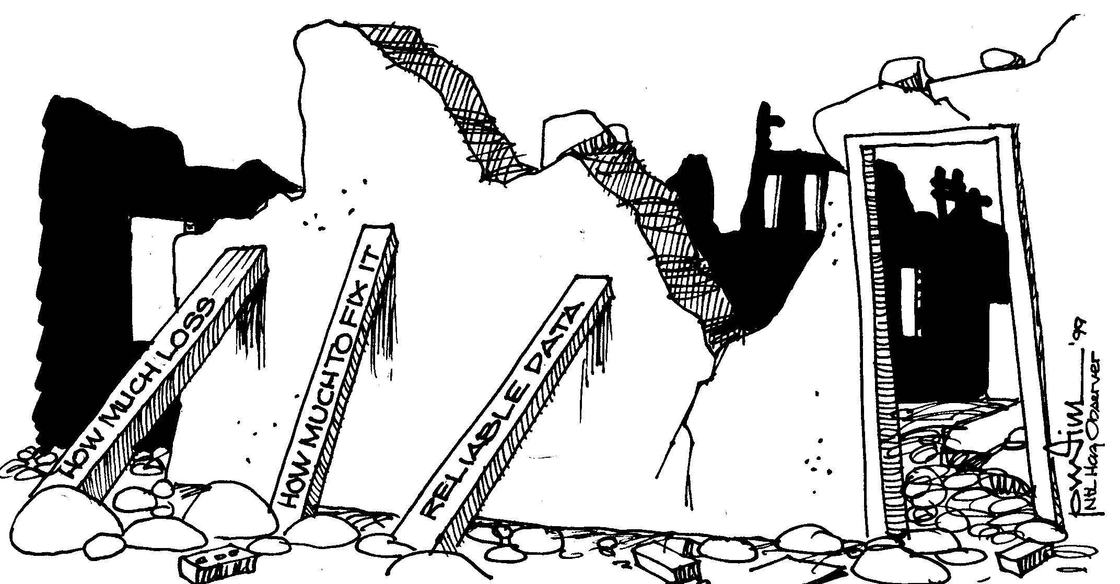
Structural hazards
Examples:
Two accesses to a single ported memory
Two operations need the same function unit
at the same time
Two operations need the same function unit
in successive cycles, but the unit is not pipelined
Solutions:
stalling
add more hardware

Slide 40
Structural hazards on MIPS
Q: Do we have structural hazards on our simple MIPS pipeline?
- is there any resource clash?
time
IF
ID
EX
MEM
WB
IF
ID
EX
MEM
WB
Instruction stream
IF
ID
EX
MEM
WB
IF
ID
EX
MEM
WB
IF
ID
EX
MEM
WB

Slide 41

Data hazards; due to data dependences
Data dependences:
  RaW (read-after-write)
  WaW (write-after-write)
  WaR (write-after-read)
  between register operands and/or between memory operands
Hardware solution:
  Forwarding / Bypassing
  Detection logic
  Stalling
Software solution: Scheduling

Slide 42
Three Data dependences types: RaW, WaR, WaW
add r1, r2, 5 ; r1 := r2+5
sub r4, r1, r3 ; RaW of r1
add r1, r2, 5
sub r2, r4, 1 ; WaR of r2
add r1, r2, 5
sub r1, r1, 1 ; WaW of r1
st r1, 5(r2) ; M[r2+5] := r1
ld r5, 0(r4) ; RaW if 5+r2 = 0+r4
WaW and WaR do not occur in simple pipelines, but they limit scheduling freedom!
Problems for your compiler and your Laptop processor!
⇒ use register renaming to solve this!

Slide 43
RaW on MIPS pipeline
T
i
m
e
(
i
n
c
l
o
c
k
c
y
c
l
e
s
)
V
a
l
u
e
o
f
C
C
1
C
C
2
C
C
3
C
C
4
C
C
5
C
C
6
C
C
7
C
C
8
C
C
9
r
e
g
i
s
t
e
r
$
2
:
1
0
1
0
1
0
1
0
1
0
/
–
2
0
–
2
0
–
2
0
–
2
0
–
2
0
P
r
o
g
r
a
m
e
x
e
c
u
t
i
o
n
o
r
d
e
r
(
i
n
i
n
s
t
r
u
c
t
i
o
n
s
)
s
u
b
$
2
,
$
1
,
$
3
I
M
R
e
g
D
M
R
e
g
a
n
d
$
1
2
,
$
2
,
$
5
I
M
R
e
g
D
M
R
e
g
o
r
$
1
3
,
$
6
,
$
2
I
M
R
e
g
D
M
R
e
g
a
d
d
$
1
4
,
$
2
,
$
2
I
M
R
e
g
D
M
R
e
g
s
w
$
1
5
,
1
0
0
(
$
2
)
I
M
R
e
g
D
M
R
e
g

Slide 44
Use forwarding hardware
- Do not wait till the result is in the register file
ALU forwarding circuitry principle:
from register file
buf
ALU
buf
to register file
from register file
buf
Note: there are two options
buf - ALU – bypass – mux - buf
buf - bypass – mux – ALU - buf

Slide 45
Forwarding example
T
i
m
e
(
i
n
c
l
o
c
k
c
y
c
l
e
s
)
C
C
1
C
C
2
C
C
3
C
C
4
C
C
5
C
C
6
C
C
7
C
C
8
C
C
9
V
a
l
u
e
o
f
r
e
g
i
s
t
e
r
$
2
:
1
0
1
0
1
0
1
0
1
0
/
–
2
0
–
2
0
–
2
0
–
2
0
–
2
0
V
a
l
u
e
o
f
E
X
/
M
E
M
:
X
X
X
–
2
0
X
X
X
X
X
V
a
l
u
e
o
f
M
E
M
/
W
B
:
X
X
X
X
–
2
0
X
X
X
X
P
r
o
g
r
a
m
e
x
e
c
u
t
i
o
n
o
r
d
e
r
(
i
n
i
n
s
t
r
u
c
t
i
o
n
s
)
s
u
b
$
2
,
$
1
,
$
3
I
M
R
e
g
D
M
R
e
g
a
n
d
$
1
2
,
$
2
,
$
5
I
M
R
e
g
D
M
R
e
g
What if this
$2 was $13?
o
r
$
1
3
,
$
6
,
$
2
I
M
R
e
g
D
M
R
e
g
a
d
d
$
1
4
,
$
2
,
$
2
I
M
R
e
g
D
M
R
e
g
s
w
$
1
5
,
1
0
0
(
$
2
)
I
M
R
e
g
D
M
R
e
g

Slide 46
Forwarding
I
D
/
E
X
W
B
E
X
/
M
E
M
C
o
n
t
r
o
l
M
W
B
M
E
M
/
W
B
I
F
/
I
D
E
X
M
W
B
n
M
o
u
i
t
c
x
u
ForwardA
r
t
s
R
e
g
i
s
t
e
r
s
n
D
a
t
a
P
C
I
n
s
t
r
u
c
t
i
o
n
I
A
L
U
m
e
m
o
r
y
m
e
m
o
r
y
M
u
M
x
u
ForwardB
x
I
F
/
I
D
.
R
e
g
i
s
t
e
r
R
s
R
s
I
F
/
I
D
.
R
e
g
i
s
t
e
r
R
t
R
t
I
F
/
I
D
.
R
e
g
i
s
t
e
r
R
t
R
t
M
E
X
/
M
E
M
.
R
e
g
u
i
s
t
e
r
R
d
I
F
/
I
D
.
R
e
g
i
s
t
e
r
R
d
R
d
x
F
o
r
w
a
r
d
i
n
g
M
E
M
/
W
B
.
R
e
g
u
n
i
t
i
s
t
e
r
R
d

Slide 47
Forwarding check
Check for matching register-ids:
  For each source-id of operation in the EX-stage check if there is a matching pending dest-id
Example:
if (EX/MEM.RegWrite) ∧
(EX/MEM.RegisterRd ≠ 0) ∧
(EX/MEM.RegisterRd = ID/EX.RegisterRs)
then ForwardA = 10
Q. How many comparators do we need?

Slide 48
Can't always forward: Load !!
Load word can still cause a hazard:
  an instruction tries to read register r following a load to the same r
Need a hazard detection unit
to “stall” the load instruction
T
i
m
e
(
i
n
c
l
o
c
k
c
y
c
l
e
s
)
P
r
o
g
r
a
m
C
C
1
C
C
2
C
C
3
C
C
4
C
C
5
C
C
6
C
C
7
C
C
8
C
C
9
e
x
e
c
u
t
i
o
n
o
r
d
e
r
(
i
n
i
n
s
t
r
u
c
t
i
o
n
s
)
l
w
$
2
,
2
0
(
$
1
)
I
M
R
e
g
D
M
R
e
g
a
n
d
$
4
,
$
2
,
$
5
I
M
R
e
g
D
M
R
e
g
o
r
$
8
,
$
2
,
$
6
I
M
R
e
g
D
M
R
e
g
a
d
d
$
9
,
$
4
,
$
2
I
M
R
e
g
D
M
R
e
g
s
l
t
$
1
,
$
6
,
$
7
I
M
R
e
g
D
M
R
e
g

Slide 49
Stalling
We can stall the pipeline by keeping an instruction in the same stage
P
r
o
g
r
a
m
T
i
m
e
(
i
n
c
l
o
c
k
c
y
c
l
e
s
)
e
x
e
c
u
t
i
o
n
C
C
1
C
C
2
C
C
3
C
C
4
C
C
5
C
C
6
C
C
7
C
C
8
C
C
9
C
C
1
0
o
r
d
e
r
(
i
n
i
n
s
t
r
u
c
t
i
o
n
s
)
l
w
$
2
I
M
R
e
g
D
M
R
e
g
,
2
0
(
$
1
)
a
n
d
$
4
I
M
R
e
g
R
e
g
D
M
R
e
g
,
$
2
,
$
5
o
r
$
8
R
e
g
,
$
2
,
$
6
I
M
I
M
D
M
R
e
g
b
u
b
b
l
e
a
d
d
$
9
,
$
4
,
$
2
I
M
R
e
g
D
M
R
e
g
In CC4 the ALU is not used,
Reg, and IM are redone
s
l
t
$
1
,
$
6
,
$
7
I
M
R
e
g
D
M
R
e
g

Slide 50
Hazard Detection Unit
H
a
z
a
r
d
I
D
/
E
X
.
M
e
m
R
e
a
d
d
e
t
e
c
t
i
o
n
u
n
i
t
I
D
/
E
X
e
W
B
t
i
E
X
/
M
E
M
r
W
D
M
I
/
C
o
n
t
r
o
F
l
u
M
W
B
I
x
M
E
M
/
W
B
0
I
F
/
I
D
E
X
M
W
B
e
t
i
r
W
n
M
C
o
u
P
i
t
c
x
u
r
t
R
e
g
s
i
s
t
e
r
s
n
D
a
t
a
P
C
I
n
s
t
r
u
c
t
i
o
n
I
A
L
U
m
e
m
o
r
y
m
e
m
o
r
y
M
u
M
x
u
x
I
F
/
I
D
.
R
e
g
i
s
t
e
r
R
s
I
F
/
I
D
.
R
e
g
i
s
t
e
r
R
t
R
I
F
/
I
D
t
.
R
e
g
i
s
t
e
r
R
t
M
E
X
/
M
E
M
u
.
R
e
g
i
s
t
e
r
R
d
I
F
/
I
D
.
R
e
g
i
s
t
e
r
R
d
R
d
x
I
D
/
E
X
.
R
e
g
i
s
t
e
r
R
t
R
s
F
o
r
w
a
r
d
i
n
g
M
E
M
/
W
B
.
R
e
g
R
u
n
i
t
i
s
t
e
r
R
d
t

Slide 51
Software only solution?
Have compiler guarantee that no hazards occur
Example: where do we insert the “NOPs” ?
sub $2, $1, $3
and $12, $2, $5
or $13, $6, $2
add $14, $2, $2
sw $13, 100($2)
Problem: this really slows us down!
sub $2, $1, $3
nop
nop
nop
and $12, $2, $5
or $13, $6, $2
add $14, $2, $2
nop
nop
sw $13, 100($2)

Slide 52
Scheduling data hazards: example 1
Try and avoid RaW stalls (in this case load interlocks)!
E.g., reorder these instructions:
lw $t0, 0($t1)
lw $t2, 4($t1)
sw $t2, 0($t1)
sw $t0, 4($t1)
lw $t0, 0($t1)
lw $t2, 4($t1)
sw $t0, 4($t1)
sw $t2, 0($t1)
?

Slide 53
Scheduling data hazards example 2
Unscheduled code:
Lw R1,b
Lw R2,c
Add R3,R1,R2 interlock
Sw a,R3
Lw R1,e
Lw R2,f
Sub R4,R1,R2 interlock
Sw d,R4
Avoiding RaW stalls:
Reordering instructions for following program
(by you or the compiler)
Code:
a = b + c
d = e - f
Scheduled code:
Lw R1,b
Lw R2,c
Lw R5,e extra reg. needed!
Add R3,R1,R2
Lw R2,f
Sw a,R3
Sub R4,R5,R2
Sw d,R4

Slide 54
Control hazards
Control operations may change the sequential flow of instructions
  branch (conditional)
  jump (unconditional)
  call (unconditional jump and link)
  return (unconditional)
  exception/interrupt and RTI / return from interrupt

Slide 55
Control hazard: Branch
Branch requires 3 actions:
Compute new address
Determine condition
Perform the actual branch (if taken):
if Cond=True : PC := new address

Slide 56
Branch example
P
r
o
g
r
a
m
T
i
m
e
(
i
n
c
l
o
c
k
c
y
c
l
e
s
)
e
x
e
c
u
t
i
o
n
C
C
1
C
C
2
C
C
3
C
C
4
C
C
5
C
C
6
C
C
7
C
C
8
C
C
9
o
r
d
e
r
(
i
n
i
n
s
t
r
u
c
t
i
o
n
s
)
4
0
b
e
q
$
1
,
$
3
,
7
I
M
R
e
g
D
M
R
e
g
4
4
a
n
d
$
1
2
,
$
2
,
$
5
I
M
R
e
g
D
M
R
e
g
4
8
o
r
$
1
3
,
$
6
,
$
2
I
M
R
e
g
D
M
R
e
g
5
2
a
d
d
$
1
4
,
$
2
,
$
2
I
M
R
e
g
D
M
R
e
g
7
2
l
w
$
4
,
5
0
(
$
7
)
I
M
R
e
g
D
M
R
e
g

Slide 57
Branching
Squash pipeline:
When we decide to branch, other instructions are in the pipeline!
We are predicting “branch not taken”
  need to add hardware for flushing instructions if we are wrong

Slide 58
Branch with predict not taken
Clock cycles
Branch L
IF
ID
EX
MEM
WB
IF
ID
EX
MEM
WB
Predict not taken
IF
ID
EX
MEM
WB
IF
ID
EX
MEM
WB
L:
IF
ID
EX
MEM
WB

Slide 59
Branch speedup
Earlier address computation
Earlier condition calculation
Put both in the ID pipeline stage
  adder
  comparator
Clock cycles
Branch L
IF
ID
EX
MEM
WB
Predict not taken
IF
ID
EX
MEM
WB
L:
IF
ID
EX
MEM
WB

Slide 60
Improved branching / flushing IF/ID
I
F
.
F
l
u
s
h
d
H
a
z
a
r
d
e
t
e
c
t
i
o
n
u
n
i
t
M
I
D
/
E
X
u
x
W
B
E
X
/
M
E
M
M
C
o
n
t
r
o
l
u
M
W
B
M
E
M
/
W
B
0
x
I
F
/
I
D
E
X
M
W
B
4
l
S
h
i
f
t
e
f
t
2
M
u
=
x
I
n
s
t
r
u
c
t
i
o
n
R
e
g
i
s
t
e
r
s
D
a
t
a
P
C
m
e
m
o
r
y
A
L
U
m
e
m
o
r
y
M
u
M
x
u
x
e
S
i
g
n
x
t
e
n
d
M
u
x
F
o
r
w
a
r
d
i
n
g
u
n
i
t

Slide 61
Scheduling control hazards
T_{execution} = N_{instructions} x CPI x T_{cycle,}
_{where:}
CPI = CPI_{ideal} + f_{branch} x P_{branch}
P_{branch} = N_{delayslots} x miss_rate // effective branch penalty
Modern processors tend to have large branch penalty, P_{branch,} due to:
  many pipeline stages (i.e. a long pipeline)
  multi-issue (i.e. multiple instructions can start each cycle)
  so the pipeline contains many operations !
Note: penalties have larger impact when CPI_{ideal} is low !! Why ?

Slide 62
Exercise: Impact of branches
Assume: 20% branch instructions, 90% correct prediction.
What is the branch impact (slow down) for the following architectures:
  RISC with CPI_{base} = 1, branch penalty is 1 cycle
  Core i7, 4 issue, with CPI_{base} = 0.25, branch penalty is 10 cycles
Answers:
CPI = CPI_{base} + f_{branch} * f_{miss} * N_{PenaltyCycles}
= 1 + 0.2*0.1*1 = 1.02
Slowdown = CPI/ CPI_{base} = 1.02/1 =1.02
CPI = 0.25 + 0.2*0.1*10 = 0.45
Slowdown = 0.45/0.25 = 1.8,
or (1-1/1.8) * 100% = 44.4% slower
Conclusion?

Slide 63
Scheduling control hazards
What can we do about control hazards and CPI penalty?
Make penalty P_{branch} low:
  Early computation of new PC
  Early determination of condition
  Visible branch delay slots filled by compiler (MIPS)
Branch prediction
Reduce control dependencies (control height reduction) [Schlansker and Kathail, Micro’95]
Remove branches: if-conversion
  Conditional instructions: CMOVE, cond skip next
  Guarding all instructions: e.g. in the TriMedia

Slide 64
Branch delay slot
Add a branch delay slot:
  the next instruction after a branch is always executed
  rely on compiler to “fill” the slot with something useful
Is this a good idea?
  let's look how it works

Slide 65
Branch delay slot scheduling
Q. What to put in the delay slot?
op 1
beq r1,r2, L
.............
op 2
'fall-through'
(branch not taken)
.............
branch target
(branch taken)
L: op 3
.............

Slide 66

Overview Processor Microarchitecture
Instruction set architecture (ISA)
  we use the MIPS ISA as example
Pipelining and Implementation
  discuss the MIPS 5-stage pipeline in detail
Hazards = problems with the pipeline
Exceptions
RISC principles &
Other architecture styles

Slide 67
Exceptions, traps and interrupts
Exceptions are rare events triggered by the hardware and forcing the processor to execute an exception handler
  Includes traps and interrupts
Examples:
  I/o device interrupts
  Operating system calls
  Instruction tracing and breakpoints
  Integer or floating-point arithmetic exceptions (e.g. overflow)
  Page faults
  Misaligned memory accesses
  Memory protection violations
  Undefined operation
  Hardware failure/alarms
  Power failures

Slide 68
Exception handling
User program
Exception handling
Disable exceptions
Enter kernel
mode
Save process state
Optional, if handler
is re-entrable
Enable exceptions
instructions
Exception raised
Enable exceptions
Return to user
mode
Disable exceptions
Restore process state
Optional
RTI
Note, typically user program is put in 'ready queue'
instead of return to it directly
Notes:
Note, practice is a little different
- after finishing the exception, the user program enters the OS ready state, and will be scheduled later for running.

Slide 69
Exceptions
Pipeline benefits come from overlapped instruction executions
  Things go wrong when the flow of instructions is suddenly interrupted (exceptions)
Many exceptions must be precise, i.e.:
  All instructions preceding the faulting instruction must complete
  The faulting instruction and all following instructions must be squashed (flushed)
  The handler must start its execution
It is not practical to take an exception in the cycle when it happens
  Multiple exceptions may occur in the same cycle
  It is complex to take exceptions in various pipeline stages
  The major reason is that exceptions must be taken in process order and not in temporal order
Instead, flag the exception and record its cause when it happens, keep it “silent” and wait until the instruction reaches the WB stage to take it.
1
IF
ID
EX
ME
WB
2
except.
3
except.
4

Slide 70
Possible problems for precise exceptions in CISC machines
Exceptions are handled easily in the WB stage because our ISA is RISC
  machine states are updated at the end of the pipeline
Precise exceptions are more difficult in CISC machines because of:
  Early (in the pipeline) register changes due to complex addressing modes
    Auto-increment and auto-decrement addressing modes
  Condition codes
    Problem if they can be set in multiple stages
    If set early they must be restored on an exception
  Multi-cycle instructions
    Where to stop?
    How to restart?
  Use of registers as working storage in the microcode of complex instructions
1
IF
ID
EX
ME
WB
2
except.
3
except.
4

Slide 71


Wrap-Up

Slide 72
Overview Processor Microarchitecture
Instruction set architecture (ISA)
  we use the MIPS ISA as example
Pipelining and Implementation
  discuss the MIPS 5-stage pipeline in detail
Hazards = problems with the pipeline
Exceptions
RISC principles &
Other architecture styles

Slide 73

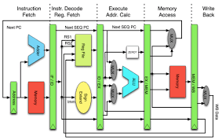
Why RISC? Keep it simple
RISC characteristics:
Reduced number of instructions
Limited addressing modes
  load-store architecture
  enables pipelining
Large register set
  uniform (no distinction between e.g. address and data registers)
Limited number of instruction sizes (preferably one)
  know directly where the following instruction starts
Limited number of instruction formats
Memory alignment restrictions
......
Based on quantitative analysis
  " the famous MIPS one % rule": don't even think about it when its not used more than one percent

Slide 74
Other architecture styles
Accumulator architecture
  one operand (in register or memory), accumulator almost always implicitly used
Stack
  zero operand: all operands implicit (on TOS)
Register (load store)
  three operands, all in registers
  loads and stores are the only instructions accessing memory (i.e. with a memory (indirect) addressing mode
Register-Memory
  two operands, one in memory
Memory-Memory
  three operands, may be all in memory
(there are more varieties / combinations)

Slide 75
Accumulator Architecture
latch
Accumulator
ALU
Memory
address
registers
latch
Example code: a = b+c;
load b; // accumulator is implicit operand
add c;
store a;

Slide 76
Stack Architecture
latch
latch
top of
stack
ALU
Memory
latch
stack pt
Example code: a = b+c;
push b;
push c;
add;
pop a;
push b
push c
add
pop a
stack:
b
c
b+c
b

Slide 77
Other architecture styles
Let's look at the code for C = A + B
Stack Architecture | Accumulator Architecture | Register-Memory | Memory-Memory | Register (load-store)
Push A | Load A | Load r1,A | Add C,B,A | Load r1,A
Push B | Add B | Add r1,B |  | Load r2,B
Add | Store C | Store C,r1 |  | Add r3,r1,r2
Pop C |  |  |  | Store C,r3
Q: What are the advantages / disadvantages of load-store (RISC) architecture?

Slide 78
General addressing modes
MODE | EXAMPLE | MEANING
REGISTER | ADD R4, R3 | reg[R4] <- reg[R4] +reg[R3]
IMMEDIATE | ADD R4, #3 | reg[R4] <- reg[R4] + 3
DISPLACEMENT | ADD R4, 100(R1) | reg[R4] <- reg[R4] + Mem[100 + reg[R1]]
REGISTER INDIRECT | ADD R4, (R1) | reg[R4] <- reg[R4] + Mem[reg[R1]]
INDEXED | ADD R3, (R1+R2) | reg[R3] <- reg[R3] + Mem[reg[R1] + reg[R2]]
DIRECT OR ABSOLUTE | ADD R1, (1001) | reg[R1] <- reg[R1] + Mem[1001]
MEMORY INDIRECT | ADD R1, @R3 | reg[R1] <- reg[R1] + Mem[Mem[Reg[3]]]
POST INCREMENT | ADD R1, (R2)+ | ADD R1, (R2) then R2 <- R2+d
PREDECREMENT | ADD R1, -(R2) | R2 <- R2-d then ADD R1, (R2)
PC-RELATIVE | BEZ R1, 100 | if R1==0, PC <- PC+100
PC-RELATIVE | JUMP 200 | Concatenate bits of PC and offset

Slide 79

ISA essentials
Assembly & Machine formats
RISC implementation
(Static) Pipelining
Various Hazards
  HW solutions
  SW solutions
Out-of-Order pipelines
SW techniques
  Re-scheduling code to reduce stalls, improve performance
  Loop unroling
  Software pipelining
RISC vs CISC: key RISC principles
Other architecture styles and other addressing modes: pros and cons
What did we learn?

