Slide 1
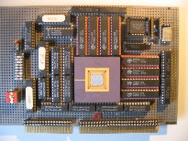
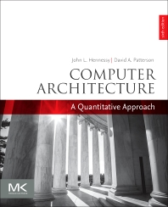

Embedded Computer Architecture
5SAI0
Wrap-Up, we are almost there...
Henk Corporaal
www.ics.ele.tue.nl/~heco/courses/ECA
h.corporaal@tue.nl
TUEindhoven
2021-2022

Slide 2

Did we meet our Course goals?
Learn advanced computer architecture concepts like:
  ILP, DLP, multi-threading and multi-issue architectures;
  O-O-O and Speculative execution;
  Advanced memory / cache hierarchy; speedup methods; CPI impact;
  Correlating branch prediction; CPI impact, and
  Energy consumption and Technology issues.
Learn multi-processor architecture concepts like:
  Multi-threading and Multi-processing;
  Communication models;
  Topologies, and
  Cache Coherence, Synchronization and Memory Consistency.
Study the good books!

Slide 3
Crucial Topics of Embedded Computer Architecture
Indepth treatment of Processor components:
  RISC, CISC, VLIW, Superscalar, SIMD, SIMT, GPU, SMT, TTA, CGRA
Memory hierarchy with all kinds of optimizations
  All details about cache design, and many optimizations, incl. the model of the 4 Cs
All types of Parallelism and How to Parallelize
  (more on this in 5LIM0, Parallelization-Compilers-Platforms)
Simulation options
The energy / power law
Introduction to Loop transformations (much more on this in PCP course 5LIM0, Q3)
Multi-Processing systems (more on this in 5KK80, multiprocessors)
  shared memory and their issues, like Coherence, Consistency and Synchronization
  message passing
  interconnect networks and their metrics
Accelerators
  Neural Networks and their accelerators

Slide 4
Original Schedule
2021-2022
Date | Topic | Book H&P
15 Nov | Overview + Fundamentals of Computer Architecture | Ch 1
17 Nov | RISC/MIPS recap (1): ISA (Instruction-Set Architecture) | App A
 | DSE/SImulation Lab < Dec 12
22 Nov | Memory hierarchy 1 | Ch 2+App B
24 Nov | Simulation + Loop trafos (Intro) | Dubois ch 9
29 Nov | RISC/MIPS recap (2): pipelining/hazards | App C
1 Dec | Memory hierarchy 2, incl. Flash memory, Virtual Memory | Ch 2
6 Dec | DLP Architectures: Vector, SIMD and GPU architectures | Ch 4.1-4.3, 4.5
 | GPU lab < Jan 9
8 Dec | GPU: Gert-Jan van den Braak (Philips Medical Systems) | Ch 4.4
13 Dec | ILP Architecturen 1: Out-of-Order execution | Ch 3
15 Dec | ILP Architecturen 2: Branch Pred + Multiple Issue architectures | Ch 3
20 Dec | ILP Architectures 3: TTA, How much ILP, compiler support | Ch 3
22 Dec | CGRA arch (video) + CGRA Lab
 | CGRA lab < Jan 21
10 Jan | Multi-threading/processing + Networks-on-Chip | Ch 5
12 Jan | Domain-Specific Arch + ML: Maurice Peemen (FisherScientific) | Ch 7.1-7.4
 | Try-out exam online
17 Jan | Coherence, synchr. and consistency 1 | Ch 5.3
19 Jan | Coherence, synchr. and consistency 2 + Wrap up | Ch 5.5-5.6

Slide 5

Recap topics
Computer systems
Micro Architecture
  RISC principles
Multi-Issue architectures
  Superscalar
  VLIW + TTA
Memory hierarchy & Caches
Simulation
Loop transformations
Multi-threading & Multi-Processors
Networks
Coherency, Synchronization, Consistency
Introduction to Deep Learning and their Accelerators

Slide 6
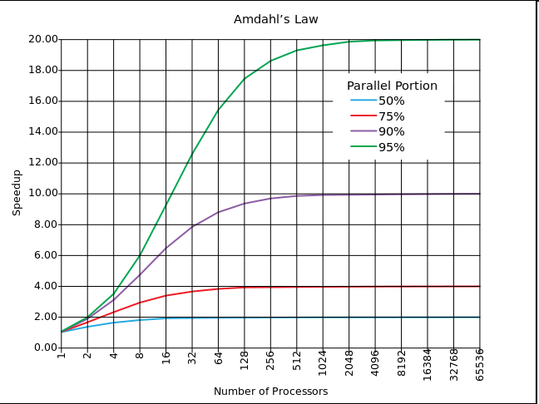
Computer systems
Trends
  Performance increase slows down
    almost none for single processor
  Technology factors, Energy problem
Main design issues, like parallelism, performance,
cost & energy
  Amdahl's law vs Gustafson's law
  What are their assumptions? Make some calculations!
How the cost of a computer is build up
Performance measurement
  Benchmarks & Metrics; summarizing performance
  Arithmetic or Weighted mean, Harmonic mean, Geometric mean: When to use what?
System reliability: Dependability calculations
  Availability MTTF & FIT: calculate them for a system containing many parts

Slide 7
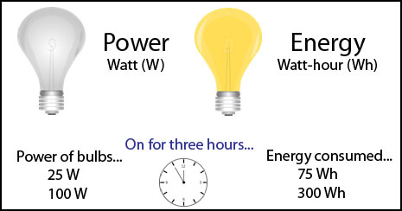
Computer systems: Power & Energy
Energy E = P*t
(power P, execution time t)
P = P_{static} + P_{dynamic}
static: leakage ~ chip area (more circuits & transistors => more leakage)
  P_{static} = I_static * V
  scales with #transistors
  reduce leakage by power gating
dynamic: switching ( 0->1 or 1->0 )
  P_{dynamic} = ½ α f C V_{dd}²
  E_{dynamic} = ½ α C V_{dd}²
Clock gating vs Power gating
Reducing clock rate reduces power, not energy
Power vs Energy

Slide 8
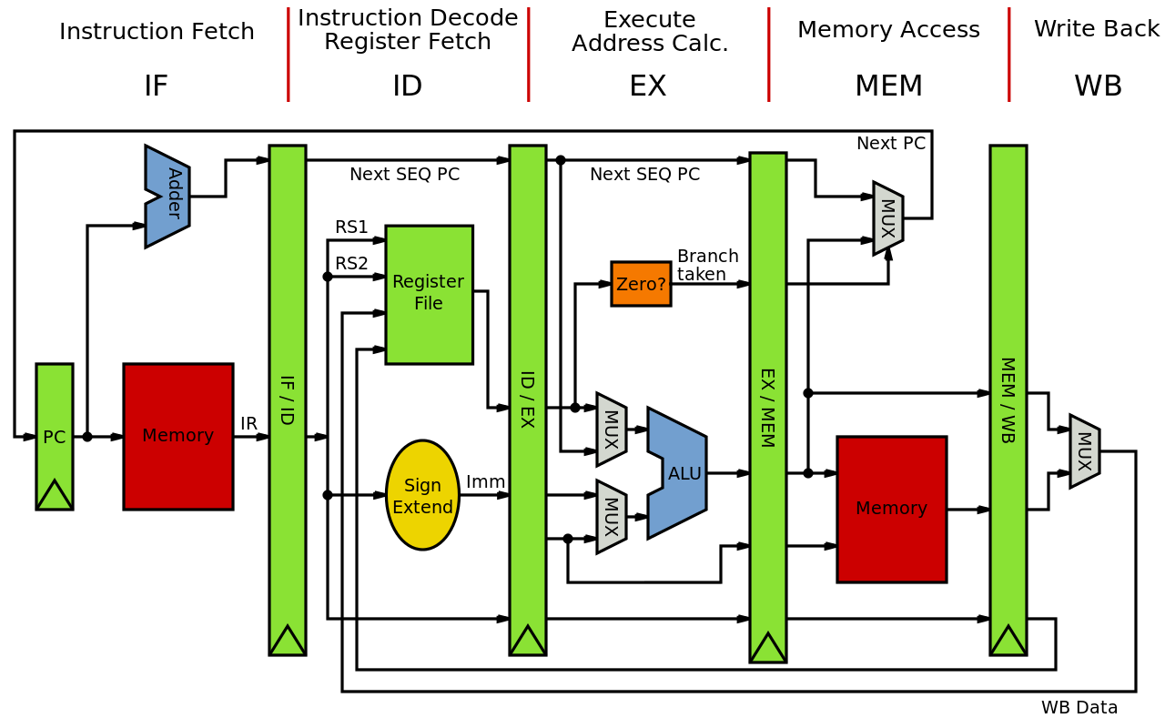
MIPS Micro Architecture
ISA + MIPS instruction set
  3 basic instruction types: Arithmetic, Memory & Control
  calculation of next address for branch and jump from label
  handling immediates; building longer immediates
Assembly language
Process layout in memory: Stack, Heap, Code, Global data
Translating C code into MIPS assembly code
Machine code / Instruction formats
  R, I and J formats
Other architecture styles
  Stack, Load-Store (= RISC), Memory-Memory, Register-Memory & Accumulator Architecture
op rs rt rd shamt funct
R
I
J
op rs rt 16 bit address
op 26 bit address

Slide 9
MIPS
ISA
Summary

Slide 10
What's the next address (Branch & Jump)?
Branch Instructions:
  bne $t4,$t5,Label Next instruction is at Label if $t4 ≠ $t5
  beq $t4,$t5,Label Next instruction is at Label if $t4 = $t5
Formats (use the I-format):
Most branches are local (principle of locality):
  use Instruction Address Register (PC = program counter), and use relative addressing:
  PC_next = PC + 4 + (16-bit label || 00)
Jump instructions just use high order bits of PC
  address boundaries of 256 MB
  PC_next = (PC + 4 )[31..28] || 26-bit Label || 00
op rs rt 16 bit address label
I

Slide 11
MIPS has (only) 3 data addressing modes
data operands
next instruction address

Slide 12
Micro Architecture: MIPS pipelining
P
C
S
r
c
Understand fully
this data path
Derive its control
How to handle
exceptions?
Explain Hazards
Explain what happens when we introduce an error in the data/control
0
I
D
/
E
X
M
W
B
u
E
X
/
M
E
M
x
1
C
o
n
t
r
o
l
M
W
B
M
E
M
/
W
B
I
F
/
I
D
E
X
M
W
B
A
d
d
4
A
d
d
r
e
A
d
d
e
s
u
l
t
t
i
r
B
r
a
n
c
h
W
S
h
i
f
t
g
l
e
f
t
2
e
e
t
R
i
A
L
U
S
r
c
r
W
n
R
e
a
d
m
g
o
r
e
g
i
s
t
e
r
1
e
e
P
C
A
d
d
r
e
s
s
i
M
R
t
R
e
a
d
c
o
u
d
a
t
a
1
t
r
m
t
R
e
a
d
s
Z
e
r
o
e
n
r
e
g
i
s
t
e
r
2
M
I
n
s
t
r
u
c
t
i
o
n
I
R
e
g
i
s
t
e
r
s
R
e
a
d
A
L
U
A
L
U
m
e
m
o
r
y
W
r
i
t
e
d
a
t
a
2
0
r
e
s
u
l
t
A
d
d
r
e
s
s
R
e
a
d
1
r
e
g
i
s
t
e
r
M
D
a
t
a
d
a
t
a
M
W
r
i
t
e
u
m
e
m
o
r
y
u
d
a
t
a
x
x
1
W
r
i
t
e
0
d
a
t
a
I
n
s
t
r
u
c
t
i
o
n
1
6
3
2
6
[
1
5
–
0
]
S
i
g
n
A
L
U
M
e
m
R
e
a
d
e
x
t
e
n
d
c
o
n
t
r
o
l
I
n
s
t
r
u
c
t
i
o
n
[
2
0
–
1
6
]
0
A
L
U
O
p
M
I
n
s
t
r
u
c
t
i
o
n
u
[
1
5
–
1
1
]
x
1
R
e
g
D
s
t

Slide 13

Micro Architecture: Hazards
Three Hazard types:
Structural
  same resource is needed multiple times in the same cycle
Data
  data dependencies limit pipelining
Control
  next executed instruction may not be the next specified instruction
Questions:
  how to deal with hazards (SW / HW solutions)
  calculate the t_{execution} time impact of hazards
    t_{execution} = N_{instr}* CPI * t_{cycle}, where
    CPI = CPI_{base} + Σ freq_{hazard_i} * cycles_penalty_{hazard_i}

Slide 14
Three Data dependences types: RaW, WaR, WaW
add r1, r2, 5 ; r1 := r2+5
sub r4, r1, r3 ; RaW of r1
add r1, r2, 5
sub r2, r4, 1 ; WaR of r2
add r1, r2, 5
sub r1, r1, 1 ; WaW of r1
st r1, 5(r2) ; M[r2+5] := r1
ld r5, 0(r4) ; RaW if 5+r2 = 0+r4
WaW and WaR do not occur in simple pipelines, but they limit scheduling freedom!
Problems for your compiler and your Laptop processor!
⇒ use register renaming to solve this!

Slide 15
Forwarding example
T
i
m
e
(
i
n
c
l
o
c
k
c
y
c
l
e
s
)
C
C
1
C
C
2
C
C
3
C
C
4
C
C
5
C
C
6
C
C
7
C
C
8
C
C
9
V
a
l
u
e
o
f
r
e
g
i
s
t
e
r
$
2
:
1
0
1
0
1
0
1
0
1
0
/
–
2
0
–
2
0
–
2
0
–
2
0
–
2
0
V
a
l
u
e
o
f
E
X
/
M
E
M
:
X
X
X
–
2
0
X
X
X
X
X
V
a
l
u
e
o
f
M
E
M
/
W
B
:
X
X
X
X
–
2
0
X
X
X
X
P
r
o
g
r
a
m
e
x
e
c
u
t
i
o
n
o
r
d
e
r
(
i
n
i
n
s
t
r
u
c
t
i
o
n
s
)
s
u
b
$
2
,
$
1
,
$
3
I
M
R
e
g
D
M
R
e
g
a
n
d
$
1
2
,
$
2
,
$
5
I
M
R
e
g
D
M
R
e
g
What if this
$2 was $13?
o
r
$
1
3
,
$
6
,
$
2
I
M
R
e
g
D
M
R
e
g
a
d
d
$
1
4
,
$
2
,
$
2
I
M
R
e
g
D
M
R
e
g
s
w
$
1
5
,
1
0
0
(
$
2
)
I
M
R
e
g
D
M
R
e
g

Slide 16
Forwarding
I
D
/
E
X
W
B
E
X
/
M
E
M
When to forward?
Explain forwarding
equations
C
o
n
t
r
o
l
M
W
B
M
E
M
/
W
B
I
F
/
I
D
E
X
M
W
B
n
M
o
u
i
t
c
x
u
r
t
s
R
e
g
i
s
t
e
r
s
ForwardA
n
D
a
t
a
P
C
I
n
s
t
r
u
c
t
i
o
n
I
A
L
U
m
e
m
o
r
y
m
e
m
o
r
y
M
u
M
x
u
x
ForwardB
I
F
/
I
D
.
R
e
g
i
s
t
e
r
R
s
R
s
I
F
/
I
D
.
R
e
g
i
s
t
e
r
R
t
R
t
I
F
/
I
D
.
R
e
g
i
s
t
e
r
R
t
R
t
M
E
X
/
M
E
M
.
R
e
g
i
s
t
e
r
R
d
I
F
/
I
D
u
.
R
e
g
i
s
t
e
r
R
d
R
d
x
F
o
r
w
a
r
d
i
n
g
M
E
M
/
W
B
.
R
e
g
u
n
i
t
i
s
t
e
r
R
d

Slide 17
Can't always forward: Load !!
Load word can still cause a hazard:
  an instruction tries to read register r following a load to the same r
Need a hazard detection unit
to “stall” the load instruction
T
i
m
e
(
i
n
c
l
o
c
k
c
y
c
l
e
s
)
P
r
o
g
r
a
m
C
C
1
C
C
2
C
C
3
C
C
4
C
C
5
C
C
6
C
C
7
C
C
8
C
C
9
e
x
e
c
u
t
i
o
n
o
r
d
e
r
(
i
n
i
n
s
t
r
u
c
t
i
o
n
s
)
l
w
$
2
,
2
0
(
$
1
)
I
M
R
e
g
D
M
R
e
g
a
n
d
$
4
,
$
2
,
$
5
I
M
R
e
g
D
M
R
e
g
o
r
$
8
,
$
2
,
$
6
I
M
R
e
g
D
M
R
e
g
a
d
d
$
9
,
$
4
,
$
2
I
M
R
e
g
D
M
R
e
g
s
l
t
$
1
,
$
6
,
$
7
I
M
R
e
g
D
M
R
e
g

Slide 18
Stalling
We can stall the pipeline by keeping an instruction in the same stage
P
r
o
g
r
a
m
T
i
m
e
(
i
n
c
l
o
c
k
c
y
c
l
e
s
)
e
x
e
c
u
t
i
o
n
C
C
1
C
C
2
C
C
3
C
C
4
C
C
5
C
C
6
C
C
7
C
C
8
C
C
9
C
C
1
0
o
r
d
e
r
(
i
n
i
n
s
t
r
u
c
t
i
o
n
s
)
l
w
$
2
I
M
R
e
g
D
M
R
e
g
,
2
0
(
$
1
)
a
n
d
$
4
I
M
R
e
g
R
e
g
D
M
R
e
g
,
$
2
,
$
5
o
r
$
8
R
e
g
,
$
2
,
$
6
I
M
I
M
D
M
R
e
g
b
u
b
b
l
e
a
d
d
$
9
,
$
4
,
$
2
I
M
R
e
g
D
M
R
e
g
In CC4 the ALU is not used,
Reg, and IM are redone
s
l
t
$
1
,
$
6
,
$
7
I
M
R
e
g
D
M
R
e
g

Slide 19
Hazard
Detection
Unit
H
a
z
a
r
d
I
D
/
E
X
.
M
e
m
R
e
a
d
d
e
t
e
c
t
i
o
n
u
n
i
t
I
D
/
E
X
e
W
B
t
i
E
X
/
M
E
M
r
W
D
M
I
/
C
o
n
t
r
o
F
l
u
M
W
B
I
x
M
E
M
/
W
B
0
I
F
/
I
D
E
X
M
W
B
e
t
i
r
W
n
M
C
o
u
P
i
t
c
x
u
r
t
R
e
g
s
i
s
t
e
r
s
n
D
a
t
a
P
C
I
n
s
t
r
u
c
t
i
o
n
I
A
L
U
m
e
m
o
r
y
m
e
m
o
r
y
M
u
M
x
u
x
I
F
/
I
D
.
R
e
g
i
s
t
e
r
R
s
I
F
/
I
D
.
R
e
g
i
s
t
e
r
R
t
R
I
F
/
I
D
t
.
R
e
g
i
s
t
e
r
R
t
M
E
X
/
M
E
M
u
.
R
e
g
i
s
t
e
r
R
d
I
F
/
I
D
.
R
e
g
i
s
t
e
r
R
d
R
d
x
I
D
/
E
X
.
R
e
g
i
s
t
e
r
R
t
R
s
F
o
r
w
a
r
d
i
n
g
M
E
M
/
W
B
.
R
e
g
R
u
n
i
t
i
s
t
e
r
R
d
t

Slide 20
Remember the RISC design principles
Reduced number of instructions
Limited addressing modes
  load-store architecture
  enables pipelining
Large register set
  uniform register set (no distinction between e.g. address and data registers)
Limited number of instruction sizes (preferably one)
  know directly where the following instruction starts
Limited number of instruction formats
  3 for MIPS
  Keep reg-source-id at the same place so that register read and instruction decoding can be done in parallel
Memory alignment restrictions
  current RISCs support non-aligned data accesses but better not to use them

Slide 21
Multi-Issue architectures
Multi-issue = executing multiple instructions (or operations) per cycle from 1 Instr-stream
  VLIW vs Superscalar
O-O-O execution mechanisms
Branch prediction techniques: why do we need them?
  problems with 1-bit branch predictors => 2-bit predictors
  branch correlation
  more advanced predictors
HW and SW speculation techniques
TTAs
Measuring ILP in programs
What can the compiler do to avoid stalls
  re-schedule code
  unrolling
  speculation: moving instructions before branches; deferred exceptions

Slide 22
Superscalar
Instruction
Memory
Instruction
Instruction
Cache
What defines a superscalar
  out-of-order execution
  multi-issue
  speculative execution
Needed
  register renaming
  reservation stations
  reorder buffer
  late commit
  dealing with mispredictions and exceptions
  advanced pipeline administration
Decoder
Reservation Stations
Branch
Unit
ALU-1
ALU-2
Logic &
Shift
Load
Unit
Store
Unit
Address
Data
Cache
Reorder
Buffer
Data
Data
Register
File
Data
Memory

Slide 23
VLIW
Instruction Memory
Example 7-issue VLIW
Main principles
  compiler is in control
  no HW dependency & parallelism checking
  visible FU pipeline
  latencies
Int FU
Int FU
Int FU
LD/ST
LD/ST
FP FU
FP FU
Int Register File
Floating Point
Register File
Data Memory

Slide 24
VLIW characteristics
add
sub
sll
nop
bne
Multiple operations per instruction, e.g.
One instruction per cycle issued (at most)
Compiler is in control
Typically RISC like operations (for each issue slot)
  Short cycle times
  Easier to compile for
Flexible: Can implement any FU mixture
Extensible / Scalable
However:
tight inter FU connectivity required
not binary compatible !!
  (new long instruction format)
low code density

Slide 25
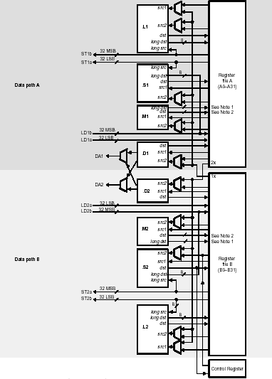
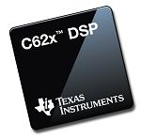
VelociTI
C6x datapath

Slide 26
TTA
Compiler controls the inter FU data transports
Explicit writes to register files
Essentially a VLIW with
multiple transport issue-slots
Data Memory
load/store
unit
load/store
unit
integer
ALU
integer
ALU
float
ALU
Socket
integer
RF
float
RF
boolean
RF
instruct.
unit
immediate
unit
Instruction Memory

Slide 27
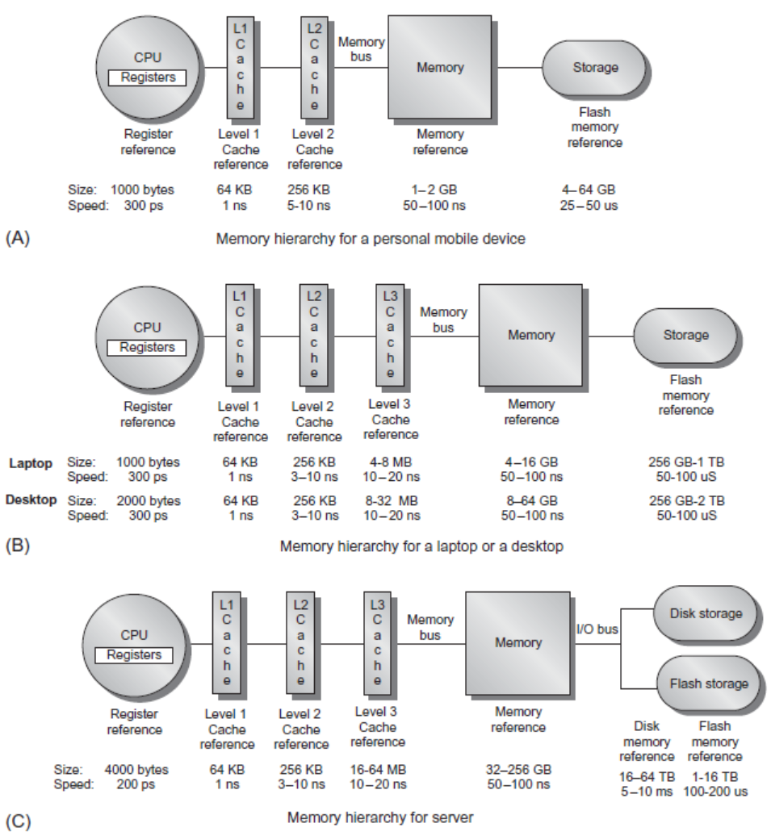
Memory hierarchy and caches
Cache organization
SRAM and DRAM organization
Virtual memory
  TLBs
  its operation
    how can we speed up the memory access
  size of page tables
    how to reduce them
Intel i7 and ARM examples of their memory hierarchy

Slide 28
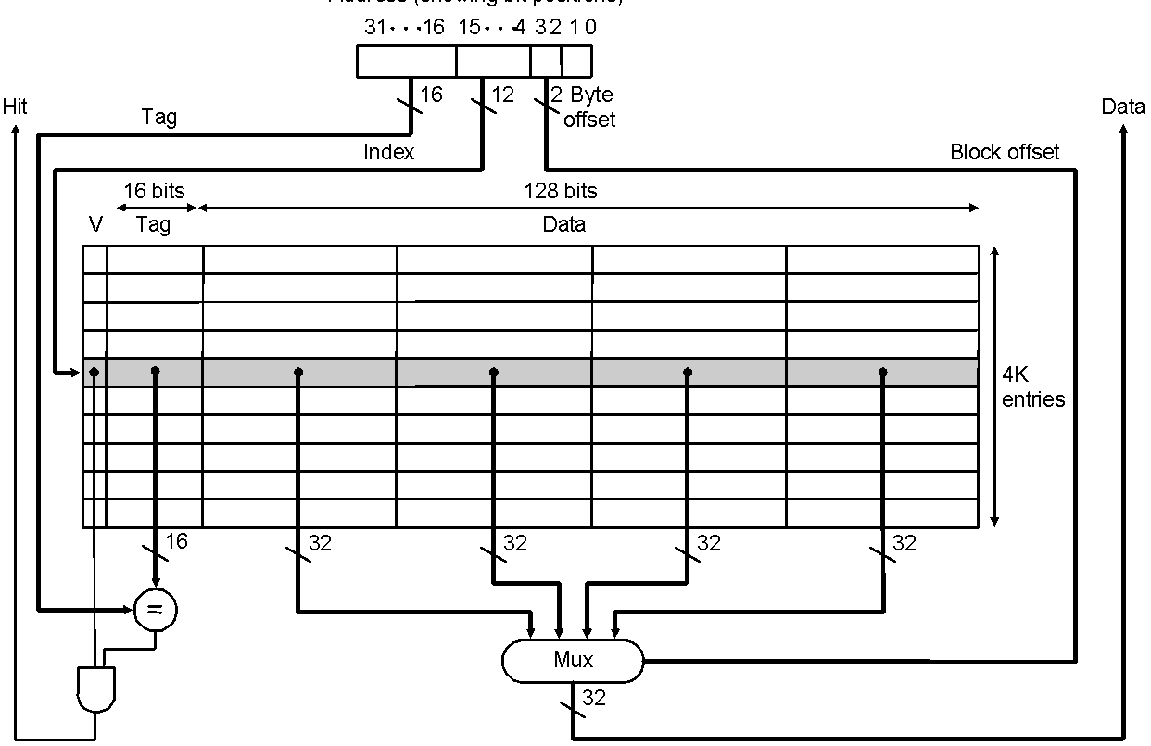
Direct Mapped Cache: the basics
Make sure you understand
these bits !
Taking advantage of spatial locality:
Address (bit positions)

Slide 29
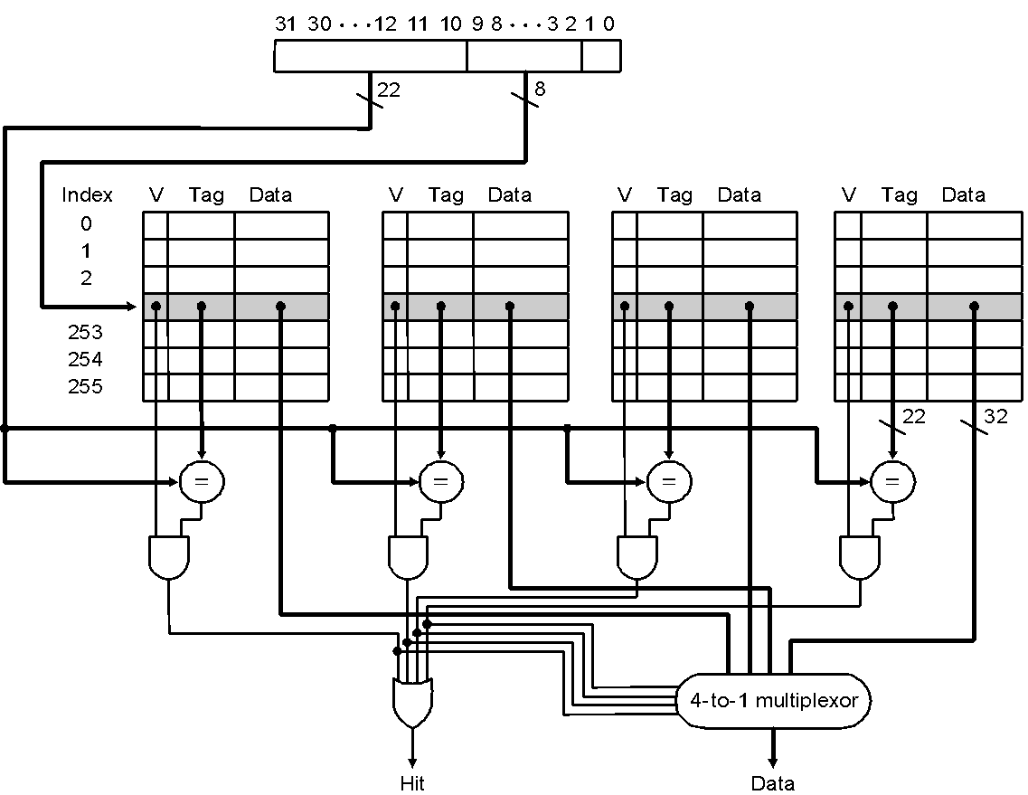
4-way Associative Cache
Make sure you understand
these bits !
4-ways set-associative cache (N_{sets} =4):
each of the 256 sets in the figure contains 4 blocks

Slide 30
Cache basics
Apply the cache performance equations; calculate the impact on CPI and t_{execution}
  Also for multi-level caches
Know the relation between cache parameters and division of the address bits into:
  tag, index, block offset, byte offset
Model of the 4-Cs
Write policies
Inclusion
Replacement policies, LRU
Many cache optimizations and there effects on miss rate, latency, cost
Hardware and Software prefetching techniques
  where to place the SW prefetch instructions
  primary vs secondary misses in non-blocking caches

Slide 31
Simulation
Why Simulators
  More accurate than models
  Cheaper than building hardware
Simulation detail
  Full-System vs User-level
  Functional vs Cycle Accurate (micro-arch.) vs Gate-Level
  Execution- vs Trace-driven
(Fast) Multiprocessor Simulation
  Discrete event simulation
  Quantum simulation
  Slack simulation
Workload Sampling

Slide 32
Simulation: Execution vs Trace-driven
Application Binary
Execution-Driven
Simulator
Metrics
mov edx,len
mov ecx,msg
mov ebx,1
mov eax,4
int 0x80
Execution Driven: Application executes on simulator
Execution-Driven
Simulator
Application Binary
Instruction
Trace
OR
Trace-Driven
Simulator
Metrics
ISA compatible
Processor
Trace Driven: simulator uses trace as input

Slide 33
Loop Transformations
Most important ones are:
  Loop unrolling
    what if the number of iterations is not a multiple of the unroll factor ?
    what if the number of iterations is not know at compile time?
  Vectorization / Strip mining
  Tiling (see next slide)
  Fusion of two loop(-nests)
  Reordering (or Interchange) the loops

Slide 34
Loop transformation example: Tiling the Iteration Order
Result in Iteration Space
for(jj=0; jj<N; jj+=Tj){
for(i=0; i<N; i++){ for(i=0; i<N; i++){
for(j=0; j<N; j++){ for(j=jj; j<jj+Tj; j++){
f(A[i],A[j]); f(A[i],A[j]);
assume
Tj=4
Notes:
Example to show the potential locality increase due to tiling

Slide 35
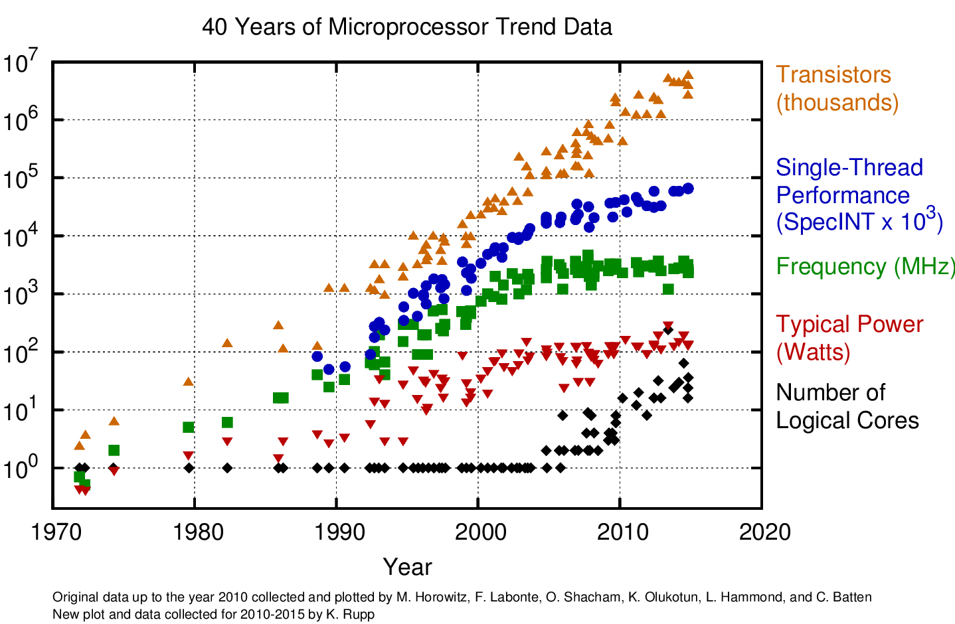
Multi-processing: why?
which trends
do you see?
explain them all!
www.karlrupp.net/2015/06/40-years-of-microprocessor-trend-data

Slide 36
Multi-Processors
How to communicate
between processes?
  2 models / architectures
Shared memory space:
  loads & stores, and
  explicit synchronization,
  e.g. by using semaphores
  & barriers
Distributed memory space:
  message passing
  implicit synchronization
Memory
I/O
Communication Network
Processing
node
Processing
node
Processing
node
Processing
node
Processing
node

Slide 37
Multi-Processors: Communication models
Shared-Memory (used by e.g. OpenMP)
  Compatibility with well-understood (language) mechanisms
  Ease of programming for complex or dynamic communications patterns
  Shared-memory applications; sharing of large data structures
  Efficient for small items
  Supports hardware caching
Messaging Passing (used by e.g. MPI)
  Simpler hardware
  Explicit communication
  Implicit synchronization (with any communication)
What do you prefer?

Slide 38
Network: Shared Bus or Switched Network
Bus based communication
Bus
  all to all connection
  timeshared
    all communication is sequentialized
Network:
  claimed to be more scalable
  no bus arbitration
  point-to-point connections
  Disadvantage: router overhead
node
node
node
node
R
R
R
R
node
node
node
node
NoC with 2x4 mesh
routing network
R
R
R
R

Slide 39
Design Characteristics of a Network
Topology (how things are connected):
  Crossbar, ring, 2-D and 3-D meshes or torus, hypercube, tree, butterfly, perfect shuffle, ....
Routing algorithm (path used):
  Example in 2D torus: first east-west, then north-south (avoids deadlock)
Switching strategy:
  Circuit switching: full path reserved for entire message, like the telephone.
  Packet switching: message broken into separately-routed packets, like the post office.
Flow control and buffering (what if there is congestion):
  Stall, store data temporarily in buffers
  re-route data to other nodes
  tell source node to temporarily halt, discard, etc.
QoS (quality of service) guarantees
Error handling
2-D mesh

Slide 40
Networks: what should you know?
The main interconnect topologies and their properties
Several routing protocols
  Deadlock conditions, how to avoid it
Switching protocols
Network metrics: we discussed 4 topology metrics
  comparing metrics of various networks
Reason about performance: Bandwidth and Latency

Slide 41
Switch / Network, Topology metrics:
Degree = number of links from a node
Diameter = max number of links crossed between nodes
Average distance = number of links to random destination
Bisection bandwidth = link bandwidth * bisection
  Bisection = minimum number of links that separate the network into two halves
not a
bisection
cut
bisection
cut
bisection bw= link bw
bisection bw = sqrt(n) * link bw

Slide 42
Comparison between topologies
Interconnection network | Switch degree | Network diameter | Bisection width | Network size
Crossbar switch | N | 1 | N | N
Butterfly (built from k-by-k switches) | k | log_{k} N | N/2 | N
k-ary tree | k+1 | 2log_{k} N | 1 | N
Linear array | 2 | N-1 | 1 | N
Ring | 2 | N/2 | 2 | N
n-by-n mesh | 4 | 2(n-1) | n | N=n²
n-by-n torus | 4 | n | 2n | N=n²
k-dimensional hypercube | k | k | 2^{k-1} | N=2^{k}
k-ary n-cube | 2k | nk/2 | 2k^{n-1} | N=n^{k}
Switch degree: # of ports for each switch (switch complexity)
Network diameter: worst-case routing distance between any two nodes
Bisection width: # of links in bisection (worst-case bandwidth)
Network size: # of nodes

Slide 43
2 Packet switching strategies
store-and-forward = packets move from node to node and
are stored in buffers in each node
cut-through = packets move through nodes in pipeline fashion, so that the entire packet moves through several nodes at one time
  Two implementations of cut-through:
    Virtual cut-through switching:
      The entire packet is buffered in the node when there is a transmission conflict
      When traffic is congested and conflicts are high, virtual cut through behaves like store-and-forward
    Wormhole switching:
      Each node has enough buffering for a flit (flow control unit)
      A flit is made of consecutive phits (physical transfer unit), which basically is the width of a link (= number of bits transferred per clock)
      A flit is a fraction of the packet, so the packet can be stored in several nodes (one or more flits per node) on its path
  Note: In virtual cut-through the flit is the whole packet

Slide 44
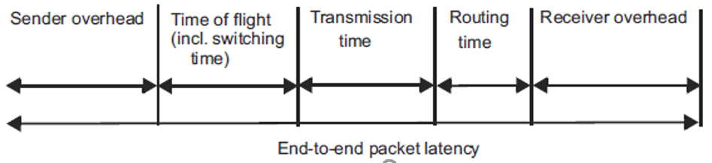
Packet Latency
A
12ns
12ns
B
10ns
10ns
10ns
L_{packet} = SO+ ToF + TT +RT + RO
10 switches => 9 hops ( or links)
Sender Overhead (SO): creating the packet and moving it to NI (Network Interface)
Time of Flight (ToF): time to send a bit from source to destination when the route is established and without conflicts; this includes switching time
  ToF can include buffering time at switches (as in store-and-forward or virtual cut-through)
Transmission Time (TT): time to transfer a packet from source to destination, once the first bit has arrived at destination
  phit: number of bits transferred on a link per cycle, so Link BW = phit*freq_{link}
  Transmission time = packet size/phit size
  note: a flit = unit of flow control (over a link), containing 1 or more phits
Routing Time (RT): time to set-up route (as in circuit switching), or setting switches (in packet switching)
Receiver Overhead (RO): time to strip packet and move it out of the input buffer (of the NI)

Slide 45
Message latency
Routing distance: Number of links traversed by a packet
Average routing distance: average over all pairs of nodes
Network diameter: longest routing distance over all pairs of nodes
Packet transfer (of a message) can be pipelined:
  Transfer pipeline has 3 stages
    Sender overhead-->transmission -->receiver overhead
  Total message time = time for the first packet + (n-1)/pipeline throughput
End-to-end message latency (a message contains multiple packets) =
sender overhead + time of flight + transmission time + routing time +
(n-1) * MAX(sender overhead, transmission time, receiver overhead)
Message
P
P
P
P
P
P
P
P
P
P
A
110ns, per packet
80ns
B
ToF = 20 ns, TT = 100ns
per packet

Slide 46
Coherency, Synchronization and Consistency
Coherence,
about: Do I see the most recent data?
  e.g., when I load from address 1200, do I get the latest value written to address 1200
Consistency,
about: When do I see a written value?
  e.g. do different processors see writes in the same order
  (w.r.t. other memory accesses)?
Synchronization
How to synchronize processes?
  how to protect access to shared data?
  how to make sure 2 processes communicate correctly?

Slide 47
Coherence
  problem caused if multiple copies of data in system exist (caches)
    even in single processor system with DMA the problem exists
  understand Snooping and Directory based protocols (+ some optimizations)
    calculate time and space overhead
    2 FSMs for Snooping: understand all possible actions
Synchronization
  requires atomic read/write access operations to memory, like
    exchange, test-and-set, ...
    or use a load-linked / store-conditional scheme
  critical sections
  spinlock implementation and its optimization in the context of caches
Consistency
  understand the fundamental problem (what’s the difference with coherence?)
  sequential the most costly, but easiest for reasoning about your programs
    it makes write buffer largely useless
  relaxed models used in practice (i.e. ignore certain orderings)

Slide 48
Deep Learning
Perceptron model
Multi-layer models
Convolution Neural Networks
multiple
output channels (M)
multiple
input channels (C)

Slide 49
What can Neural Networks do?
Classification
Approximation
Optimization
Clustering

Slide 50

What did we learn
Computer systems
Micro Architecture
  RISC principles
Multi-Issue architectures
  Superscalar
  VLIW + TTA
Memory hierarchy & Caches
Simulation
Loop transformations
Multi-threading support
Multi-Processors
Networks & Routing
Coherency, Synchronization, Consistency
Deep learning and architectures supporting it

Slide 51

Feedback from you
What are the major things you learned?
  What was your favorite topic(s)?
  What are the key issues?
Theory: What topics did you miss?
  note, you can also select an interesting topic for you bonus paper presentation
Labs: What did you think about the 3 labs?
  did you miss anything?
  what was our experience with the (GPU) server? We used it for the first time.
What should we further change next year?
Check our website 5SIA0:
www.es.ele.tue.nl/~heco/courses/EmbeddedComputerArchitecture/
Send an email if you have feedback and ideas; highly appreciated !

Slide 52

Grading, max 100 points (gives a 10)
3 lab reports, each up to 10 points
On-campus exam, max 70 points: Monday Jan 31, 13.30h (login a little earlier)
  use and test your laptop with the ‘stepstick’
  questions about each lab: each 15 points
  questions about general / discussed theory: 25 points
  Note: to get access to the exam you have to pass the trial exam with an 8
    you may try as many times as you like, before the deadline (see oncourse)
Bonus, up to 10 points: Thursday Febr 10, 2022, 13h-17.30h (10 min slots)
  studying and presenting a recent scientific high quality article, strongly related to the course; follow instructions on the course website (http://www.es.ele.tue.nl/~heco/courses/ECA)
  you have to sign up (you’ll get an email); penalty (5 points) for no-show
Resit: April 19, Monday, at 18-21h; same procedure as main exam !
  Labs reports which are insufficient can be improved; hand-in before April 10, 23.59h

Slide 53

Finally
Interesting follow-up courses
  Intelligent Architectures 5LIL0 (Q3)
    Deep Learning, Efficient Implementation
    http://www.es.ele.tue.nl/~heco/courses/IA-5LIL0/index.html
  Parallelization, Compilers and Platforms: 5LIM0 (Q3)
    all about the newest LLVM compiler and much more
  Project based course on designing an Embedded System, Embedded Visual Control: 5LIA0 (Q4)
    http://www.es.ele.tue.nl/~heco/courses/EmbeddedVisualControl/
Many Student Internship and Thesis assignements:
  see PARSE (Parallel Architecture Research Eindhoven) website, then go to student projects:
  http://parse.ele.tue.nl
Hope you enjoyed the course, and especially, learned a lot
Wish you success !!

Slide 54

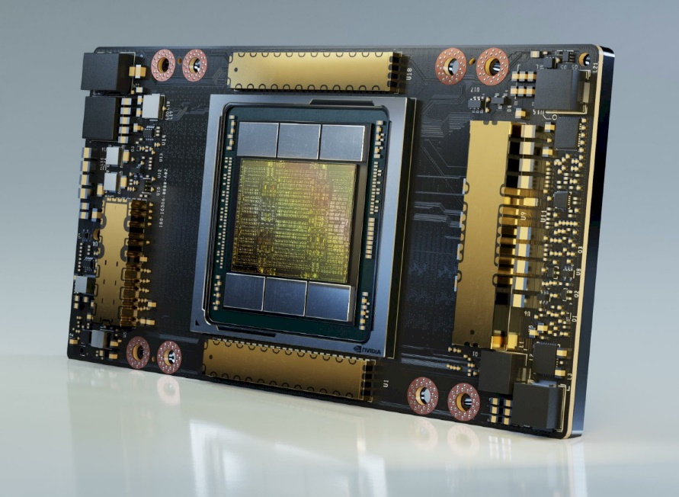
Embedded Computer Architectures
5SIA0
What computer architecture to use? Where is computing going?
Making it efficient, that's really fun
We hope you learned a lot and
enjoyed our course !!
Nvidia ampere, 2020

