Slide 1
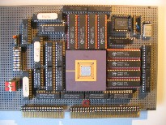
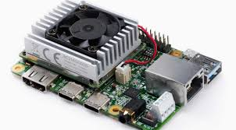
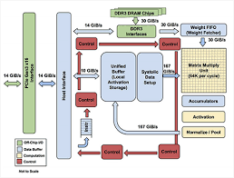
Intelligent Architectures 5LIL0 Overview + Guidelines
TPU board
Henk Corporaal
Alexios Balatsoukas
www.ics.ele.tue.nl/~heco/courses/IA
h.corporaal@tue.nl
TUEindhoven 2022
TPU datapath

Slide 2
Intelligent Architectures (IA, 5LIL0)
Q3 course, with focus on:
Deep Learning using ANNs with Efficient Implementations
ANN = Artificial Neural Network / DNN = Deep Neural Network
we had a try-out in previous academic year
What's Deep Learning?
self learning algorithms
using huge data sets to learn
deep: many "learning layers"
brain inspired, based on neurons and synapses (connections)
high classification accuracy
Many applications; let's look at an example: ImageNet

Slide 3
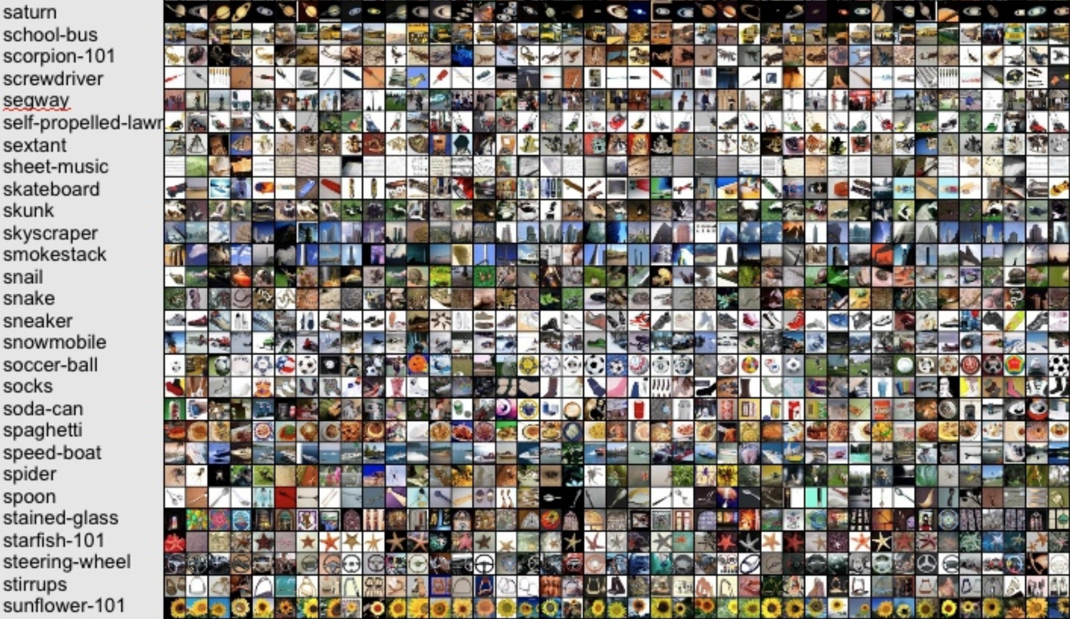
ImageNet challenge: 10M images, 10000 classes

Slide 4
ImageNet Winners (top-5 classification error)
2012: DL beats all traditional methods
2015: DL beats humans !

Slide 5
Example (small) ANN for image recognition

Slide 6
ML vs DL (from Walter Riveira (Intel))

Slide 7
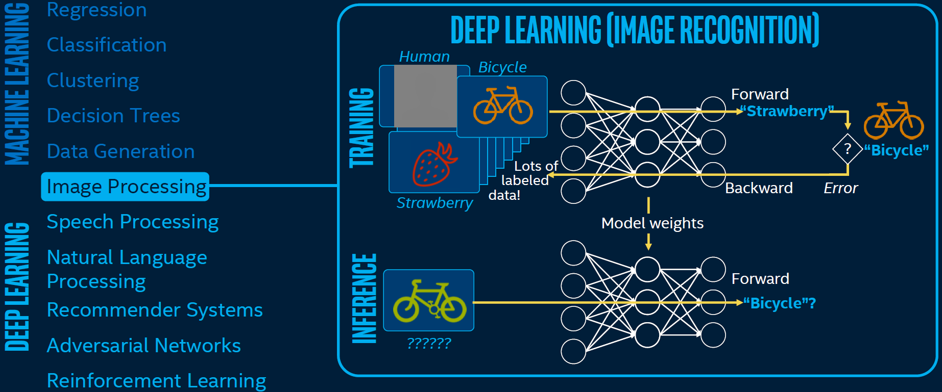
How does DL work

Slide 8
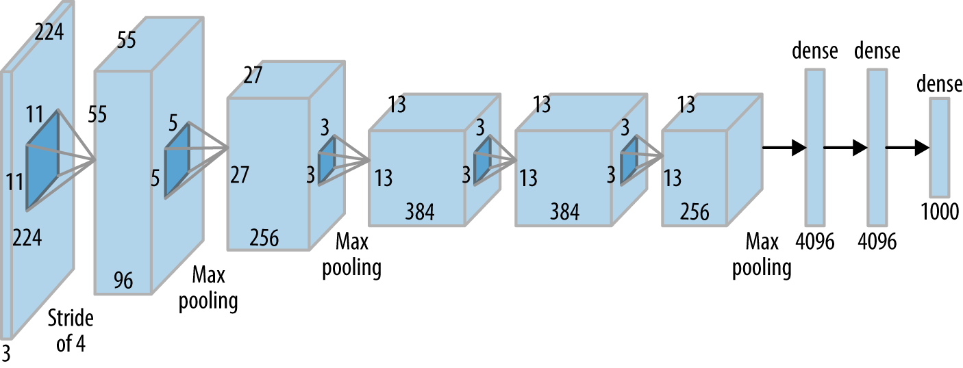
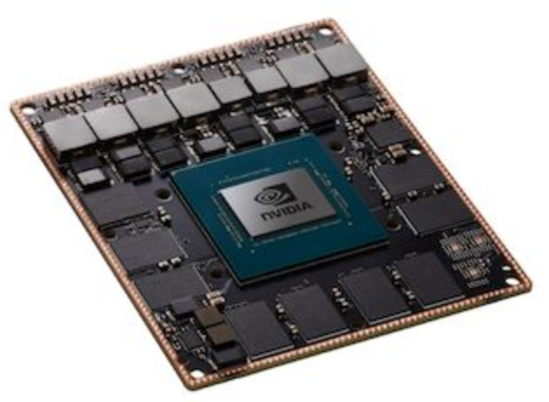
Intelligent Architectures course: 3 parts
AlexNet (partly)
AivoTTA (partly)
NVIDIA Xavier
embedded GPU
Notes:
Photo is of an Intel Conroe (Core 2 Duo Desktop processor). Photo taken from Intel web site.

Slide 9
Course topics
Introduction: ‘once over lightly’
What are ANNs and how do they operate
Convolutional Neural Networks
Learning principles
Learning Frameworks
Applications using ANNs
Optimizations: 3 types
Making the NW more compact
Quantization of activations and weights
Exploiting data & weight reuse by advanced loop transformations and local buffering
ANN architectures and accelerators
The future: Beyond ANNs

Slide 10
Learning goals
Understanding deep learning, including:
network architectures
inference
learning methods
Design of Deep Neural Networks (ANNs/DNNs), using current frameworks
in particular Convolutional Neural Networks (CNNs) using PyTorch
Implement and optimize ANNs using various optimization methods
Current deep ANNs, including newer operators
Special processing hardware efficiently supporting Deep Learning
Alternative approaches to the ''classical‘’ ANNs, like:
Bayesian learning and Neuromorphic computing

Slide 11
Prerequisites
Background in computer architecture
like pipelining, caching, instruction-sets, assembly programming
e.g. Embedded Computer Architecture (5SIA0), or Computation I/II
Good SW programming skills, e.g. in C, C++ or Python
Basic knowledge of GPU CUDA programming
as taught in e.g. ECA, 5SIA0
Differential calculus skills
Optional: HDL experience,
like in Verilog or VHDL (optional part of lab3)
#include <stdio.h>
void
main(void) { neuzel(1);
}
neuzel(t,_,a)
char *a;
{return!0<t?t<3?neuzel(-79,-13,a+neuzel(-87,1-_,
neuzel(-86, 0, a+1 )+a)):1,t<_?neuzel(t+1, _, a ):3,neuzel ( -94, -27+t, a
)&&t == 2 ?_<13 ?neuzel ( 2, _+1, "%s %d %d\n" ):9:16:t<0?t<-72?neuzel(_,
t,"@n'+,#'/*{}w+/w#cdnr/+,{}r/*de}+,/*{*+,/w{%+,/w#q#n+,/#{l,+,/n{n+\
,/+#n+,/#;#q#n+,/+k#;*+,/'r :'d*'3,}{w+K w'K:'+}e#';dq#'l q#'+d'K#!/\
+k#;q#'r}eKK#}w'r}eKK{nl]'/#;#q#n'){)#}w'){){nl]'/+#n';d}rw' i;# ){n\
l]!/n{n#'; r{#w'r nc{nl]'/#{l,+'K {rw' iK{;[{nl]'/w#q#\
n'wk nw' iwk{KK{nl]!/w{%'l##w#' i; :{nl]'/*{q#'ld;r'}{nlwb!/*de}'c \
;;{nl'-{}rw]'/+,}##'*}#nc,',#nw]'/+kd'+e}+;\
#'rdq#w! nr'/ ') }+}{rl#'{n' ')# }'+}##(!!/")
:t<-50?_==*a ?putchar(a[31]):neuzel(-65,_,a+1):neuzel((*a == '/')+t,_,a\
+1 ):0<t?neuzel ( 2, 2 , "%s"):*a=='/'||neuzel(0,neuzel(-61,*a, "!ek;dc \
i@bK'(q)-[w]*%n+r3#l,{}:\nuwloca-O;m .vpbks,fxntdCeghiry"),a+1);
}
this is compilable C-code,
but you can do much better

Slide 12
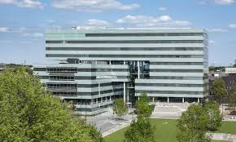
Course Organization
Credits:
5LIL0: 5 credit points (ECTS)
Weekly online meetings
Tuesdays: 10.45-12.45 (Aud 12)
Fridays: 15.30-17.30 (Aud 12)
3 advanced Labs: You can do them at home (effort: 35 h/lab)
Oral examination in the exam weeks
date will be scheduled later
Optional: Student literature research of TOP recent conferences

Slide 13
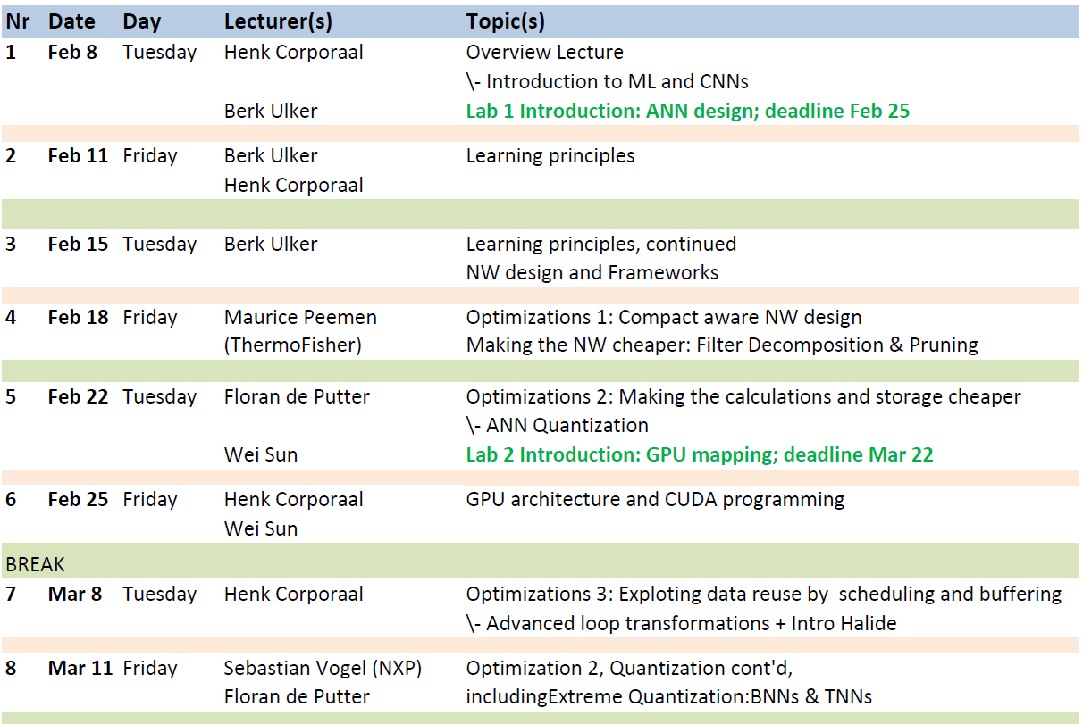
Tentative Schedule Lectures 1-8

Slide 14
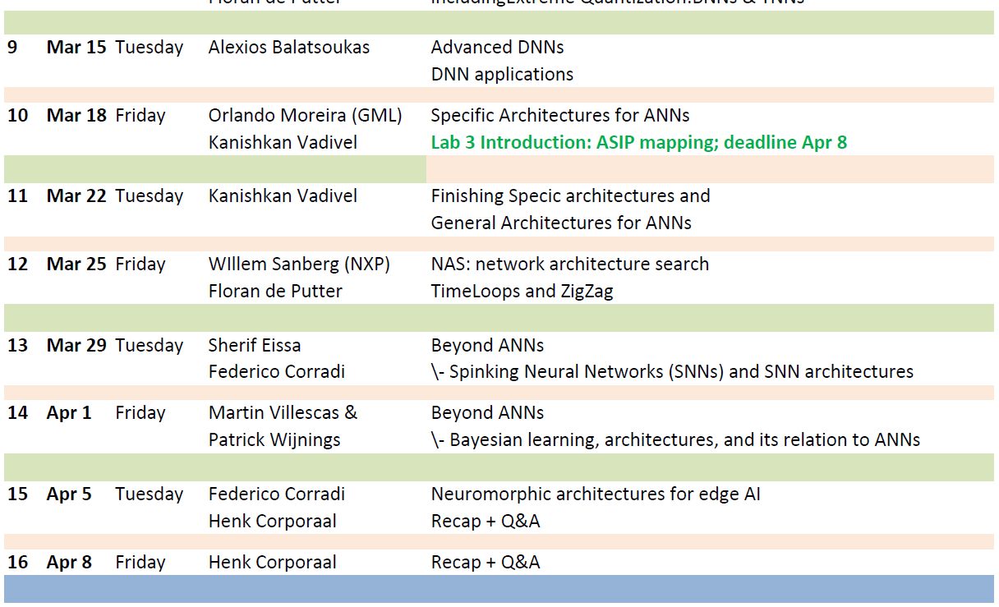
Tentative Schedule Lectures 9-16

Slide 15
Intelligent Architectures Team
Many (Guest) Lectures:
Alexios Balatsoukas (TUE)
Maurice Peemen (Thermo Fisher)
Sherif Eissa (TUE)
Federico Corradi (IMEC/TUE)
Sebastian Vogel (NXP)
Willem Sanberg (NXP)
Orlando Moreira (GML)
Web resources
http://www.es.ele.tue.nl/~heco/courses/IA-5LIL0
https://canvas.tue.nl/courses/19645
Lectures and Lab support:
Berk Ulker (lab 1)
Martin Villescas (lab 1)
Wei Sun (lab 2)
Ali Banagozar (lab 2)
Floran de Putter (lab 2+3)
Kanishkan Vadivel (lab 3)

Slide 16
Practical Experience
3 lab assignments:
Design an ANN using PyTorch (< Feb 25)
Map an ANN to an Embedded GPU (< Mar 22)
Map an ANN to an ASIP (< Apr 8) (Application Specific Instruction-set Processor)
Lab support team:
See slide 10
Note: check the report delivery deadline

Slide 17
Lab1: Design an ANN using PyTorch
You will design a (small) ANN for recognizing words (sound)
Framework: PyTorch, primarily developed by Facebook AI group
We will use a ''cook book'' approach
go through all the steps, including how to use the tools
as preparation there is a detailed guideline using Jupyter Notebook on learning PyTorch
whole lab can be done on your own laptop
hand-in a small report (before deadline)

Slide 18
Lab2: Map an ANN to an GPU
You will map a deep ANN (for image recognition) to an GPU
We use EE-ES HPC cluster (you’ll get accounts)
GPU: RTX2080ti
NVIDIA Xavier
embedded GPU

Slide 19
Lab3: Map an ANN to an ASIP
Map an ANN to a Application Specific Instruction-set Architecture
We start with a small TTA; you may add new units
Example of a big one: AivoTTA from Tampere University
AivoTTA (partly)

Slide 20
Material
Handouts and slides; see oncourse and course web sites:
canvas (go to 5LIL0)
http://www.es.ele.tue.nl/~heco/courses/IA-5LIL0
Articles
Efficient Processing of Deep Neural Networks:
A Tutorial and Survey by Vivienne Sze, e.a. arXiv, August 2017 (slides available)
Stanford lecture collection: CNNs for Visual Recognition (Spring 2017)
https://www.youtube.com/playlist?list=PL3FW7Lu3i5JvHM8ljYj-zLfQRF3EO8sYv
Nice Github with many DL articles / DL accelerators >= 2014:
https://github.com/fengbintu/Neural-Networks-on-Silicon
Others will follow during the lectures

Slide 21
Exam + Grading: Oral exam (in exam weeks)
Grading: with a maximum of 100 points (giving a grade 10):
3 lab reports + defense: each up to 25 points
theory, up to 25 points
questions about all the lecture topics
Depending on exam scores we may decide on a Bonus: studying and presenting a recent (>= 2019) scientific high quality article, strongly related to the course: up to 10 points
Study recent article from top conferences and journals (see course page for details)
Bonus stays valid for the resit (no extra resit bonus session)

Slide 22
Intelligent Architectures, 5LIL0
Deep & Automated, Learning
is even more fun
Making it efficient, that's really fun
Wish you a very nice course !!
Questions?
Core i7 Extreme 5960X Haswell ©Intel

