Slide 1
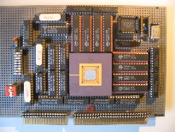
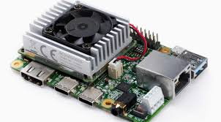
Intelligent Architectures
5LIL0
Machine Learning
Convolutional Neural Networks Inference
Henk Corporaal
www.ics.ele.tue.nl/~heco/courses/IA
h.corporaal@tue.nl
TUEindhoven
2022

Slide 2


“Once over Lightly”
Motivation and overview of Deep Learning
What is (machine) learning
Deep Neural Networks (DNN)s: operating principles
Convolutional Neural Networks
Network examples

Slide 3
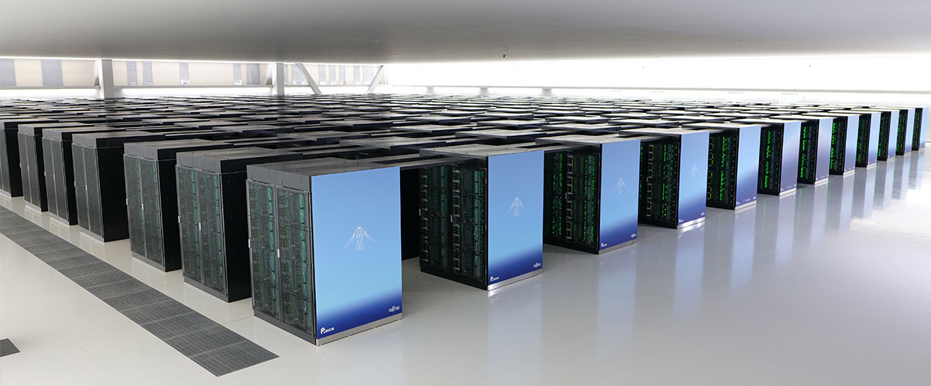
#1: Japan’s Fugaku Supercomputer (Nov 2021)
Although it can simulate huge DNNs
it’s not our example. Why not?
7.6 M processor cores
5 PetaByte main memory

Slide 4
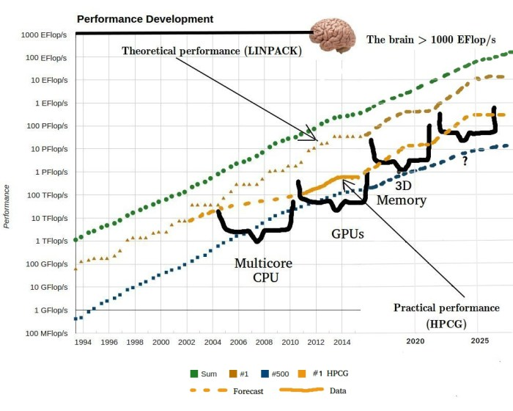
Inspiration: Our Brain is extremely powerful & efficient
Power = 20 Watt
Speed = 1000 Exa Op/s*
Energy/operation =
Power / Speed =
2x10⁻⁸ pJ/operation
Compare to Fugaku
  Power = 30 MW
  Peak = 537 PetaFlop/s
  Energy/op. = 56 pJ/op
*Tim Dettmers:
"making deep learning accessible"
2015
Notes:
3.2*10^9 more efficient
Spikes x100
Double x100
Brain is sparse active so only 1-10% active x100
Leaky bucket 10x suppresses propagation

Slide 5
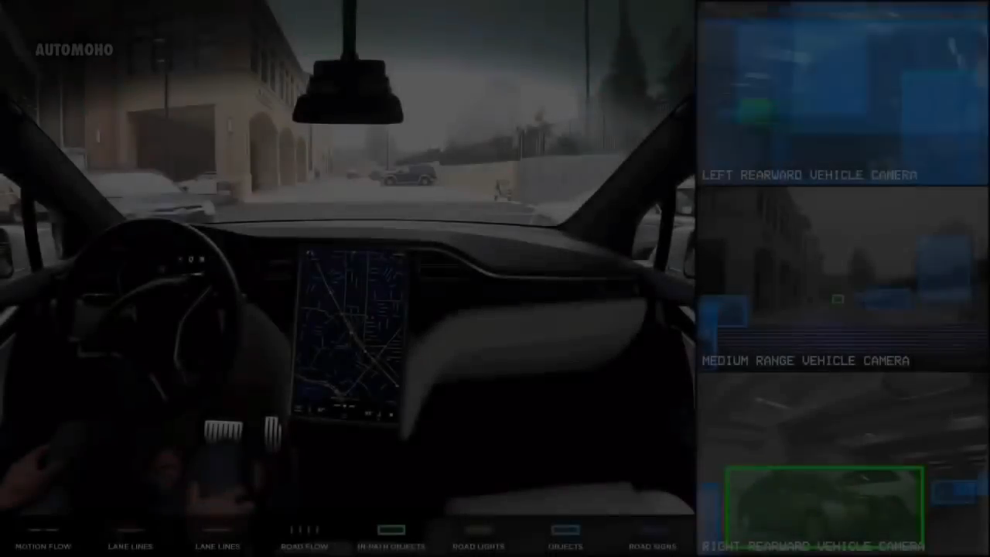
AI: Tesla Autopilot
Tesla Model S demonstration of autonomous driving
Computing system monitors radar and several cameras
  Detect objects like cars, and pedestrians
  Monitor traffic signs
  Lane tracking and possible lane changing
  Auto parking
More videos on Tesla web page: www.tesla.com/videos/

Slide 6

AI: Google assistant schedules an appointment
Google demonstrated a real phone call
Assistant Google Duplex acts as a real human
  Natural language processing
  Deep Learning
  Text to speech
  Understanding of context
Google I/O keynote, may 2018
Notes:
Google assistant make a phonecall

Slide 7
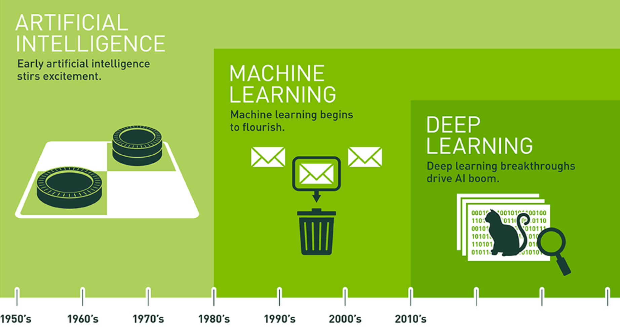

Slide 8
Overview
Motivation and overview of Deep Learning
What is learning ?
  Traditional computing vs Machine Learning
  Example: Polynomial Curve Fitting
    Least Squares Fitting
    Overfitting
    Regularization
Deep Neural Networks (DNN)s
Convolutional Neural Networks
Network examples

Slide 9
Learning
Traditional CS
Program
Output
Data
Machine Learning
Data
Program
Output
Concl: We learn 'by example'

Slide 10

3 key functions of a learning system
Score function (Classifier) : Function to map input to output
Loss Function : Evaluate quality of mapping
Optimization Function : Update classifier (minimizing Loss)
Label 'cat'
Classifier
(DNN or Bayesian model)
Loss
(measure of the error)
Class
values
Optimization:
Improve
classifier

Slide 11
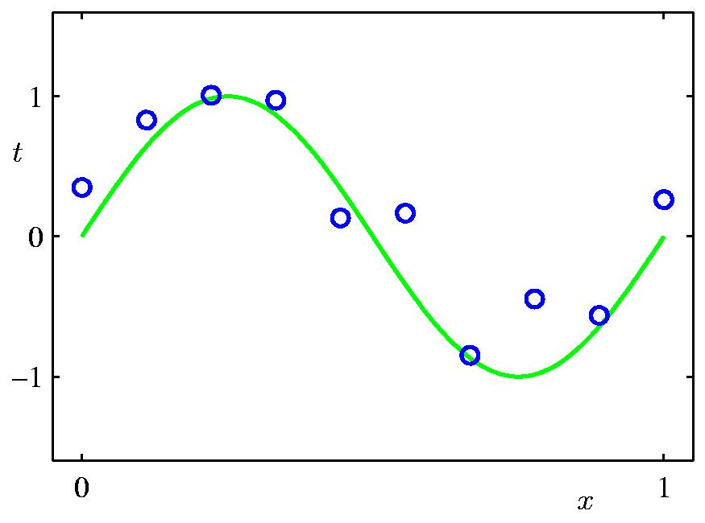
Example: Learning a curve
Measured values (x_{i},t_{i})
Generated by: t = sin(x) + noise
Can we learn this curve from
the measurements?
Let's use a model and learn its parameters w_{i}
hidden, not known
Model: y(x,w) = w₀ + w₁x + w₂x² + ... + w_{m}x^{m}
Example taken from C.M. Bishop: Pattern Recognition and Machine Learning

Slide 12
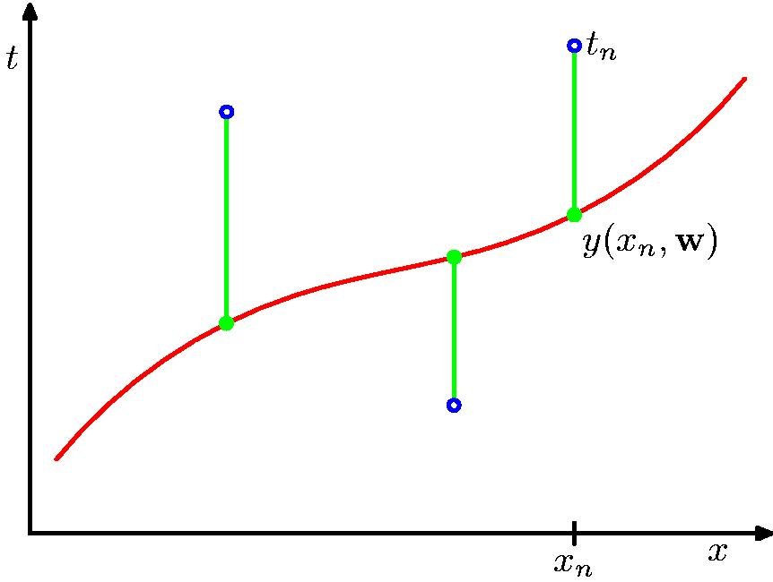
Loss E(w): Sum-of-Squares Error Function
t_{n} (observations)
error = (y_{n}-t_{n})
Model
y_{n}
Total error: E(w) = ∑ {y_{n} – t_{n}}²
Tune model such that difference
between y_{n} and t_{n} gets smaller

Slide 13
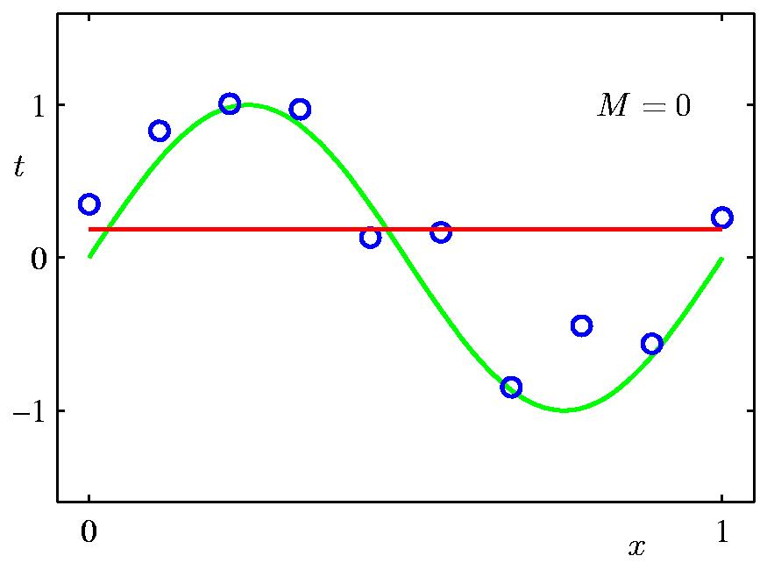
0th Order Polynomial
Parameter | Value
w₀ | 0.19
Model: y(x,w) = w₀

Slide 14
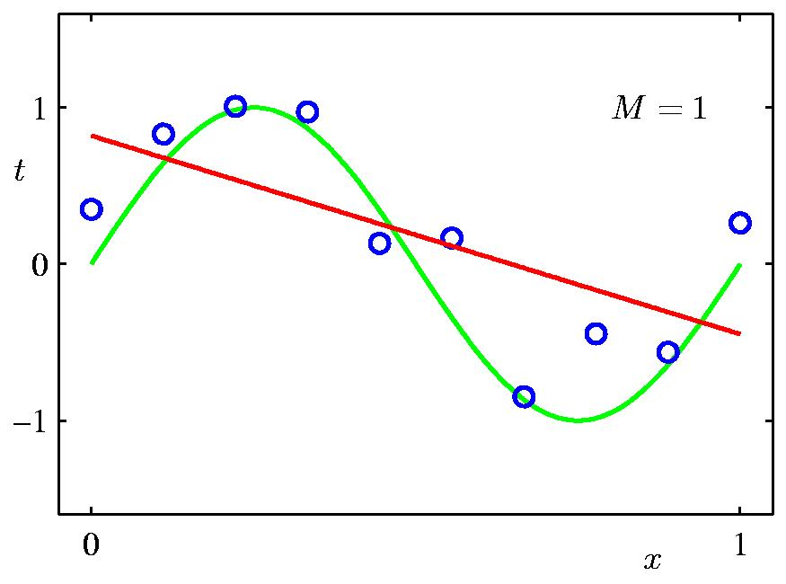
1st Order Polynomial
Just a straight line
2 parameters, learned
by minimizing Loss
Model
Parameter | Value
w₀ | 0.82
w₁ | -1.27
Model: y(x,w) = w₀ + w₁x
=> 0.82 -1.27 x

Slide 15
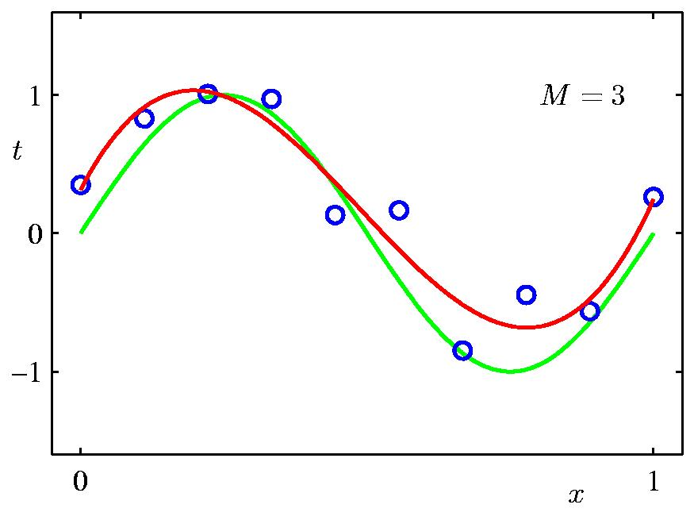
Much better: 3rd Order Polynomial
4 parameters
Model
Parameter | Value
w₀ | 0.31
w₁ | 7.99
w₂ | -25.43
w₃ | 17.37
Model: y(x,w) = w₀ + w₁x + w₂x² + w₃x³

Slide 16
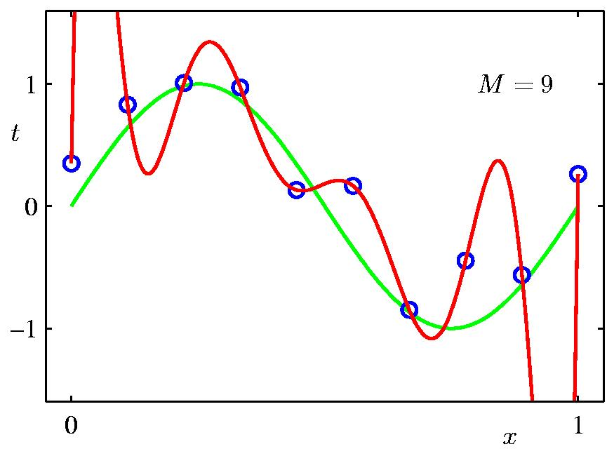
9th Order Polynomial => Overfitting
10 parameters
Parameter | Value
w₀ | 0.35
w₁ | 232
w₂ | -5321
w₃ | 45688
w₄ | -231630
w₅ | 640042
w₆ | -1061800
w₇ | 1042400
w₈ | -557682
w₉ | 125201
Model
Model: y(x,w) = w₀ + w₁x + w₂x² + ... + w₉x⁹

Slide 17
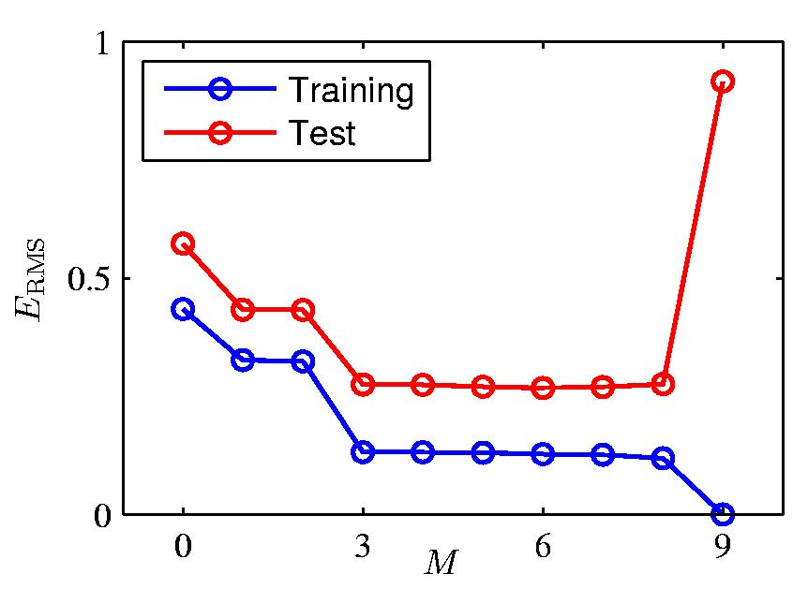
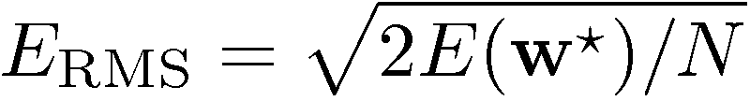
Over-fitting
Overfitting !!
Root-Mean-Square (RMS) Error:

Slide 18
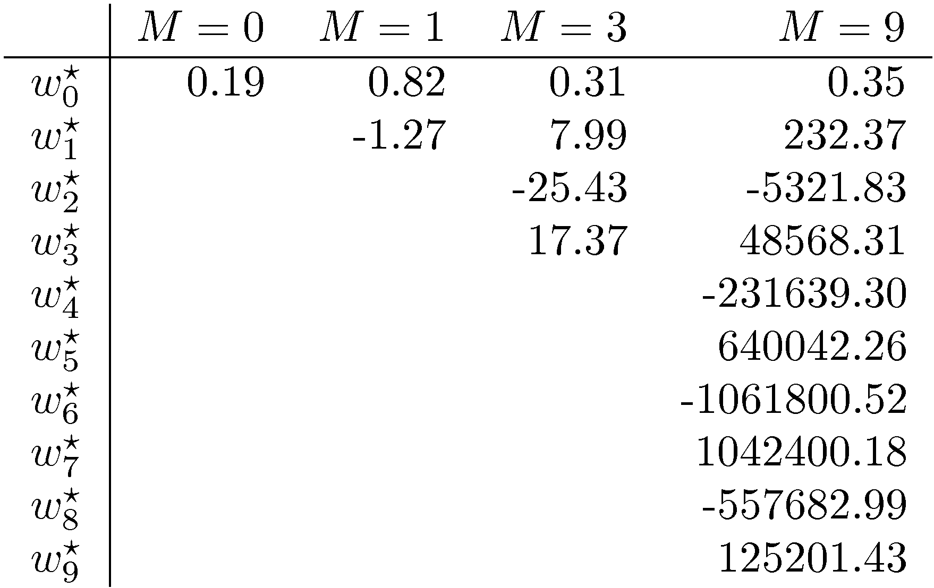
Polynomial Coefficients

Slide 19
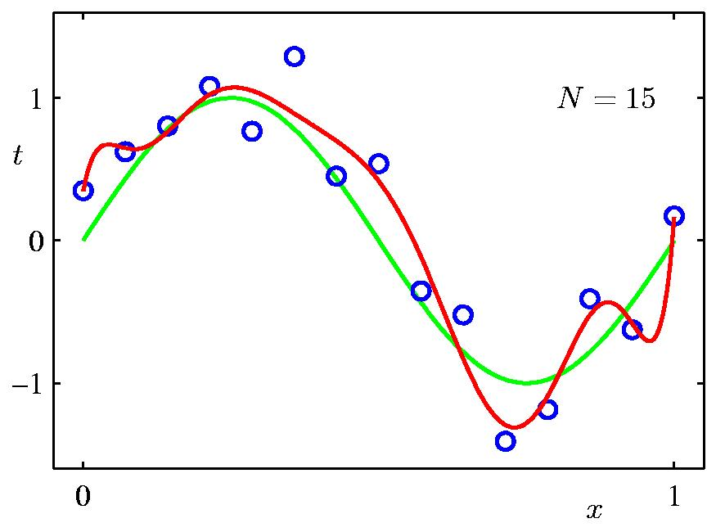
Increasing Data Set Size to 15 points
9th Order Polynomial
N = 15
Model
Model: y(x,w = w₀ + w₁x + w₂x² + ... + w₉x⁹

Slide 20
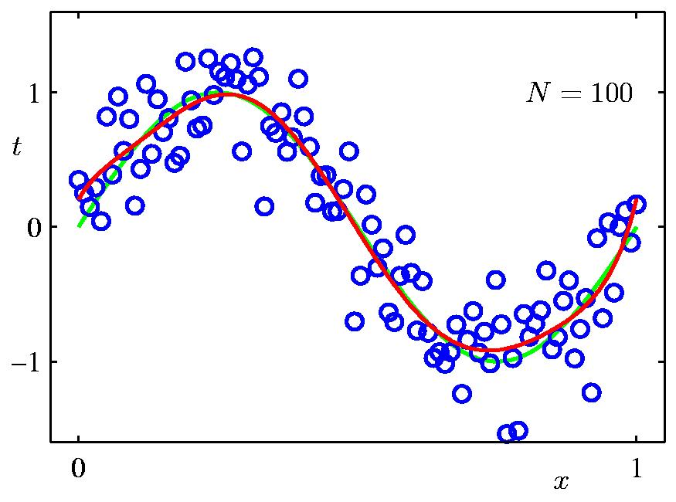
Increasing Data Set Size to 100 points
9th Order Polynomial
N = 100
Q: is this a good idea?
why? why not?
Model: y(x,w) = w₀ + w₁x + w₂x² + ... + w₉x⁹

Slide 21
Regularization
Penalize large coefficient values =>
add regularization term:
E(w) = ∑ {y_{n} – t_{n}}² + λ|w|²
λ is one of the many hyper parameters for learning
Notes:
Note, if we reduce the number of parameters, such that their number is much smaller than the data set, we reduce the memory capacity of the network!

Slide 22
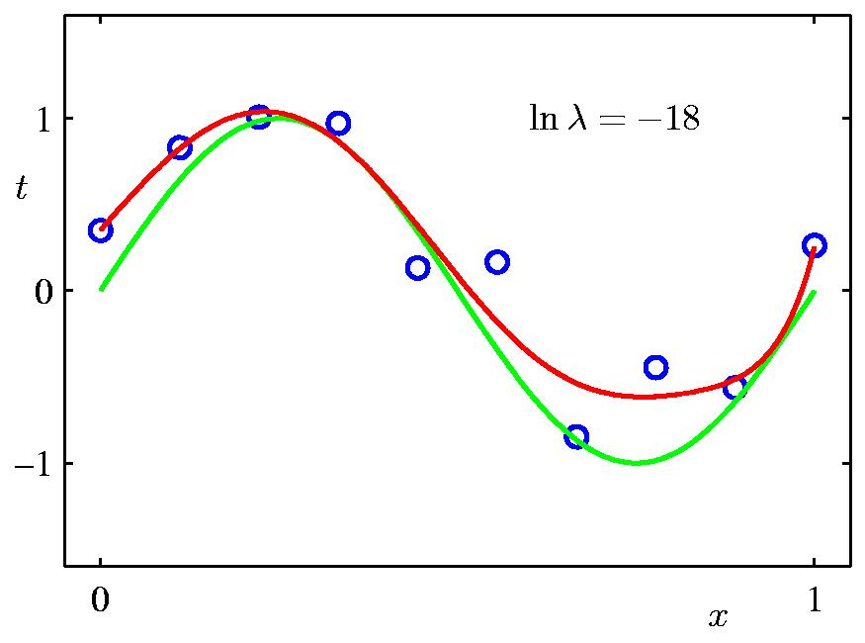
Regularization: ln λ = -18 (i.e. λ=e⁻¹⁸); 9th Order
Parameter | Value | New Value
w₀ | 0.35 | 0.35
w₁ | 232 | 4.74
w₂ | -5321 | -0.77
w₃ | 45688 | -31.97
w₄ | -231630 | -3.89
w₅ | 640042 | 55.28
w₆ | -1061800 | 41.32
w₇ | 1042400 | -45.95
w₈ | -557682 | -91.53
w₉ | 125201 | 72.68

Slide 23
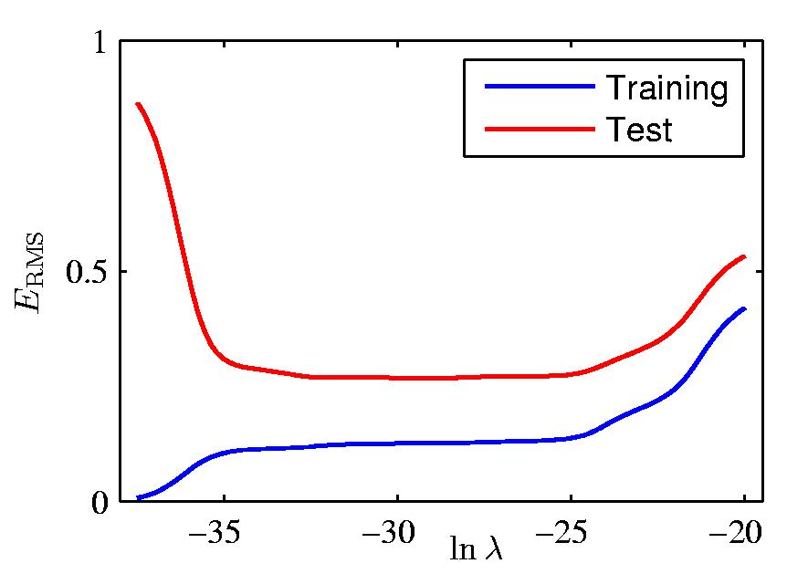
Regularization: ERMS vs. ln λ
Right value of
λ is critical !
Determining best
values for all
hyperparameters
is empirical process

Slide 24
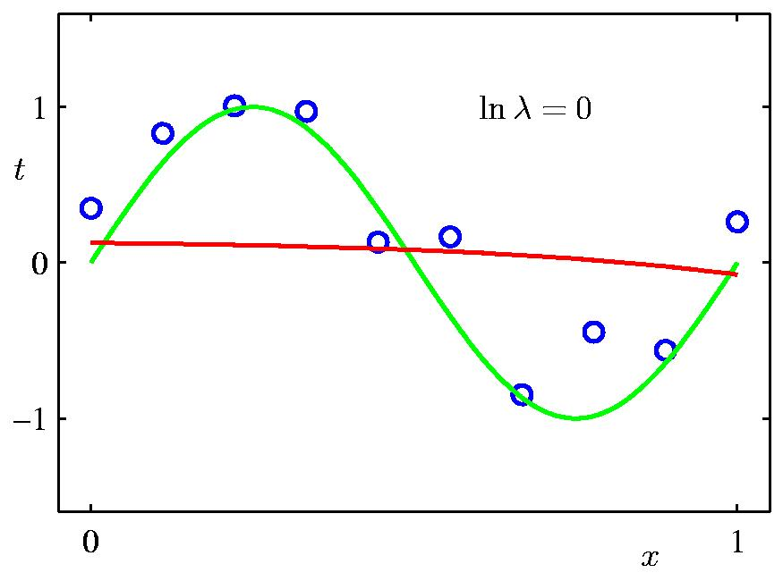
Regularization: ln λ = 0
What’s wrong
here?

Slide 25
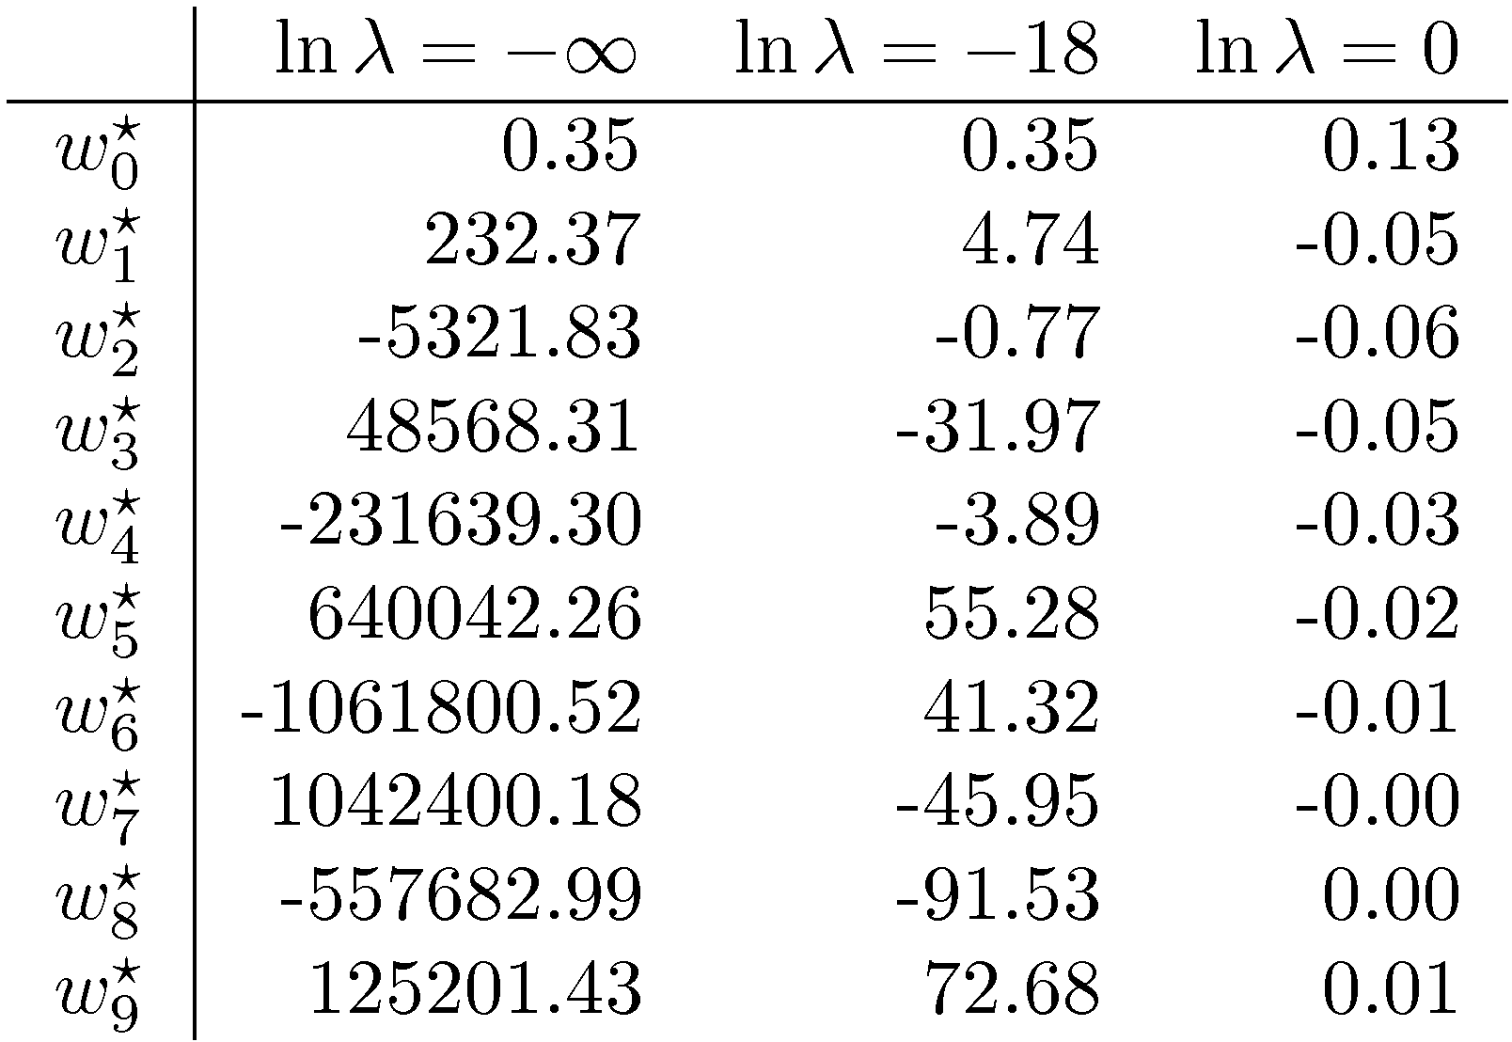
Polynomial Coefficients

Slide 26
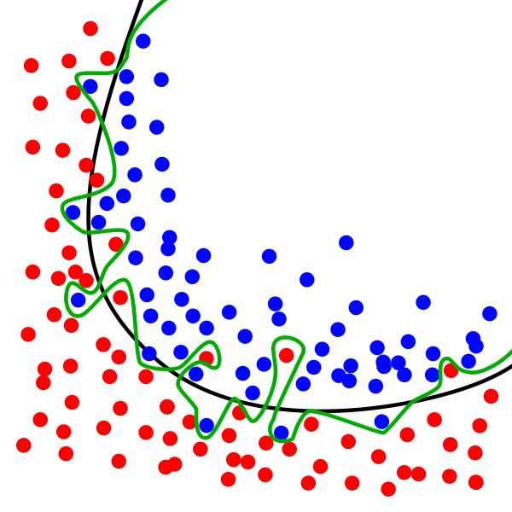
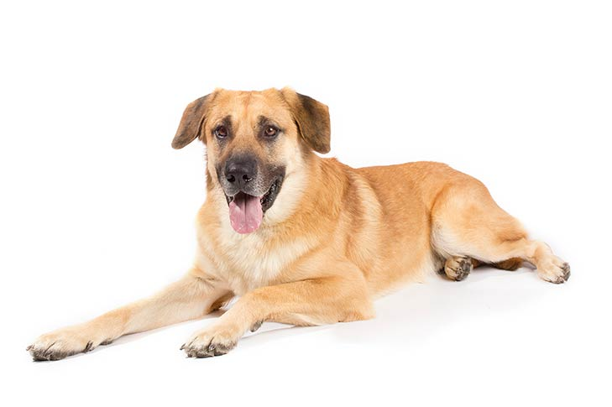

Overfitting vs. Generalization

Slide 27
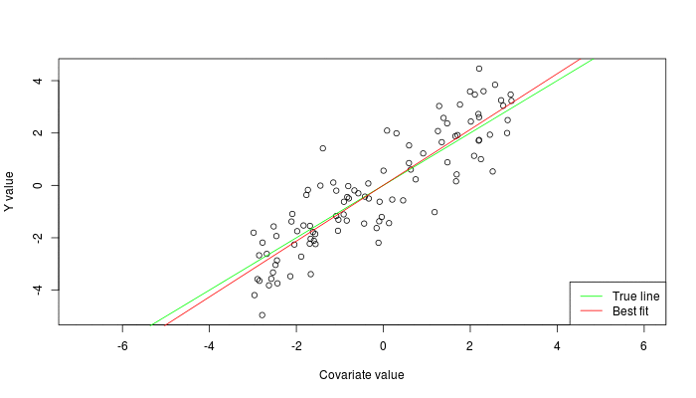

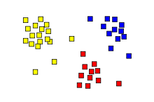
Types of learning:
Supervised: Learning with a labeled training set
  Example: email classification with already labeled emails
Unsupervised: Discover patterns in unlabeled data
  Example: cluster similar documents based on text
Reinforcement learning: learn to act based on feedback/reward
  Example: learn to play Go, reward: win or lose
class A
class B
Classification
Regression
Clustering

Slide 28
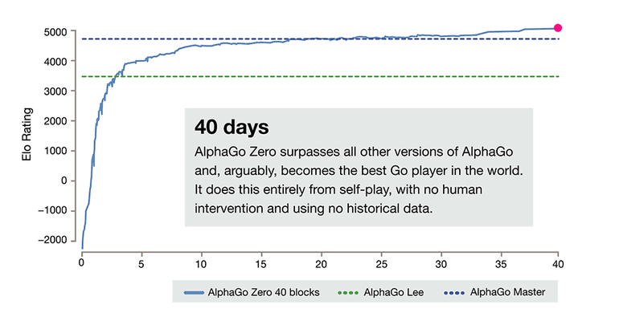
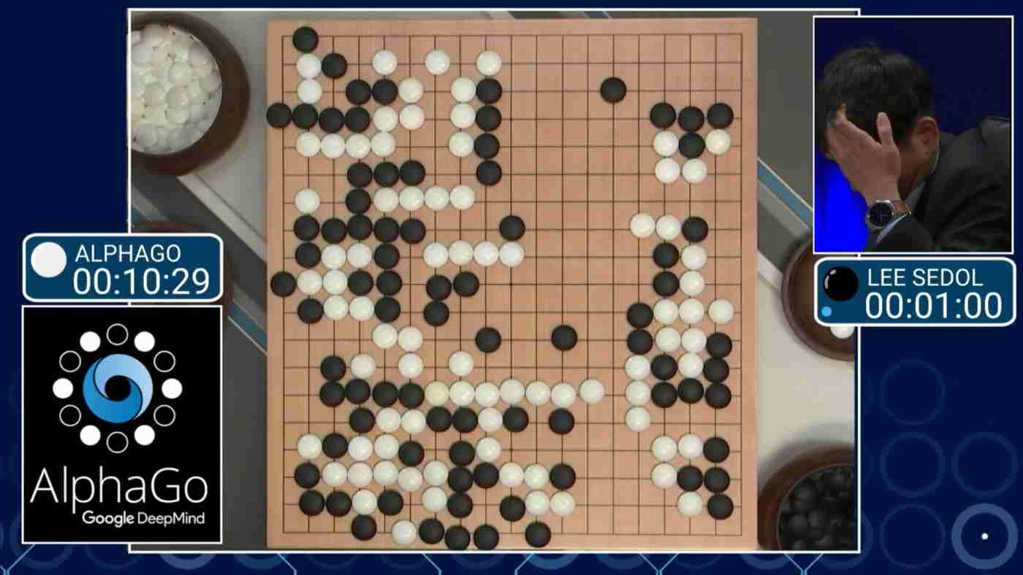
Reinforcement example
AlphaGo Zero: learning from scratch [4]
AlphaGo: first superhuman Go player [3]
[3] Silver, D. et al. Mastering the game of Go with deep neural networks and tree search. Nature’16
[4] Silver, D. et al. Mastering the game of Go without human knowledge. Nature’18
Notes:
Very difficult to setup and make succesfull

Slide 29
Overview
Motivation and overview of Deep Learning
What is learning ?
Deep Neural Networks (DNN)s
  Principles of operation & Terminology
  Neuron & Layers
  See article and slides of the Eyeriss group
    Efficient Processing of DNNs: A Tutorial and Survey
    Vivienne Sze e.a., arXiv 2017
    http://eyeriss.mit.edu/tutorial.html
Convolutional Neural Networks
Network examples

Slide 30
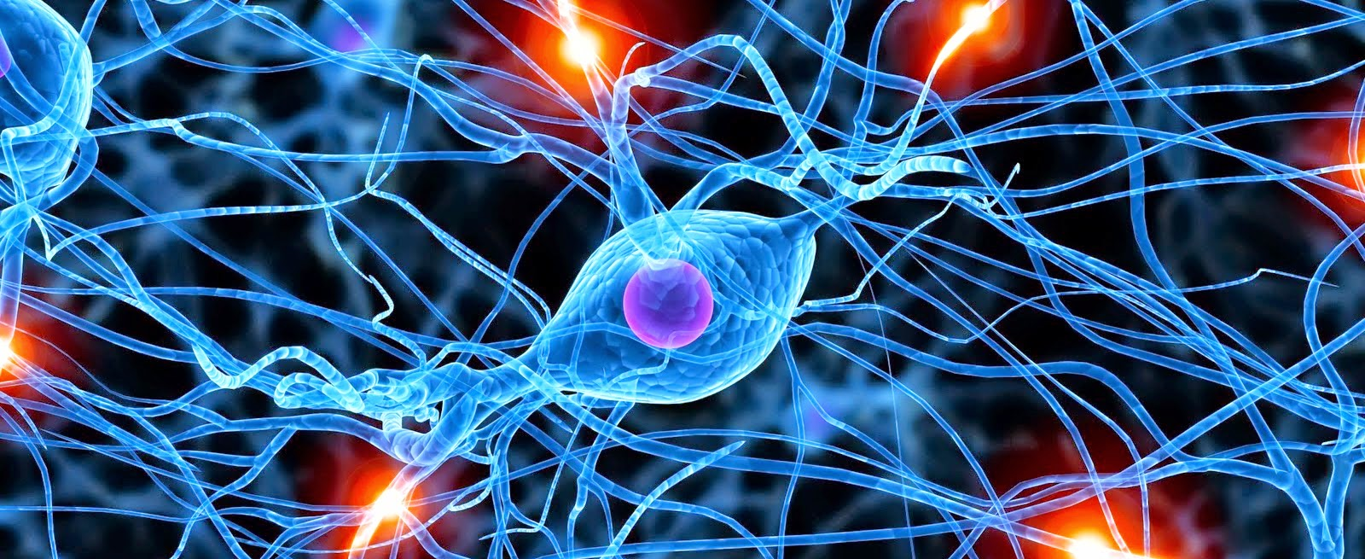
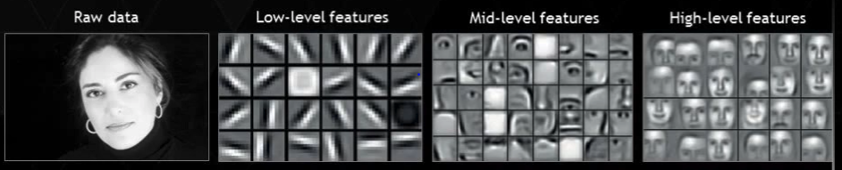
Deep Learning, a quick tour
A Simple Task
Detect face
Training data
1 M images
Network
6 layers
951 parameters
Training time
< 1 day
Low-level features
Mid-level features
High-level features

Slide 31
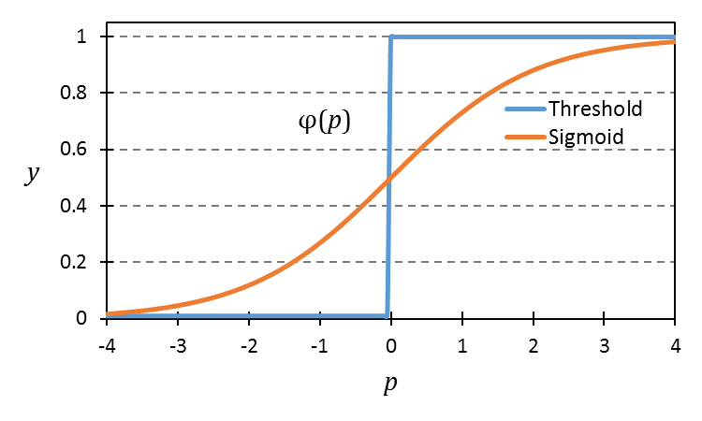
Convolutional network as a deep loop-nest
for l in layers:
for o in output_maps[l]:
for i in input_maps[l]:
for x in columns[l]:
for y in rows[l]:
for kx in kernel_widht[l]:
for ky in kernel_height[l]:
out[l][o][x][y] += in[l][i][x+kx][y+ky] * w[l][i][o][kx][ky]
fout[l][o][x][y]= f_act(out[l][o][x][y])

Slide 32
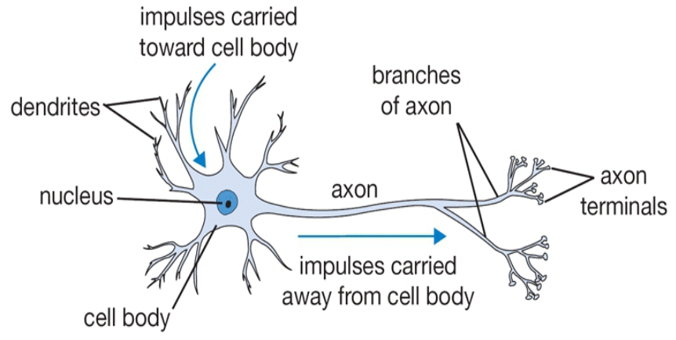
Our Brain
The basic computational unit of the brain is a neuron
  about 80 Billion neurons in our brain
  Neurons are connected with about 10¹⁴ – 10¹⁵ synapses
  Neurons receive input signals from dendrites and produce output signal along axon, which interact with the dendrites of other neurons via synaptic weights
Synaptic weights – learnable & control influence strength

Slide 33
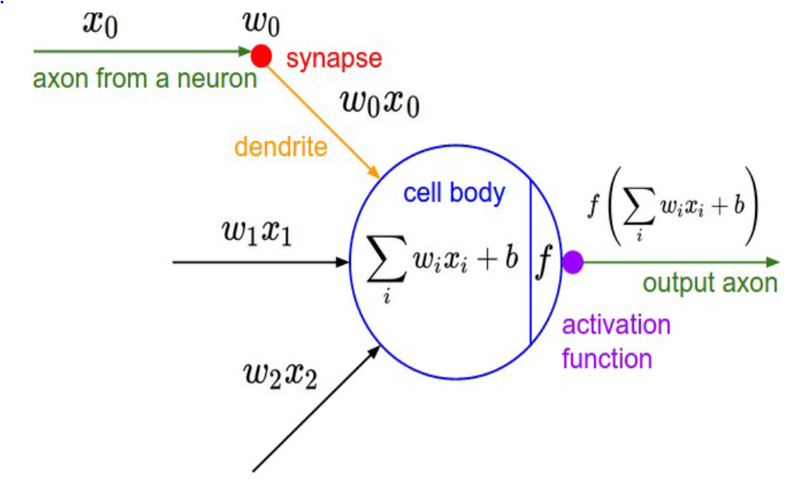
Artificial Neuron
extra parameter:
bias b

Slide 34
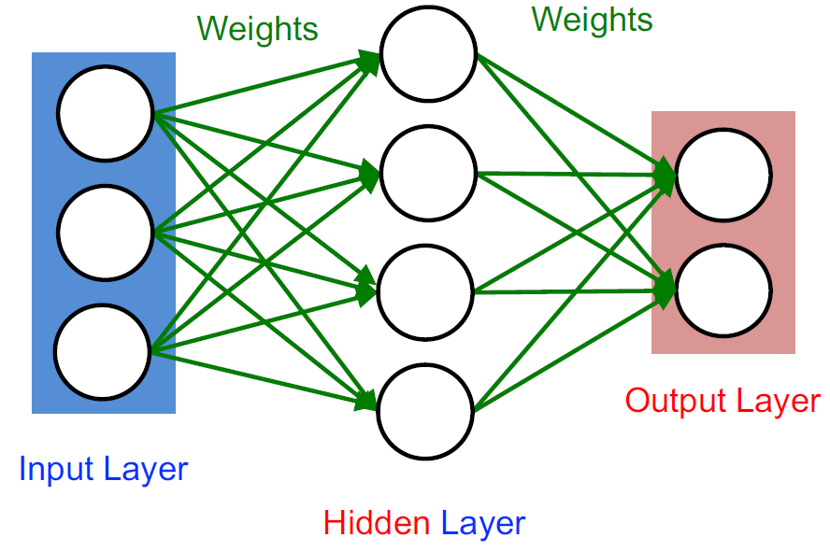
Neurons, structured in (hidden and output) Layers
Weights represent synaptic strength

Slide 35
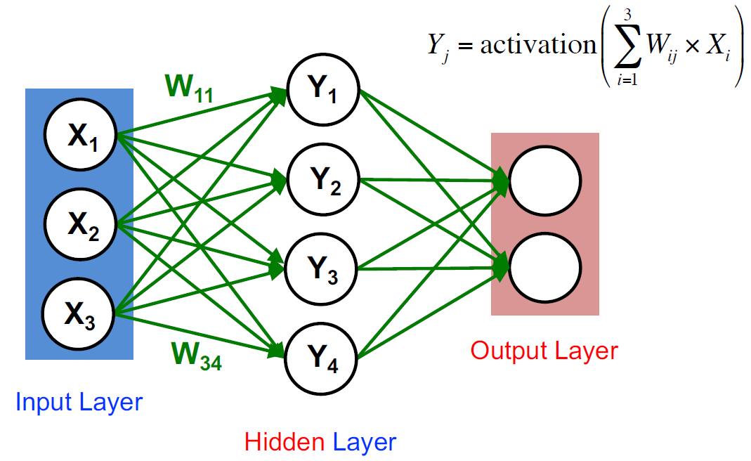
Neuron calculation
All neurons perform same type of calculation

Slide 36
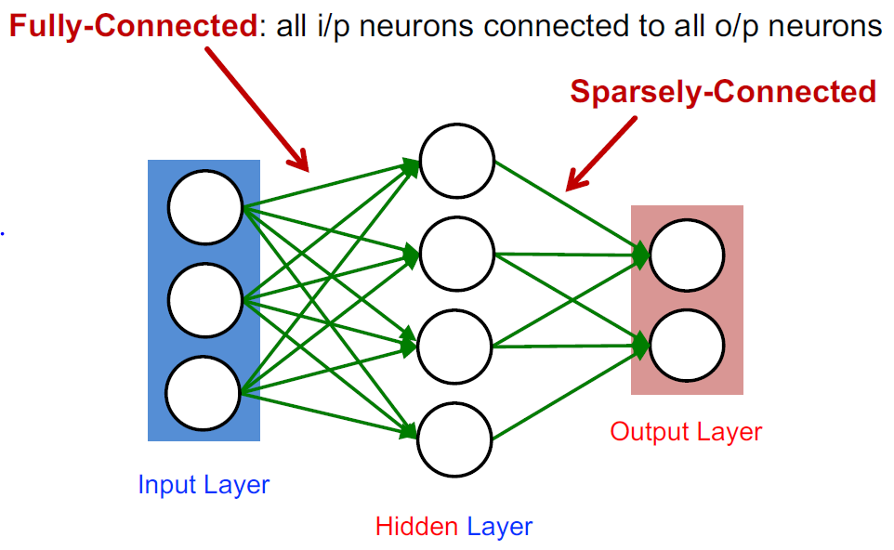
Fully vs Sparsely connected

Slide 37
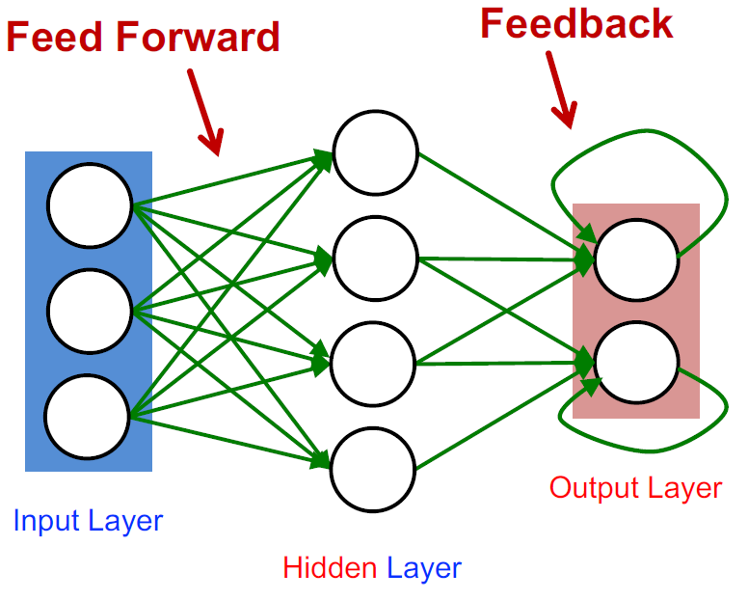
Feedforward vs Feedback connections

Slide 38
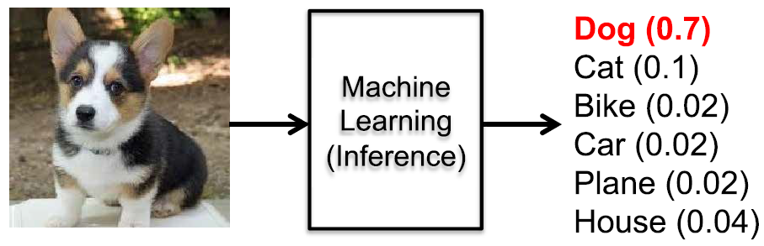
NN Classification: Class probability
Input: Image
Output: Class probability

Slide 39
Overview
Motivation and overview of Deep Learning
What is learning ?
Deep Neural Networks (DNN)s: operating principles
Convolutional Neural Networks
  Neuron structure
  Multiple input and output feature maps (fmaps)
  Sliding window
  Equations for DNN convolution & Code
  Activation functions
  Fully Connected (FC) layer
Network examples

Slide 40

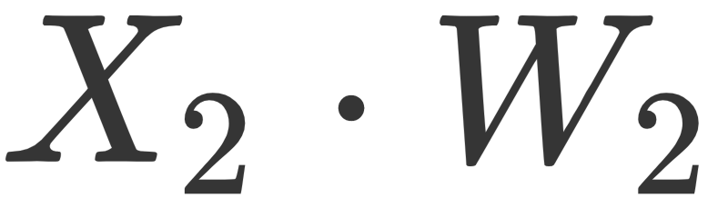



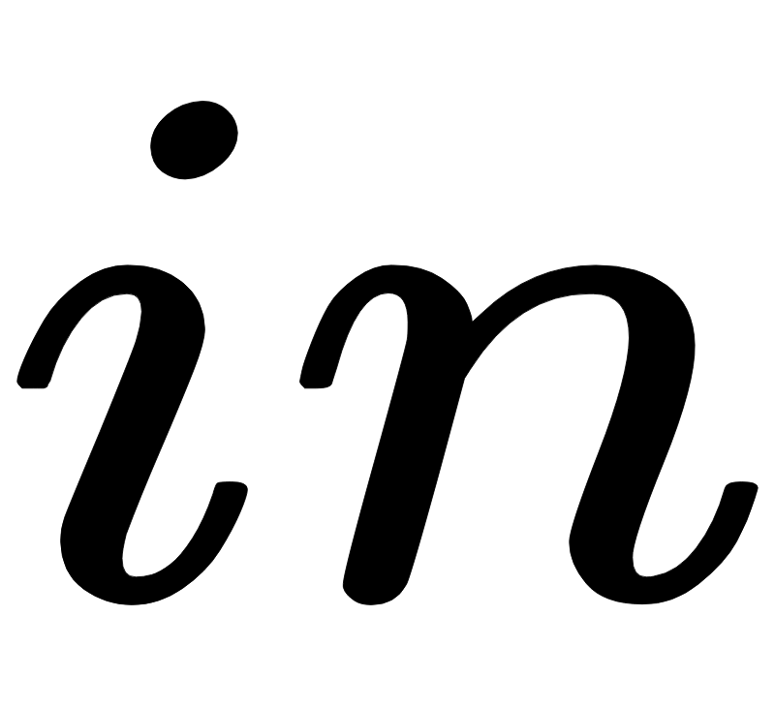
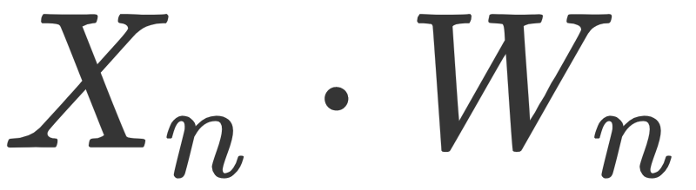
Artificial Neuron Model
Dot Product
Activation function:
Non Linear
Transformation

Slide 41
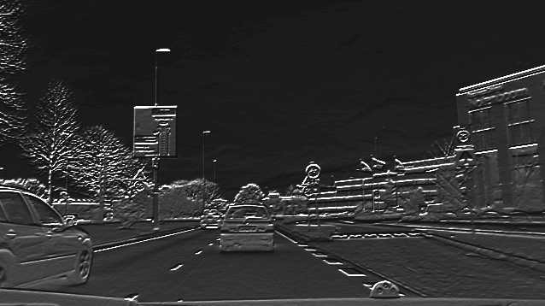
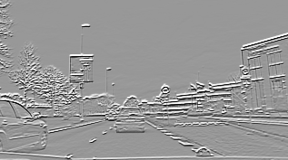
Neuron Applied to Image Region
Neuron detects features in region
Convolution: Same neuron applied to all regions in the image yields an output feature map
=> translational invariance

Slide 42
Input from multiple input (feature) maps
Input can be taken from multiple input feature maps

Slide 43
Multiple neurons / convolutions
Multiple neurons generate multiple output feature maps

Slide 44
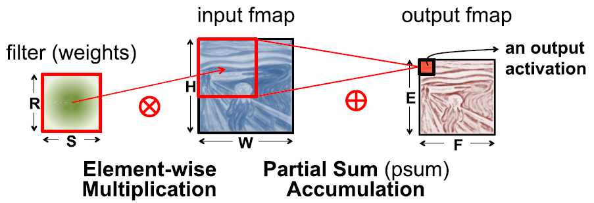
2D Convolution

Slide 45
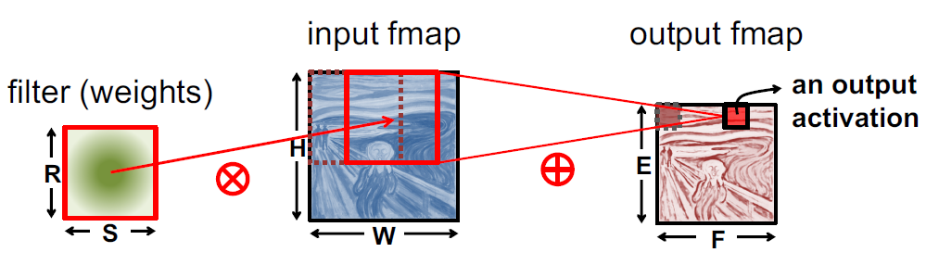
2D Convolution: sliding window

Slide 46
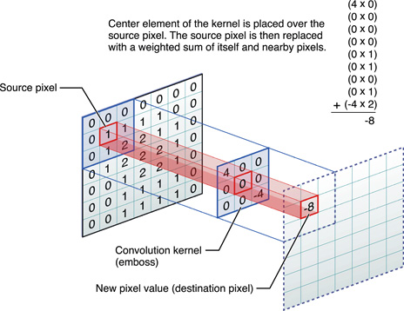
2D Convolution, viewed differently

Slide 47
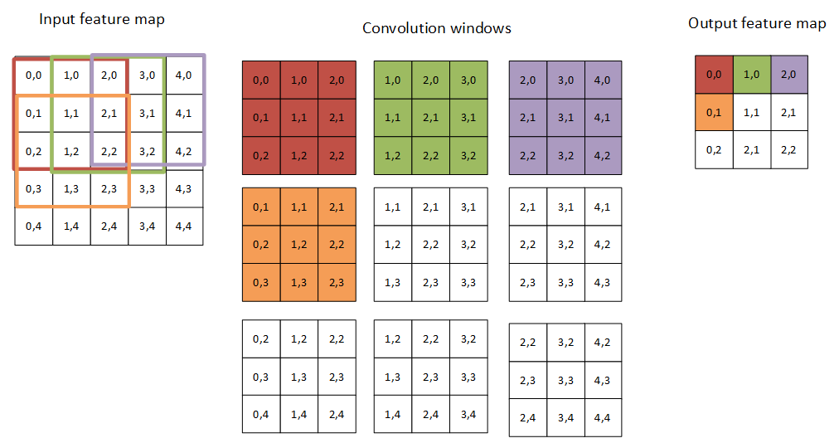
2D Convolution, sliding window
input 5x5
3x3 kernel
output 3x3

Slide 48
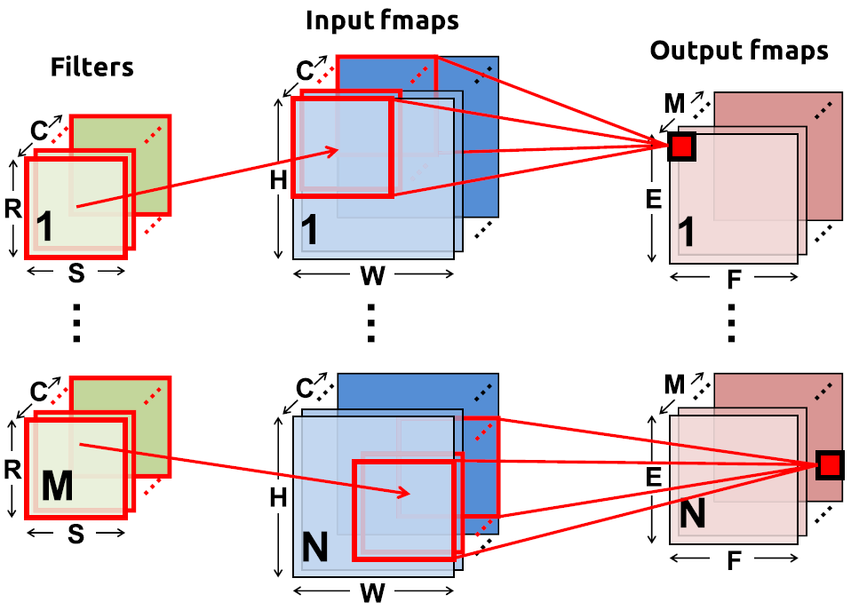
Convolution in CNNs: 1 layer generic picture
N = batch size
C input feature maps of size HxW
M output feature maps of size ExF
M filters of size RxS

Slide 49
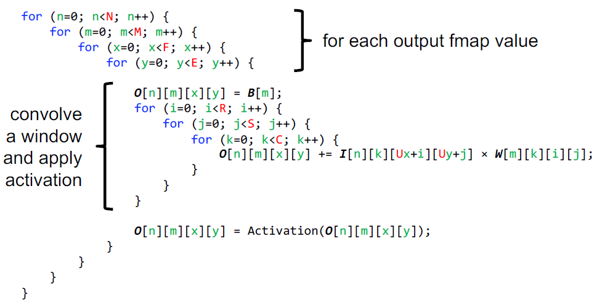
Convolution code

Slide 50
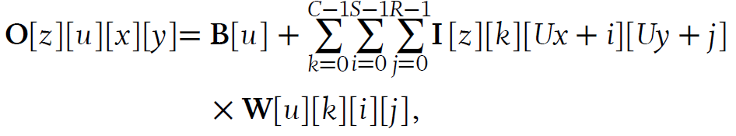
Convolution equations
U = stride
B = bias vector
Note: W has 4-dimensions
  i,j for kernel
  k for input feature maps
  u for output feature maps
Notes:
Note: small u (output feature map) and big U (stride) are different
Note: this slide uses partially a different notation: (z –> n / batch), (u –> n / output feature map)

Slide 51
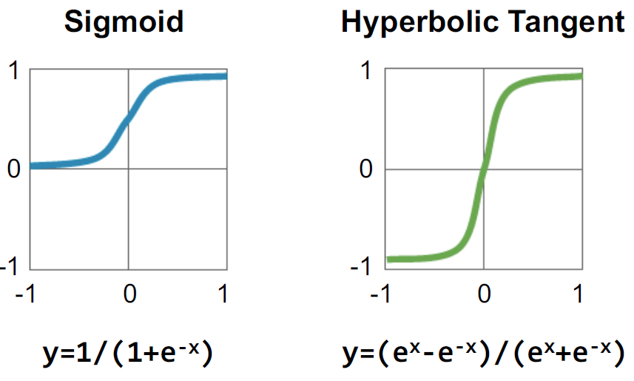
Activation functions: traditional

Slide 52

Activation functions: modern

Slide 53

Fully Connected (FC) layer
FC can be viewed as a special case of convolution, with:
  H=R
  W=S
  E=F=1
Size of input fmaps = size of convolution kernel
Output fmaps have size 1x1, i.e. each output fmap represents 1
output neuron

Slide 54

Pooling
Reduce resolution
Increase receptive (input) area of outputs
Overlapping or
Non-overlapping,
depending on stride U
Using the max or average

Slide 55

Normalization
Batch normalization
  normalize activations of a batch such that:
    average => 0, and
    standard deviation σ => 1
  based on statistics of training set
  gives higher accuracy, and faster training

Slide 56

Normalization: correction of activation y
this equation can be ''absorbed'' in the weights => no overhead

Slide 57
Overview
Motivation and overview of Deep Learning
What is learning ?
Deep Neural Networks (DNN)s: operating principles
Convolutional Neural Networks
Network examples

Slide 58

Popular networks
LeNet-5 (1998): used for digit recognition
AlexNet (2012): winner of ImageNet competition
VGG (2014): going deeper, 16+ layers
GoogLeNet (2014): based on "inception module"
ResNet (2015): adding residual connections, many versions
ResNet18:

Slide 59

LeNet-5 used for MNIST database
Digit classification
input: 28x28 pixels (B&W)
output: 10 classes
60k training pictures
10k testing pictures

Slide 60

LeNet-5 structure
2 Conv layers
2 FC layers
60k weights, 341k MACs (mult-acc) per input picture
[Lecun e.a. Proc. of the IEEE, 1998]

Slide 61

Adapted LeNet-5 for traffic sign recognition
[M. Peemen, 2011]
Note:
input is 720x1280, but
network is trained on patches (traffic signs) of 28x28

Slide 62

Popular
DNNs

Slide 63

Model Size Explodes
Object recogn.
11 Billion
parameters !!
Simple face detection, 951
parameters

Slide 64

What did you learn today?
The concept of Learning
Deep Learning using Deep Artificial Neural Networks
Convolutional Neural Networks
Convolution layers
Fully connected layers
Pooling
Normalization
DNN examples
A lot of terminology
Start with Lab 1

Slide 65
ML Terminology
training or learning phase: determine a model for y(x)
on the basis of the training data
  split data into: 1) training set, 2) validation set, and 3) test set
  inference: use the learned model for classification
supervised learning : input+target vectors (labels) in the training data
classification (discrete categories) vs. regression (continuous variables)
unsupervised learning : no labels; also called clustering, or density estimation
reinforcement learning, credit assignment, exploration, exploitation
overfitting, generalization

Slide 66
CNN terminology
N = batch size
C input feature maps of size HxW
M output feature maps of size ExF
M filters of size RxS
Total filter size =
Mx (RxSxC)
Dream this picture !

