Slide 1
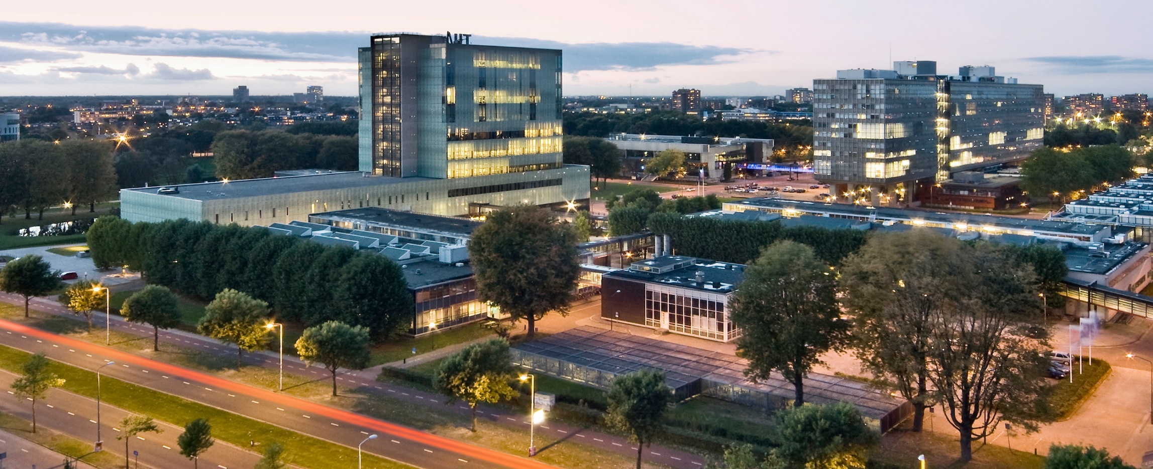
General Architectures for DNN
Kanishkan Vadivel
Electrical Engineering – Electronic Systems group
Notes:
‹#›

Slide 2
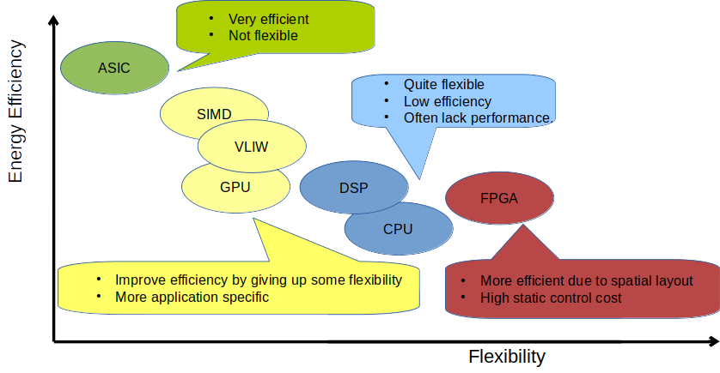
Hardware Platform for DNN
‹#›

Slide 3
Outline
REVISE: DNN structure and computation model
Accelerators (ASICs) for DNN (+Lab 3)
  Design for data reuse (IS, WS, and OS mappings)
  Performance evaluation framework
  Practical Example – Google Tensor Core
DNN on Traditional Compute Platforms
  General Purpose Processor (CPU)
  Domain Specific Processors (DSPs, VLIW-SIMD)
  Graphics Processing Unit (GPU)
Today
‹#›

Slide 4
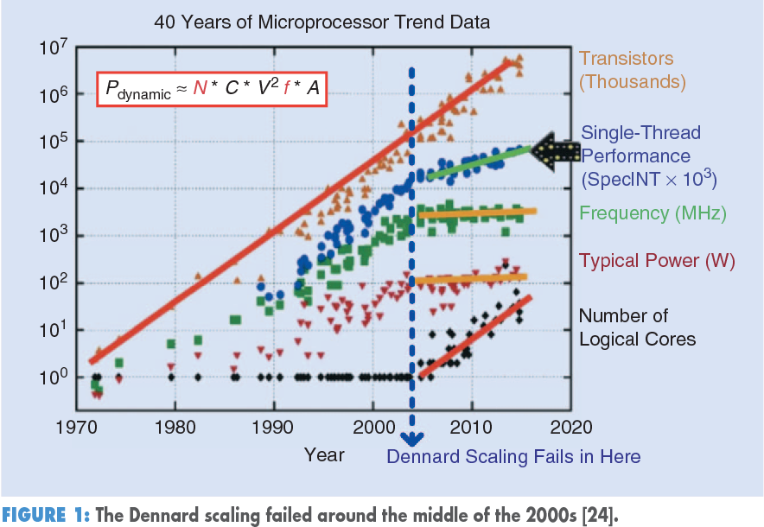
Overview of Microprocessor Designs (CPU)
Source: Time Moore, Liming Xiu 2019.
‹#›

Slide 5
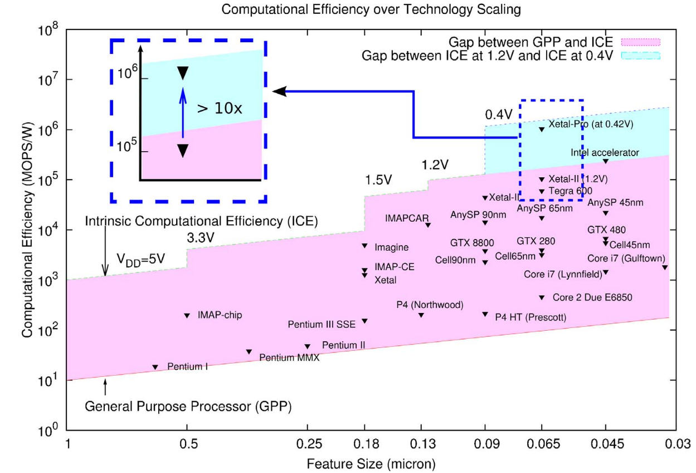
Intrinsic Compute Capability
TPU
~200x for DL
CPU
Difference in
Performance/Watt
Source: XETAL-II, 2010
‹#›

Slide 6
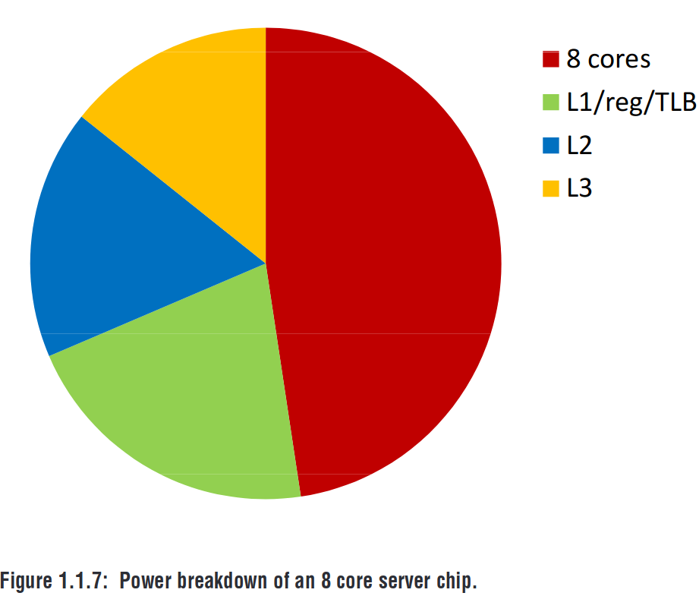
Source of Inefficiency
How to improve?
Results does not include DRAM power
More than 50% of energy is spent on Cache and Control logic
  Reduce control overhead
  Improve Cache hierarchy
Multi-Core/Cluster concepts provides an additional performance gain
Cache & Control
Compute
Source: Computing’s Energy Problem, ISSCC 2014
‹#›

Slide 7
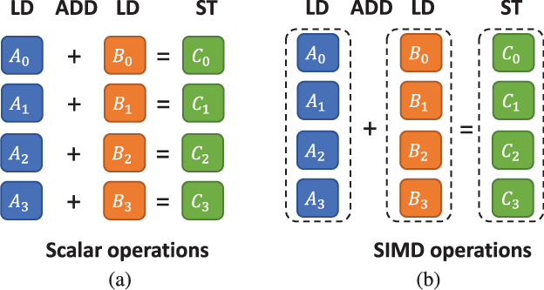
Reduce Control Overhead: SIMD Extensions
Intel
  SSE (streaming SIMD Extension, 4x32-bit single precision) [SSE2, SSE3, SSSE3, SSE4]
  AVX, AVX2, AVX-512– 256/512bit
AMD – 3DNow
Arm – VFP (single/double precision co-processor), NEON → 128bitm SVE → 128 to 2048bit
Qualcomm – 4x1024b → 4096bits
DNN specific extensions: Reduced Precision and Instruction-set extension
‹#›

Slide 8
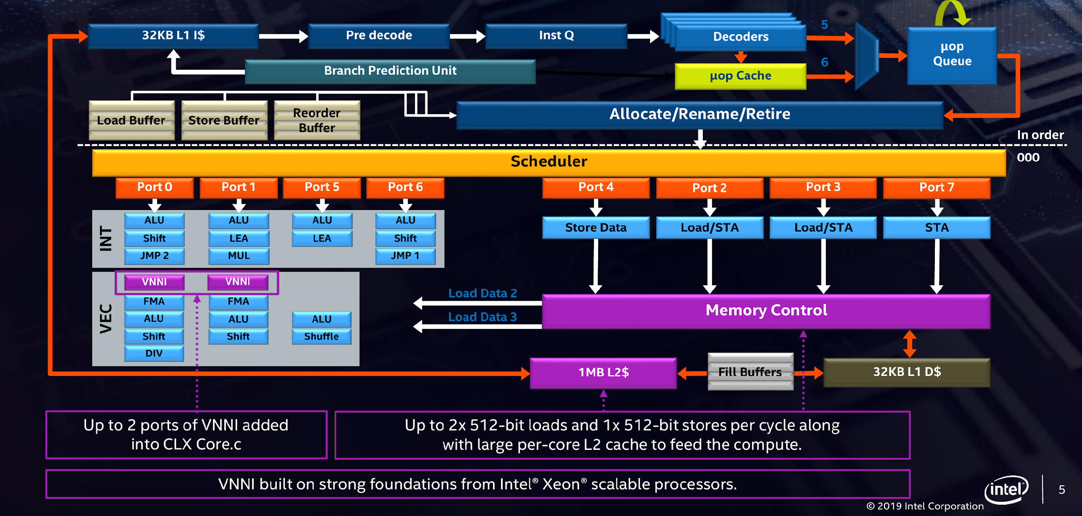
Example: Intel – Cascade Lake 2019
(VNNI – Vector Neural Net Instructions)
x28-cores
VNNI Instructions
‹#›

Slide 9
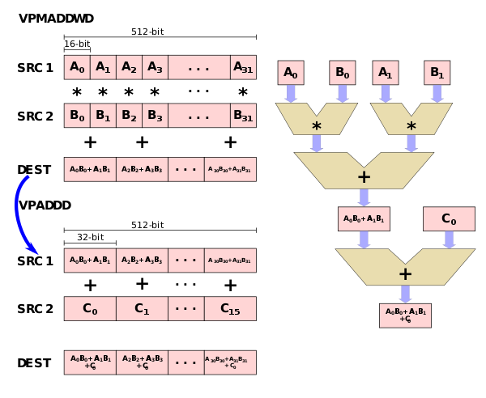
SIMD Extensions for DNNs - 1st Gen Intel Xeon
CNN → Repeated multiplication(8/16bit) and accumulation (32bit)
We need TWO instricitons in AVX-512 for 16-bit data
psum
source: wikichip
‹#›

Slide 10
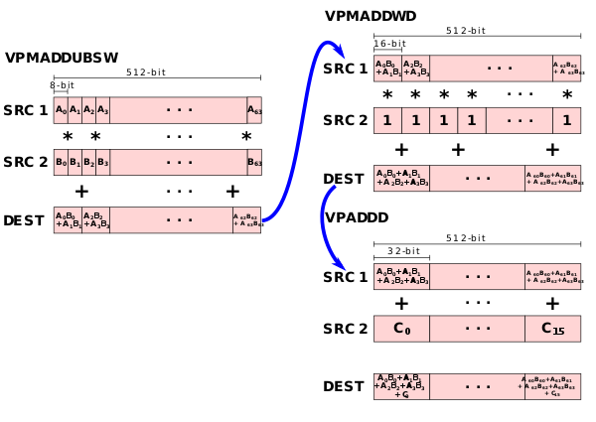
SIMD Extensions for DNNs - 1st Gen Intel Xeon
We need THREE instructions in AVX-512 for 8-bit data
VPMADDWD → converts 16bit data to 32-bit
source: wikichip
‹#›

Slide 11
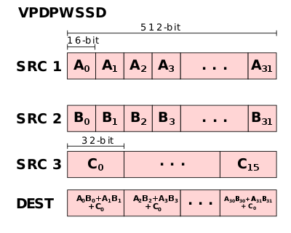
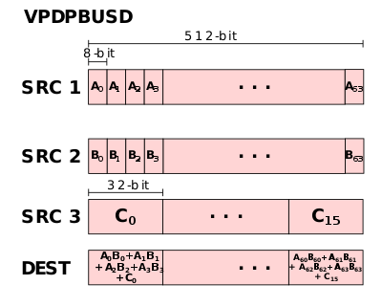
SIMD Extensions for DNNs - 2nd Gen Intel Xeon
TWO new instructions;
  VNNI – FMA on single cycle compared to 3-cycles with normal SIMD instructions
Mixed-precision mode – INT8 x INT8 + INT32
Some architectures support “2x2 dot-product” as well
source: wikichip
‹#›

Slide 12
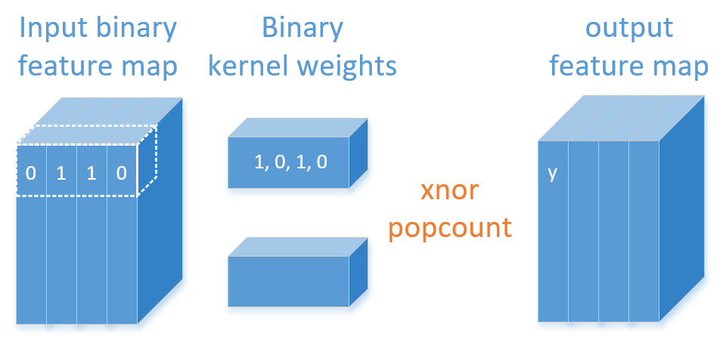
How about BNN?
y = popcount (W XNOR X)
‹#›

Slide 13

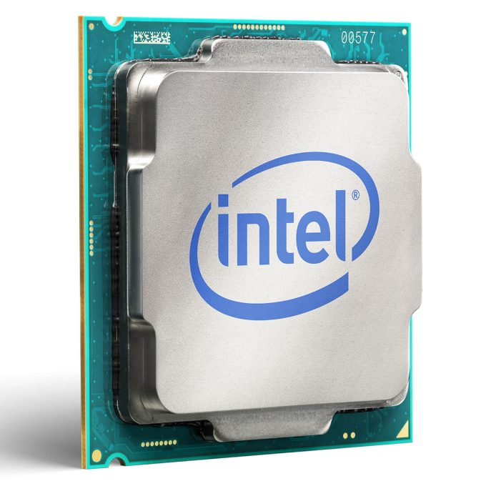
Software Stack for DNN
Parallelizing Compiler
  Inline assembly
  Intrinsics
Optimized libraries
MKL-DNN, clDNN, BLAS, Arm NN, Arm CIMSIS-NN, and many more..
?
‹#›

Slide 14
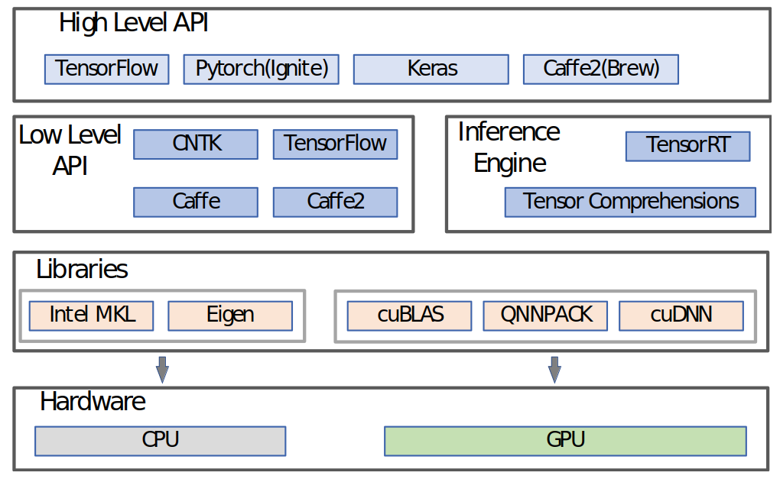
Optimized Library Calls
High Level API: Provides abstractions for application use
Low Level API: Integrate system level support libraries and provide DL functionality
System Level Support libraries: provides efficient kernel implementation of
  Basic linear algebra subprograms (BLAS)
  DNN Primitives
  GPU kernels
Refer Topic-3 slides
‹#›

Slide 15
Outline
DNN on Traditional Compute Platforms
  General Purpose Processor (CPU)
  Domain Specific Processors (DSPs, VLIW-SIMD)
  Graphics Processing Unit (GPU)
‹#›

Slide 16
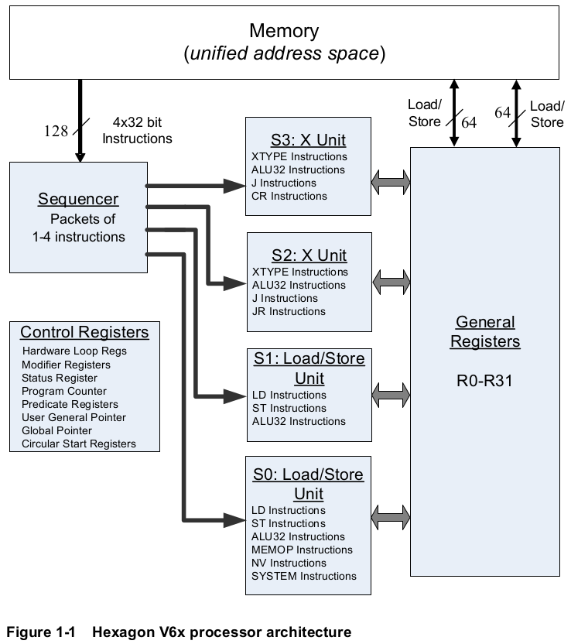
Domain Specific
Processors (VLIW-SIMD)
Processors optimized for specific application domain (e.g: Vision, signal processing, etc)
Example: Qualcomm Hexagon, Movidious (Intel), Ceva, and many more..
Support for DNN
  Instruction-set extensions
  DNN Accelerator in the execution pipeline
‹#›

Slide 17
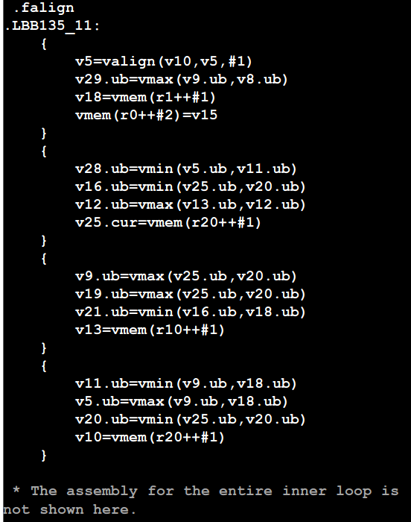
Programming Model
‹#›

Slide 18
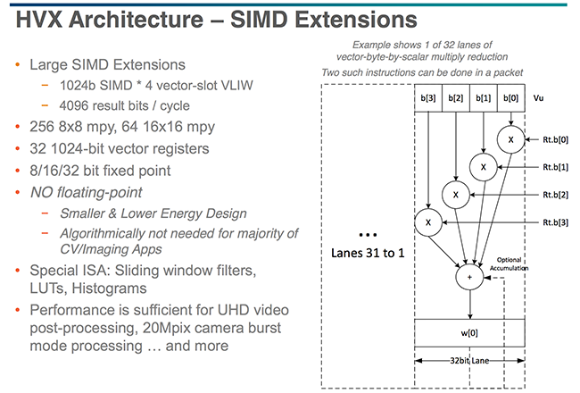
Hexagon
DSP
(Qualcomm)
‹#›

Slide 19
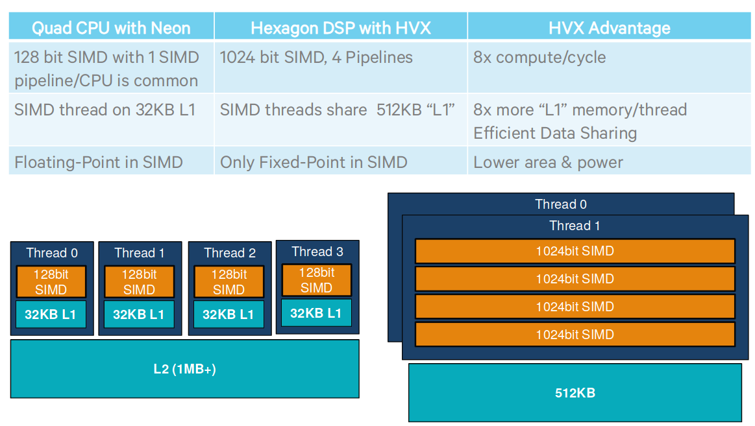
Hexagon over Quad CPU
Source: Hotchips
‹#›

Slide 20
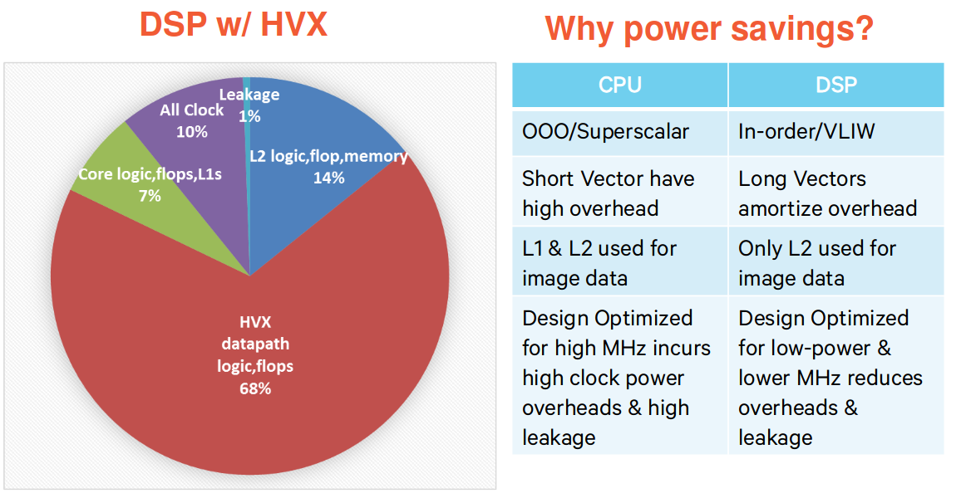
Hexagon – Power breakdown
Less overhead on control logic and memory compared to CPUs
‹#›

Slide 21
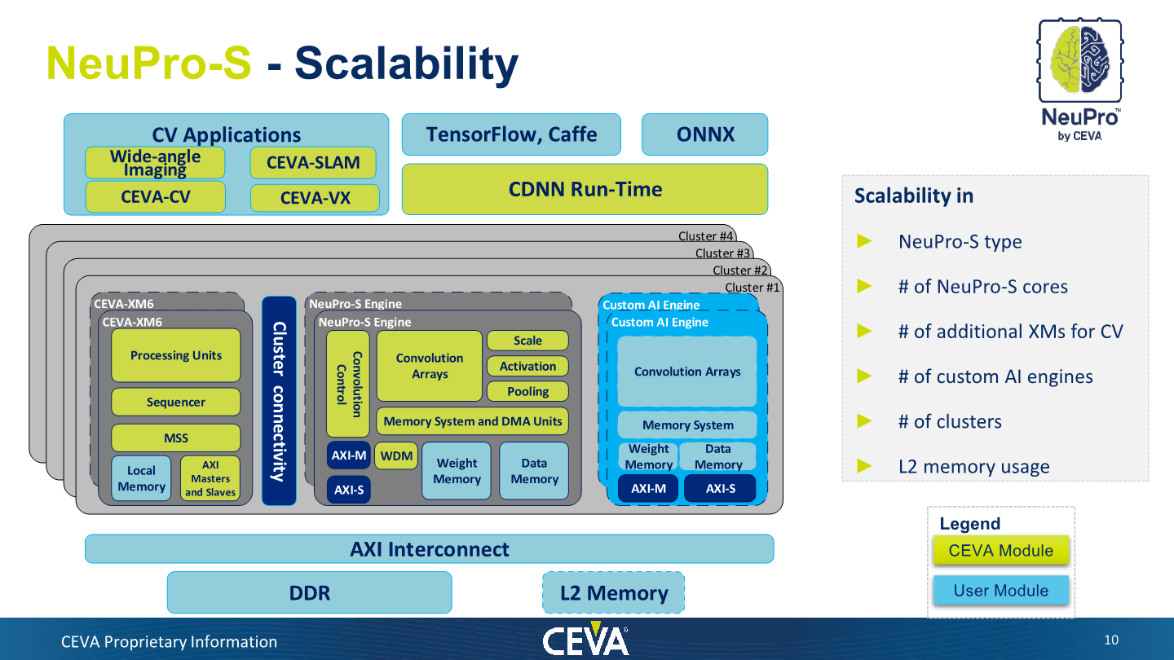
Example-2: Ceva DSP
Source: Anandtech
‹#›

Slide 22
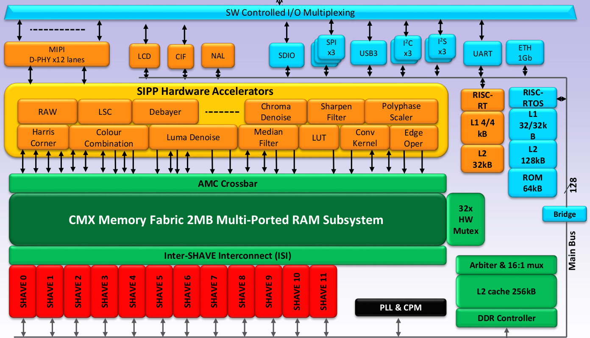
Example-3: Movidius v2
Source:
Hotchips’14
‹#›

Slide 23
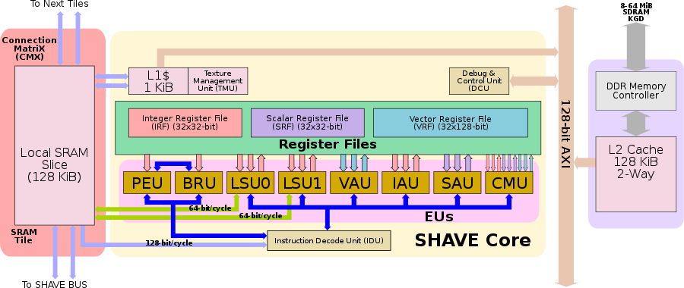
Example-3: Movidius v2 (VLIW)
Source: Hotchips’14
‹#›

Slide 24
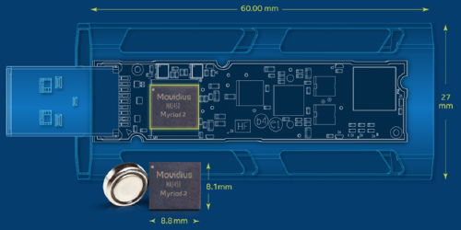
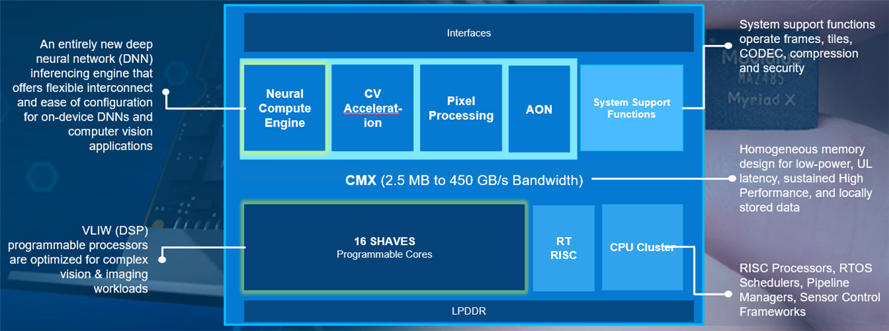
Example-3:
Intel Neural Compute Stick
Processor: Intel Movidius Myriad 2 VPU
Supported Framework: Tensorflow, Caffe
‹#›

Slide 25
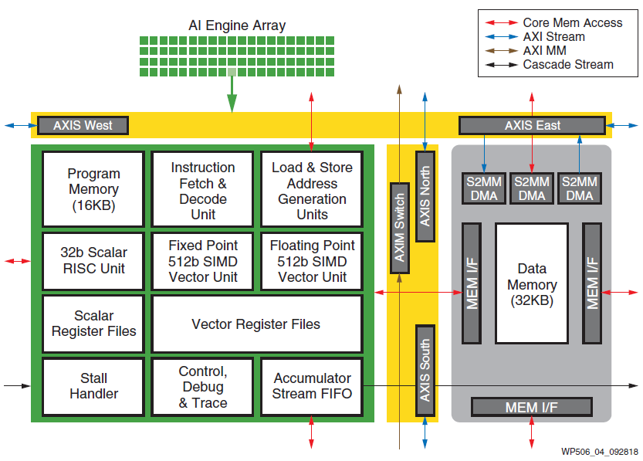
Final Example: Xilinx -
Edge AI Platforms
AI Vector Engines
32b RISC
512b fixed/float vector unit + RF
wp506-ai-engine.pdf
‹#›

Slide 26
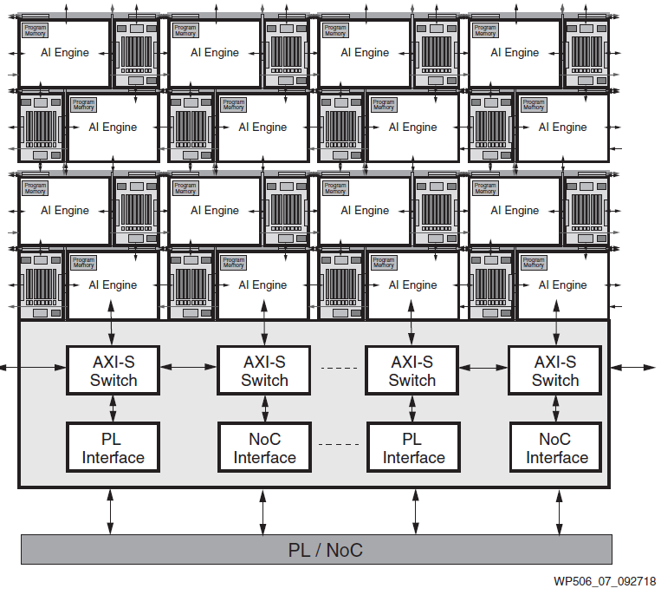
Connect to PL
(Programmable
Logic Fabric)
wp506-ai-engine.pdf
‹#›

Slide 27
Outline
DNN on Traditional Compute Platforms
  General Purpose Processor (CPU)
  Domain Specific Processors (DSPs, VLIW-SIMD)
  Graphics Processing Unit (GPU)
‹#›

Slide 28
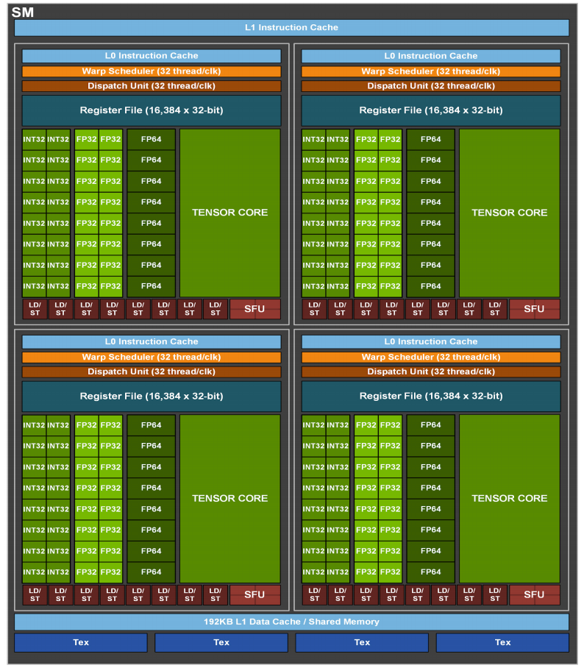
Example: NVIDIA Ampere - 2020
Streaming Multiprocessors (SM)
  108 - SMs
  64 – INT32/FP32 core/SM
  32 – FP64 cuda core/SM
  8 – Tensor core/SM
    Supports binary, INT4/8, FP16, BF16, TF32, FP64
    Support fine-grained sparsity
8x 256 FMA FP16/FP32
Clock – 1.41 GHz
Peak Tensor TFLOPS – 321
‹#›

Slide 29
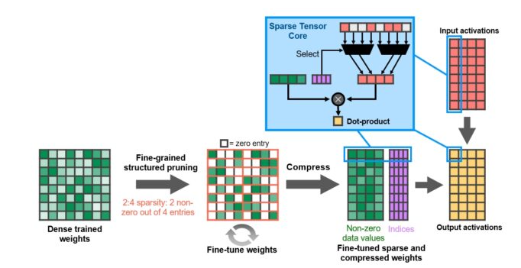
Tensor cores –Fine-grained sparsity
Structure is enforced through a new 2:4 sparse matrix definition that allows two non-zero values in every four-entry vector
Efficient compression reduce memory storage and bandwidth by almost 2x
2:4 Structured pruning has no accuracy drop [1]
[1]Learning N:M Fine-grained Structured Sparse Neural Networks From Scratch, ICLR2021. (https://arxiv.org/abs/2102.04010)
‹#›

Slide 30
Concluding Remarks
Compute and memory requirement of DNN is quite high and a major part of the computation is from Matrix Multiplications (i.e. MAC ops)
Common DNN specific extensions in
  Generic architecture
    Instruction-set extensions - Generally SIMD support for complex instructions with reduced/mixed precision support
    DNN accelerator on datapath (Co-processor, Tensor core, etc)
  DSPs - Better energy efficiency due to reduced control overhead (comes from Domain Specific acceleration [eg: DNN extensions on VLIW-SIMD processors])
  GPUs – Tensor cores with support for sparsity
The effective performance of the platform depends on the hardware capability and software support (programming model and library used to realize the network)
The energy efficiency is still a limitation of generic platforms for DNN
‹#›

Slide 31
Reference
Evaluating the Energy Efficiency of Deep Convolutional Neural Network on CPUs and GPUs, Da Li and Xinbo Chen, 2016
‹#›

