Slide 1
Neuromorphic Computing and Engineering (Spiking Neural Networks)
29th March 2022
Federico Corradi, Assistant Professor, Neuromorphic Edge Computing Systems Lab.
Electrical Engineering Department, Neuromorphic Edge Computing Systems Lab

Slide 2
Intelligent Architectures
The main challenge is lessening the computational burden for running AI
Deep Learning Accelerators
Hardware accelerators.
Network Compression.
New Networks Architectures.
New Hardware Design Styles.
Unconventional Brain-Inspired Architectures (Spiking Neural Networks)
Machine Learning
Brain-inspired models
SNN
Competitive Computer Architectures
Spike-based computing for edge AI – F. Corradi

Slide 3
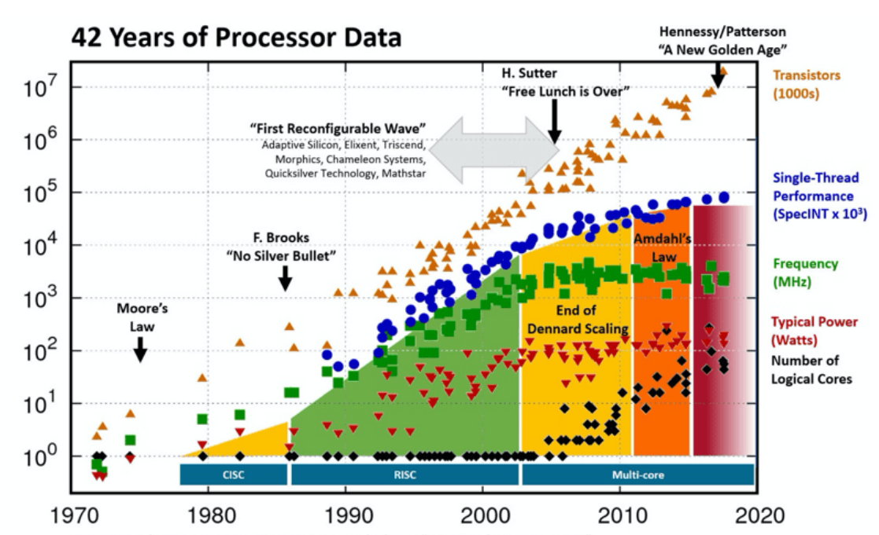
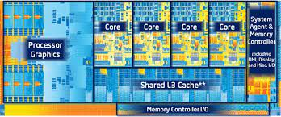
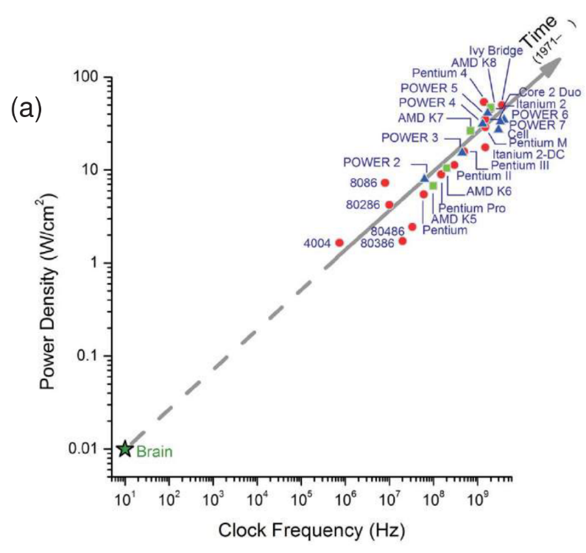
Why neuromorphic?
[Muralidhar R. et al 2021]
The trend of modern computing systems is to increase power density and frequency.
Silicon technology has some limits (Dennard scaling, Moore’s Law, Memory Wall)
[Merolla P.A. et al. 2014]
Spike-based computing for edge AI – F. Corradi

Slide 4
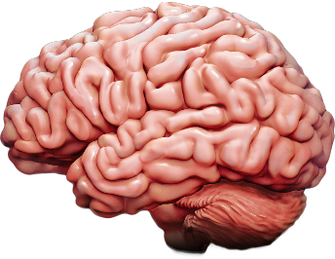
Why neuromorphic?
[Muralidhar R. et al 2021]
The trend of modern computing systems is to increase power density and frequency.
Silicon technology has some limits (Dennard scaling, Moore’s Law, Memory Wall)
Brain’s operating point is in a different place!
Brain consumes ~20W, 2L
At the system level, brains seem very efficient. Why? Are we doing something wrong?
[Merolla P.A. et al. 2014]
Spike-based computing for edge AI – F. Corradi

Slide 5
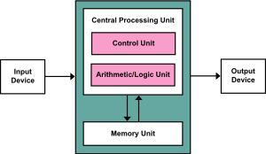
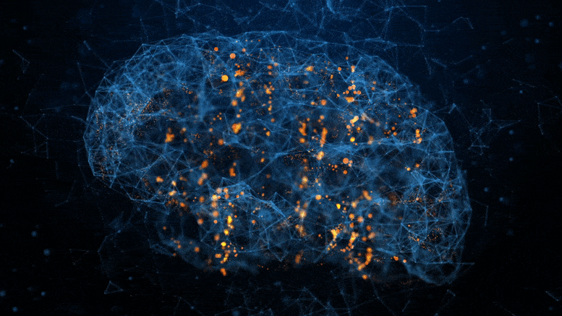
Neuromorphic computing
The brain employs different models of computation
At the system level, brains seem very efficient. Why?
COMPUTERS
Fast clocks (global)
Bit-perfect deterministic logic state
Memory distant to computation (high-energy data movements)
BRAINS
Self-timed, data-driven (spiking neurons)
Fault-tolerant system (adaptive)
Synaptic memory at computation (co-location memory and computation, in-memory computation)
Spike-based computing for edge AI – F. Corradi

Slide 6
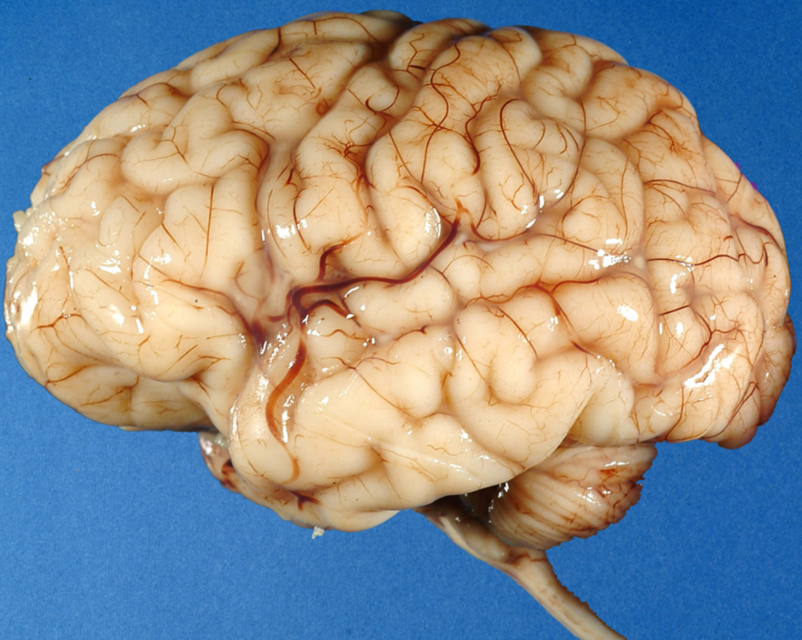
The Brain
The brain employs a different architecture
At the system level, brains seem very efficient. Why?
Massively parallelism (${10}^{11}$ neurons)
Massive connectivity (${10}^{15}$ synapses) 1,000/10,000 conn/neu
Excellent power efficiency (~20W)
Slow components (∼ 10 − 100 Hz)
Low-speed communication (∼ 100 meters/sec)
Adaptability - tolerant to component failure
Autonomous learning
Stochastic
Spike-based computing for edge AI – F. Corradi

Slide 7
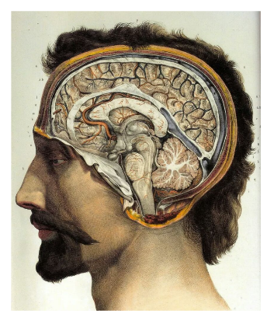
Neural Systems In Nature
Neural systems are used across multiple scales in several species (${10}^{2}$ to ${10}^{11}$ neurons)
86B
100-200B
100M
16M
1M
100K
302
They all use neurons and synapses, scaling up 10⁶ times!!!
Learning from biology. What are the computational primitives of neural information processing?
Spike-based computing for edge AI – F. Corradi

Slide 8
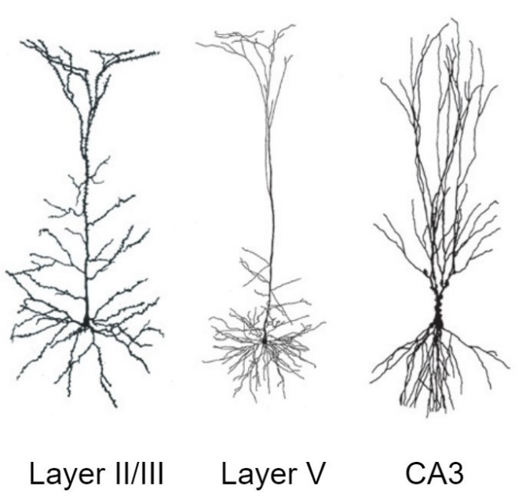
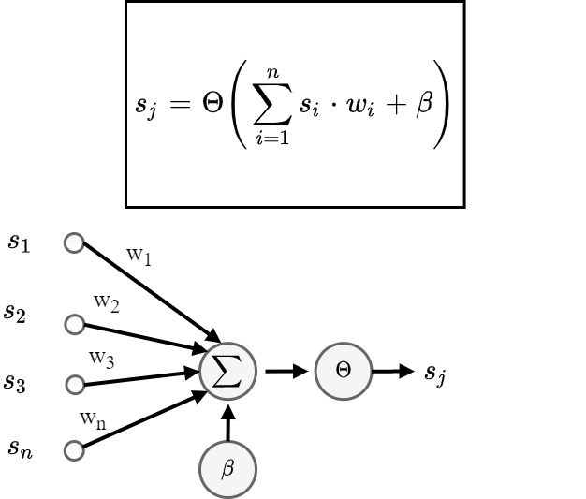
Neural-inspired Models of Computation
Current neuron’s artificial models are lacking in representing the complexity of biological neurons.
Algorithms in digital time-multiplexed hardware
Distinction between hardware and software
Dynamical neuron models (time)
The neuron morphology is part of its functionality
Spike-based computing for edge AI – F. Corradi

Slide 9
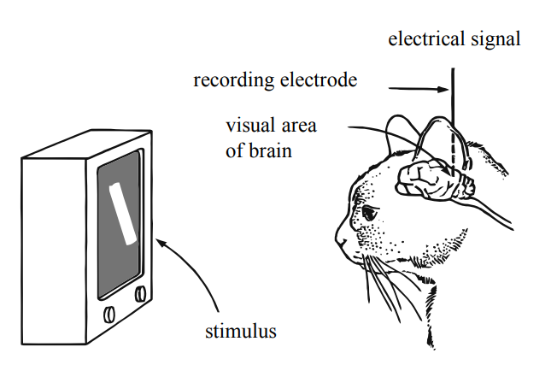
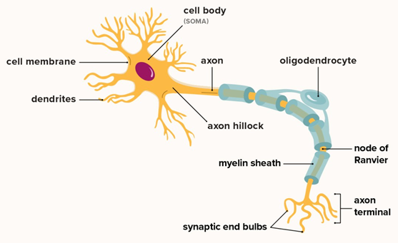
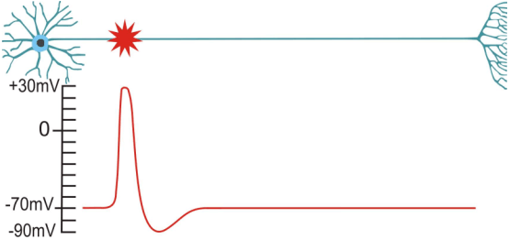
Neural electrical signal: the action potential
Neurons communicates by means of action potentials (i.e., spikes)
Dynamics (living cells), adapt (e.g., firing frequency adaptation)
Biological neurons are stochastic (noisy)
They respond to specific input stimuli
e.g. visual cortical neurons responds to specific stimuli [Hubel and Wiesel, 1959]
Spike-based computing for edge AI – F. Corradi

Slide 10
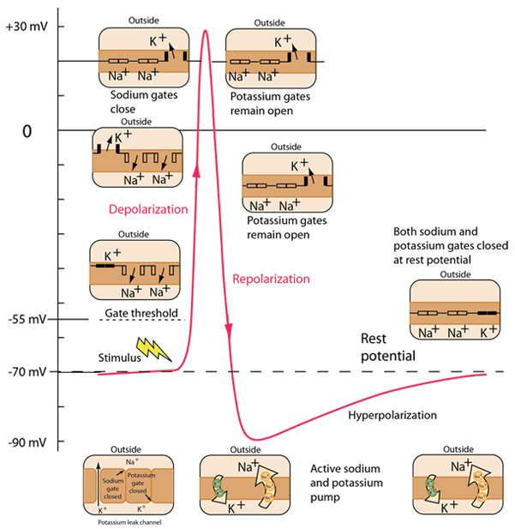
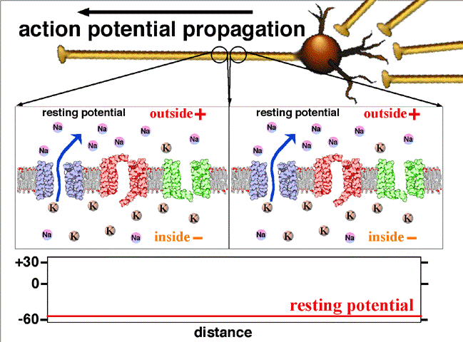
Propagation of Action Potentials
Action Potential: charges flow in and out of the cell
Red: Voltage-gated sodium (Na) Channel
Blue: Potassium (K) Leak Channel
Green: Voltage-gated potassium (K) Channel
Action potentials (i.e., spikes) are ion charges moving in and out of the cell membrane, trough the ion channels.
Voltage gated-ion channels open and close to propagate the action potential.
Spike-based computing for edge AI – F. Corradi

Slide 11
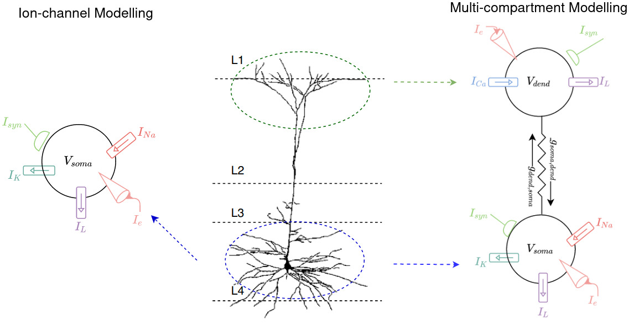
Neuron Models – complexity of bio-realism
Several differential equations that describe several voltage-gated ion channels over time.

Slide 12
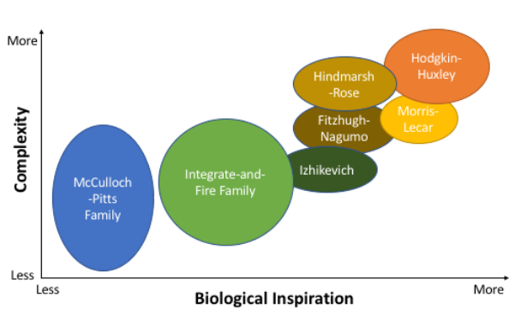
Neuron Models
Neuron models have some concept of accumulation of charge and firing to affect other neurons, but their model can significantly vary. Several level of bio-mimicking.
Trade-off among complexity of simulation and biological realism!
[Schuman C., et al. 2017]

Slide 13
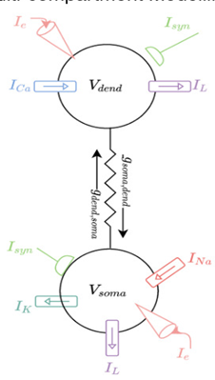
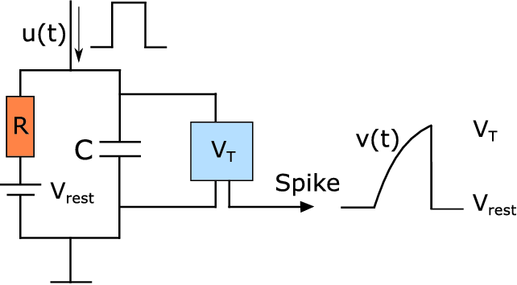
Leaky-Integrate-And-Fire Neuron Model
Neuron is modeled with an RC circuit
We do not model each single compartment (single channel) with its specific voltage-gated conductance (1/R).
LIF model is a simple RC circuit!
$$τ_{m}\text{ = }\text{RC}$$
$$τ_{m} \frac{du}{dt}=−\left[u\left(t\right)−u_{rest}\right]+RI\left(t\right)$$
$$u_{θ}$$
$$u\left(t\right)$$
$$u\left(t\right)$$
$$u_{rest}$$
$$u_{rest}$$

Slide 14
Leaky-Integrate-And-Fire Neuron Model
•Input spikes, output spikes (digital communication)
•The time of arrival of the spikes is important for spike generation and learning
•Membrane potential decays over time (stateful neurons)
•Simple to implement in both the analog domain (e.g., RC circuit) and in the digital domain

Slide 15
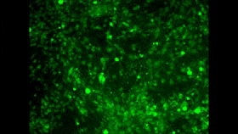
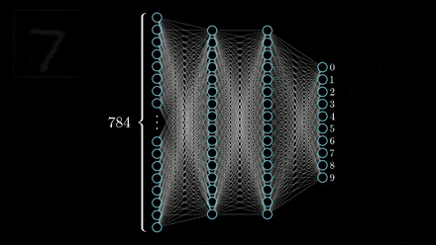
Spiking Neural Network
[S. Weisenburger et al 2019]
In vivo Ca²⁺ imaging of ∼12,000 neurons in mouse cortex at single-cell resolution

Slide 16
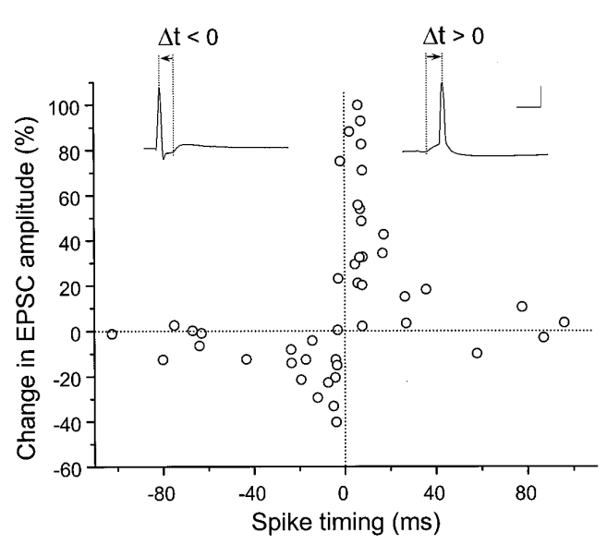
Synapse Model
Spike-Time-Dependent Plasticity (STDP) as a weights update rule
If there exists causality between the pre- and post-synaptic spikes, the synapse is strengthened (potentiated).
If there is no causality between the pre- and post-synaptic spikes, the synapse is weakened (depressed).
PRE
w
POST
Pros:
i) Local on-line learning (simple to implement)
ii) Temporal information (bio-inspired)
[Bi Poo 1998]
PRE
Cons:
Weak convergence compared to batch training
POST
Time
Time
Cultured hippocampal neurons
Synapses are dynamics. They undergo conformational changes depending on the input and output spike times.

Slide 17
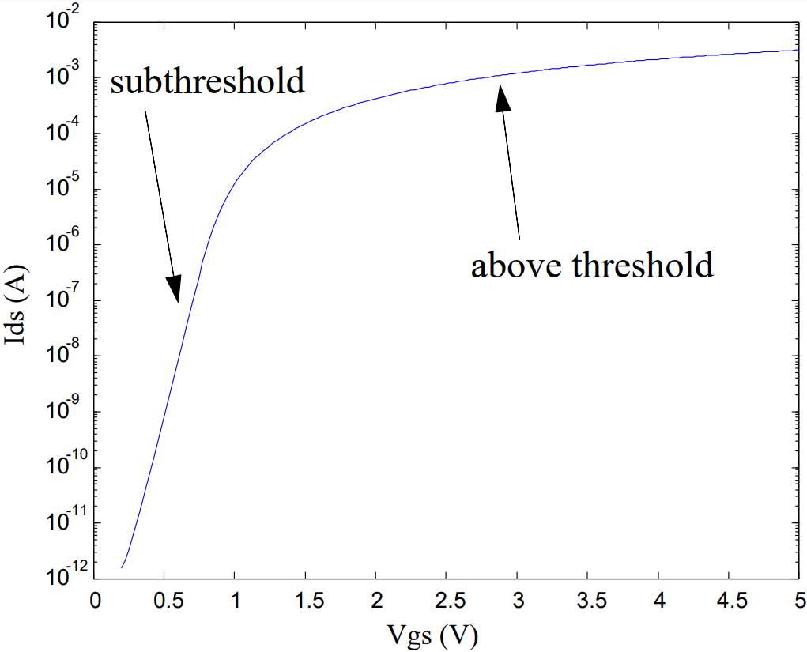
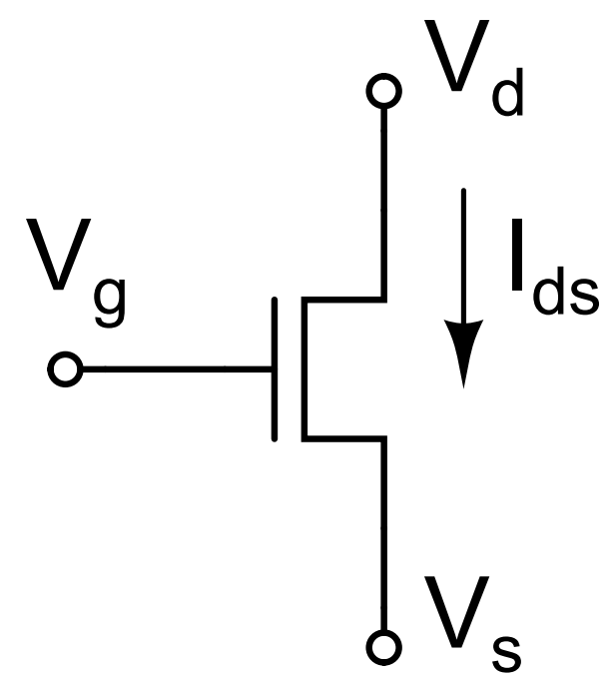
Leaky-Integrate-And-Fire Neuron: Subthreshold CMOS
Carver Mead late 80s coined the term neuromorphic engineering
Analog VLSI sub-threshold

Slide 18
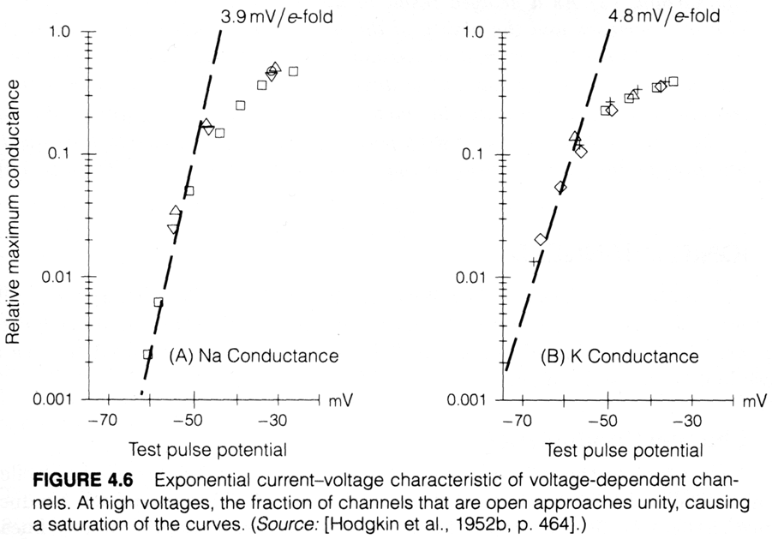
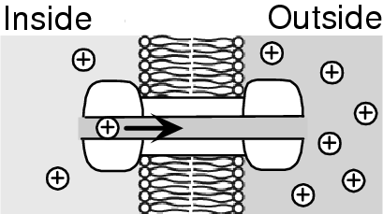
Leaky-Integrate-And-Fire Neuron: Subthreshold CMOS
1. Build neuromorphic circuits to reverse engineering the brain (understand)
2. Reverse engineer the brain to build efficient neural processing systems (apply)
Carver Mead late 80s coined the term neuromorphic engineering
Analog VLSI sub-threshold

Slide 19
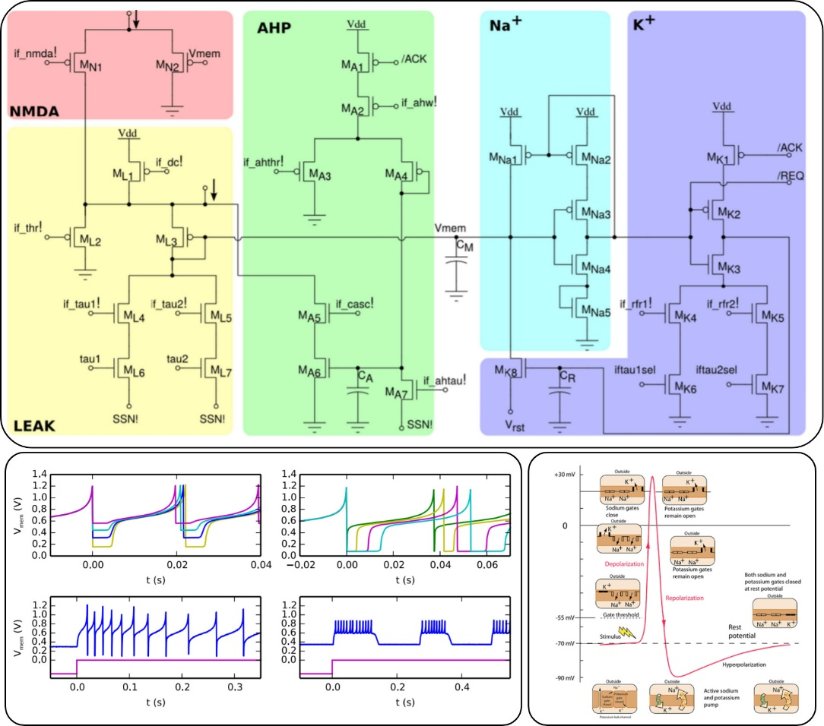
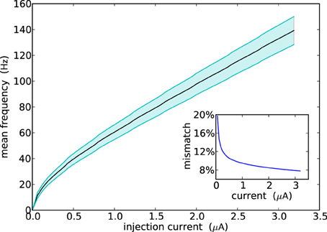
Neuromorphic Analog Systems
Subthreshold analog electronics
Current domain circuit
Few (~2pJ) per spike
Pros:
Bio-realistic: adaptive exponential integrate-and-fire-neuron model (non-linear)
Exhibit bio-realistic behaviors (e.g., adaptation, bursting)
Asynchronous (event-driven), no clock!
Cons:
Mismatch (transistor to transistor)
Noise
Parameter variations (neurons to neurons)
[Qiao N et al 2015]

Slide 20
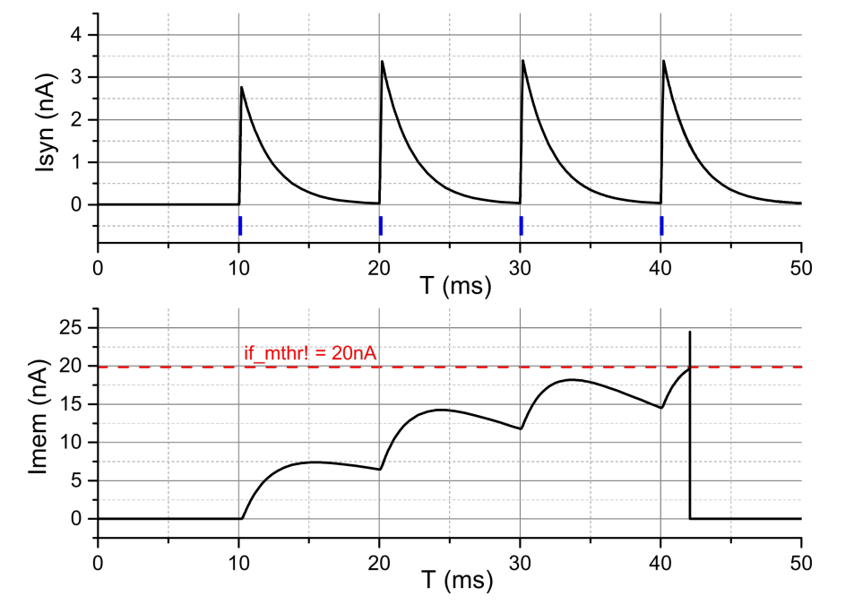
Neuromorphic Analog Architectures
Typical neuromorphic analog (mixed-signal) architecture
Neurosynaptic core
Neurosynaptic core
1
1
2
2
3
2 3 1 2
3
Encode
Address-event representation
Decode
Neuron
Synapse
Inputs Spikes
Outputs Spikes
Spike
Neurons and synapses are physically implemented and emulates the biochemical processes with current-based or voltage-based circuits.

Slide 21
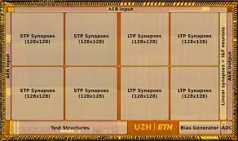
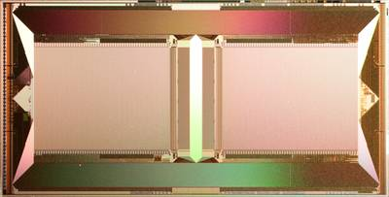
Neuromorphic Analog Systems
HICANN 2010
ROLLS 2015
DYNAPs 2017
High Input Count Analog Neural Network
50 mm^2
2x 512 membrane circuits and 128k synapses with plasticity (STDP), both digital (4-bit) and analog
Asynchronous interfaces
Chips can be tiled in a reticle (384 chips in a wafer - multichip)
Faster than real biological time (10^4)
Reconfigurable Online Learning System
51mm ^2
1 linear array of adaptive-exponential neurons (analog 180nm, fully asynchronous)
256 Neurons/C (physically implemented)
65 Synapses/N (4b) With plasticity
~0.5pJ per synaptic operation
Dynamic Asynchronous Processor
4 cores (analog 180nm, fully asynchronous)
256 Neurons/C (physically implemented)
65 Synapses/N (4b) With plasticity
Resources per neuron and 65K synapses:
$210μm×210μm$
0.13pJ per synaptic operation
[T. Pfiel et al. 2012]
[Qiao N et al. 2015]
[Moradi et al. 2017]

Slide 22
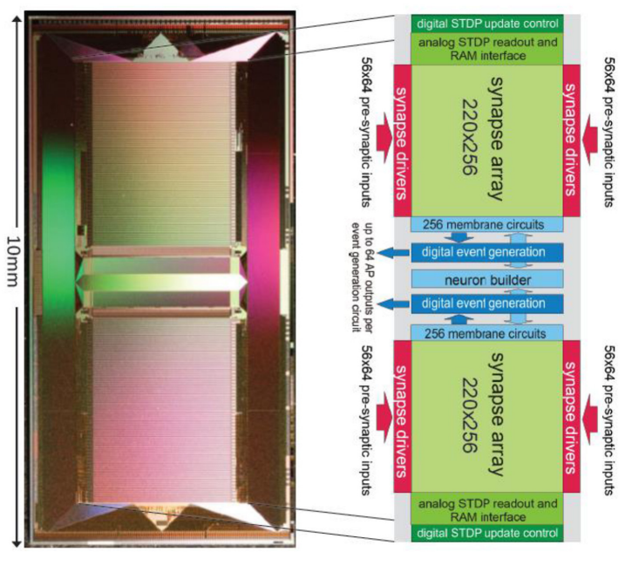
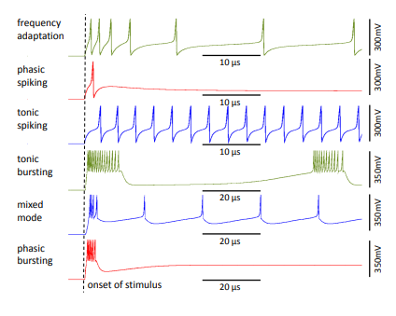
Neuromorphic Analog Systems
Bio-realistic neuron behaviors
100x faster than real time!
neuroscientific simulations
how to scale?
[Karlheinz Meier, Heidelberg University, HICANN 2010]

Slide 23
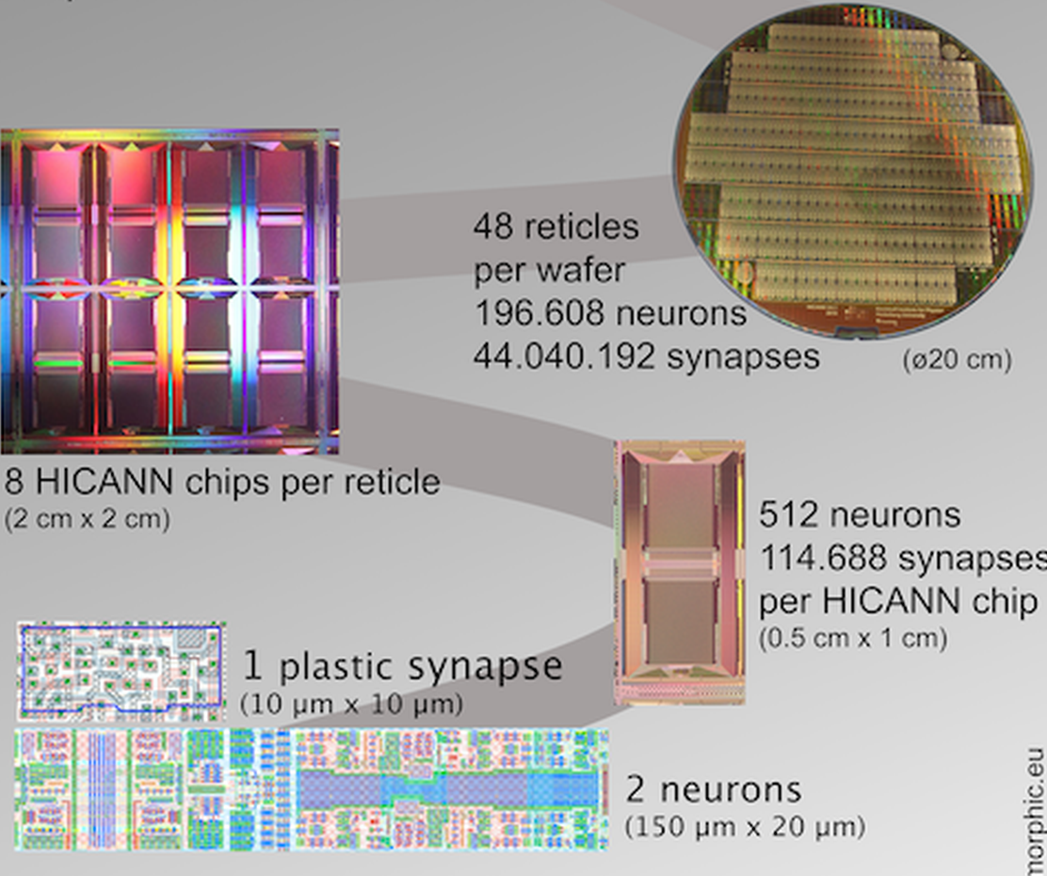
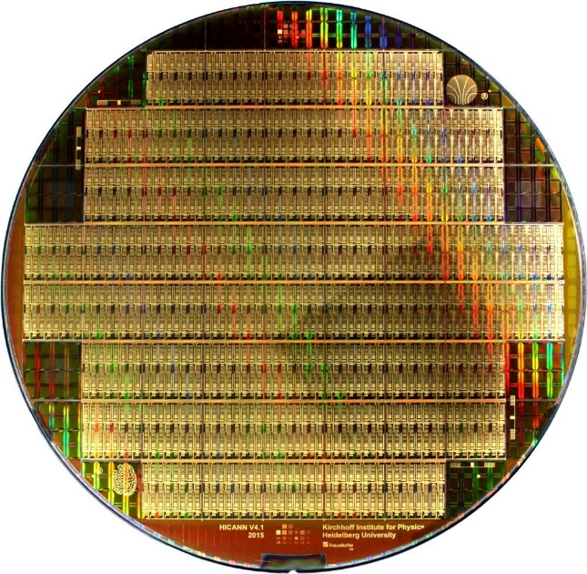
Neuromorphic Analog Systems
384 chip system in a whole wafer!
It aims at understanding and emulating the function and interaction of multiple spatial and temporal scales in brain information processing.
[Karlheinz Meier, Heidelberg University, HICANN 2010]

Slide 24
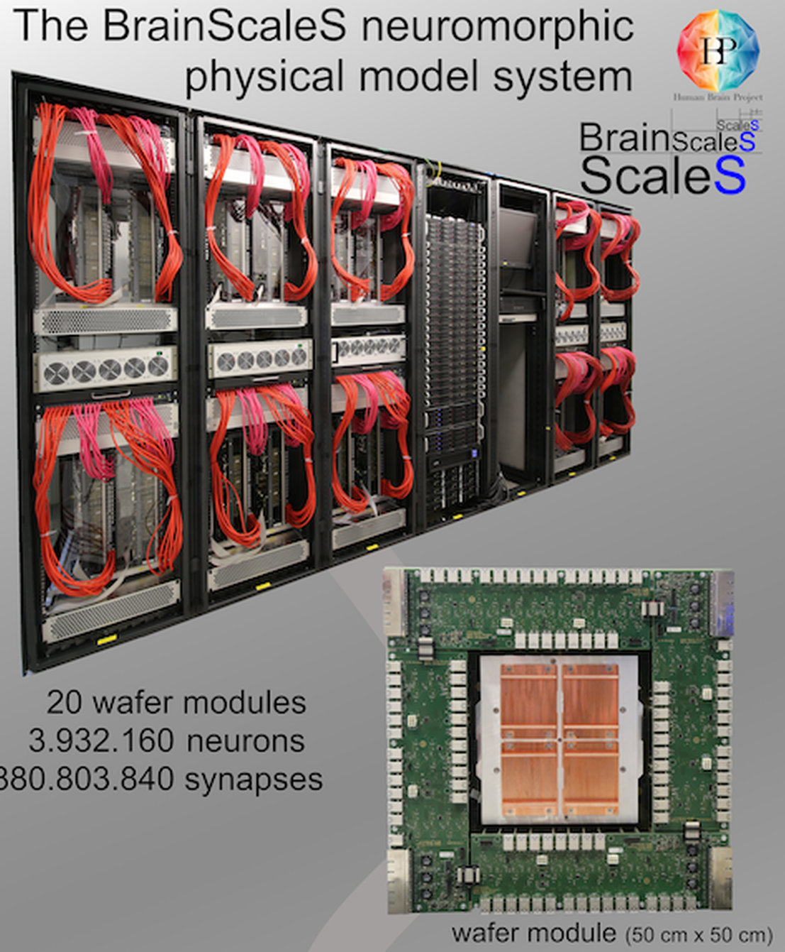
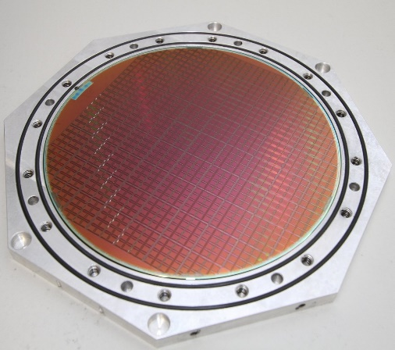
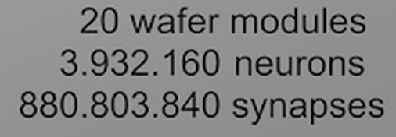
Neuromorphic Analog Systems
https://wiki.ebrains.eu/bin/view/Collabs/neuromorphic/BrainScaleS/
~4 Million bio-realistic neurons
880 Million learning synapses
105 faster than real time
164 Giga-events/s (normal)
1 Tera-event/s (burst)
several hundreds of kW [2010]

Slide 25
Neuromorphic Analog Systems
Summary
Pros:
Can replicate exponential behaviors and bio-realistic models (use the same physics)
Neuroscientific simulations
Real-time (or faster) speed
Cons:
Chip area, analog CMOS requires larger nodes
e.g., 180 nm, 65 nm, or special CMOS features Fully Depleted Silicon on Insulator FDSOI
Suffer from noise, mismatch (require calibration)
Complex algorithms (asynchronous), but it is part of the research!
Matching biological time constants requires larger capacitors (or tricks) to slow down the silicon
Applications:
Limited to few startups (SynSense, Innatera)
Small ASIC for specific functions (audio, surveillance, bio-medical monitoring), IoT

Slide 26
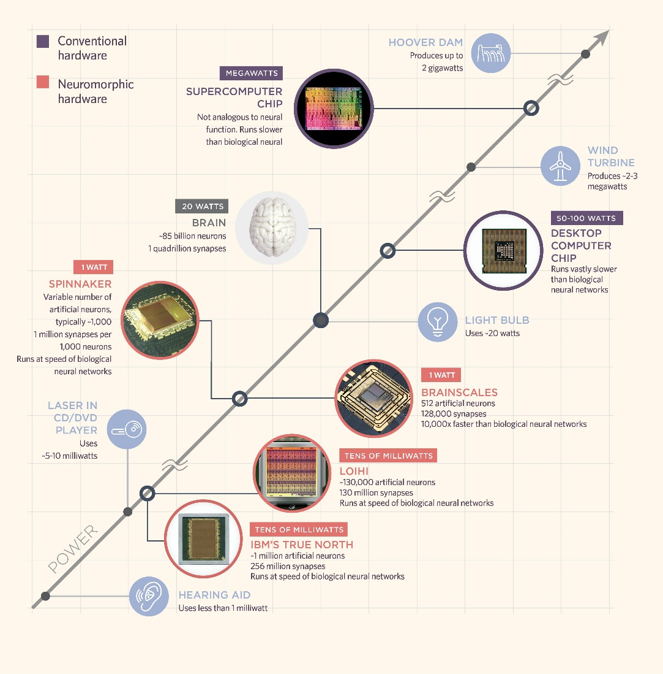
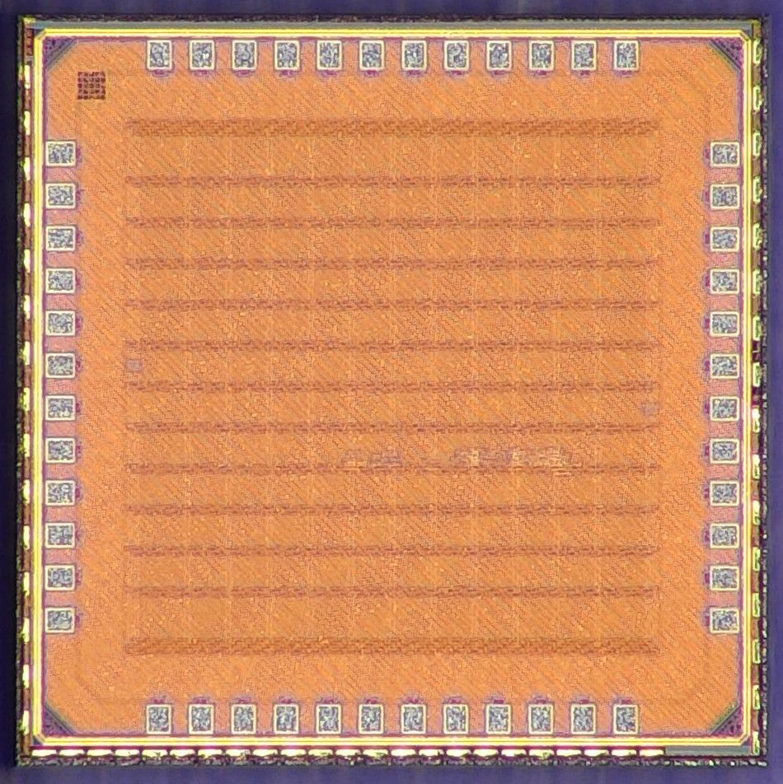
Neuromorphic computing
Today’s digital neuromorphic hardware
Parallel processing
Many Processing Units (neurons)
Distributed Memory
More tightly coupled data memory, caches
More memory close to the processing
Sparse Encoding
Exploit sparsity of natural world (on-demand)
Data-flow communication
Data move towards the place it is consumed
Direct communication between processors
[Adapted from The Scientist, 2019]
Efficient computer architectures for brain-inspired models of computations (spiking neural networks)

Slide 27
Neuromorphic computing
Typical large scale neuromorphic digital architecture
MEM
EP
Many, many cores (1000 and more)
Event-driven processing
Distributed memory architectures for near-memory computing
Scalable connectivity interfaces

Slide 28
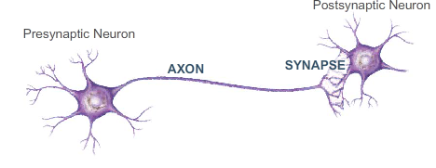
Neuromorphic computing
Event-driven processor
Synapse Memory
Event Driven Processor
Neuron State Memory
Axon Memory
Synapse Memory:
Synaptic parameters (weights)
State Memory:
Neurons’ state (membrane potential)
Axon Memory:
Destination core address (to store the network’s graph)
One processing core updates the state of many neurons, based on the input events (time-multiplexing)

Slide 29
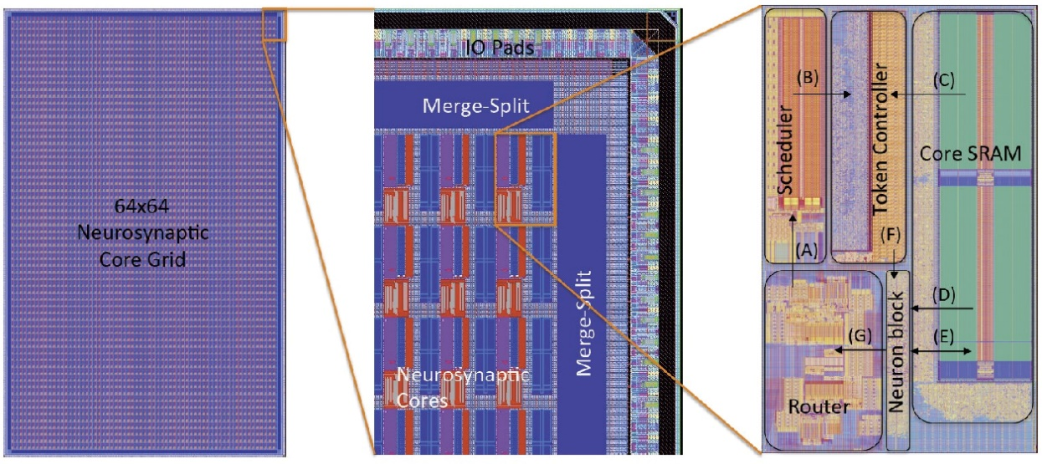
Neuromorphic computing
Digital neuromorphic hardware
TrueNorth 2014
Event processor execute on-demand a fixed number of neurons (SNN Processor)
28 nm
1M neurons
268 million synapses
~ 90 mW
4 square centimeters area

Slide 30
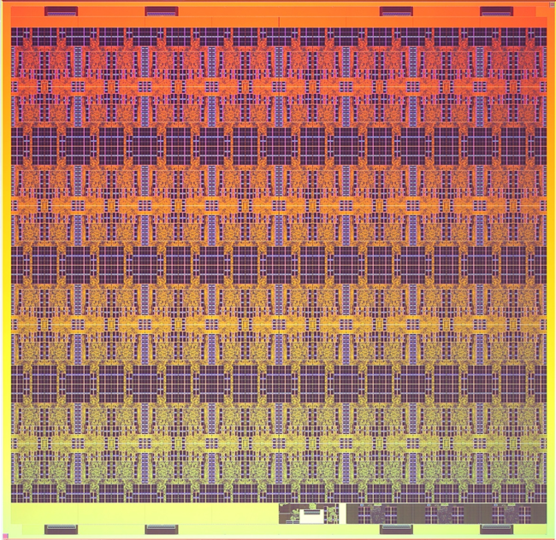
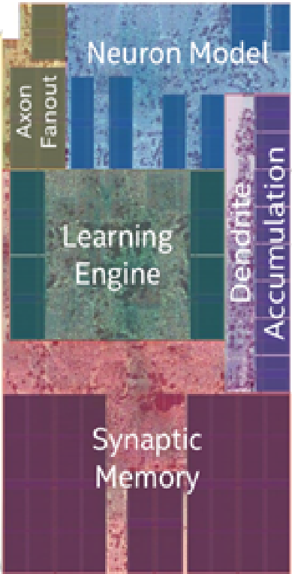
Neuromorphic computing
Digital neuromorphic hardware
Loihi 2018
More flexible than TrueNorth
On-chip learning
Spiking Neural Networks
14 nm FinFet
128 cores
1024 neurons/core -> 131K tot
1M synapses/core -> 128M tot
60 square millimeters area

Slide 31
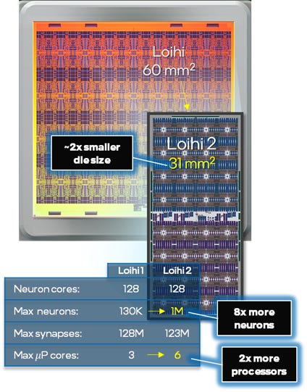
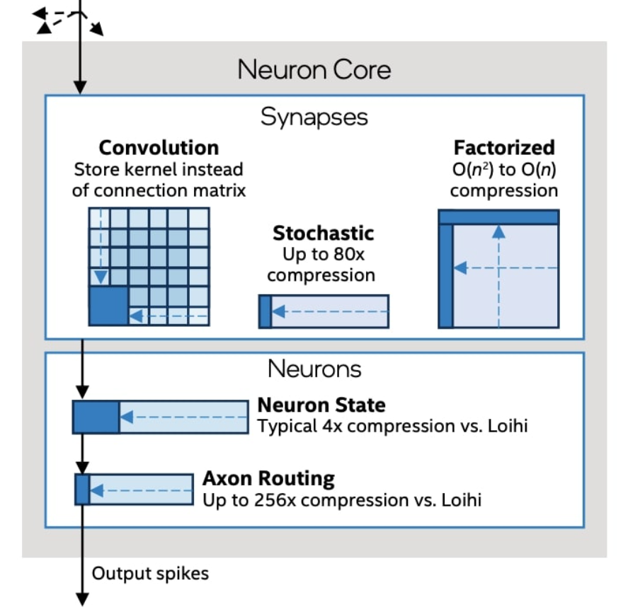
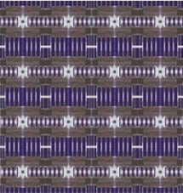
Neuromorphic computing
Digital neuromorphic hardware
Loihi2 2021
Flexible on-chip learning
Spiking Neural Networks
Graded spike values
4 nm
128 cores
8092 neurons/core -> 1 Million tot
1M synapses/core -> 120M tot
31 square millimeters area

Slide 32
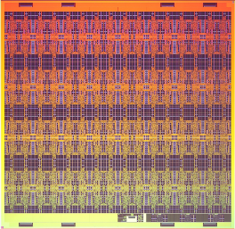
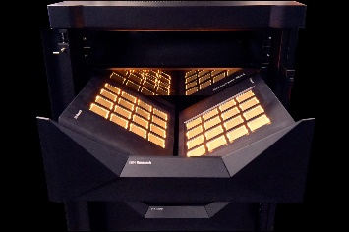
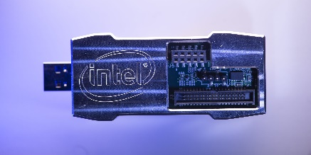
Neuromorphic computing
Digital neuromorphic hardware
And many more... GML (Orlando)
TrueNorth 2014
Loihi 2018
Loihi2 2021
Global Asynchronous Local Synchronous (GALS) – extremely scalable
Event-Driven Processing – power consumption depends on activity (spikes or events)
Near Memory Computing- memory hierarchy (reduce data movement)
Scalable connectivity interfaces – network on chip with routers

Slide 33
Digital Neuromorphic processors: TrueNorth
TrueNorth: Asychronous communication for scalability
DATA
SENDER
RECEIVER
Data transfer relies on req/ack cycles, no need for global uniform clock!
Neurosynaptic cores operate in parallel, and are governed by spike generation/transmission/delivery (event-driven data generation)
No need of a uniform clock distribution network (consume dynamic power even when not needed)
Asynchronous design relies on req/ack cycles (naturally data-driven)
[Akopyan et a et al. 2015]

Slide 34
Digital Neuromorphic processors: TrueNorth
TrueNorth: neurosynaptic core is a crossbar array of fully-connected neurons.
TrueNorth: Asynchronous communication for scalability
[Merolla P.A. et al. 2014]

Slide 35
Digital Neuromorphic processors: TrueNorth
TrueNorth: digital LIF Neuron
Dual stochastic and deterministic neuron based on an integrate-and-fire neuron model.
Time-division multiplexing to compute 256 logical neurons with one circuit.
The SRAM stores the synaptic connectivity, weight values, the leak, the threshold, the configuration parameters, and the membrane potential state

Slide 36
Digital Neuromorphic processors: TrueNorth
Bio-inspired SNN combines detector for changes (“where path”) with a low-resolution classification (“what path”)
Power consumption
Leak: 42mW (0.70 V, 0 Hz firing rate)
323mW (1.05 V, 200 Hz firing rate, 256 synapses/neuron)
[Merolla P.A. et al. 2014]
TRUENORTH: DEMO

Slide 37
Digital Neuromorphic processors: Intel Loihi
Loihi: digital LIF neuron
LIF differential equations are approximated using a discrete timestep whereby all neurons maintain a timestamp synchronized throughout the entire chip.
fine-graded synchronization
[Davies M. et al. 2018]

Slide 38
Digital Neuromorphic processors: Intel Loihi
Loihi: fine-graded synchronization
Fine grained mesh operation:
1- initial idle state for time-step t (each square represents a core in the mesh containing multiple neurons)
2- neurons n1 and n2 in cores A and B fire and generate spike messages (first in the time multiplexed order)
3- spikes from all other neurons firing on time-step t in cores A and B are distributed to their destination cores
4- each core advances its algorithmic time-step to t + 1 as it handshakes with its neighbors through barrier synchronization messages
[Davies M. et al. 2018]

Slide 39
Digital Neuromorphic processors: Intel Loihi
Loihi: On-line Learning
Local learning rule - essential for scalability
Plasticity on wide range of time scales for: - immediate supervised (labelled) learning, - unsupervised (self-organization), working memory
- reinforcement-based delayed feedback
[Davies et al. 2018]

Slide 40
Digital Neuromorphic processors: Intel Loihi
Loihi: DEMO keyword spotting (mean-rate ANN-to-SNN)
Train an ANN with ReLU activation function
Convert to SNN, each firing rate output of neurons encode the output of a ReLU
Need threshold balancing, scaling, and normalization
[Rueckauer and Liu 2018; Han, Srinivasan, and Roy 2020]

Slide 41
Digital Neuromorphic processors: Intel Loihi
Loihi: DEMO keyword spotting (mean-rate ANN-to-SNN)
Loihi provides 5-10x lower energy than closest conventional DNN architectures
Ceaveats: batchsize=1 and reduced accuracy! (90.6% SNN, vs 92.7% DNN)
[Blouw et al.2019]

Slide 42
Digital Neuromorphic processors: Intel Loihi
Loihi: DEMO Spike-Based LSNN (directly train SNN)
[Bellec et al. 2018]
Batchsize=1
Real-time
Low-latency

Slide 43
Neuromorphic Digital Systems
Summary
Pros:
Leverage advanced node technologies (1M neurons in 4nm, Intel Loihi2)
Low-latency
Low-power density
TrueNorth 60^mm2 / 90mW
Loihi 2 large dynamic range of power 100mW to Watts
Responsive edge AI (efficient for batch size = 1)
Compute-on demand (event-based)
Scalable (asynchronous interfaces for large scale networks)
Cons:
Limited programmability (e.g., neuron models)
On-chip memory
Cost (chip-size)
Applications:
Energy-efficient inference for the edge, example GML (Orlando lecture 10 – NeuroFlow)
Limited to Loihi neuromorphic research
Real-time, low-latency edge IoT

Slide 44
Neuromorphic Computing and Engineering
Neuromorphic Engineering emerged in the late 80s with two main goals
The scientific goal to understand the information processing and computational principles of biological neural systems by emulating them with microelectronic systems
There is the engineering goal of exploiting the known properties of biological systems to design and implement efficient devices for engineering application (edge AI)
Today NCE and engineering is a much broader field that includes:
Emerging memories and materials (nano-scale devices for replicating biophysical properties)
Bio-inspired algorithms that go beyond traditional deep learning alone
Novel sensory systems (event-based cameras – silicon retina, dynamic audio sensors - silicon cochlea, neuromorphic touch, neuromorphic smell)
Unconventional computer architectures (GML, Intel, IMEC, SynSense, Innatera, ..)
Novel bio-inspired robotic systems (TUD, UZH, IIT, ..)

Slide 45
References
Akopyan, Filipp et al. (2015). “Truenorth: Design and tool flow of a 65 mw 1 million neuron programmable neurosynaptic chip”. In: IEEE transactions on computer-aided design of integrated circuits and systems 34.10, pp. 1537–1557. Amorim Da Costa, Nuno Miguel M and Kevan Martin (2010). “Whose cortical column would that be?” In: Frontiers in neuroanatomy 4, p. 16. Bellec, Guillaume et al. (2018). “Long short-term memory and learning-to-learn in networks of spiking neurons”. In: Advances in neural information processing systems 31. Bianco, Simone et al. (2018). “Benchmark analysis of representative deep neural network architectures”. In: IEEE Access 6, pp. 64270–64277. Blouw, Peter et al. (2019). “Benchmarking keyword spotting efficiency on neuromorphic hardware”. In: Proceedings of the 7th Annual Neuro-inspired Computational Elements Workshop, pp. 1–8. Brown, Tom et al. (2020). “Language models are few-shot learners”. In: Advances in neural information processing systems 33, pp. 1877–1901. Davies, Mike et al. (2018). “Loihi: A neuromorphic manycore processor with on-chip learning”. In: Ieee Micro 38.1, pp. 82–99. Dutta, Sangya et al. (2017). “Leaky integrate and fire neuron by charge-discharge dynamics in floating-body MOSFET”. In: Scientific reports 7.1, pp. 1–7. Grillner, Sten et al. (2005). “Microcircuits in action–from CPGs to neocortex”. In: Trends in neurosciences 28.10, pp. 525–533. Han, Bing, Gopalakrishnan Srinivasan, and Kaushik Roy (2020). “Rmp-snn: Residual membrane potential neuron for enabling deeper high-accuracy and low-latency spiking neural network”. In: Proceedings of the IEEE/CVF Conference on Computer Vision and Pattern Recognition, pp. 13558–13567. Markram, H. et al. (2004). “Interneurons of the neocortical inhibitory system”. In: Nature reviews neuroscience 5.10, pp. 793–807. Mehonic, Adnan and Anthony J Kenyon (2021). “Brain-inspired computing: We need a master plan”. In: arXiv preprint arXiv:2104.14517. Merolla, Paul A et al. (2014). “A million spiking-neuron integrated circuit with a scalable communication network and interface”. In: Science 345.6197, pp. 668–673. Rueckauer, Bodo and Shih-Chii Liu (2018). “Conversion of analog to spiking neural networks using sparse temporal coding”. In: 2018 IEEE International Symposium on Circuits and Systems (ISCAS). IEEE, pp. 1–5. Schuman, Catherine D et al. (2022). “Opportunities for neuromorphic computing algorithms and applications”. In: Nature Computational Science 2.1, pp. 10–19

