Slide 1
Spiking Neural Networks and Neuromorphic Computing
Training spiking neural networks
Sherif Eissa
Electrical Engineering – Electronic Systems group

Slide 2
Acknowledgment
Slides adopted from snnTorch tutorial and paper
  Tutorial: https://www.youtube.com/watch?v=O2-mT291ygg
  Documentation: https://snntorch.readthedocs.io/en/latest/
  Paper: https://arxiv.org/abs/2109.12894
  Contact: jason.eshraghian@uwa.edu.au

Slide 3
Training Spiking Neural Networks
Going Spiking
Leaky-Integrate-and-fire neuron model​
Spike coding​
Objective function​
Training Spiking Neural Networks​
Future trends and outlook​
Applications

Slide 4
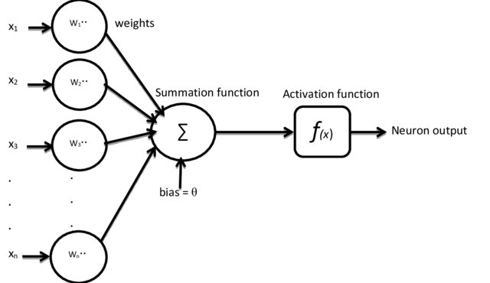
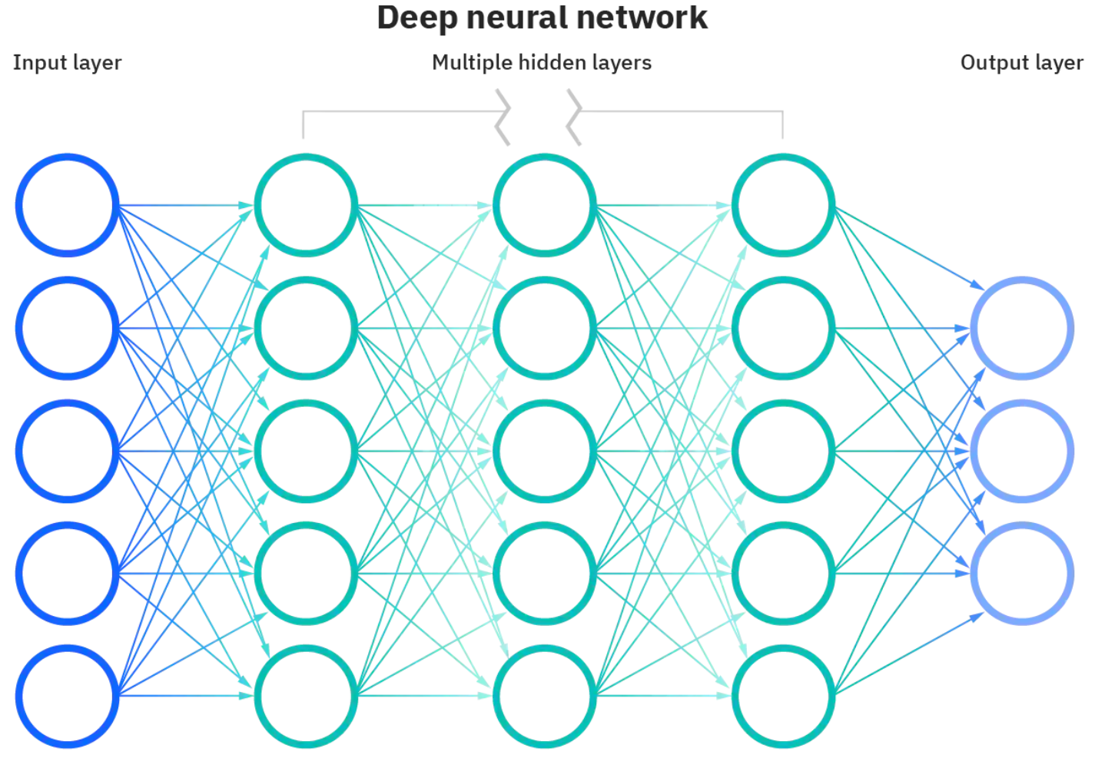
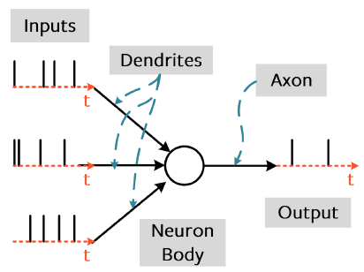
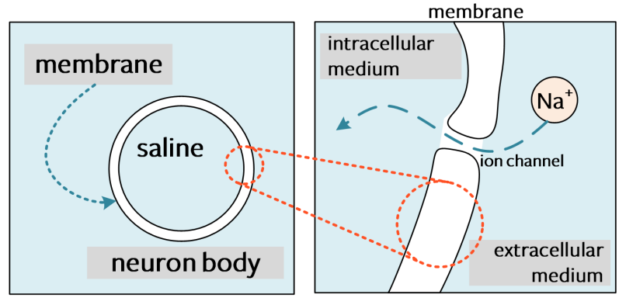
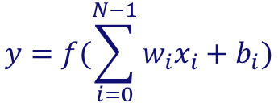
Going Spiking
$$y=f(\sum_{i=0}^{N−1}{w_{i}x_{i}+b_{i})}$$

Slide 5
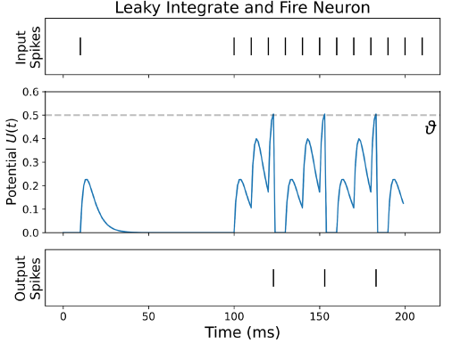
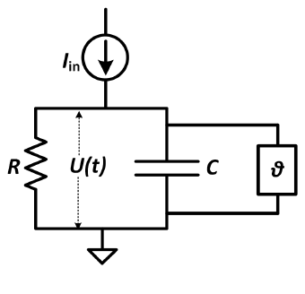
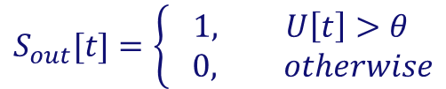

Leaky Integrate-and-Fire (LIF) Neuron Model
Many neuron models in literature
Integrate-and-Fire model offer a trade-off between hardware friendliness and modeling of the neuron’s firing behaviors
$$τ\frac{dU(t)}{dt}=−U\left(t\right)+I_{in}\left(t\right)R, τ=RC$$
leaky
integrate
$$U\left[t\right]= βU\left[t−1\right]+\left(1−β\right)I_{in}\left[t\right], β=e^{\frac{−1}{τ}}$$
$$S_{out}[t]=\left\{\begin{aligned}1, U\left[t\right]>θ \\ & 0, otherwise\end{aligned}\right.$$
$$U\left[t\right]= βU\left[t−1\right]+WX\left[t\right]−S_{out}[t−1]θ$$
leaky
integrate
and fire
Other famous I&F models: non-leaky IF, Adaptive LIF (ALIF)
reset by subtract

Slide 6
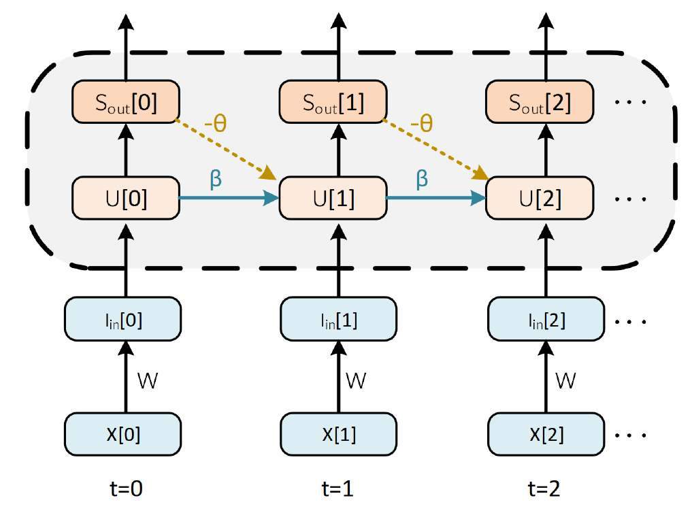
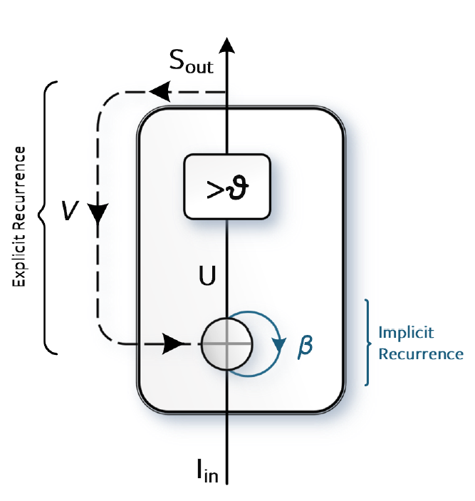
Recurrent Neuron Model
$$U\left[t\right]= βU\left[t−1\right]+WX\left[t\right]−S_{out}[t−1]θ$$

Slide 7
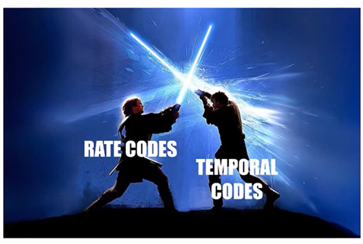
Spike Encoding
Spikes are binary signals fired at specific times.
Information can hardly be encoded in the shape or value of a spike.
Information is encoded in the number of spikes and/or their timing.
From here, a war has started between two factions of spike coding; rate-coding and
latency-coding
Rate Coding: encodes a value in number of spikes.
Latency Coding: encodes a value in relative spike timing.

Slide 8
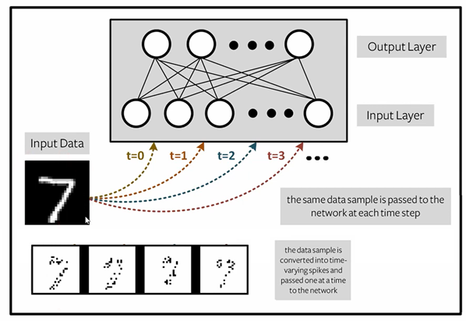
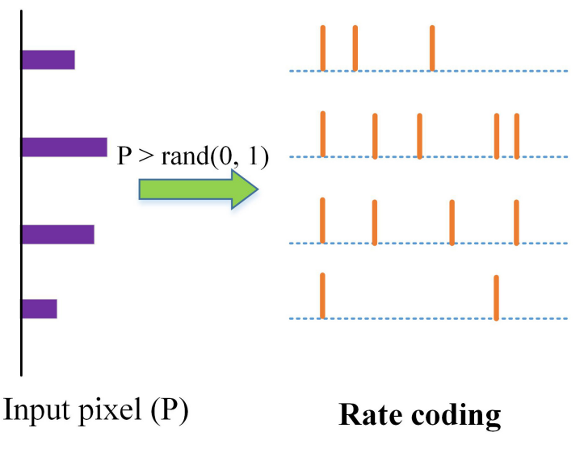
Rate Encoding
  Value ∝ number of spikes
  Same input is represented for multiple timesteps and/or by multiple neurons
  Usually, value is encoded in firing probability to randomize firing pattern
[Guo et al. 2021]
Rate-coded output decoding: correct class fires the most or accumulates the highest membrane potential

Slide 9
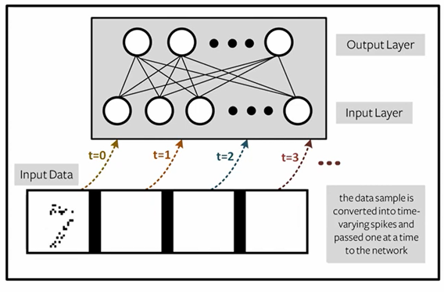
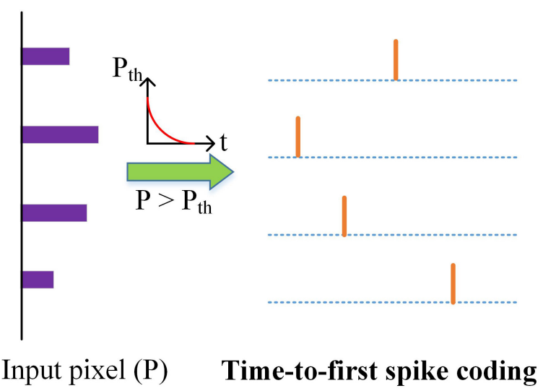
Latency Encoding
  Value ∝ spike timing
  Neurons usually spike at most once and network is reset per classification
  Time-to-first-spike:
  earlier spike = larger value
[Guo et al. 2021]
Latency-coded output decoding: correct class fires the earliest

Slide 10
Spike Encoding: Comparison
Advantage of Rate Codes
Advantage of Latency Codes
  Error tolerance: ideally, there is an abundance of spikes to recover a spike error.
  Faster learning: more spikes provide a stronger gradient signal via error backpropagation (learning happens around a spike’s timing)
  Power: less spikes is usually less energy
  Speed: (most of) relevant information is in the early spikes

Slide 11
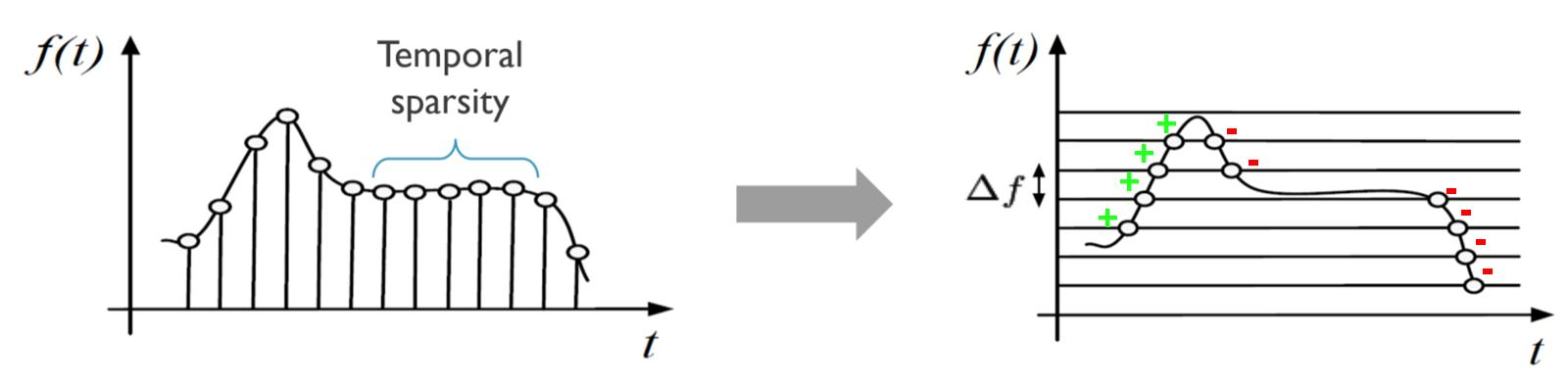
Input Delta Encoding
  Sensory data (analogue Real-Time input) are at the heart of any neuromorphic app.
  Why? Because Neuromorphic computing is an AI edge solution
  Hence, input will be usually a time-varying signal
  Delta encoding: Neurons fire in response to positive and negative changes in the input signal
[Yousefzadeh and Sifalakis 2021]

Slide 12
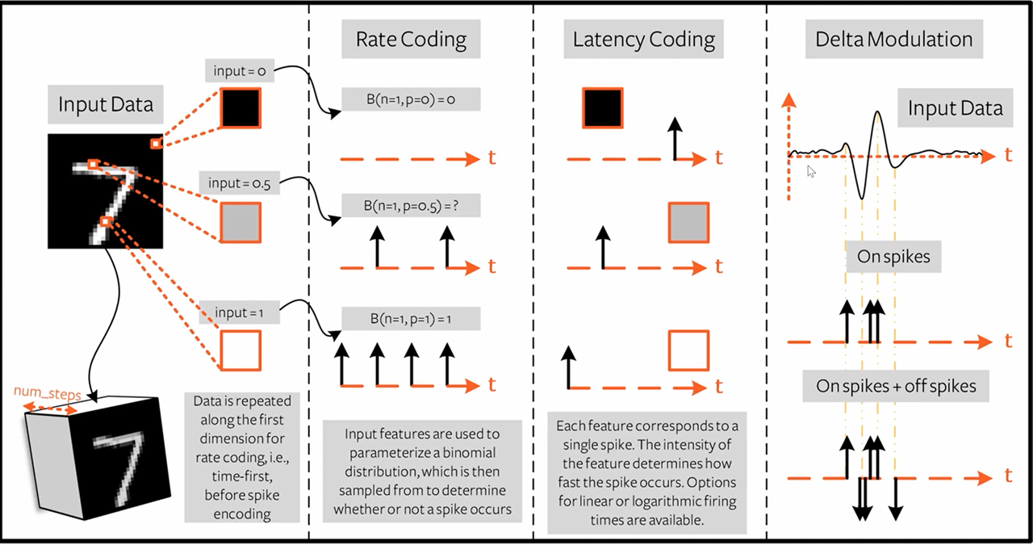
Spike Encoding Summary

Slide 13
Rate-based objective/error function
For learning and optimization, we need to evaluate an error function
Rate-based error can be based on spike rates or on membrane potentials of output neurons
Penalizing number of spikes (e.g L1 norm) is good for efficiency
Below are non-exhaustive means to formulate rate-based error function
 | Spike Count | Membrane Potential
Cross-Entropy Loss | Maximize firing of correct class and penalize firing of others [Amir et al. 2017] | Maximize membrane potential of correct class and minimize others [Yin, Corradi and Bohte 2021]
Mean Square Error | Set a target firing rate for each neuron [Shrestha and Orchard 2018] | Set a target membrane potential for each neuron Less common approach

Slide 14
Latency-based objective/error function
For learning and optimization, we need to evaluate an error function
Latency-based error is based on spike timing of output neurons
Below are non-exhaustive means to formulate rate-based error function
 | Spike Timing
Cross-Entropy Loss | Encourage correct class neuron to fire as early as possible and discourage others from firing (early) [Zhang et al. 2020]
Mean Square Error | Set a target firing time for each neuron [Shrestha and Orchard 2018]

Slide 15
Training Spiking Neural Networks
  ANN-to-SNN Conversion: An ANN is converted to an SNN.
  Local learning: Synaptic changes are functions of spatially and temporally
  local signals
  Native SNN Training: An SNN is trained from scratch. Most popular method is error backpropagation through time (BPTT) as in sequential/recurrent models

Slide 16
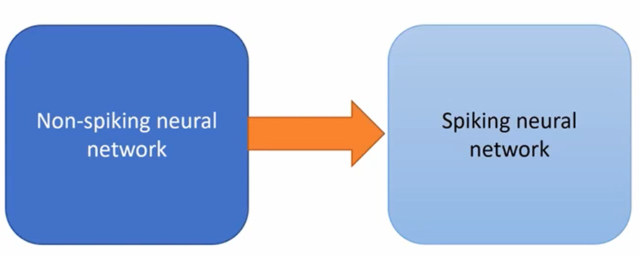
ANN-to-SNN Conversion
  Pros:
    State-of-the-art accuracy
    Can train very deep SNNs
  Cons:
    Approximation of an ANN
    Conversion of temporal ANNs is under-explored
  [Rueckauer et al. 2017] made the first mathematical conversion of ANNs to SNNs by mapping ReLU to I&F
  Recent “hybrid training” methods apply retraining after conversion to produce highly accurate and more efficient SNNs [Rathi et al. 2020]

Slide 17
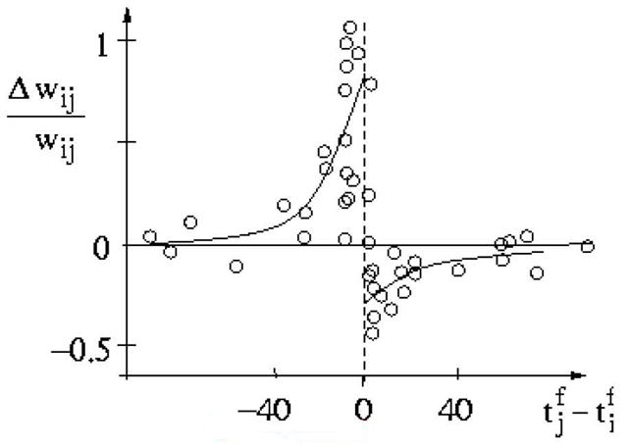
Local learning
In 1949, Donald Hebb derived a relationship between a synapse’s plasticity and its pre- and post-synaptic spikes.
Simply ”neurons that fire together wire together”.
Famously known as Spike Time-Dependent Plasticity (STDP) rule and Hebbian learning.
[Gerstner et al. 2010]

Slide 18


Local learning
  If there’s causality between pre- and post-synaptic spikes, synapse is strengthened (potentiated).
  If there’s no causality between the pre- and post-synaptic spikes, synapse is weakened (depressed).
Pre-synaptic spikes ($t_{j}^{f})$
Pros:
  Locality. Enables online learning.
  Bio-plausible
Cons:
  Unsupervised learning
  Slow conversions compared to batching
Post-synaptic spikes ($t_{i}^{f})$

Slide 19
Native SNN Training
Spike Backpropagation
Surrogate Gradient
Backpropagation Through Time (BPTT)
Spiking Recurrent Neural Networks [Yin, Corradi and Bohte, 2021]

Slide 20
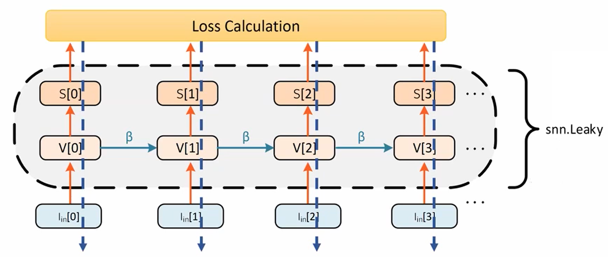
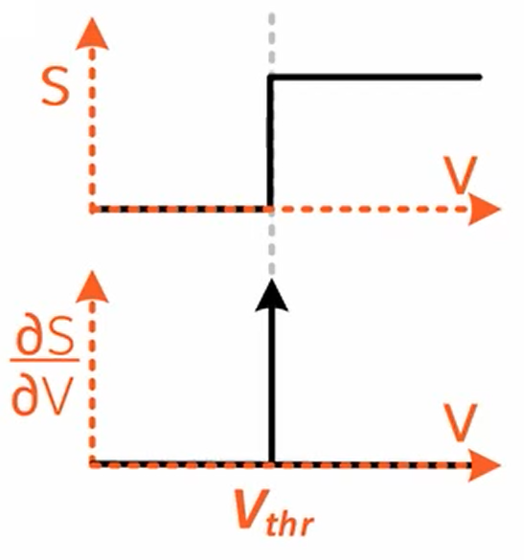

Native SNN Training: Spike Backpropagation
$$\frac{dL}{dW}=f(\frac{dL}{dS\left[3\right]}\text{⋅}\frac{dS\left[3\right]}{dV\left[3\right]}\text{⋅}\frac{dV\left[3\right]}{dI\left[3\right]}\text{⋅}\frac{dI\left[3\right]}{dW})$$
obj fnc
1
Input spike

Slide 21
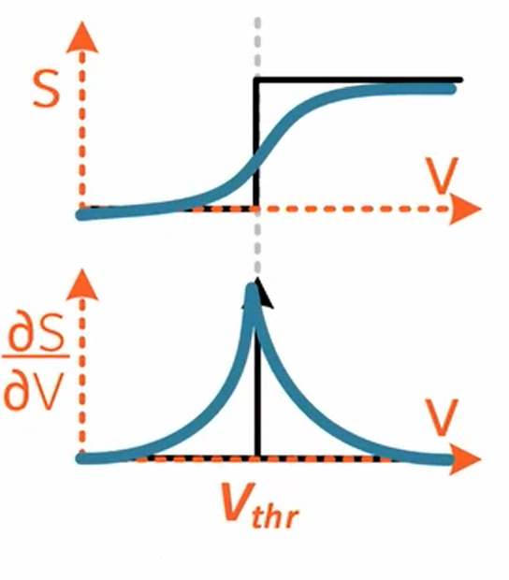
Native SNN Training: Surrogate Gradient
  A neuron’s output (spike) is non-differentiable w.r.t its membrane potential
  Solution: approximate the gradient
  Numerous different ways to approximate gradient

Slide 22
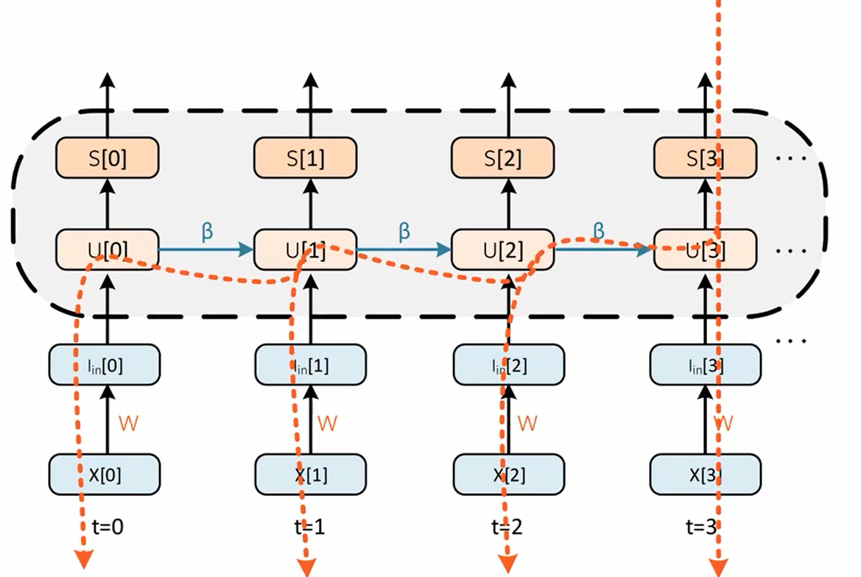
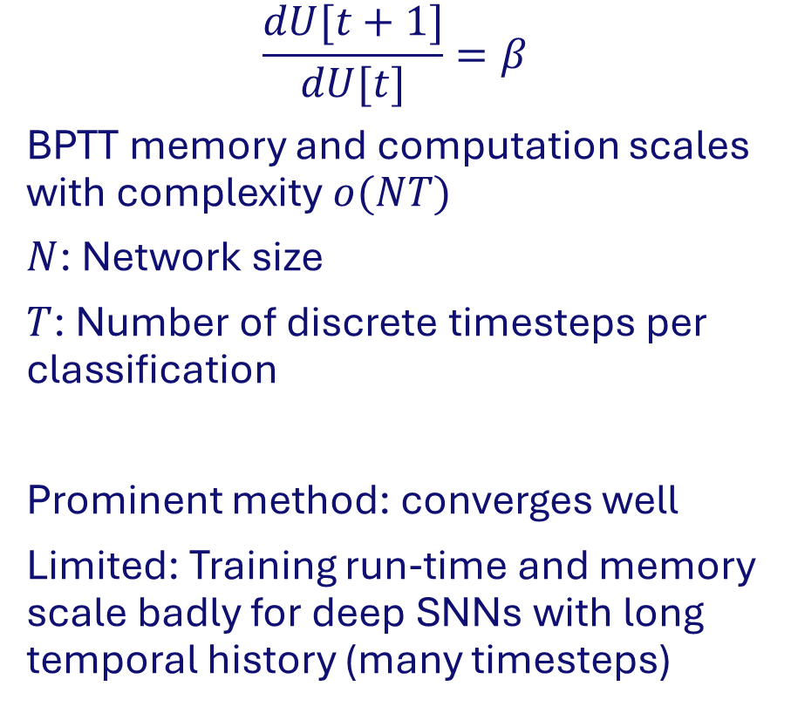
Native SNN Training: Backpropagation Through Time
$$\frac{dU[t+1]}{dU[t]}=β$$
BPTT memory and computation scales with complexity $o(NT)$
$N$: Network size
$T$: Number of discrete timesteps per classification
Prominent method: converges well
Limited: Training run-time and memory scale badly for deep SNNs with long temporal history (many timesteps)

Slide 23
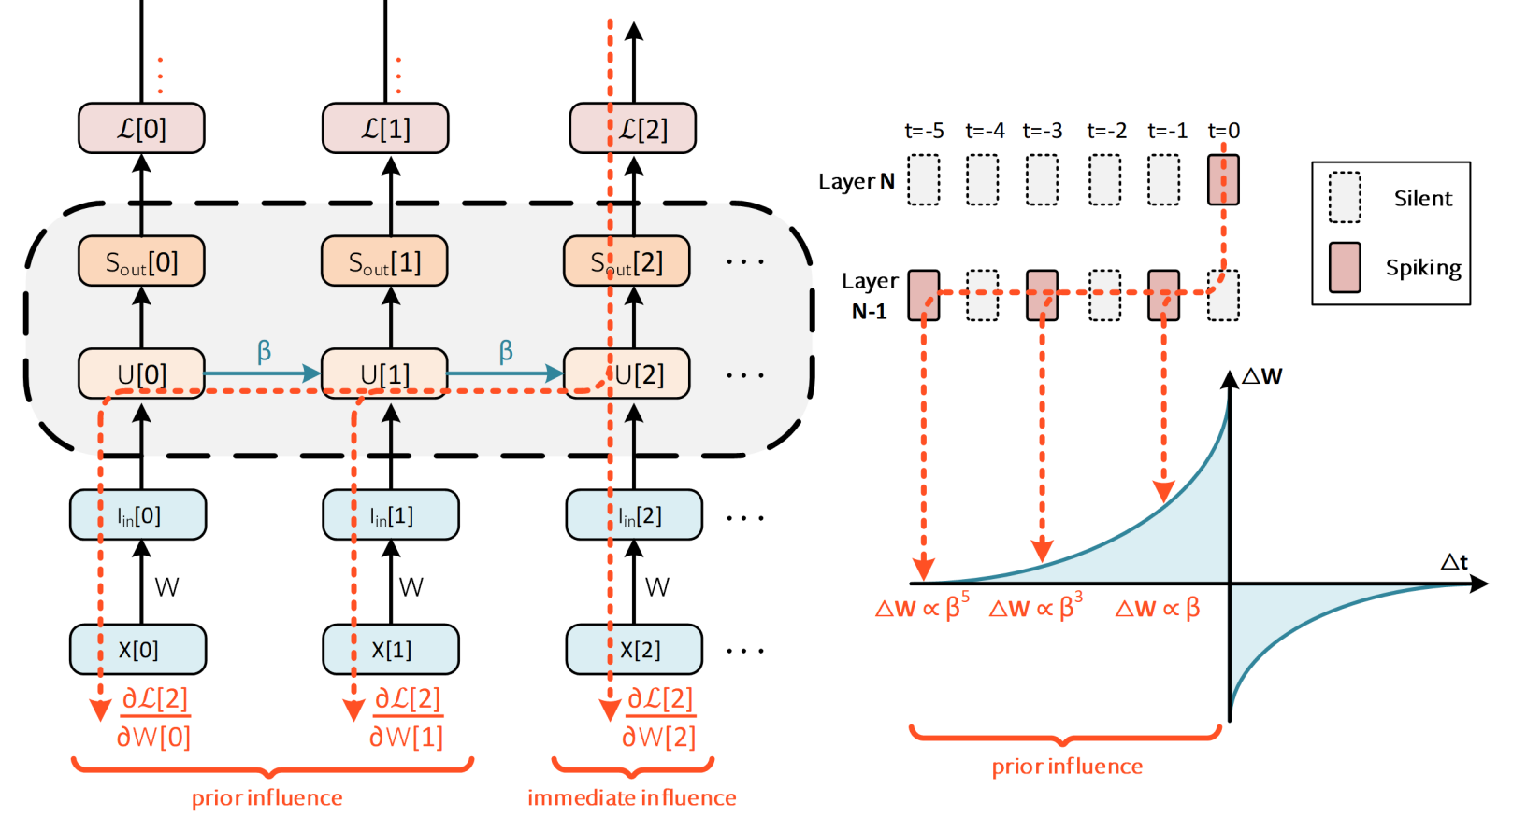
Native SNN Training: Backpropagation Through Time

Slide 24
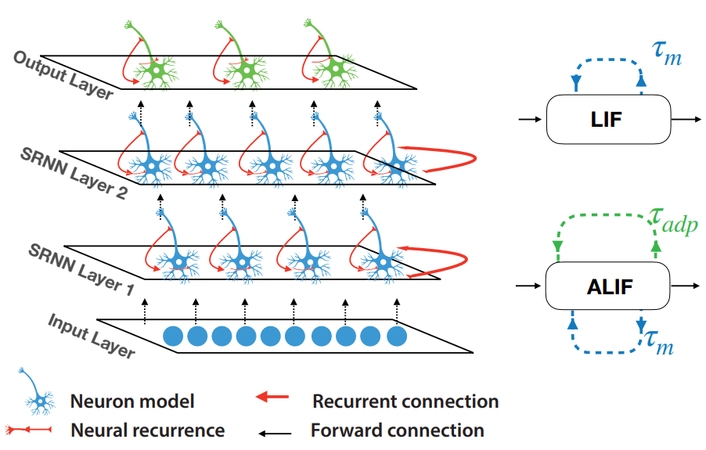
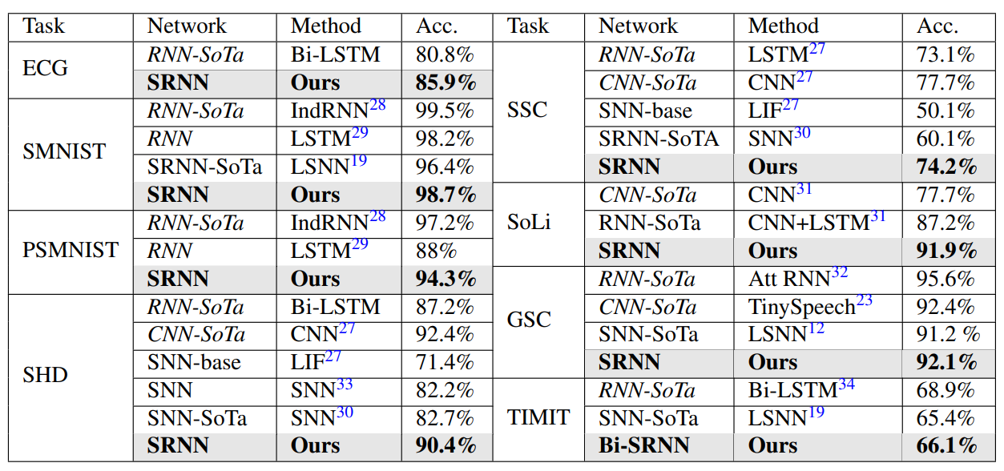
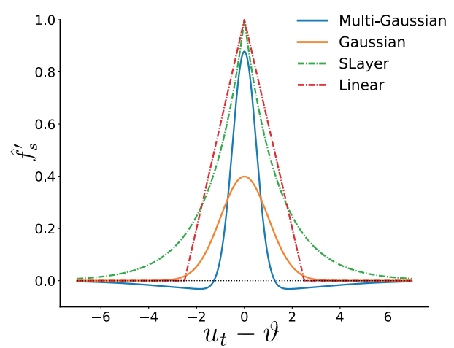
Spiking Recurrent Neural Networks
SRNN [Yin, Corradi, Bohte 2021]
  Recurrent fully-connected layers
  LIF and ALIF neurons
  Rate-encoded with output membrane potential
  Trainable time-constants
  Multi-gaussian surrogate gradient

Slide 25
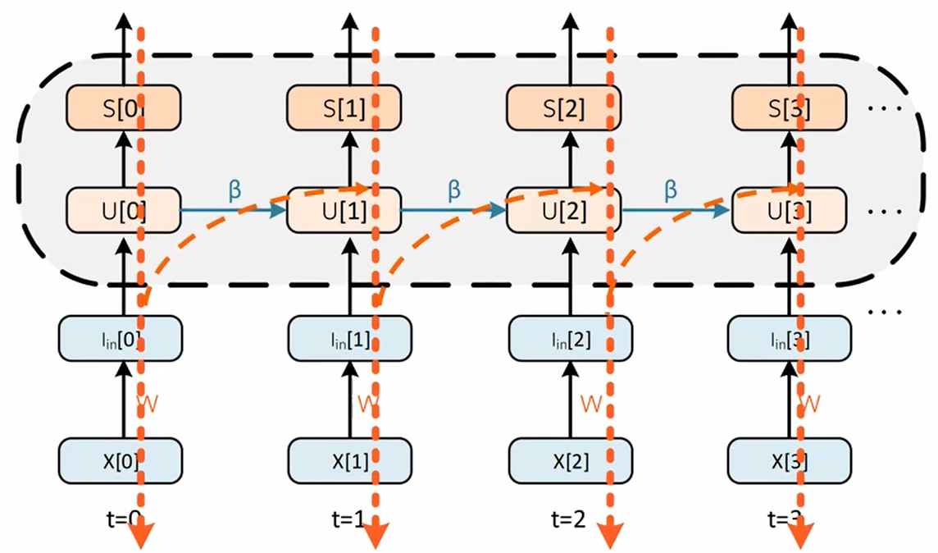
Future Trends and outlook
Forward Propagation Through Time (FPTT)
  FPTT solves scalability issue
  with time in BPTT
  FPTT enables (spatially) deep
  and (temporally) long SNN simulations
  [Yin, Corradi and Bohte, 2021]

Slide 26
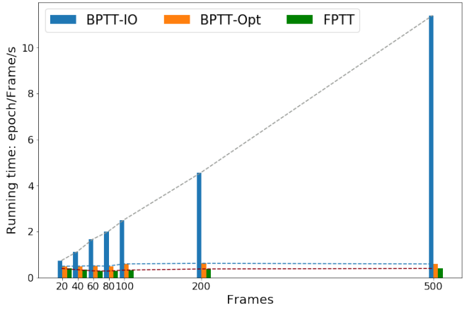
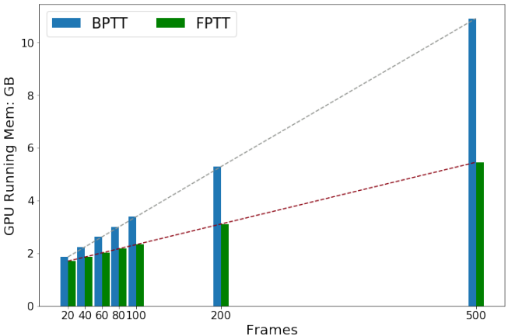
Future Trends and outlook
Forward Propagation Through Time (FPTT)

Slide 27
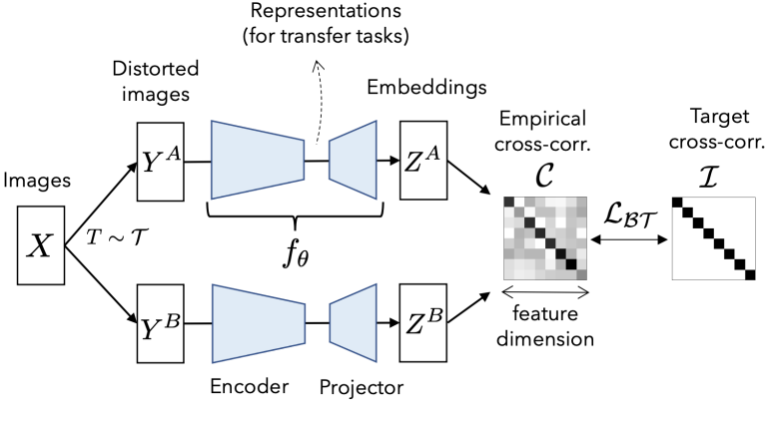
Future Trends and outlook
Self Supervised Learning (SSL)
  SSL is a new learning paradigm which aligns better with real intelligence
  No direct supervision
  Learns to predict missing parts or future parts of an input
  Applying SSL to SNNs and neuromoprhic hardware is an interesting and under-explored topic.
[Zbontar et al. 2021]

Slide 28
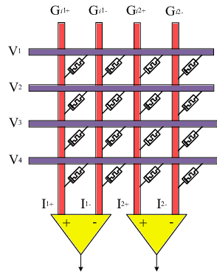
Future Trends and outlook
Emerging Memory Technology
Recent demand in AI has reignited interests in analogue computation
In-memory computing opportunities in deep learning:
  High memory density
  Low latency/fully parallel operation
  Low power
This comes at the cost of:
  Fixed/constrained connectivity
  Fixed operation (usually Matrix-Vector Multiplication)
[Hassan et al. 2018]

Slide 29
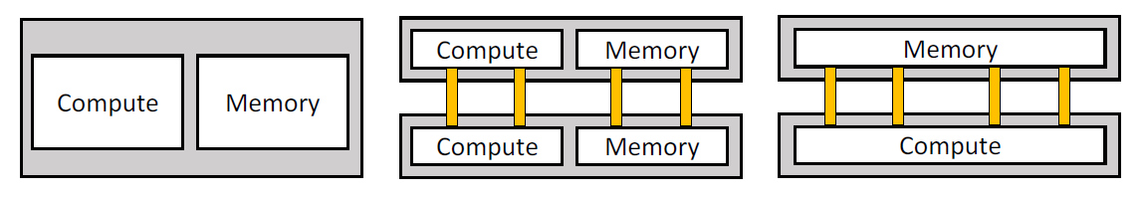
Future Trends and outlook
3D Integration Technology
So far, we have commercialized 2D system layouts.
3D integration stacks wafers vertically.
Combining 3D integration with emerging memory technologies could achieve high data transfer rate and throughput.
Our brain is a 3D architecture, so why not build 3D computers?
[Bouvier et al. 2019]

Slide 30

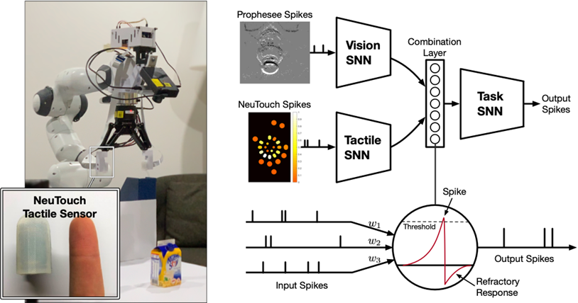
Applications
Real-time Sensor Processing
Tactile Sensing
Dynamic Vision
TEE Research Group
prophesee.ai

Slide 31

Applications
Autonomous Drones and Robotics
Micro Air Vehicle Lab - TUDelft

Slide 32
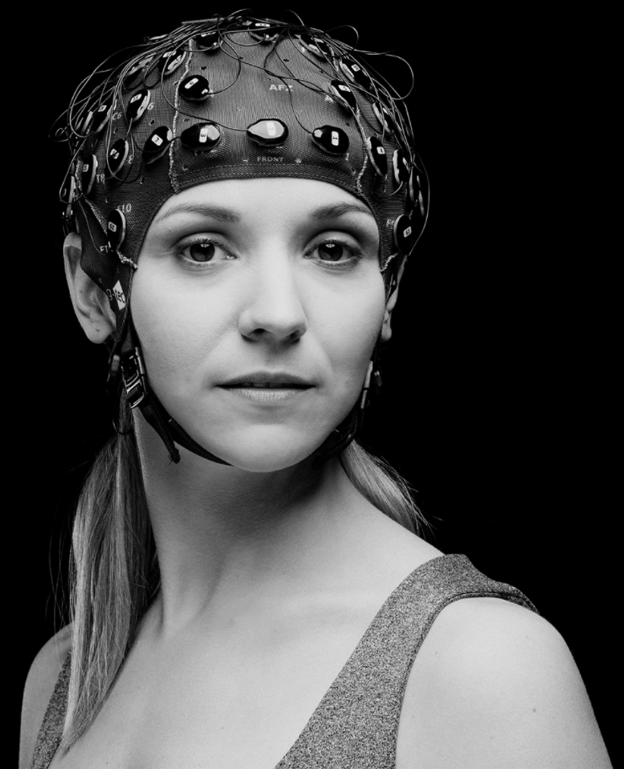
Applications
Brain-Computer Interface (BCI)
g.tec

Slide 33
References
Amir, Arnon et al. (2017). “A Low Power, Fully Event-Based Gesture Recognition System”. In: 2017 IEEE Conference on Computer Vision and Pattern Recognition (CVPR), pp. 7388–7397. doi: 10.1109/CVPR.2017.781.
Bouvier, Maxence et al. (June 2019). “Spiking Neural Networks Hardware Implementations and Challenges”. In: ACM Journal on Emerging Technologies in Computing Systems 15.2, pp. 1–35. issn: 1550-4840. doi: 10.1145/3304103. url: http://dx.doi.org/10.1145/3304103.
Eshraghian, Jason Kamran et al. (2021). “Training Spiking Neural Networks Using Lessons From Deep Learning”. In: CoRR abs/2109.12894. url: https://arxiv.org/abs/2109.12894.
Gerstner, Wulfram et al. (2010). “Spike-timing dependent plasticity”. In: Spike-timing dependent plasticity 35.0, pp. 0–0.
Guo, Wenzhe et al. (2021). “Neural Coding in Spiking Neural Networks: A Comparative Study for Robust Neuromorphic Systems”. In: Frontiers in Neuroscience 15. ISSN: 1662-453X. doi: 10.3389/fnins.2021.638474. url: https://www.frontiersin.org/article/10.3389/fnins.2021.638474.
Hassan, Amr M. et al. (2018). “Real-Time Cardiac Arrhythmia Classification Using Memristor Neuromorphic Computing System”. In: 2018 40th Annual International Conference of the IEEE Engineering in Medicine and Biology Society (EMBC), pp. 2567–2570. doi: 10.1109/EMBC.2018.8512868.
Rathi, Nitin et al. (2020). “Enabling Deep Spiking Neural Networks with Hybrid Conversion and Spike Timing Dependent Backpropagation”. In: CoRR abs/2005.01807. arXiv: 2005.01807. url: https://arxiv.org/abs/2005.01807.
Rueckauer, Bodo et al. (2017). “Conversion of Continuous-Valued Deep Networks to Efficient Event-Driven Networks for Image Classification”. In: Frontiers in Neuroscience 11. ISSN: 1662-453X. doi: 10.3389/fnins.2017.00682. url: https://www.frontiersin.org/article/10.3389/fnins.2017.00682.
Shrestha, Sumit Bam and Garrick Orchard (2018). “SLAYER: Spike Layer Error Reassignment in Time”. In: CoRR abs/1810.08646. url: http://arxiv.org/abs/1810.08646.
Yin, Bojian, Federico Corradi, and Sander M. Bohte (2021). “Accurate online training of dynamical spiking neural networks through Forward Propagation Through Time”. In: CoRR abs/2112.11231. arXiv: 2112.11231. url: https://arxiv.org/abs/2112.11231.
Yin, Bojian, Federico Corradi, and Sander Bothe (2021). “Accurate and efficient time-domain classification with adaptive spiking recurrent neural networks”. In: Nature Machine Intelligence.
Yousefzadeh, Amirreza and Manolis Sifalakis (2021). “Training for temporal sparsity in deep neural networks, application in video processing”. In: CoRR abs/2107.07305. arXiv: 2107.07305. url: https://arxiv.org/abs/2107.07305.
Zbontar, Jure et al. (2021). “Barlow Twins: Self-Supervised Learning via Redundancy Reduction”. In: CoRR abs/2103.03230. arXiv: 2103.03230. url: https://arxiv.org/abs/2103.03230.
Zhang, Malu et al. (2020). “Spike-Timing-Dependent Back Propagation in Deep Spiking Neural Networks”. In: CoRR abs/2003.11837. url: https://arxiv.org/abs/2003.11837.

