Slide 1
Quantization from float32 to int8
Optimizing neural networks for inference
Floran de Putter
Electrical Engineering – Electronic Systems group

Slide 2
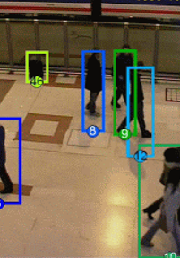
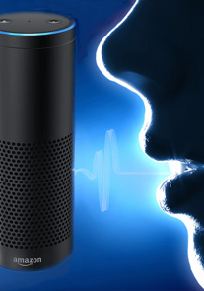
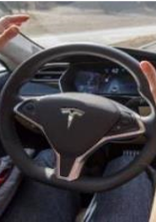
AI is everywhere!
Object detection
Speech recognition
Autonomous driving

Slide 3
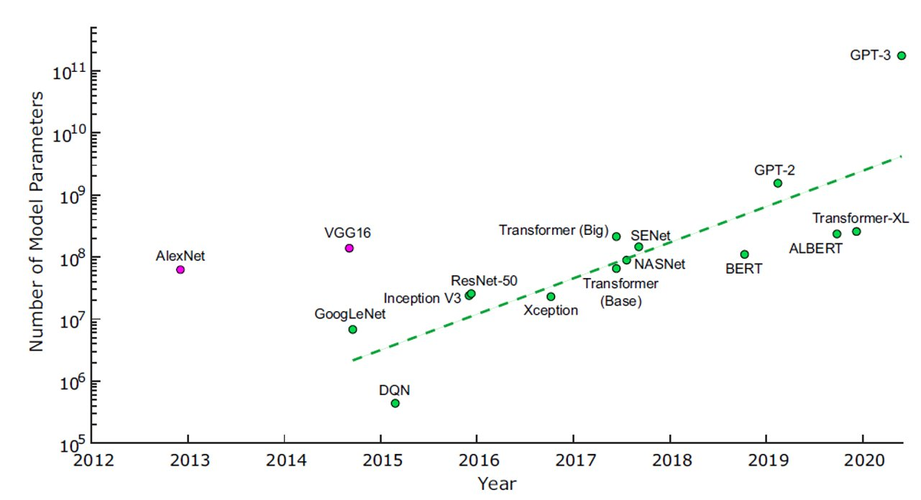
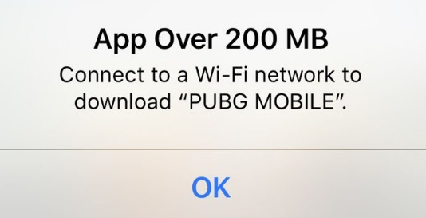
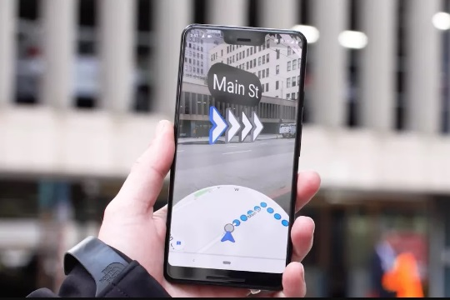
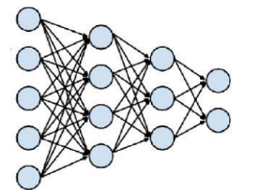
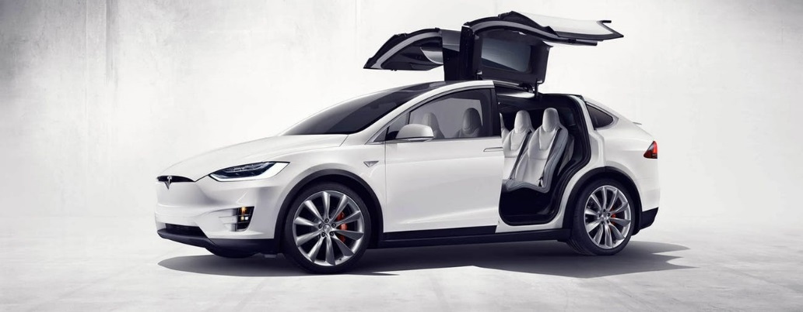
Challenge 1: model size
DNNs have too many parameters!​
60M parameters → 240MB file
Hard to distribute large models through over-the-air updates

Slide 4
Challenge 2: speed
Network design and training time have become a huge bottleneck
Such a long training time limits the productivity of ML researchers
 | Error rate | Training time
ResNet-18 | 10.76% | 2.5 days
ResNet-50 | 7.02% | 5 days
ResNet-101 | 6.21% | 1 week
ResNet-152 | 6.16% | 1.5 weeks

Slide 5
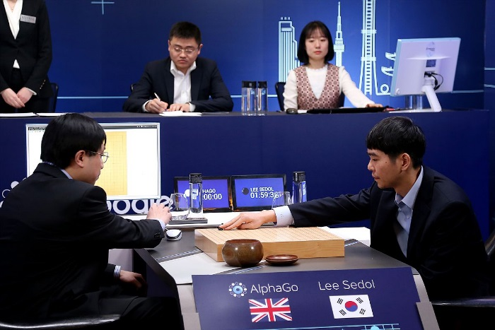
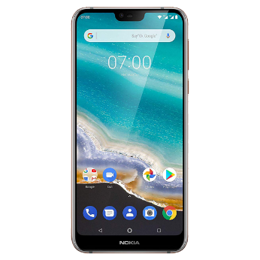
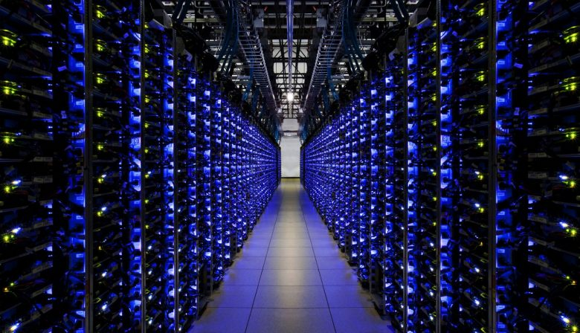
Challenge 3: energy efficiency
AlphaGO: 1920 CPUs and 280 GPUs, $3000 electric bill per game
On smartphone: battery drains quickly
On data-center: Increased TCO

Slide 6
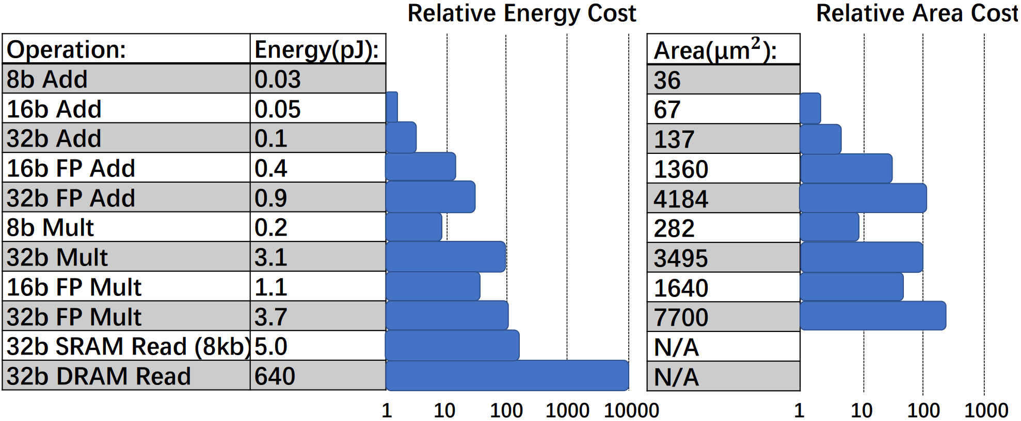
Where is the energy consumed?

Slide 7
We need Efficient Deep Learning!
Efficient Deep Learning Methods
Model compression
Code transformation
Pruning
Loop tiling
Quantization
Loop unrolling
Compact model
Operator fusion
Goal: Maximize
  Compression Ratio
  Accuracy
  Hardware Usability
Goal: Apply code optimizations to maximize
  Hardware Usability

Slide 8
Why quantization?
Challenge 1: model size
4x decrease when using 8-bit parameters
Challenge 2: speed
Hardware is less complex/less area → more throughput
Challenge 3: energy efficiency
Smaller model → less fetches from memory → less energy
Hardware is less complex → less energy
Problem:
Quantization is an irreversible process and causes information loss

Slide 9
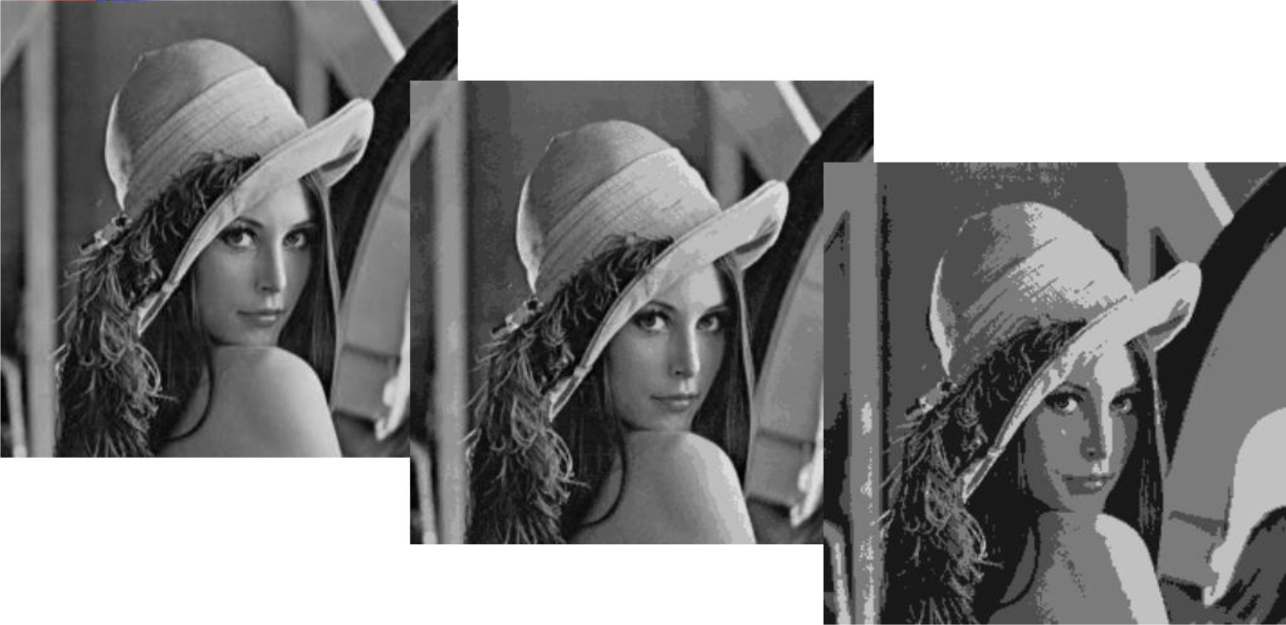
Quantizing an image - example
8 bits/pixel
4 bits/pixel
2 bits/pixel

Slide 10
Overview
Why quantization?
Basics of quantization
  Quantize to which data format?
  How to quantize?
  When to quantize?
Advanced quantization topics

Slide 11
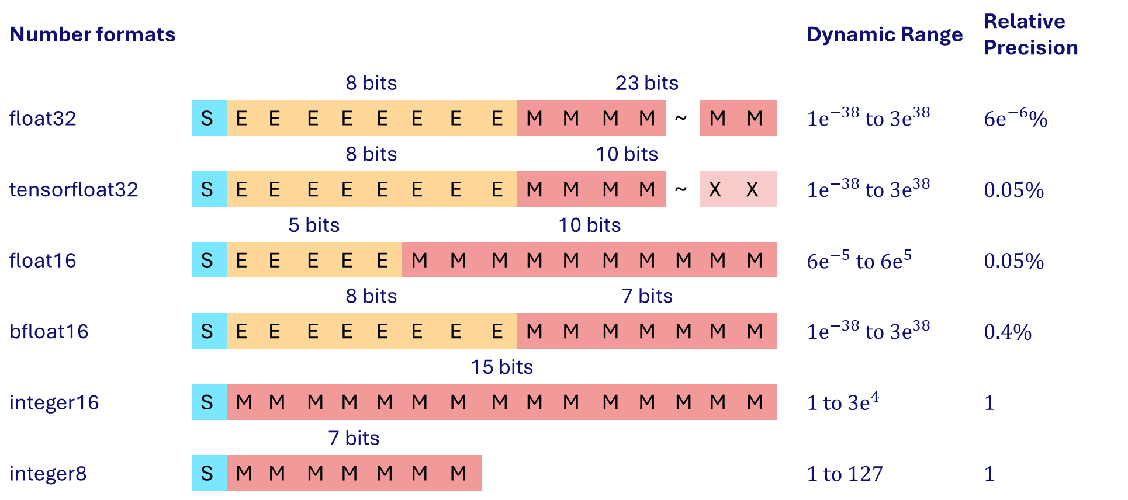
Typical data formats used in DNNs
Number formats |  |  |  |  |  |  |  |  |  |  |  |  |  |  |  |  |  |  | Dynamic Range | Relative Precision
 |  |  | 8 bits |  |  |  |  |  |  |  | 23 bits
float32 |  | S | E | E | E | E | E | E | E | E | M | M | M | M | ~ | M | M |  | $${1\text{e}}^{−38} \text{to} {3\text{e}}^{38}$$ | $${6\text{e}}^{−6}\%$$
 |  |  | 8 bits |  |  |  |  |  |  |  | 10 bits
tensorfloat32 |  | S | E | E | E | E | E | E | E | E | M | M | M | M | ~ | X | X |  | $${1\text{e}}^{−38} \text{to} {3\text{e}}^{38}$$ | $$0.05\%$$
 |  |  | 5 bits |  |  |  |  | 10 bits
float16 |  | S | E | E | E | E | E | M | M | M | M | M | M | M | M | M | M |  | $${6\text{e}}^{−5} \text{to} {6\text{e}}^{5}$$ | $$0.05\%$$
 |  |  | 8 bits |  |  |  |  |  |  |  | 7 bits
bfloat16 |  | S | E | E | E | E | E | E | E | E | M | M | M | M | M | M | M |  | $${1\text{e}}^{−38} \text{to} {3\text{e}}^{38}$$ | $$0.4\%$$
 |  |  | 15 bits
integer16 |  | S | M | M | M | M | M | M | M | M | M | M | M | M | M | M | M |  | $${1 \text{to} 3\text{e}}^{4}$$ | $$1$$
 |  |  | 7 bits
integer8 |  | S | M | M | M | M | M | M | M |  |  |  |  |  |  |  |  |  | $$1 to 127$$ | $$1$$

Slide 12
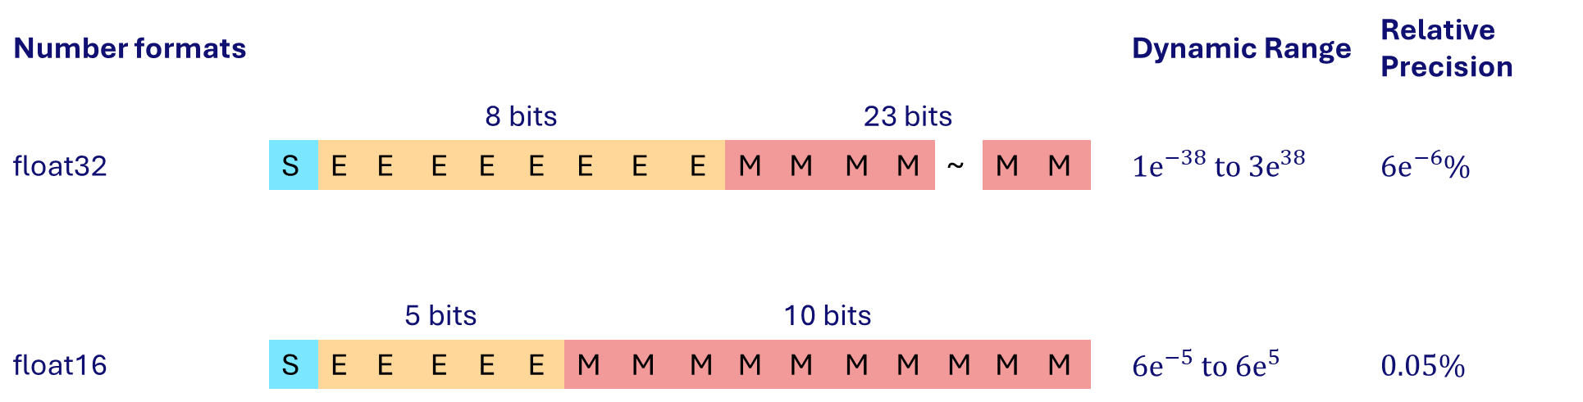
Typical data formats used in DNNs
Number formats |  |  |  |  |  |  |  |  |  |  |  |  |  |  |  |  |  |  | Dynamic Range | Relative Precision
 |  |  | 8 bits |  |  |  |  |  |  |  | 23 bits
float32 |  | S | E | E | E | E | E | E | E | E | M | M | M | M | ~ | M | M |  | $${1\text{e}}^{−38} \text{to} {3\text{e}}^{38}$$ | $${6\text{e}}^{−6}\%$$
 |  |  | 5 bits |  |  |  |  | 10 bits
float16 |  | S | E | E | E | E | E | M | M | M | M | M | M | M | M | M | M |  | $${6\text{e}}^{−5} \text{to} {6\text{e}}^{5}$$ | $$0.05\%$$
Floating-point numbers have (roughly) constant relative precision
Float32 can represent a very wide dynamic range of numbers!

Slide 13
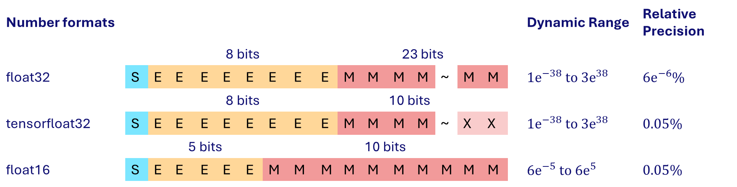
Typical data formats used in DNNs
Number formats |  |  |  |  |  |  |  |  |  |  |  |  |  |  |  |  |  |  | Dynamic Range | Relative Precision
 |  |  | 8 bits |  |  |  |  |  |  |  | 23 bits
float32 |  | S | E | E | E | E | E | E | E | E | M | M | M | M | ~ | M | M |  | $${1\text{e}}^{−38} \text{to} {3\text{e}}^{38}$$ | $${6\text{e}}^{−6}\%$$
 |  |  | 8 bits |  |  |  |  |  |  |  | 10 bits
tensorfloat32 |  | S | E | E | E | E | E | E | E | E | M | M | M | M | ~ | X | X |  | $${1\text{e}}^{−38} \text{to} {3\text{e}}^{38}$$ | $$0.05\%$$
 |  |  | 5 bits |  |  |  |  | 10 bits
float16 |  | S | E | E | E | E | E | M | M | M | M | M | M | M | M | M | M |  | $${6\text{e}}^{−5} \text{to} {6\text{e}}^{5}$$ | $$0.05\%$$
Tensorfloat32 (Nvidia) uses the same 10-bit mantissa as IEEE float16, shown to be sufficient for DNNs.
And it adopts the same 8-bit exponent as IEEE float32 so it can support the same numeric range.

Slide 14
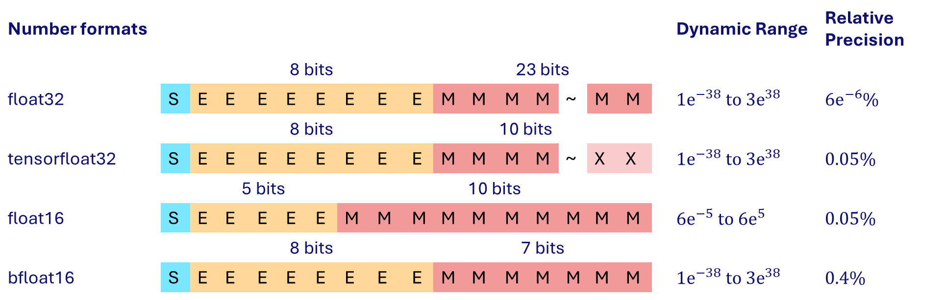
Typical data formats used in DNNs
Number formats |  |  |  |  |  |  |  |  |  |  |  |  |  |  |  |  |  |  | Dynamic Range | Relative Precision
 |  |  | 8 bits |  |  |  |  |  |  |  | 23 bits
float32 |  | S | E | E | E | E | E | E | E | E | M | M | M | M | ~ | M | M |  | $${1\text{e}}^{−38} \text{to} {3\text{e}}^{38}$$ | $${6\text{e}}^{−6}\%$$
 |  |  | 8 bits |  |  |  |  |  |  |  | 10 bits
tensorfloat32 |  | S | E | E | E | E | E | E | E | E | M | M | M | M | ~ | X | X |  | $${1\text{e}}^{−38} \text{to} {3\text{e}}^{38}$$ | $$0.05\%$$
 |  |  | 5 bits |  |  |  |  | 10 bits
float16 |  | S | E | E | E | E | E | M | M | M | M | M | M | M | M | M | M |  | $${6\text{e}}^{−5} \text{to} {6\text{e}}^{5}$$ | $$0.05\%$$
 |  |  | 8 bits |  |  |  |  |  |  |  | 7 bits
bfloat16 |  | S | E | E | E | E | E | E | E | E | M | M | M | M | M | M | M |  | $${1\text{e}}^{−38} \text{to} {3\text{e}}^{38}$$ | $$0.4\%$$
Google introduced bfloat16 on the observation that “neural networks are far more sensitive to the size of the exponent than that of the mantissa”
Moreover: the physical size of a bfloat16 multiplier is roughly two times smaller than that of float16

Slide 15
Typical data formats used in DNNs
Number formats |  |  |  |  |  |  |  |  |  |  |  |  |  |  |  |  |  |  | Dynamic Range | Relative Precision
 |  |  | 8 bits |  |  |  |  |  |  |  | 23 bits
float32 |  | S | E | E | E | E | E | E | E | E | M | M | M | M | ~ | M | M |  | $${1\text{e}}^{−38} \text{to} {3\text{e}}^{38}$$ | $${6\text{e}}^{−6}\%$$
 |  |  | 8 bits |  |  |  |  |  |  |  | 10 bits
tensorfloat32 |  | S | E | E | E | E | E | E | E | E | M | M | M | M | ~ | X | X |  | $${1\text{e}}^{−38} \text{to} {3\text{e}}^{38}$$ | $$0.05\%$$
 |  |  | 5 bits |  |  |  |  | 10 bits
float16 |  | S | E | E | E | E | E | M | M | M | M | M | M | M | M | M | M |  | $${6\text{e}}^{−5} \text{to} {6\text{e}}^{5}$$ | $$0.05\%$$
 |  |  | 8 bits |  |  |  |  |  |  |  | 7 bits
bfloat16 |  | S | E | E | E | E | E | E | E | E | M | M | M | M | M | M | M |  | $${1\text{e}}^{−38} \text{to} {3\text{e}}^{38}$$ | $$0.4\%$$
 |  |  | 15 bits
integer16 |  | S | M | M | M | M | M | M | M | M | M | M | M | M | M | M | M |  | $${1 \text{to} 3\text{e}}^{4}$$ | $$1$$
 |  |  | 7 bits
integer8 |  | S | M | M | M | M | M | M | M |  |  |  |  |  |  |  |  |  | $$1 to 127$$ | $$1$$
Integers are cheap, but their relative precision fluctuates
Floats are expensive, but their relative precision is constant
Range problem of integers can be solved by the fixed-point number format

Slide 16



Fixed-point number format
Bit-width = Fractional Length + Integer Length + 1 (Sign)
Approximate real value $x$ by computing $\hat{x}=Round\left(x⋅2^{FL}\right)⋅2^{−FL}$
Representable range: $−2^{IL}≤\hat{x}≤2^{IL}−2^{−FL}$ with step size $2^{−FL}$
Integer
Length (3)
Fractional Length (4)
IL = -1
FL = 5
0
0
1
0
1
0
1
0
$=42⋅2^{−4}$ $= 2.625$
0
1
0
1
1
$=11⋅2^{−5}$ $=0.34375$
Bit Width (8)
BW = 5
Ristretto: A Framework for Empirical Study of Resource-Efficient Inference in Convolutional Neural Networks – Gysel et al.

Slide 17


Example: integer-based MAC data path
K times
Inputs I
X
+
Accumulator
Requantize
Weights W
$$I_{1,1}W_{1,1}+I_{1,2}W_{2,1}+I_{1,3}W_{3,1}+…$$
Operands’ width = ${BW}_{I}$ or ${BW}_{w}$
Product’s width = ${BW}_{I}+{BW}_{W} −1^{∗}$
Accumulation width = $\left({BW}_{I}+{BW}_{W} −1\right)+\left\lceil {\text{log}}_{2}K\right\rceil$
Input/output precision between layers is aligned using a scale (requantize)

Slide 18
Overview
Why quantization?
Basics of quantization
  Quantize to which data format?
  How to quantize?
  When to quantize?
Advanced quantization topics

Slide 19
How to quantize?
Efficient Deep Learning Methods
Model compression
Code transformation
Pruning
Loop tiling
Quantization
Loop unrolling
Linear (uniform)
Compact model
Operator fusion
Symmetric/asymmetric
Per-tensor/per-channel
Non-linear (non-uniform)
Power-of-two
Logarithmic
Codebook quantization

Slide 20
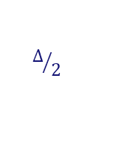






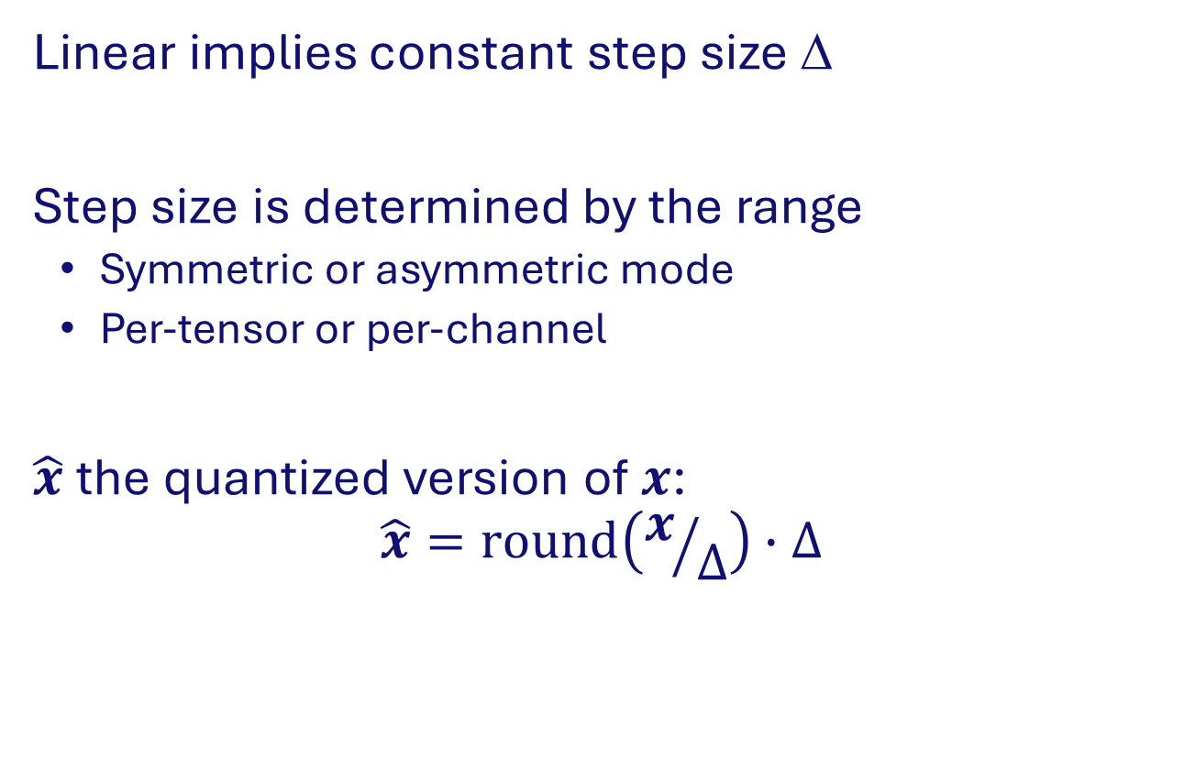



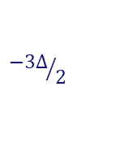


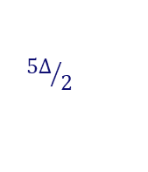





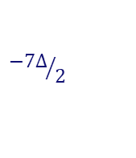
Linear (uniform) quantization
Linear implies constant step size ∆
Step size is determined by the range
  Symmetric or asymmetric mode
  Per-tensor or per-channel
$\hat{x}$ the quantized version of $x$:
$$\hat{x}=round\left(x/∆\right)∙∆$$
$$\hat{x}$$
$$3∆$$
$$011$$
$$2∆$$
$$010$$
$$001$$
$$1∆$$
$$000$$
$${−7∆}/2$$
$${−5∆}/2$$
$${−3∆}/2$$
$$∆/2$$
$${3∆}/2$$
$${5∆}/2$$
$$x$$
$$−1∆$$
$$110$$
$$−2∆$$
$$101$$
$$−3∆$$
$$100$$
3 bits quantization example

Slide 21

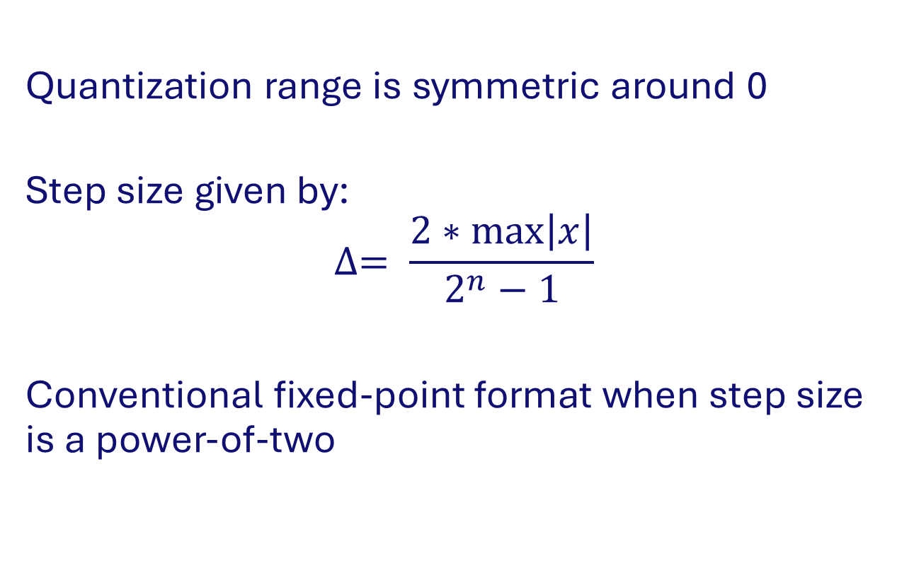

Symmetric mode
Quantization range is symmetric around 0
Step size given by:
$$∆= \frac{2∗max\left|x\right|}{2^{n}−1}$$
Conventional fixed-point format when step size is a power-of-two
$$−\text{max}\left|\text{x}\right|$$
0
$$\text{max}\left|\text{x}\right|$$
-128
0
127

Slide 22

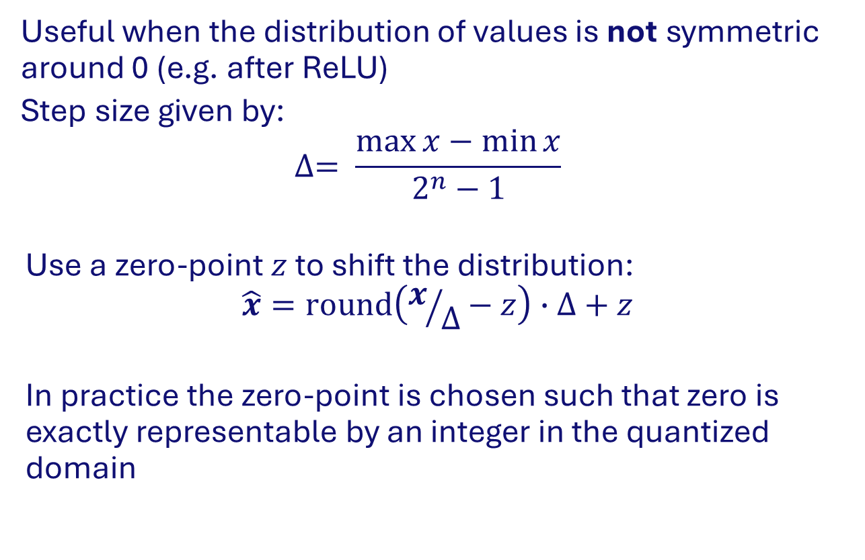

Asymmetric mode
  Useful when the distribution of values is not symmetric around 0 (e.g. after ReLU)
  Step size given by:
  $$∆= \frac{\max{x}−\min{x}}{2^{n}−1}$$
  Use a zero-point $z$ to shift the distribution:
  $$\hat{x}=round\left(x/∆−z\right)∙∆+z$$
  In practice the zero-point is chosen such that zero is exactly representable by an integer in the quantized domain
$$\text{min}\left|\text{x}\right|$$
0
z
$$\text{max}\left|\text{x}\right|$$
-128
-z
0
127

Slide 23
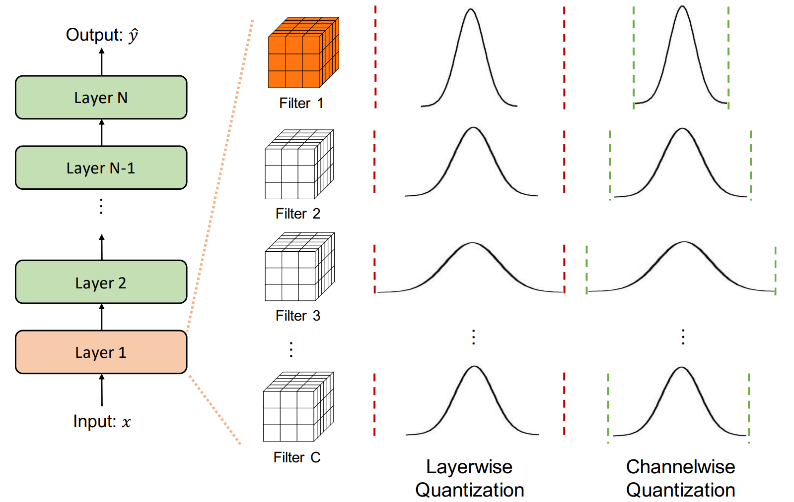
Per-tensor vs per-channel
Per-channel is useful when channels have different ranges
Note: per-channel quantization does not require special hardware when applied to weights

Slide 24
Hardware implication for 8-bit integer data path
Weights
Q2.6
Q4.4
Q3.5
Q1.7
Input
*
*
*
*
Q4.4
Q6.10
Q8.8
Q7.9
Q5.11
ACC
ACC
ACC
ACC
32-bit accumulators
>>6
>>4
>>5
>>7
Requantize stage
Per-channel: multiple shift values
Per-tensor: one shift value
Clip to 8-bit integer
Clip int8
Clip int8
Clip int8
Clip int8
Output channels
Q4.4

Slide 25
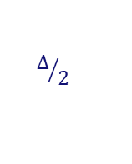


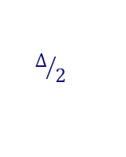





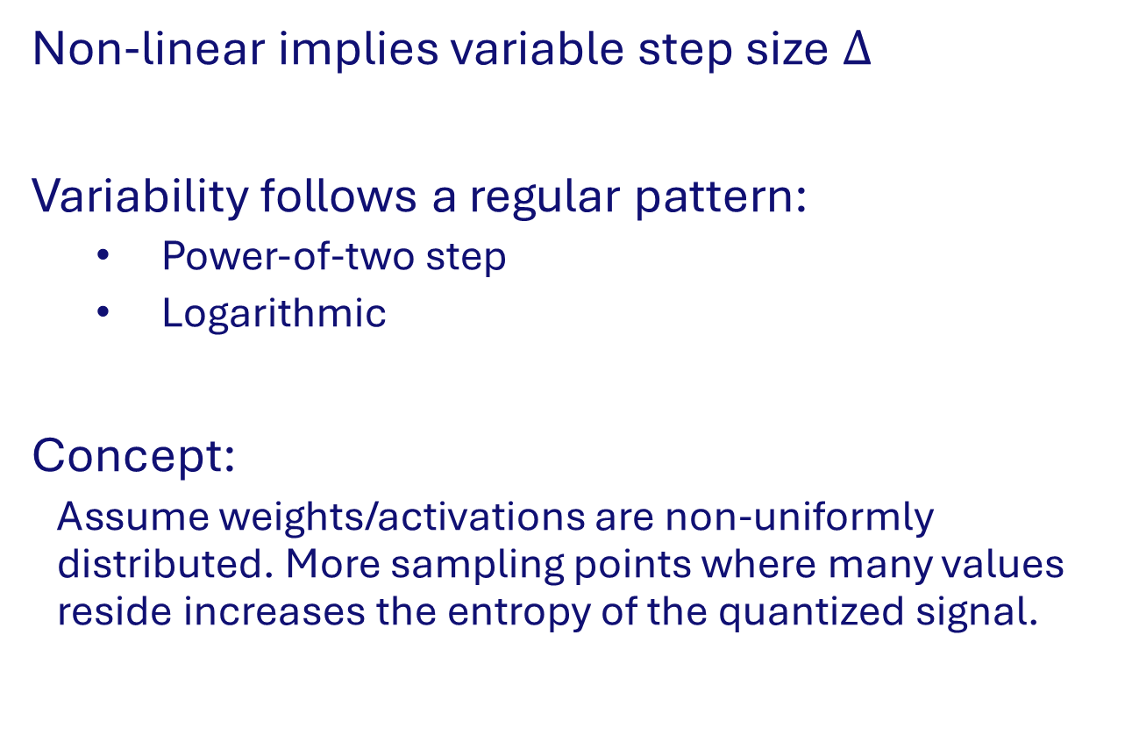


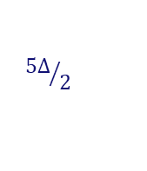

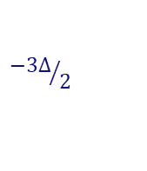




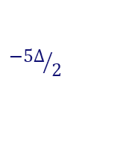






Non-linear (non-uniform) quantization
$$\hat{x}$$
$$3∆$$
$$011$$
$$2∆$$
$$010$$
$$1∆$$
$$001$$
Non-linear implies variable step size $∆$
Variability follows a regular pattern:
  Power-of-two step
  Logarithmic
Concept:
  Assume weights/activations are non-uniformly distributed. More sampling points where many values reside increases the entropy of the quantized signal.
$$000$$
$${−7∆}/2$$
$${−5∆}/2$$
$${−3∆}/2$$
$$∆/2$$
$${3∆}/2$$
$${5∆}/2$$
$$x$$
$$−1∆$$
$$110$$
$$−2∆$$
$$101$$
$$−3∆$$
$$100$$
Linear quantization
$$\hat{x}$$
$$011$$
$$3∆$$
$$2∆$$
$$010$$
$$001$$
$$000$$
$${−5∆}/2$$
$${−3∆}/2$$
$$∆/2$$
$${3∆}/2$$
$${5∆}/2$$
$$x$$
$$110$$
$$−2∆$$
$$101$$
$$−3∆$$
Non-linear quantization

Slide 26
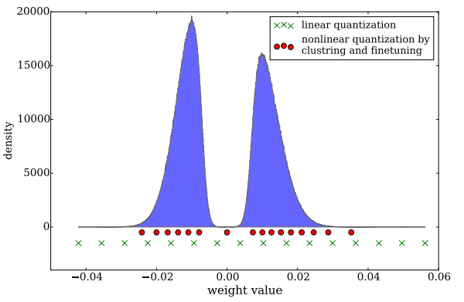
Codebook quantization
Useful when distribution of values is not normally distributed
Quantized values (codewords) are represented by a codebook
Codewords are selected using a clustering algorithm or training process
Codewords may be scalars or vectors
Note: requires hardware support for lookup
Codebook example
Index | Value | Interval
0 | -0.07 | [-0.08, -0.04]
1 | 0 | [-0.04, 0.05]
2 | 0.01 | [0.05, 0.011]
3 | 0.012 | [0.011, 0,013]

Slide 27
How to quantize? - Summary
Scheme | Step size | Step size pattern
Linear | Fixed | Regular
Non-linear | Variable | Regular
Codebook | Variable | Irregular

Slide 28
Overview
Why quantization?
Basics of quantization
  Quantize to which data format?
  How to quantize?
  When to quantize?
Advanced quantization topics

Slide 29
When to quantize?
Quantization-Aware Training
Post-Training Quantization
(Pre-trained) model
Training data
Pre-trained model
Calibration data
Calibration
Quantization-Aware Training
(from scratch or finetuning)
Quantization
Quantized model
Quantized model

Slide 30
Post-Training Quantization
Typical PTQ procedure:
Range analysis using calibration data (subset of training data)
  To determine step size for activations
  Step size for weights can be determined without any data
Check if quality of final solution is sufficient. If not, do some finetuning (using entire training data)

Slide 31
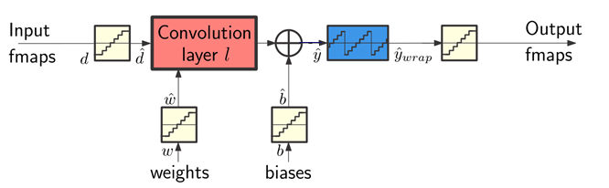
Quantization-Aware Training
Forward pass: simulated quantization to compute loss function
Backward pass: how to back propagate through the quantizers?

Slide 32
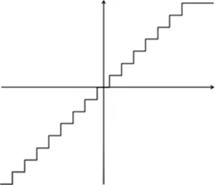
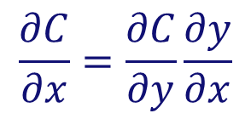

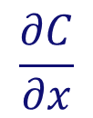

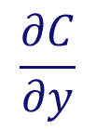

Quantizers: how to backpropagate?
$$y=\text{quantize}(x)$$
Forward pass
4-bits
$$x$$
quantize
$$y$$
Backward pass
input
$$\frac{∂C}{∂x}$$
$$\frac{∂C}{∂y}$$
quantize
$$\frac{∂C}{∂x}=\frac{∂C}{∂y}\frac{∂y}{∂x}$$
?
output

Slide 33
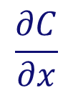
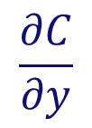
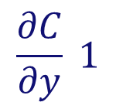
Quantizers: how to backpropagate?
$$y=\text{quantize}(x)$$
Forward pass
4-bits
$$x$$
quantize
$$y$$
Backward pass
input
$$\frac{∂C}{∂x}$$
$$\frac{∂C}{∂y}$$
quantize
Straight-through
estimator
$$\frac{∂C}{∂x}=\frac{∂C}{∂y}\frac{∂y}{∂x}$$
$$\frac{∂C}{∂y} 1$$
output

Slide 34
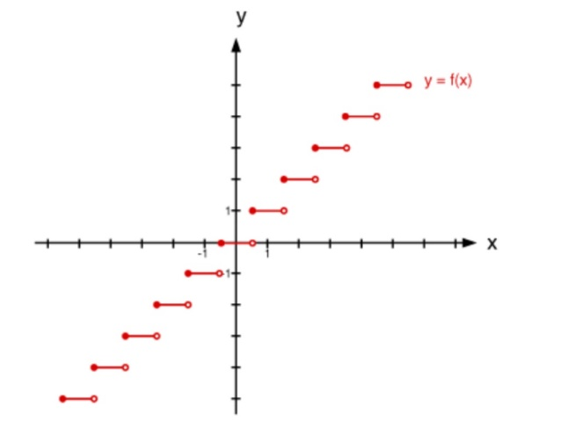
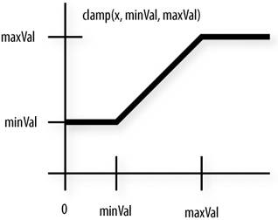
Quantizer implementation in PyTorch
(IA assignment 1)
import math
import torch
pow2 = lambda x: math.pow(2,x)
def quantize(input, bits, frac_len, inplace=False):
# reduce precision
y = input if inplace else input.clone()
y.mul_(pow2(frac_len))
y.round_() # policy: Round half away from zero (ex: 23.5 becomes 24, -23.5 becomes -24)
y.mul_(pow2(-frac_len))
# clamp range
y_min = -pow2(bits-1) * pow2(-frac_len)
y_max = (pow2(bits-1)-1) * pow2(-frac_len)
y.clamp_(y_min, y_max)
return y
...
y = round(x)
Notes:
Two interesting functions:
Round(): has derivative of zero everywhere (and infinite at tie-breaking point (in theory))
Clamp(): has derivative of 1 inside range and 0 outside

Slide 35
Quantizer implementation in PyTorch
(IA assignment 1)
...
# Create the graph and forward x
x = torch.tensor(2.0, requires_grad=True)
y = x ** 3
y.retain_grad()
z = quantize(y, bits=16, frac_len=8)
z.retain_grad()
# Backward pass: compute gradient of the output with respect to
# model parameters (all Tensors with requires_grad=True).
z.backward()
print(y.grad) # should print '1' which is dz/dy
print(x.grad) # should print '12' which is dz/dx
Actual console output:
>> tensor(0.)
>> tensor(0.)
Round() has derivative of zero almost everywhere.
Result is actually correct, but not very useful!
Notes:
The values that we get are correct, but not what we want.

Slide 36
Quantizer implementation in PyTorch
(IA assignment 1)
class Quantize(torch.autograd.Function):
"""
Symmetric Linear Quantizer. The forward pass reduces the precision and clamps the range.
The backward pass computes the unclipped Straight-Through Estimator (STE) i.e. the gradients
are not affected by this node.
"""
@staticmethod
def forward(ctx, input, bits, frac_len, inplace):
# reduce precision
y = input if inplace else input.clone()
y.mul_(pow2(frac_len))
y.round_() # policy: Round half away from zero (ex: 23.5 becomes 24, -23.5 becomes -24)
y.mul_(pow2(-frac_len))
# clamp range
y_min = -pow2(bits-1) * pow2(-frac_len)
y_max = (pow2(bits-1)-1) * pow2(-frac_len)
y.clamp_(y_min, y_max)
return y
@staticmethod
def backward(ctx, grad_output):
return grad_output, None, None, None # Straight-through estimator (unclipped). Only input needs gradient.
def quantize(input, bits, frac_len, inplace=False):
return Quantize.apply(input, bits, frac_len, inplace)

Slide 37
Quantizer implementation in PyTorch
(IA assignment 1)
...
# Create the graph and forward x
x = torch.tensor(2.0, requires_grad=True)
y = x ** 3
y.retain_grad()
z = quantize(y, bits=16, frac_len=8)
z.retain_grad()
# Backward pass: compute gradient of the output with respect to
# model parameters (all Tensors with requires_grad=True).
z.backward()
print(y.grad) # should print '1' which is dz/dy
print(x.grad) # should print '12' which is dz/dx
Actual console output:
>> tensor(1.)
>> tensor(12.)
Notes:
The values that we get are correct, but not what we want.

Slide 38
When to quantize? - Summary
Approach | Training time | Quantization time | Quality of results
Post-Training Quantization | None | 1 forward pass | Low
Post-Training Quantization with fine-tuning | Short | Multiple forward & backward passes | Medium
Quantization-Aware Training | Long | Entire training | High
Quantized Training Procedure* | Shorter | Entire training | High

Slide 39
Overview
Why quantization?
Basics of quantization
Advanced quantization topics
  Mixed-precision quantization
  Data-free quantization
  Extreme quantization

Slide 40
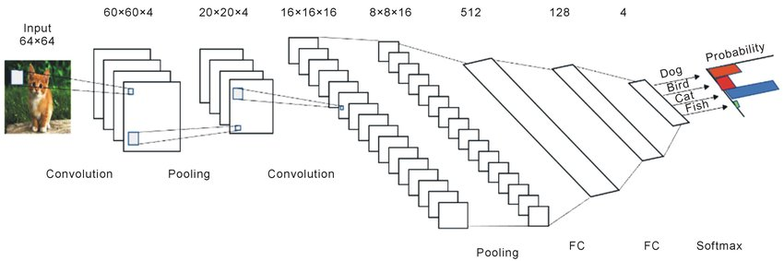
Mixed-precision quantization
Which bit-width do we use for weights/activations in each layer?
Brute forcing the solution space is too costly…
One bit-width choice influences other choices
We need to employ heuristics:
  Second derivative
  Learned bit-width quantization
  Something else?

Slide 41

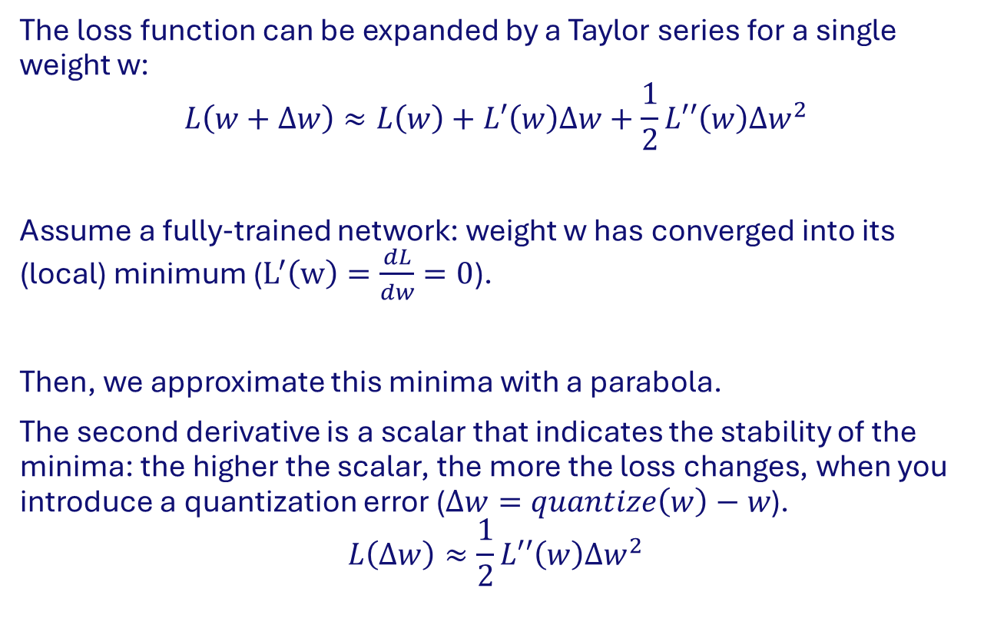
Second derivative as quantization heuristic
The loss function can be expanded by a Taylor series for a single weight w:
$$L\left(w+∆w\right)≈L\left(w\right)+L′\left(w\right)∆w+\frac{1}{2}L′′\left(w\right){∆w}^{2}$$
Assume a fully-trained network: weight w has converged into its (local) minimum ($L^{′}\left(w\right)=\frac{dL}{dw}=0$).
Then, we approximate this minima with a parabola.
The second derivative is a scalar that indicates the stability of the minima: the higher the scalar, the more the loss changes, when you introduce a quantization error ($∆w=quantize\left(w\right)−w$).
$$L\left(∆w\right)≈\frac{1}{2}L′′\left(w\right){∆w}^{2}$$
Loss
$$W$$
W*

Slide 42
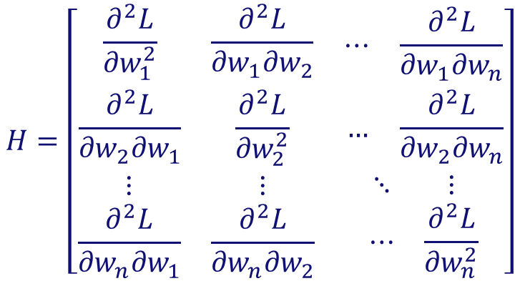
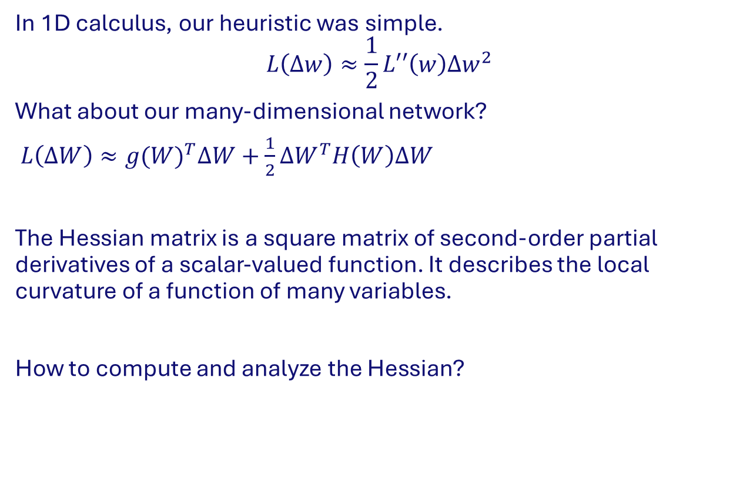
Second derivative as quantization heuristic
In 1D calculus, our heuristic was simple.
$$L\left(∆w\right)≈\frac{1}{2}L′′\left(w\right){∆w}^{2}$$
What about our many-dimensional network?
$L\left(∆W\right)≈{g(W)}^{T}∆W+\frac{1}{2}{∆W}^{T}H\left(W\right)∆W$
The Hessian matrix is a square matrix of second-order partial derivatives of a scalar-valued function. It describes the local curvature of a function of many variables.
How to compute and analyze the Hessian?
$$H=\left[\begin{matrix}\begin{matrix}\frac{∂^{2}L}{{∂w}_{1}^{2}} & \frac{∂^{2}L}{{∂w}_{1}{∂w}_{2}} \\ \frac{∂^{2}L}{{∂w}_{2}{∂w}_{1}} & \frac{∂^{2}L}{{∂w}_{2}^{2}}\end{matrix} & \begin{matrix}⋯ & \frac{∂^{2}L}{{∂w}_{1}{∂w}_{n}} \\ … & \frac{∂^{2}L}{{∂w}_{2}{∂w}_{n}}\end{matrix} \\ \begin{matrix}⋮ & ⋮ \\ \frac{∂^{2}L}{{∂w}_{n}{∂w}_{1}} & \frac{∂^{2}L}{{∂w}_{n}{∂w}_{2}}\end{matrix} & \begin{matrix}⋱ & ⋮ \\ ⋯ & \frac{∂^{2}L}{{∂w}_{n}^{2}}\end{matrix}\end{matrix}\right]$$

Slide 43
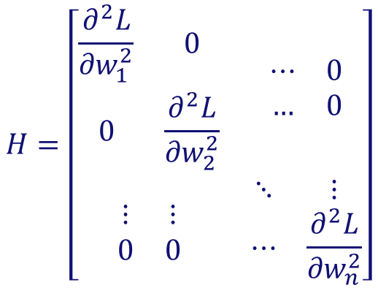
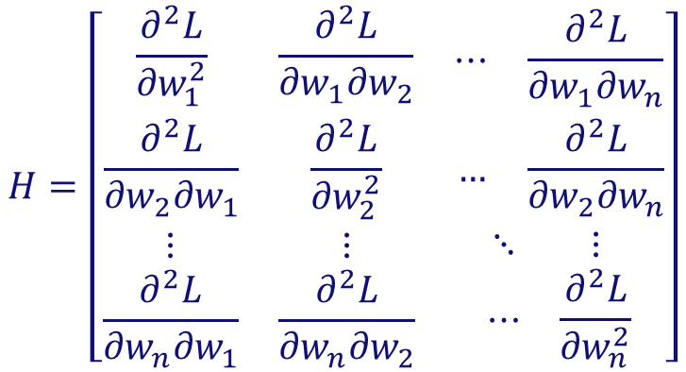
Computing the Hessian
$$H=\left[\begin{matrix}\begin{matrix}\frac{∂^{2}L}{{∂w}_{1}^{2}} & \frac{∂^{2}L}{{∂w}_{1}{∂w}_{2}} \\ \frac{∂^{2}L}{{∂w}_{2}{∂w}_{1}} & \frac{∂^{2}L}{{∂w}_{2}^{2}}\end{matrix} & \begin{matrix}⋯ & \frac{∂^{2}L}{{∂w}_{1}{∂w}_{n}} \\ … & \frac{∂^{2}L}{{∂w}_{2}{∂w}_{n}}\end{matrix} \\ \begin{matrix}⋮ & ⋮ \\ \frac{∂^{2}L}{{∂w}_{n}{∂w}_{1}} & \frac{∂^{2}L}{{∂w}_{n}{∂w}_{2}}\end{matrix} & \begin{matrix}⋱ & ⋮ \\ ⋯ & \frac{∂^{2}L}{{∂w}_{n}^{2}}\end{matrix}\end{matrix}\right]$$
Computing the Hessian (n by n matrix) is quite intensive and not feasible for networks with many parameters.
For simplicity we ignore the off-diagonal elements, then our Hessian is a diagonal matrix. This implies its eigenvalues are on the diagonal.
To calculate the diagonal, we now have two options:
Directly calculate the 2nd derivatives
Using RandNLA we can find the trace of the matrix (sum of the diagonal elements)
$$H=\left[\begin{matrix}\begin{matrix}\frac{∂^{2}L}{{∂w}_{1}^{2}} & 0 \\ 0 & \frac{∂^{2}L}{{∂w}_{2}^{2}}\end{matrix} & \begin{matrix}⋯ & 0 \\ … & 0\end{matrix} \\ \begin{matrix}⋮ & ⋮ \\ 0 & 0\end{matrix} & \begin{matrix}⋱ & ⋮ \\ ⋯ & \frac{∂^{2}L}{{∂w}_{n}^{2}}\end{matrix}\end{matrix}\right]$$

Slide 44
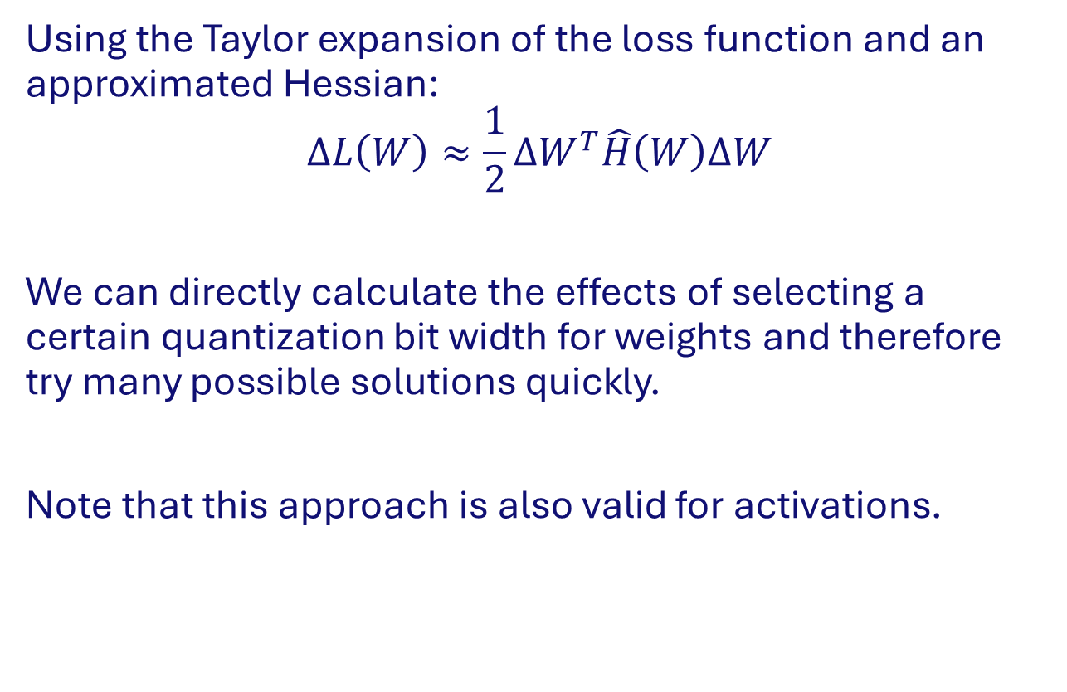
Second derivative as quantization heuristic
Using the Taylor expansion of the loss function and an approximated Hessian:
$$∆L\left(W\right)≈\frac{1}{2}{∆W}^{T}\hat{H}\left(W\right)∆W$$
We can directly calculate the effects of selecting a certain quantization bit width for weights and therefore try many possible solutions quickly.
Note that this approach is also valid for activations.
Loss
$$W$$
W*

Slide 45
Quantization vs Pruning
  In previous lecture you have seen pruning, which removes a specific set of neurons. Or, in other words pruning sets weights to 0.
  Is this not identical to heavy quantization?
  No.. In quantization we are deviating a value slightly from its optimum.
  In pruning we typically deviate so much, the parabola approximation of a minimum is no longer valid.
  Note that the loss can stabilize even though a minimum is very sharp.
Loss
$$W$$
W*

Slide 46

Learned bit-width quantization

Slide 47

Data-free quantization

Slide 48
Summary
Quantization is an essential tool for efficient deep learning
Remember: model size, speed and energy efficiency
The current quantization standard is linear quantization using 8-bit integers and 32-bit accumulators. Weights are quantized in symmetric per-channel fashion, while activations are asymmetric per-tensor.
Model fine-tuning is essential to recover accuracy loss from PTQ. To enable quantization-aware training/fine-tuning, quantizers have to be simulated.
More advanced quantization procedures possible, but not standard (yet)

Slide 49
Extreme quantization beyond int8
Optimizing neural networks for inference
Floran de Putter
Electrical Engineering – Electronic Systems group

Slide 50

Extreme quantization
Usually 8-bit quantization is sufficient for many applications
Can we do better?
Yes, to the extremes:
  Binary values $\{−1, +1\}$
    Single bit per symbol
  Ternary values $\{−1, 0, +1\}$
    1.585 bits per symbol ($\log_{2}{3 }≈1.585$)
Reminder: during training all values are kept in full-precision!

Slide 51
Overview
Preliminary
  Binary and ternary quantization
  Backwards pass
Naive binary neural network
Overview of common repair methods
Specialized bitwise accelerators
Summary and conclusions

Slide 52



Basic operation of DNNs
K times
Inputs A
Non-linear activation $σ(x)$
$$y$$
X
+
Accumulator
Weights W
Convolutional layer: $y=σ(W∗A)$
  Large number of (floating-point) multiplications and additions
  MAC is the majority of calculations during inference

Slide 53





Binary quantization
$Sign$ function is used for binarization:
$$sign\left(x\right)= \left\{\begin{matrix}+1, & \text{if} x ≥0 \\ −1, & \text{otherwise}\end{matrix}\right.$$
Convolutional layer becomes:
$$y=σ\left(W_{r}∗A_{r}\right)=σ\left(W_{b}⊗A_{b}\right)$$
$⨂$ denotes binary multiply-accumulate!
$$sign\left(x\right)$$
$$1$$
$$x$$
$$−1$$

Slide 54









Binary multiply-accumulate
Multiplication and addition are replaced by bitwise XNOR and PopCount.
Why $\left\{−1, +1\right\}$ and not $\{0, +1\}$?
  XNOR- vs AND-gate multiply
$$A_{r}$$
+1
+1
-1
-1
Mul
Accumulate
-1
+1
+1
+1
+2
$$W_{r}$$
-1
+1
-1
-1
$$4×float32$$
$$A_{b}$$
1
1
0
0
XNOR
PopCount
0
1
1
1
+2
$$W_{b}$$
0
1
0
0
$$\#pos −\#neg$$
$$=2⋅PopCount(x)−bitwidth$$
$$4×1bit$$

Slide 55
Binary convolutions – savings
Savings on off-the-shelf platforms (compared to float32 version):
  Memory size and accesses: 1/32 → memory energy savings: >32x*
  Speedup:
    CPU (64-bit): ~58x**
    GPU: ~23x***
  Energy per operation:
    *→ bitwise XNOR
    + → popcount
    We will see the Joules/Op later
Reminder: with quantization comes accuracy loss!
Notes:
XNOR-net has the following repairs already:
Scaling factors
Pooling layer before activation

Slide 56






Ternary quantization
Popular definition for ternarization is as follows:
  $$\text{ternarize}\left(x\right)=\left\{\begin{matrix}+1 & \text{if} x ≥α \\ 0 & \text{if}−α≤x <α \\ −1 & \text{if} x <−α \end{matrix}\right.$$
Convolutional layer becomes:
$$y=σ\left(W_{r}∗A_{r}\right)=σ\left(W_{t}⊛A_{t}\right)$$
$⊛$ denotes ternary multiply-accumulate!
$$ternarize\left(x\right)$$
$$1$$
$$0$$
$$−α$$
$$α$$
$$x$$
$$−1$$

Slide 57

Ternary multiply-accumulate
Ternary encoding requires 1.585 bits per symbol ($\log_{2}{3 }≈1.585$)
  In practice we need to use 2 bits
Example encoding from GXNOR-Net:
Other encodings are possible too!
Encoding
+1 | 11
0 | 00
-1 | 10

Slide 58






Ternary multiply-accumulate
Multiplication and addition are replaced by Gated XNORs and two PopCounts.
$$A_{r}$$
+1
+1
-1
-1
Mul
Accumulate
-1
+1
0
+1
+1
$$W_{r}$$
-1
+1
0
-1
Encoding
+1 | 11
0 | 00
-1 | 10
$$4×float32$$
$$A_{b}$$
11
11
10
10
GX(N)OR
PopCount
10
11
00
11
+1
$$W_{b}$$
10
11
00
10
$$\#pos −\#neg$$
$$=PopCount(+1^{′}s)−PopCount(−1^{′}s)$$
$$4×2bits$$

Slide 59



Gated XNOR and ternary MAC implementation
Gated XNOR:
Gated XOR:
x[msb]
1 if non-zero
y[msb]
Encoding
+1 | 11
0 | 00
-1 | 10
Popcount +1’s
x[lsb]
y[lsb]
+
x[msb]
-
y[msb]
Popcount -1’s
x[lsb]
y[lsb]

Slide 60






Backwards pass: how to backpropagate?
Forward pass
$$y=sign\left(x\right)$$
$$y$$
$$x$$
quantize
$$y$$
$$1$$
Backward pass
$$\frac{∂C}{∂x}$$
$$\frac{∂C}{∂y}$$
$$x$$
quantize
$$−1$$
$$\frac{∂C}{∂x}=\frac{∂C}{∂y}\frac{∂y}{∂x}$$
?

Slide 61

Backwards pass: how to backpropagate?
Forward pass
$$y=sign\left(x\right)$$
$$y$$
$$x$$
quantize
$$y$$
$$1$$
Backward pass
$$\frac{∂C}{∂x}$$
$$\frac{∂C}{∂y}$$
$$x$$
quantize
Straight-through
estimator
$$−1$$
$$\frac{∂C}{∂x}=\frac{∂C}{∂y}\frac{∂y}{∂x}$$
$$\frac{∂C}{∂y} 1$$

Slide 62
Backwards pass: how to backpropagate?
Forward pass
$$y=sign\left(x\right)$$
$$y$$
$$x$$
quantize
$$y$$
$$1$$
Backward pass
$$\frac{∂C}{∂x}$$
$$\frac{∂C}{∂y}$$
$$x$$
quantize
Clipped
straight-through
estimator
Straight-through
estimator
$$−1$$
$$\frac{∂C}{∂x}=\frac{∂C}{∂y}\frac{∂y}{∂x}$$
$$\frac{∂C}{∂y} 1$$

Slide 63
More next time!

