Slide 1
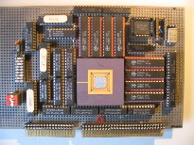
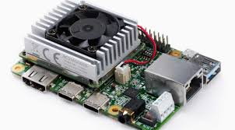
Intelligent Architectures
5LIL0
GPU
Graphics Processing Unit
Henk Corporaal
Gert-Jan van de Braak
Zhenyu Ye
www.ics.ele.tue.nl/~heco/courses/IA
h.corporaal@tue.nl
TUEindhoven
2022

Slide 2
Graphics Processing Units
Exploiting massive parallelism by running thousands of threads

Slide 3
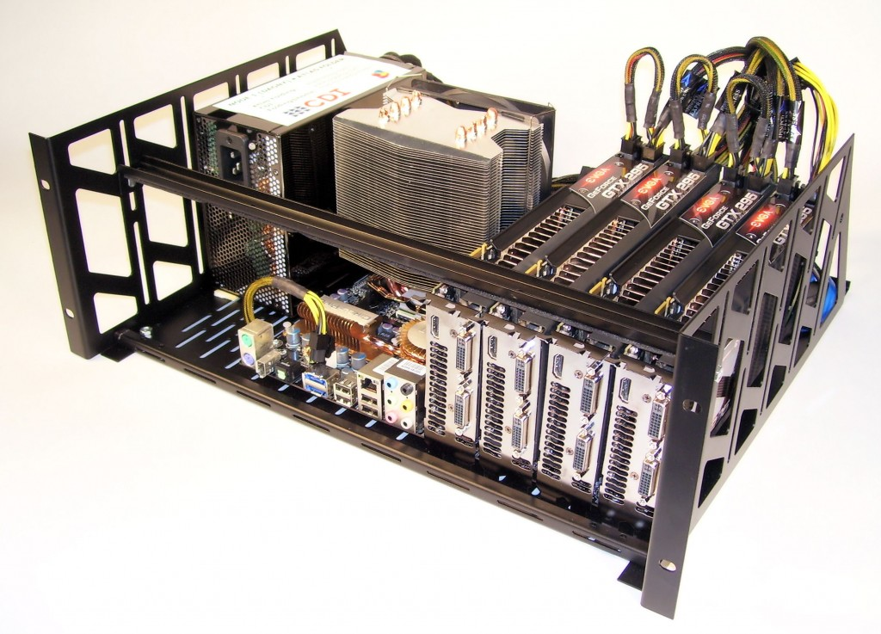

In need of PetaFlops on your desk?
Summit, Top 1

Slide 4

Topics Covered
The architecture of GPUs
  Single Instruction Multiple Thread
  Memory hierarchy
    Global and Shared (=local)
The programming model of GPUs
  The threading hierarchy
    Grids, Blocks, Warps and Treads
  SIMD vs SIMT
  Use of Memory Hierarchy
Lab 2

Slide 5
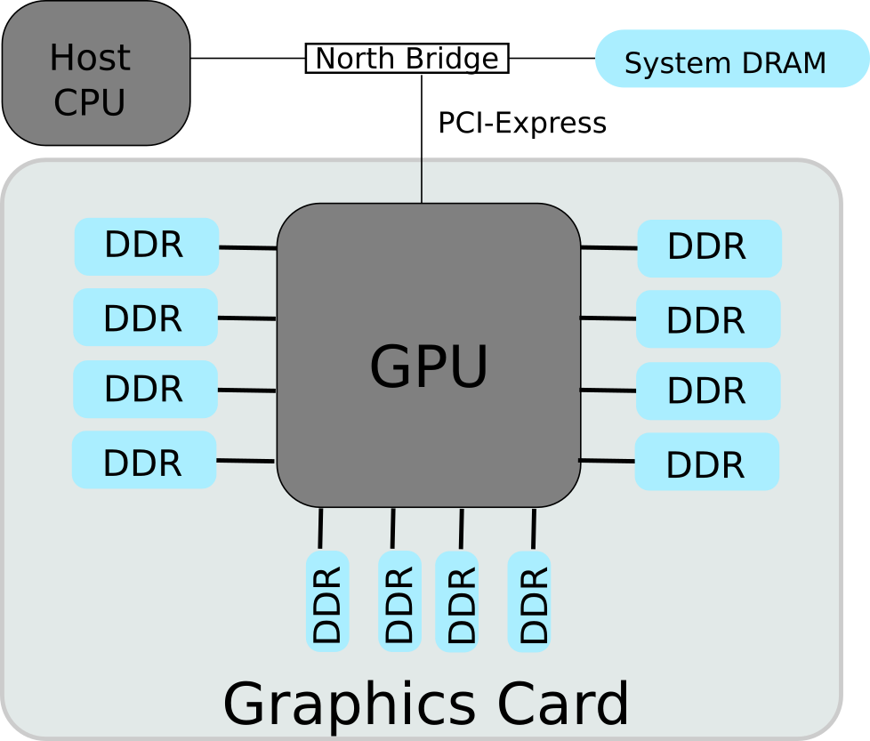
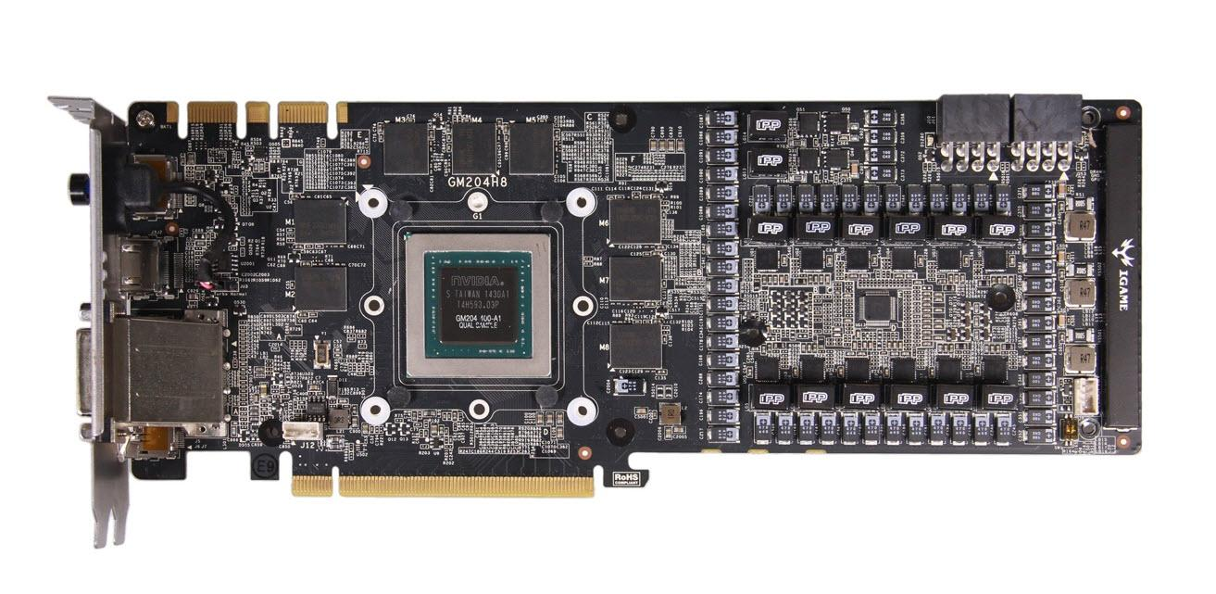
GPU in Graphics Card
Image: Nvidia GTX 980
Notes:
The number of Graphics DDR (GDDR) memory varies by configuration. The North Bridge and the GPU are now often integrated into the CPU die.

Slide 6
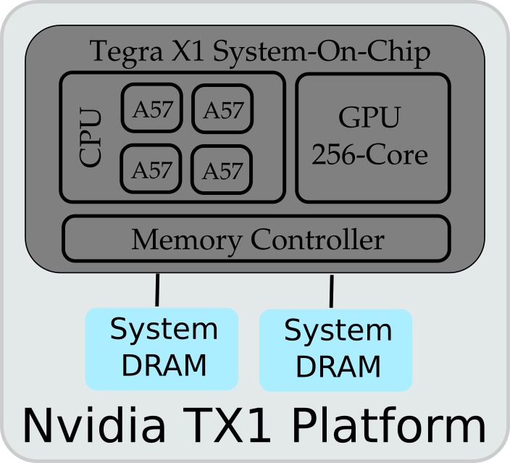
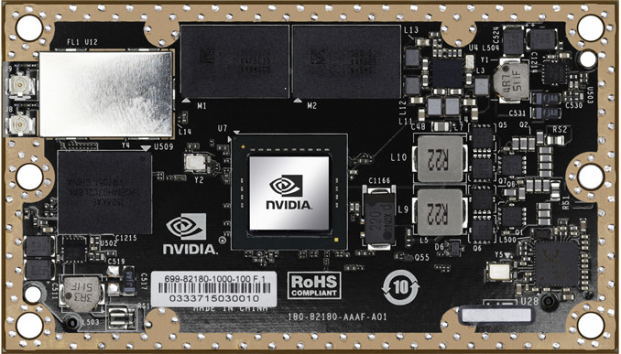
GPU in Mobile Processors
Image: Nvidia Jetson TX1 (Tegra X1 SOC)
Notes:
On the left is the Nvidia Jetson JX1 Development platform, which contains the Nvidia Tegra X1 System-On-Chip (SOC) with integrated GPU.
On the right is the an overview of major components in the platform and SOC.
Compared to the GPUs in discrete graphics card, the GPU in mobile SOC is tightly integrated with the CPU, sharing on-chip network and off-chip memory.
Reference:
https://devblogs.nvidia.com/parallelforall/nvidia-jetson-tx1-supercomputer-on-module-drives-next-wave-of-autonomous-machines/

Slide 7
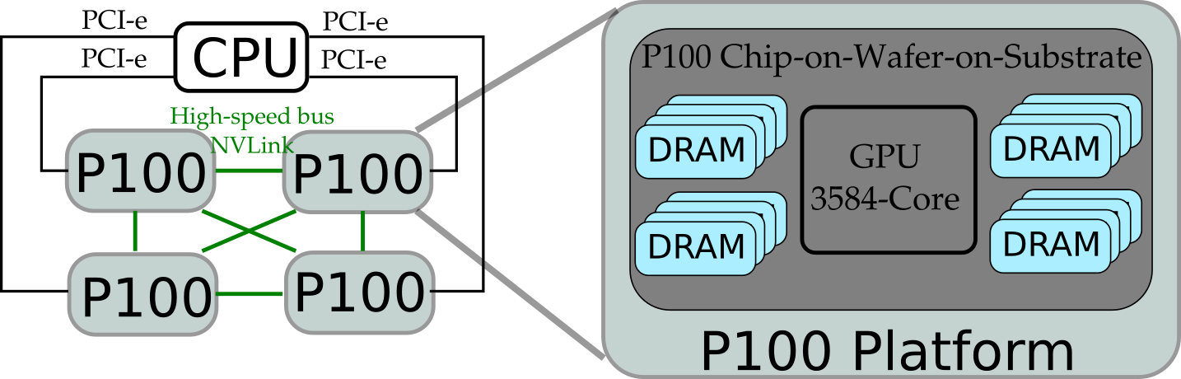
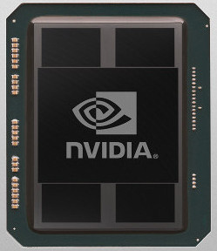
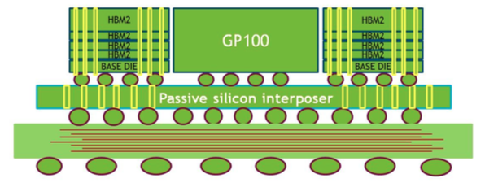
GPU in High-Performance Computers
Image: Nvidia P100
(Pascal Architecture)
Chip-on-Wafer-on-Substrate
Notes:
On the top left is the Nvidia P100 chip, designed for high-performance computing.
At the bottom is the mechanism of Chip-on-Wafer-on-Substrate, which integrates the GPU with stacked DDR memories on the same substrate.
On the top right is one possible configuration of multiple GPUs with one CPU.
Details of the Pascal architecture are available in this whitepaper:
https://images.nvidia.com/content/pdf/tesla/whitepaper/pascal-architecture-whitepaper.pdf

Slide 8
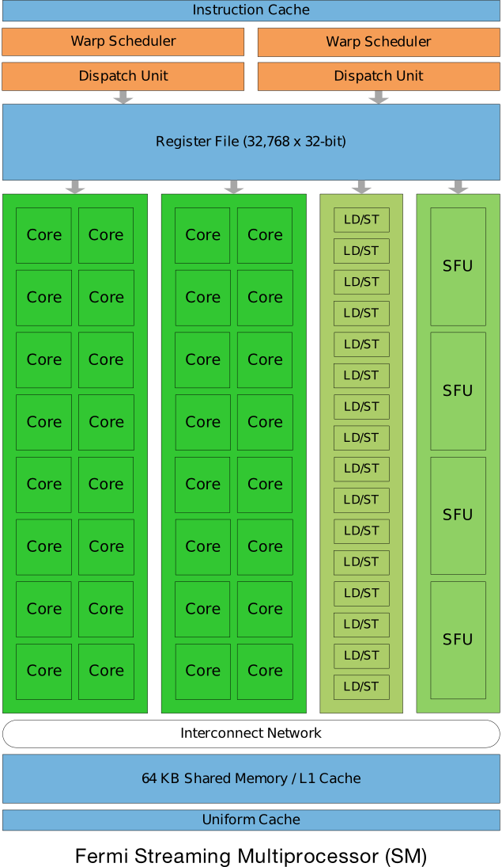
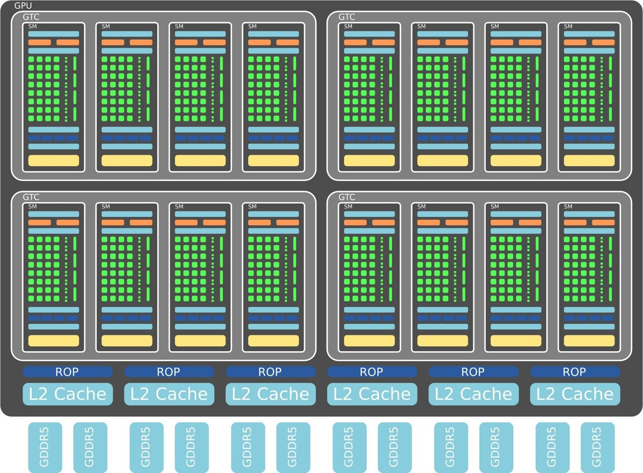
NVIDIA (Fermi Arch.)
ref: http://www.nvidia.com/content/PDF/fermi_white_papers/NVIDIA_Fermi_Compute_Architecture_Whitepaper.pdf
Notes:
NVIDIA Fermi architecture can scale to 512 Cores, also called Processing Elements (PEs), although low-end versions are configured with less PEs.
In the context of this lecture, and related documents, these three terms are equivalent and interchangeable:
Processing Element (PE)
Stream Processor (SP)
Core

Slide 9
Transistor Count
ref: http://en.wikipedia.org/wiki/Transistor_count
Processor | Transistor | Tech. Node
61-Core Xeon Phi | 5,000,000,000 | 22nm
22-core Xeon Broadwell-E5 | 7,200,000,000 | 14nm
32-Core Sparc M7 | 10,000,000,000+ | 20nm
Multicore
Manycore
SOC
GPU
Processor | Transistor | Tech. Node
Nvidia GP100 Pascal | 15,300,000,000 | 16nm
FPGA | Transistor | Tech. Node
Virtex-Ultrascale XCVU440 | 20,000,000,000+ | 20nm
Stratix 10 10GX5500 | 30,000,000,000+ | 14nm
FPGA
Notes:
The Xilinx Ultrascale architecture stacks multiple dies into a silicon interposer. The 20bn transistors is on a multi-die “2.5D” chip (http://www.xilinx.com/publications/archives/xcell/Xcell86.pdf)

Slide 10
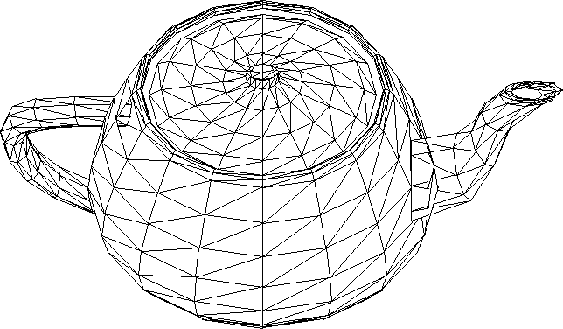

GPUs originally ‘only’ used for ….
Render billions of triangles per second
ref: "How GPUs Work", http://dx.doi.org/10.1109/MC.2007.59
Notes:
The image is the Utah teapot (http://en.wikipedia.org/wiki/Utah_teapot).

Slide 11
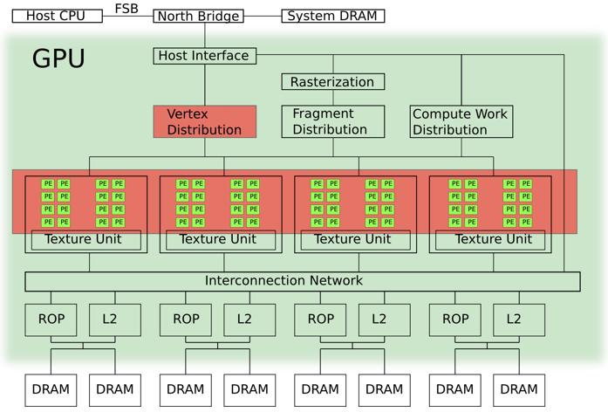
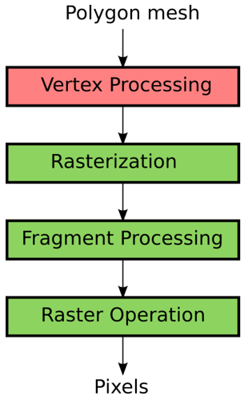
Graphics Pipeline on GPU
Notes:
Vertex processing is mainly done on the programmable cores, with the help of some dedicated hardware.

Slide 12
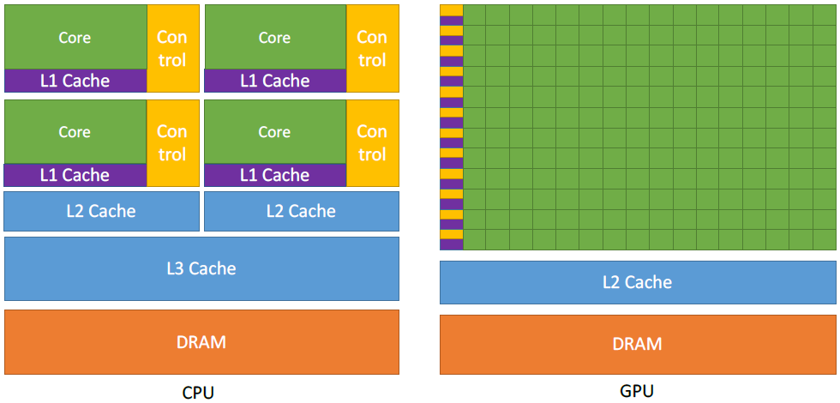
CPU vs GPU: where are the transistors going?

Slide 13
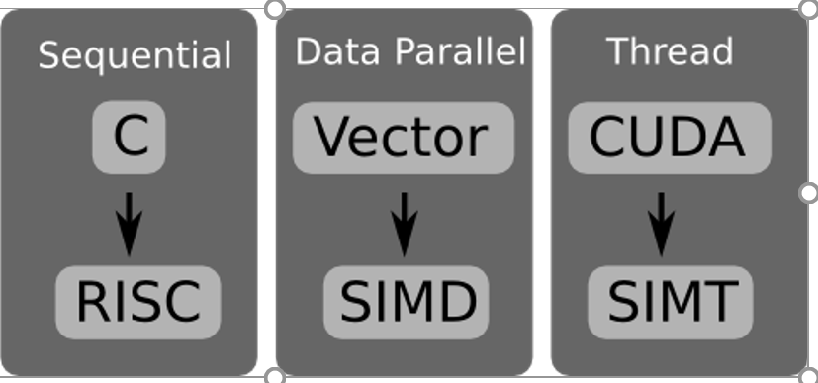
Programming model
Programming model vs Architecture
  Note: no strict coupling, but some models fit better to a certain architecture
Notes:
The programming model is not necessarily coupled to the architecture. For example, the vector programming model can be mapped to RISC architecture.
This lecture chooses to map the aforementioned programming models to the architectures that are most suitable.

Slide 14
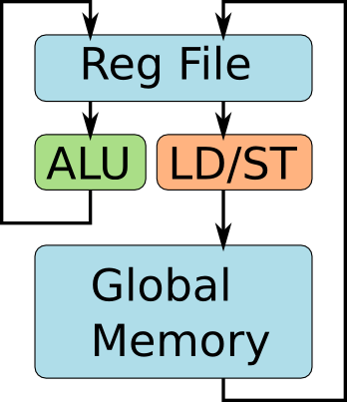
Let's Start with C and RISC
Assembly
code of
inner-loop
int A[2][4];
for(i=0;i<2;i++){
for(j=0;j<4;j++){
A[i][j]++;
}
}
lw r0, 4(r1)
addi r0, r0, 1
sw r0, 4(r1)
Programmer's view of RISC
Notes:
To process an array of elements, a typical C program will use loop nests.
The programmers see a global memory space. The memory hierarchy, with multiple levels of caches, is transparent to programmers.

Slide 15
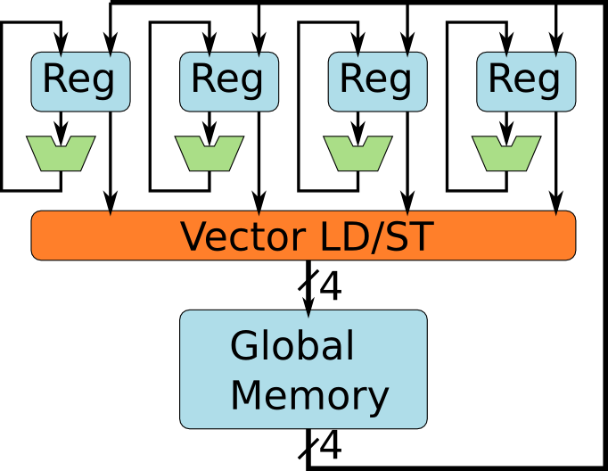
Most CPUs Have Vector SIMD Units
Programmer's view of a vector SIMD, e.g. SSE.
Notes:
The Intel Streaming SIMD Extension (SSE) starts with 4 data lanes. It later evolves to the Advanced Vector Extensions (AVX) of 16 data lanes and higher. This lecture assumes 4 data lanes for the sake of simplicity.

Slide 16
Let's Program the Vector SIMD
Unroll inner-loop to vector operation.
int A[2][4];
for(i=0;i<2;i++){
for(j=0;j<4;j++){
A[i][j]++;
}
}
int A[2][4];
for(i=0;i<2;i++){
movups xmm0, [ &A[i][0] ] // load
addps xmm0, xmm1 // add 1
movups [ &A[i][0] ], xmm0 // store
}
Looks like the previous example,
but each SSE instruction executes on 4 ALUs.
Notes:
One inner loop of 4 interactions can be exactly unrolled into a vector of 4 elements. Note that the programmers need to know the width of the SIMD.

Slide 17
How Do Vector Programs Run?
int A[2][4];
for(i=0;i<2;i++){
movups xmm0, [ &A[i][0] ] // load
addps xmm0, xmm1 // add 1
movups [ &A[i][0] ], xmm0 // store
}
Notes:
There are three major steps:
Loading a vector of four elements (red rectangles in the figure) from global memory to vector register.
Perform the vector computation using the vector register.
Store the resulted vector into the global memory.

Slide 18
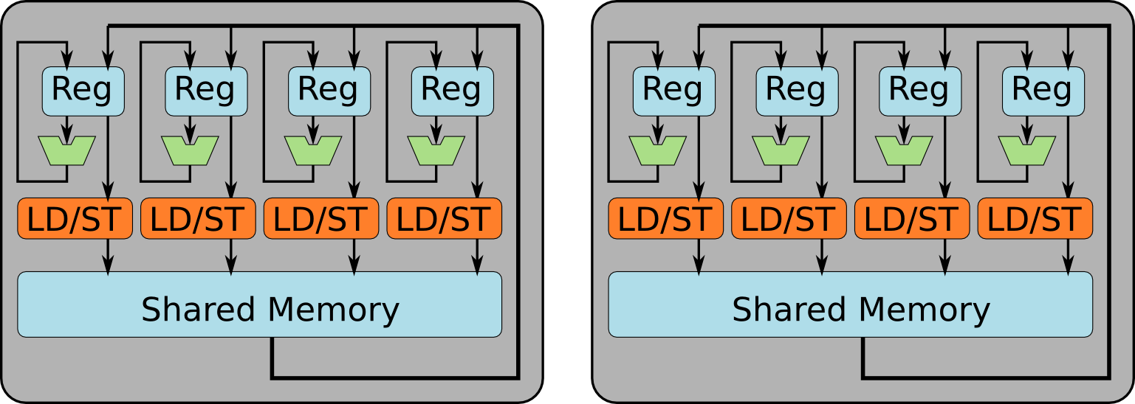
CUDA Programmer's View of GPUs
A GPU contains multiple SIMD Units.
Notes:
The GPU consists of multiple SIMD-like clusters. Each cluster has its own local memory, shared by the four PEs within the SIMD cluster. Therefore, the local memory is also called shared memory.
For the sake of simplicity, two SIMD clusters are illustrated. The SIMD cluster of Nvidia GPUs is actually different than the SIMD in CPUs. These differences will be discussed later in the lecture.

Slide 19
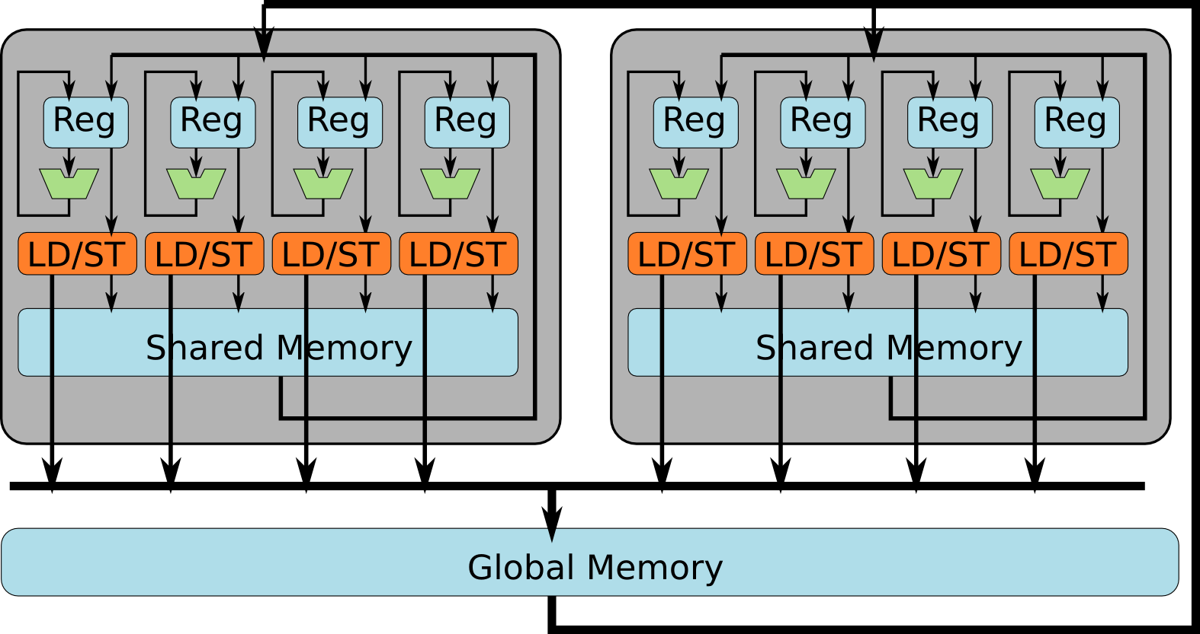
CUDA Programmer's View of GPUs
A GPU contains multiple SIMD Units
All of them can access global memory
Notes:
The GPU typically has multiple levels of memory hierarchy that are exposed to the programming model. Two most important memory spaces are the shared memory space and the global memory space.
Shared memory: shared among the PEs within a cluster. Cluster 2 cannot access the shared memory in cluster 1, and vice vesa.
Global memory: any PE from any cluster can access the data in global memory.
There are more subtle difference between these two memories, mostly related to the threading hierarchy, which will be discussed later.

Slide 20
What Are the Differences?
GPU
SSE
2 important differences:
GPUs use threads instead of vectors
GPUs have the "Shared Memory" spaces
Notes:
The threading programming model and its architectural support is a fundamental difference between modern GPUs and CPUs. Although OpenCL (and, theoretically, CUDA) can also run on SSE, the SSE lacks the architectural support for the threading programming model.
The explicit managed shared memory space is not a fundamental difference, because many SIMD processors have an explicitly managed local memory. For the sake of consistency, we stick to the example of SSE, and therefore the shared memory space is considered as a difference.

Slide 21
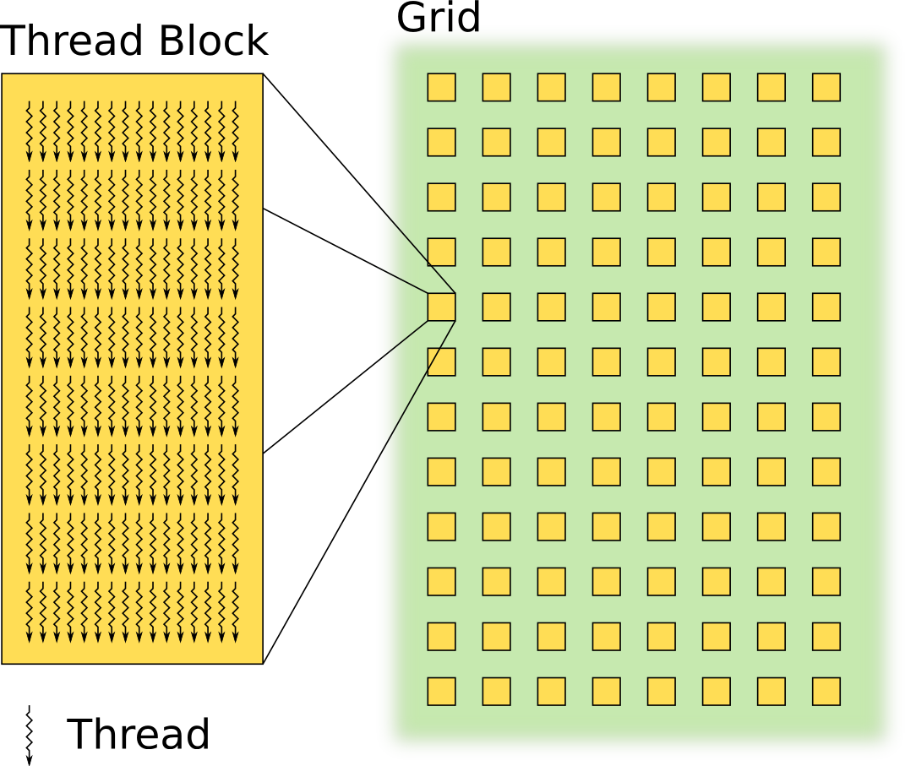
Thread Hierarchy in CUDA
Grid
contains
Thread Blocks
Thread Block
contains
Threads
Notes:
To keep thousands of PEs busy, programmers need to create a massive number of threads, at the scales of millions and beyond.
To organize millions of threads, hierarchy is imposed.
Hundreds of threads are grouped into a thread block.
Tens to thousands of threads block are grouped into a grid.

Slide 22
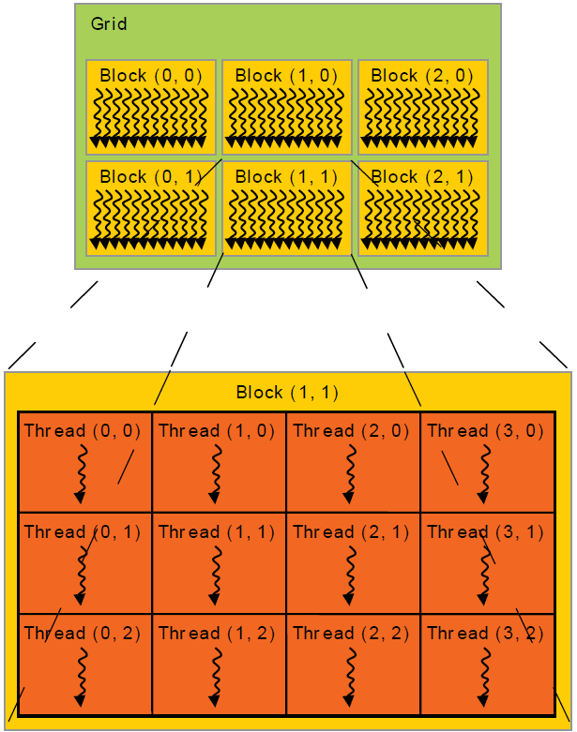
Thread Hierarchy in CUDA
Upto 3 grid dimensions
Upto 3 block dimensions
Example: kernelF<<<(3,2),(4,3)>>>
Grid
Block

Slide 23
Let's Start Again from C
int A[2][4];
for(i=0;i<2;i++)
for(j=0;j<4;j++)
A[i][j]++;
convert into CUDA
int A[2][4];
kernelF<<<(2,1),(4,1)>>>(A);
__device__ kernelF(A){
i = blockIdx.x;
j = threadIdx.x;
A[i][j]++;
}
// define 2x4=8 threads
// all threads run same kernel
// each thread block has its id
// each thread has its id
// each thread performs 1 increment
Notes:
Programmers explicitly express the available parallelism into threads. In this example, there are two thread blocks, each with four threads.

Slide 24
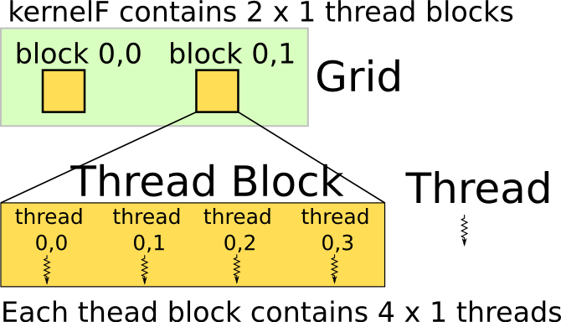
Thread Hierarchy
Example:
thread 3 of block 1 operates
on element A[1][3]
int A[2][4];
kernelF<<<(2,1),(4,1)>>>(A);
__device__ kernelF(A){
i = blockIdx.x;
j = threadIdx.x;
A[i][j]++;
}
// define 2x4=8 threads
// all threads run same kernel
// each thread block has its id
// each thread has its id
// each thread has different i and j
Notes:
The syntax of declaring the thread hierarchy is <<<(a,b,c),(d,e,f)>>>, in which
a,b,c are the three dimensions of the grid, which has (a*b*c) blocks
d,e,f, are the three dimensions of the block, which has (d*e*f) threads
If the a dimension is not specified, the default size of that dimension is one.

Slide 25
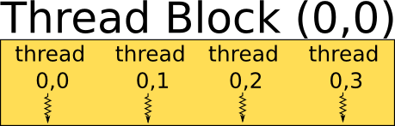
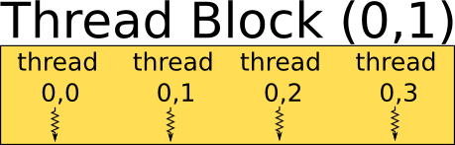

How Are Threads and Thread Blocks Scheduled?
Notes:
Each thread block can only run on one SIMD cluster.
Threads within the same thread block can share data via the same shared memory.
Threads in different blocks can only share data via global memory.

Slide 26
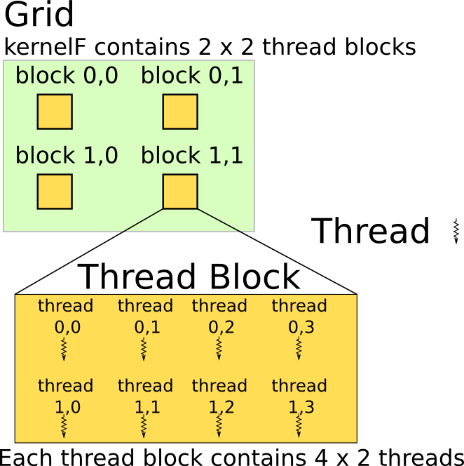
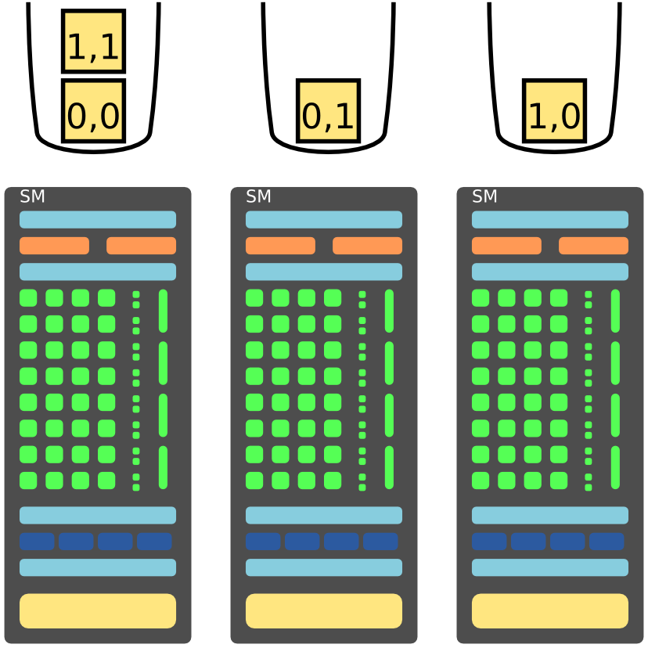
Blocks Are Dynamically Scheduled
- 4 blocks on 3 SMs
Notes:
Thread blocks are scheduled to the SIMD clusters dynamically.

Slide 27
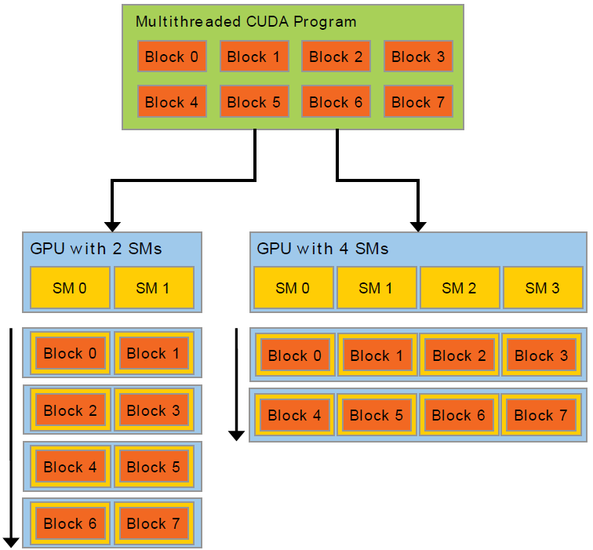
Scalability & HW agnostic
Dynamic block scheduling
allows to HW independent:
  same program runs on
  GPUs with different
  # of SMs

Slide 28
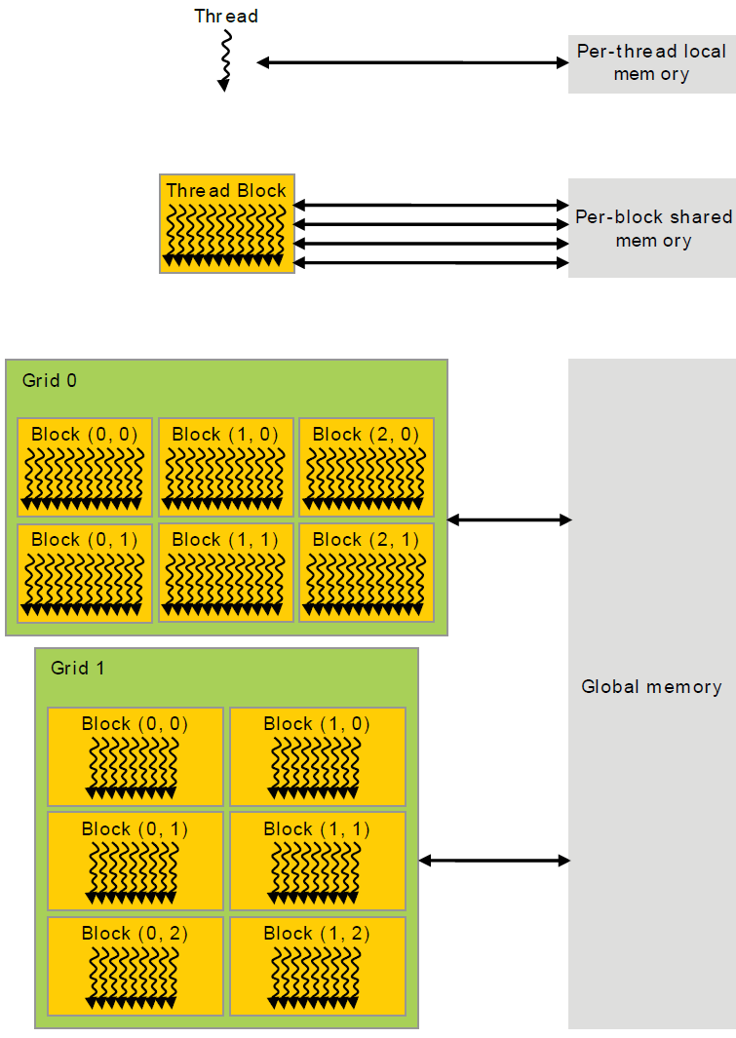
Memory Hierarchy

Slide 29
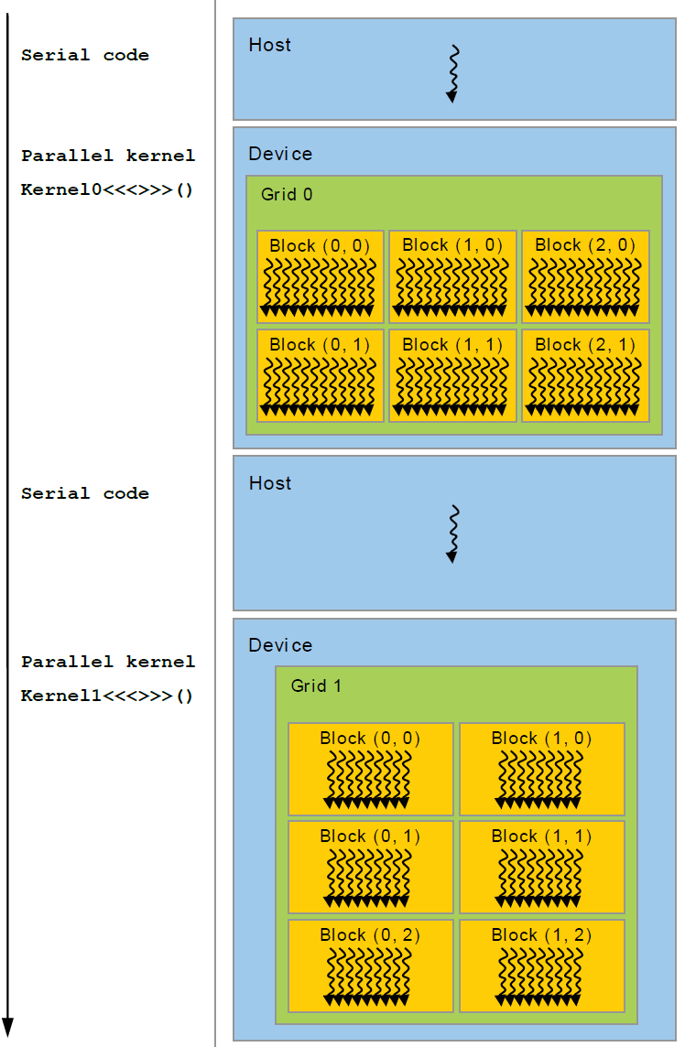
Host vs Device code

Slide 30
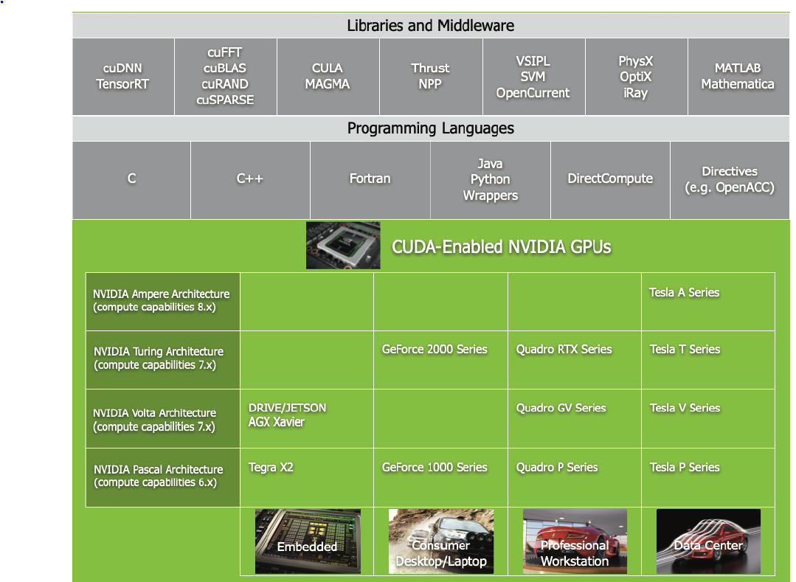
GPU Computing
Applications

Slide 31
How Are Threads Executed?
int A[2][4];
kernelF<<<(2,1),(4,1)>>>(A);
__device__ kernelF(A){
i = blockIdx.x;
j = threadIdx.x;
A[i][j]++;
}
mv.u32 %r0, %ctaid.x
mv.u32 %r1, %ntid.x
mv.u32 %r2, %tid.x
mad.u32 %r3, %r2, %r1, %r0
ld.global.s32 %r4, [%r3]
add.s32 %r4, %r4, 1
st.global.s32 [%r3], %r4
// r0 = i = blockIdx.x
// r1 = "threads-per-block"
// r2 = j = threadIdx.x
// r3 = i * "threads-per-block" + j
// r4 = A[i][j]
// r4 = r4 + 1
// A[i][j] = r4
Notes:
The assembly code shown here is similar to the syntax of Nvidia Parallel Thread Execution (PTX) virtual machine ISA:
http://docs.nvidia.com/cuda/parallel-thread-execution/
For the sake of simplicity, the code here does not follow the exact syntax of PTX.

Slide 32
Utilizing Memory Hierarchy
Memory
access
latency
several cycles
100+ cycles
Notes:
Access to shared memory takes a few cycles of delay, which can be hidden by multithreading. Moreover, the shared memory has multiple banks to improve bandwidth.
Access to global memory takes hundreds of cycles, because it is off-chip. Moreover, the bandwidth of global memory is two orders of magnitude smaller than shared memory.

Slide 33
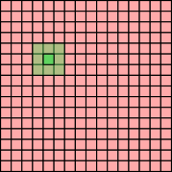
Example: Average Filters
Average over a
3x3 window for
a 16x16 array
kernelF<<<(1,1),(16,16)>>>(A);
__device__ kernelF(A){
i = threadIdx.y;
j = threadIdx.x;
tmp = (A[i-1][j-1] + A[i-1][j] +
… + A[i+1][i+1] ) / 9;
A[i][j] = tmp;
}
Each thread loads 9 elements
from global memory.
It takes hundreds of cycles.
Notes:
The bottlenecks are two folded:
It is bandwidth bound. For every byte loaded from off-chip memory, too few operations are performed. The computation to (off-chip) memory ration if too low. The PEs are therefore starved for data most of the time.
It is also latency bound. Even if the off-chip memory bandwidth is infinite, the latency of the off-chip access requires thousands of active threads to hide, which is hard to maintain.

Slide 34
Utilizing the Shared Memory
kernelF<<<(1,1),(16,16)>>>(A);
__device__ kernelF(A){
__shared__ int smem[16][16];
i = threadIdx.y;
j = threadIdx.x;
smem[i][j] = A[i][j]; // load to smem
A[i][j] = ( smem[i-1][j-1] + smem[i-1][j] +
… + smem[i+1][i+1] ) / 9;
}
Average over a
3x3 window for
a 16x16 array
Notes:
Programmers can declare a variable or an array as located in the shared memory, using the “__shared__” intrinsics.

Slide 35
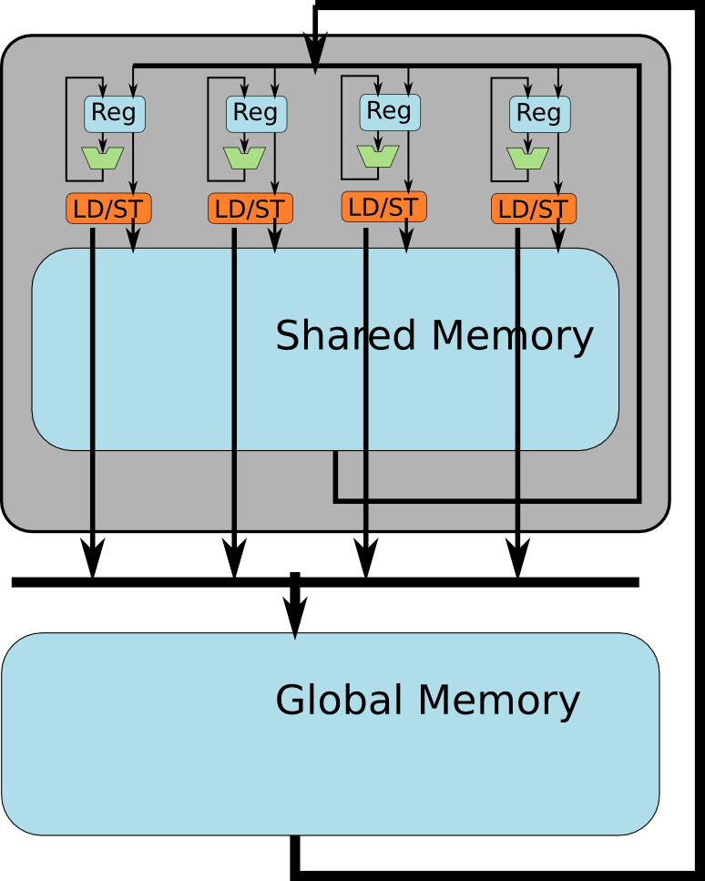

Utilizing the Shared Memory
kernelF<<<(1,1),(16,16)>>>(A);
__device__ kernelF(A){
__shared__ smem[16][16];
i = threadIdx.y;
j = threadIdx.x;
smem[i][j] = A[i][j]; // load to smem
A[i][j] = ( smem[i-1][j-1] + smem[i-1][j] +
… + smem[i+1][i+1] ) / 9;
}
allocate
shared
mem
Each thread loads one element from global memory
Notes:
There are three major steps:
each of the 16x16 threads loads 1 element from global memory to shared memory
each thread compute over a 3x3 window using shared memory
each thread store its result of window operation into the global memory
Now the computation to (off-chip) memory ratio is 9:2 (assuming 8-bit data, eight addition, one division, one read, one write).

Slide 36
However, the Program Is Incorrect
kernelF<<<(1,1),(16,16)>>>(A);
__device__ kernelF(A){
__shared__ smem[16][16];
i = threadIdx.y;
j = threadIdx.x;
smem[i][j] = A[i][j]; // load to smem
A[i][j] = ( smem[i-1][j-1] + smem[i-1][j] +
… + smem[i+1][i+1] ) / 9;
}
Hazards!
Notes:
As in all threaded programs, there are race hazards. Let’s debug the program step by step.

Slide 37
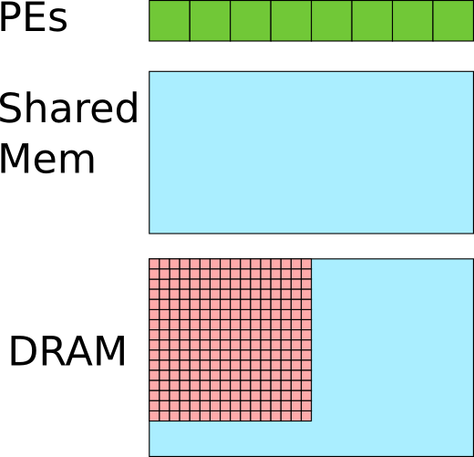
Let's See What's Wrong
Assume 256 threads are scheduled on 8 PEs.
kernelF<<<(1,1),(16,16)>>>(A);
__device__ kernelF(A){
__shared__ smem[16][16];
i = threadIdx.y;
j = threadIdx.x;
smem[i][j] = A[i][j]; // load to smem
A[i][j] = ( smem[i-1][j-1] + smem[i-1][j] +
… + smem[i+1][i+1] ) / 9;
}
Before load instruction
Notes:
Before the load instruction, all the 16x16 elements are in the global memory.

Slide 38
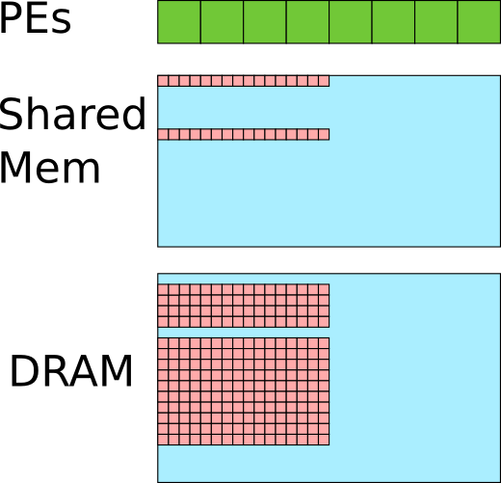
Let's See What's Wrong
Assume 256 threads are scheduled on 8 PEs.
kernelF<<<(1,1),(16,16)>>>(A);
__device__ kernelF(A){
__shared__ smem[16][16];
i = threadIdx.y;
j = threadIdx.x;
smem[i][j] = A[i][j]; // load to smem
A[i][j] = ( smem[i-1][j-1] + smem[i-1][j] +
… + smem[i+1][i+1] ) / 9;
}
Some threads finish the load earlier than others.
Notes:
Now some threads loads the data to shared memory ahead of other threads, because threads are executed out of order.

Slide 39
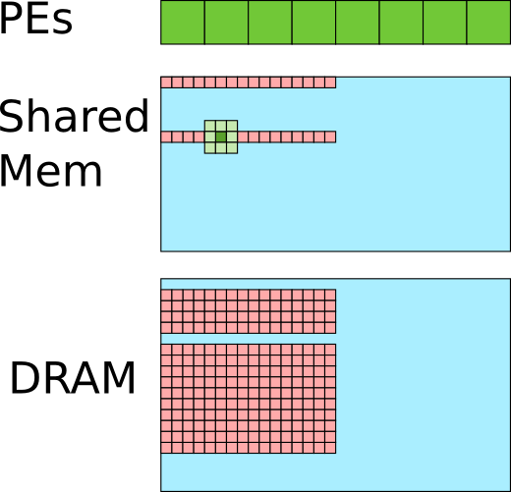
Let's See What's Wrong
Assume 256 threads are scheduled on 8 PEs.
kernelF<<<(1,1),(16,16)>>>(A);
__device__ kernelF(A){
__shared__ smem[16][16];
i = threadIdx.y;
j = threadIdx.x;
smem[i][j] = A[i][j]; // load to smem
A[i][j] = ( smem[i-1][j-1] + smem[i-1][j] +
… + smem[i+1][i+1] ) / 9;
}
Some elements in the window are not yet loaded by other threads. Error!
Notes:
Some threads start execute the window operation before other threads finish loading the data to shared memory. Therefore, the window operation operates on faulty data.

Slide 40
How To Solve It?
Assume 256 threads are scheduled on 8 PEs.
kernelF<<<(1,1),(16,16)>>>(A);
__device__ kernelF(A){
__shared__ smem[16][16];
i = threadIdx.y;
j = threadIdx.x;
smem[i][j] = A[i][j]; // load to smem
A[i][j] = ( smem[i-1][j-1] + smem[i-1][j] +
… + smem[i+1][i+1] ) / 9;
}
Notes:
How to solve the race condition in threaded program?

Slide 41
Use a "SYNC" barrier
kernelF<<<(1,1),(16,16)>>>(A);
__device__ kernelF(A){
__shared__ smem[16][16];
i = threadIdx.y;
j = threadIdx.x;
smem[i][j] = A[i][j]; // load to smem
__SYNC();
A[i][j] = ( smem[i-1][j-1] + smem[i-1][j] +
… + smem[i+1][i+1] ) / 9;
}
Assume 256 threads are scheduled on 8 PEs.
Notes:
CUDA introduce a “SYNC” barrier, at which all threads within the same thread block will synchronize. Threads cannot advance beyond the SYNC barrier unless all other threads within the same thread block arrive at the SYNC barrier.

Slide 42
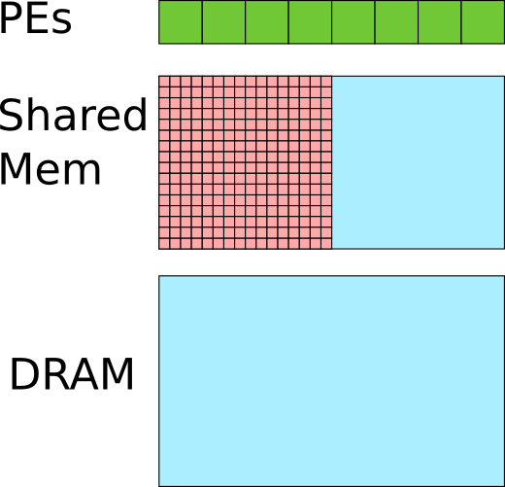
Use a "SYNC" barrier
kernelF<<<(1,1),(16,16)>>>(A);
__device__ kernelF(A){
__shared__ smem[16][16];
i = threadIdx.y;
j = threadIdx.x;
smem[i][j] = A[i][j]; // load to smem
__SYNC();
A[i][j] = ( smem[i-1][j-1] + smem[i-1][j] +
… + smem[i+1][i+1] ) / 9;
}
Assume 256 threads are scheduled on 8 PEs.
Wait until all
threads
hit barrier
Notes:
When all threads hit the SYNC barrier, the 16x16 elements are all loaded to shared memory.

Slide 43
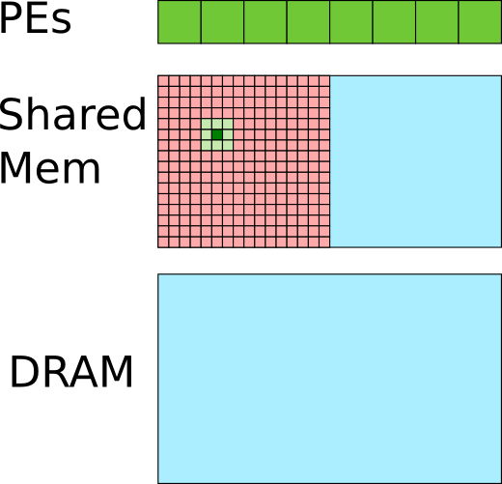
Use a "SYNC" barrier
kernelF<<<(1,1),(16,16)>>>(A);
__device__ kernelF(A){
__shared__ smem[16][16];
i = threadIdx.y;
j = threadIdx.x;
smem[i][j] = A[i][j]; // load to smem
__SYNC();
A[i][j] = ( smem[i-1][j-1] + smem[i-1][j] +
… + smem[i+1][i+1] ) / 9;
}
Assume 256 threads are scheduled on 8 PEs.
All elements in the window are loaded when each thread starts averaging.
Notes:
After the SYNC barrier, the threads does not need to be synchronized any more.

Slide 44

Review what we have learned so far
1. Single Instruction Multiple Thread (SIMT)
2. Shared memory
Q: What are the pros and cons of explicitly managed memory?
Q: What are the fundamental differences between SIMT and vector SIMD programming model?

Slide 45
Take the same example again
Assume vector SIMD and SIMT both have shared memory
What are the differences?
Average over a
3x3 window for
a 16x16 array
Notes:
As mentioned earlier, the shared memory is not a fundamental difference between vector SIMD and SIMT. We will now look into the fundamental difference.

Slide 46
Vector SIMD v.s. SIMT
int A[16][16]; // A in global memory
__shared__ int B[16][16]; // B in shared mem
for(i=0;i<16;i++){
for(j=0;j<16;j+=4){
movups xmm0, [ &A[i][j] ]
movups [ &B[i][j] ], xmm0 }}
for(i=0;i<16;i++){
for(j=0;j<16;j+=4){
addps xmm1, [ &B[i-1][j-1] ]
addps xmm1, [ &B[i-1][j] ]
… divps xmm1, 9 }}
for(i=0;i<16;i++){
for(j=0;j<16;j+=4){
addps [ &A[i][j] ], xmm1 }}
kernelF<<<(1,1),(16,16)>>>(A);
__device__ kernelF(A){
__shared__ int smem[16][16];
i = threadIdx.y;
j = threadIdx.x;
smem[i][j] = A[i][j]; // load to smem
__sync(); // threads wait at barrier
A[i][j] = ( smem[i-1][j-1] + smem[i-1][j] +
… + smem[i+1][i+1] ) / 9;
}
(1)
(1)
(2)
(3)
(2)
(3)
load to shared mem
compute
store to global mem
Notes:
Let’s look at two pieces of code, with vector SIMD code on the left and SIMT code on the right. They both execute the window average example that we have discussed earlier. Both have three major steps, but with differences.

Slide 47
Vector SIMD v.s. SIMT
kernelF<<<(1,1),(16,16)>>>(A);
__device__ kernelF(A){
__shared__ smem[16][16];
i = threadIdx.y;
j = threadIdx.x;
smem[i][j] = A[i][j]; // load to smem
__sync(); // threads wait at barrier
A[i][j] = ( smem[i-1][j-1] + smem[i-1][j] +
… + smem[i+1][i+1] ) / 9;
}
int A[16][16]; // A in global memory
__shared__ int B[16][16]; // B in shared mem
for(i=0;i<16;i++){
for(j=0;j<16;j+=4){
movups xmm0, [ &A[i][j] ]
movups [ &B[i][j] ], xmm0 }}
for(i=0;i<16;i++){
for(j=0;j<16;j+=4){
addps xmm1, [ &B[i-1][j-1] ]
addps xmm1, [ &B[i-1][j] ]
… divps xmm1, 9 }}
for(i=0;i<16;i++){
for(j=0;j<16;j+=4){
addps [ &A[i][j] ], xmm1 }}
(a)
(b)
(c)
(d)
HW vector width explicit to programmer
HW vector width transparent to programmers
each vector executed by all PEs in lock step
threads executed out of order, need explicit sync
Notes:
The difference of (a) and (b) is not a clear cut. There are SIMD programming models that can abstract the HW vector width. That said, between SSE and CUDA, the difference of (a) and (b) is apparent.
The difference of (c) and (d) is more fundamental. Elements in a vector should have the same program state, while threads can have different program states.

Slide 48
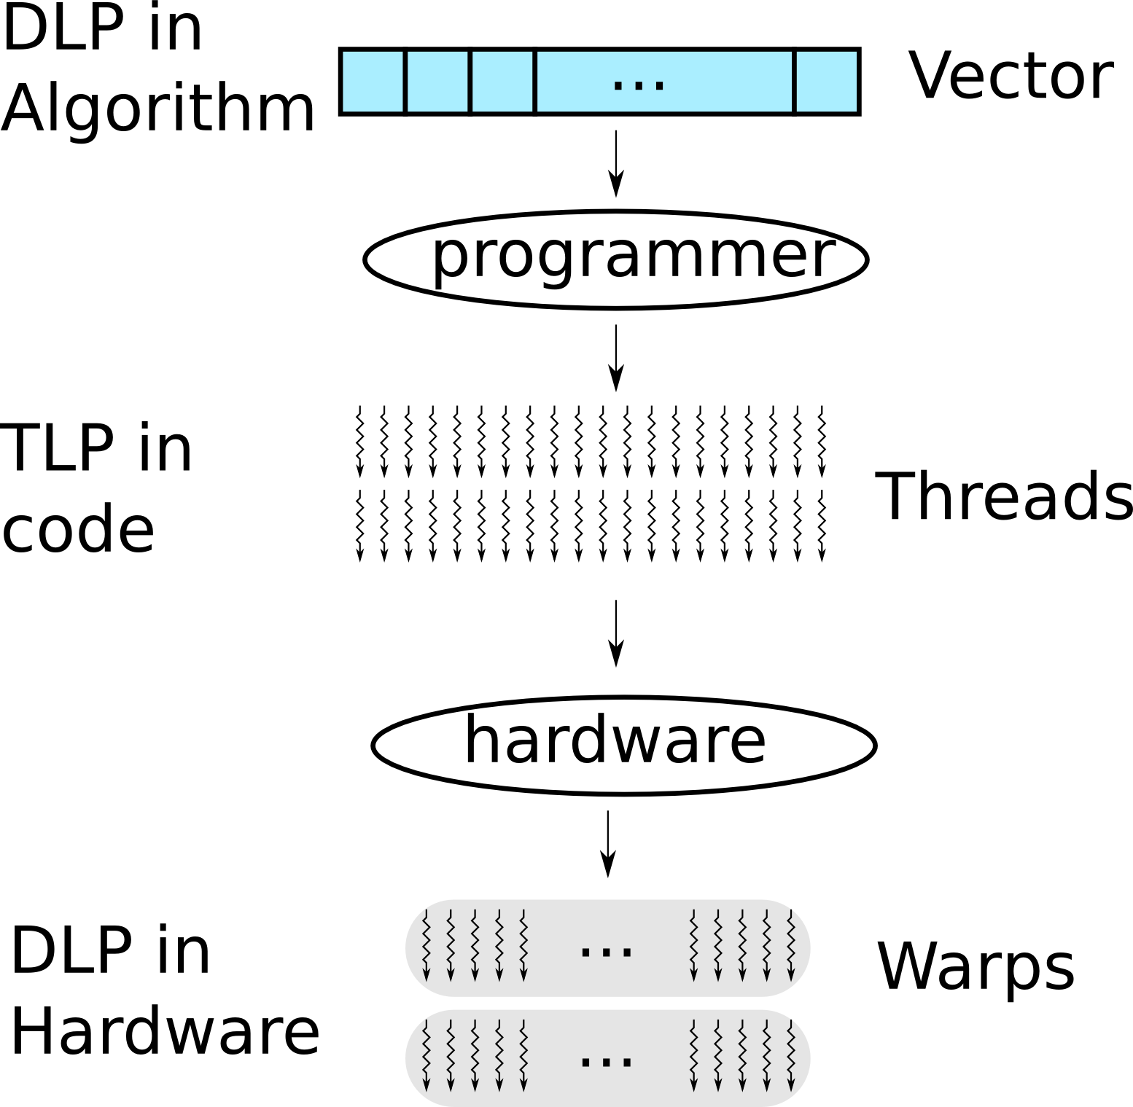
Review What We Have Learned
?
Programmers convert data level parallelism (DLP) into thread level parallelism (TLP)
Notes:
The application algorithm usually consists of data level parallelism (DPL). GPU programmers need to convert DPL into thread level parallelism (TLP) for the GPU programming model. On the GPU hardware, the TLP is dynamically converted into DPL. In Nvidia GPUs, 32 threads (within a thread block) are grouped into a warp, which is scheduled for execution together.

Slide 49
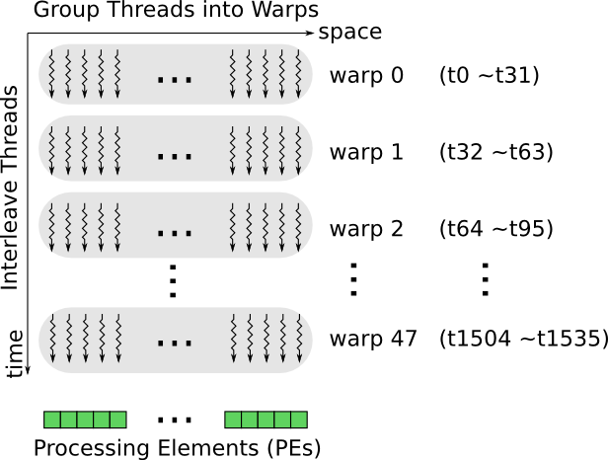
HW Groups Threads Into Warps
Example: 32 threads per warp
Notes:
Threads are grouped into warps, shown in the horizontal direction.
Warps are time-multiplexed on the PEs, shown in the vertical direction.

Slide 50
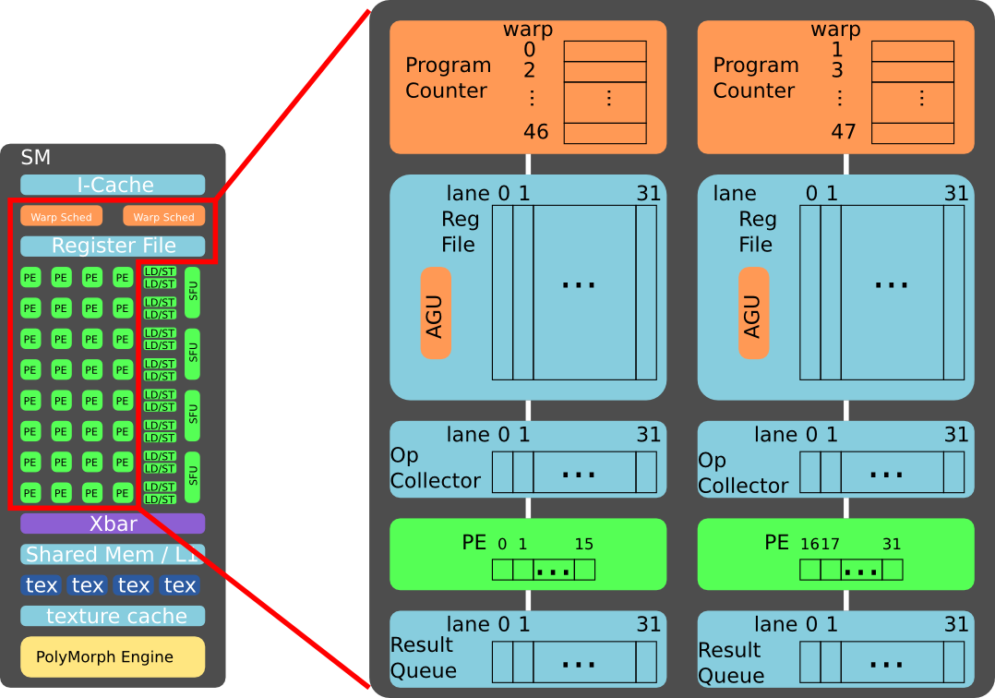
Example of Warp Implementation
Note: NVIDIA may use a more complicated implementation.
See patent: US 8555035 B1
Notes:
This example assumes the two warp schedulers are decoupled. It is possible that they are coupled together, at the cost of hardware complexity.
There are several components:
Warp scheduler, with 46 program counters, each for a warp.
Register file, with 32 lanes, typically one read port and one write port per lane.
Operant collector, with 32 lanes, can have multiple read ports.
Processing elements, 16 PEs per 32 data lane.
Result queue, with 32 lanes.

Slide 51
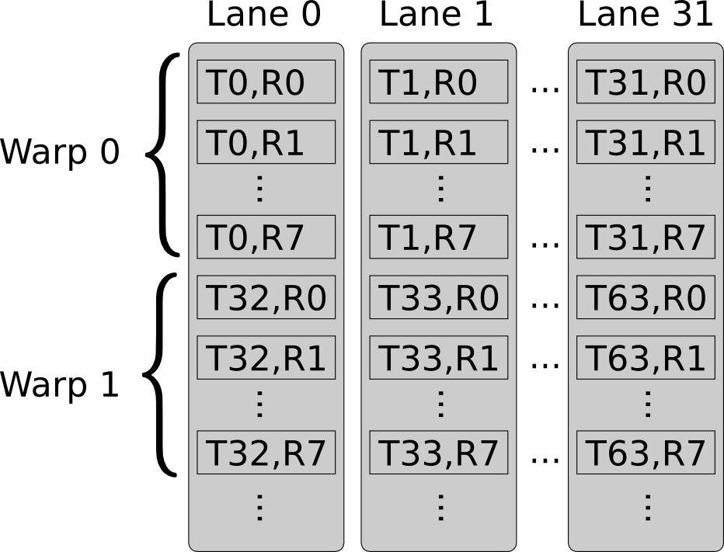
Example of Register Allocation
Assumption:
register file has 32 lanes
each warp has 32 threads
each thread uses 8 registers
Acronym:
“T”: thread number
“R”: register number
Note: NVIDIA may use a more complicated allocation method.
See patent: US 7634621 B1, “Register file allocation”.
Notes:
For the sake of simplicity, assume warp 0 and warp 1 are assigned to the same 32-lane register file, next to each other. In reality, warp 0 and warp 1 can be assigned differently, and to different register files.

Slide 52
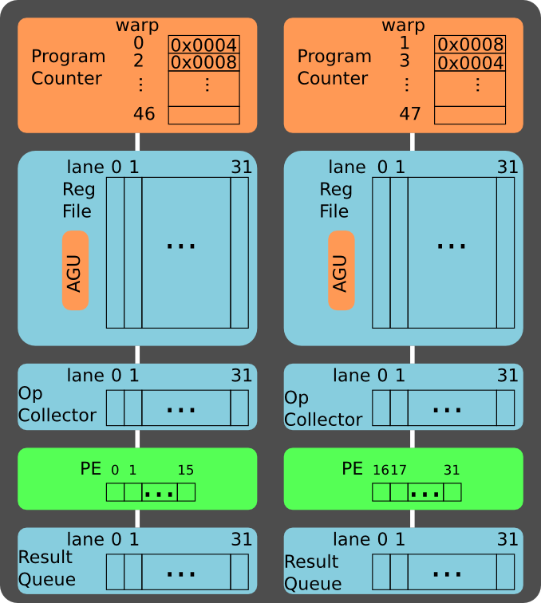
Example
Address : Instruction
0x0004 : add r0, r1, r2
0x0008 : sub r3, r4, r5
Assume:
two data paths
warp 0 on left data path
warp 1 on right data path
Acronyms:
“AGU”: Address Generation Unit
“r”: register in a thread
“w”: warp number
Notes:
Example of two warps:
Warp 0 executes on the left data path with the instruction add r0, r1, r2
Warp 1 executes on the right data path with the instruction sub r3, r4, r5

Slide 53
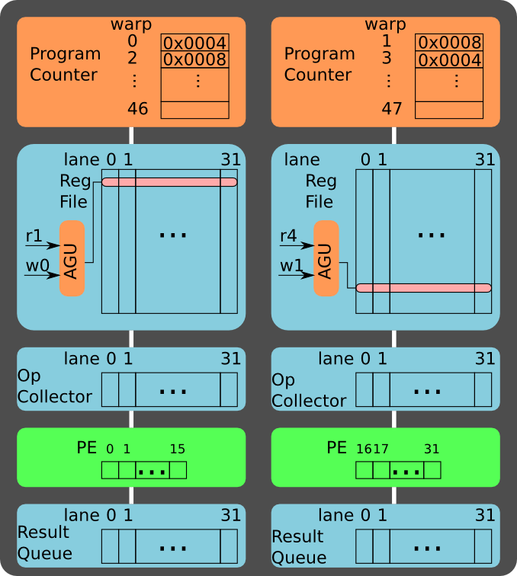
Read Src Op 1
Address : Instruction
0x0004 : add r0, r1, r2
0x0008 : sub r3, r4, r5
Read source operands:
r1 for warp 0
r4 for warp 1
Notes:
Assume the register file has one read port. In cycle 1, warp 0 reads r1, while warp 1 reads r4.
The address generation unit (AGU) maps the warp id and register id into the physical address.
The register file may need two read port to support instructions with 3 source operands, e.g. the Fused Multiply Add (FMA).

Slide 54
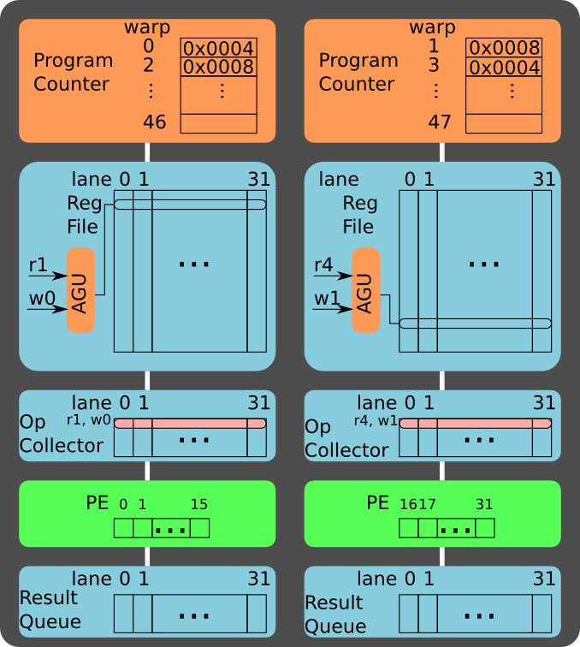
Buffer Src Op 1
Address : Instruction
0x0004 : add r0, r1, r2
0x0008 : sub r3, r4, r5
Push ops to op collector:
r1 for warp 0
r4 for warp 1
Notes:
The 32 register values of the warp (32 threads) are read out from the register file within a single cycle.
The PEs cannot execute the actual operation yet, because the second operand of the instruction (r2 for warp 0 and r5 for warp 1) is not yet available.
Therefore, the first operand needs to be store at a buffer, called operand collector. The operand collector is a buffer and is less deep than the register file. Therefore, the operand collector can afford multiple read ports.

Slide 55

Read Src Op 2
Address : Instruction
0x0004 : add r0, r1, r2
0x0008 : sub r3, r4, r5
Read source operands:
r2 for warp 0
r5 for warp 1
Notes:
In cycle 2, warp 0 reads r2, while warp 1 reads r5.

Slide 56
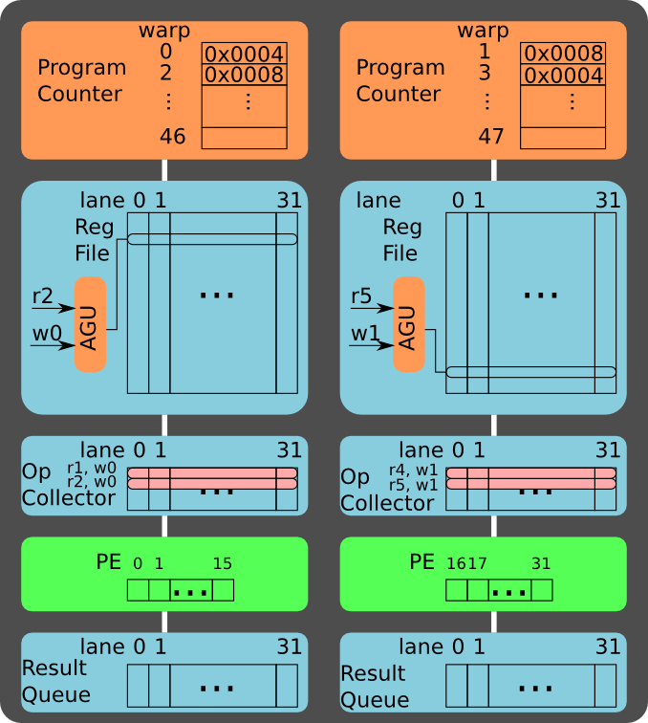
Buffer Src Op 2
Address : Instruction
0x0004 : add r0, r1, r2
0x0008 : sub r3, r4, r5
Push ops to op collector:
r2 for warp 0
r5 for warp 1
Notes:
The second operand is also pushed to the operand collector.

Slide 57
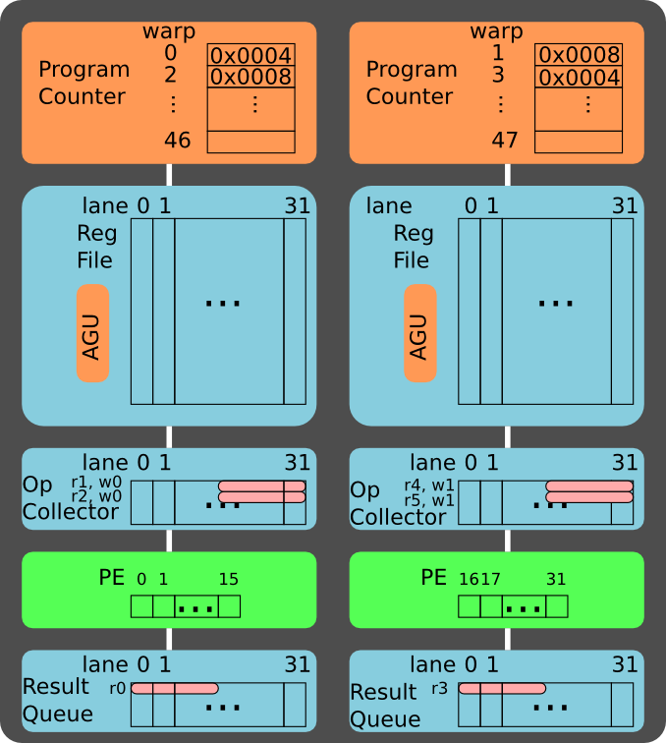
Execute Stage 1
Address : Instruction
0x0004 : add r0, r1, r2
0x0008 : sub r3, r4, r5
Compute the first 16 threads in the warp.
Notes:
Now both operands are available in the operand collector. Therefore, warp 0 can perform the “add”, and warp 1 can perform the “sub”.
There are 16 PEs for every 32-lane data path. Therefore, each warp execution is performed in two stages:
In the first stage, 16 PEs execute the first 16 threads of the 32-thread warp
In the second stage, 16 PEs execute the last 16 threads of the 32-thread warp
Note that now other warps can start their read out stage.
Question: Does it help if we use 32 PEs (instead of 16 PEs) for each 32-lane data path?
Answer: If we use 32 PEs (instead of 16 PEs) for each 32-lane data path, the execution is done in one cycle. However, the source operands are only available every two cycles (due to a single read port in the register file), the PEs will be idle every other cycle.

Slide 58
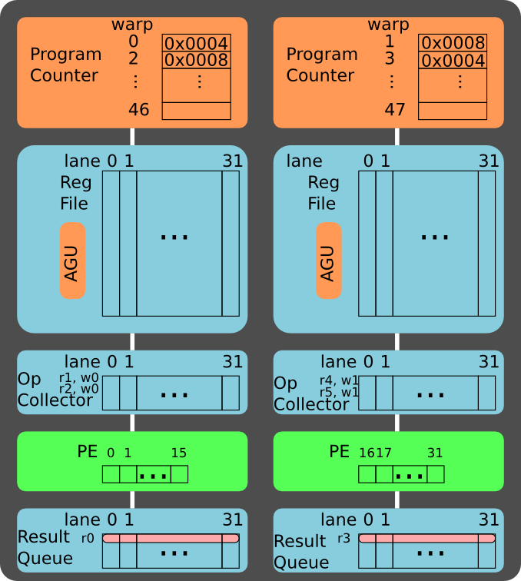
Execute Stage 2
Address : Instruction
0x0004 : add r0, r1, r2
0x0008 : sub r3, r4, r5
Compute the last 16 threads in the warp.
Notes:
The results of the two-stage are buffered into the result queue, waiting to be written back to the register file.

Slide 59
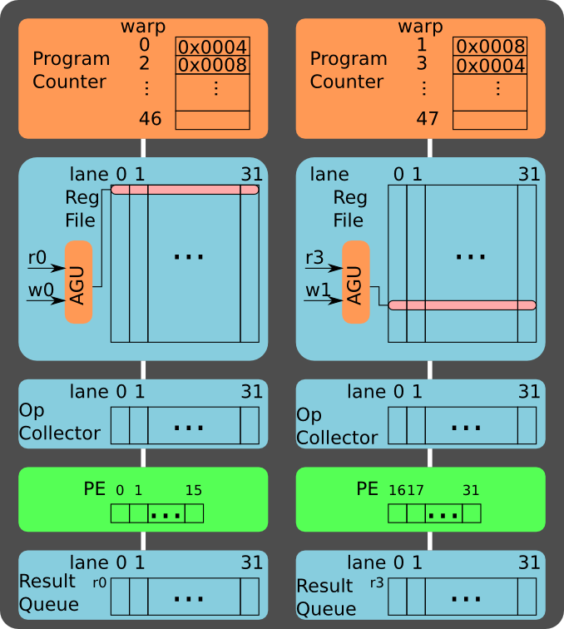
Write Back
Address : Instruction
0x0004 : add r0, r1, r2
0x0008 : sub r3, r4, r5
Write back:
r0 for warp 0
r3 for warp 1
Notes:
After the write back stage, the instruction retires. The program counter of the warp can be advanced.
In this example, there are only five stages in the execution pipeline. In the GPU, the pipeline can be as deep as 10 to 20 cycles, although the pipeline throughput can keep the PEs busy every cycle.

Slide 60
Recap
What we have learned so far:
Pros and cons of massive threading
How threads are executed on GPUs
Next:
variations of GPUs, multiprocessor clusters

Slide 61
NVIDIA Fermi (2009)
ref: http://www.nvidia.com/content/PDF/fermi_white_papers/NVIDIA_Fermi_Compute_Architecture_Whitepaper.pdf
Notes:
NVIDIA Fermi architecture can scale to 512 Cores, also called Processing Elements (PEs), although low-end versions are configured with less PEs.
In the context of this lecture, and related documents, these three terms are equivalent and interchangeable:
Processing Element (PE)
Stream Processor (SP)
Core

Slide 62


NVIDIA Kepler (2012)
ref: http://www.nvidia.com/object/nvidia-kepler.html
Notes:
Nvidia Kepler architecture scales to 2000+ cores (http://www.nvidia.com/object/tesla-servers.html). It resembles the previous generation, but packs more PEs into a cluster.
Here is a detailed review of the difference between Kepler and Fermi architecture:
http://www.anandtech.com/show/5699/nvidia-geforce-gtx-680-review/

Slide 63


NVIDIA Maxwell (2014)
ref: http://international.download.nvidia.com/geforce-com/international/pdfs/GeForce_GTX_980_Whitepaper_FINAL.PDF
Notes:
Nvidia Maxwell is focusing on energy efficiency. The PE cluster contains multiple partitions, within which threads are scheduled locally. It is beneficial for hardware complexity and energy efficiency.
White paper on NVIDIA Maxwell architecture:
http://international.download.nvidia.com/geforce-com/international/pdfs/GeForce_GTX_980_Whitepaper_FINAL.PDF
Here is a detailed review of the difference between Maxwell and Kepler architecture:
http://www.anandtech.com/show/5699/nvidia-geforce-gtx-680-review/

Slide 64


NVIDIA Pascal (GP100, 2016)
ref: https://images.nvidia.com/content/pdf/tesla/whitepaper/pascal-architecture-whitepaper.pdf
Notes:
Nvidia Pascal GP100 focusses on professional compute applications. A full GP100 GPU consists of 60SMs which have only 64 FP32 cores per SM, but also 32 FP64 cores in each SM.
Whitepaper of the GP100: https://images.nvidia.com/content/pdf/tesla/whitepaper/pascal-architecture-whitepaper.pdf
Detailed review of the Pascal architecture: https://www.anandtech.com/show/10325/the-nvidia-geforce-gtx-1080-and-1070-founders-edition-review/2

Slide 65


NVIDIA Volta (2017): TC units
ref: https://images.nvidia.com/content/pdf/tesla/whitepaper/pascal-architecture-whitepaper.pdf
Notes:
Nvidia Pascal GV100 focusses on professional compute applications. A full GV100 GPU consists of 80SMs which have only 64 FP32 cores, 32 FP64 cores and 8 Tensor cores per SM. Tensor cores are designed for deep-learning and can perform 4x4 matrix operations (e.g. matrix multiplication) in FP16.
Whitepaper of the GV100 (log-in required): http://www.nvidia.com/object/volta-architecture-whitepaper.html
Great article about GV100 and comparison to GP100:
https://www.anandtech.com/show/11367/nvidia-volta-unveiled-gv100-gpu-and-tesla-v100-accelerator-announced

Slide 66


NVIDIA Turing (2018)
ref: https://www.nvidia.com/content/dam/en-zz/Solutions/design-visualization/technologies/turing-architecture/NVIDIA-Turing-Architecture-Whitepaper.pdf
Notes:
Nvidia Pascal GV100 focusses on professional compute applications. A full GV100 GPU consists of 80SMs which have only 64 FP32 cores, 32 FP64 cores and 8 Tensor cores per SM. Tensor cores are designed for deep-learning and can perform 4x4 matrix operations (e.g. matrix multiplication) in FP16.
Whitepaper of the GV100 (log-in required): http://www.nvidia.com/object/volta-architecture-whitepaper.html
Great article about GV100 and comparison to GP100:
https://www.anandtech.com/show/11367/nvidia-volta-unveiled-gv100-gpu-and-tesla-v100-accelerator-announced

Slide 67


NVIDIA Ampere (2020)
ref: https://developer.nvidia.com/blog/nvidia-ampere-architecture-in-depth/
Notes:
Nvidia Ampere GA100
https://developer.nvidia.com/blog/nvidia-ampere-architecture-in-depth/
https://www.anandtech.com/show/15801/nvidia-announces-ampere-architecture-and-a100-products
The full implementation of the GA100 GPU includes the following units:
8 GPCs, 8 TPCs/GPC, 2 SMs/TPC, 16 SMs/GPC, 128 SMs per full GPU
64 FP32 CUDA Cores/SM, 8192 FP32 CUDA Cores per full GPU
4 third-generation Tensor Cores/SM, 512 third-generation Tensor Cores per full GPU
6 HBM2 stacks, 12 512-bit memory controllers
The A100 Tensor Core GPU implementation of the GA100 GPU includes the following units:
7 GPCs, 7 or 8 TPCs/GPC, 2 SMs/TPC, up to 16 SMs/GPC, 108 SMs
64 FP32 CUDA Cores/SM, 6912 FP32 CUDA Cores per GPU
4 third-generation Tensor Cores/SM, 432 third-generation Tensor Cores per GPU
5 HBM2 stacks, 10 512-bit memory controllers

Slide 68

Variations of Multiprocessor Cluster
From Fermi to Kepler: More cores per cluster
From Kepler to Maxwell: Partition cluster into sub-clusters
Question: What are the Pros and Cons of these variations?
Notes:
From Fermi to Kepler:
Change: More cores per compute cluster.
Pros: Increase computation density.
Cons: Complexity of communication network. Pressure on instruction cache throughput.
From Kepler to Maxwell:
Change: Partition a cluster into sub-clusters.
Pros: Improve energy efficiency by eliminating complex network between sub-clusters.
Cons: Less area efficient. For example, each sub-cluster will need its own set of SFU and LD/ST unit.
References:
Comparison between Kepler and Fermi:
http://www.anandtech.com/show/5699/nvidia-geforce-gtx-680-review/
Comparison between Maxwell and Kepler:
http://www.anandtech.com/show/8526/nvidia-geforce-gtx-980-review/

Slide 69


Tensor cores
Specialized core for e.g. deep learning
  Operates on narrow data types, e.g. fp16
Example: 4x4x4 matrix-multiply accumulate
ref: https://www.anandtech.com/show/12673/titan-v-deep-learning-deep-dive/3

Slide 70

Tensor cores – supported formats
Floating point (see picture):
  FP32, TF32, FP16, BF16
  Note the easy conversion from FP32 to TF32 and BF16 (just dropping mantissa bits)
Integer
  32, 16, 8, 4 and 1-bit
ref: https://developer.nvidia.com/blog/nvidia-ampere-architecture-in-depth/

Slide 71
Matrix-Matrix Multiplication on TC unit

Slide 72
Programming Tensor cores – example of 1 fragment
#include <mma.h>
using namespace nvcuda;
__global__ void wmma_ker(half *a, half *b, float *c) {
// Declare 3 fragments
// m = 16, n =16 , k=16
wmma::fragment<wmma::matrix_a, 16, 16, 16, half, wmma::row_major> a_frag;
wmma::fragment<wmma::matrix_b, 16, 16, 16, half, wmma::col_major> b_frag;
wmma::fragment<wmma::accumulator, 16, 16, 16, float> c_frag;
// Initialize output c_frag to zero
wmma::fill_fragment(c_frag, 0);
// Load the inputs a&b into a_frag & b_frag
wmma::load_matrix_sync(a_frag, a, 16);
wmma::load_matrix_sync(b_frag, b, 16);
// Perform the matrix multiplication
wmma::mma_sync(c_frag, a_frag, b_frag, c_frag);
// Store the output
wmma::store_matrix_sync(c, c_frag, 16, wmma::mem_row_major);
}
WMMA (Warp Matrix Multiply Accumulate) API
Notes:
https://docs.nvidia.com/cuda/cuda-c-programming-guide/
https://developer.nvidia.com/blog/programming-tensor-cores-cuda-9/

Slide 73

Tensor Cores data type tables
More info: CUDA programming guide: https://docs.nvidia.com/cuda/cuda-c-programming-guide/
Support for other floating point formats (__nv_bfloat16)
Experimental support for sub-byte operations (half-byte [u4/s4] and bit [b1])
Notes:
https://docs.nvidia.com/cuda/cuda-c-programming-guide/
https://developer.nvidia.com/blog/programming-tensor-cores-cuda-9/

Slide 74
What Are the Possible Hazards in GPUs?
Three types of hazards we have learned earlier:
Structural hazards
Data hazards
Control hazards

Slide 75

Structural Hazards
E.g. when MEM and IF stage use same single ported memory
In practice, structural hazards need to be handled dynamically.
Notes:
Assume the register file of MIPS has two read port and one write port. What would happen for a three-operand operation? Multiple issue? Instructions of different latency?

Slide 76

Data Hazards
In practice, we have a much longer pipeline.
Notes:
What happened when the pipeline is deeper? The Netburst went Netbust (https://en.wikipedia.org/wiki/Pentium_4).

Slide 77

Control Hazards
We cannot travel back in time. What should we do?
Notes:
CPUs typically uses branch predictors (https://en.wikipedia.org/wiki/Branch_predictor).
Can we play some better tricks? What if we can switch threads at zero cycle cost?

Slide 78

Additional Hazards: Mem Bank Conflicts
Similar to structural hazard
Example: 32 threads try to perform loads or stores simultaneously to the 32-bank memory.

Slide 79


Shared Memory (compute capability 2.x)
Without
bank
conflict:
With
bank
conflict:
Programmers take the responsibility to eliminate bank conflicts
Notes:
Reference on shared memory conflicts:
https://docs.nvidia.com/cuda/cuda-c-programming-guide/

Slide 80

Global Memory: Access Coalescing
Example: 32 thread access the global memory (off-chip GPU board DRAM)
The memory transaction will load/store consecutive data at 32/64/128-Byte boundary
Non-aligned access will cause additional memory transactions
Below: coalesced, but non-alligned
Notes:
Reference on global memory alignment:
https://docs.nvidia.com/cuda/cuda-c-programming-guide/

Slide 81

Additional Hazards: Branch Divergence
GPUs (and SIMDs in general) have additional challenges: branch divergence
Notes:
What is some elements (threads) within a vector (warp) diverge at branch?

Slide 82

Let's Start Again from a simple CPU
Let's start from MIPS.

Slide 83

A Naive SIMD Processor
How to handle branch divergence within a vector?
Notes:
Copy and paste the data path and we have a naive SIMD processor. How should we handle branch?
Most SIMD execute both paths of a branch, masking out the part of the vectors accordingly.

Slide 84

Handling Branch In GPU
Threads within a warp are free to branch.
if( $r17 > $r19 ){
$r16 = $r20 + $r31
}
else{
$r16 = $r21 - $r32
}
$r18 = $r15 + $r16
Assembly code on the right are disassembled from cuda binary (cubin) using "decuda", link
Notes:
GPU handles branches more dynamically. Let’s play with an example.
At the branch (PC: 0x0012), the “else” path (label10) is pushed into a branch stack. The program first executes the “if” path, and then jump to the merge point (label11). At the merge point, the branch stack pops out the “else” path (label10).

Slide 85

If No Branch Divergence in a Warp
If threads within a warp take the same path, the other path will not be executed.
Notes:
If no thread takes the “else” path, there is no need to push the “else” path (label10) into the branch stack. Therefore, only the “if” path is executed.

Slide 86

Branch Divergence within a Warp
If threads within a warp diverge, both paths have to be executed.
Masks are set to filter out threads not executing on current path.
Notes:
If the threads within a warp indeed diverge, both paths of the branch are executed. Some PEs are idle in this case, because the data lanes cannot be rounded to arbitrary PEs dynamically.

Slide 87


Dynamic Warp Formation
Example: merge two divergent warps into a new warp if possible.
Create warp 3 from warp 0 and 1
Create warp 4 from warp 0 and 1
ref: Dynamic warp formation: Efficient MIMD control flow on SIMD graphics hardware. http://dx.doi.org/10.1145/1543753.1543756
Notes:
A more advanced technique is dynamic branch formation. If warp 0 and warp 1 both diverge at a branch, there are chances that threads can be re-organized into warps such that they can keep the PEs busy.

Slide 88

Performance modeling: the Roofline Model
Performance bottleneck: computation bound v.s. bandwidth bound
Note: log-log scale
Notes:
The Roofline model is a first-order model for bottleneck analysis:
http://dx.doi.org/10.1145/1498765.1498785
For the architecture, it takes peak performance and memory bandwidth into account.
For the algorithm, it take operational intensity (or computation to off-chip memory ratio) into account
The figure is taken from 8800 GPU. According to the analysis, if an algorithm has an operational intensity of 8 or higher, the algorithm will hit the peak performance of the GPU, which is computation bounded. If an algorithm has an operational intensity less than 8, the algorithm will hit the bandwidth limit, thus making it bandwidth bounded.

Slide 89

Optimization is Key for Attainable Gflops/s
Notes:
In reality, it is difficult to reach the theoretical peak computational performance and the peak bandwidth. For example, if the off-chip memory is irregular, the effective bandwidth will be lower, which requires the algorithms to have a higher operational intensity to avoid being bandwidth bounded.

Slide 90
Learned so far….
Vector / SIMD processing
  Exploiting DLP (data-level parallelism)
  It's everywhere
  Energy efficient = many operations / Joule
GPU, the processing workhorse of the future
  Support SIMT execution model
  Based on SIMD execution cores (called SMs)
    can contain thousands of PEs (Processing Elements)
  Thousands of parallel threads
GPU programming in CUDA (or OpenCL)
  SIMT programming model
  Avoid bottlenecks / hazards

Slide 91
CUDA programming
CUDA programming manual
  https://docs.nvidia.com/cuda/cuda-c-programming-guide/index.html
  ch 2.1-2.4, 2.6
  ch 3.1-3.2.4
  ch 4.1-.4.2
  ch 5 Performance guidelines
Best Practices Guide:
  https://docs.nvidia.com/cuda/cuda-c-best-practices-guide/index.html
An even easier introduction to CUDA:
  https://developer.nvidia.com/blog/even-easier-introduction-cuda/
Lab2: Efficient mapping of a convolution layer to an NVIDIA GPU

Slide 92


Lab 2
Mapping and Accelerating a Convolutional Neural Netowrk on a GPU
AlexNet (partly)

Slide 93

AlexNet: Where is the execution time going?

Slide 94

1-layer Convolution in CNNs
N = batch size
C input feature maps of size HxW
M output feature maps of size ExF
M filters of size RxS

Slide 95


Turing architecture (2019)
SM unit

Slide 96

Convolution vs Matrix Multiply: im2col transformation

Slide 97

Matrix-Matrix Multiplication

Slide 98
Lab2: Matrix-Matrix Multiplication Optimizations
Tiling
Memory coalescing
Avoiding memory bank conflicts
Quantization to bfoat 16
Use Tensor Cores using WMMA instructions
  Warp Matrix Multiply Accumulate
Optional:
Prefetching
Extend to complete deep neural network
Integrate the im2col transformation
Use 8-bit or smaller on Tensor Cores

