Slide 1
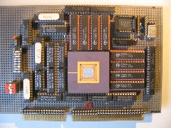
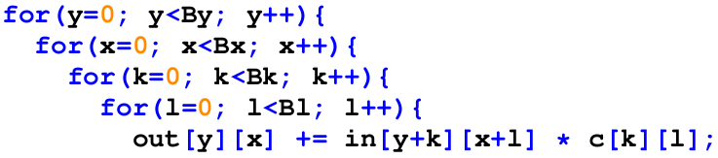
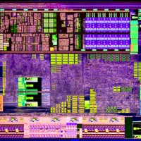

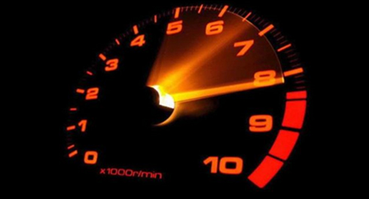
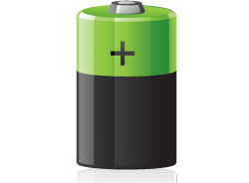
Intelligent Architectures
5LIL0
Exploiting Data Reuse: Loop Transformations
Henk Corporaal
www.ics.ele.tue.nl/~heco/courses/IA
h.corporaal@tue.nl
TUEindhoven
2022

Slide 2
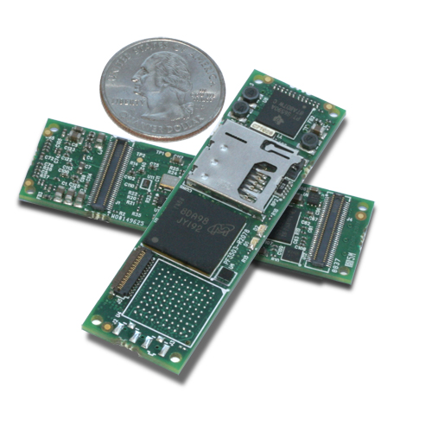
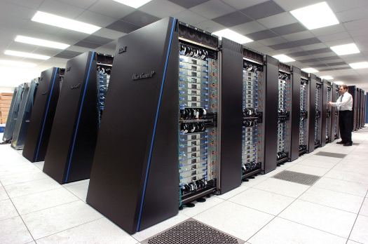
Application Excecution Time & Energy
High performance computing
Embedded computing
Small portions of the code dominate execution time
  Hot spots
  Loops
Apply Loop Transformations
for(i=0; i<N; i++){
for(j=0; j<N; j++){
for(k=0; k<N; k++)
c[i][j] += a[i][k] * b[k][j];
}}

Slide 3
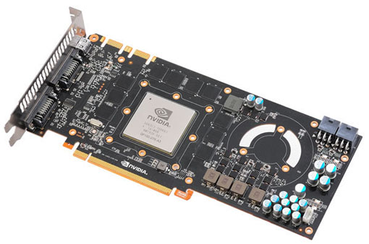
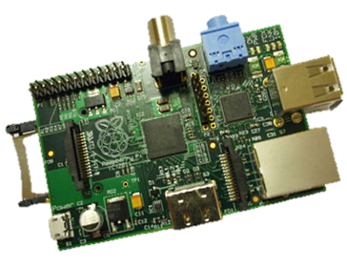
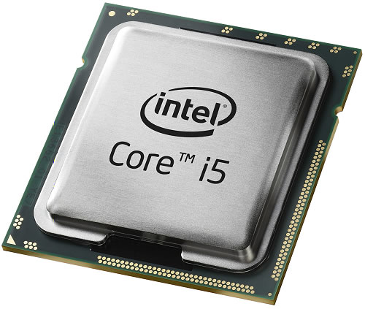
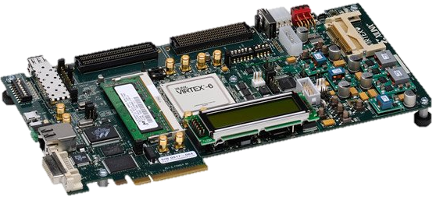
Loop Transformations
Can help you in many compute domains
Convert Loops to
GPU Threads
Embedded Devices
Fine-tune for architecture
CPU Code
Parallelism
Memory Hierarchy
(multi-level caches)
ASICs & FPGAs
HDL, HW Description Languages

Slide 4
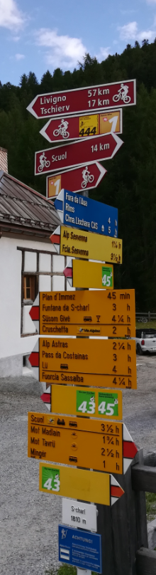
Overview
RECAP: Constructing a DNN / CNN
  Neuron & Single layer
  Network: multiple layers
  Energy
Loop transformations
  data flow
  reordering
  restructuring: tiling & fusion
Buffer management
  Store and Compute level

Slide 5
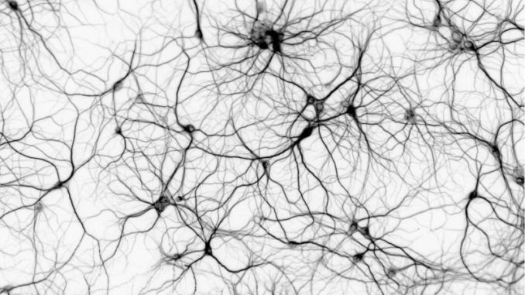
Background: Artificial Neural Networks

Slide 6
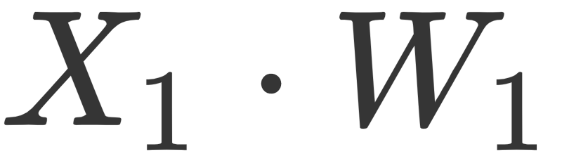
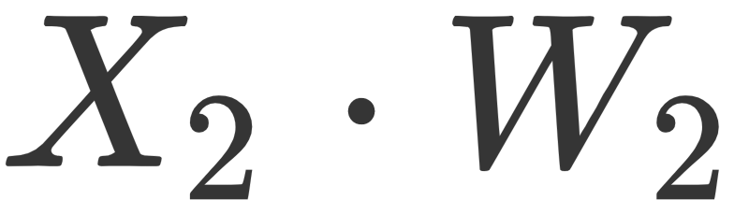



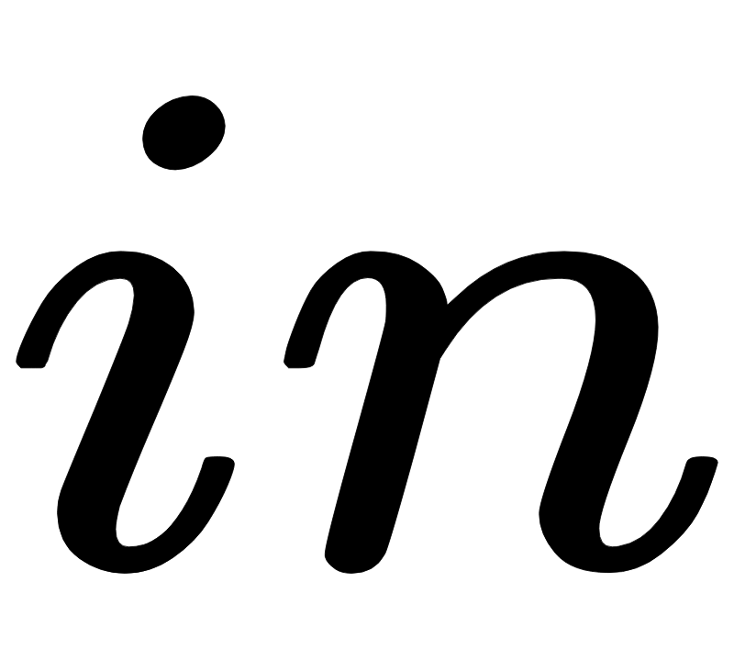
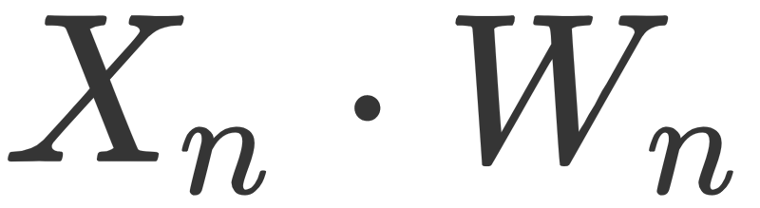
Artificial Neuron Model
Dot Product
Activation function:
Non Linear
Transformation

Slide 7
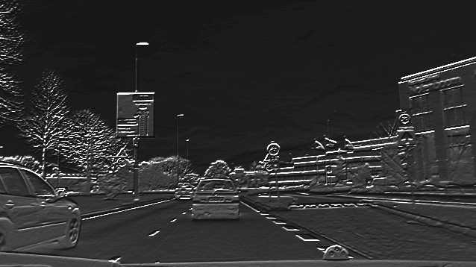
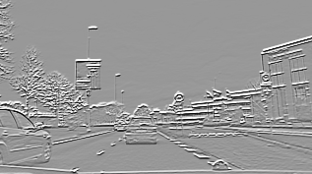
Neuron Applied to Image Region
Neuron detects features in region
Convolution: Same neuron applied to all regions in the image yields an output feature map

Slide 8
Input from multiple input (feature) maps
Input can be taken from multiple input feature maps

Slide 9
Multiple neurons / convolutions
Multiple neurons generate multiple output feature maps

Slide 10
Overview
RECAP: Constructing a DNN / CNN
  Neuron & Single layer
    Computational model of a single layer
  Network: multiple layers
  Energy
Loop transformations
  data flow
  reordering
  restructuring: tiling
Buffer management
  Store and Compute level

Slide 11
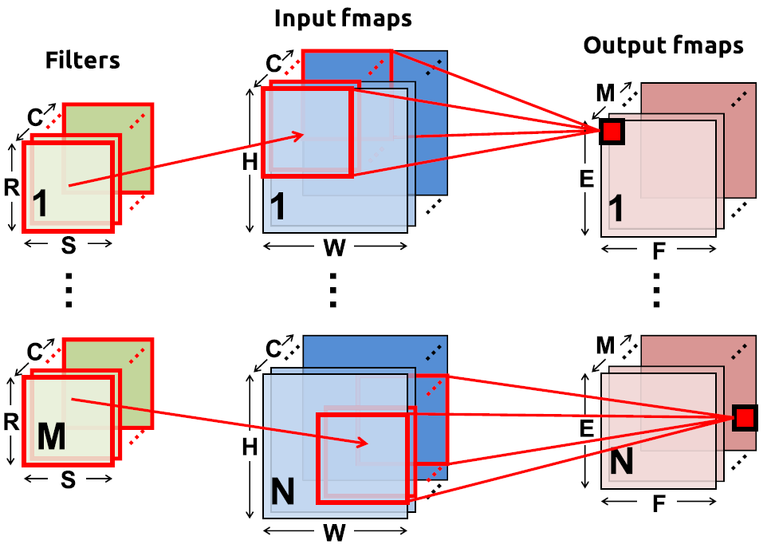
Convolution layer: Overview + Notation
N = batch size
C input feature maps of size HxW
M output feature maps of size ExF
M filters of size RxS
Note: for fully connected layer filter size is input size, RS = HW

Slide 12
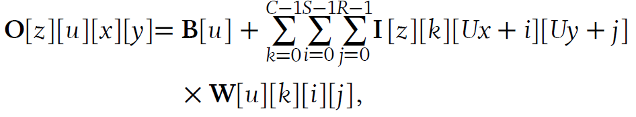
Generic Convolution Equations
U = stride
B = bias vector
C input fmaps
M output fmaps
N = batch size
RxS = filter size
Note: W has 4-dimensions
  i,j for kernel
  k for input feature maps
  u for output feature maps

Slide 13
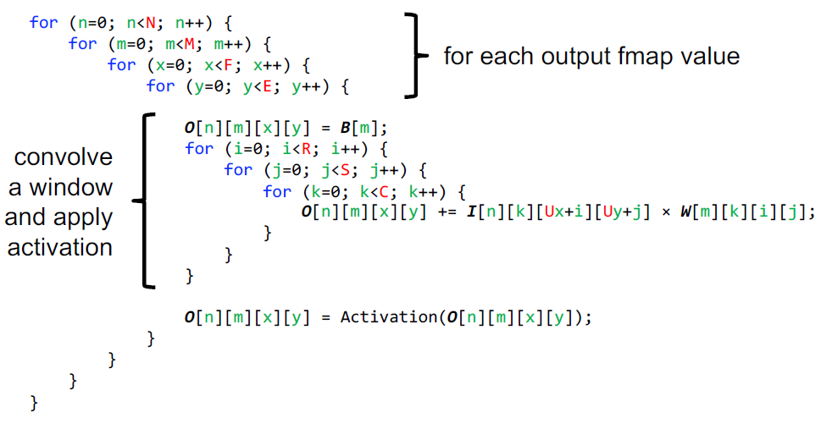
Convolution code, for 1 layer

Slide 14
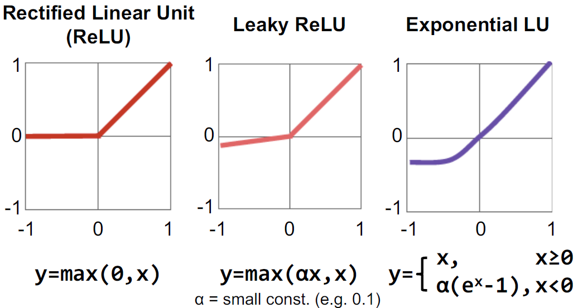
Several recent activation functions

Slide 15
Computation Model of a CNN Layer
Input fmap
C
weights
Output fmap
C
2
1
R
X
H
=
E
S
W
F
Number of MACs = R x S x (H – R + 1) x (W - S + 1) x C
E
F

Slide 16
Computation Model of a CNN Layer
Adding multiple (M) output Feature maps (fmap / output channels)
separate weights per output channel
Input fmap
weights
Output fmap
M
=
M
X
Number of MACs = R x S x (H – R + 1) x (W - S + 1) x C x M

Slide 17
Overview
RECAP: Constructing a DNN / CNN
  Neuron & Single layer
  Network: multiple layers
  Energy
Loop transformations
  data flow
  reordering
  restructuring: tiling & fusion
Buffer management
  Store and Compute level

Slide 18


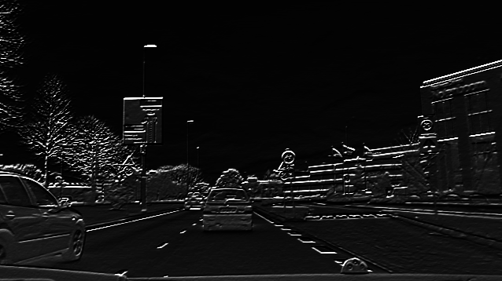
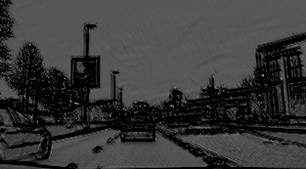
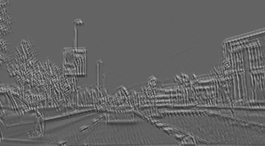
Sequence of feature maps forms the network

Slide 19
How does it suffer from the memory wall?
On Chip Memory
Data Path
MAC
MAC
MAC
MAC
CNN Accelerator

Slide 20
How does it suffer from the memory wall?
A lot of data!
Weights
Intermediate data
Input data
On Chip Memory
Data Path
MAC
MAC
MAC
MAC
CNN Accelerator

Slide 21
How does it suffer from the memory wall?
External memory needed to store all data
External
Memory
On Chip Memory
Data Path
MAC
MAC
MAC
MAC
CNN Accelerator

Slide 22
How does it suffer from the memory wall?
Huge amount of traffic between external memory and the processor!*
External
Memory
On Chip Memory
Data Path
MAC
MAC
MAC
MAC
CNN Accelerator
* Note: Off-chip requires about 200x more energy than on-chip memory - Jonathan Ragan-Kelley, Decoupling Algorithms from the Organization of Computation for High Performance Image Processing

Slide 23
Data Reuse – Ordering your computations
Data elements are used multiple times
Objective: Keep those uses close in time, and store data in on chip storage
All about ordering/scheduling
computations

Slide 24
Overview
RECAP: Constructing a DNN / CNN
  Neuron & Single layer
  Network: multiple layers
  Energy
Loop transformations
  data flow
  reordering
  restructuring: tiling & fusion
Buffer management
  Store and Compute level

Slide 25
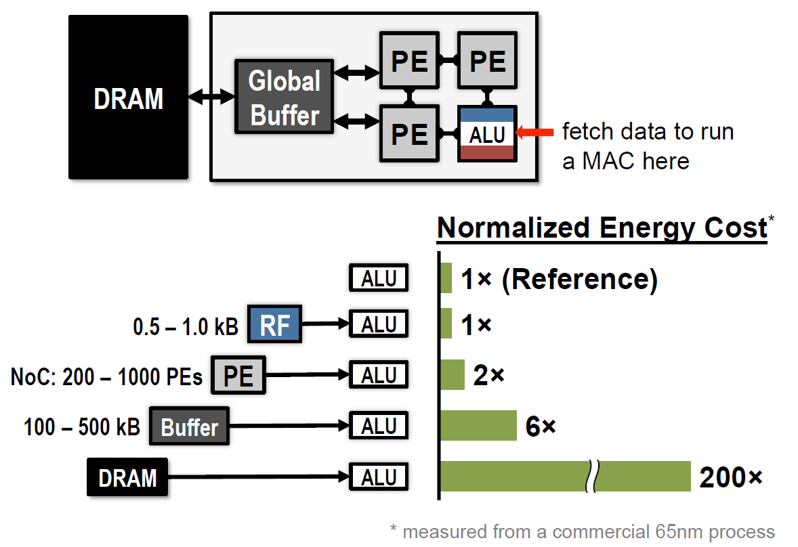
Where is the energy going

Slide 26
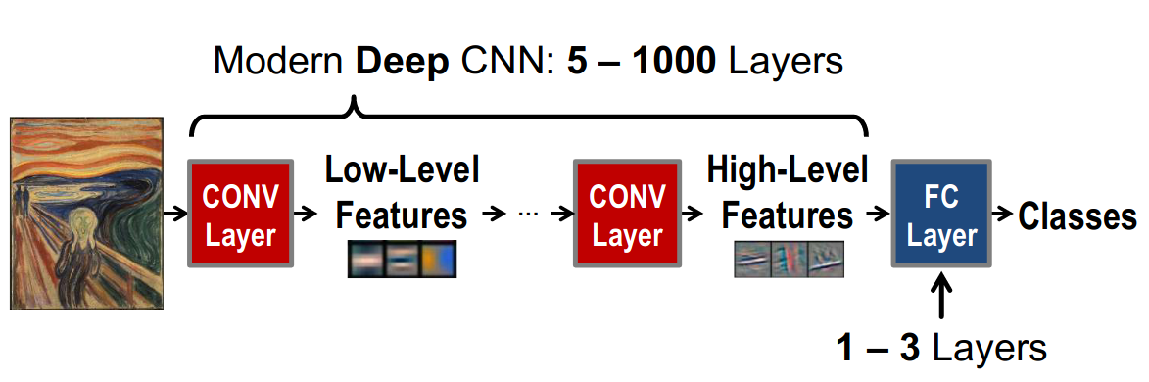
Deep Convolutional Neural Networks
Contributes more than 90% of
overall computation and memory access,
dominating runtime and energy consumption
Source: ICIP Tutorial, 2019

Slide 27
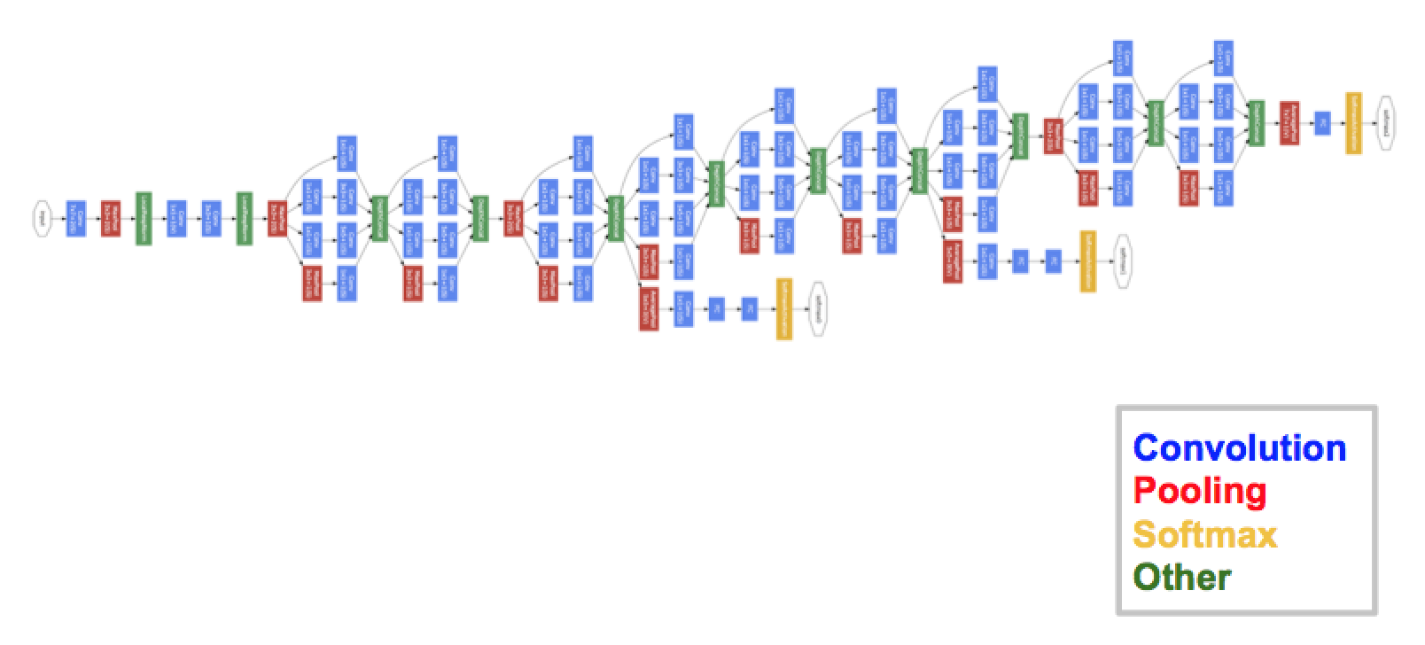
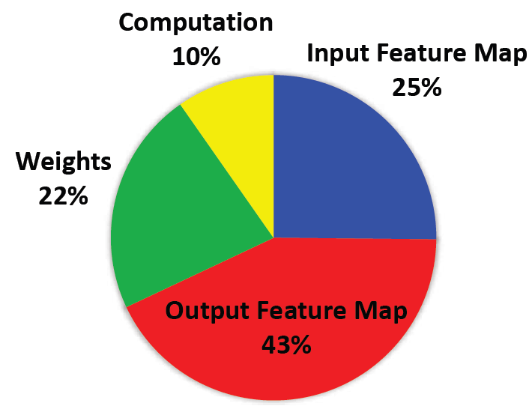
GoogLeNet: Energy
CNN layers: 21 depth, 57 in total
FC layer: 1
Weights: 7.0 M
MACs: 1.43 G per input
Yang.e.a CVPR'17

Slide 28
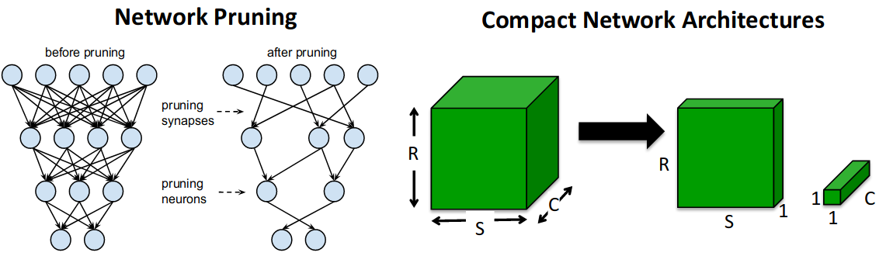
Recap: what did we treat so far?
Inference and Learning principles: Designing and Simulating a DNN
Improving Network Efficiency: Pruning, Quantization
Loop Optimizations - Software tricks to effectively use the Memory hierarchy
Quantization
fp32
S
E (8)
M (23)
fp16
S
E(5)
M(10)

Slide 29
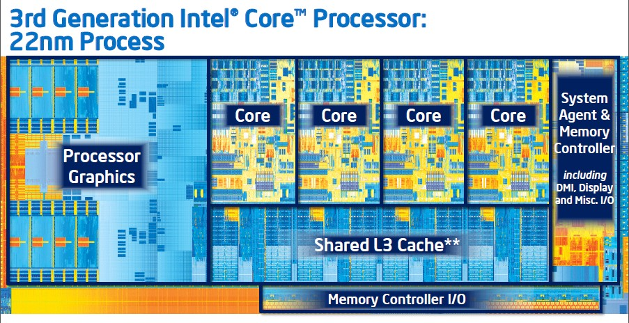
Exploiting data reuse: Intel i7 Ivy Bridge, 22 nm
3 levels of cache; see next slide

Slide 30
Reduce external loads and stores
3-level Memory Hierarchy
Exploiting
  temporal locality = data/instr reuse
  spatial locality
Shared
I&D
$
Main Memory
I$
I&D
$
CPU
D$
L1
L2
L3

Slide 31
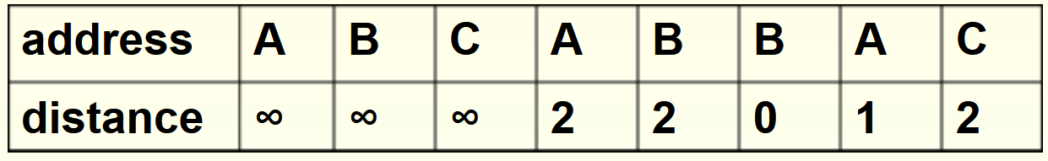
Data Reuse Distance (RD)
RD[a] of memory access to address a = # of unique addresses referenced since the last access to address a
RD[a] indicate if access a is cache hit:
  RD[a]< Cache size => Cache hit (under certain assumptions)

Slide 32
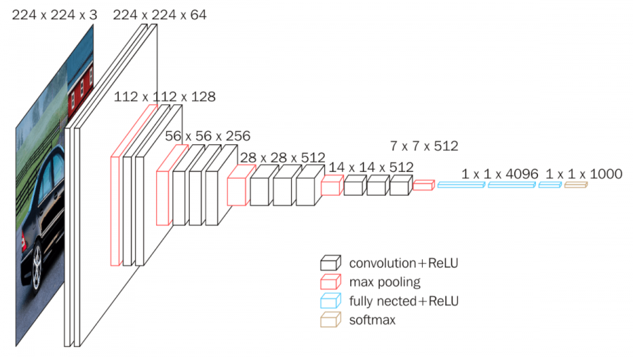
VGG16 example
Conv layers: 13
FC Layers: 3
Weights: 138 M
MACs: 15.5 G per input
Simonyan, ICLR 2015

Slide 33
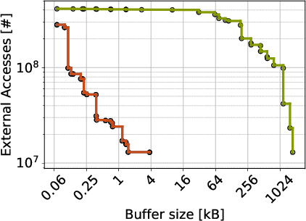
Reducing external memory accesses: VGG16
Original code
Rescheduled code
How did we achieve this?

Slide 34
Overview
RECAP: Constructing a DNN / CNN
  Neuron & Single layer
  Network: multiple layers
  Energy
Loop transformations
  data flow transformations
  reordering
  restructuring: tiling
  loop fusion
Buffer management

Slide 35
Data-Flow-Based Transformations
Can be very useful in case of a:
  Simple compiler
  Simple architecture
    No Hardware Multiplier
    No Out-Of-Order Superscalar
    No Speculative Branch Prediction
  If you are in a hurry and missing a few percent
These are the easy tricks
To get ready for the more difficult ones ☺
* Examples are from:
D.F. Bacon, S.L. Graham, and O.J. Sharp, Compiler transformations for high-performance computing. ACM Comput. Surv. 26, (1994)

Slide 36
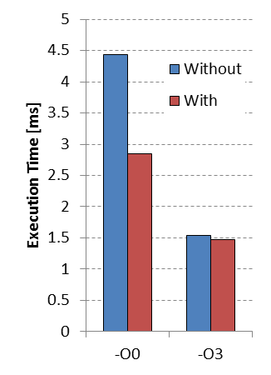
Loop-Based Strength Reduction
Replace an expensive operation
Can be multiplication, especially for embedded cores
No HW multiplier, e.g. MicroBlaze
An optimizing compiler can help
c=3;
for(i=0; i<N; i++){
a[i] = a[i] + i*c;
}
c=3;
T=0;
for(i=0; i<N; i++){
a[i] = a[i] + T;
T = T + c;
}

Slide 37
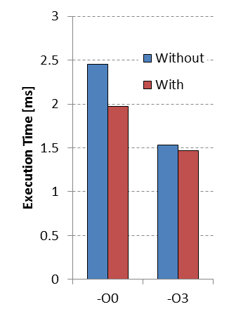
Induction Variable Elimination
Induction variable? Used to:
  Compute loop exit conditions
  Compute memory addresses
Given a known final value and relation to addresses
  Possible to eliminate index calculations
Again an optimizing compiler can help
for(i=0; i<N; i++){
a[i] = a[i] + c;
}
A = &a[0];
T = &a[0] + N;
while(A<T){
*A = *A + c;
A++;
}
Notes:
Performing the control of a loop is basically overhead. I refer to the increment of i and the compare of i<N to check if the exit condition is not met.
With induction variable elimination we can reduce this overhead.

Slide 38
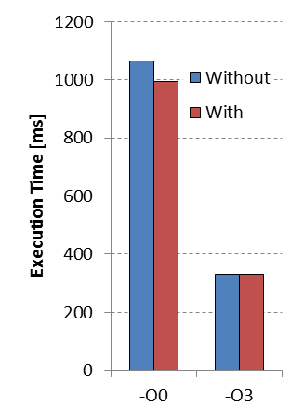
Loop-Invariant Code Motion
Index of c[] does not change
Move one loop up and store in register
Reuse it over iterations of inner loop
Most compilers can perform this
Example is similar to
Scalar Replacement Transformation
for(i=0; i<N; i++){
for(j=0; j<N; j++){
a[i][j]=b[j][i]+c[i];
}
}
for(i=0; i<N; i++){
T=c[i];
for(j=0; j<N; j++){
a[i][j]=b[j][i]+T;
}
}

Slide 39
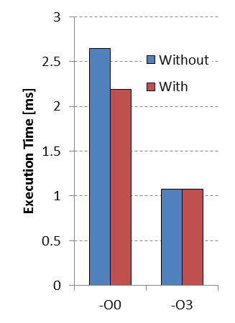
Loop Unswitching
Conditional execution inside a loop-body
  Move it outside the loop
  Each execution path independent loops
Increases code size
if(x<7){
for(i=0; i<N; i++){
a[i]=b[i];
a[i]+=5;
}
}
else{
for(i=0; i<N; i++){
a[i]=b[i];
}
}
for(i=0; i<N; i++){
a[i] = b[i];
if(x<7){a[i]+=5;}
}

Slide 40
Overview
RECAP: Constructing a DNN / CNN
  Neuron & Single layer
  Network: multiple layers
  Energy
Loop transformations
  data flow
  reordering / loop interchange
  restructuring: tiling & fusion
Buffer management
  Store and Compute level

Slide 41
Iteration Reordering Transformations
Change the relative ordering
  Expose parallelism by altering iteration dependencies
  Improve locality by matching with a memory hierarchy
Normal compilers often don’t help you with this
Only state-of-the-art compilers can help
  Often research compilers ;)
*Based on:
M. Wolf, M. Lam, A Data Locality Optimizing Algorithm. ACM SIGPLAN, PLDI (1991)

Slide 42
Loop representation as Iteration Space
for(i=0; i<N; i++){
for(j=0; j<N; j++){
A[i][j] = B[j+3][i+2];
Each position represents an iteration
  At each position 1 or more array elements are accessed

Slide 43
Visitation order in Iteration Space
for(i=0; i<N; i++){
for(j=0; j<N; j++){
A[i][j] = B[j+3][i+2];
Iteration space is not data space

Slide 44
But we don’t have to be regular
A[j][j] = B[j+3][i+2];
But order can have huge impact on:
  Memory Hierarchy
    E.g. Reuse of data
  Parallelism
  Loop or control overhead

Slide 45
Data Reuse – Ordering your computations
Data elements are used multiple times
Objective: Keep those uses close in time, and store data in on chip storage
All about ordering/scheduling
computations

Slide 46
CNN: Just a Deep Loopnest
for l in layers:
for z in output_maps[l]:
for i in input_maps[l]:
for y in rows[l]:
for x in columns[l]:
for ky in kernel_height[l]:
for kx in kernel_widht[l]:
Y[l][z][x][y]+= X[l][i][x+kx][y+ky]* \
W[l][i][z][kx][ky]
Note: notation a little different; no Batch input, but Multiple layers in this code

Slide 47
Loop Interchange
for(j=0; j<N; j++)
for(i=0; i<M; i++) B[j][i]+=A[i];

Slide 48
Loop Interchange
N-1
for(j=0; j<N; j++)
for(i=0; i<M; i++) B[j][i]+=A[i];
j
0
0
i
M-1

Slide 49
Loop Interchange
N-1
for(j=0; j<N; j++)
for(i=0; i<M; i++) B[j][i]+=A[i];
j=0
i=0
j
0
0
i
M-1

Slide 50
Loop Interchange
N-1
for(j=0; j<N; j++)
for(i=0; i<M; i++) B[j][i]+=A[i];
j=0
i=1
j
0
0
i
M-1

Slide 51
Loop Interchange
N-1
for(j=0; j<N; j++)
for(i=0; i<M; i++) B[j][i]+=A[i];
j=0
i=2
j
0
0
i
M-1

Slide 52
Loop Interchange
N-1
for(j=0; j<N; j++)
for(i=0; i<M; i++) B[j][i]+=A[i];
j=0
i=M
j
0
0
i
M-1

Slide 53
Loop Interchange
N-1
for(j=0; j<N; j++)
for(i=0; i<M; i++) B[j][i]+=A[i];
j=1
i=0
j
0
0
i
M-1

Slide 54
Loop Interchange
N-1
for(j=0; j<N; j++)
for(i=0; i<M; i++) B[j][i]+=A[i];
j=2
i=0
j
0
0
i
M-1

Slide 55
Loop Interchange
N-1
for(j=0; j<N; j++)
for(i=0; i<M; i++) B[j][i]+=A[i];
j
Let’s have a look at the uses of
A[0]
0
0
i
M-1

Slide 56
Loop Interchange
N-1
for(j=0; j<N; j++)
for(i=0; i<M; i++) B[j][i]+=A[i];
j
Let’s have a look at the uses of
A[0]
0
0
i
M-1
Reuse distance of (M-1)

Slide 57
Loop Interchange
N-1
for(j=0; j<N; j++)
for(i=0; i<M; i++) B[j][i]+=A[i];
j
Let’s have a look at the uses of
A[0]
0
0
i
M-1

Slide 58
Loop Interchange
N-1
for(i=0; i<M; i++)
for(j=0; j<N; j++) B[j][i]+=A[i];
j=0
i=0
j
Let’s have a look at the uses of
A[0]
0
0
i
M-1

Slide 59
Loop Interchange
N-1
for(i=0; i<M; i++)
for(j=0; j<N; j++) B[j][i]+=A[i];
j=1
i=0
j
Let’s have a look at the uses of
A[0]
0
0
i
M-1

Slide 60
Loop Interchange
N-1
for(i=0; i<M; i++)
for(j=0; j<N; j++) B[j][i]+=A[i];
j=2
i=0
j
Let’s have a look at the uses of
A[0]
0
0
i
M-1

Slide 61
Loop Interchange
N-1
for(i=0; i<M; i++)
for(j=0; j<N; j++) B[j][i]+=A[i];
j=0
i=1
j
Let’s have a look at the uses of
A[0]
0
0
i
M-1
Reuse distance of 0

Slide 62
How can loop interchange help CNNs ?
keep weights, input or outputs close to processing elements,
or even stationary
for l in layers:
for z in output_maps[l]:
for i in input_maps[l]:
for x in columns[l]:
for y in rows[l]:
for ky in kernel_height[l]:
for kx in kernel_widht[l]:
Y[l][z][x][y]+= X[l][i][x+kx][y+ky]* \
W[l][i][z][kx][ky]

Slide 63
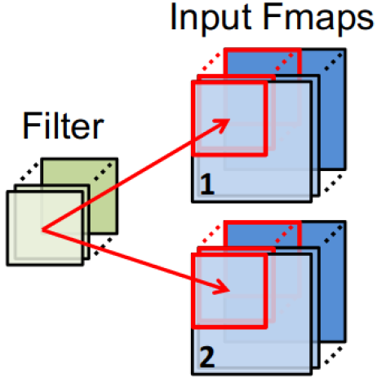
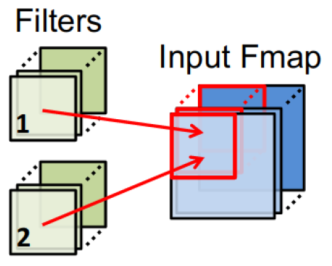
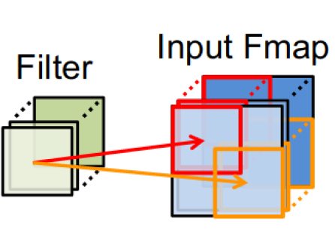
Types of reuse in CNNs
Convolutional reuse
(sliding window)
Input map reuse
Filter reuse
for larger batch size
Reuse
activations
weights
Reuse
activations
Reuse
weights

Slide 64
Overview
RECAP: Constructing a DNN / CNN
  Neuron & Single layer
  Network: multiple layers
  Energy
Loop transformations
  data flow
  reordering
  restructuring: tiling
  restructuring: loop fusion
Buffer management

Slide 65
Loop Tiling
for(j=0; j<N; j++)
for(i=0; i<M; i++)
B[j][i]+=A[i]+C[j];

Slide 66
Loop Tiling
N-1
for(j=0; j<M; j++)
for(i=0; i<N; i++)
B[j][i]+=A[i]+C[j];
j
0
0
i
M-1

Slide 67
Loop Tiling
N-1
for(j=0; j<M; j++)
for(i=0; i<N; i++)
B[j][i]+=A[i]+C[j];
j
0
0
i
M-1

Slide 68
Loop Tiling
N-1
for(j=0; j<M; j++)
for(i=0; i<N; i++)
B[j][i]+=A[i]+C[j];
j
Reuse distances of:
A[0] = M-1
C[0] = 0
0
0
i
M-1

Slide 69
Loop Tiling
N-1
for(j=0; j<M; j++)
for(i=0; i<N; i++)
B[j][i]+=A[i]+C[j];
For M=8 a memory of size 5 with LRU policy would miss A[0]
j
Reuse distances of:
A[0] = M-1
C[0] = 0
0
0
i
M-1

Slide 70
Loop Tiling: interchange i,j and tile i
N-1
for(i=0; i<M; i++)
for(j=0; j<N; j++)
B[j][i]+=A[i]+C[j];
j
0
0
i
M-1

Slide 71
Loop Tiling: interchange i,j and tile i
N-1
for(i=0; i<M; i+=Ti)
for(j=0; j<N; j++)
for(ii=0; ii<i+Ti;ii++)
B[j][ii]+=A[ii]+C[j];
j
0
0
0
i
M-1

Slide 72
Loop Tiling
N-1
for(i=0; i<M; i+=Ti)
for(j=0; j<N; j++)
for(ii=0; ii<i+Ti;ii++)
B[j][ii]+=A[ii]+C[j];
j
Reuse distances of:
A[0] = M-1 → Ti-1
C[0] = 0 → 0 / N-1
0
0
i
M-1

Slide 73
Loop Tiling
N-1
for(i=0; i<M; i+=Ti)
for(j=0; j<N; j++)
for(ii=0; ii<i+Ti;ii++)
B[j][ii]+=A[ii]+C[j];
For M=8 a memory of size 5 with LRU policy would hit A and C*
j
Reuse distances of:
A[0] = M-1 → Ti-1
C[0] = 0 → 0 / N-1
0
0
i
M-1
* Except when: (i mod Ti) = 0 and j=0

Slide 74
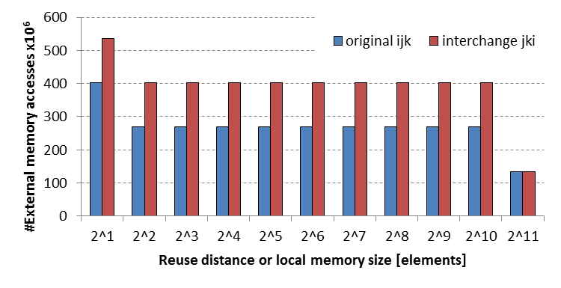
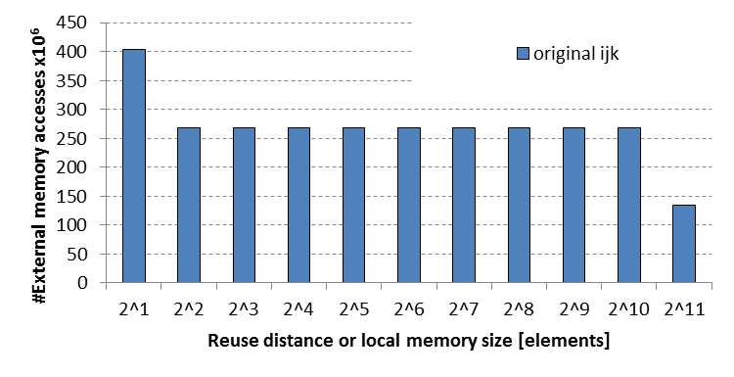
Study matrix multiplication : Loop interchange
for(i=0; i<Bi; i++){
for(j=0; j<Bj; j++){
for(k=0; k<Bk; k++){
C[i][j] += A[i][k] * B[k][j];
for(j=0; j<Bj; j++){
for(k=0; k<Bk; k++){
for(i=0; i<Bi; i++){
C[i][j] += A[i][k] * B[k][j];

Slide 75
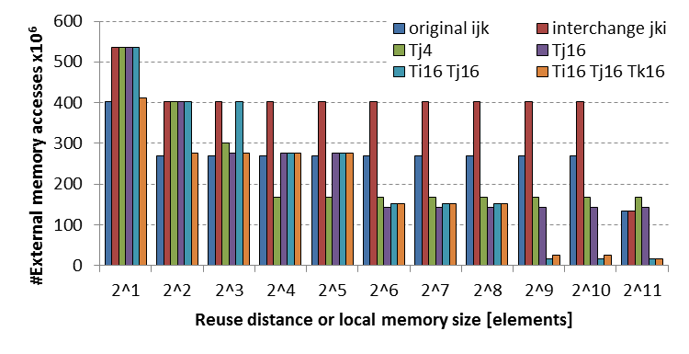
Adding Loop tiling
for(i=0; i<Bi; i++){
for(jj=0; jj<Bj; jj+=Tj){
for(k=0; k<Bk; k++){
for(j=jj; j<jj+Tj; j++)
C[i][j] += A[i][k] * B[k][j];
Can be done in multiple
dimensions
Manual exploration is
intractable
for(i=0; i<Bi; i++){
for(j=0; j<Bj; j++){
for(k=0; k<Bk; k++){
C[i][j] += A[i][k] * B[k][j];

Slide 76
Overview
RECAP: Constructing a DNN / CNN
  Neuron & Single layer
  Network: multiple layers
  Energy
Loop transformations
  data flow
  reordering
  restructuring: tiling
  restructuring: loop fusion
Buffer management

Slide 77
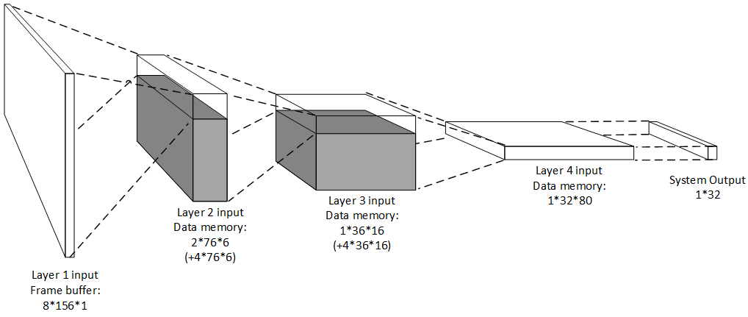
Layer Fusion
Avoid redundant computation: buffer the pixels that are required for the next tile
Buffers stored in local scratchpad memory

Slide 78
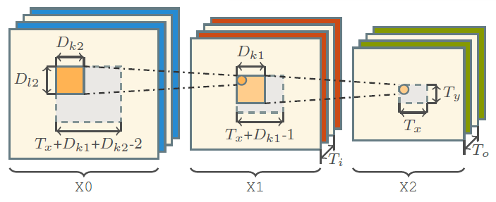
Layer Fusion (Waeijen, Goetschalckx)
Literature:
M. Alwani, H. Chen, M. Ferdman, and P. Milder, “Fused-layer cnn accelerators,” in 2016 49th Annual IEEE/ACM Internationa6l Symposium on Microarchitecture (MICRO), Oct 2016
J. IJzerman, e.a., “Aivotta: An energy efficient programmable accelerator for cnn-based object recognition, SAMOS ’18.
K. Goetschalckx and M. Verhelst, “Breaking high-resolution cnn bandwidth barriers with enhanced depth-first execution,” IEEE Journal on Emerging and Selected Topics in Circuits and Systems, vol. 9, no. 2, pp. 323–331, 2019.
Luc Waeijen e.a., “ConvFusion: A Model for Layer Fusion in Convolutional Neural Networks”, accepted by IEEE Access 2022

Slide 79
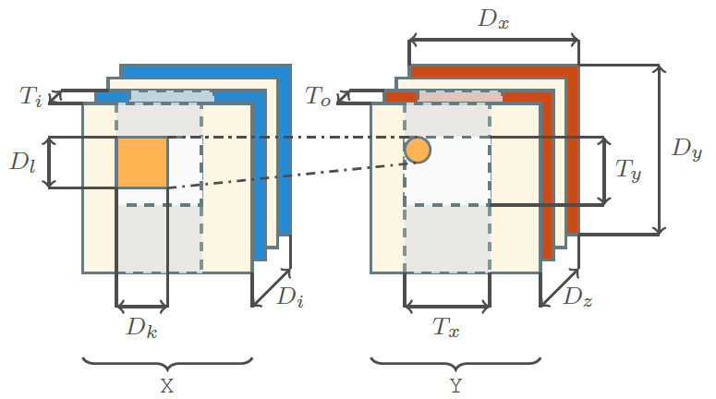
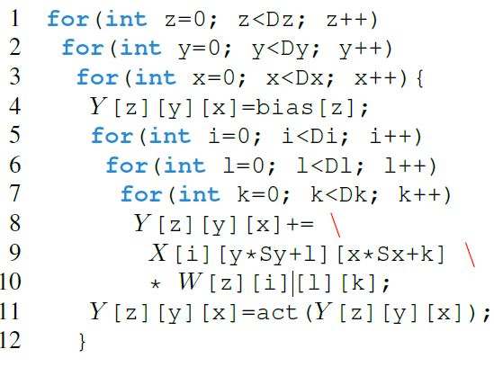
Convolution
Single convolution from X -> Y

Slide 80
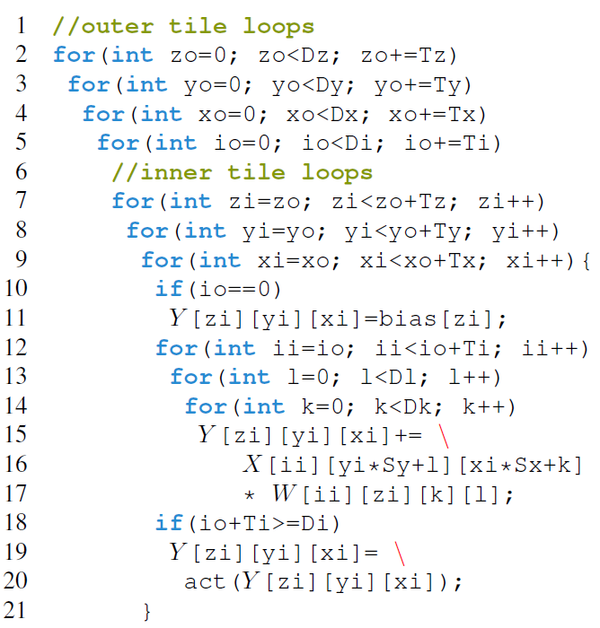

Convolution, tiled
Overlap of (Dk-1) elements in the input data X between iterations ‘n’ and ‘n+1’ of loop xi
Required volume = (Ti x Dl x (Tx + Dk - 1)), yet a rotating buffer of size (Ti xv Dl x Dk) is sufficient.

Slide 81
Fusing 2 convolutions X0 -> X1 -> X2
To produce tile ToTxTy on X2, a tile of Ti(Tx+Dk-1)(Ty+Dl-1) is required from array X1
Fused schedule, this tile of X1 is produced in-line to the production of the tile in X2, rather than first computing X1 completely
Recomputation vs Reload:
Data in X1 has multiple uses in X2. We can store it, or recompute it from the stored X0

Slide 82

Internal memory + 64 entry register file
Notes:
  We can recompute inner, fused layer(s) from previous (input) layer, or store computed intermediate results
  We still have a problem to find the right schedule for both the internal memory and the register file
L3NetWide 4k input

Slide 83
Overview
RECAP: Constructing a DNN / CNN
  Neuron & Single layer
  Network: multiple layers
  Energy
Loop transformations
  data flow
  reordering
  restructuring: tiling & fusion
Buffer management
  Store and Compute level

Slide 84
Scratchpad Memory: explicit scheduling of memory transfers
On Chip Scratchpad Memory
Data Path
MAC
MAC
MAC
MAC
CNN Accelerator

Slide 85
Introducing: Store level
for y from 0->Dy:
for x from 0->Dx:
for l from 0->Ky:
for k from 0->Kx:
out[x][y]+=in[x+kx][y+ky]
Filter kernel
Implementation for 1 (input and output) Feature map*
*Weights omitted

Slide 86
Introducing: Store level
for y from 0->Dy:
for x from 0->Dx:
for l from 0->Ky:
for k from 0->Kx:
out[x][y]+=in[x+kx][y+ky]
Ky
Kx
y
x

Slide 87
Introducing: Store level
for y from 0->Dy:
for x from 0->Dx:
for l from 0->Ky:
for k from 0->Kx:
out[x][y]+=in[x+kx][y+ky]
Ky
Kx
y
x

Slide 88
Introducing: Store level
for y from 0->Dy:
for x from 0->Dx:
for l from 0->Ky:
for k from 0->Kx:
out[x][y]+=in[x+kx][y+ky]
Ky
Kx
y
x

Slide 89
Introducing: Store level
for y from 0->Dy:
for x from 0->Dx:
for l from 0->Ky:
for k from 0->Kx:
out[x][y]+=in[x+kx][y+ky]
Ky
Kx
y
x

Slide 90
Introducing: Store level
Store Level
for y from 0->Dy:
for x from 0->Dx:
for l from 0->Ky:
for k from 0->Kx:
out[x][y]+=in[x+kx][y+ky]
Ky
Kx
y
x

Slide 91
Introducing: Store level
Store Level
for y from 0->Dy:
for x from 0->Dx:
for l from 0->Ky:
for k from 0->Kx:
out[x][y]+=in[x+kx][y+ky]
Ky
Kx
y
Store level says what to store in local buffer (volume for 1 iteration)
For every iteration of y, we load
all required data once
x

Slide 92
Introducing: Store level
Store Level
for y from 0->Dy:
for x from 0->Dx:
for l from 0->Ky:
for k from 0->Kx:
out[x][y]+=in[x+kx][y+ky]
Ky
Kx
y
Store level says what to store in local buffer (volume for 1 iteration)
For every iteration of y, we load
all required data once
x

Slide 93
Introducing: Store level
for y from 0->Dy:
for x from 0->Dx:
for l from 0->Ky:
for k from 0->Kx:
out[x][y]+=in[x+kx][y+ky]
Ky
Store Level
Kx
y
Store level says what to store in local buffer (volume for 1 iteration)
For every iteration of x, we load
all required input data once
x

Slide 94
Introducing: Store level
for y from 0->Dy:
for x from 0->Dx:
for l from 0->Ky:
for k from 0->Kx:
out[x][y]+=in[x+kx][y+ky]
Store Level
y
Missed overlap!
But less buffer space required than higher store level.
Store level says what to store in local buffer (volume for 1 iteration)
For every iteration of x, we load
all required input data once
x

Slide 95
Transfer volume != Buffer size
Store Level
for y from 0->Dy:
for x from 0->Dx:
for l from 0->Ky:
for k from 0->Kx:
out[x][y]+=in[x+kx][y+ky]
Ky
Kx
y
x

Slide 96
Transfer volume != Buffer size
Store Level
for y from 0->Dy:
for x from 0->Dx:
for l from 0->Ky:
for k from 0->Kx:
out[x][y]+=in[x+kx][y+ky]
Ky
Kx
y
Live volume at any time is only KxKy
x

Slide 97
Transfer volume != Buffer size
Store Level
for y from 0->Dy:
for x from 0->Dx:
for l from 0->Ky:
for k from 0->Kx:
out[x][y]+=in[x+kx][y+ky]
Ky
Kx
y
Live volume at any time is only KxKy
x

Slide 98
Transfer volume != Buffer size
Store Level
for y from 0->Dy:
for x from 0->Dx:
for l from 0->Ky:
for k from 0->Kx:
out[x][y]+=in[x+kx][y+ky]
Ky
Kx
y
Live volume at any time is only KxKy
x

Slide 99
Introducing: Compute Level
Store Level
for y from 0->Dy:
for x from 0->Dx:
for l from 0->Ky:
for k from 0->Kx:
out[x][y]+=in[x+kx][y+ky]
Ky
Kx
y
Live volume at any time is only KxKy
By not transferring data at the start of y, but later a smaller buffer is required.
x

Slide 100
Introducing: Compute Level
Store Level
for y from 0->Dy:
for x from 0->Dx:
for l from 0->Ky:
for k from 0->Kx:
out[x][y]+=in[x+kx][y+ky]
Ky
Compute lvl
Kx
y
Live volume at any time is only KxKy
Compute level determines when data is transferred
x

Slide 101





Pareto front of 6 CNNs
VDSR
Traffic Sign Detect
VGG16
Orders of Magnitude better than baseline!
(even without fusion)
Resnet 101
Resnet 152
MobileNet V2

Slide 102
#pragma omp parallel for
for (int yTile = 0; yTile < out.height(); yTile += 32) {
__m128i a, b, c, sum, avg;
__m128i tmp[(128/8) * (32 + 2)];
for (int xTile = 0; xTile < out.width(); xTile += 128) {
__m128i *tmpPtr = tmp;
for (int y = 0; y < 32+2; y++) {
const uint16_t *inPtr = &(in(xTile, yTile+y));
for (int x = 0; x < 128; x += 8) {
a = _mm_load_si128((const __m128i*)(inPtr));
b = _mm_loadu_si128((const __m128i*)(inPtr+1));
c = _mm_loadu_si128((const __m128i*)(inPtr+2));
sum = _mm_add_epi16(_mm_add_epi16(a, b), c);
avg = _mm_mulhi_epi16(sum,one_third);
_mm_store_si128(tmpPtr++, avg);
inPtr+=8;
}
}
tmpPtr = tmp;
for (int y = 0; y < 32; y++) {
__m128i *outPtr = (__m128i *)(&(out(xTile, yTile+y)));
for (int x = 0; x < 128; x += 8) {
a = _mm_load_si128(tmpPtr+(2*128)/8);
b = _mm_load_si128(tmpPtr+128/8);
c = _mm_load_si128(tmpPtr++);
sum = _mm_add_epi16(_mm_add_epi16(a, b), c);
avg = _mm_mulhi_epi16(sum, one_third);
_mm_store_si128(outPtr++, avg);
}
}
}
}
Code can become extremely complex
after some transformations !!

Slide 103
#pragma omp parallel for
for (int yTile = 0; yTile < out.height(); yTile += 32) {
__m128i a, b, c, sum, avg;
__m128i tmp[(128/8) * (32 + 2)];
for (int xTile = 0; xTile < out.width(); xTile += 128) {
__m128i *tmpPtr = tmp;
for (int y = 0; y < 32+2; y++) {
const uint16_t *inPtr = &(in(xTile, yTile+y));
for (int x = 0; x < 128; x += 8) {
a = _mm_load_si128((const __m128i*)(inPtr));
b = _mm_loadu_si128((const __m128i*)(inPtr+1));
c = _mm_loadu_si128((const __m128i*)(inPtr+2));
sum = _mm_add_epi16(_mm_add_epi16(a, b), c);
avg = _mm_mulhi_epi16(sum,one_third);
_mm_store_si128(tmpPtr++, avg);
inPtr+=8;
}
}
tmpPtr = tmp;
for (int y = 0; y < 32; y++) {
__m128i *outPtr = (__m128i *)(&(out(xTile, yTile+y)));
for (int x = 0; x < 128; x += 8) {
a = _mm_load_si128(tmpPtr+(2*128)/8);
b = _mm_load_si128(tmpPtr+128/8);
c = _mm_load_si128(tmpPtr++);
sum = _mm_add_epi16(_mm_add_epi16(a, b), c);
avg = _mm_mulhi_epi16(sum, one_third);
_mm_store_si128(outPtr++, avg);
}
}
}
}
Func blur_3x3(Func in) {
Func bx, by;
Var x, y, xi, yi;
// The algorithm - no storage or order
bx(x, y) = (in(x-1, y) + in(x, y) + in(x+1, y));
by(x, y) = (bx(x, y-1) + bx(x, y) + bx(x, y+1));
// The schedule - defines order, locality; implies storage
by.tile(x, y, xi, yi, 128, 32)
.vectorize(xi, 8).parallel(y);
bx.compute_at(by, x).vectorize(x, 8);
return by;
}
Halide alternative

Slide 104

Main Take-Aways
Data-Flow-Based Transformations
  Good compilers can help
Iteration Reordering Transformations
  High-level transformations
  Compilers are often not enough
  Huge gains for parallelims and locality/data reuse
  Be carefull with dependencies
Loop Restructuring Transformations
  Similar to reordering
Halide can help you

