Slide 1
Extreme quantization beyond int8
Optimizing neural networks for inference
Floran de Putter
Electrical Engineering – Electronic Systems group

Slide 2
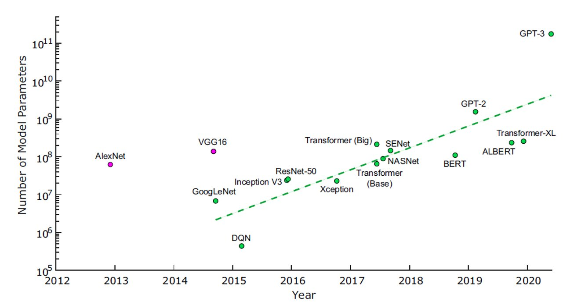
Deep Learning Challenges
Challenge 1: model size
Challenge 2: speed (throughput, latency)
Challenge 3: energy efficiency
We need Efficient Deep Learning!

Slide 3
Efficient Deep Learning
Efficient Deep Learning Methods
Model compression
Code transformation
Pruning
Loop tiling
Quantization
Loop unrolling
Compact model
Operator fusion
Goal: Maximize
Compression Ratio
Accuracy
Hardware Usability
Goal: Apply code optimizations to maximize
Hardware Usability

Slide 4
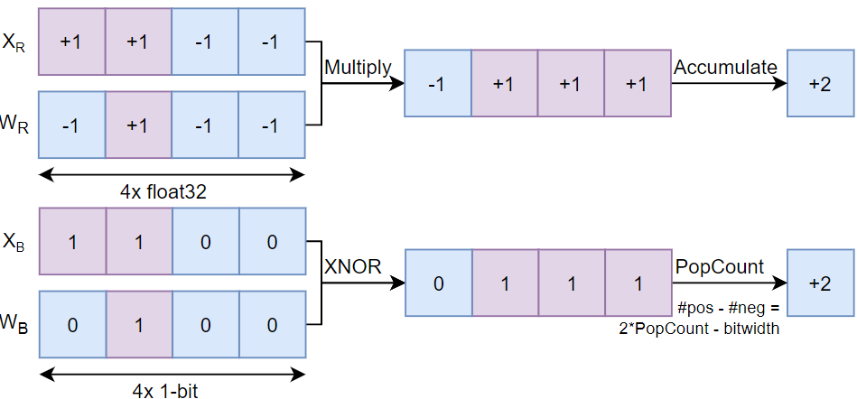
Basics of Binary/Ternary Neural Networks
Forward pass (XNOR-POPCOUNT during inference)
(Ternary MAC uses similar compute logic: Gated X(N)OR & PopCount)
Backward pass (training only)
Straight-through estimation (SignSTE)

Slide 5
Overview
Naive binary neural network
Overview of accuracy repair methods
Specialized accelerators
Summary and conclusion

Slide 6
Naive BNN: BinaryNet
3x3 conv
sign
batchnorm
sign
linear
batchnorm
3x3 conv
maxpool
VGG9 architecture
CIFAR10 dataset
First and last layer remain full precision (orange)
Convolution and linear (red) are fully binary!
Binarization using sign-function with clipped STE
88.6% top-1 accuracy, promising results?
batchnorm
sign
3x3 conv
sign
batchnorm
maxpool
linear
sign
batchnorm
batchnorm
3x3 conv
sign
linear
3x3 conv
sign
maxpool
batchnorm
3x3 conv
batchnorm
sign

Slide 7
BinaryNet on ImageNet
Building block:
ResNet-18 architecture
$$A_{r}$$
$$A_{r}$$
batchnorm
$$A_{r}$$
batchnorm
3x3 conv
3x3 conv
sign
sign
+
$$W_{b}$$
$$W_{b}$$
From 69.7% to 42.2% top-1 accuracy on ImageNet…

Slide 8
Accuracy of state-of-the-art BNNs
Note: accuracy repair methods do not come for free!

Slide 9
Overview of accuracy repair methods
Repair methods
Network topology unchanged
Network topology changed
Binarizer (STE)
Non-linearity
Normalization
Scaling factor
Training strategy
Ensemble
Extra loss terms
Miscellaneous

Slide 10
Ensemble per-layer (Weight only)
$$A_{B}$$
$$A_{B}$$
Approximate using 3 binary bases
$$W_{B1}$$
BinConv
$$α_{1}$$
$$W_{R}$$
Conv
$$output$$
$$W_{B2}$$
$$α_{2}$$
+
$$output$$
BinConv
$$α_{3}$$
$$W_{B3}$$
BinConv
Approximate $W_{R}$ using linear combination binary filters $W_{Bi}$:
$$W_{R}≈α_{1}W_{B1}+α_{2}W_{B2}+…+α_{M}W_{BM}$$
$W_{Bi}$constructed by shifting ($u_{i}$) over the standard deviation: $W_{Bi}=\text{sign}\left(W_{R}−\text{mean}\left(W_{R}\right)+u_{i}⋅\text{std}\left(W_{R}\right)\right)$
Scaling parameters $α_{i}$ found by:
$$\min_{α_{i}}{ {\left\|W_{R}−W_{Bi}α_{i}\right\|}^{2}}$$

Slide 11
Numerical example
Say you want to approximate $W=\left[\begin{matrix}−0.135 & 0.125 \\ −0.065 & 0.075\end{matrix}\right]$ by three binary bases $μ={\left[−1, 0, 1\right]}^{T}$.
$\text{mean}\left(W\right)≈0\text{, }\text{s}td\left(W\right)≈0.12$, then bases are:
$$B_{1}=sign\left(W−0.12\right)=\left[\begin{matrix}−1 & 1 \\ −1 & −1\end{matrix}\right], B_{2}=sign\left(W+0.00\right)=\left[\begin{matrix}−1 & 1 \\ −1 & 1\end{matrix}\right]$$
$$B_{3}=sign\left(W+0.12\right)=\left[\begin{matrix}−1 & 1 \\ 1 & 1\end{matrix}\right]$$
From$\min_{ α}{ {\left\|W −αB\right\|}^{2}}$, it follows that $α={\left[0.0275, 0.07, 0.0325\right]}^{T}$, thus
$$W≈\left[\begin{matrix}−0.0275−0.07−0.0325 & 0.0275+0.07+0.0325 \\ −0.0275−0.07+0.0325 & −0.0275+0.07+0.0325\end{matrix}\right]=\left[\begin{matrix}−0.13 & 0.13 \\ −0.065 & 0.075\end{matrix}\right]$$
Notes:
Idea: with binary weights and scaling factors you can recover the original weights.
Python code:
import numpy as np
vec = lambda x: x.flatten() # matrix to vector
sign = lambda x: np.where(x >= 0, 1, -1) # sign activation
# base parameters and input weights
u = [-1, 0, 1]
W = np.array([[-0.135, -0.065],[0.125, 0.075]])
# compute reconstruction
mu, std = np.mean(W), np.std(W, ddof=1)
B = np.array([vec(sign(W - mu + i*std)) for i in u]) # compute bases
a, _, _, _ = np.linalg.lstsq(B.T, vec(W))
W_hat = (B * a[:,None]).sum(axis=0).reshape(W.shape)

Slide 12
Ensemble per-layer (Activation only)
Approximate activations like we did with weights: $A_{R1}≈β_{1}A_{B1}+β_{2}A_{B2}+…+β_{N}A_{BN}$
$A_{Bi}$ constructed using shift vector $v_{i}$: $A_{Bi}=\text{cli}p\left(sign(x+v_{i}),0, 1\right)$
Two examples ($β=[1,…,1]$):
3 bases; $v=\left[−0.2,0,0.2\right]$
10 bases; $v=\left[−1,−0.78,…,0.78,1\right]$
Notes:
import numpy as np
import matplotlib.pyplot as plt
sign = lambda x: np.where(x >= 0, 1, -1) # sign activation
clip = lambda x: np.clip(sign(x), 0, 1)
v1 = np.linspace(-1/5,1/5,3)
v2 = np.linspace(-1,1,10)
x = np.linspace(-10,5,1000)
y1 = np.array([clip(x+i) for i in v1]).sum(axis=0)
y2 = np.array([clip(x+i) for i in v2]).sum(axis=0)
fig,ax = plt.subplots(dpi=80)
ax.scatter(x, y1, marker='.', c='r')
ax.scatter(x, y2, marker='.', c='b')
ax.set_xlabel("x", fontsize=18)
ax.set_ylabel("y", fontsize=18)
ax.set_title("y = sum(clip(x+v_i, 0, 1))", fontsize=18)
plt.xticks(fontsize=14)
plt.yticks(fontsize=14)
ax.spines['right'].set_visible(False)
ax.spines['top'].set_visible(False)
ax.set_xlim([-2,2])

Slide 13
ABC-Net: ensemble per-layer
Convolution becomes:$A_{R}∗W_{R}≈\sum_{m=1}^{M}{\sum_{n=1}^{N}{α_{m}β_{n} ∙(W_{Bm}⊗A_{Bn})}}$
Workload increases by $M×N$ plus scaling multiplications
Number of weights increases by $M$ times
Approximated convolution
Binary weights and activations
Shifted Sign
Shifted Sign
Shifted Sign
BinConv
BinConv
BinConv
ApproxConv
ApproxConv
ApproxConv
Weighted Sum
Weighted Sum
BatchNorm

Slide 14
Group-Net: ensemble per-block
Per-block ensemble
Quantization error is accumulated less
Binary base weights are learned
Workload increases by $M$ plus scaling multiplications
Number of weights increases by $M$ times
ABCNet layer-wise expansion
BinConv
$$α_{1}$$
BinConv
$$α_{1}$$
$$A_{B}$$
$$α_{2}$$
+
$$α_{2}$$
+
BinConv
BinConv
$$α_{3}$$
$$α_{3}$$
BinConv
BinConv
GroupNet group-wise expansion
BinConv
BinConv
$$α_{1}$$
$$A_{B}$$
$$α_{2}$$
+
BinConv
BinConv
$$α_{3}$$
BinConv
BinConv

Slide 15
ReActNet repairs
ReActNet
building block
Binary ResNet
building block
Topology changing:
RPReLU
Double Residual
Scaling factor
Topology unchanging:
RSign (normalization)
RSign (STE)
Training strategy
RSign
BinaryConv
Sign
BatchNorm
Binary Conv
+
BatchNorm
RPReLU
Sign
RSign
Binary Conv
BinaryConv
BatchNorm
BatchNorm
+
+
tanh
RPReLU

Slide 16
ReActNet STE

Slide 17
Specialized BNN/TNN accelerators
Binary:
XNOR Neural Engine
ChewBaccaNN
Mixed-Signal Processor
Ternary:
CUTIE

Slide 18
XNOR Neural engine – System on Chip overview

Slide 19
XNE accelerator
Throughput Parameter TP = 4
Streamer
TP x 32-bit memory interface for input data, weights, and activations.
Address generation and word-alignment functionality.
Controller
Small 28 Byte register file to load layer configuration for execution.
Small micro-processor to generate loop counters and addresses.
Engine
XNE datapath that can processor binary convolution and fully-connected layers.

Slide 20
XNE engine
Throughput Parameter TP = 8
Dedicated registers for Parameters and Features
Data reuse
TP XNORs are computed in parallel
PopCount can be masked
16-bit accumulators are used to compute TP pixels in parallel
Hardwired limitation on TP input/output channels
Dedicated threshold stage
For TP=128:
21.6 fJ/Op at 0.4V in 22nm (SCM)
115 fJ/Op at 0.6V in 22nm (SRAM)

Slide 21
ChewBaccaNN
Dedicated memory (SCM) for Parameters and Features.
Row bank for data reuse.
Compute logic inside BPU array
A BPU employs shift register for data reuse.
7 BPUs give a hardwired 7x7 kernel with 16 input channels.
NMCU accumulates partial results and finally binarizes.

Slide 22
ChewBaccaNN Floorplan
Total chip area: 0.7 mm²
Compute units occupy 1%
32 SCM blocks in FMM1
1 block = 1kB of memory
At 0.4V in 22nm:
4.48 fJ/Op for 7x7 kernel
15.38 fJ/Op for 3x3 kernel

Slide 23
Mixed-Signal Binary CNN Processor
Mix of digital and analog design
Accumulation (popcount operation) is analog circuitry
Hardwired 2x2 kernel with 256 input and output channels
1.88 fJ/Op at 0.6V&0.8V in 28nm

Slide 24
CUTIE: Ternary DNN Inference
Completely unrolled data path w.r.t. all feature map and filter dimensions to reduce data transfer cost
Immense data reuse!
Large chip area
Ternary compression
5 ternary symbols in 8 bits = 1.6 bits/symbol
Their TNN has high level of sparsity
Reduces switching activity
1.69 fJ/Op at 0.65V in 22nm!

Slide 25
BNN/TNN accelerator limitations
Most accelerators assume that all data can be stored on-chip
Not valid for large networks -> costly memory traffic is ignored
Most accelerators assume they can directly calculate an output pixel
Not valid for large networks -> partial high-bitwidth sums + limited data reuse
Most accelerators cannot skip the thresholding phase
Needed for state-of-the-art BNNs
Most accelerators fix the amount of input/output channels
Flexibility issue

Slide 26
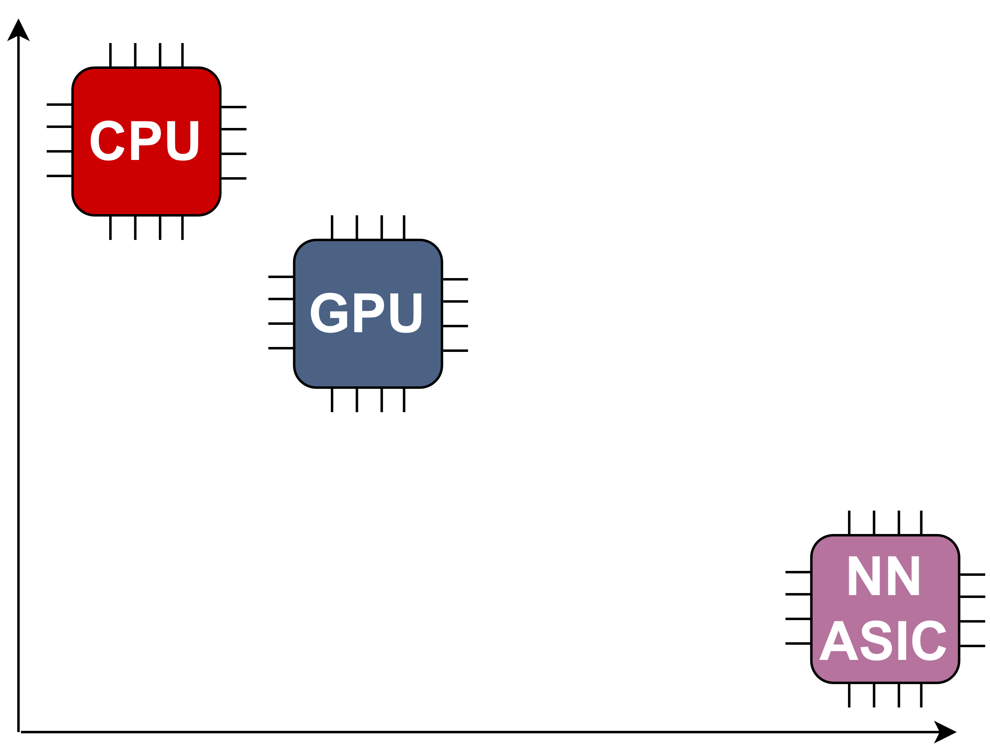
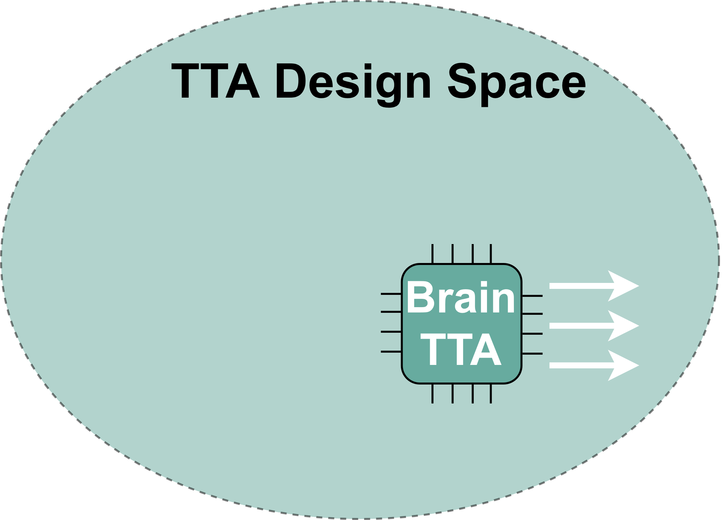
BrainTTA master project: Energy vs flexibilty trade-off
Flexibility
Energy efficiency

Slide 27
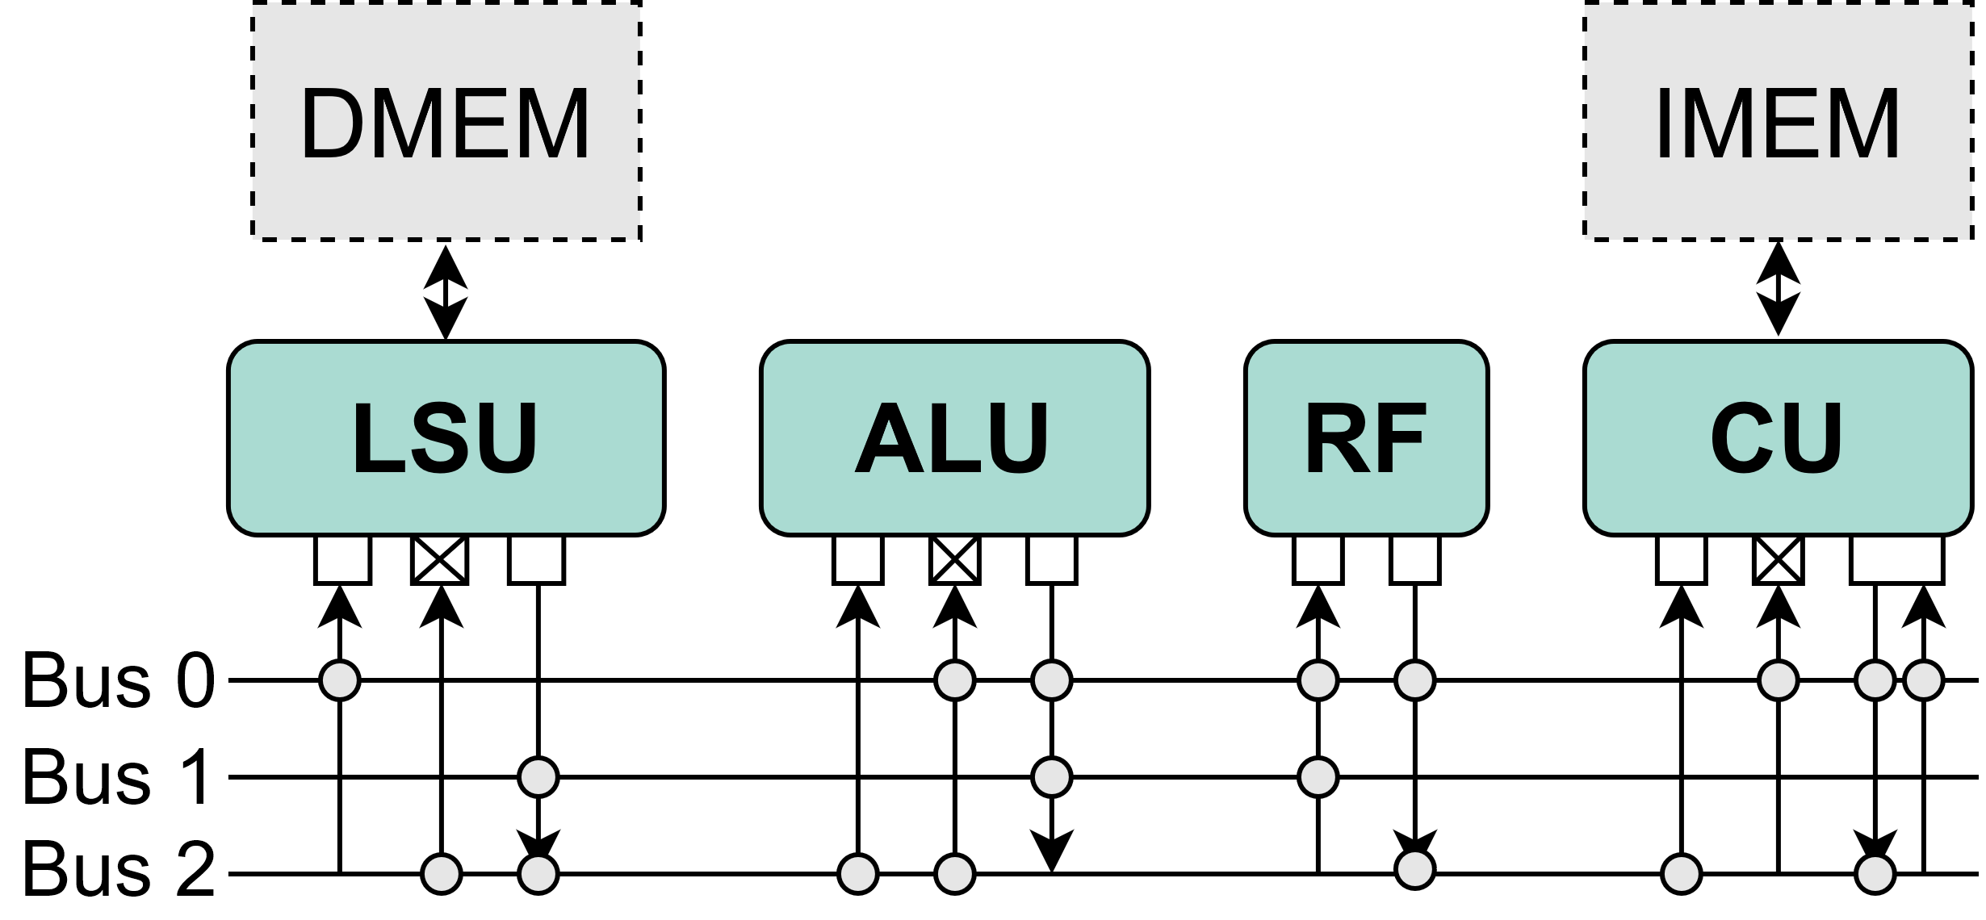
Transport-Triggered Architecture
Example instruction
RF.out → ALU.in1t.add
nop
LSU.out → ALU.in2
Notes:
FU
Ports
Busses
Moves; Exposed datapath
Suitable candidate
Minimize data movement
Retaining control
Example instruction
Another flexibility aspect lacking…

Slide 28
BrainTTA: SoC Overview
Notes:
Proposed architecture
TTA core – Compute powerhouse
DMEM/PMEM/IMEM
Banked, wide accesses; next slide
RISC start/stop, mem init
RISC comms outside
Programmed JTAG
Zoom core

Slide 29
BrainTTA: TTA Core
vMAC
8-bit MAC
Scalar-Vector MAC
Vector-Vector MAC
Binary MAC
Ternary MAC
vADD
Vector-Vector addition
Residual support
vOPS
Requantization
Binarization
Ternarization
MaxPool
Auxiliary ops
Notes:
Scalar & Vector datapath
Load-Store unit
Banked DMEM PMEM
Banked IMEM
vMAC, vADD, vOPS
Rest for addr calc
Architecture done, move on to app mapping

Slide 30
Comparison table
BrainTTA
 | ChewBaccaNN | CUTIE |  | XNE |  | Baseline | Optimized
Node (nm) | 22 | 22 |  | 22 |  | 28
Voltage (V) | 0.4 | 0.65 | 0.65 | 0.4 | 0.6 | 0.9 | 0.56
PT (GOPS) | 240 | 16000 | 16000 | 5 | 67 | 880 | 180
Precisions | 1 | 1, T |  | 1 |  | 1, T, 8
E/Op (fJ) | 4.48 – 15.38 | 1.70 | 2.19 | 21.6 | 115 | 101/188/1105 | 59/90/572
Mem tech | SCM | SCM | SRAM | SCM | SRAM | SRAM
Mem cap (kB) | 153 | n/a | n/a | 8 | 520 | 1024
Area (mm²) | 0.7 | 7.5 |  | 2.32 |  | 3.6
C multiple of | 16 | 128 |  | 128 |  | 32/16/4
M multiple of | Any | 128 |  | 128 |  | 32/16/32
R is | 7 | 3 |  | Any |  | Any
S is | 7 | 3 |  | Any |  | Any
Partial result | Yes | No |  | No |  | Yes
Programmability | Limited | None |  | Limited |  | C

Slide 31
Summary and conclusion
BNNs or TNNs might be the holy grail for running DNNs on the edge
MAC can be replaced by cheap bitwise operations: XNOR and Popcount
There is still some research required to make them competitive in terms of accuracy without a large increase in computational workload
State-of-the-art BNN/TNN accelerators achieve down to ~1fJ/Op

